Slide 2
Exam 70-698: Installing and Configuring Windows 10
BRK3267
Alfred Ojukwu
Senior Consultant II
Microsoft Consulting Services
Microsoft Certified Trainer
Joe Lurie
Senior Consultant
Microsoft Consulting Services
Microsoft Certified Trainer

Slide 3



Joe Lurie
Senior Consultant - Microsoft
jolurie@microsoft.com
System Center consultant with Microsoft Consulting Services, including Windows client and server upgrades
TechReady Speaker, exam prep sessions for Windows 8 and 10, Azure, and EMS
Microsoft Certified Trainer since 2000
Active in Devices and Mobility community
From Boston – GO SOX
Fun fact (you decide): Never watched Star Trek of any flavor – no episodes of any variety, no movies

Slide 4








Alfred Ojukwu
Senior Consultant - Microsoft
alojukwu@microsoft.com
Mobility Consultant with Microsoft Consulting Services (MCS)
Certified Trainer – MCT - Mobility
20+ Years in IT Administration
WW Community Lead, Devices and Mobility
Extensive involvement with Internal and External Readiness
Blog: http://thedevicepros.com
Interesting Fact: Grew up in Hawaii
alojukwu@

Slide 5

70-698: Installing and Configuring Windows 10
Implement Windows
Configure and support core services
Manage and maintain Windows

Slide 6
01-Implement Windows

Slide 7
Prepare for installation requirements
  Determine hardware requirements and compatibility
  Choose between an upgrade and a clean installation
  Determine appropriate editions according to device type
  Determine requirements for particular features:
    Hyper-V
    Cortana
    Miracast
    Virtual Smart Cards
    Secure Boot
  Determine and create appropriate installation media

Slide 8

Windows 10 Hardware Requirements
Hardware Requirements (minimums)
Component | Requirement
Processor | A 1-gigahertz (GHz) or faster processor
Memory | 1 gigabyte (GB) or RAM on 32-bit versions and 2 GB for 64-bit versions
Hard disk space | 16 GB for 32-bit versions and 20 GB for 64-bit versions
Graphics card | DirectX 9 or later with a Windows Display Driver Model (WDDM) 1.0 driver
Display Resolution | 800 x 600 pixels

Slide 9
Windows 10 Hardware Compatibility
Internet Explorer
Verify hardware compatibility for multiple devices
Secure, agentless PC, heterogeneous server, and database inventory
Automated hardware and software readiness assessment
Detailed and comprehensive reports
Quicker, easier migrations and upgrades
Saves your organization time, effort and money
Office 2013
Windows 10
Windows Azure
Platform
MAP Toolkit
Software Usage Tracking
SQL Server 2014
Heterogeneous Server and Database Inventory
Benefits of the Map Toolkit
Determine feasibility to upgrade scanned devices to Windows 10.
Determine your organization’s readiness to move to Microsoft Azure or Office 365.
Plan for virtualizing workloads to Hyper-V.
Windows Server 2012
Hyper-V
https://www.microsoft.com/en-us/download/confirmation.aspx?id=7826

Slide 10
Deployment Options
Wipe & Load
In-Place Upgrade
Provisioning
Familiar enterprise process for all scenarios
Capture Data / Settings
Deploy (custom) OS image
Inject Drivers
Install Apps
Restore Data / Settings
Still an option for all scenarios
Let Windows do the work
Preserve data, settings, apps, drivers
Install (standard) OS image
Restore everything
Recommended for existing Windows 7 / 8 / 8.1 devices
New capability for new devices
Transform into an enterprise device
Remove existing items
Add organizational apps
Add organizational configuration
For Windows 10 CYOD scenarios

Slide 11
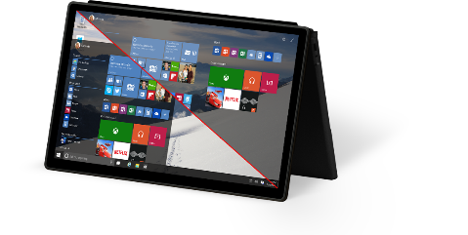
Option for Deploying Windows 10
New Device
Bare Metal
(Custom Image)
Existing Device
Device Considerations
Operating System Considerations
Application
Considerations
In-Place
Upgrade
Upgrade key apps as needed post OS update
BIOS → UEFI
Disk partitioning
WinPE Offline Operation
3rd party disk encryption*
Architecture (x86 → x64)
Base OS language
Domain
Local Administrators
Configuration drift
Moving from XP or Vista
Custom base image
Bulk app change
Refresh (Wipe & Load)
Re-install the operating system (Custom Image)
Install applications
Migrate user state

Slide 12
Wipe & Load Overview
Minimal changes to existing process
Familiar with enterprises
Out of the box support with Windows 7, Windows 8, and Windows 8.1
Customized approach required to move from Windows XP/Vista to Windows 10
Use System Center Configuration Manager or MDT for managing the process – requires update
Administrator to configure preservation of existing apps, settings, and drivers
Wipe & Load (Refresh) Process
Start
Windows 7
Windows 8
Windows 8.1
Capture data and settings
Remove existing OS
Install new OS image
Install apps
Restore data and settings
Finish
Windows 10
USMT
DISM
USMT
Deployment Tools (MDT, System Center Configuration Manager)

Slide 13
In-Place Upgrade to Windows 10
Preferred Option for Enterprises
Supported with Windows 7, Windows 8, and Windows 8.1
Supported to upgrade Windows 10 RTM to November Update
Consumers use Windows Update, but enterprises want more control
Use System Center Configuration Manager or MDT for managing the process
Uses the standard Windows 10 image
Automatically preserves existing apps, settings, and drivers
Proven process - popular for Windows 8 to Windows 8.1 upgrade
In-Place Upgrade Process
Start
Windows 7
Windows 8
Windows 8.1
Capture data and settings
Remove existing OS
Install new OS image
Restore data and settings
Finish
Windows 10
Windows Setup

Slide 14
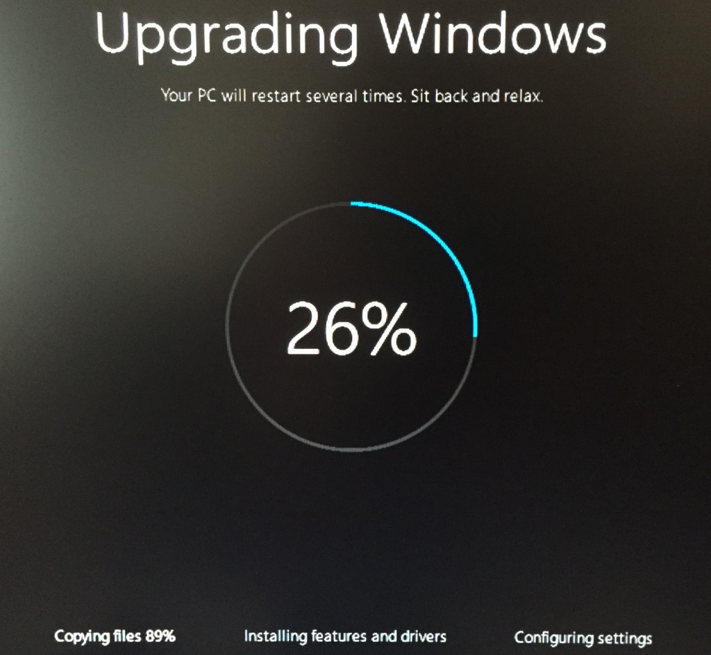
Upgrading to Windows 10
Considerations for In-Place Upgrade
It is a simple process and is ideal for small groups of computers.
It provides for rollback to the earlier version of Windows.
User and application settings and user data files are retained automatically.
Installed applications are retained; however, retained applications might not work correctly after upgrading from an earlier Windows version.
You do not need to provide for external storage space for data and settings migration.
It does not allow for edition changes and is available only on supported operating systems.
It does not provide the opportunity to start with a clean, standardized configuration

Slide 15
Windows 10 Provisioning (Not Re-imaging)
Flexible Methods
Using media, USB tethering, or even e-mail for manual distribution
Automatically trigged from the cloud or connection to a corporate network
Leverage NFC or QR codes
Transform a Device
Enable the Enterprise SKU
Install apps and enterprise configuration
Enroll the device to be managed via MDM
Provisioning Process
Start
Windows 10
Remove existing items
Enable Enterprise SKU
Add corporate apps
Add corporate config
Finish
Windows 10
Provisioning Package
Provisioning Package
(Deployment)
Provisioning Package
(Runtime)

Slide 16
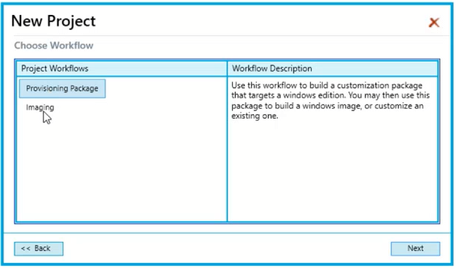
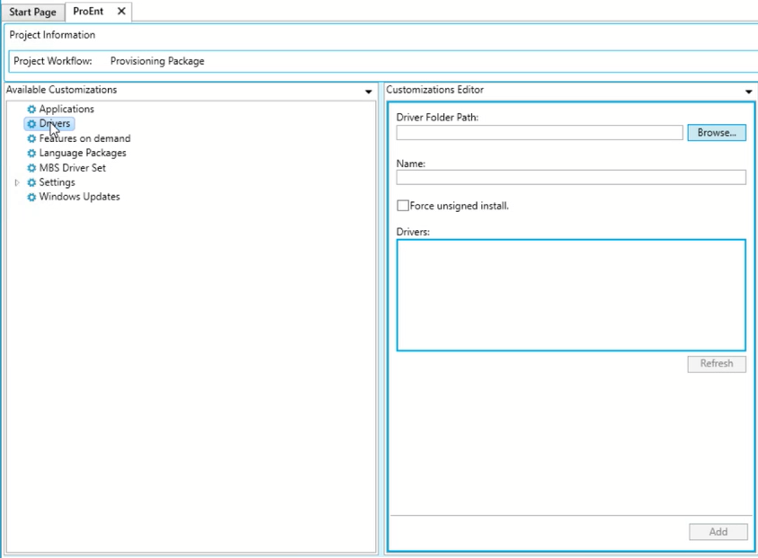
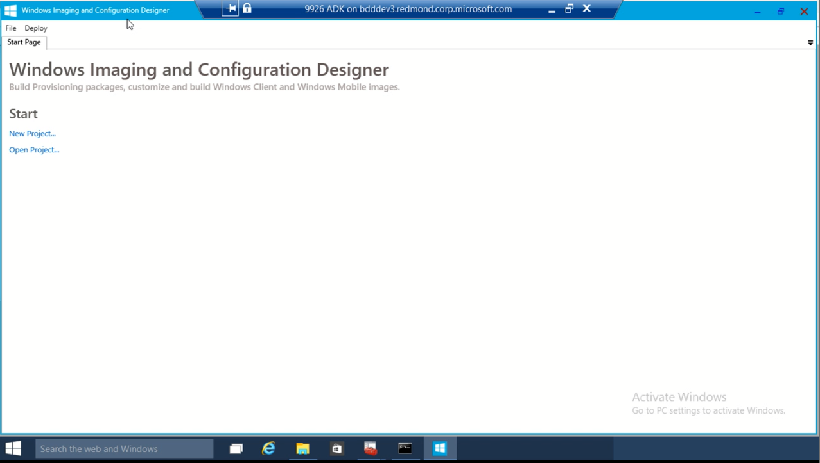
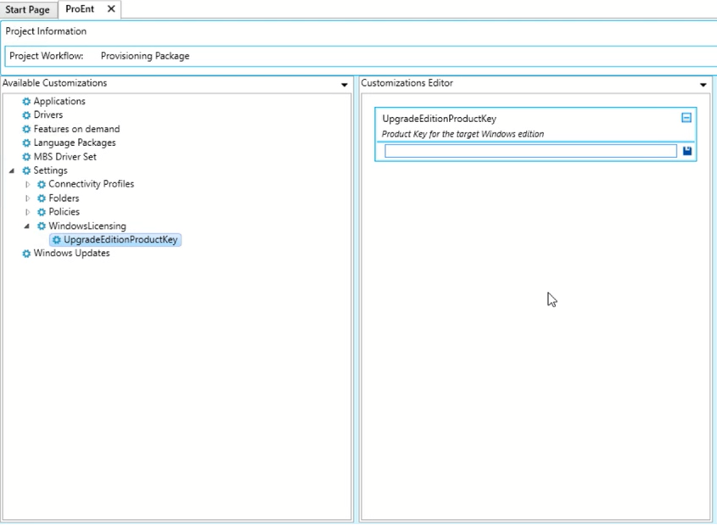
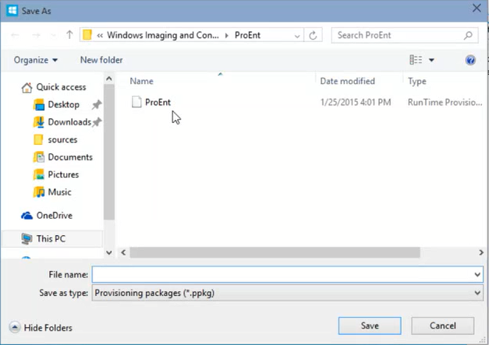
WICD Provisioning Tool
WICD Uses
View settings and policies in a Windows 10 image or provisioning package.
Create and manage Windows provisioning answer files.
Define applications and drivers in an answer file.

Slide 17
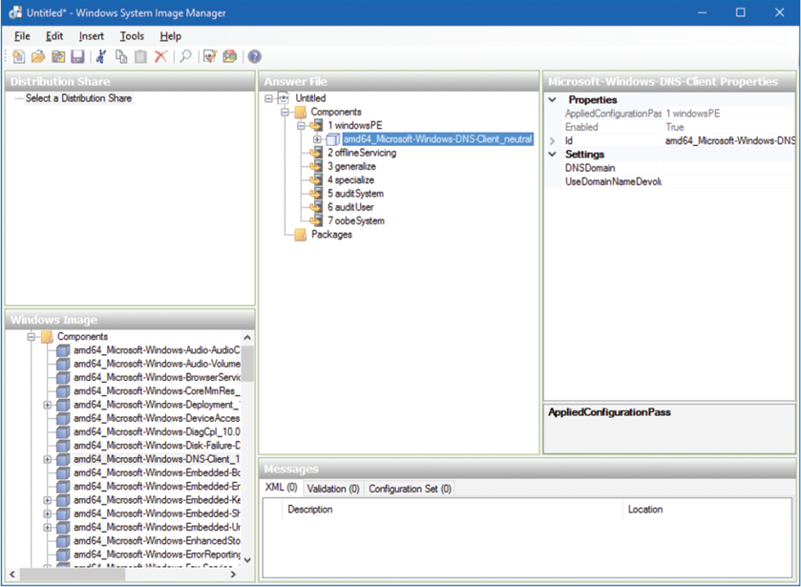
Windows System Image Manager (WSIM)
Creates answer files
Contains configuration information
Associate file with USB or installation media
Works with MDT 2013
Answer file can be placed on a WDS Server

Slide 18
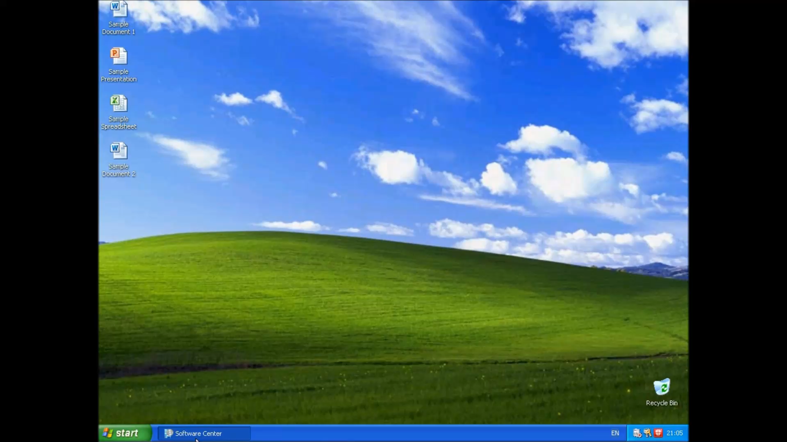
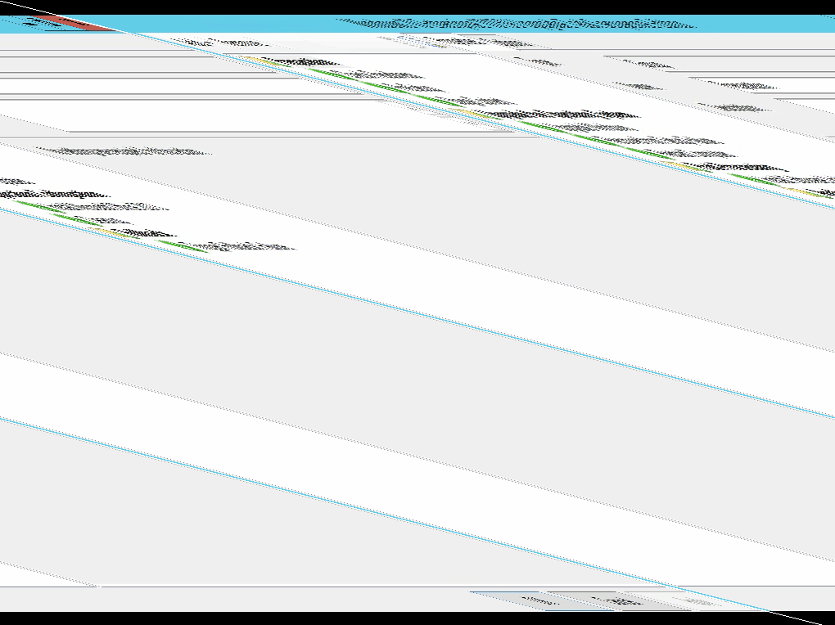

Upgrading to Windows 10 (Videos)
Windows XP to Windows 10
(Wipe & Load)
Windows 7 to Windows 10
(In-place Upgrade)
Windows 7 to Windows 10
(Fail Scenario)

Slide 19
The Path to Windows 10 Upgrades
Path | Technology
Windows 7, Windows 8 and Windows 8.1 to Windows 10 | In-place upgrade using Windows Update, Installation Media or Task Sequence
Windows 10 RTM to Windows 10 (Fall 2015) Windows 7, Windows 8 and Windows 8.1 to Windows 10 (Fall 2015) | In-place upgrade using Windows Update, Installation Media, Task Sequence or WSUS
Windows 10 (Fall 2015) to Windows 10 (Summer 2016) | In-place upgrade (via Servicing) using Windows Update or WSUS
Windows 7, Windows 8 and Windows 8.1 to Windows 10 (Summer 2016) | In-place upgrade using Windows Update, Installation Media, Task Sequence or WSUS
LTSB 2015 to LTSB 2016 | In-place Upgrade

Slide 20
Supported upgrade paths to Windows 10
Earlier Windows version | Windows 10 Home | Windows 10 Pro | Windows 10 Enterprise
Windows 8/8.1 | X
Windows 8/8.1 Pro |  | X
Windows 8/8.1 Enterprise |  |  | X
Windows RT
Windows 7 Starter | X
Windows 7 Home Basic | X
Windows 7 Home Premium | X
Windows 7 Professional |  | X
Windows 7 Ultimate |  | X
Windows 7 Enterprise |  |  | X

Slide 21
USMT Components & Windows 10 Support
ScanState.exe
  Collects the files and settings from the source computer and creates a store
LoadState.exe
  Migrates the files and settings from the store to the destination computer
Migration XML files
  MigDocs.xml, MigApp.xml, MigUser.xml, and any custom XML files that you create
Unsupported on USMT 10
Any version of Windows Server operating systems, Microsoft Windows 2000 or Windows XP
Any starter or home edition of Windows Vista / 7 / 8 / 10, Windows RT

Slide 22
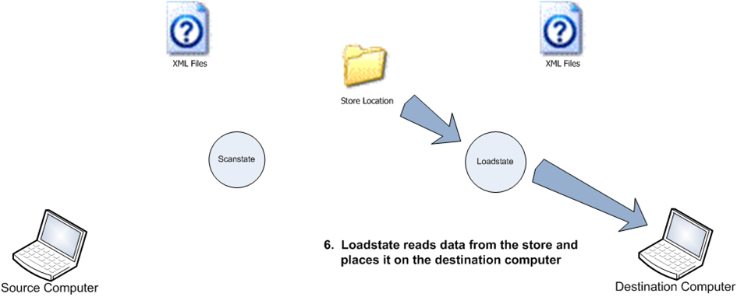
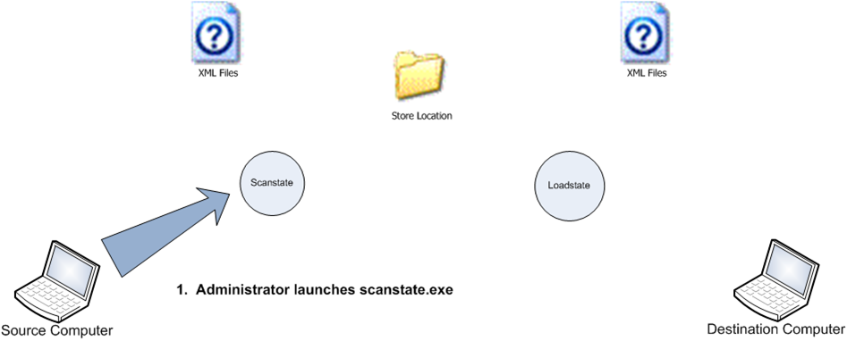
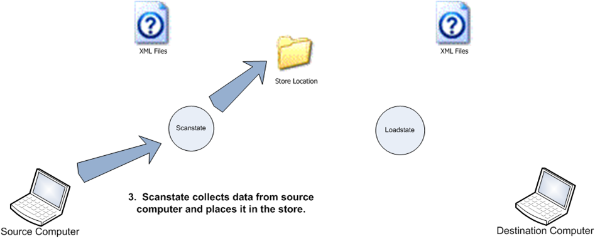
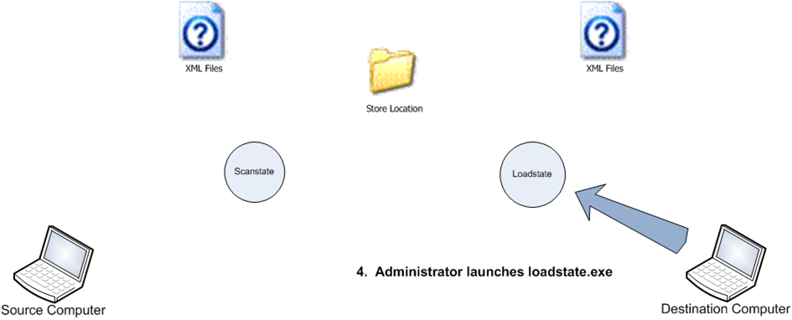
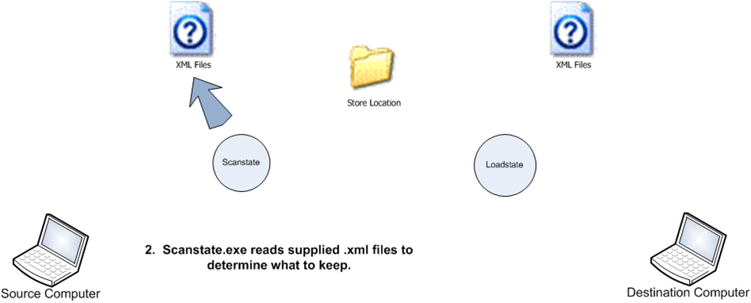
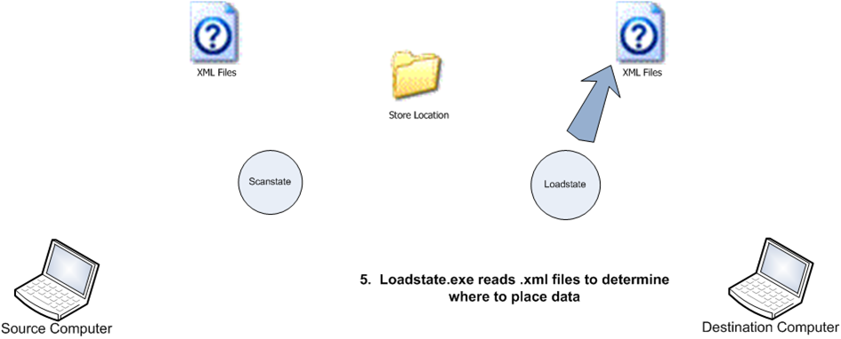
The USMT Process (Still the same)
Admin Launches Scanstate
Scanstate Reads the XML
Scanstate Collects Data
Admin launches loadstate
Loadstate Reads the supplied XML
Loadstate writes data from store and writes to the store.
Note: User must log on and log off to save changes.

Slide 23
Option for the Windows 10 USMT
Overview
User state migration preserves user generated content, the user’s customized experience of Windows, and application settings within the constraints of operating system and application compatibility.
Supported
Versions
Customers moving from earlier versions of Windows may choose to move to an intermediate Operating System version to allow full USMT support.
 | Windows XP Pro | Windows Vista | Windows 7 | Windows 8 | Windows 8.1 | Windows 10
Windows XP Pro | 3.0 | 4.0 | 4.0, 5.0 | 5.0
Windows Vista |  | 4.0 | 4.0, 5.0 | 5.0
Windows 7 |  |  | 4.0, 5.0, 6.3 | 5.0, 6.3 | 6.3 | 10
Windows 8 |  |  |  | 5.0, 6.3 | 6.3 | 10
Windows 8.1 |  |  |  |  | 6.3 | 10
Windows 10 |  |  |  |  | 10 | 10

Slide 24
Practice Question
Your company’s desktops run 32-bit Windows 7 with Service Pack 1 (SP1). You are planning the migration to 64-bit Windows 10. You have confirmed that all of the hardware is compatible with 64-bit Windows 10.
The migration must meet the following requirements:
User settings and files must be preserved during the migration
Existing hardware should be used
What is the best path for this migration?
In-Place Upgrade with a provisioning package
Wipe and Load Migration. Use User State Migration Tool (USMT) to migrate user files and settings
In-place Upgrade
Side-by-side migration

Slide 25
Windows 10 Editions
Windows 10 Home
Designed for use in PCs
Windows 10 Pro
Windows 10 Pro is comparable with Windows 7 Professional, Ultimate and Windows 8/8.1 Pro.
Windows 10 Pro Education
Introduced in July 2016 for hardware partners
Windows 10 Enterprise
Windows 10 Enterprise provides all the features] of Windows 10 Pro
Windows 10 Enterprise LTSB
Enterprise version that does not include Cortana, Windows Store, Edge, Photo Viewer and UWP Calculator
Windows 10 Education
For use in schools, colleges, and universities.
Windows 10 Mobile
For use in schools, colleges, and universities.
Windows 10 Mobile Enterprise
Provides security updates more quickly

Slide 26
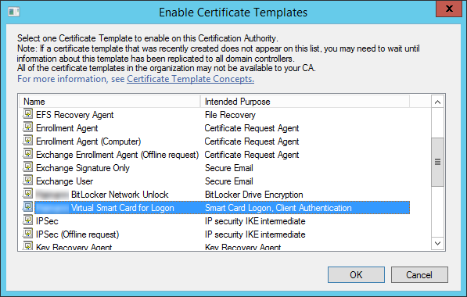
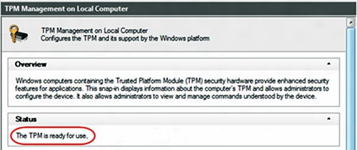

Configure a Virtual Smart Card
Sample Exam Steps:
Step 1: Create a certificate Template
Step 2: Create the virtual TPM smartcard
Step 3: Enroll the certificate on the TPM virtual smartcard
Key Exam Content
Understand how to use tpsvmcmgr.exe to configure a smart card.
tpmvscmgr.exe create /name tpmvsc /pin default /adminkey random /generate

Slide 27
General Features in Windows 10
Cortana
Windows 10 Digital Assistant
Continuum
Optimization of the Experience across device types
Miracast
Used to connect to monitors or projectors Windows device wirelesses
Touch
Allows for interactive, touch-centric operating system experience
OneDrive
Free online storage
Sync your settings
Data remains synced across multiple Windows 10 devices

Slide 28
Security Features in Windows 10
BitLocker
A TPM works with BitLocker to help protect against data theft
Device Health Attestation
Ensures Windows 10 Boot process meets the requirements of the organization
Secure Boot
Secures the process of Booting up the Windows 10 device
Two-Factor Authentication
Enforces the need for more than one form factor to authenticate to the device
Virtual Secure Mode
The VSM moves sensitive elements of the OS to a more secure location
Virtual Smart Card
Allows for the use of a virtual smart card without having a physical smart card

Slide 29
Feature Availability Pro vs Enterprise
Feature name | Windows 10 Pro | Windows 10 Enterprise
Bitlocker | X | X
Bitlocker to Go | X | X
Multilingual User Interface | X | X
Hyper-V host | x64 only | x64 only
Auto triggered VPN | X | X
WorkFolders | X | X
MDM enrollment | X | X
Virtual SmartCard | X | X
Azure AD join | X | X
Full MDM support | X | X
Business Store | X | X
Microsoft Passport | X | X
Enterprise Data Protection | X | X
2 factors authentication | X | X
Windows Update for Business | X | X
Current Branch for Business | X | X*
Long Term Servicing Branch |  | X
AppLocker |  | X
Enterprise Search Scope |  | X
Branch Cache |  | X
Direct Access |  | X
Granular UX Control / Embedded functionalities |  | X
Start screen control |  | X
Telemetry Control |  | X
Credential Guard |  | X64 Only
Device Guard |  | X64 Only
Windows Defender Advanced Threat Protection - Soon |  | X*
Windows To Go |  | X*
User Environment Virtualization |  | X*
Application Virtualization |  | X*
Advanced Group Policy Management Console |  | X*
Microsoft Bitlocker Administration and Monitoring |  | X*
Diagnostic And Recovery Toolkit |  | X*
Virtualization Right for 4 desktops Sessions (VDI) |  | X*

Slide 30
Install Windows
  Perform clean installations
  Upgrade using Windows Update
  Upgrade using installation media
  Configure native boot scenarios
  Migrate from previous versions of Windows
  Install to virtual hard disk (VHD)
  Boot from VHD
  Install on bootable USB
  Install additional Windows features
  Configure Windows for additional regional and language support

Slide 31
Switches for configuring Windows 10 Updates
Commonly used commands
  /Auto {Clean | DataOnly | Upgrade}
    Automates setup UI and selects migration option
  /Compat {IgnoreWarning | ScanOnly}
    IgnoreWarnings auto accepts dismissible compat warnings
    ScanOnly runs setup through the down-level compat scan
  /DynamicUpdate {enable | disable}
    Enable or disable downloading updates (default is enabled)
  /InstallLangPacks <location>
    Auto install language packs during upgrade
  /NoReboot
    Use to postpone first reboot during upgrade
Full list is documented below
  https://msdn.microsoft.com/en-us/library/windows/hardware/dn938368(v=vs.85).aspx

Slide 32
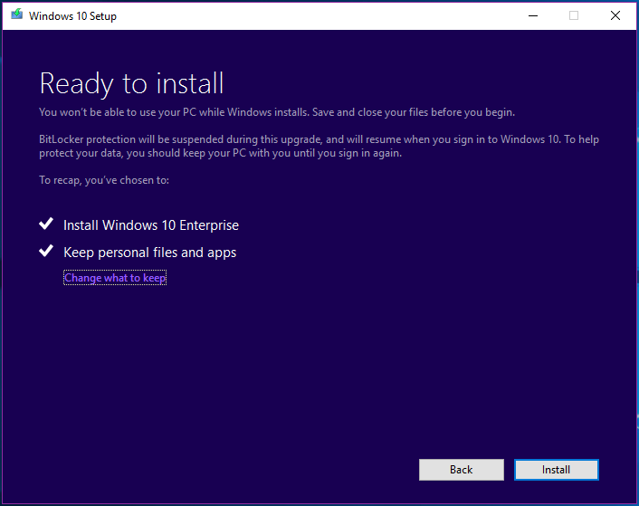
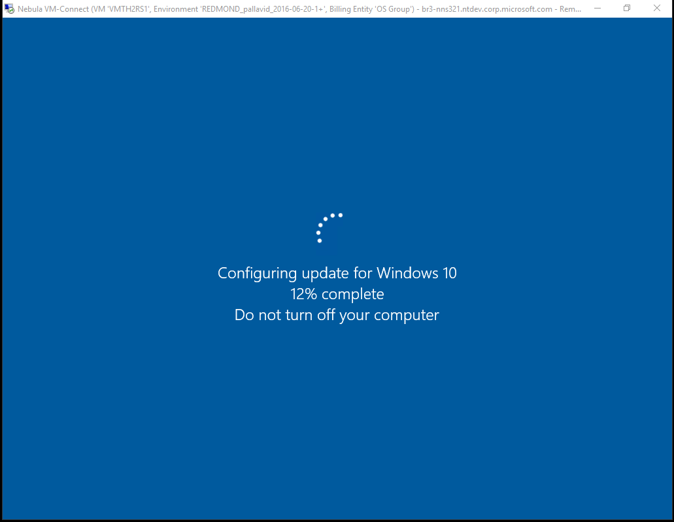
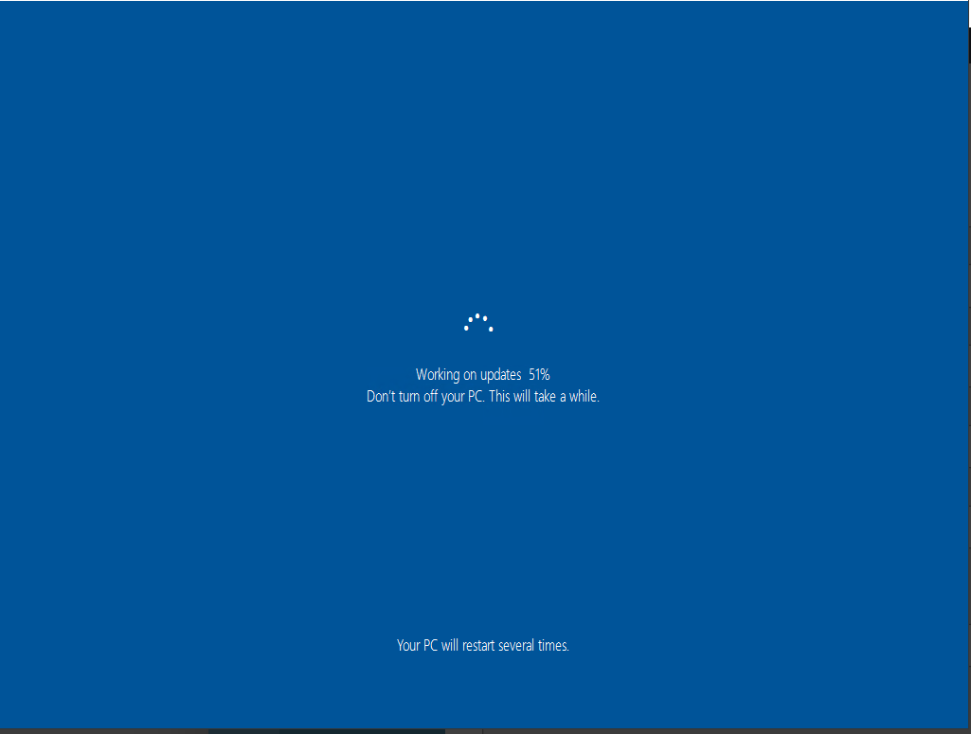
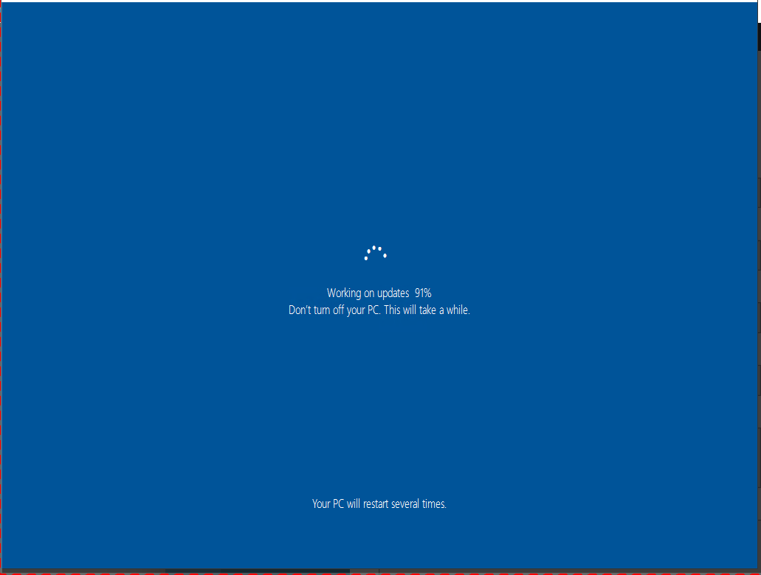
User experience (media-based)

Slide 33
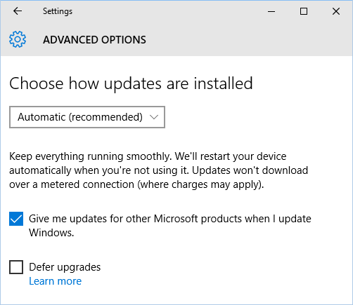
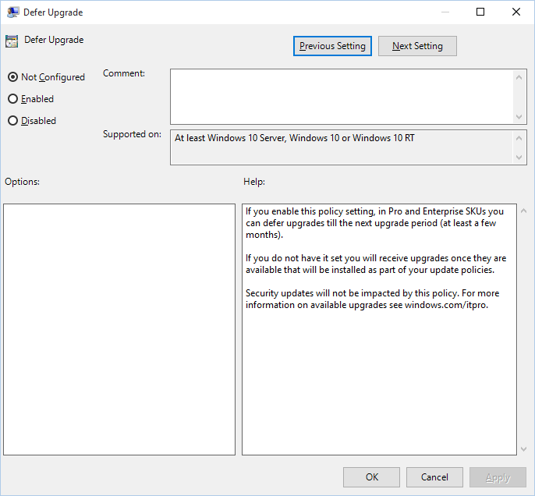
Current Branch vs. Current Branch for Business
Computer Configuration -> Administrative Templates -> Windows Components -> Windows Update
If you are using WSUS or ConfigMgr, the setting doesn’t really matter. Affects Windows Update.

Slide 34
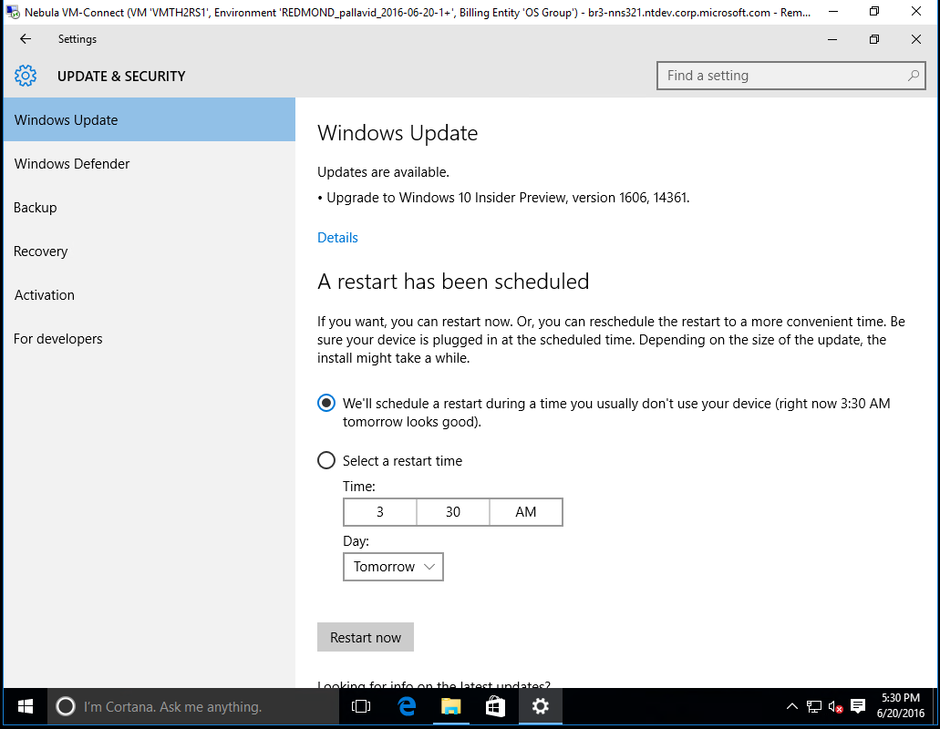
User experience (WU-based)

Slide 35
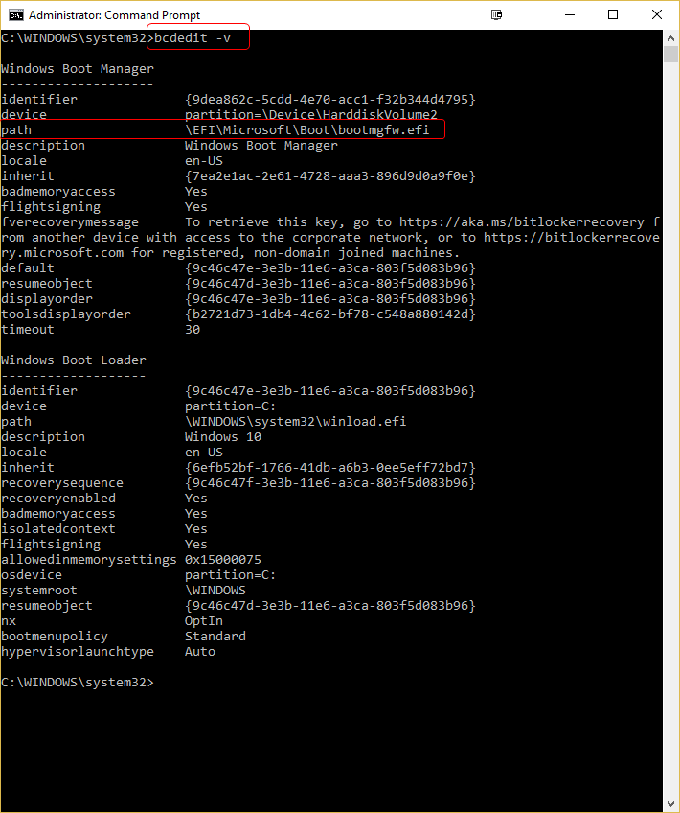
Configure Native Boot Scenarios
Boot Partition
  Contains Files Required to Boot Windows 10
System Partition
  Contains Windows 10 System Files
Boot Terms & Commands
  Diskmgmt.msc
  BCDEDIT -v

Slide 36
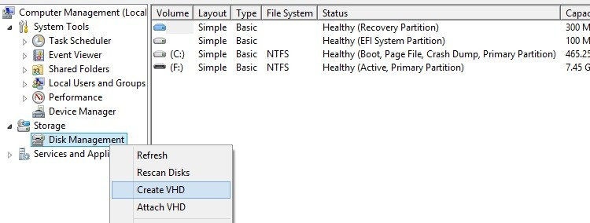
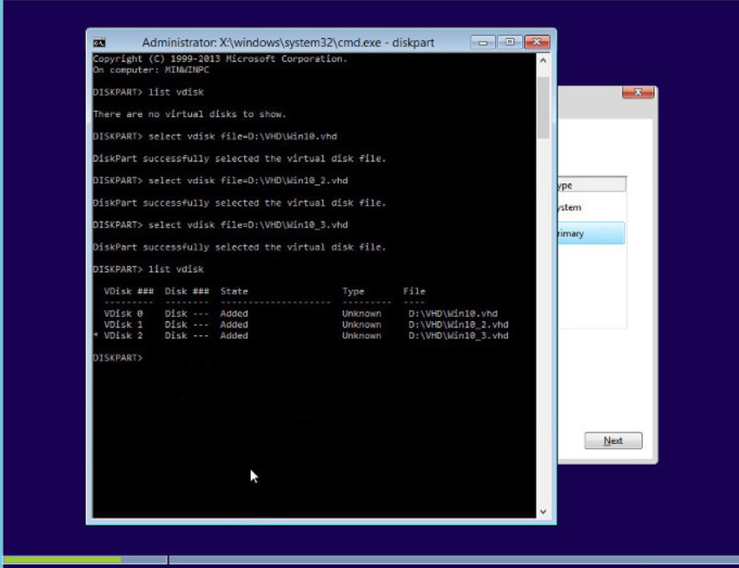
Boot to VHD (Native Boot)
Sample Powershell
New-VHD -Path C:\VHD\<File>-Fixed SizeBytes 32GB
Mount-VHD – Path C:\VHD\<File>
get-disk
Initialize-Disk Number 2
Get-Disk -Number 2 | New-Partition -AssignDriveLetter -UseMaximumSize | Format-Volume -FileSystem NTFS -Confirm:$false –Force

Slide 37
Upgrade Process – Additional Info
Languages
System UI language of the running OS must match that of the image being used to upgrade
Additional language packs must be reinstalled after the upgrade – you can provide a set of them to SETUP and it will take care of it
You can change the system UI language in the OS or in the image to make it match, e.g. “Dism /image:E:\ /Set-UILang:en-US”, but only offline
Disk encryption
Third-party encryption products need to be hooked into media – OK with task sequences, but not with servicing (WU, WSUS, ConfigMgr SUP)
BitLocker is so much easier

Slide 38
Configure devices and device drivers
  Install, update, disable, and roll back drivers
  Resolve driver issues
  Configure driver settings, including signed and unsigned drivers
  Manage driver packages
  Download and import driver packages
  Use the Deployment Image Servicing and Management (DISM) tool to add packages

Slide 39
Gotchas - Drivers and Dynamic Updates
Drivers
Display and Bluetooth drivers are not migrated during the upgrade, other drivers may be left behind too
If other drivers are needed, provide them to SETUP but understand driver ranking rules for installation
Dynamic Update
SETUP wants to download needed drivers, a cumulative update (which is injected on the fly), and an updated compatibility database – can be 500+MB per machine
This doesn’t work well/at all with ConfigMgr or WSUS today

Slide 40
Perform post-installation configuration
  Configure and customize start menu, desktop, taskbar, and notification settings, according to device type; configure accessibility options
  Configure Cortana
  Configure Microsoft Edge
  Configure Internet Explorer
  Configure Hyper-V
  Configure power settings

Slide 41
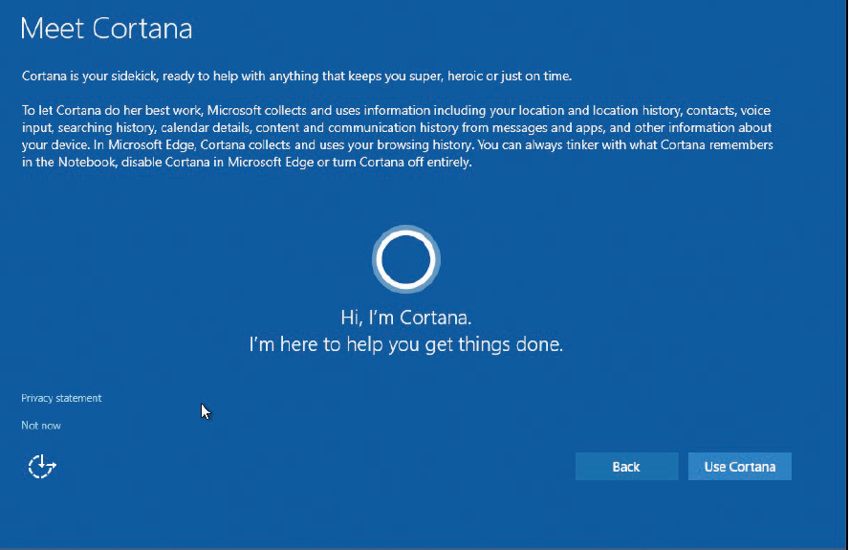
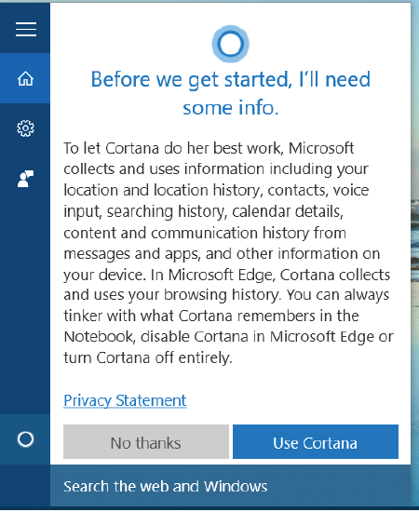
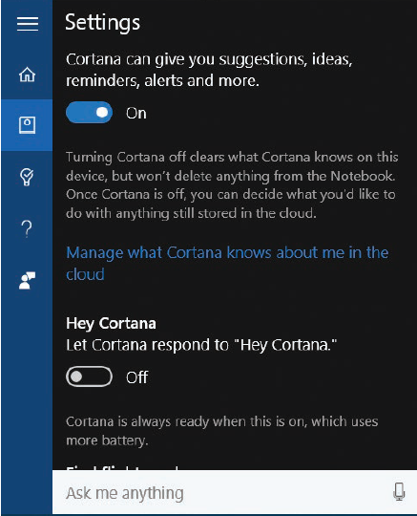
Post-Installation: Configuring Cortana
Personal Digital Assistant
Enabling Cortana
Available Configuration
Suggestions, Ideas, Reminders, Alerts and More..
Hey Cortana
Find Flights And More
Taskbar Titbits
Missed Call Notifications On Windows 10 Mobile
Device Search History
Web Search History

Slide 42
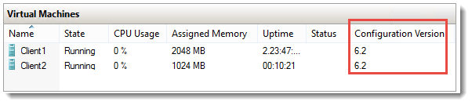
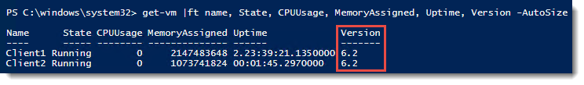
Windows 10 - Hyper-V Client
UI has been changed to display Configuration Version
Features
  Delayed Upgrade
  Integration Components
  Production Checkpoints
  Connected Standby
  PowerShell Improvements
  Reduced VM Downtime
Shielded VM
Virtual Machine Groups

Slide 43
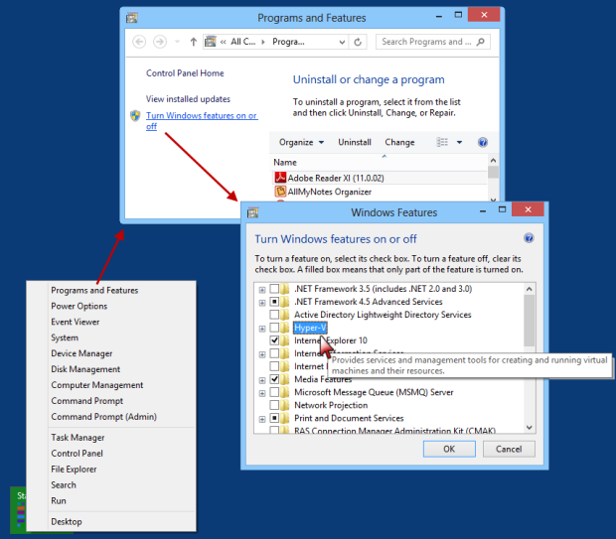
Configuring Client Hyper-V for Windows 10
Built into Windows 10 and Windows 8.x.
Previously only available in Windows Server
Enables the ability to run VMs
Nested VMs are the latest feature available in Hyper-V

Slide 44
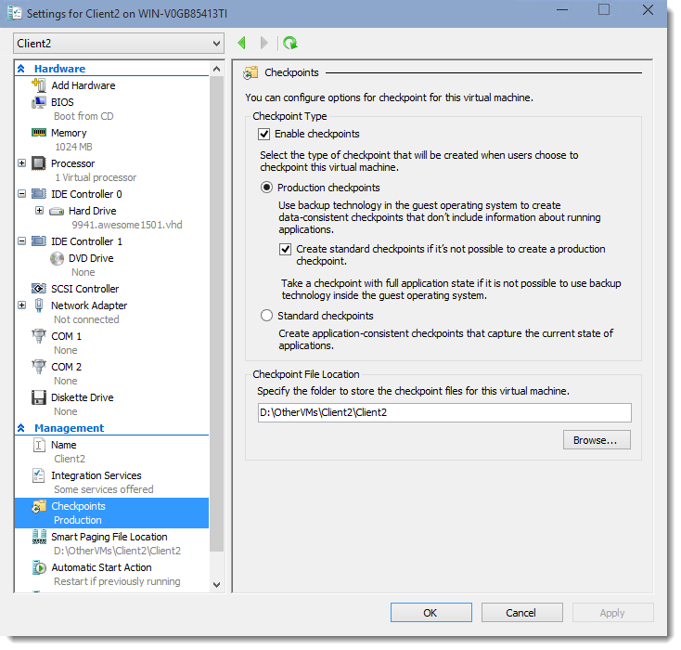
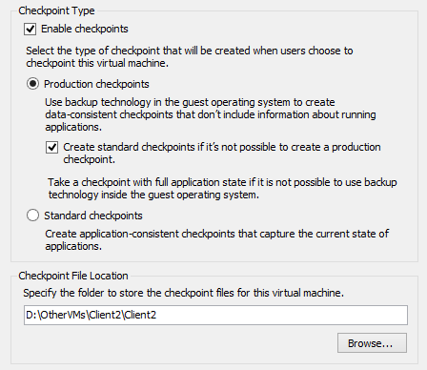
Production Checkpoints: New UI
Standard Checkpoints
Production Checkpoints
Action:
Using Hyper-V Manager
Open Hyper-V Manager.
Right click on a virtual machine and select settings.
Under Management select Checkpoints.
Select the desired checkpoint type.
PowerShell Samples:
Get-VMCheckpoint -VMName <VMName>
Restore-VMCheckpoint -Name <checkpoint name> -VMName <VMName> -Confirm:$false

Slide 45
Implement Windows in an enterprise environment
  Provision with the Windows Imaging and Configuration Designer (ICD) tool
  Implement Active Directory–based activation
  Implement volume activation using a Key Management Service (KMS)
  Query and configure activation states using the command line
  Configure Active Directory, including Group Policies
  Configure and optimize user account control (UAC)

Slide 46
WICD Provisioning Tool
WICD Uses
View settings and policies in a Windows 10 image or provisioning package.
Create and manage Windows provisioning answer files.
Define applications and drivers in an answer file.

Slide 47
Windows 10 Activation Methods
Advantages
Disadvantages
Considerations
Multiple Activation Key (MAK)
Single activation key
Multiple uses
Similar to retail activation
No infrastructure required
One time activation, no renewal
Key can be used for any activations
IT staff has full control of key
Single activation key for entire organization
Can require implementation in image creation service
May be beneficial for development purposes.
Key Management Service (KMS)
Key management server governs all transactions
Activation renewal required
Active directory activation
No IT support required for devices on LAN/VPN/DirectAccess
Requires activation renewal
Disconnected machines require manual intervention
Server infrastructure required
Allows machines on network immediate activation
Very useful for full environment rollout of activation.

Slide 48
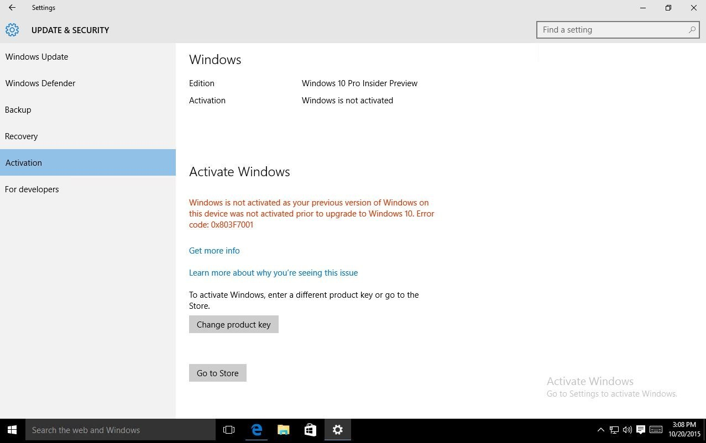
Windows 10 Activation Options
KMS Activation
Open an elevated command prompt.
Enter one of the following commands.
    To install a KMS key, type slmgr.vbs /ipk <KmsKey>.
    To activate online, type slmgr.vbs /ato.
    To activate by using the telephone, type slui.exe 4.
After activating the KMS key, restart the Software Protection Service.
Basic Activation Options
    Retail
    OEM
    Volume Licensing
Finding Activation States
    slmgr.vbs /ipk <KmsKey>.
    Slmgr.vbs /xpr
    slmgr.vbs /ato.
    slmgr.vbs [MachineName [User Password]] [<Option>]

Slide 49
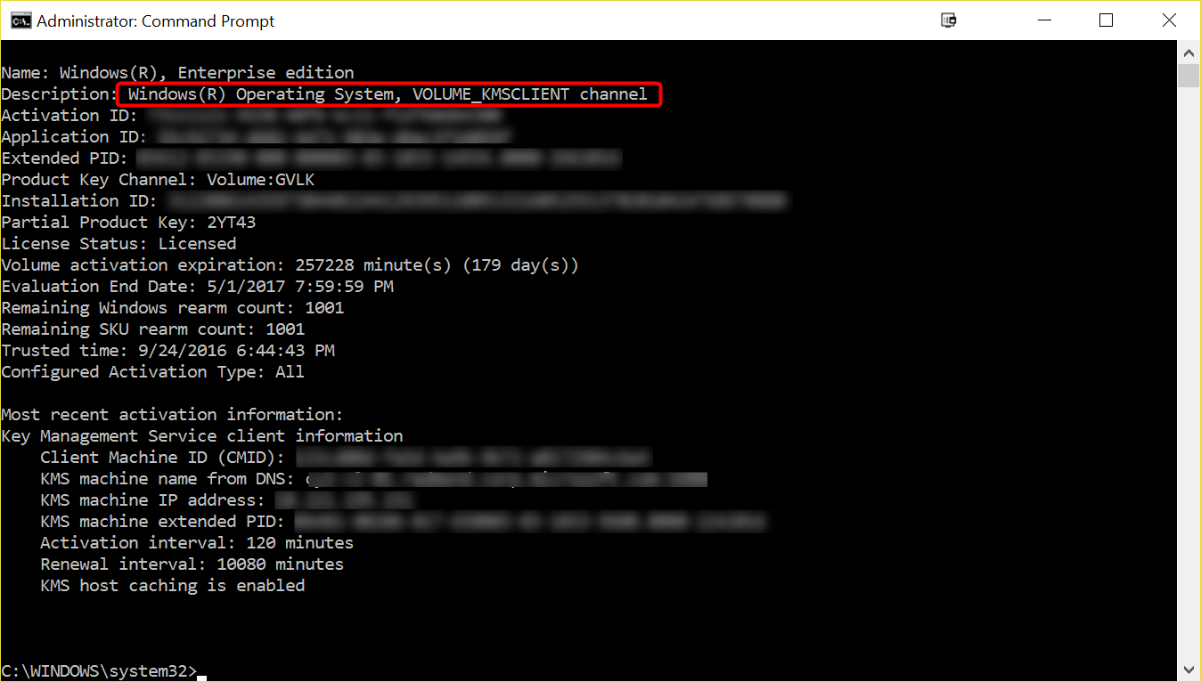
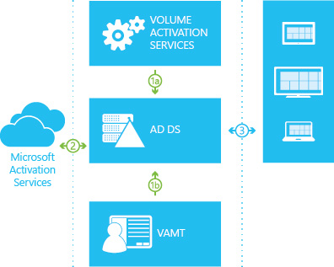
Windows 10 Activation Options
Active Directory Activation
Use an account with Domain Administrator and Enterprise Administrator credentials to sign in to a domain controller.
Launch Server Manager.
Add the Volume Activation Services role
Click the link to launch the Volume Activation Tools
Select the Active Directory-Based Activation option
Enter your KMS host key and (optionally) a display name
Activate your KMS host key by phone or online
After activating the key, click Commit, and then click Close

Slide 50
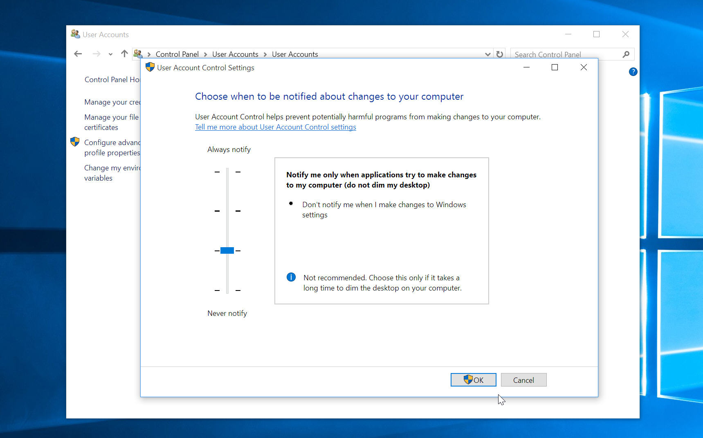
User Account Control (UAC) in Windows 10
Benefits
Prevents Malware
Runs in Secure Context
Block Automatic Installation
Encourage Standard User Accounts
Can be controlled using Group Policy
Settings
Prompt for credentials on the secure desktop
Prompt for consent on the secure desktop
Prompt for credentials
Prompt for consent
Prompt for consent for non-Windows binaries

Slide 51
Configuring UAC in Windows 10
No Elevation Required
Change their user account passwords
Configure accessibility options
Configure power options
Install updates by using Windows Update
Install device drivers included in the operating system or by using Windows Update
View Windows 10 settings
Pair Bluetooth devices
Establish network connections, reset network adapters, and perform network diagnostics and repair
Requires Elevation
Install or remove apps
Install a device driver not included in Windows or Windows Update
Modify UAC settings
Open Windows Firewall in Control Panel
Add or remove user accounts
Restore system backups
Configure Windows Update settings

Slide 52
Windows 10 – Group Policy
New Policies in Windows 10
Start screen and start menu management
Microsoft Edge settings
Next-Generation Credential PIN settings
Universal app management
New Policies From Windows 7
New capabilities released in Windows 8.1
Policy caching
IPv6 support for printers, VPN, targeting
New capabilities released in Windows 8
Sign-in optimization for DirectAccess clients
Better use of larger registry policies (registry.pol)
Remote group policy refresh (GPUpdate)
More efficient background processing
Security Baselines
Microsoft will continue to work with relevant parties to expedite the release of Windows 10 Security Baselines.

Slide 53
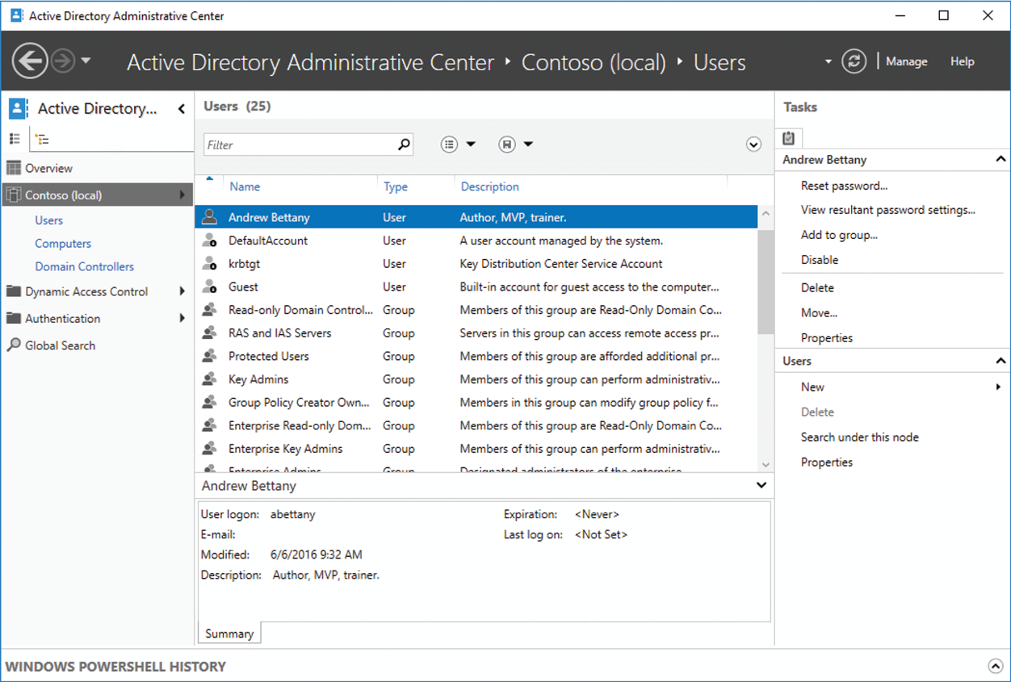
Active Directory Terms
Terms to be Familiar with:
Site
Forest
Domain
Domain trees
Organizational units
Domain controllers
Global catalog servers
Operations masters
Read-only domain controllers (RODC)
Note: In the ADAC, at the bottom is Windows PowerShell History. You can click the small caret at the bottom right to display the Windows PowerShell History Viewer, which displays a history of the Windows PowerShell commands that are executed when you perform administrative tasks with ADAC.

Slide 54
Practice Question
You are planning your company’s User Account Control (UAC) policies and need to provide the security team with a list of actions which do not require UAC.
Which of the following actions do not require UAC? Select 3.
Installing Windows Updates
Configuring Windows Update settings
Installing a device driver from a USB drive
Pairing a Bluetooth microphone and headset
Configuring Windows Firewall settings
Configuring Accessibility options

Slide 55
Implement Windows
Tip #1
USMT order-of-operations:
Scan settings using scanstate.exe
Upgrade OS (or wipe and load OS)
Restore settings using Loadstate.exe
In-place Upgrade
--
Wipe and Load
Going from 32-bit OS to 64-bit OS
Hint: wipe and load
Tip #2
Know the different activation methods and commands
Tip #3
As of TODAY: exam does not include Anniversary edition specific Group Policy or system settings

Slide 56
02-Configure and Support Core Services

Slide 57
Configure networking
  Configure and support IPv4 and IPv6 network settings
  Configure name resolution
  Connect to a network
  Configure network locations
  Configure Windows Firewall
  Configure Windows Firewall with Advanced Security
  Configure network discovery
  Configure Wi-Fi settings
  Configure Wi-Fi Direct
  Troubleshoot network issues
  Configure VPN, such as app-triggered VPN, traffic filters, and lockdown VPN
  Configure IPsec; configure Direct Access

Slide 58
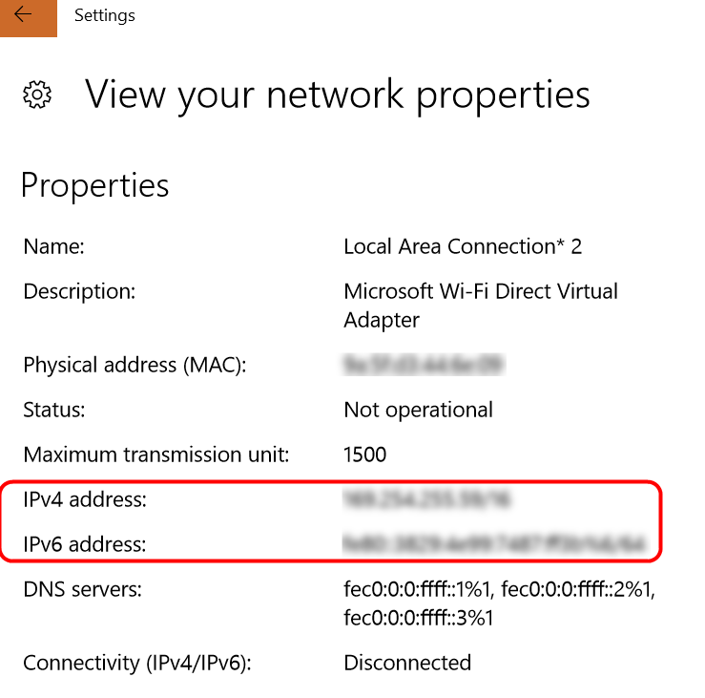
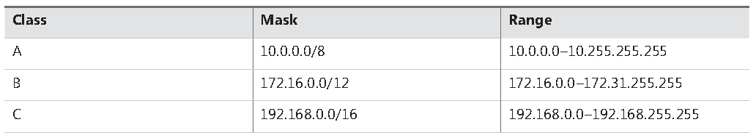
Overview of IPv4 and Networking Terms
Terms to Know
An IPv4 Address
A subnet mask
A default gateway address
A Domain Name Server (DNS) server address
Subnets
Simple Networks
Complex Networks
Public and Private Addressing
Class A, B and C
Masks: {10.0… } {172.16…} {192.168…}
Ranges

Slide 59
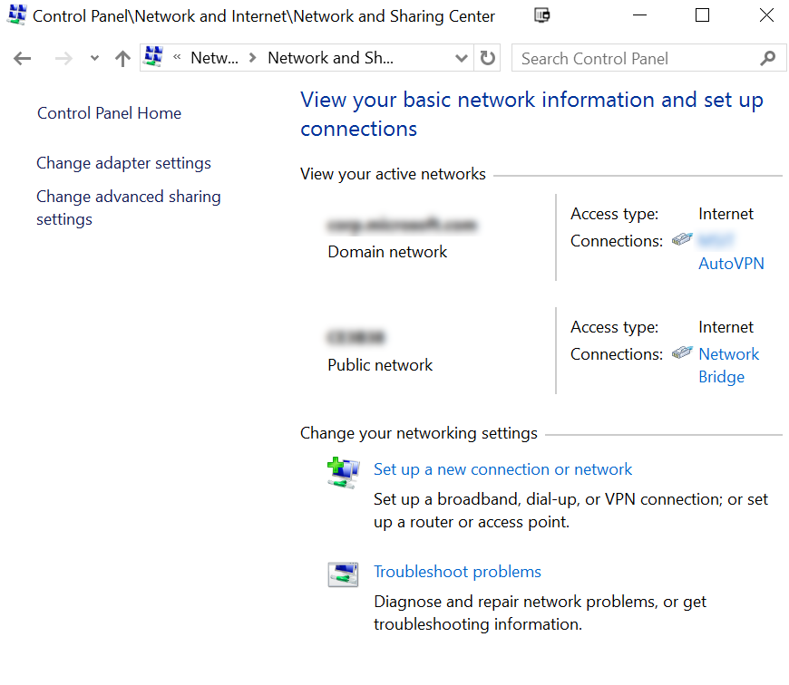
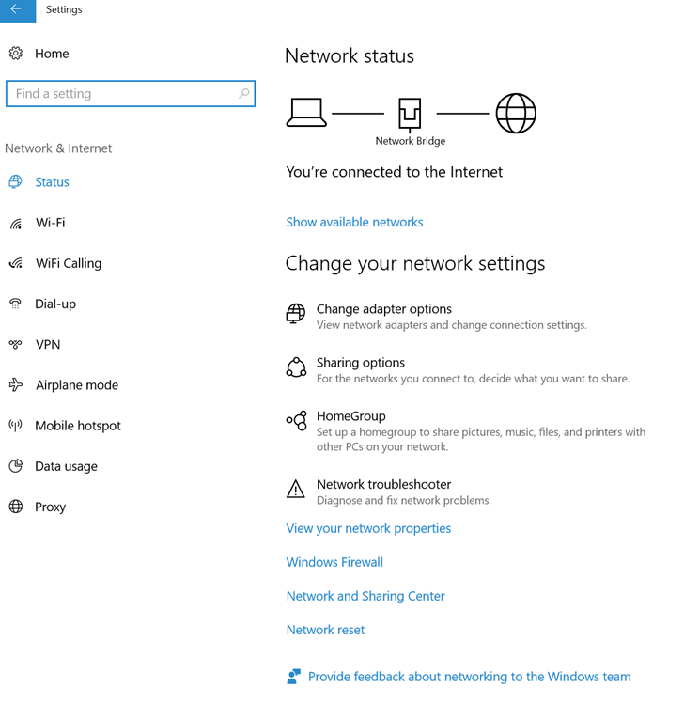
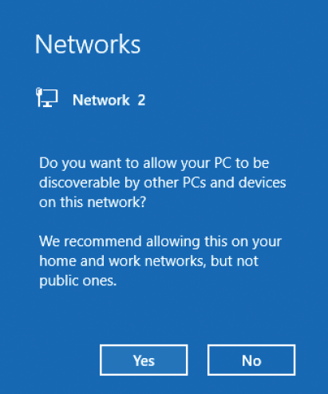
A look at Network Locations
Domain Networks
Private Networks
Guest Networks

Slide 60
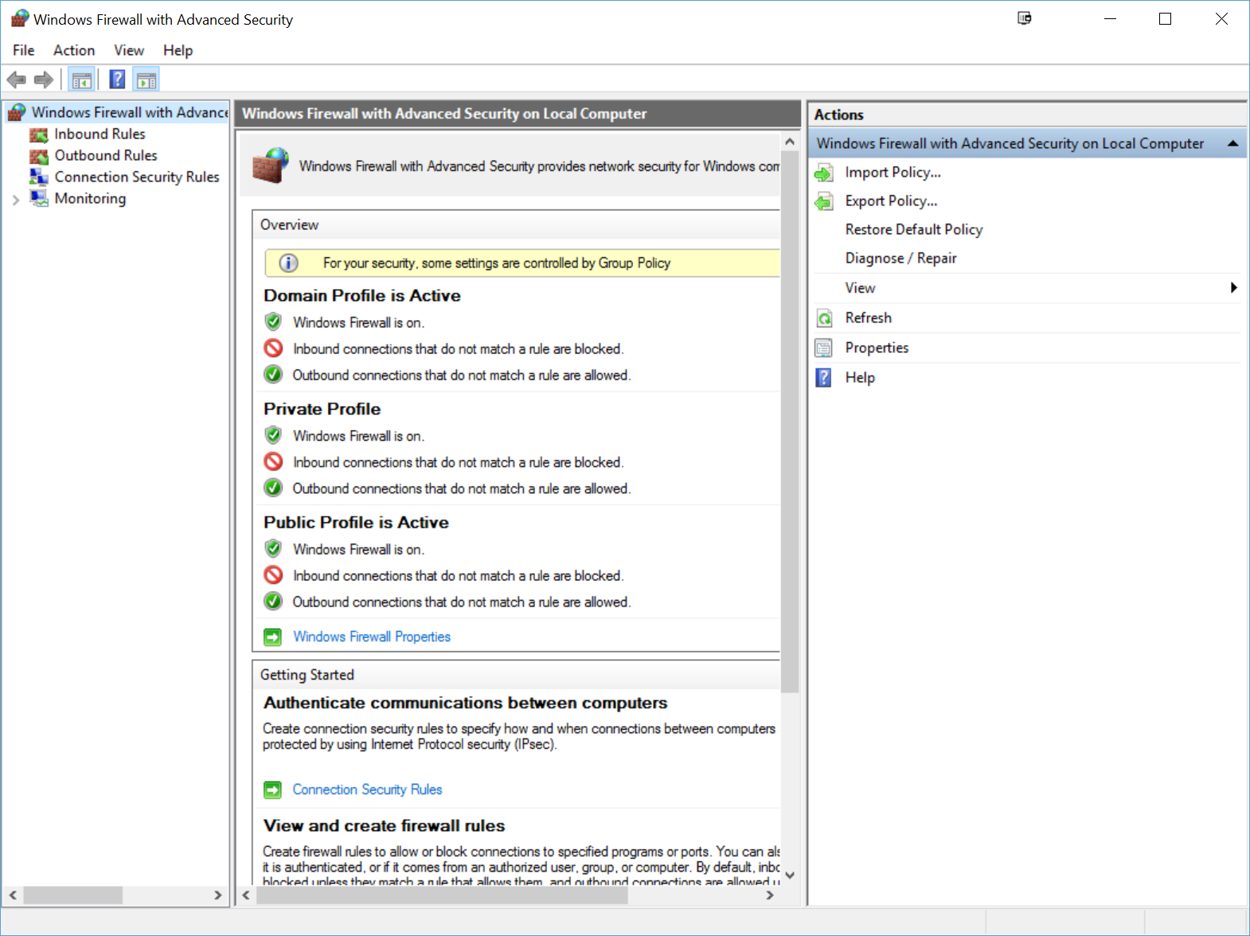
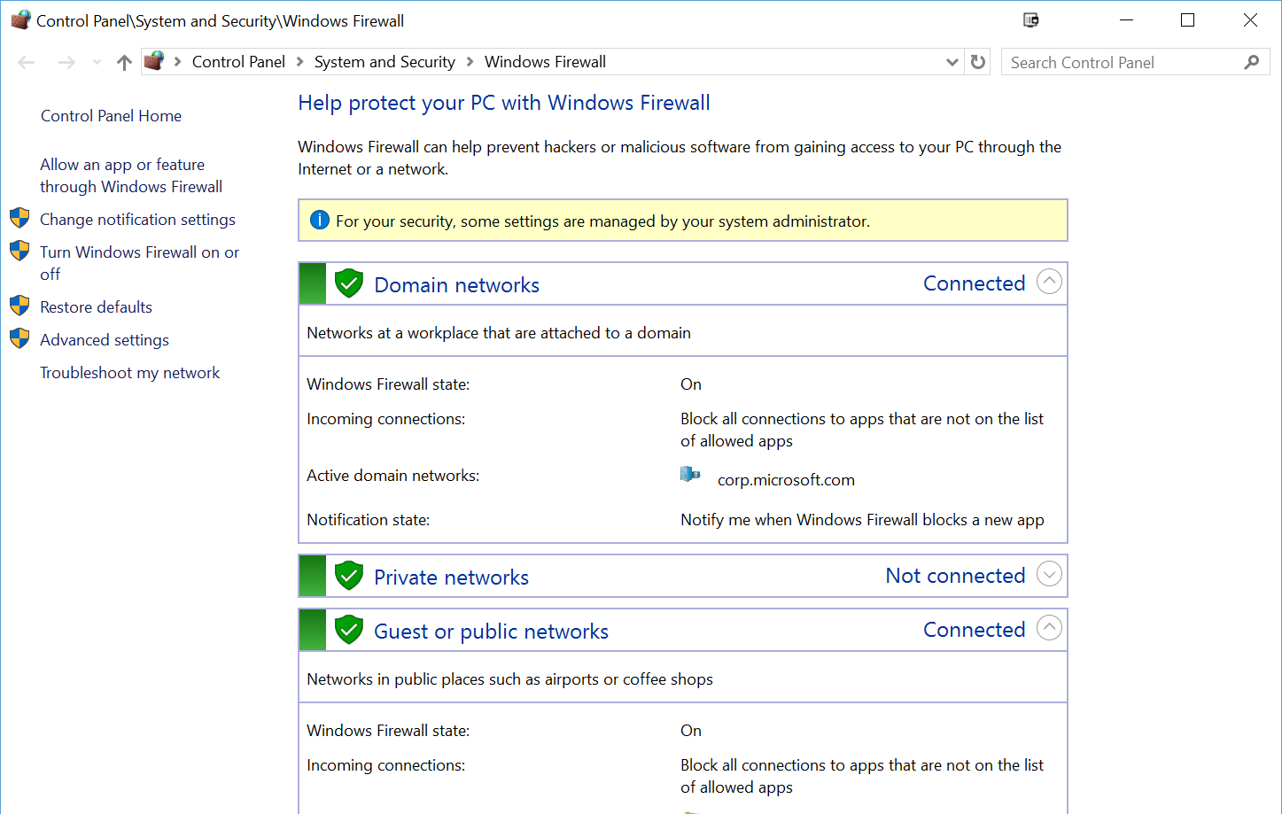
Configure Windows Firewall concepts
Windows Firewall State Default
Incoming Connections
Active Domain/Private/Public Networks
Notification State
Get-NetFirewallRule Displays a list of available firewall rules
Enable-NetFirewallRule Enables an existing firewall rule
Disable-NetFirewallRule Disables an existing firewall rule
New-NetFirewallRule Creates a new firewall rule
Set-NetFirewallRule Configures the properties of an existing firewall rule

Slide 61
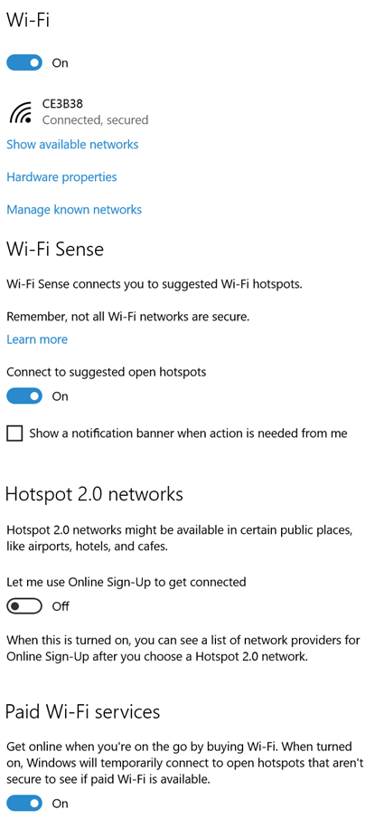
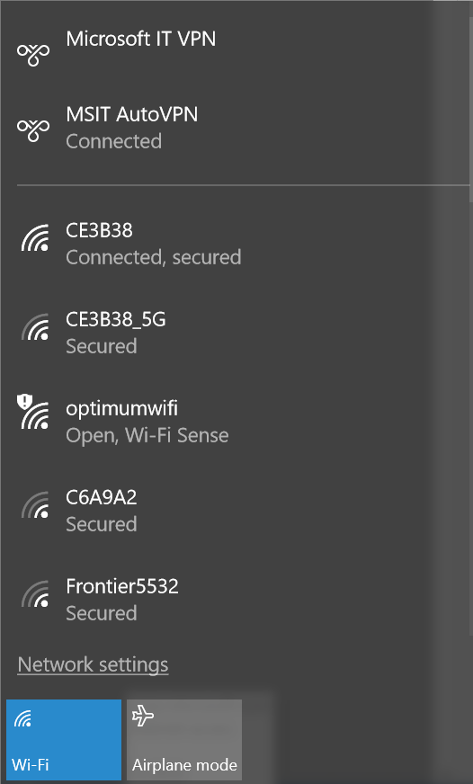
Configure Wi-Fi-Settings and Wi-Fi-Direct
Modes
Ad-Hoc
Wifi Direct
Infrastructure
Netsh wlan show profile
Standards
802.11 a-ac
Wifi Direct
Infrastructure
Wi-Fi Security
Wired Equivalent Privacy (WEP)
Wi-Fi Protected Access
WPA2

Slide 62

Troubleshooting Network Issues
Troubleshooting Steps
Determine the scope of the problem. Knowing how many users are affected can help you determine possible causes.
Determine the IP configuration. Verify that the network configuration of affected devices is correct.
Determine the network’s hardware configuration. Determine whether there are problems with the networking hardware or device drivers for that hardware.
Test communications. Perform a series of tests that help you pinpoint the nature of the problem.
  Verifying basic communications.
  Checking the routing and firewall configuration of your network.
  Testing name resolution.
  Testing connectivity to specific applications on servers.

Slide 63

Practice Question
You are the help desk technician at Contoso.com. A user calls you because they are unable to access a resource on Server1.
You ask the user for the Internet Protocol (IP) Address of the computer, and walk the user through getting you that information.
The user’s IP Address is displayed to the right.
What should you do?
Add a default gateway to the Network Interface Card (NIC) IPv4 properties of Computer1
Enable IP Routing on Computer1
Check the DHCP server to see if it is online and has IP Addresses available
Check the DNS server to see if it is online and able to resolve Server1 to an IP Address

Slide 64
Configure Storage
  Configure disks, volumes, and file system options using Disk Management and Windows PowerShell
  Create and configure VHDs
  Configure removable devices
  Create and configure storage spaces
  Troubleshoot storage and removable devices issues

Slide 65

Configure Disks, Volumes and File Systems
Disk Partitions
Master Boot Record (MBR)
GUID Partition Table (GPT)
Disk Management Tools
Disk Management
Windows PowerShell
DiskPart
Volumes
Mirrored
Spanned
Striped
File Systems
NTFS
ReFS
exFAT
FAT32
FAT

Slide 66

Configure shared folder permissions
Benefits
Allow data resources to be available over a corporate network
Managed by Server message Block (SMB)
Note: SMB Share permissions are ignored for local accessed resource or via RDP

Slide 67
Demo:
Create and Configure a VHD

Slide 68

Create a Virtual Disk using Storage Spaces
Create a Virtual Disk using Storage Spaces
Physical Disk
Storage Pool
Storage Space
Disk Drive
Provision
Thin Provisioning
Fixed Provisioning
Storage Layouts
Simple
Two-Way or Three-Way Mirroring
Parity

Slide 69
Configure data access and usage
  Configure file and printer sharing and HomeGroup connections
  Configure folder shares, public folders, and OneDrive
  Configure file system permissions
  Configure OneDrive usage
  Troubleshoot data access and usage

Slide 70
Configure shared folder permissions
Benefits
Allow data resources to be available over a corporate network
Managed by Server message Block (SMB)
Note: SMB Share permissions are ignored for local accessed resource or via RDP

Slide 71
Implement apps
  Configure desktop apps
  Configure startup options
  Configure Windows features
  Configure Windows Store
  Implement Windows Store apps
  Implement Windows Store for Business
  Provision packages, create packages
  Use deployment tools
  Use the Windows Assessment and Deployment Kit (ADK)

Slide 72

Supporting Windows Store and Cloud Apps
Key concepts:
  Integrate User’s Microsoft Account into their organization to enable synchronization.
  Manage apps by using Office 365, DISM, and Microsoft Intune
  Configure Group Policy to manage apps, manage access to the Windows Store, and enable sideloading
  Sideload apps to enable LOB apps without going through the Windows Store

Slide 73


Windows Store for Business
Why:
  Application & License Manageability, Ease of Use, Integration with Management Systems
Need for Managed Store
  Acquire apps in volume
  Manage Licenses
  Use Organizational Identities
  Pre-Load Apps
  Connect with management systems
  Manage LOB Apps
Roles:
  User, IT Professional
Scenarios
  Inventorying App, Online Distribution, Offline Distribution

Slide 74







A Walk through the Windows Store
Step Through
Sign to Office 365
Accept the Agreement
Get the App
Add the App to your Private Store
Click activate to enable integration with Intune
Student and Teachers can now shop for Apps

Slide 75


Configuring Windows Store Apps
What can I do?
Block the App
Sideload Apps
Distribute Apps through the Windows Store
Download Apps
Store Apps in Different Drives
Apps Installed per-user

Slide 76
Sideloading Store Apps
Add and Appx Package
Add-AppxProvisionedPackage -Online -FolderPath C:\Appx
Get all appx packages installed for all users:
Get-AppxPackage –AllUsers
Get all appx packages installed for a specific user:
Get-AppxPackage -User domain\username
Get the manifest, including the package ID of an app:
Get-AppxPackageManifest -Package Package1

Slide 77
Windows Assessment and Deployment Kit (ADK)
Overview
The Windows® Assessment and Deployment Kit (Windows ADK) is a collection of tools that can be used to customize, assess, and deploy Windows operating systems to devices
Features
The ADK includes the following tools:
Application Compatibility Tools
Deployment Tools
Windows Pre-installation Environment
Windows Image and Configuration Designer
Configuration Designer
User State Migration Tools
Volume Activation Management Tool
Windows Performance Toolkit
Windows Assessment Toolkit / Services
Application Virtualization Sequencer
UE-V Template Generator
Media eXperience Analyzer
Requirements
Latest version of the Windows ADK for Windows 10
Windows 10 Enterprise Pilot
The Windows ADK is used in the Windows 10 Enterprise Pilot to facilitate the configuration of the image for automated deployment

Slide 78
Microsoft Deployment Toolkit 2013 Update 2
Overview
Microsoft Deployment Toolkit is a free solution accelerator that allows for Windows Image Creation and unattended operating system deployment. It is the recommended tool for creating Windows Images
Use Cases
Windows 10 Image Creation
Scenarios which require minimal infrastructure requirements
Scenarios where System Center Configuration Manager needs extended functionality
Image Engineering Design Benefits
Unattended Installation Configuration
Custom Application Installation
Custom Application Configuration
User Profile Configuration
Patch and Update Implementation
Unattended Image Generation
Implementation of Custom Security Settings
Modular Application Sets
Organizational Branding
Multi-Platform Image Development
Driver Management
Framework for custom script development

Slide 79
Windows Image and Configuration Designer
Overview
Starting with Windows 10, the Image Configuration and Designer (WICD) can be used to provide limited customization to Windows 10 clients. This allows common items like PKI Profiles, WIFI settings, Applications and even security settings to be applied as part of a single package.
Use Cases
Apply a limited configuration to devices brought by users into the enterprise
Deploy standard settings to BYOD devices
Deploy standard applications to CYOD devices
Prevent Re-imaging
Considerations
Limited Configuration Options
Another baseline delivery mechanism to manage
Promotes non-standard hardware purchase
Recommendation
Use WICD to configure settings on employee owned devices to allow limited access to corporate resources, by allowing IT to deploy a single package to configure a multitude of settings
Continue to use Microsoft Deployment Toolkit to create Windows 10 Images

Slide 80
Configure remote management
  Choose the appropriate remote management tools; configure remote management settings
  Modify settings remotely by using the Microsoft Management Console (MMC) or Windows PowerShell
  Configure Remote Assistance, including Easy Connect
  Configure Remote Desktop
  Configure remote PowerShell

Slide 81





Configure Remote Desktop
Creating and Editing Remote Desktop connections
General
Display
Local Resources
Experiences

Slide 82
Practice Question
You are the administrator for contoso.com. A user named Jane attempts to access a resource on Server1 named LegalDocs (\\Server1\LegalDocs) but is denied access. She then uses Remote Desktop to connect to Server1, opens File Explorer, and is able to access LegalDocs.
You need to make sure when Jane attempts to access LegalDocs, she is denied access. All other users should not be effected by any changes you make.
You connect to Server1 through Computer Management, expand Shared Folders, click LegalDocs, and then click Properties.
What should you do next?
On the Share Permissions tab, add Jane’s account and select Deny Read
On the Security tab, add Jane’s account and select Deny Read
On the General tab, change the User Limit to 0
On the General tab, change the share name to LegalDocs$

Slide 83
Configure and support core services
Tip #1
Refresh yourself on how to subnet and supernet. Know common IPv6 addresses
IPv4, IPv6, CIDR, Subnetting – it’s all there
Remote Desktop
--
Remote PowerShell
Tip #2
netsh is still relevant on exams!
Tip #3
Folder Permissions haven’t changed. Know the relationship between Shared and NTFS

Slide 84
03-Manage and Maintain Windows

Slide 85
Configure updates
  Configure Windows Update options
  Implement Insider Preview, Current Branch (CB), Current Branch for Business (CBB), and Long Term Servicing Branch (LTSB) scenarios
  Manage update history
  Roll back updates
  Update Windows Store apps

Slide 86
Windows Update Options
Windows Update
  Default online location for home/small business PCs
Windows Update for Business
  WU for the location, but with deferral settings that can be managed
WSUS
  Administrator defined releases of updates and upgrades.
System Center Configuration Manager
  Similar to WSUS but for Config Manager clients.

Slide 87


Configuring Windows Updates

Slide 88
Demo:
Configuring Windows Update Settings

Slide 89
Servicing Options
Insider Preview
Prestaging for CB. Enthusiasts and non-production PCs
Latest builds deployed
Current Branch (CB)
Officially released updates for consumers/businesses.
Any PC not set to defer updates will receive updates for immediate installation.
Current Branch for Business (CBB)
Staged update releases for companies wishing to allow time for testing.
Deferrals for up to 8 months for feature updates, and 4 weeks for quality updates.
Support for 2 concurrent CBB builds.
Managed by Intune or Group Policy.
Long Term Servicing Branch (LTSB)
Slowest release ring, new build every 1-3 years
No feature updates, only quality updates (which are optional)
Designed for mission critical non-Internet facing systems

Slide 90

Windows 10 release cycles

Slide 91
Service Branch Comparison Chart
 | Current Branch (CB) | Current Branch for Business (CBB) | Long-Term Servicing Branch (LTSB)
New feature upgrades for installation available | Immediately | Deferred by ~ 4 months | Not applicable
Features included | Windows 10 Home, Windows 10 Pro, Windows 10 Education, Windows 10 Enterprise | Windows 10 Pro, Windows 10 Education, Windows 10 Enterprise | Windows 10 Enterprise LTSB
Optional month deferral | ~ 4 months | ~ 8 months | 10 years
Ongoing installation of new feature upgrades required to receive servicing updates | ● | ●
Supports Windows Server Update Services for release deployment | ● (excludes Home edition) | ● | ●
Supports | Configuration Manager/configuration management systems for release deployment (excludes Home) | Configuration Manager/configuration management systems for release deployment | Configuration Manager/configuration management systems for release deployment
Browser | Microsoft Edge, Internet Explorer 11 included | Microsoft Edge, Internet Explorer 11 included | Internet Explorer 11 included
System apps | No Notable Windows system apps removed | No Notable Windows system apps removed | System apps removed: Microsoft Edge, Windows Store Client, Cortana (limited search available)
Universal apps | No notable Windows universal apps removed | No notable Windows universal apps removed | Universal apps removed: Outlook Mail/Calendar, OneNote, Weather, News, Sports, Money, Photos, Camera, Music, Clock

Slide 92

Manage Update History
Updates can be viewed and also rolled back from control panel
Use Get-Hotfix to determine what is installed

Slide 93

Update Store Apps
Controlled through WU settings
Can also obtain from PCs on the local network

Slide 94
Monitor Windows
  Configure and analyze Event Viewer logs
  Configure event subscriptions
  Monitor performance using Task Manager
  Monitor performance using Resource Monitor
  Monitor performance using Performance Monitor and Data Collector Sets
  Monitor system resources
  Monitor and manage printers
  Configure indexing options
  Manage client security by using Windows Defender
  Evaluate system stability using Reliability Monitor
  Troubleshoot performance issues

Slide 95
Update History and Rollback of Updates
What is it
  Can be viewed in Control Panel\Programs and Features\View Updates or Settings\All Settings\Update & Security\Windows Updates\Advanced Options
Notes
  Updates can be uninstalled individually or the OS can be rolled back to the previous build
  App update history logs can be viewed in Event Viewer:
    Applications and Services logs\Microsoft\Windows\AppxDelpoyment-Server
      Search for Event 10001 (successful)

Slide 96
Which Tool for the job?
Exam Tip: Understand which tool(s) are best suited for a given task.
Sometimes more than one will appear to be correct, but there is often a catch such as 'real-time' monitoring or 'logged' events.

Slide 97

Event Viewer and subscriptions
Understand views and filtering.
Know how to create subscriptions and what is required to enable this.
Wecutil.exe

Slide 98

Task Manager and Resource Monitor
Real-time tool showing app usage, processes and performance data.
No way to save data.

Slide 99

Task Manager and Resource Monitor
Real-time tool showing processes and performance data.
How is it different to Task Manager?

Slide 100

Performance Monitor
Real time or logged performance data.
Data based on 100's of counters.
Data collector sets.
Allow scheduling and automated performance data collection.
Can also collect event trace data and system configuration data.

Slide 101


Windows Defender
PowerShell and settings app configuration

Slide 102
Configure system and data recovery
  Configure a recovery drive
  Configure a system restore
  Perform a refresh or recycle
  Perform a driver rollback
  Configure restore points
  Resolve hardware and device issues
  Interpret data from Device Manager
  Restore previous versions of files and folders, configure File History
  Recover files from OneDrive
  Use Windows Backup and Restore
  Perform a backup and restore with WBAdmin
  Perform recovery operations using Windows Recovery

Slide 103
Exam Tip!
There are so many options for recovery of Windows and data, it can be confusing.
Understand the ins and outs of each technology and where they may overlap.

Slide 104

Recovery Drive
Creates bootable USB media that can be used to troubleshoot a system that won't start.
Not to be confused with recovery partitions on hard drives.

Slide 105


System Restore Tools
System Restore
Restore points allow point in time recovery of the OS and apps
Driver rollback
Updated drivers can be rolled back once
Refresh PC

Slide 106

Data Recovery Tools
File History
OneDrive
Backup/Restore
Wbadmin.exe

Slide 107
Configure authorization and authentication
  Configure Microsoft Passport
  Configure picture passwords and biometrics
  Configure workgroups
  Configure domain settings
  Configure HomeGroup settings
  Configure Credential Manager
  Configure local accounts
  Configure Microsoft accounts
  Configure Device Registration
  Configure Windows Hello
  Configure Device Guard
  Configure Credential Guard
  Configure Device Health Attestation
  Configure UAC behavior

Slide 108

Windows Authentication
Windows Hello
Microsoft Passport for Work
Know about biometric methods and what is required to support them.

Slide 109
Workgroup/Domain/HomeGroup/Azure AD
Describe each scenario and how each is configured.
What options are there for joining each one?
e.g. domain join online and offline.
How do you configure a HomeGroup?

Slide 110

Device Registration
Connecting a device to a domain.
SSO for web applications.
Need Web Application Proxy, DNS record, AD FS.

Slide 111

Microsoft Accounts
Why use a Microsoft Account with Windows 10?
Sync options
Sign-in settings

Slide 112
Configure advanced management tools
  Configure services
  Configure Device Manager
  Configure and use the MMC
  Configure Task Scheduler
  Configure automation of management tasks using Windows PowerShell

Slide 113

Configure Services
Tasks relating to services:
Change startup type
Which account the service starts under
Recovery actions
Manual start/stop
PowerShell related to Services
Stop-Service
Get-Service
Set-Service

Slide 114

Configure Task Scheduler
User-defined and system tasks.
Tasks have triggers and actions.
E.g. at 10:00 am daily, run app1.exe.
Common PowerShell CMDs
Get-ScheduledTask
New-ScheduledTask

Slide 115
Task Automation with Windows PowerShell
PowerShell is a key component of Windows for IT Pros.
Learn it, use it and enjoy it!
Exam questions may ask you GUI or PowerShell related questions on the same technology. Be prepared!
Understand how to create scripts, jobs, and schedule them.
Sample Commands
New-JobTrigger
Register-ScheduledJob

Slide 116
Practice Question
You are the help desk technician for Contoso.com. A user connects to her desktop each evening from home to run some reports. The user calls you to tell you that recently the reports seem to be taking a long time to run.
You decide to schedule the collection of the relevant performance data.
Which tool below allows you to schedule the capturing of performance data?
Resource Monitor
Task Manager
Performance Monitor
Data Collector Sets
Event Viewer

Slide 117

Managing and Maintaining Windows
Tip #1
Many recovery options, between file-level and OS level. Understand them all:
Restore files, recover files, previous versions, Refresh the OS, reset the OS, etc…
Roll back an update
--
Roll back an OS
Monitoring tools are abundant
Tip #2
You can roll-back a specific update or even rool-back to a previous OS. Watch for the required end result
Tip #3
There are many tools, like Perf Mon, Resource Mon, Reliability Mon, Task Manager. Read the questions carefully to determine the *BEST* tool for the given scenario

Slide 118
70-698: Installing and Configuring Windows 10
Implement Windows
Configure and support core services
Manage and maintain Windows

Slide 119
Related Content
Certification Sessions
  CRT311-R1 Cert Exam Prep: Exam 70-697: Configuring Windows Devices, Tue. 14:30
  CRT305 Cert Exam Prep: Exam 70-398: Managing Windows Applications and Devices, Thur. 10:15
  Breakout Sessions/Chalk Talks
  WAD220 Windows as a Service: An Overview, Wed 10:30
  WAD300 Deploying Windows 10 Mobile phones and tablets for the mobile workforce of the future, Part 1, Tue 14:30
  WAD301 Deploying Windows 10 Mobile phones and tablets for the mobile workforce of the future, Part 2, Wed 13:00
  WAD302 Managing Windows 10 with CSPs, Tue 16:15
  Any Windows and Devices session | Any Enterprise and Mobility Security Session
  Hands-on Labs
  EMSHOL200 Microsoft Intune 1/7: Getting Started with EMS through 7/7 Configure MFA
  WADIL300 Build, Deploy and customize Windows 10 image the WICD way!
  WADIL200 Windows Store for Business - Seeing is believing, Thur, 10:15
  WADIL402 How to troubleshoot Device Management in Windows 10

Slide 120

Exam Ref Book
​
https://www.microsoftpressstore.com/store/exam-ref-70-698-installing-and-configuring-windows-9781509302307

Slide 121


Please evaluate this session
Your feedback is important to us!
From your PC or Tablet visit MyIgnite at http://myignite.microsoft.com
From your phone download and use the Ignite Mobile App by scanning the QR code above or visiting https://aka.ms/ignite.mobileapp

