Slide 1
Exam Prep: 70-483 Programming in C#
BRK3260
Mark Rosenberg, MCT, MVP
Senior Development Instructor
New Horizons
@m_rosenberg

Slide 2
Ubiquitous Outline Slide
What we’re going to cover:
Technical content
Technical content
Couple of exam tips
Technical content

Slide 3
A Little More Detail
What we will touch on:
Complex concepts
Technologies you might not be familiar with
Sample questions
What we won’t touch on:
Console.WriteLine("Hello, world!");

Slide 4
Outline
Manage program flow
Create and use types
Debug applications and implement security
Implement data access

Slide 5
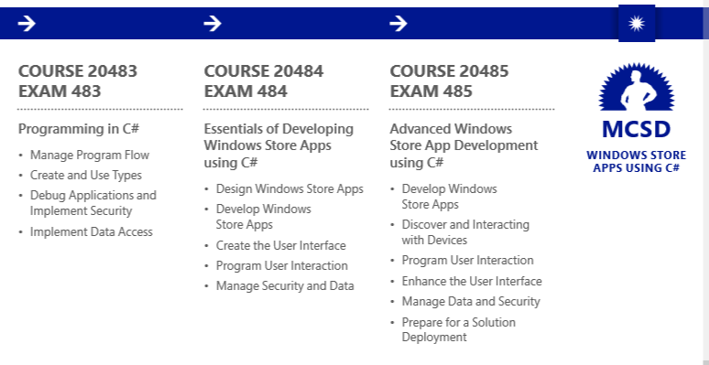
Roadmap – Developer Certification
Exam 483 can be used as an elective in
MCSD: Web Applications
MCSD: SharePoint Applications
MCSA: SQL Server 2012
http://bit.ly/Ignite-CertApp

Slide 6
Check the Exam Guide
Exam 70-483 Guide
Skills Measured
Functional groups and individual topics
Relative weighting of functional groups
Links to more information about functional topics
Preparation Options

Slide 7
70-483 Exam Outline
Objective | %
Manage program flow | 25%
Create and use types | 24%
Debug applications and implement security | 25%
Implement data access | 26%

Slide 8
Outline
Manage program flow
Create and use types
Debug applications and implement security
Implement data access

Slide 9
Creating threads
Thread object
Advantage: complete control over thread
Disadvantage: complete control over thread
ThreadPool
CLR manages a pool of threads based on environment
New ThreadPool requests are placed in queue
Preferred over creating threads manually

Slide 10
Tasks
Represents an asynchronous operation
References an Action delegate
Can have a return type
No parameters
Can have a state object

Slide 11
Cancel task

Slide 12
async and await
Offers simplest method of asynchronous development
async method can run on a separate thread
await keyword instructs runtime to pause until async method completes
Other threads are not blocked

Slide 13
async and await syntax

Slide 14
Understanding Async
Click
async void Button1_Click(){ await LoadSettingsAsync();
UpdateView(); }
Task ... LoadSettingsAsync
LoadSettings
async Task LoadSettingsAsync() {
await IO.Network.DownloadAsync(path); }
Message pump
Task ... DownloadAsync
Download
Click

Slide 15
Async void is only for event handlers
private async void Button1_Click(object Sender, EventArgs e) {
try {
SendData("https://secure.flickr.com/services/oauth/request_token");
await Task.Delay(2000);
DebugPrint("Received Data: " + m_GetResponse);
}
catch (Exception ex) {
rootPage.NotifyUser("Error posting data to server." + ex.Message);
}
}
private async void SendData(string Url) {
var request = WebRequest.Create(Url);
using (var response = await request.GetResponseAsync())
using (var stream = new StreamReader(response.GetResponseStream()))
m_GetResponse = stream.ReadToEnd();
}

Slide 16
Async void is only for event handlers
private async void Button1_Click(object Sender, EventArgs e) {
try {
SendData("https://secure.flickr.com/services/oauth/request_token");
// await Task.Delay(2000);
// DebugPrint("Received Data: " + m_GetResponse);
}
catch (Exception ex) {
rootPage.NotifyUser("Error posting data to server." + ex.Message);
}
}
private async void SendData(string Url) {
var request = WebRequest.Create(Url);
using (var response = await request.GetResponseAsync()) // exception on resumption
using (var stream = new StreamReader(response.GetResponseStream()))
m_GetResponse = stream.ReadToEnd();
}

Slide 17
Parallel.ForEach

Slide 18
Question
You have the following code. (Line numbers are for reference only)
1. var items = new List<string>
2. {"Christopher", "Susan", "Veronica"};
3. var result = items.Where(n => Method1(n));
4. foreach (var item in result)
{ tbStatus.Text += item + "\n"; }
Method1 takes several seconds to complete. You need to ensure your code executes in the shortest amount of time possible.
What should you do?
Update line 1 to var items = new List<object>
Update line 3 to var result = items.Where(n => Method1(n)).AsParallel();
Update line 3 to var result = items.AsParallel().Where(n => Method1(n));
Update line 4 to foreach (var item in result.AsParallel())

Slide 19
Question
You have the following code. (Line numbers are for reference only)
1. var items = new List<string>
2. {"Christopher", "Susan", "Veronica"};
3. var result = items.Where(n => Method1(n));
4. foreach (var item in result)
{ tbStatus.Text += item + "\n"; }
Method1 takes several seconds to complete. You need to ensure your code executes in the shortest amount of time possible.
What should you do?
Update line 1 to var items = new List<object>
Update line 3 to var result = items.Where(n => Method1(n)).AsParallel();
Update line 3 to var result = items.AsParallel().Where(n => Method1(n));
Update line 4 to foreach (var item in result.AsParallel())
Correct answer: C

Slide 20
Question
You have a method that accesses a database, using the following code.
private void Method1(string data)
{
try {
...
} catch (Exception ex) {
...
}
}
You need to ensure the original exception is thrown back to caller. What code should you add to line 7?
throw;
throw ex;
throw new Exception(ex);
return ex;

Slide 21
Question
You have a method that accesses a database, using the following code.
private void Method1(string data)
{
try {
...
} catch (Exception ex) {
...
}
}
You need to ensure the original exception is thrown back to caller. What code should you add to line 7?
throw;
throw ex;
throw new Exception(ex);
return ex;
Correct answer: A

Slide 22
Outline
Manage program flow
Create and use types
Debug applications and implement security
Implement data access

Slide 23
Constructors and inheritance

Slide 24
Creating generic methods and classes

Slide 25
Question
You create a class using the following code:
public class Class1
{ ... }
You add the following method to a class named Class2:
using(var class1 = new Class1()) {
...
}
You need to ensure Class1 functions correctly in the using statement.
What interface should you implement?
ICloneable
IDisposable
IEquatable
IComparer

Slide 26
Question
You create a class using the following code:
public class Class1
{ ... }
You add the following method to a class named Class2:
using(var class1 = new Class1()) {
...
}
You need to ensure Class1 functions correctly in the using statement.
What interface should you implement?
ICloneable
IDisposable
IEquatable
Icomparer
PRO TIP:
All interfaces
(and other methods/classes/etc.)
must exist
Correct answer: A

Slide 27
Question
You have the following code (line numbers are for reference only)
class Program {
static void Main(string[] args) {
var string1 = "String 1";
var class1 = new Class1();
}
}
public class Class1 {
public List<string> Collection1;
}
You need to add string1 to Collection1. What lines of code should you do? (Choose all that apply. Each answer represents part of the solution.)
Update line 3 to string string1 = "String 1";
Update line 4 to Class1 class1 = new Class1();
At line 5, insert class1.Collection1 = new List<string>();
At line 6, insert class1.Collection1.Add(string1);

Slide 28
Question
You have the following code (line numbers are for reference only)
class Program {
static void Main(string[] args) {
var string1 = "String 1";
var class1 = new Class1();
}
}
public class Class1 {
public List<string> Collection1;
}
You need to add string1 to Collection1. What lines of code should you do? (Choose 2. Each answer represents part of the solution.)
Update line 3 to string string1 = "String 1";
Update line 4 to Class1 class1 = new Class1();
At line 5, insert class1.Collection1 = new List<string>();
At line 6, insert class1.Collection1.Add(string1);
Correct answers: C & D

Slide 29
Outline
Manage program flow
Create and use types
Debug applications and implement security
Implement data access

Slide 30
Symmetric encryption
Reversible encryption, single key
System.Security.Cryptography.SymmetricAlgorithm
DES
RC2
TripleDES
Hello, world!
Hello, world!
Agaa5#*26ayzzdft

Slide 31
Asymmetric Encryption
Reversible encryption, two keys
System.Security.Cryptography.AsymmetricAlgorithm
DSA
ECDsa
RSA
Hello, world!
Hello, world!
Agaa5#*26ayzzdft

Slide 32
Hashing
Irreversible encryption
System.Security.Cryptography.HashAlgorithm
MD5
SHA1
SHA256
Hello, world!
Agaa5#*26ayzzdft

Slide 33
Serialize and deserialize

Slide 34
Write to the event log

Slide 35
Configuring tracing in app.config
<system.diagnostics>
<sources>
<source name="DemoSource" switchName="DemoSwitch“
switchType="System.Diagnostics.SourceSwitch">
<listeners>
<add name="console" type="System.Diagnostics.ConsoleTraceListener"
initializeData="false" />
<remove name="Default" />
</listeners>
</source>
</sources>
<switches>
<add name="DemoSwitch" value="Warning"/>
</switches>
</system.diagnostics>

Slide 36
Tracing, using app.config

Slide 37
Tracing, programmatically

Slide 38
Compiler directives

Slide 39
Outline
Manage program flow
Create and use types
Debug applications and implement security
Implement data access

Slide 40
Reading streams

Slide 41
Reading streams

Slide 42
LINQ query results (join)
Pizza Food
Pasta Food
Soda Beverage
Water Beverage
Ketchup Condiment
Mustard Condiment

Slide 43
LINQ query results (group)
Group key: 1
Pizza
Pasta
Group key: 2
Soda
Water
Group key: 3
Ketchup
Mustard

Slide 44
Question
You are creating an app that will process orders.
You need to ensure all orders are processed in the order in which they are received.
What collection type should you use?
Hashtable
Dictionary
Stack
Queue

Slide 45
Question
You are creating an app that will process orders.
You need to ensure all orders are processed in the order in which they are received.
What collection type should you use?
Hashtable
Dictionary
Stack
Queue
Correct answer: D

Slide 46
Question
You have the following code (line numbers are for reference only):
var list1 = new List<int>() { 1, 2, 3, 4 };
var result = list1.Where(i => i > 3);
foreach (var item in list1) {
Console.WriteLine(item);
}
list1.Add(5);
foreach (var item in list1) {
Console.WriteLine(item);
}
You need to ensure both foreach loops display the same data. What should you do?
Update line 2 to var result = list1.Where(i => i > 3).ToList();
At line 3, insert lock(result);
Update line 4 to foreach(var item in list1.ToList()) {
Update line 8 to foreach(var item in list1.ToList()) {

Slide 47
Question
You have the following code (line numbers are for reference only):
var list1 = new List<int>() { 1, 2, 3, 4 };
var result = list1.Where(i => i > 3);
foreach (var item in list1) {
Console.WriteLine(item);
}
list1.Add(5);
foreach (var item in list1) {
Console.WriteLine(item);
}
You need to ensure both foreach loops display the same data. What should you do?
Update line 2 to var result = list1.Where(i => i > 3).ToList();
At line 3, insert lock(result);
Update line 4 to foreach(var item in list1.ToList()) {
Update line 8 to foreach(var item in list1.ToList()) {
Correct answer: A

Slide 48
Resources
Microsoft Learning Site microsoft.com/learning
Your one-stop location for info on all available Microsoft certifications, training, and exam prep resources
Microsoft Virtual Academy microsoftvirtualacademy.com
Your source for on-demand, online technical training
Microsoft Training and Certification Guide -Link to the app: http://aka.ms/ignite-certapp
Interactive Windows 8.1 app, to help you choose and traverse your path

Slide 49
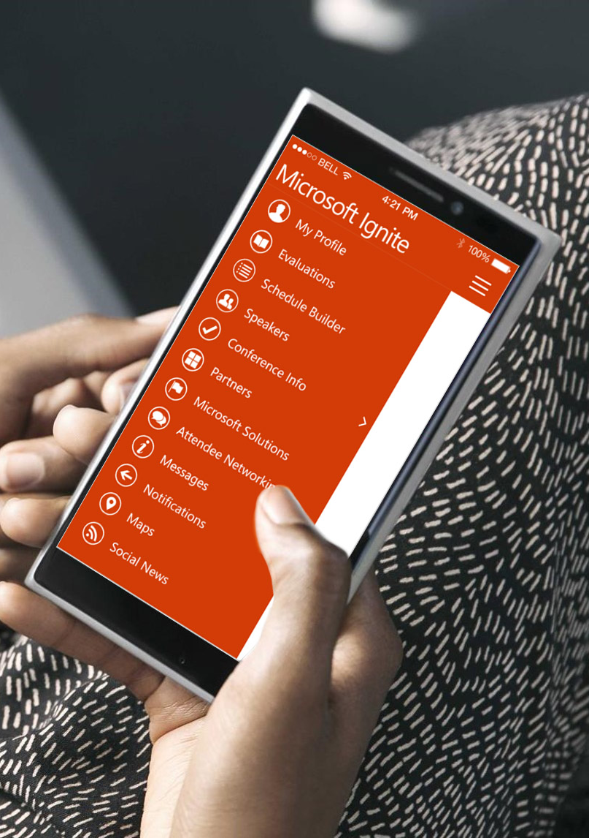
Please evaluate this session
Your feedback is important to us!
From your PC or Tablet visit MyIgnite at http://myignite.microsoft.com
From your phone download and use the Ignite Mobile App by scanning the QR code above or visiting https://aka.ms/ignite.mobileapp

