Slide 1
Gain visibility and control with Office 365 Advanced Security Management
BRK3249
Yair Cohen
Sr Program Manager
Anthony (A.J.) Smith
Sr Product Marketing Manager

Slide 2

Change is Constant
Evolving threat landscape
Industry regulations
and standards
Peoples work expectations

Slide 3

Security Challenges
73%
of enterprises indicated security as a top challenge holding back SaaS adoption
140+
The median number of days that attackers reside within a victim’s network before detection
80%+
of employees admit to using non-approved SaaS apps in their jobs
87%
Of senior managers admit to regularly uploading work files to a personal email or cloud account
75%+
of all network intrusions are due to compromised user credentials

Slide 4

Advanced Security Management
Enhanced visibility and control for Office 365
Threat Detection
Enhanced Control
Discovery and Insights
Identify high-risk and abnormal usage, security incidents,
and threats
Shape your Office 365 environment with granular security controls and policies
  Gain enhanced visibility and context into your Office 365 usage and shadow IT – no agents required.

Slide 5
Portal and Alerts Demo

Slide 6
Before Getting Started
Office 365 Advanced Security Management is powered by Microsoft Cloud App Security
Office 365 E5 or ASM Add-on License for the tenant
  License purchase required for all users
Office 365 Global Admin or Security Administrator
  Security Administrator role only available via PowerShell, will be in Office 365 UI soon!
After the admin opt-in (One time action)
  System uses audit data from the Office 365 Management Activity API + other sources (e.g. threat feeds)
  Data is stored in a Microsoft Cloud App Security tenant hosted in Azure

Slide 7
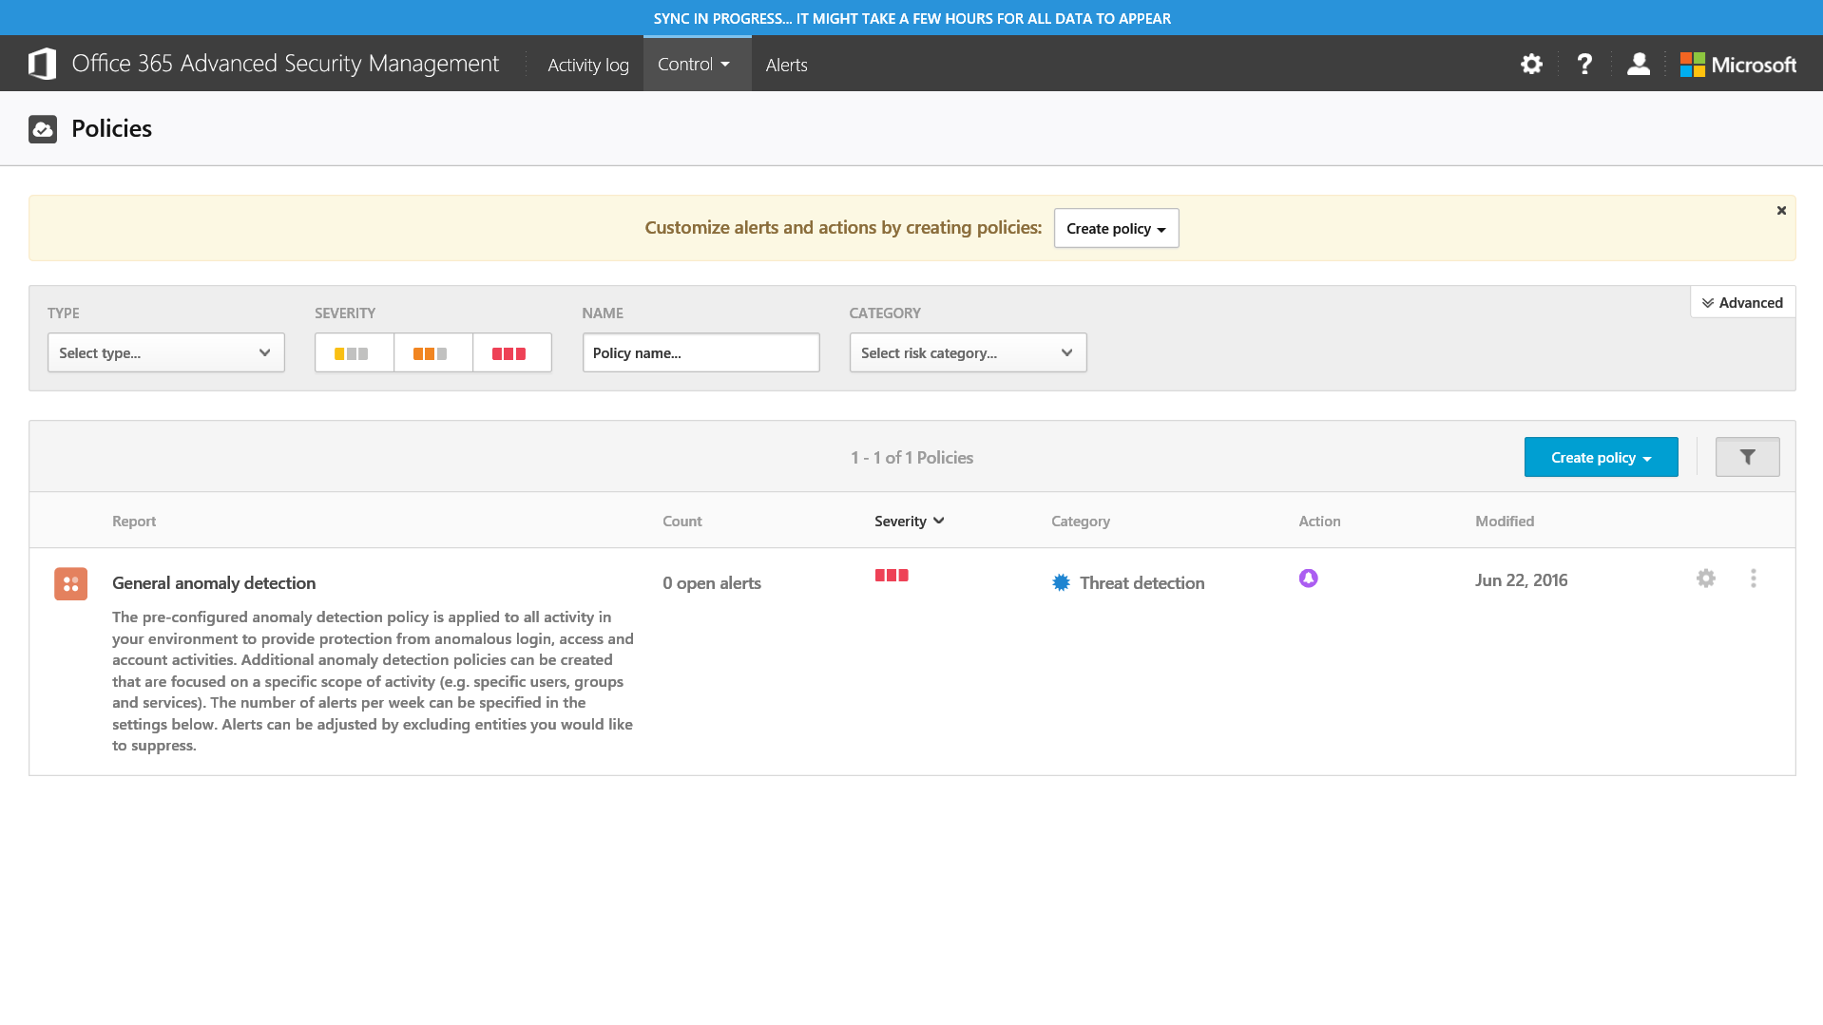
Advanced Security Management Alerts
First Run Experience

Slide 8
Anomaly and Activity Alerts

Slide 9

So Much Data …. So Little Time ….

Slide 10



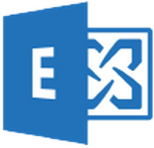
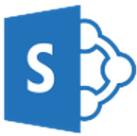

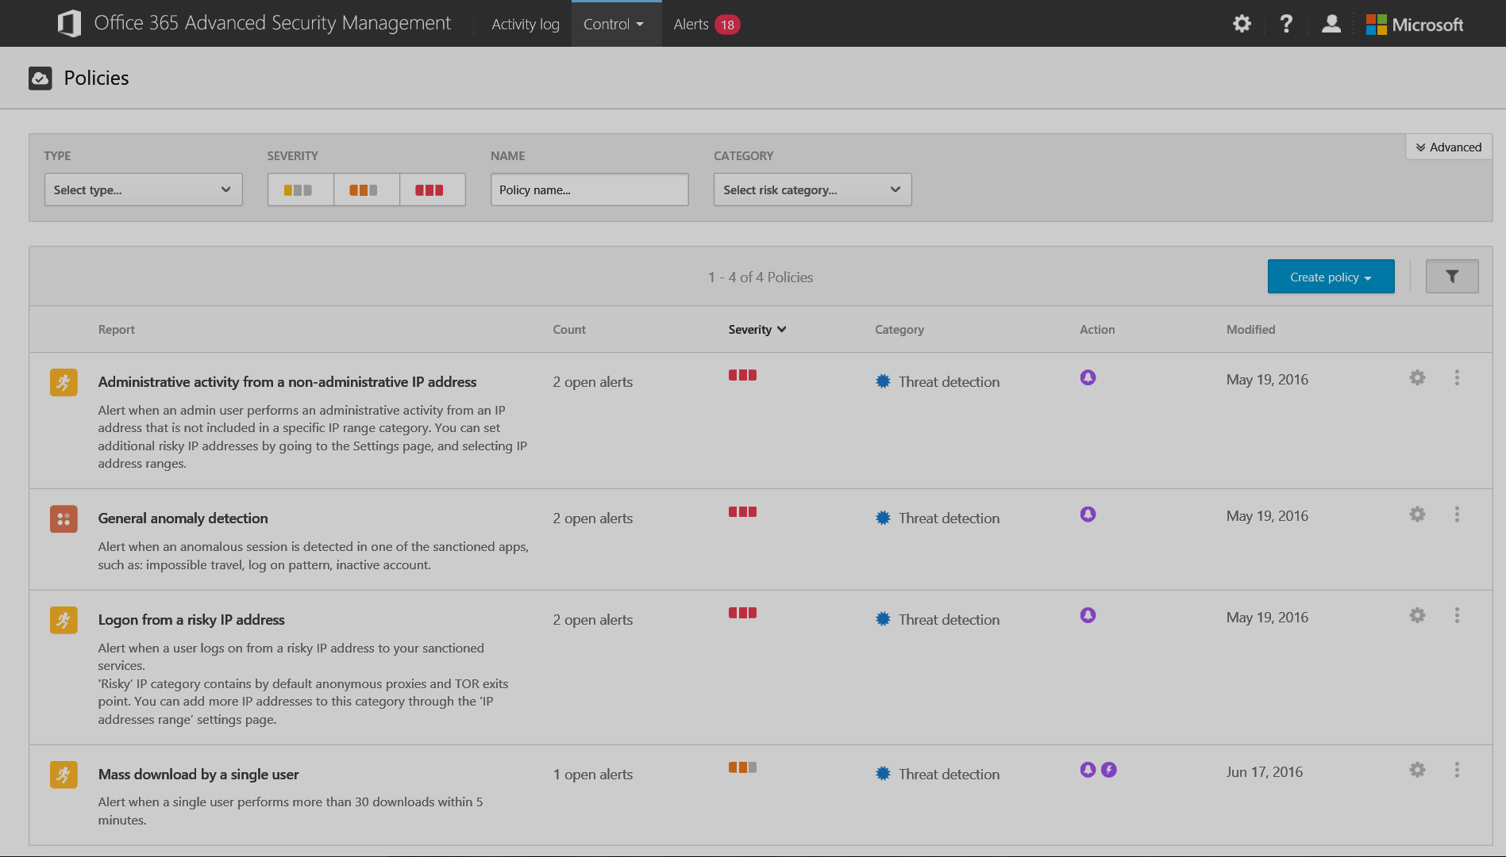
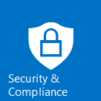
How Alerting Works
Azure
Microsoft Cloud App Security
Intelligence feeds
e.g. Location, registered ISP
Management Activity API
Audit Data Service
Event enrichment
Microsoft Threat Intelligence Center
Big data and machine learning based alerts engine
Anomaly detection
Activity policy evaluation
e.g. Risky IP addresses
Customer settings
e.g. IP Address Ranges
Users/Groups
Users
Admins
Microsoft
Admins
Alert investigation & notification
You have mail!
SMS
SIEM connector
(Coming Q4)
Advanced Security Management Portal

Slide 11





Anomaly Detection Architecture
Alert engine inputs
Alert Investigation & Notification
Anomaly Detection Engine
User activities
Risks: | Location | User-Agent | Admin user? | Anonymous proxy? | Time since last activity | ISP | . . . | Session Risk
Session #1 | 39 | 71 | 100 | 0 | 68 | 84 |  | 97
Session #2 | 97 | 56 | 0 | 100 | 50 | 34 |  | 80
Session #3 | 39 | 5 | 0 | 0 | 2 | 26 |  | 49
Session #4 | 59 | 85 | 0 | 0 | 48 | 50 |  | 29
…
Session #N | 5 | 76 | 0 | 0 | 39 | 40 |  | 14
Geo-location DB
Threshold
Microsoft threat Intelligence feed
SIEM Connector
(Coming soon)
Session-based: Recent user activities across apps, devices and locations are combined to create a user session
Risk score: Risk factors are calculated for each session and combined to calculate the total session risk score
Alert trigger: sessions above risk threshold trigger an alert (top k sessions) containing risk breakdown & related activities
User feedback: anomaly engine is customized by turning on/off risk factors for specific users/groups

Slide 12
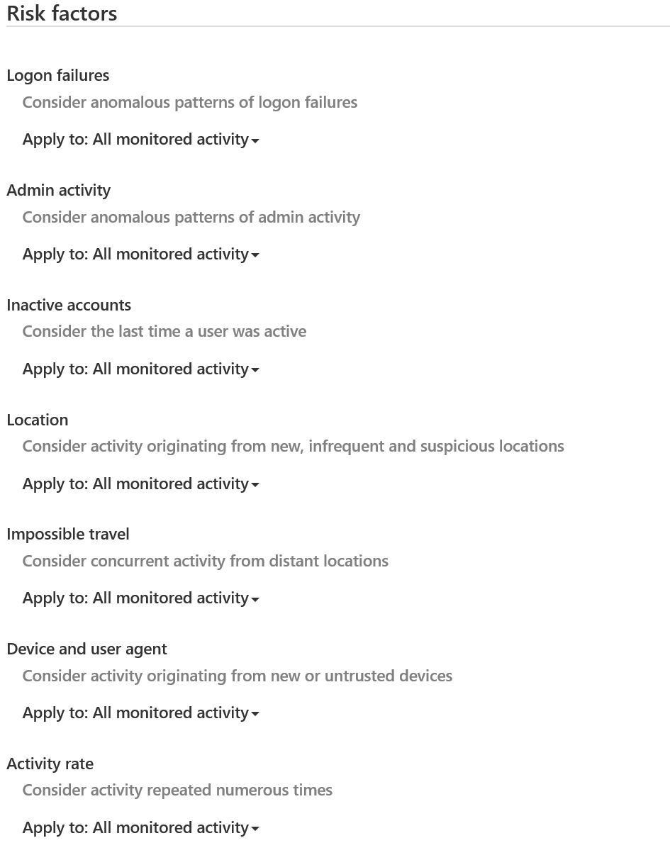
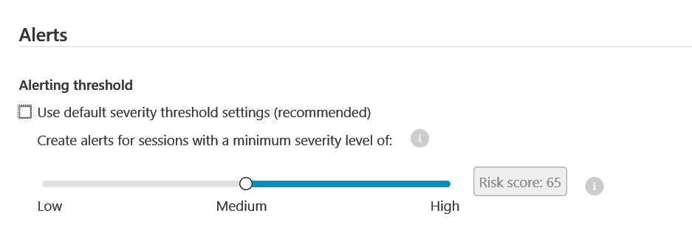
Tuning Anomaly Detection Policies
Set Alert threshold and alert notifications
Turn On/Off risk factors
Define activity filters if needed
Note: Initial 7-day learning period for anomalous behavior alerts.

Slide 13
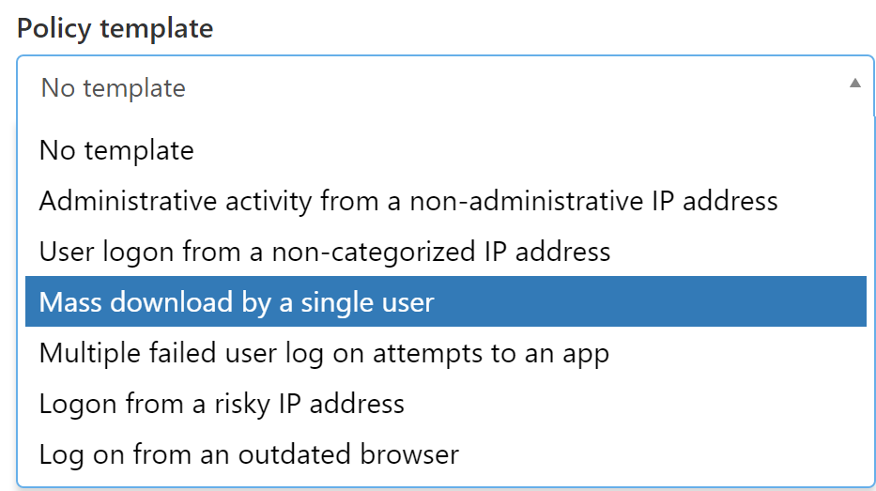
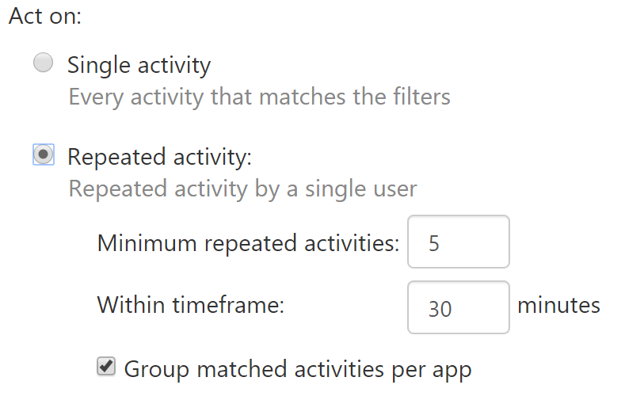
Creating Activity Policies
Templates for common activities
Rich activity filters
  Data Enrichment – Define IP Address Ranges
Repeated activity, Single Event
  Can create from Activity Search
Automated Governance Action:
e.g. Suspend User

Slide 14
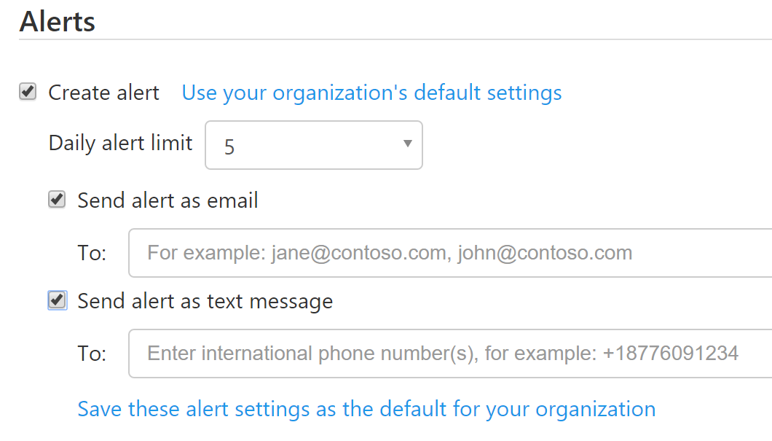
Alert Notification
Email
  Make sure the address can receive mail from external recipients
  (Alert sender: no-reply@cloudappsecurity.com)
  You can provide up to 10 email recipients per alert
SMS Text
  International Format e.g. +1 425 555 5555
  You can provide up to 3 phone numbers per alert
Default organization alert settings
Daily alert limits

Slide 15

Alert Management
Remediate – Suspend User
  Action recorded: Governance Log
  Undo action: Governance Log or Office 365 Portal
Dismiss
  Provide feedback (reason for dismissal)
Investigate
  Activity Log
  Advanced Filters
  Export Results
  Create new policy from search
  Resolve

Slide 16
Productivity App Discovery

Slide 17

View into your Office 365 usage
See what shadow IT is happening
Nothing to install
Productivity App Discovery

Slide 18
Productivity App Discovery Demo

Slide 19
Productivity App Discovery Details
Selected app categories
  Collaboration – Office 365 (for logs with no URLs information), SharePoint
  Cloud storage – OneDrive
  Webmail – Exchange Online
  Social Network – Yammer
  Online Meeting – Skype for Business
Snapshot data
  Each upload (up to 20 log files) treated as a separate report/dashboard
  Mail notifications upon report generation
  Data is exportable (to CSV)

Slide 20

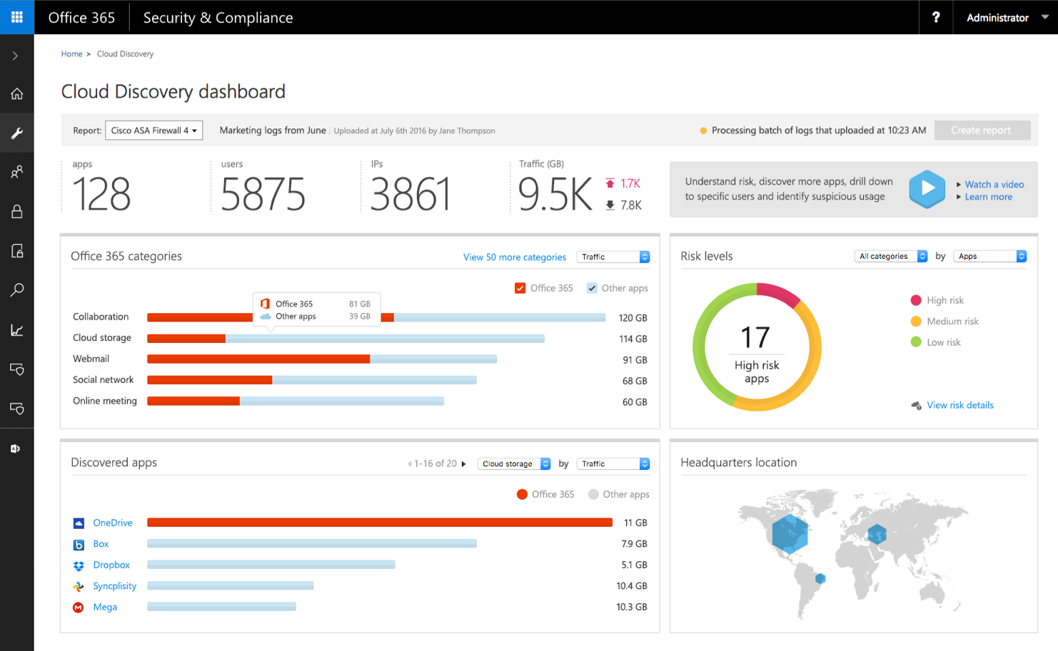
Productivity App Discovery Architecture
Azure
Microsoft Cloud App Security
On-Premise Network
Log parser
Network logs manually uploaded
Log analysis (SaaS DB)
SaaS DB
Discovery aggregations
Tenant DB
Discovery dashboard
Web proxy
Firewall
Cloud apps

Slide 21
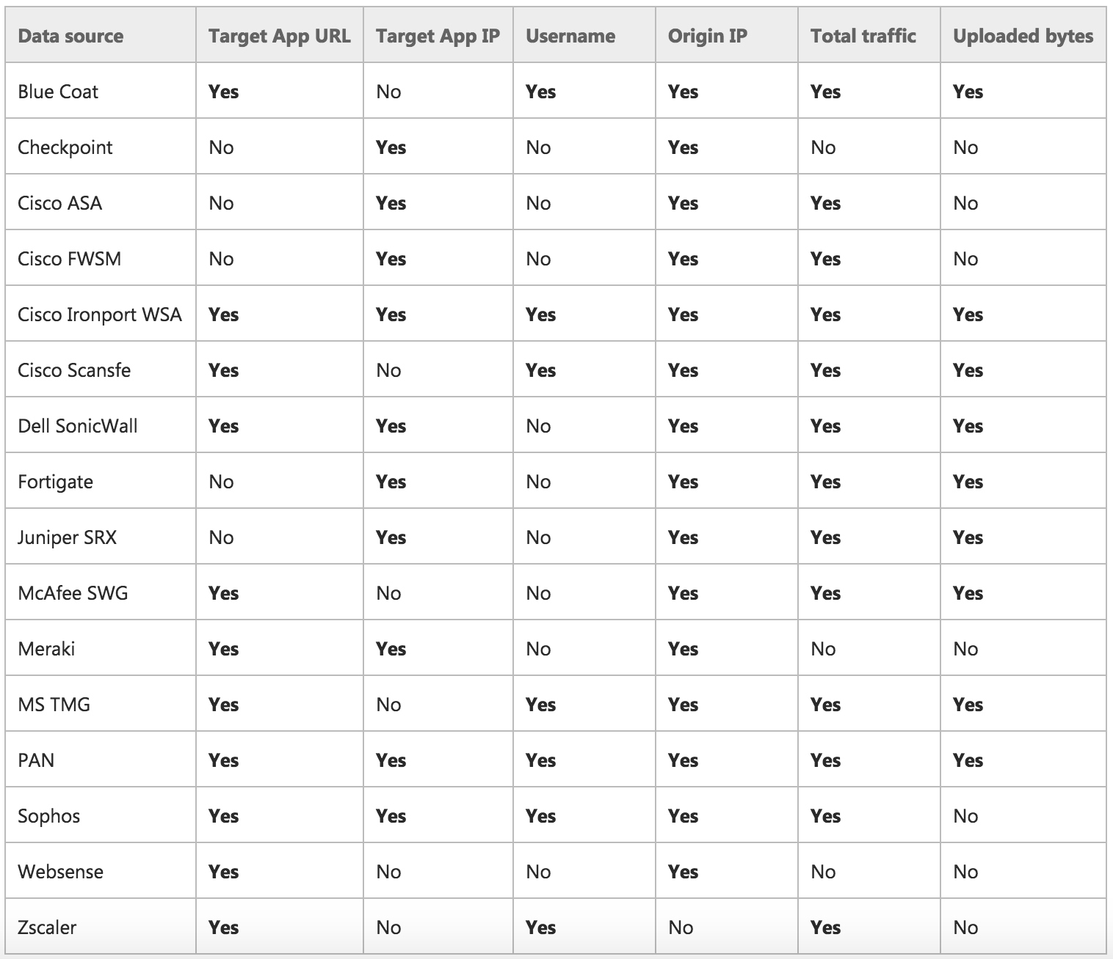
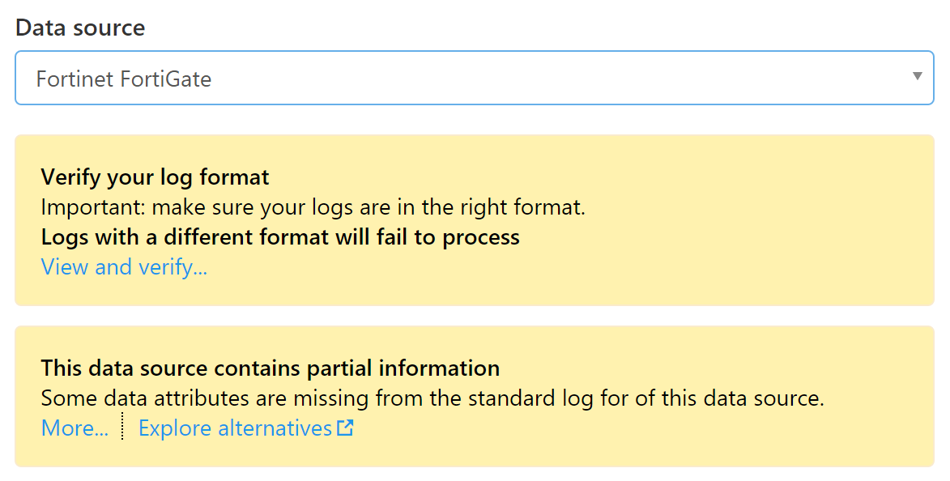
Log Format Compatibility
Network traffic logs include a notification/ disclaimer that explains if there is missing data in the chosen format.

Slide 22
App Permissions

Slide 23
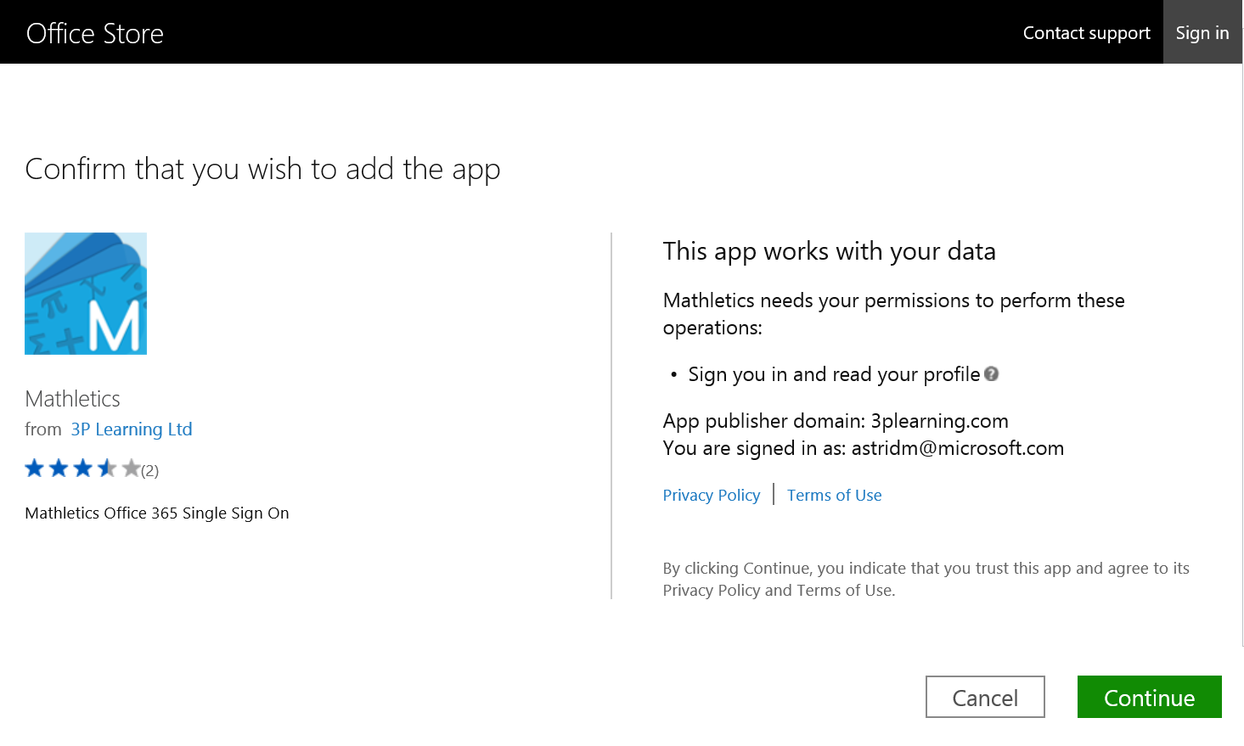
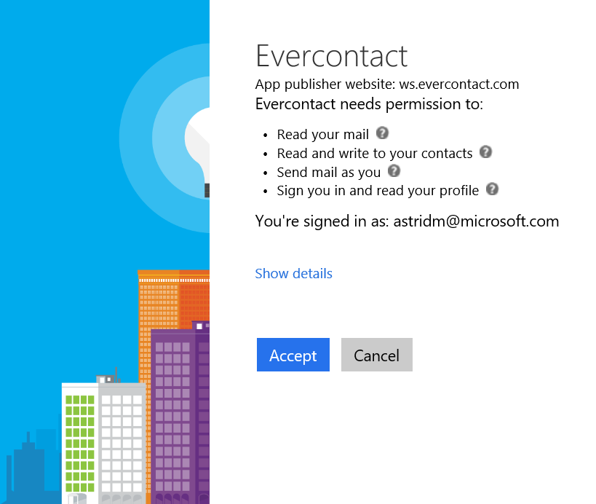
Users grant apps permission to Office 365
IT has limited visibility
Revoke app permissions across organization
App Permissions

Slide 24
App Permissions Demo

Slide 25
Advanced Security Management
Enhanced visibility and control for Office 365
Threat Detection
Enhanced Control
Discovery and Insights
Identify high-risk and abnormal usage, security incidents,
and threats
Shape your Office 365 environment with granular security controls and policies
  Gain enhanced visibility and context into your Office 365 usage and shadow IT – no agents required.

Slide 26
Microsoft Cloud App Security

Slide 27











Introducing Microsoft Cloud App Security
Enterprise-grade security for your cloud apps
Cloud-delivered service bringing visibility and control to cloud apps
Committed to support third-party cloud apps
Based on the Adallom acquisition
Available as: standalone and in EM+S E5 (Oct 1, 2016)

Slide 28
Complete framework to secure your cloud apps
Coming soon
Cloud
discovery
Information
protection
Threat
protection
In-session
control
Discover all cloud usage in your organization
Monitor and control your data in the cloud
Detect usage anomalies and security incidents
Control and limit user access based on session context
DISCOVER
INVESTIGATE
CONTROL
PROTECT

Slide 29
Related Sessions
BRK3017 - Monitor and investigate actions taken on your data with Office 365 Auditing and Insights
BRK3091 - Get visibility, data control and threat protection with Microsoft Cloud App Security
BRK3213 - Learn how to deploy and manage Microsoft Cloud App Security

Slide 30
Questions

Slide 31


Please evaluate this session
Your feedback is important to us!
From your PC or Tablet visit MyIgnite at http://myignite.microsoft.com
From your phone download and use the Ignite Mobile App by scanning the QR code above or visiting https://aka.ms/ignite.mobileapp

