Slide 1
Build Successful Big Data infrastructure using Azure HDInsight
BRK3248
Rashim Gupta
Principal Program Manager, Azure Big Data

Slide 2
Survey

Slide 3
Session Objectives and Takeaways
Session objectives
Understanding different scenarios of Hadoop
Building an end to end pipeline using HDInsight
Using in-memory techniques to analyze data interactively
Takeaways
Azure makes using Big Data easy
ETL, EDW, Ad-hoc multiple scenarios possible

Slide 4
Big Data vs. Traditional DW

Slide 5
Two Approaches to Information Management for Analytics: Top-Down + Bottom-Up
Top-Down
(Deductive)
Bottom-Up
(Inductive)
VALUE
How can we make it happen?
Prescriptive Analytics
What will happen?
Theory
Theory
Predictive Analytics
Why did it happen?
Hypothesis
Hypothesis
OPTIMIZATION
Diagnostic Analytics
Pattern
Observation
What happened?
Observation
Confirmation
Descriptive Analytics
INFORMATION
DIFFICULTY

Slide 6
Data Warehousing Uses A Top-Down Approach
Understand Corporate Strategy
Gather Requirements
Implement Data Warehouse
Reporting & Analytics Design
Reporting & Analytics Development
BI and analytic
Business
Requirements
Dashboards
Reporting
Dimension Modelling
Physical Design
Data warehouse
ETL Design
ETL Development
ETL
Technical
Requirements
Setup Infrastructure
Install and Tune
Data sources
OLTP
ERP
CRM
LOB

Slide 7
The “data lake” Uses A Bottom-Up Approach
Ingest all data regardless of requirements
Store all data
in native format without schema definition
Do analysis
Using analytic engines like Hadoop
Devices
Social
Batch queries
LOB applications
Video
Devices
Interactive queries
LOB applications
Social
Real-time analytics
Web
Sensors
Sensors
Video
Machine Learning
Relational
Web
Clickstream
Data warehouse
Relational
Clickstream

Slide 8
Data Lake + Data Warehouse Better Together
What happened?
What is happening?
Why did it happen?
What are key relationships?
BI and analytic
What will happen?
What if?
How risky is it?
What should happen?
What is the best option?
How can I optimize?
Dashboards
Reporting
Data warehouse
LOB applications
Devices
Social
Relational
Video
ETL
Web
Sensors
Clickstream
Data sources
OLTP
ERP
CRM
LOB

Slide 9
What is HDInsight?

Slide 10
Microsoft Hadoop Stack
Analytics
Hadoop Distributions running in Azure VMs
Azure HDInsight
Hadoop
Map reduce, Pig, Hive
Interactive Hive
Hive
HBase
NoSql
Storm
Real Time
Spark
Streaming
Interactive
Batch
ML
R Server
Machine Learning
Storage
Local (HDFS) or Cloud (Azure Blob/Azure Data Lake Store)

Slide 11
Azure HDInsight
Fully-managed Hadoop and Spark for the cloud
100% Open Source Hortonworks data platform
Clusters up and running in minutes
Supported by Microsoft with industry’s best SLA
Familiar BI tools for analysis
Open source notebooks for interactive data science
63% lower TCO than deploying Hadoop on-premise*
Hadoop and Spark as a Service on Azure
*IDC study “The Business Value and TCO Advantage of Apache Hadoop in the Cloud with Microsoft Azure HDInsight”

Slide 12
Hadoop on HDInsight

Slide 13
HDInsight Workloads
Hadoop
Batch: Hive and MapReduce
Interactive Hive using LLAP (New – just launched)
HBase (NoSQL)
Storm (Streaming)
Spark (Interactive)

Slide 14
HDInsight Architecture
Java
SQL (Hive)
Spark
Stream
(Storm)
NoSQL
(HBase)
Map Reduce Engine
Tez Engine
Spark Engine
Real Time Engine
YARN: Data Operating System
HDFS Storage
(Azure Storage/Azure Data Lake Store)

Slide 15
Intro to Hive

Slide 16
Apache Hive: Scalable Data Warehousing
2006
Hive incubated at Facebook
2012
ODBC/JDBC drivers released
2015
Hive introduces ACID
2010
Top level Apache project
2013
Hive introduces Tez, vectorization, ORC
2016
In-memory through LLAP

Slide 17
Hive: Capabilities and Applications
Scenario
ETL
Reporting
Data Mining
Deep Analytics
Reporting
BI Tools: Tableau, Excel etc.
Ad-Hoc
Drill-Down
BI Tools: Tableau, Excel
Continuous ingestion from operational DB
Slowly changing dimensions
Multidimensional Analytics
MDX Tools
Excel
Legend
Capabilities
High Perf Batch SQL
Interactive SQL
Sub-Second SQL
ACID/Merge
OLAP/Cube
Existing
Development
Emerging
Platform Core SQL Engine Connectivity
Core Hive
SQL 2011 Compiler
MDX
Compute
Cost based optimizer
ODBC
Storage
Tez Execution Engine
Security

Slide 18
Demo: HDInsight cluster & Hive

Slide 19
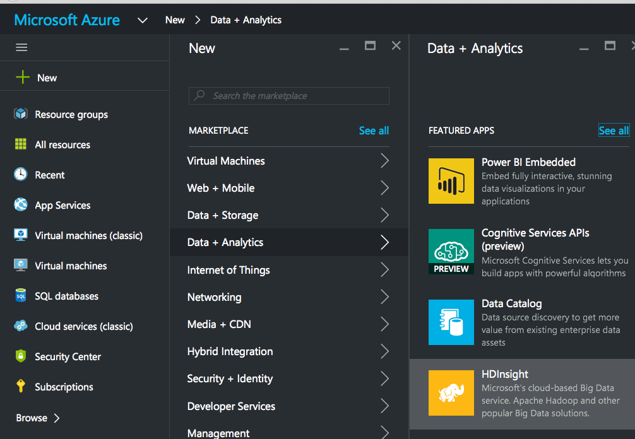
Creating an HDInsight cluster

Slide 20
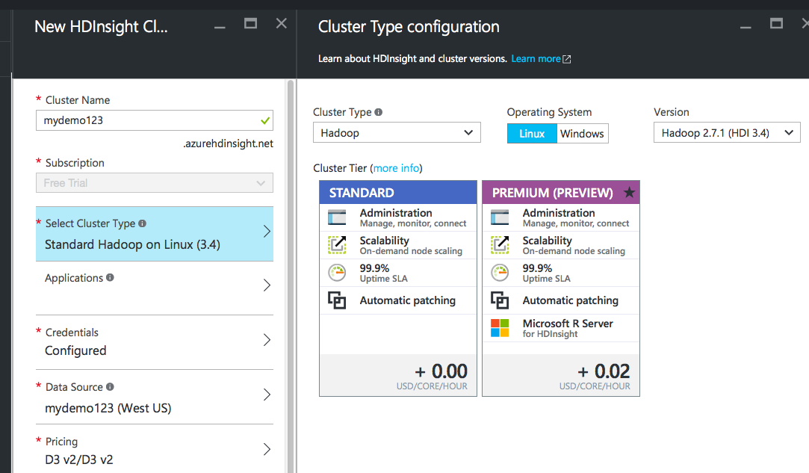
Creating an HDInsight cluster

Slide 21
Creating an HDInsight cluster

Slide 22
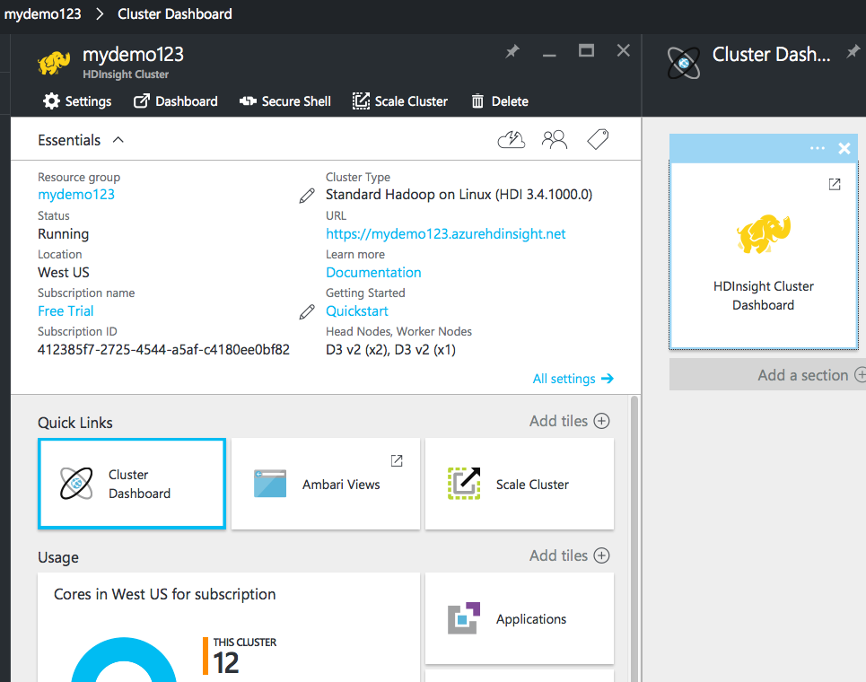
Cluster Dashboard

Slide 23
HDInsight scenarios

Slide 24
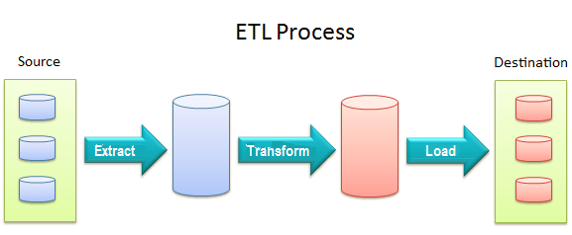
Typical Hadoop Scenarios
ETL
Data ingested from various sources
Transformed and cooked to structured data
Then loaded into a DB for querying
Typically batch scenario
BI Scenarios
Used by business analyst for ad-hoc querying
Requires interactive response

Slide 25
Traditional HDInsight Architecture
Hadoop
cluster
ETL Clients
BI Clients
SDK, PowerShell
JDBC, ODBC, Visual Studio, Hue, Ambari
Templeton
HiveServer2
Azure SQL (Metastore)
Execution Engine (MapReduce, Tez)
AM
AM
AM
AM
YARN
Cloud Storage (WASB/ADLS)
Azure VM
Azure VM
Azure VM
…
Azure VM
Azure VM
Azure VM

Slide 26
HDInsight scenarios
 | ETL | Ad-Hoc / Exploratory
Common patterns | Cluster shape: Dedicated cluster Job pattern: Fire and forget Typical job: Full table scan, large joins | Cluster Shape: Shared cluster Job pattern: Short running jobs Typical job: Ad-hoc over refined data
Problems that customer face | How do I run my jobs fast? What tools do I have to just submit and forget? What file formats should I use? | How do I effectively share my cluster? How do I optimize my output data for final consumption? How do I connect BI tools to my cluster?

Slide 27
Building an Enterprise DW using Hadoop

Slide 28
Enterprise Data Warehouse using HDInsight
Planning
Cluster planning
Cluster Deployment model
Development
Author and Debug Queries
Optimize queries
Deployment
Use ADF/Oozie to schedule and productionalize your jobs
Monitor and manager cluster using Ambari
Connecting with BI tools
Create tables on ORC data from shared storage account
Have BI tools connect to cluster using ODBC driver

Slide 29
EDW using HDInsight – Cluster Planning
Planning
Cluster planning
Cluster Deployment model
Query Development
Author and Debug Queries
Optimize queries
Deployment and Monitoring
Use ADF/Oozie to schedule and productionalize your jobs
Monitor and manager cluster using Ambari
Connecting with BI tools
Create tables on ORC data from shared storage account
Have BI tools connect to cluster using ODBC driver

Slide 30
Cluster Planning
Understand requirements
What is scenario?
What is SLA?
What is budget?
How often?
Who is the customer?
Type of cluster
Production, Dev or Test?
On-demand vs. persistent?
Custom vs. default metastore?
Security model?
Trade-offs
Single or multi tenant?
CPU or Memory bound?

Slide 31
Cloud Deployment Models
 | Always on cluster (Persistent) | Cluster as a service (On demand)
Storage choice | Local HDFS, Azure Blob, Azure Data Lake Store | Azure Blob, Azure Data Lake Store
Job Scheduling | Oozie | Azure Data Factory
Data persistence after cluster deletion | N/A | Azure Blob, Azure Data Lake Store
Metadata persistence after cluster deletion | N/A | Azure SQL
Billing | Billing for entire time cluster is up | Billing per job
Why use Cluster as a Service?
Pay only for time the cluster was actually used
Since data & metadata is persisted, experience is as if the cluster was never deleted

Slide 32
EDW using HDInsight – Query Development
Cluster Planning
Cluster planning
Cluster Deployment model
Query Development
Author and Debug Queries
Optimize queries
Deployment and Monitoring
Use ADF/Oozie to schedule and productionalize your jobs
Monitor and manager cluster using Ambari
Connecting with BI tools
Create tables on ORC data from shared storage account
Have BI tools connect to cluster using ODBC driver

Slide 33
Query Authoring
Ambari Views
Provides graphical UX for authoring and debugging Hive queries
Pros: One of the few tools that can be used to debug Tez queries
Visual Studio
Enables writing Hive queries using Visual Studio
Pros: Offers choice between Templeton and HiveServer2
Command-Line
Provides SSH and Windows CLI access
Pros (and also cons): Very powerful
Beeline
Command line shell that works with HiveServer2.
Pros: Very thin JDBC client

Slide 34
Demo: Query Authoring Tools

Slide 35
Query Authoring Plan for iteration
Build queries from smaller pieces
Use sampling when you can
Validate results at each stage
Use views when necessary

Slide 36
Query Debugging
Using Yarn UI
Yarn UI can be accessed directly from Ambari
Enables identifying errors related to tasks
Using Ambari Tez Views
For Tez jobs, Tez Views shows a graphical view of the job run
Also shows long running tasks so you can investigate issues like Data Skew etc.

Slide 37
Demo
Where are the logs?

Slide 38
ProTip: Out of Memory
Most Common Error
Increase Container Size
mapreduce.map.memory.mb = 768 (increase to something larger)
mapreduce.map.java.opts = "-Xmx512m" (increase to something larger, for example -Xmx2048m or more)
Disable MapJoin
Set hive.auto.convert.join = false
Disables Map Joins if one of the tables is quite large

Slide 39
Optimizing Queries
Last year at Ignite
Used TPCH1 benchmarking query
Ran query over 1TB data
Using optimizations improved latency 23x*
More details: BRK 3556
* More optimizations possible; this is not the most optimal run but just showing basic optimizations

Slide 40
Optimization Summary
Scale up/Scale out
Choose from dozens of VMs and scale out capability to increase parallelism
Tez Execution Engine
Choose Tez execution Engine
Partitions
Avoid reading entire partitions by breaking files into pieces
ORC
Columnar format supported by Hive which also allows you to use ACID and LLAP
Vectorization
Enables Hive to process 1024 rows at one time to make execution faster

Slide 41
EDW using HDInsight – Deployment
Cluster Planning
Cluster planning
Cluster Deployment model
Query Development
Author and Debug Queries
Optimize queries
Deployment
Use ADF/Oozie to schedule and productionalize your jobs
Connecting with BI tools
Create tables on ORC data from shared storage account
Have BI tools connect to cluster using ODBC driver

Slide 42
Going to production: Cortana Intelligence Suite
Information Management
Big Data Stores
Machine Learning and Analytics
Intelligence
Data Sources
People
Data Factory
Data Lake Store
Machine Learning
Cognitive Services
Data Catalog
SQL Data
Warehouse
Data Lake Analytics
Bot Framework
Web
Apps
HDInsight
(Hadoop and Spark)
Event Hubs
Cortana
Mobile
Apps
Stream Analytics
Bots
Dashboards & Visualizations
Sensors and devices
Power BI
Automated Systems
Data
Intelligence
Action

Slide 43
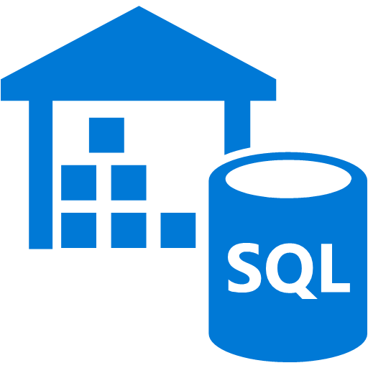
Going to production: Cortana Intelligence Suite
Power BI
Notebooks
Interactive Analytics
Data Preparation
Batch Analytics
Business apps
Bulk Load
Raw Data
Prepared Data (Unstructured)
Azure SQL DW
Custom apps
Prepared Data (Structured)
Azure Data Lake Store
Sensors and devices
Azure Data Factory

Slide 44
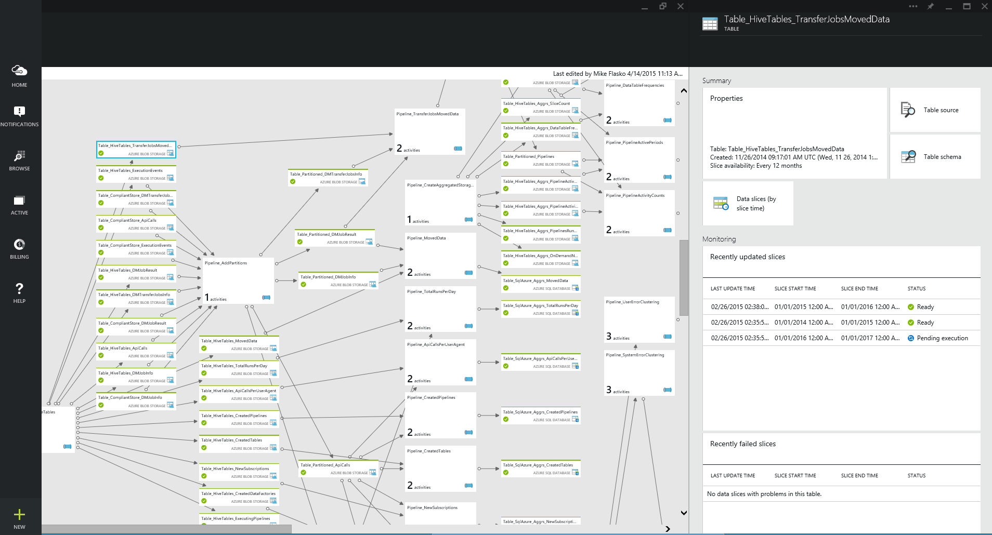
Azure Data Factory
Orchestrate, monitor & schedule
compose data processing, storage & movement services (on premises & cloud)
Automatic infrastructure management
combine pipeline intent w/ resource allocation & management
data movement as a service (global footprint & on premises)
Single pane of glass
one place to manage your network of data flows

Slide 45
Demo: Using ADF with HDInsight

Slide 46
EDW using HDInsight – Deployment
Cluster Planning
Cluster planning
Cluster Deployment model
Query Development
Author and Debug Queries
Optimize queries
Deployment
Use ADF/Oozie to schedule and productionalize your jobs
Connecting with BI tools
Create tables on ORC data from shared storage account
Have BI tools connect to cluster using ODBC driver

Slide 47
Demo: 100GB query with Batch

Slide 48
Demo: TPCH on Batch
create external table lineitem100gb_orc
(L_ORDERKEY INT, L_PARTKEY INT,
L_SUPPKEY INT, L_LINENUMBER INT,
L_QUANTITY DOUBLE, L_EXTENDEDPRICE DOUBLE,
L_DISCOUNT DOUBLE, L_TAX DOUBLE,
L_RETURNFLAG STRING, L_LINESTATUS STRING,
L_SHIPDATE STRING, L_COMMITDATE STRING,
L_RECEIPTDATE STRING, L_SHIPINSTRUCT STRING,
L_SHIPMODE STRING, L_COMMENT STRING)
STORED AS ORC
LOCATION 'wasb://llap3@rashimgstorage.blob.core.windows.net/TPCH100GB/lineitem_orc/';
select l_returnflag, l_linestatus, sum(l_quantity) as sum_qty, sum(l_extendedprice) as sum_base_price, sum(l_extendedprice * (1 - l_discount)) as sum_disc_price, sum(l_extendedprice * (1 - l_discount) * (1 + l_tax)) as sum_charge, avg(l_quantity) as avg_qty, avg(l_extendedprice) as avg_price, avg(l_discount) as avg_disc, count(*) as count_order from lineitem100gb_orc where l_shipdate <= '9/16/1998 12:00:00 AM' group by l_returnflag, l_linestatus order by l_returnflag, l_linestatus;

Slide 49
Biggest Pain Point from customers
What about interactivity?
Suited for batch, not interactive
Moving data to relational is an additional step and takes time
BI tools too slow to work with Hadoop cluster
Handling capacity between production and ad-hoc jobs

Slide 50
Can we create a new interactive cluster type?

Slide 51
Our Vision: Building a DW using HDInsight
ETL Clients
BI Clients
Interactive Hive
cluster (new)
SDK, PowerShell
Hadoop cluster
JDBC, ODBC, Visual Studio, Hue, Ambari
Templeton/HiverServer2
HiveServer2
Azure SQL (Metastore)
Execution
Engine
Execution
Engine
AM
AM
AM
AM
YARN
YARN
Cloud Storage (WASB/ADLS)
…
…
Azure VM
Azure VM
Azure VM
Azure VM

Slide 52
Introducing Hive LLAP: Making Hive Interactive
YARN Cluster
Query
Coordinators
LLAP Daemon
LLAP Daemon
LLAP Daemon
LLAP Daemon
ODBC /
JDBC
SQL
Queries
Coord-inator
Query
Executors
Query
Executors
Query
Executors
Query
Executors
HiveServer2 (Query Endpoint)
Coord-inator
In-Memory Cache
In-Memory Cache
In-Memory Cache
In-Memory Cache
Coord-inator
Deep Storage
HDFS
Other HDFS Compatible Filesystems

Slide 53
Hive LLAP Enabling Data Warehousing Scenarios
Interactive Querying through in-memory compute
10x-25x faster than using Hive1
Allows multiple users to run queries simultaneously
Provides enterprise class security
Separate capacity for ETL and EDW scenarios
Integration with world class BI tools

Slide 54
What is LLAP
Hybrid Model
Combines daemons and containers
Concurrent queries without specialized YARN queue setup
Multi-threaded execution of vectorized operator pipelines
In Memory Caching
Uses Asynchronous IO for efficient in-memory caching
Node
Query Fragment
LLAP Process
Cache
HDFS

Slide 55
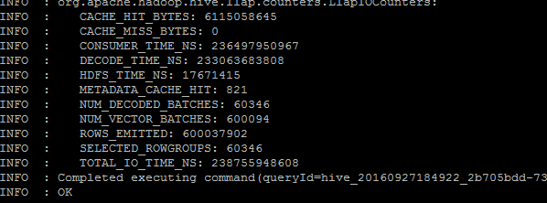
Cache Hit – output from Beeline

Slide 56
Demo: Hive LLAP Demo

Slide 57
Demo 2: LLAP
create external table lineitem100gb_orc
(L_ORDERKEY INT, L_PARTKEY INT,
L_SUPPKEY INT, L_LINENUMBER INT,
L_QUANTITY DOUBLE, L_EXTENDEDPRICE DOUBLE,
L_DISCOUNT DOUBLE, L_TAX DOUBLE,
L_RETURNFLAG STRING, L_LINESTATUS STRING,
L_SHIPDATE STRING, L_COMMITDATE STRING,
L_RECEIPTDATE STRING, L_SHIPINSTRUCT STRING,
L_SHIPMODE STRING, L_COMMENT STRING)
STORED AS ORC
LOCATION 'wasb://llap3@rashimgstorage.blob.core.windows.net/TPCH100GB/lineitem_orc/';
beeline -u 'jdbc:hive2://localhost:10001/;transportMode=http' -n admin
select l_returnflag, l_linestatus, sum(l_quantity) as sum_qty, sum(l_extendedprice) as sum_base_price, sum(l_extendedprice * (1 - l_discount)) as sum_disc_price, sum(l_extendedprice * (1 - l_discount) * (1 + l_tax)) as sum_charge, avg(l_quantity) as avg_qty, avg(l_extendedprice) as avg_price, avg(l_discount) as avg_disc, count(*) as count_order from lineitem100gb_orc where l_shipdate <= '9/16/1998 12:00:00 AM' group by l_returnflag, l_linestatus order by l_returnflag, l_linestatus;

Slide 58
Scaling HDInsight

Slide 59
Scaling for Big Data workloads
Challenges
Improving High Availability
Elastic scaling
Ability to scale to multiple users
How HDInsight helps with scaling
Platform Availability improvements
Ability to scale during and after cluster creation
Ability to create Edge Nodes

Slide 60
Scaling for Big Data workloads HA Improvements
Community already has HA support for:
HDFS HA
Job scheduling HA through Resource Manager
Job resiliency i.e. no need to restart entire job
HDInsight further adds HA support for:
Ensuring Job History stays persistent across Head Node failures
Also work in progress to add persistency for Ambari metrics in case of Ambari failure

Slide 61
Scaling for Big Data workloads Elastic scaling: Built for the cloud
Dozens of VM types supported
Scale to thousands of nodes
Scale after cluster creation supported
Scale Storage and Compute separately

Slide 62
Scaling for Big Data workloads Edge Nodes
Why edge nodes?
How to deploy edge nodes?
Supported apps using edge nodes

Slide 63
Using 3rd party apps
Scenario
Hadoop has a rich ecosystem of apps
Customers want to use apps beyond those provided by out of box
Why use 3rd party apps?
Provide more features than those available in Hadoop
WSIWYG Query Designer Tools
OLAP BI Capabilities over your Hadoop cluster
Fine grained access control
Drag and Drop data pipeline design and orchestration

Slide 64
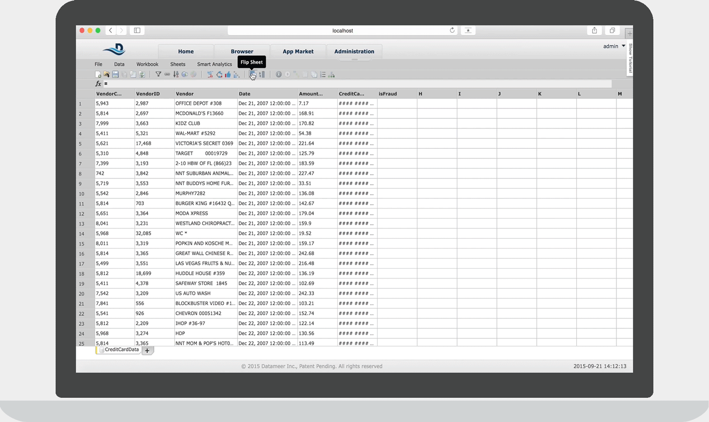
ISV apps: Datameer
Datameer
WYSIWIG Query Designer in an Excel-like Interface
Schedule recurring jobs
Easily share projects with other analysts/data engineers in your company

Slide 65
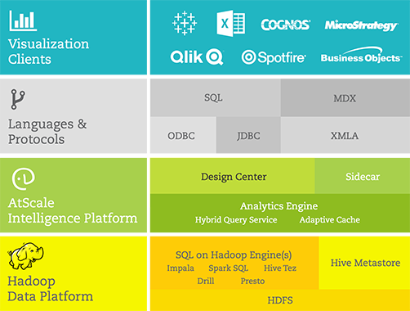
ISV apps: AtScale
AtScale
AtScale is an OLAP engine purpose-built for Hadoop. It leverages the latest advancements in the Hadoop ecosystem to support existing BI workloads.
Multiple SQL-on-Hadoop Engine Support
Access Data Where it LaysBuilt-in
Support for Complex Data Types
Single Drop-in Gateway Node Deployment

Slide 66
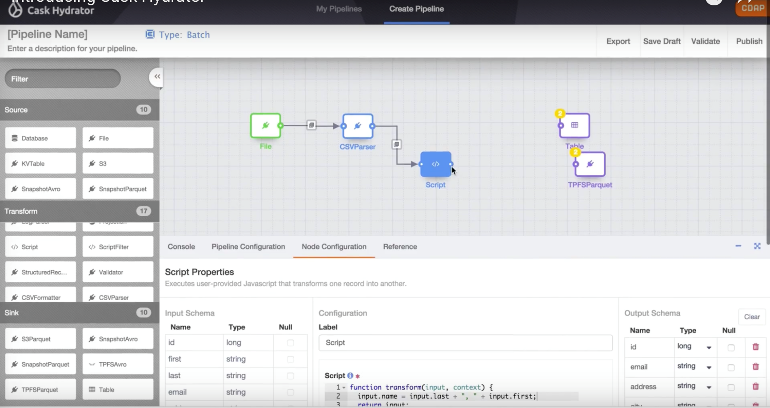
ISV apps: Cask
Cask
Build pipeline using Drag & Drop
Source connections from on prem relational databases, or cloud stores for big data into HDInsight/Data Lake Storage
Common data pipeline task library
Free, open source license to get started, enterprise option for dedicated use

Slide 67
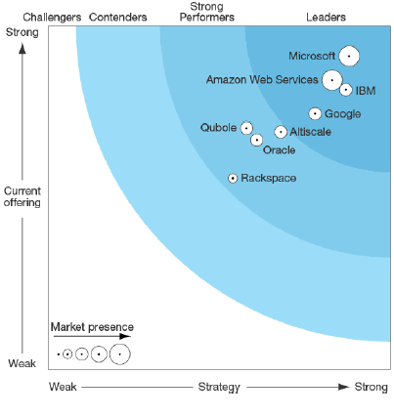
Big Data Cloud Vendors: Forrester 2016 Ratings

Slide 68
Free IT Pro resources To advance your career in cloud technology
Plan your career path
Cloud role mapping
Expert advice on skills needed
Self-paced curriculum by cloud role
$300 Azure credits and extended trials
Pluralsight 3 month subscription (10 courses)
Phone support incident
Weekly short videos and insights from Microsoft’s leaders and engineers
Connect with community of peers and Microsoft experts
Microsoft IT Pro Career Center
www.microsoft.com/itprocareercenter
Get started with Azure
Microsoft IT Pro Cloud Essentials
www.microsoft.com/itprocloudessentials
Demos and how-to videos
Microsoft Mechanics
www.microsoft.com/mechanics
Connect with peers and experts
Microsoft Tech Community
https://techcommunity.microsoft.com

Slide 69
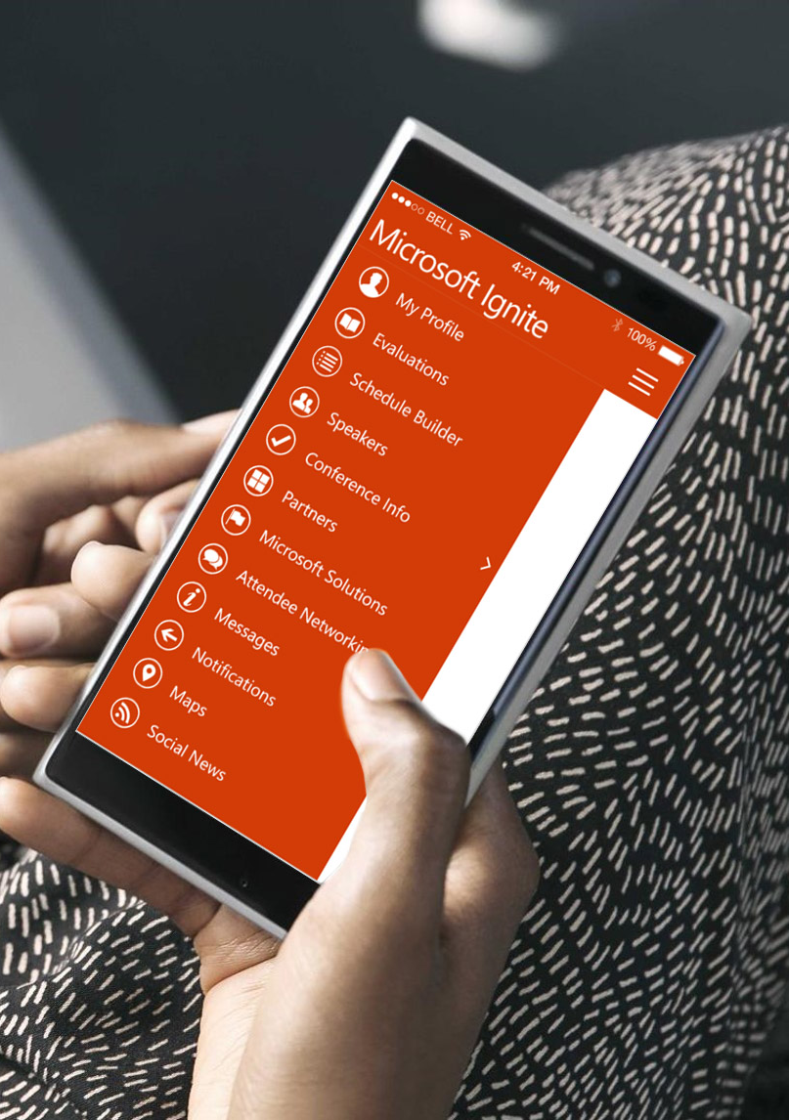
Please evaluate this session
Your feedback is important to us!
From your PC or Tablet visit MyIgnite at http://myignite.microsoft.com
From your phone download and use the Ignite Mobile App by scanning the QR code above or visiting https://aka.ms/ignite.mobileapp

