Slide 1
The Preferred Architecture Reality Show
BRK3221
Ross Smith IV
Principal Program Manager
Microsoft
Mike Cooper
Messaging Engineering Manager
General Motors

Slide 2
Today’s Lineup
@12:30
  Highlights of the Preferred Architecture
@1:00
  The General Motors Talk Show
@4:00
  Design your Exchange infrastructure right (or consider moving to Office 365)

Slide 3
Highlights of the Preferred Architecture
Your Host: Ross Smith IV

Slide 4
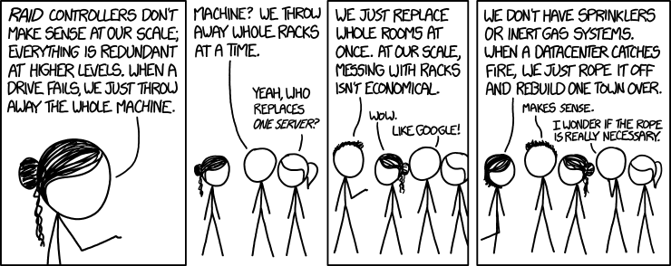
Why?
Failure is a fact of life
  Complexity breeds failure
  Drive failure to be predictable
Complexity introduces multiple recovery scenarios
  There can only be one: activation of another database copy
Remove unnecessary redundancy
Microsoft
Comic taken from http://xkcd.com/1737

Slide 5
Preferred architecture
Namespace design
For a site resilient datacenter pair, a single namespace / protocol is deployed across
both datacenters
  autodiscover.contoso.com
  HTTP: mail.contoso.com
  IMAP: imap.contoso.com
  SMTP: smtp.contoso.com
For Office Online Server, a namespace is deployed per datacenter
Load balancer configuration
For Exchange VIPs: no session affinity, one VIP/datacenter, per-protocol health checking
For OWAS VIPs: session affinity
Round robin, geo-DNS, or other solutions are used to distribute Exchange traffic equally across both datacenters
DC1
mail VIP
DC2
mail VIP

Slide 6


Single namespace/layer 7 (no session affinity)
MBX
Health check executes against each virtual directory
OWA
health check
USER
ECP
mail.contoso.com
EWS
Layer 7LB
EAS
autodiscover.contoso.com
OAB
RPC
MAPI
AutoD

Slide 7


Geo-distributed namespace
mail.contoso.com
DNS Resolution
DNS Resolution
Sue
(somewhere
in NA)
na.contoso.com
eur.contoso.com
Jane
(somewhere
in Europe)
na VIP1
na VIP2
eur VIP1
eur VIP2
DAG
DAG

Slide 8

OOS namespace planning and load balancing
Always deploy a separate namespace for OOS
For site resilience, follow a bound namespace model for OOS
Even when Exchange leverages an unbound namespace
Namespace manipulation during datacenter activation is not required
Requires persistence at the load balancer
autodiscover.contoso.com
mail.contoso.com
oos-west.contoso.com
oos-east.contoso.com
West
autodiscover VIP
mail VIP
oos-west VIP
East
autodiscover VIP
mail VIP
oos-east VIP
DAG
OOS
OOS
oos-west.contoso.com
oos-east.contoso.com

Slide 9

Preferred architecture
DAG design
mail VIP
DC2
Each datacenter should be its own Active Directory site
Increase DAG size density before creating new DAGs
DAG configuration
Unbound, symmetrical DAG model spanning across datacenters
No administrative access point
Single network for replication and client traffic
Utilize a third datacenter or Azure for Witness server placement, if possible
Database configuration
Deploy four copies, two copies in each datacenter
Distribute active copies across all servers in the DAG
One copy is a lagged copy (seven days) with automatic play down enabled
Native Data Protection is utilized
DC1
mail VIP
DAG
DC3/Azure
Witness Server

Slide 10
Native Data Protection
Reason for Backup
Exchange 2016
  Software / Hardware / Datacenter Failures
Mailbox Resiliency
  Accidental / Malicious Item Deletion
Single Item Recovery or In-Place Hold
  Physical Corruption
Single Page Restore
  Logical Corruption
  In-Place Hold
  Calendar Repair
  Mailbox Moves
  New-MailboxRepairRequest
  and
  Lagged Database Copy
  Single Page Restore
  Administrative / Automation Errors
  Rogue Administrators
RBAC
  Corporate/Regulatory Compliance Requirements
In-Place Hold
  Long-term Data Retention
  Large Mailbox and/or Archive Mailbox

Slide 11
What we’ve heard…
Native Data Protection sounds good, except….
Why can’t I recover deleted items to the original folder?

Slide 12
Announcing…

Slide 13
Recovering Items to their Original Folders
What does the feature do?
Keeps track of the last folder the item was in before going to Recoverable Items\Deletions folder (last active parent folder ID or LAPFID)
LAPFID is stamped when item is deleted
Uses LAPFID as the move destination when the item is recovered from Recoverable Items\Deletions folder
Since we are tracking the folder ID, the tracked folder ID will point to the original folder even when the folder has been moved or renamed
Since E2016 CU1, we have been stamping items with the LAPFID (WOAH, right, we’re sneaky bastards)
What does the feature not cover?
Does not cover folder deletion
Does not work for items that do not have a LAPFID stamped
If LAPFID doesn’t exist when item is recovered, the item will be recovered similar to recovery today (i.e., a message is restored to Inbox, etc.)
Client Requirements
OWA support will be included in a future CU
Does not work with Outlook or Outlook:Mac today

Slide 14


Preferred architecture
Server design
Servers are deployed on commodity hardware
  Dual-socket systems only (24 cores total, mid-range processors)
  Up to 96GB of memory
All servers handle both client connectivity and mailbox data
JBOD storage
Large capacity 7.2k SAS disks
Battery-backed cache controller (75/25)
Multiple databases/volume
AutoReseed with hot spare
Data volumes are formatted with ReFS
Data volumes are encrypted with BitLocker
mail VIP
DAG

Slide 15
In summary
The Preferred Architecture provides the optimal deployment model for on-premises
Native Data Protection keeps getting better
Simpler is the best route!

Slide 16

The
General Motors
Talk Show
Your Host: Mike Cooper

Slide 17
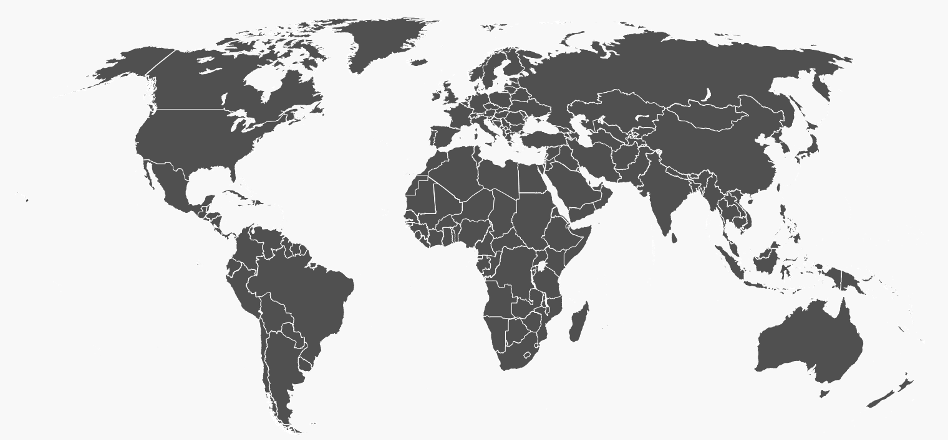

About GM…
The Business | GM Global IT | More than
215,000+ employees 396 facilities in six continents 50 languages 23 time zones 21,000 dealers that sell ~9.8 million vehicles each year | >11,300 full-time IT employees Two GM-owned IT enterprise data centers 100+ million emails/month 60 million IM’s/month | 112,000 personal computers 60,000 mobile devices 35,000 work stations 395 video collaboration rooms in 31 countries

Slide 18
About me…
Background in Fortune 100 email migrations
Working with GM since 1996
Lead Architect for Lotus Notes to Exchange Migration
Responsible for Messaging Engineering team

Slide 19
Where we came from…
IBM Lotus Notes/Domino 8
Multiple Notes domains
Highly distributed
Mixed platforms (Physical and Virtuals)
Mixed storage (SAN storage + local RAID5)
Traditional Backup (modern + tape drives)

Slide 20
Legacy problems…
Limited interoperability
High cost
Engineering for multiple platforms
Mail and Application dependencies
Limited HA capabilities
Archives everywhere = eDiscovery nightmare

Slide 21
Decision time…
What we needed:
Increase user productivity
Resolve integration issues
Reduce operational and engineering costs
Increase speed of innovation
Build a robust, highly available infrastructure
Provide industry standard eDiscovery support

Slide 22
Starting the journey
GM engaged with Microsoft Consulting Services and Microsoft Product Teams
  Partnership to deploy Exchange 2013 as an early adopter following Microsoft’s Preferred Architecture and “guardrails”
  Following Microsoft’s lead and breaking a lot of our existing “big rules”

Slide 23
Preferred Architecture Sticking Points
GM platform standards vs Office 365 standards
Direct Attached Storage
No traditional backup
LAG + LAG Duration

Slide 24
Our Architecture
Namespace Design
Unbound
Originally one namespace for AutoDiscover, and one for everything else
Changed to follow Preferred Architecture at CU2
Load Balancer Design
Round Robin between two Enterprise Datacenters
Each datacenter is its own AD site
Custom monitors replaced with healthcheck.htm at CU2
Server Design
128GB Memory, reducing to 96GB per PA in NextGen hardware
24 physical drives per server, 600GB OS mirror limits us to 2 day LAG (vs PA’s 7 day)

Slide 25
Our Architecture
Database Availability Group Design
16 servers, 8 per data center
No third site, so Primary/Alternate witness configuration
Three HA database copies, one 48 hour old LAG copy
Office Online Server Design
Consistent with Exchange 2016 Preferred Architecture

Slide 26
High-Level Architecture
mailxyz.gm.com
User1
(Michigan)
User2
(Ireland)
LTM1
LTM1
LTMx
LTMx
Datacenter 1
Datacenter 2

Slide 27
Our Environment
Legal / Compliance
No PST files
Extensive use of In-Place Holds
Mailbox Quota
Extremely large mailboxes – Originally 10GB quotas, now 50GB quotas
Average mailbox is ~8GB
Largest mailboxes are ~200GB
User Classifications
All users have same HA capabilities and quota rules
No “special servers”

Slide 28
Experiences
General Reliability
  No outages attributable directly to the architecture
  Very limited number of incidents due to failures in other areas
  DNS
  Load Balancers
  LAN (switch failures, impact avoided by having diversity)
  WAN (mail storms, Class of Service prioritization issues)

Slide 29
Experiences
Load Balancers
  Limited use at GM for productivity applications before Exchange
  Exchange was of the first applications to use F5 vs Cisco ACE
  GM deployed Exchange 2013 before F5 deployment guide was available
  Many tweaks along the way but very stable since Cumulative Update 2
BitLocker + TPM
  Not widely used for servers
  Learning curve for everyone when hardware failures occurred
  Major improvements with the deployment of Windows Server 2012

Slide 30
Experiences
Hard Drive Failures
  Not monitored very well initially, but failures were largely transparent
  Manual processes currently after hosting team/vendor replaces the drive (relabel + BitLocker)
  Soon to be fully automated with Windows PowerShell Desired State Configuration tools
Server Failures
  Several instances where power supplies, backplanes, controller card issues have caused a server outage
  No user impact
  Biggest problem (initially) was TPM/BitLocker (teams not aware of how to handle)
  Processes have been updated and automations built to handle all failure scenarios

Slide 31
Recent changes
Windows Patching
  Monthly patching used to require change windows and outages
  Exchange Preferred Architecture allowed us to eliminate outages, but we still patched off hours
  Due to numerous patches with no visible impacts, we now patch during business hours
Cumulative Updates
  Notes/Domino was upgraded very infrequently and was often several version behind
  GM Exchange is consistently N or N-1, and was upgraded on weekends
  As with Windows patching, we now do cumulative updates during business hours

Slide 32
Patching / Maintenance Strategy
Phase 1
Phase 3
Phase 2
Phase 4
DAG1
DAG1
1
2
3
4
5
6
7
8
1
2
3
4
5
6
7
8
DAGx
DAGx
1
2
3
4
5
6
7
8
1
2
3
4
5
6
7
8
Datacenter 1
Datacenter 2

Slide 33
How do we innovate?
TAP Program Members
  We test every TAP build in our sandbox
Multiple Labs
  Large virtual + physical sandbox environment running N-1, N, and N+1 (TAP) builds
  Pre-Production (stable environment that is upgraded right before Production
Cumulative Updates
  We install (almost) every Cumulative Update

Slide 34
Future Changes
Completion of Exchange 2016 deployment
Increased utilization of PowerShell DSC
Configuration Management
Automated recovery
Automations and Process Conversions
Replacing manual processes with automations
Reworking legacy processes for Exchange vs Notes/Domino
Hardware Refresh
Exchange 2016
Windows Server 2016*

Slide 35
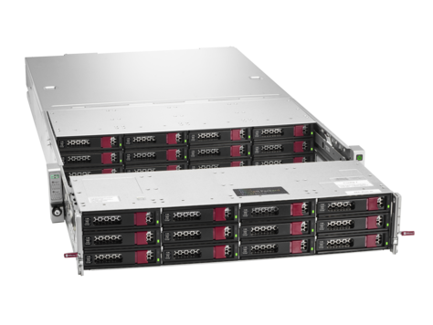
Future Changes
Current Hardware
2 RU Server
2 RU Disk Enclosure
2 SAS Controllers +Interconnect cable
Future Hardware
2 RU Server + Storage
Lower power, cost, and complexity

Slide 36
Lowlights
New dependencies on other teams
  Active Directory – Directory information and quarterly schema changes
  Load Balancing – No direct visibility into server health
Dependence on other technologies
  Active Directory, Load Balancers, Firewalls, DNS, Web Application Proxy, Intune, etc.

Slide 37
Summary
Preferred Architecture has simplified our environment and reduced operational and capital costs, while improving overall availability
Implemented and continuing to invest in processes to remain agile

Slide 38
Exchange/Outlook Ignite Public Schedule
Sunday | Monday | Tuesday | Wednesday | Thursday | Friday
 | Peer behind the curtain - how Microsoft runs Exchange Online BRK2220 2:15 pm | Debate the top 10 reasons not to move your Exchange on-premises mailboxes to Exchange Online BRK2215 9 am | Run Microsoft Exchange Hybrid for the long haul BRK3217 9 am ---------------------------------- Dive deeper into what's new and what's coming in Outlook on the web BRK1044 9 am | Deploy Microsoft Exchange Server 2016 BRK3220 9 am | Connect your business critical applications to Outlook and Groups BRK2053 9 am
 |  | Experience Scott Schnoll's Exchange tips and tricks BRK3253 10:45 am | Discover what's new with Microsoft Exchange Public Folders BRK2170 10:15 am | Unplug with the experts on Microsoft Exchange Top Issues BRK3000 10:45 am | Dive deep into Microsoft Exchange Server High Availability BRK4032 10:45 am
 |  | Meet twin sons of different mothers - Exchange Engineers and Exchange MVPs BRK2219 12:30 | Move from Exchange 2007 to Modern Exchange BRK2218 10:45 am ---------------------------------- Understand the Microsoft Exchange Server 2016 Architecture BRK3221 12:30 pm | Investigate tools and techniques for Exchange Performance Troubleshooting BRK3007 12:30 pm | Implement Microsoft Exchange Online Protection BRK3222 12:45 pm
 |  | Unplug with the experts on Exchange Server and Exchange Online BRK2216 2:15 pm | Migrate to Exchange Online via Exchange Hybrid BRK3219 2:15 pm | Unplug with the Microsoft Outlook experts BRK1021 2:15 pm
 |  | Discover what's new and what's coming for Microsoft Outlook BRK3218 4 pm | Design your Exchange infrastructure right (or consider moving to Office 365) BRK2093 4 pm | Discover modern support in Outlook for Exchange Online BRK2217 4 pm
 | Dive deeper into what's new and what's coming in Microsoft Outlook 2016 for Windows THR1005R 1 pm | Improve shared and delegated calendar experiences in Microsoft Outlook THR2017 11:05 --------------------------------- Help your users collaborate better with Office 365 Groups THR3010R 11:05 --------------------------------- Dive deeper into what's new and what's coming in Outlook mobile THR1011 2:10 pm | Focus on the emails that matter with Focused Inbox THR2001 12:40 pm --------------------------------- Migrate DL to Microsoft Office 365 Groups THR3001R 12:40 pm --------------------------------- Dive deeper into what's new and what's coming in Outlook for Mac THR1009 2:50 pm | Migrate DL to Microsoft Office 365 Groups THR3001 10:20 am --------------------------------- Dive deeper into what's new and what's coming in Outlook mobile THR1011R 12:05 pm --------------------------------- Help your users collaborate better with Office 365 Groups THR3010 1:35 pm
 |  | Dive deeper into what's new and what's coming in Microsoft Outlook 2016 for Windows THR1005 2:50 pm --------------------------------- Dive deeper into what's new and what's coming in Outlook for Mac THR1009 5:05 pm |  | Improve shared and delegated calendar experiences in Microsoft Outlook THR2017R 3:35 pm
 | Expo Hall Exchange booth and Outlook booth 12:15 – 5 pm --------------------------------- Expo Hall evening reception 5 – 7 pm | Expo Hall Exchange booth and Outlook booth 10:00 – 6 pm | Expo Hall Exchange booth and Outlook booth 10:00 – 6 pm | Expo Hall Exchange booth and Outlook booth 10:00 – 4 pm
Pre-day session: The previous decade called…they want their Exchange Server back PRE18 9 – 5 pm | Interactive Digital Labs 12:15 – 4 pm: * Use and administer Microsoft Office 365 Groups * Upgrade from Exchange 2010 to Exchange 2016 * Migrate legacy Public Folders to Exchange 2016 * Perform an Exchange hybrid deployment with Office 365 * Configure/manage doc collab for hybrid Exchange | Interactive Digital Labs 7:30 – 6 pm | Interactive Digital Labs 7:30 – 6 pm | Interactive Digital Labs 7:30 – 6 pm | Interactive Digital Labs 8 – 1:45 pm

Slide 39


Pre-Release Programs Team
Be first in line!
Go to the Exchange booth and ask for a TAP PM
Tell us about your Office 365 environment/or on-premises plans
Get selected to be in a program
Try new features first and give us feedback!
Start now by emailing davidesp@Microsoft.com or
by visiting this blog post:
Exchange On-Premises TAP Program accepting nominations

Slide 40

Deploy, ramp-up on new services and onboard new users with Microsoft FastTrack: http://fasttrack.microsoft.com/

Slide 41

Join the Microsoft Tech Community to collaborate, share, and learn from the experts: http://techcommunity.microsoft.com

Slide 42


Please evaluate this session
Your feedback is important to us!
From your PC or Tablet visit MyIgnite at http://myignite.microsoft.com
From your phone download and use the Ignite Mobile App by scanning the QR code above or visiting https://aka.ms/ignite.mobileapp

