Slide 1
Secure your data in the cloud with Microsoft Azure Storage
BRK3211
Chris Brooks
Principal Program Manager
Lavanya Kasarabada
Program Manager II

Slide 2
Azure Storage Talks @ Ignite
Session ID | When/Where | Attend if you are interested in | Talk title
BRK2201 | Tuesday 9/27 10:45-12:00 C202 - C204 | Azure Storage Overview Storage Solutions: Backup and Recovery Hybrid Storage &Global Data Access | Dive into scenarios and customer success stories with Azure Storage
BRK3210 | Tuesday 9/27 12:30-1:45 B312 - B314 | Azure Object (Blob) Storage Overview Working with Blob Storage Blob Storage Design Patterns | Build tiered cloud storage in Microsoft Azure
BRK3209 | Wednesday 9/28 10:45-12:00 B312 - B314 | Overview and Deep Dive on Azure Disks Azure Files | Optimize IaaS VM Storage using Azure Disks and Files
BRK3211 | Thursday 9/29 10:45-12:00 B304 - B305 | Azure Storage Security topics Control and data plane authorization Data Encryption – Client-side, in-transit and server-side | Secure your data in the cloud with Microsoft Azure Storage

Slide 3
Azure Storage
Foundational Building Block of Azure
  Azure Services: SQL Data Warehouse, HDInsight, Data Lake Store, Event Hubs, IoT Hubs…
  Microsoft Services: Office 365, OneDrive, XBox, Skype…
Hyper Scale
  >120 Trillion Objects, >19 million transactions per second
Durable
  Never lose your data. Multiple redundancy options. Automatic data checks
Secure
  Encryption at Rest. Client side Encryption. Integration with KeyVault
Highly Available
  Fault tolerance to hardware/software issues. Automatic load balancing
Open
  REST API, Open sourced Client Libraries – .NET, Java, C++, Python, Node.js, iOS, Android, Xamarin…
Hybrid
  Extensive partner ecosystem. Azure Stack for private/hosted clouds.

Slide 4
Azure Storage Services
IaaS
PaaS
Virtual
machines
Existing
frameworks
Web
and mobile
Microservices
Serverless
Compute
Storage
Networking
Disks
Persistent disks for Azure IaaS VMs
Premium Storage Disks option: SSD based, high IOPS, low latency
Files
Fully Managed File Shares in the Cloud
SMB and REST access
“Lift and shift” legacy apps
Objects
Highly scalable, REST based cloud object store
Block Blobs: Sequential file I/O
Cool Tier Available
Page Blobs: Random-write pattern data
Append Blobs
Tables
Massive auto-scaling NoSQL store
Dynamic scaling based on load
Scale to PBs of table data
Fast key/value lookups
Queues
Reliable queues at scale for cloud services
Decouple and scale components
Message visibility timeout and update message to protect against unreliable dequeuers
Built on a unified Distributed Storage System
Durability, Encryption at Rest, Strongly Consistent Replication, Fault Tolerance, Auto Load-Balancing

Slide 5
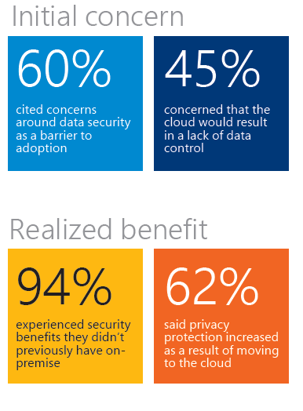
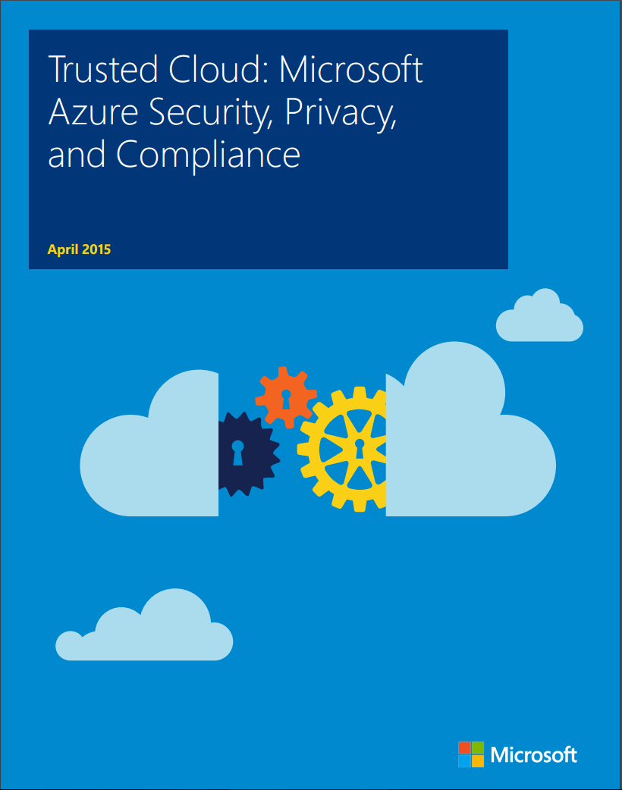
Azure Security and Compliance
Learn More:
Security, Privacy, and Compliance in Microsoft Azure white paper

Slide 6
Securing Azure Storage
Subscription
Management
Access Control
Resource Group
Client-side
Encryption
Encryption
In Transit
Custom
App
Data
Access
Control
Storage Service
Encryption
Resource Group
Azure Disk
Encryption

Slide 7
Management Access Control
Subscription
Management
Access Control
Resource Group
Client-side
Encryption
Encryption
In Transit
Custom
App
Data
Access
Control
Storage Service
Encryption
Resource Group
Azure Disk
Encryption

Slide 8
Azure Resource Manager (ARM) Security Model
Role-based Access Control aka RBAC
Subscription
Resource Group
Azure AD
Resource
Resource
Role Definition
Resource Group
Resource Providers
Resource
Learn more:
BRK3203 Manage and control your applications with Microsoft Azure Resource Manager

Slide 9
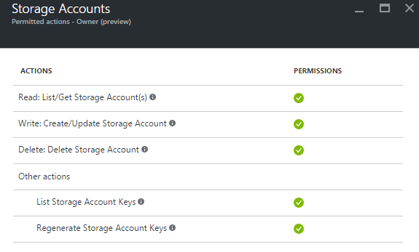
Storage Resource Provider Permissions

Slide 10
Demo:
Azure Storage
Management Access Control

Slide 11
Data Access Control
Subscription
Management
Access Control
Resource Group
Client-side
Encryption
Encryption
In Transit
Custom
App
Data
Access
Control
Storage Service
Encryption
Resource Group
Azure Disk
Encryption

Slide 12

Shared Key Security
=
Client
Service

Slide 13
Request Authorization Options
Individual Request Signing
Clients have access to key
Clients generates signatures from each request’s critical details using HMAC-SHA256
Signature is passed in authorization header
Service validates request against provided signature
Signature cannot be reused

Slide 14
Request Authorization Options
SAS Tokens
Token issuer service has key
Token issuer creates least privilege SAS token and generates signature from token using HMAC-SHA256
Token with signature given to client
Token with signature passed in URL
Service validates SAS token and signature and that request is allowed by the SAS permissions

Slide 15
Request Authorization Options - Compared
Individual Request Signing
Possession of access key authorizes all operations
To revoke access to client, key must be regenerated
Authorization in header
Appropriate only for secure, trusted application deployments
SAS Tokens
SAS tokens can grant limited, specific privileges
SAS tokens have explicit expiration, and can be revoked (stored policy)
Authorization in URL
Requires custom token issuer service
Best for most scenarios
Enables bypass of middle tier

Slide 16
Shared Key Request Signing (.NET client library)
StorageCredentials cred = new StorageCredentials(accountName, accountAccesskey);
CloudStorageAccount account = new CloudStorageAccount(cred, true);
CloudBlobClient blobclient = account.CreateCloudBlobClient();
CloudBlobContainer container = blobclient.GetContainerReference("testcontainer");
CloudBlockBlob blockblob = container.GetBlockBlobReference("testblob");
string blobtext = blockblob.DownloadText();
Provide access key
Each request is automatically signed with the key
Protocol fully documented MSDN: https://msdn.microsoft.com/en-us/library/azure/dd179428.aspx

Slide 17
Account SAS Example
https://myaccount.blob.core.windows.net/mycontainer/myblob?sv=2015-04-05&ss=b&srt=o&sp=r&se=2016-09-30T23:57:53Z&st=2016-09-14T15:57:53Z&spr=https&sig=BWLBIFazbsn96gJl2I0wKjkRRBaH9qvtF5qtsluulPk%3D
Parameter | Description
sv=2015-04-05 | SAS protocol version
ss=b | Services allowed
srt=o | Resource types allowed
sp=r | Permissions granted
st=2016-09-14T15:57:53Z | Start (valid from date/time)
se=2016-09-30T23:57:53Z | Expiration (valid until date/time)
spr=https | Allowed protocols (https or https,http)
sig=BWLBIFd8gl38avg… | Signature

Slide 18
Using SAS from code (.NET client library)
StorageCredentials cred = new StorageCredentials(sasToken);
CloudStorageAccount account = new CloudStorageAccount(cred, accountName ,null, true);
CloudBlobClient blobclient = account.CreateCloudBlobClient();
CloudBlobContainer container = blobclient.GetContainerReference("testcontainer");
CloudBlockBlob blockblob = container.GetBlockBlobReference("testblob");
string blobtext = blockblob.DownloadText();
Provide SAS token
Each request is sent with the SAS

Slide 19
SAS with Stored Access Policy
Allows separation of access policy from SAS
Enables modification and revocation of permissions after SAS token is issued
5 stored policies per container, table, queue
myaccount
https://myaccount.blob.core.windows.net/mycontainer/myblob?sv=2015-04-05&si=myreadonlypolicy&sig=BWL…lPk%3D
mycontainer
Policy: myreadonlypolicy
(permissions, expiration)
Read more on MSDN

Slide 20
SAS with Network Access Control
Limit access to Azure Storage from specific IP Addresses
Specific single IP Address, or a range
sip=168.1.5.65
sip=168.1.5.60-168.1.5.70

Slide 21
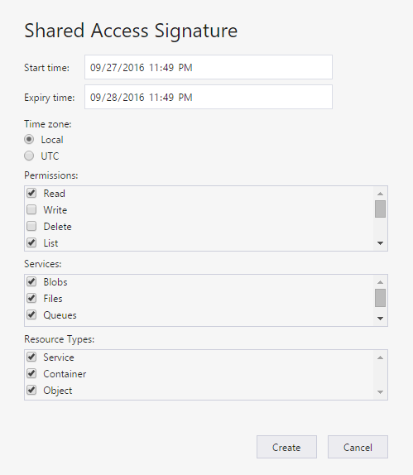
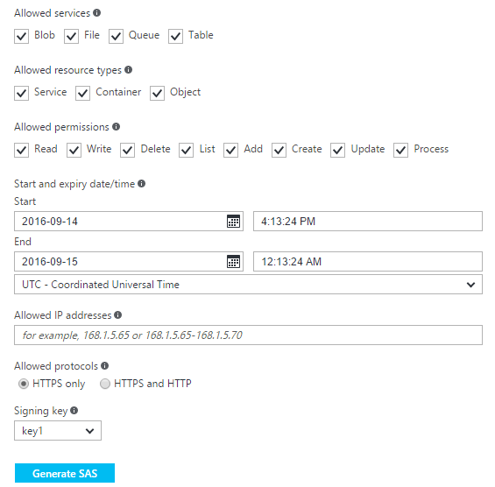
Tools to Generate SAS
Azure Portal
Storage Explorer
PowerShell
  New-AzureStorageBlobSASToken, …
Cross-Platform CLI
  storage blob sas create, …
Custom Code
  Protocol fully documented on MSDN

Slide 22
Access Key Rotation
Keys can be regenerated in response to known disclosure
Each storage account has 2 access keys to enable rotation
Regular rotation reduces the exposure of a leaked key
Key 1
Key 2

Slide 23
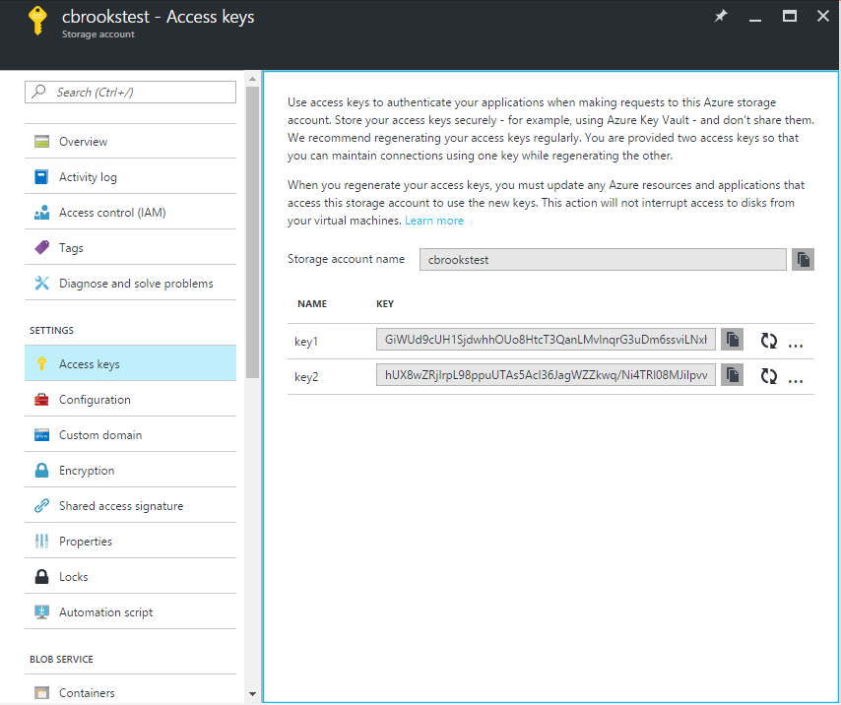
Access Key Management Tools
Azure Portal
PowerShell
    New-AzureRmStorageKey
CLI
    azure storage account keys renew
Custom Code
  Azure Storage Resource Provider API’s on MSDN

Slide 24
Secure storage access keys with Azure Key Vault
Store access keys and SAS tokens in Key Vault
Use Azure Automation job to periodically rotate keys, generate SAS Tokens, Update Key Vault
Give applications permission in Key Vault to read secrets
Applications read keys and tokens from Key Vault
  Cache secrets in app for time less than rotation period
More details here:
  http://www.dushyantgill.com/blog/2015/04/26/say-goodbye-to-key-management-manage-access-to-azure-storage-data-using-azure-ad/

Slide 25
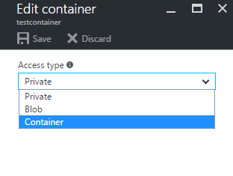
Anonymous blob access
Allows un-authenticated access to blobs by browsers and applications
Configure on blob container:
  Private: default – authentication required
  Blob: anonymous reading of fully-specified blobs
  Container: anonymous listing and reading

Slide 26
Cross-origin resource sharing (CORS)
Browsers by default limit script to the “same origin”
CORS is a W3C standard that allows web sites to grant exceptions to this policy
Azure Storage services can be configured with CORS policies to enable cross-origin, browser-based applications
See MSDN for more details
www
www

Slide 27
Demo:
Azure Storage
Data Access Control

Slide 28
Access Control Roadmap
Network ACL’s
  Configure storage accounts with no public internet access
  Control which Azure networks or Internet IP addresses can access your storage
Azure AD based Authorization
  Kerberos for Azure Files Storage via SMB
  Additional scenarios using OAuth in the future

Slide 29
Securing Azure Storage - Encryption
Subscription
Management
Access Control
Resource Group
Client-side
Encryption
Encryption
In Transit
Custom
App
Data
Access
Control
Storage Service
Encryption
Resource Group
Azure Disk
Encryption

Slide 30
Client Side Encryption
Subscription
Management
Access Control
Resource Group
Client-side
Encryption
Encryption
In Transit
Custom
App
Data
Access
Control
Storage Service
Encryption
Resource Group
Azure Disk
Encryption

Slide 31
Client Side Encryption
  Encrypt Data in Your Applications
  Scenario: Customer wants to encrypt data within their client applications prior to sending to Azure
    Support for Blob, Table and Queue Storage
    Uses AES 256 cipher
    Provides option to integrate with on-premises Key Management and Azure Key Vault
    Storage Service never sees the keys nor the unencrypted data
    Supported in .NET, Java and Python, Windows and Linux client libraries
Key Management
    Can generate and manage your own encryption keys.
    Can use keys generated by the storage client library.
    Can have Azure Key Vault generate/store the root keys.

Slide 32


Client Side Encryption
Envelope Encryption:
User brings Key Encryption Key (KEK) to key store
Storage client generates a Content Encryption Key (CEK)
User data is encrypted using CEK
CEK is wrapped using Key Encryption Key (KEK)
Key wrapping method specified by the developer
Storage client never has access to the KEK
Encrypted data along with wrapped CEK is stored as metadata on the encrypted object
KEK Interface,
Unencrypted Content
Authentication,
Key Management
Storage Client Library
Generated CEK
Key Store
Wrapped CEK
Wrapped CEK,
Key ID, IV,
Encrypted Content
Azure Storage

Slide 33
Client Side Encryption
Code Sample:
// Create the KeyWrapper to be used for wrapping.
AesCryptoServiceProvider aes = new AesCryptoServiceProvider();
SymmetricKeyWrapper aesKeyWrapper = new SymmetricKeyWrapper("symencryptionkey", aes);
// Create the encryption policy to be used for upload.
BlobEncryptionPolicy uploadPolicy = new BlobEncryptionPolicy(BlobEncryptionMode.FullBlob, aesKeyWrapper, null);
// Set the encryption policy on the request options.
BlobRequestOptions options = new BlobRequestOptions() { EncryptionPolicy = uploadPolicy };
// Upload the encrypted contents to the blob.
blob.UploadFromStream(stream, size, null, options, null);
// Download and decrypt the encrypted contents from the blob.
MemoryStream outputStream = new MemoryStream();
blob.DownloadToStream(outputStream, null, options, null);

Slide 34
Encryption In Transit
Subscription
Management
Access Control
Resource Group
Client-side
Encryption
Encryption
In Transit
Custom
App
Data
Access
Control
Storage Service
Encryption
Resource Group
Azure Disk
Encryption

Slide 35
Encryption in Transit
Always use HTTPS
  Ensures secure communication over public internet
DefaultEndpointsProtocol=https;AccountName=lakasademo1;AccountKey=<Account Key>;
SAS
https://lakasademo1.blob.core.windows.net/?sv=2015-04-05&ss=bfqt&srt=sco&sp=rwdlacup&se=2016-09-22T02:21:41Z&st=2016-09-21T18:21:41Z&spr=https&sig=hxInpKBYAxvwdI9kbBglbrgcl1EJjHqDRTF2lVGeSUU%3D
For File Storage
Encryption supported with SMB 3.0
Encryption required from outside Azure network
Future: “Secure Protocols Only” deployment configuration

Slide 36
Storage Service Encryption
Subscription
Management
Access Control
Resource Group
Client-side
Encryption
Encryption
In Transit
Custom
App
Data
Access
Control
Storage Service
Encryption
Resource Group
Azure Disk
Encryption

Slide 37
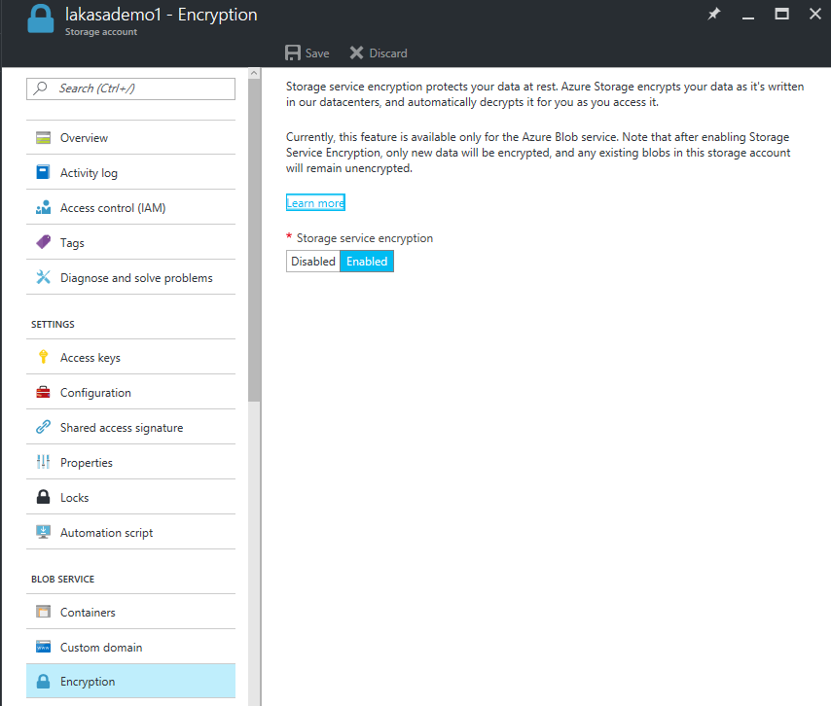
Storage Service Encryption
  Service Encrypts Data Automatically
  Scenario: Data needs to be stored encrypted with flexible access for many applications including big data analytics
    Generally Available now in all Azure regions and all Azure clouds
    Support for Block Blobs, Append Blobs and Page Blobs (Standard and Premium storage)
    Storage Account level one-click setting for enabling encryption both for new and existing storage accounts
    AES 256 cipher
Benefits
    User data is secured at rest using industry standard encryption
    technology to address organizational security and compliance requirements
    No additional costs
    Negligible performance impact to end user

Slide 38
Storage Service Encryption
Customer Experience
"Server Side Encryption is a foundational requirement for managing genomics data in the cloud. DNANexus is pleased to now also offer our software and services on Azure to help realize the promise of precision medicine enabled by genomics." - Brad Sitko, VP DNANexus
“We ran the storage test today, with input files up to 1GB per file. The result is stable and faster. We are very confident to run the HDInsight together with the encrypted blob WASB.” – IT Manager, Telecommunications industry
“We officially sign off on blob storage encryption at REST. Exceptionally happy with the ease of being able to turn it on and utilize it. It really has been one of the easiest previews we’ve used to date!” – Randy Walker, President, Harvest Data
“I can confirm, based on our load testing that encryption on the storage service has not adversely affected our results and our Data Factory pipeline meets the performance we need to go into service.” – IT Manager, Manufacturing Industry
“The testing has gone well for me. The storage account encryption works well with being able to encrypt a storage account seamlessly. The feature will be useful in being able to enforce the encryption of storage accounts for our business units.” – IT Manager, Oil and Gas Industry
“We performed tests against Azure SSE storage using various test package suites. Our tests concluded that transfers into SSE under load did not result in any measurable decrease in transfer performance” – Data Transfer Service, Microsoft IT

Slide 39

Storage Service Encryption
User creates a storage account and enables SSE
User writes data into Blob
How does it work?
Customer enables SSE on ARM Storage account
Account Encryption Key (AEK) is generated
User writes data to Blob storage
Data Encryption key (DEK) is generated
Data is encrypted using DEK and random salt
AEK version and salt is stored as metadata
All data is transparently encrypted and decrypted by Azure Storage
DEK
Data
AEK
AEK version, Salt
Encrypted Data
MS Managed Key
Azure storage

Slide 40
Storage Service Encryption
Demo
Lavanya Kasarabada

Slide 41
Azure Disk Encryption
Subscription
Management
Access Control
Resource Group
Client-side
Encryption
Encryption
In Transit
Custom
App
Data
Access
Control
Storage Service
Encryption
Resource Group
Azure Disk
Encryption

Slide 42
Azure Disk Encryption
Disk Encryption for Windows and Linux IaaS VMs
Scenario: Customer needs secure end to end encryption of Azure VMs
  Supported on all ARM VMs including VMs backed by premium storage
  Key management integrated in Azure Key vault using HSM
  Generally Available in all Azure Public regions for Windows and Linux IaaS VMs
Benefits
VM’s are secured at rest using industry standard encryption technology (Bit locker and DM-Crypt technology) to address organizational security and compliance requirements
VM’s boot under customer controlled keys and policies, and they can audit their usage in Key Vault
Encrypt both IaaS OS disks and Data disks

Slide 43
Azure Disk Encryption Scenarios
Keys/Secrets are protected in customer key vault
Encryption Scenarios
New IaaS VMs created from customer-encrypted VHD files and customer-provided encryption keys stored in Azure Key Vault.
New VM’s created from Azure Gallery
Running VM’s in Azure
OS (boot) volume
Data volume
IaaS VM
Azure storage
Protection elements
Access control: Customer control access to the keys/secrets in their key vault
Monitoring and Logging: Customer collect logs in their storage account
Data Security and Availability: Disks are stored encrypted in customer storage account and are automatically replicated by Azure storage

Slide 44
Encryption at Rest: Best Practices and Roadmap

Slide 45
Encryption at Rest: Best Practices
Storage Service Encryption | Client Side Encryption | Azure Disk Encryption
Server side | Client | Customer IaaS VM
One click enable from Portal, CLI, PS Client Libraries | .NET, Java and Python client libraries | ARM template, PS and CLI support
All Storage and VM scenario | Storage scenario only | VM scenario only
Blob Storage (Block, Append and Page blob) * | Blob, Table entities, and Queue messages | Disks only
Microsoft Managed* | Customer managed both on premise and Azure Key Vault | Customer managed and controlled in Azure Key Vault
Load only on server with negligible performance impact to user | Load on the client. Performance varies on quantity of data to be encrypted | Performance impact is in single digits
All data is encrypted after SSE is enabled* | All data is encrypted | All data is encrypted (OS drive, temp drive and data disks)

Slide 46
Encryption at Rest: Azure Storage Roadmap
Support for Files (Preview)
Customer Managed Keys (Preview)

Slide 47
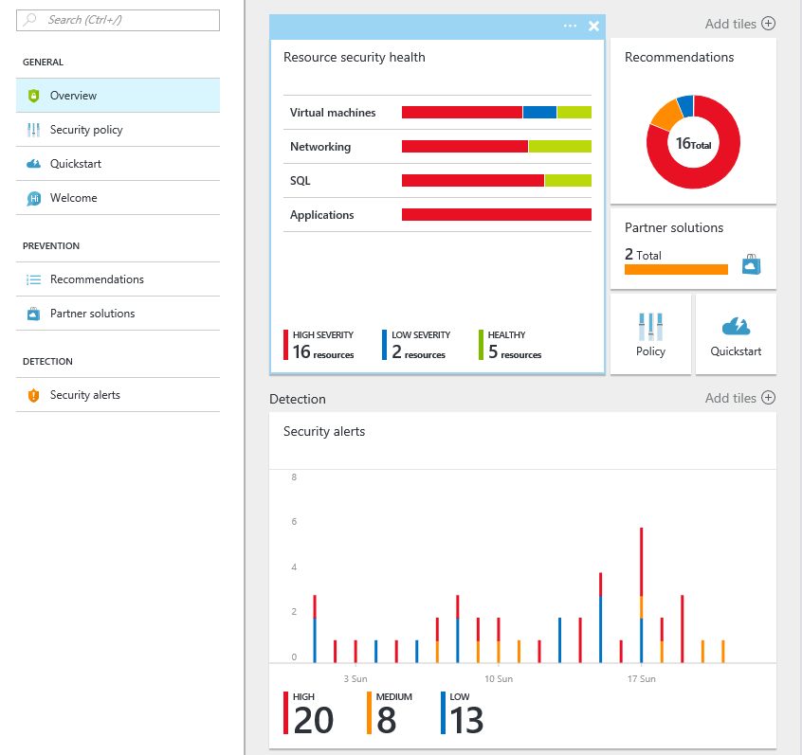
Azure Security Center
PROTECT, DETECT & RESPOND
Understand your security posture
Gain visibility into security across your Azure subscriptions
Enable security at cloud speed
Use security policies to monitor cloud resources even as they change – quickly find and fix vulnerabilities
Detect attacks early
Get alerted to attacks detected using advanced security analytics and Microsoft global threat intelligence
Act quickly to mitigate damage
Arm yourself with information about an attacker’s actions, mapped across the kill chain, as well as their known objectives and tactics

Slide 48
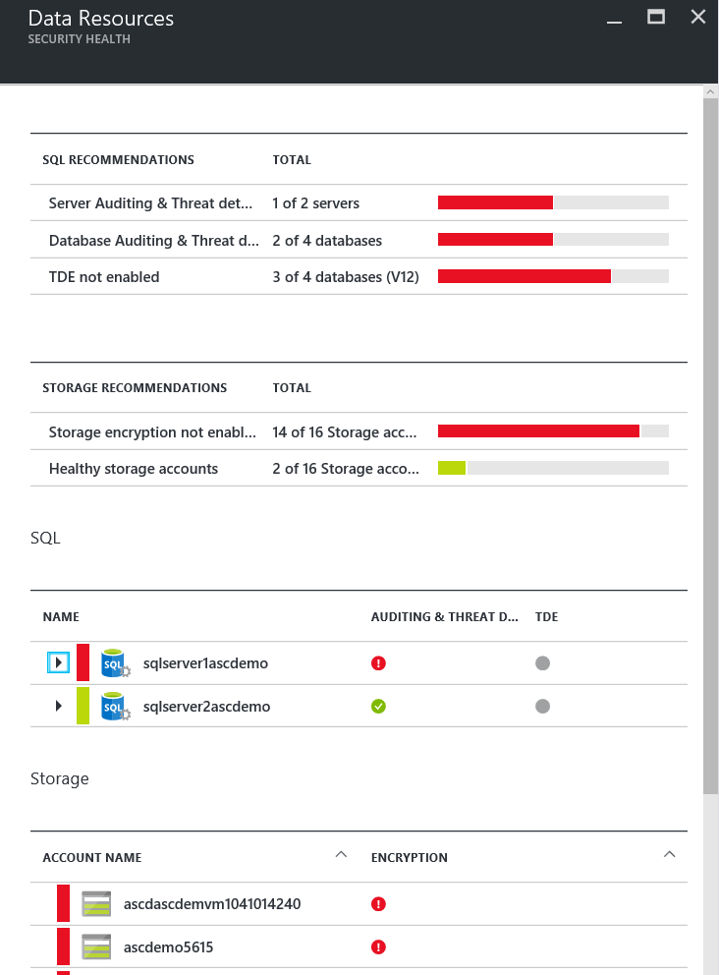
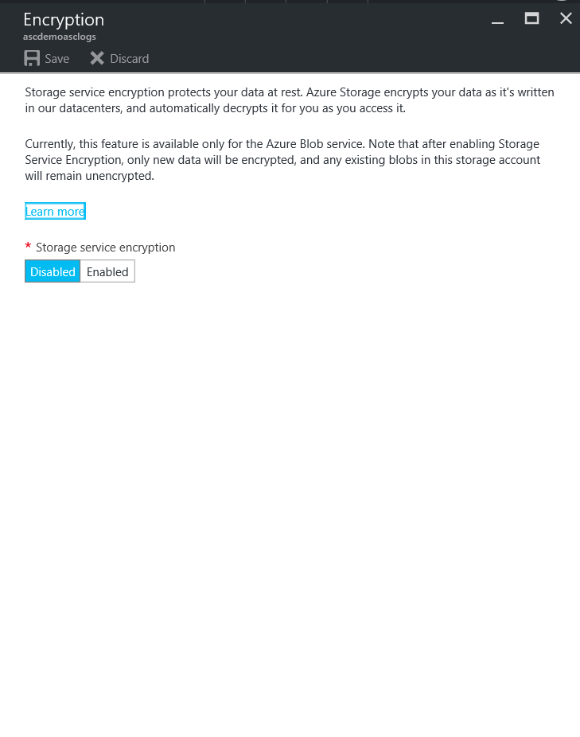
Monitors Storage accounts and recommends encryption

Slide 49
Reference
Azure security, privacy and compliance white paper
  https://go.microsoft.com/fwlink/?LinkId=392408&clcid=0x409
Azure Storage security guide
  https://azure.microsoft.com/en-us/documentation/articles/storage-security-guide/
Azure Resource Manager overview
  https://azure.microsoft.com/en-us/documentation/articles/resource-group-overview/
Azure Storage REST API security
  https://msdn.microsoft.com/en-us/library/azure/dd179428.aspx
  https://msdn.microsoft.com/en-us/library/azure/ee395415.aspx
Azure Storage Client-Side Encryption
  https://azure.microsoft.com/en-us/documentation/articles/storage-client-side-encryption/
Azure Storage Service Encryption
  https://azure.microsoft.com/en-us/documentation/articles/storage-service-encryption/

Slide 50
Free IT Pro resources
To advance your career in cloud technology
Plan your
career path
Cloud role mapping
Expert advice on skills needed
Self-paced curriculum by cloud role
$300 Azure credits and extended trials
Pluralsight 3 month subscription (10 courses)
Phone support incident
Weekly short videos and insights from Microsoft’s leaders and engineers
Connect with community of peers and Microsoft experts
Microsoft IT Pro Career Center
www.microsoft.com/itprocareercenter
Get started
with Azure
Microsoft IT Pro Cloud Essentials
www.microsoft.com/itprocloudessentials
Demos and
how-to videos
Microsoft Mechanics
www.microsoft.com/mechanics
Connect with peers and experts
Microsoft Tech Community
https://techcommunity.microsoft.com

Slide 51


Please evaluate this session
Your feedback is important to us!
From your PC or Tablet visit MyIgnite at http://myignite.microsoft.com
From your phone download and use the Ignite Mobile App by scanning the QR code above or visiting https://aka.ms/ignite.mobileapp

