Slide 1
Azure Service Bus & Event Hubs: Real World Messaging
BRK3208
John Taubensee
Program Manager - Microsoft
Kent Weare
Microsoft Azure MVP
Senior Enterprise Architect - TransAlta

Slide 2
Why use messaging?
Increase overall availability
Scale out, not up
Integrate between on premises and cloud
Protect systems from one another
Simplify programming models

Slide 3


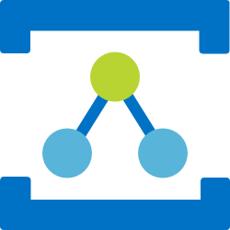
What does Azure offer?
Messaging
Event Hubs
Relay
Publish-subscribe enterprise messaging with rich features like sessions, transactions, duplicate detection, scheduling, and poison detection
A distributed, partitioned, replicated commit log service that provides the functionality of a messaging system, but with a unique design
Live socket connection that works through firewalls without VPN providing request-reply and one way cloud projections of existing services

Slide 4
Azure by the numbers
3.8 Trillion
Requests per week
in Event Hubs
6,335,813
Requests per second
average 24/7
99.9976%
Success Rate
50ms
Average Event Hubs
send latency
>28 PB
Monthly data volume
1.8 Million
Message Queues and
Topics in production
>80,000
Daily active Service Bus Namespaces
440 Billion
Message operations on
Azure Service Bus
Messaging
per month

Slide 5
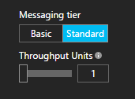
What's so special about the cloud?
Pay as you go
  No licensing or hardware costs, zero setup effort
  Only pay for what you use, no commitment
  Cheap!
Scalability / Elasticity
  Turn the knob up or down
Simplified management
  Easy to use web interface
  Infrastructure as code (Software defined capability)
SLA’s that would be hard to achieve on your own
Managed by Microsoft – call us when there’s a problem

Slide 6
What am I responsible for?
  On-Premises
  IaaS
  PaaS
Application
Operating System
Virtualization
Hardware
Networking
Physical Security
Customer Responsibility
Microsoft Responsibility

Slide 7
What do people do with messaging?
Financial Services
Utilities & Telecom
Logistics
Healthcare &
Insurance
IoT &
Telemetry
Order processing
Logging / telemetry
Connected devices
Notification / event driven systems

Slide 8
TransAlta
Kent Weare
Microsoft Azure MVP
Senior Enterprise Architect - TransAlta

Slide 9
About TransAlta
Multi-national energy company with operations in Canada, USA and Australia
Power Generation, Energy Trading and Wholesale Marketing business lines
Over 100 years of Power Generation
$3 billion CAD per year in annual revenue
$9 billion CAD in assets

Slide 10
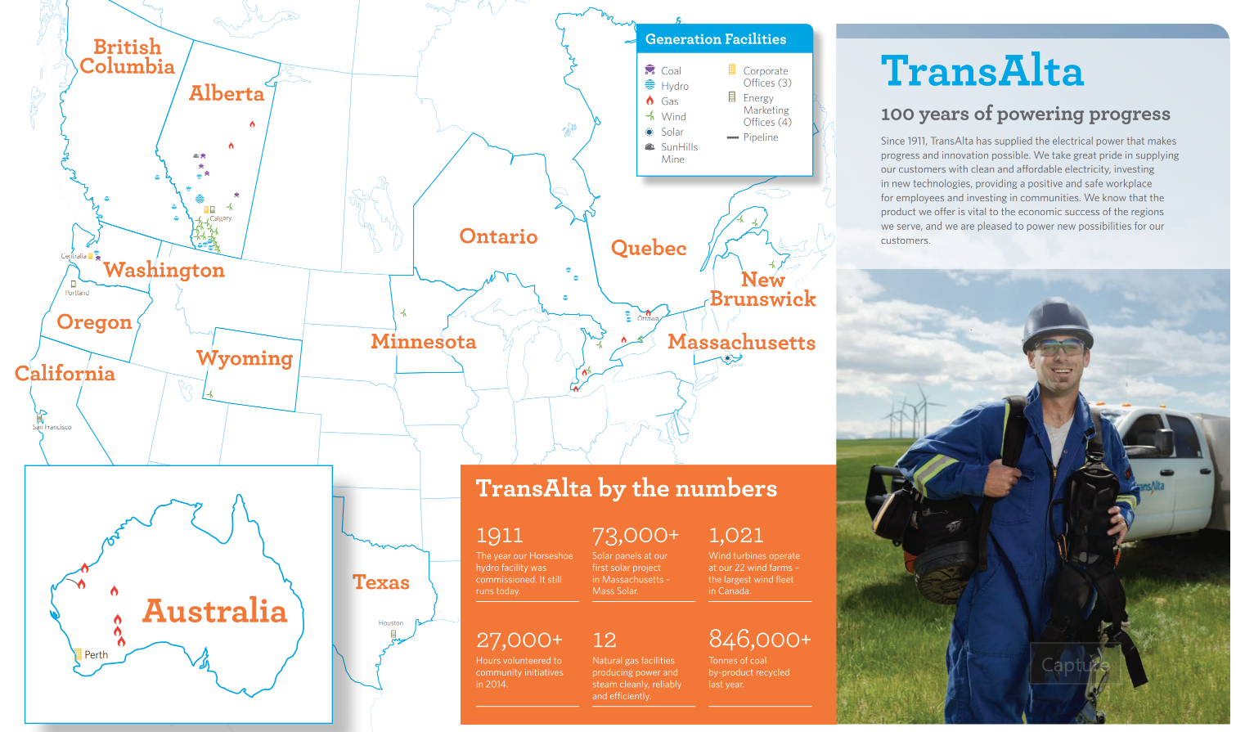

Slide 11
TransAlta’s Journey to the Cloud
A realization that what we did yesterday, will not be sufficient for tomorrow
Driven by regulatory and economic uncertainty
Avoiding large scale capital spend
Increased availability, without increased costs
LEAN Enterprise principles
Outcome needs to be, more capabilities for less

Slide 12
What is TransAlta working on?
Zero Data Center - 2019
Migrating virtual machines to Infrastructure as a Service (IaaS)
Azure Site Recovery (ASR) to Azure IaaS for Disaster Recovery
Analytics – Power BI
Adopting Platform as a Service (PaaS)
  Azure API Management
  Azure App Service
    Web and Azure SQL
  Logic Apps
  Azure Stream Analytics
Cloud Messaging
  Event Hubs
  Service Bus Queues and Topics
  Relay Messaging

Slide 13
3 Cloud Messaging Use Cases
Industrial IoT Telemetry using Event Hubs
Energy Trading Pricing using Service Bus Topics
Exposing SAP Master Data using Service Bus Relay

Slide 14
1. Industrial IoT Telemetry using Event Hubs

Slide 15
1. Industrial IoT Telemetry using Event Hubs
A Hybrid messaging platform that:
  Vendor upgrade was the catalyst
  Feeds existing Historian and allows Plant Operation personnel to monitor that state of devices and power generation output (MW)
  Provides telemetry for downstream reporting, compliance and commercial purposes.
  Real-time visibility for Field IT and Operations Support
  Flexibility to evolve

Slide 16
1. Industrial IoT Telemetry using Event Hubs
Timelines
January – POC, Architecture Reviews, Contract Negotiations
February/March – Build and Testing
April – Parallel Systems Cutover
June – Decommission Legacy Solution
Transaction Volume
Approximately 147,050,000 events processed in Production

Slide 17
1. Industrial IoT Telemetry using Event Hubs

Slide 18
Solution Deep Dive

Slide 19
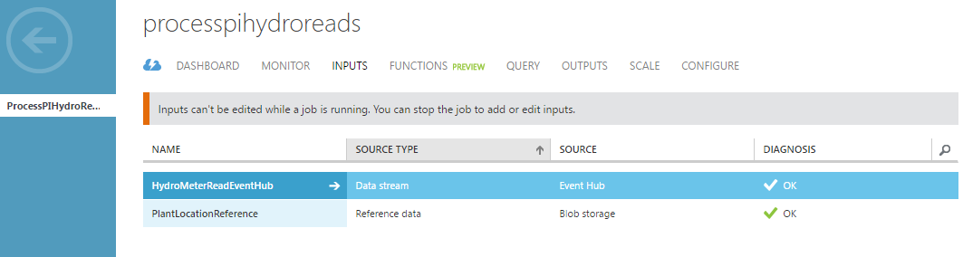
Demo 1 – Real Time Visualizations
Stream Analytics Inputs

Slide 20
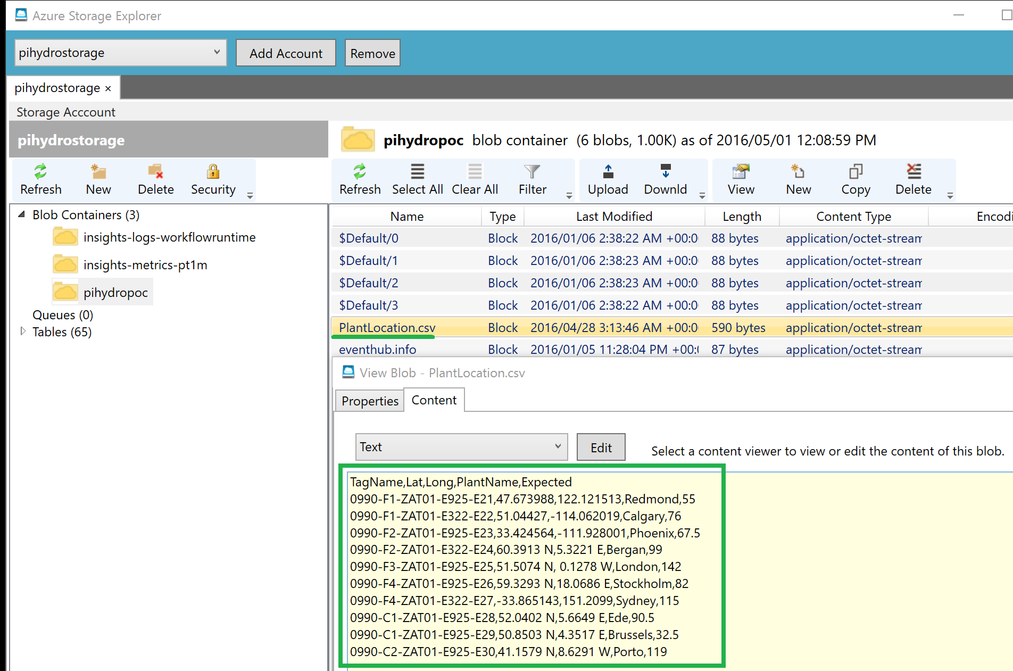
Demo 1 – Real Time Visualizations
Stream Analytics Inputs – Reference Data

Slide 21
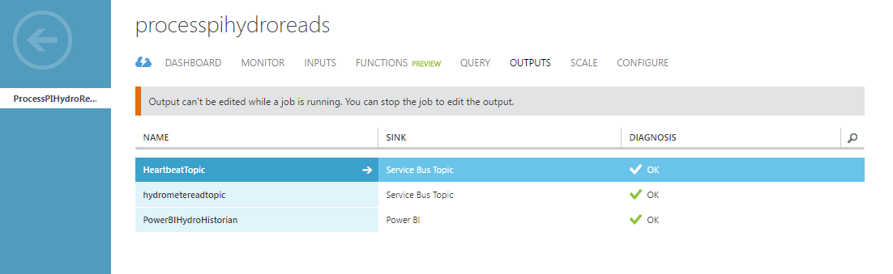
Demo 1 – Real Time Visualizations
Stream Analytics Outputs

Slide 22
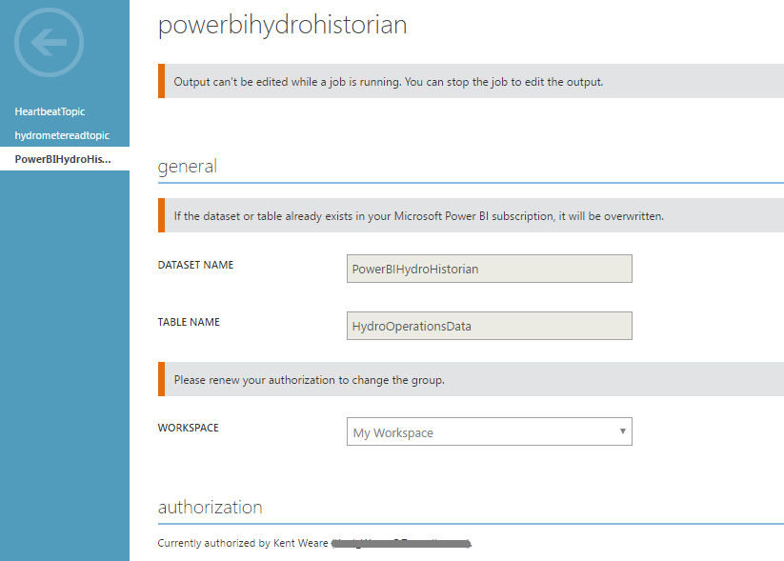
Demo 1 – Real Time Visualizations
Stream Analytics Output – Power BI

Slide 23
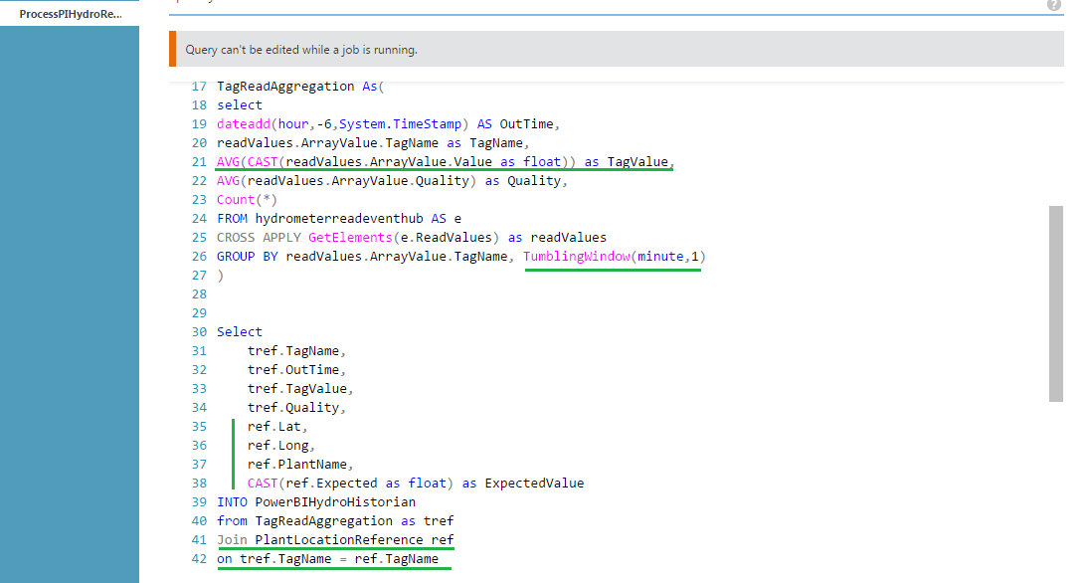
Demo 1 – Real Time Visualizations
Stream Analytics Query

Slide 24
2. Detecting Absence of Events

Slide 25
Solution Deep Dive

Slide 26
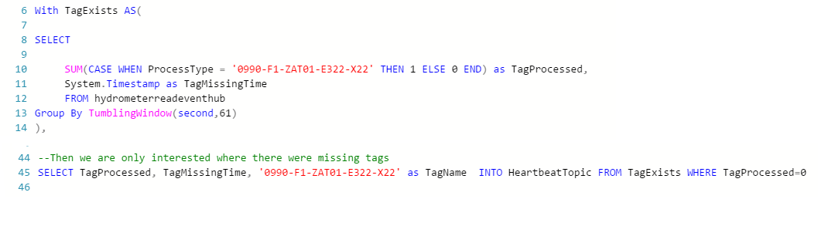
Demo 2 –Absence of Event(s) Architecture
Stream Analytics Query
Stream Analytics

Slide 27
Case Study available here: https://customers.microsoft.com/en-US/story/canadian-power-generator-shines-light-on-numbers

Slide 28
2. Energy Trading Pricing using Service Bus

Slide 29
2. Energy Trading Pricing using Service Bus
A Hybrid messaging platform that:
  Listens for pricing or business events
  Decouples sender from receiver
  Insulates Publisher from Data Center Outages
  Avoids untimely Software Updates
  Publishes data for multiple environments
  Cloud Scalability

Slide 30
2. Energy Trading Pricing using Service Bus
The Problems
Scalability
    No Load Levelling
Downstream performance issues
Network/Firewall Configuration
Planned Network/Application Outages

Slide 31
2. Energy Trading Pricing using Service Bus
The Solution
Scalability
  Load Levelling
Downstream Performance Issues
  No impact to Trading Partner
No Network/Firewall Configuration
Support Planned Network/Application Outages
  No Impact to Trading Partner
Publish events to multiple environments

Slide 32
2. Energy Trading Pricing using Service Bus
Timelines
Project had 2 weeks to get approval and into UAT
Transaction Volume
More than 25,000,000 requests processed

Slide 33
3. Exposing SAP Master Data using Relay

Slide 34
3. Exposing SAP Master Data using Relay
Existing Architecture with multiple Web Service Consumers
New SaaS Application being introduced
Wanted to avoid opening Firewalls and Network Load Balancers (NLB)

Slide 35
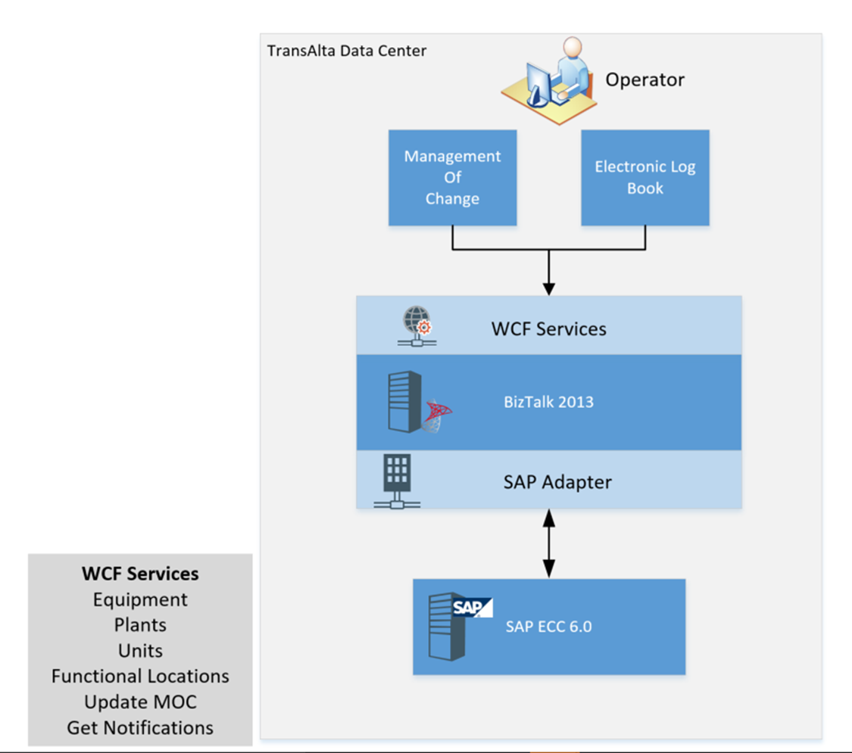
3. Exposing SAP Master Data using Relay
Existing Architecture
WCF Services Exposed
On-premises consumers

Slide 36
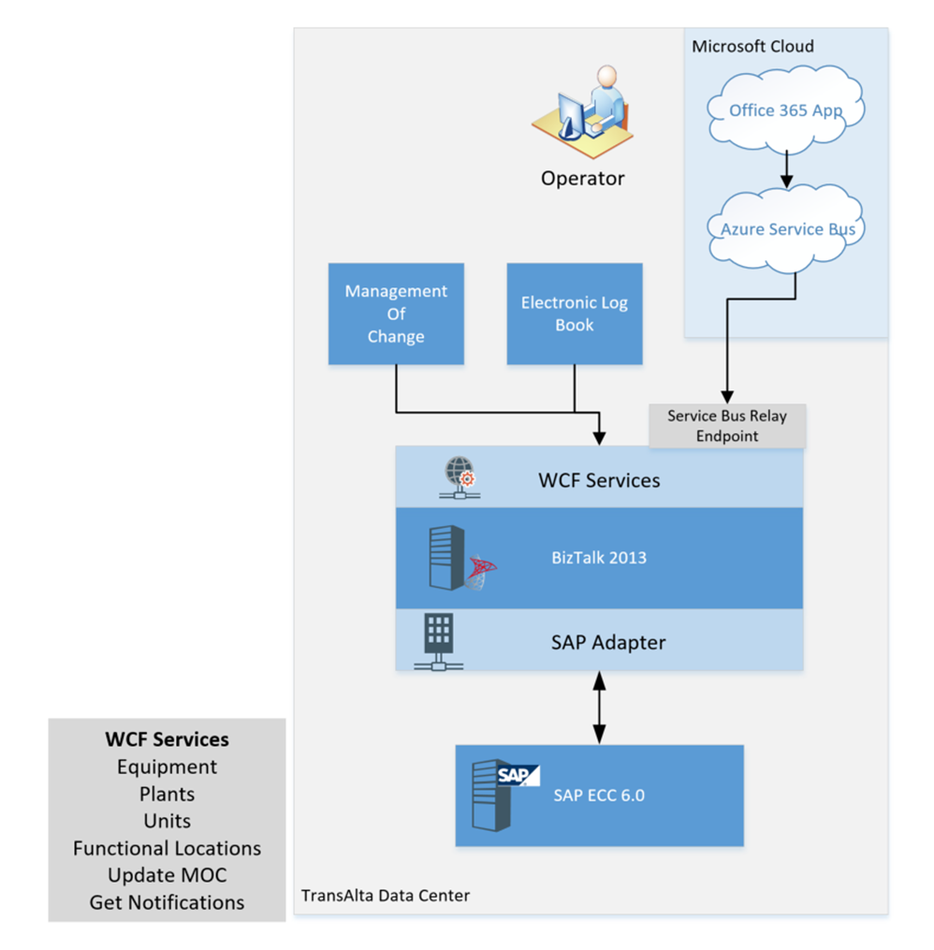
3. Exposing SAP Master Data using Relay
New Architecture
No disruption to existing applications
No NLB introduced
Cost Effective
Timelines
Proof of concept: ~ 3 hours
Implementation: ~ 8 hours

Slide 37
Lessons Learned
Drive adoption through POCs (Fail Fast/Test & Learn)
Decision makers like the option to say ‘No’ – give them that opportunity
Frame benefits holistically
Involve Security early
Write ASA queries defensively to avoid job failures
Don’t tie Power BI accounts to a user
Decouple data collection and analytic streams
Leverage Event Hub ‘re-play’ capabilities

Slide 38
TransAlta: Summary
Service Bus and Event Hubs are key pillars in our Hybrid Integration Strategy
Cost Effective
Scalable for our business needs
Reliable
Works well with other Microsoft investments we have made: BizTalk, API Management

Slide 39
How do I get started?

Slide 40
Where to look?
Messaging
Getting Started
Event Hubs
Getting Started
Platform | Messaging | Event Hubs
.NET Framework | Available | Available
.NET Standard / Core | In Development | In Preview
Java | In Development | Available
REST API | Available | Available
AMQP | Available | Available

Slide 41
How much for 1 million / day / month?
Event Hubs
  $11.16 / month / TU
  $0.868 / 31 million events
Total: $12.03
Service Bus
  $10 / month / standard
  $39.60 for 62 million operations
Total: $49.60
Rabbit on IaaS
  D12 v2
  4 cores
  28 GB RAM
Total: $485.09
$485.09
$49.60
$12.03

Slide 42
Code to get started with Messaging
var queueClient = QueueClient.CreateFromConnectionString(connectionString, queueName);
var messageBody = “This is my message!”;
var msg = new BrokeredMessage(messageBody);
await queueClient.SendAsync(msg);

Slide 43
Code to get started with Event Hubs
var eventHubClient = EventHubClient.CreateFromConnectionString(connectionString, eventHubName);
var messageBody = “This is my message!”;
await eventHubClient.SendAsync(new EventData(Encoding.UTF8.GetBytes(messageBody)));

Slide 44
Questions?

Slide 45
Free IT Pro resources
To advance your career in cloud technology
Plan your
career path
Cloud role mapping
Expert advice on skills needed
Self-paced curriculum by cloud role
$300 Azure credits and extended trials
Pluralsight 3 month subscription (10 courses)
Phone support incident
Weekly short videos and insights from Microsoft’s leaders and engineers
Connect with community of peers and Microsoft experts
Microsoft IT Pro Career Center
www.microsoft.com/itprocareercenter
Get started
with Azure
Microsoft IT Pro Cloud Essentials
www.microsoft.com/itprocloudessentials
Demos and
how-to videos
Microsoft Mechanics
www.microsoft.com/mechanics
Connect with peers and experts
Microsoft Tech Community
https://techcommunity.microsoft.com

Slide 46


Please evaluate this session
Your feedback is important to us!
From your PC or Tablet visit MyIgnite at http://myignite.microsoft.com
From your phone download and use the Ignite Mobile App by scanning the QR code above or visiting https://aka.ms/ignite.mobileapp

Slide 48
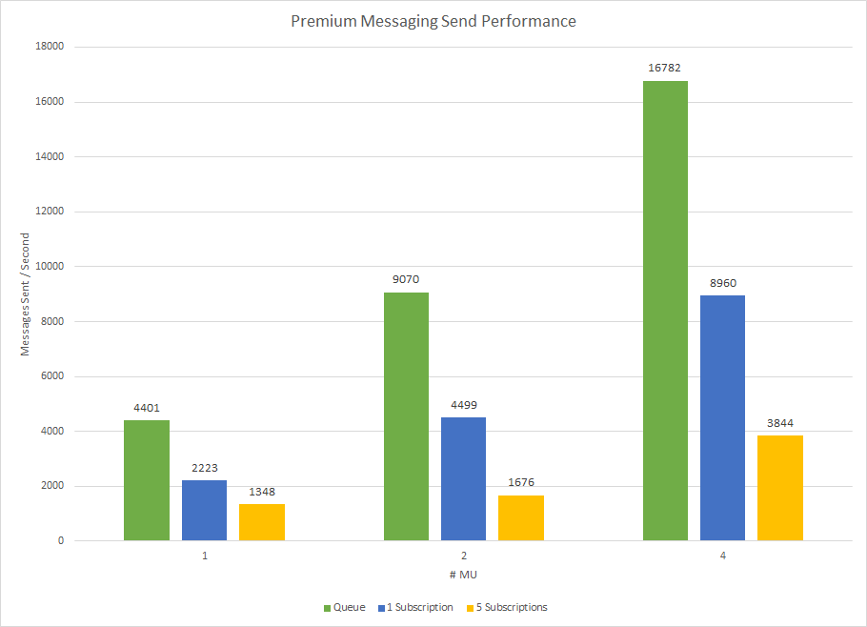
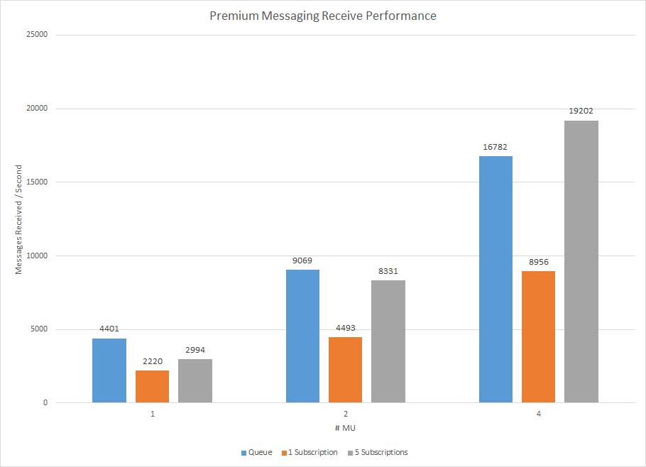
Premium Messaging: How fast is it?

Slide 49
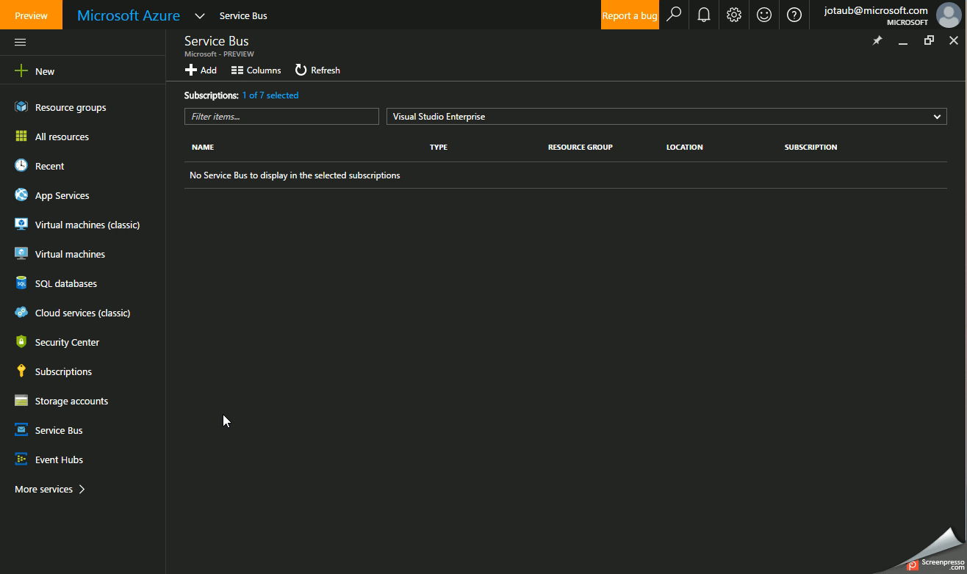
Portal Demo
Point and Click deployments

