Slide 1
Explore SQL Server Fast Track Data Warehouse (DWFT)
BRK3201
Jamie Reding
Senior Program Manager

Slide 2





What Is a Data Warehouse
  A place where a business goes to get business answers to business questions!
Point-of-sale (POS) transactions
Pricing and promotion analysis
Medical Records & Archival Data
Parts planning, inventory analysis & cost trends
Life sciences research and development
What are Data Warehouses used for?
  Tuning Production Strategies: Tune business decisions by comparing quarterly, yearly, etc.
  Customer Analysis: Analyze customer behavior, buying preferences, budget cycles, etc.
  Operation Analysis: Analyze customer relationships, business operations, etc.

Slide 3
Trends in the Data Warehouse Space
Scale
  Data warehouse system continue to grow at a fast pace
  Scalability is a key concern with systems growing from 10s of TBs to 100s of TBs, to PBs
Performance at Scale
  Ability to analyze massive amounts of data while offering interactive query response
Data Warehouse for the Masses
  Drive down the price per TB
Source: TDWI Report – Next Generation DW

Slide 4
General Data Warehouse Optimizations for Row Store and Column Store
Optimize I/O for Scans vs IOPs
  Not uncommon for a small data warehouse to be covered by hundreds of disks to overcome performance limitations of seek-based I/Os
  Aligning database files for disk scans can boost the per-disk performance to satisfy I/O needs
  Minimize Use of Secondary Indexes
  Adding non-clustered indexes help lookups, equality scans, etc.
  Generally not suitable for accessing a large number of rows
  Can add significant data management overhead
  Partitioning
  Organizing data to some natural partitioning enables faster query response by reducing the size of the data set to be queried
  Data Compression
  Compressing data can reduce storage costs and I/O bandwidth requirements significantly

Slide 5

Options for Data Warehouse Solutions
Balancing flexibility
and choice
With a Reference Architecture (SMP)
With an
Appliance (MPP)
Do It Yourself
Time to solution
HIGH
Tuning and optimization
Configuration
Tuning and optimization
Installation
Configuration
Configuration
Installation
Installation
LOW
Price
Existing or procured
hardware and support
Existing or procured
hardware and support
Procured appliance
and support
Procured software
and support
Procured software
and support
HIGH
Offerings
SQL Server 2016
Windows Server 2016
Offerings
Data Warehouse Fast Track
Offerings
Analytics Platform System
Optional, if you have hardware already

Slide 6
What Is The Data Warehouse Fast Track
  Designed to provide customers a standard and proven system architecture for data warehouse systems
  Joint effort between the Microsoft SQL Server team and many of Microsoft’s hardware partners
  Assist customers deploy data warehouse solutions with reduced risk, cost, and complexity
  Develop Data Warehouse Reference Architectures

Slide 7
Data Warehouse Fast Track
Holistic Component Architecture
  Balance the complex relationships between key system components
  Each component is a link in a chain of
  operations necessary to process data
  in SQL Server
  Evaluating the entire platform allows
  the DWFT benchmark to establish the
  Real bandwidth for each component
  This ensures that each component
  Provides sufficient throughput for
  The workload
Storage Interconnect
Storage Processor
Disk Array
SQL Server
Server OS
Host Storage Adapter
Server
Storage Enclosure

Slide 8
Balanced Performance Issues
Throughput Capacity of the IO Channel
CPU Consumption Rate and Server Throughput
Max System Throughput Capacity
Sequential IO Capacity of the Storage System
101010101010101
101010101010101
101010101010101
101010101010101
101010101010101
101010101010101
101010101010101
101010101010101
Storage System Constrained

Slide 9
Balanced Performance Issues
Sequential IO Capacity of the Storage System
CPU Consumption Rate and Server Throughput
Max System Throughput Capacity
Throughput Capacity of the IO Channel
101010101010101
101010101010101
101010101010101
101010101010101
101010101010101
101010101010101
101010101010101
101010101010101
IO Channel Constrained

Slide 10
Balanced Performance Issues
Sequential IO Capacity of the Storage System
Throughput Capacity of the IO Channel
Max System Throughput Capacity
CPU Consumption Rate and Server Throughput
101010101010101
101010101010101
101010101010101
101010101010101
101010101010101
101010101010101
101010101010101
101010101010101
CPU Consumption Rate Constrained

Slide 11
DWFT Balanced Performance
1010101010101
0101010101010
1010101010101
0101010101010
1010101010101
0101010101010
1010101010101
0101010101010
1010101010101
0101010101010
1010101010101
0101010101010
Max System Throughput Capacity
CPU Consumption Rate and Server Throughput
Throughput Capacity of the IO Channel
Sequential IO Capacity of the Storage System
1010101010101
0101010101010
1010101010101
0101010101010
Balancing the throughput begins
with the CPU consumption rate

Slide 12

Data Warehouse Fast Track Methodology
Predetermined balance across key system components
  Minimize the risk of overspending for CPU or storage resources that may never be realized at the application level
  Predictable out-of-the-box performance
  DWFT configuration are built to a capacity that already matches the capabilities of SQL Server for a selected system and target workload
  Workload-centric approach
  Rather than being a one-size-fits-all approach to the database configuration,
  the DWFT approach is aligned specifically with a data warehouse workload

Slide 13
Data Warehouse Fast Track Features
Page Compression
  Introduced in SQL Server 2008 for traditional row based data warehouse tables
  Typically achieves 2x to 5x data compression
  Recommended for smaller tables (less than a few million rows) that require equality or short range scans
  Column Store Indexes
  Stores data in a columnar format enabling 10x+ data compression and significantly speeds up query performance
  Recommended for larger tables
  Operator Pushdown
  Move both the filter and aggregation query operations closer to the data so they can be done in scan operations
  Dramatically reduces the volume of data which needs to be passed up in query processing
  Batch Mode Processing
  Processes many rows at a time rather than serially doing calculations on a single row
  Leverages Single Instruction Multiple Data (SIMD) vector processing found in Intel architectures

Slide 14
Column Store Indexes
Data Stored as Rows
  Data Stored as Columns
C1
C2
C3
C4
C5
row group
. . .
segment
  Ideal for OLTP Data
  Improved Compression
  Improved Performance
Efficient operation on a small set of rows
Data from same domain will compress better
More data fits into memory
Optimized for CPU utilization
  Reduced I/O
  Ideal for DW Workloads
Fetch on the columns needed

Slide 15
Column Store Indexes Store Index Space Savings
Space Used in GB
(101 Million Row Table)
  Provides significant
  compression and query performance
20.0
15.0
  Data is physically stored
  as a series of row groups
10.0
  A row group typically will
  have 100,000 to
  1,000,000 rows in it
Up to 90%
5.0
  Updateable CCI supports
  update/delete operations
  as well as bulk insert
0.0
Table with
Customary
Indexes
Table with
Customary
Indexes
(Page Comp.)
Table with
No Indexes
Table with
No Indexes
(Page Comp.)
Table with
Non-Clustered
Column Store
Index
Table with
Clustered
Column Store
Index
(Your mileage may vary!)

Slide 16
Data Warehouse Fast Track Process
  The test sponsor enters the system configuration information into the DWFT Reference spreadsheet
  The spreadsheet is uploaded to Microsoft for review
  The sponsor executes test runs for the Row Store and Column Store configurations with 12, 24, and 48 sessions each doing a CPU stress test
  and an I/O stress test (At least 8 hours of runtime)
  Extract the data collected by the DWFT tool (perfmon and query stats) and update the DWFT Reference spreadsheet
  Upload the spreadsheet to Microsoft for review and final certification
  Sponsor publishes a White Paper/Technical Brief of the solution

Slide 17
Data Warehouse Fast Track Workload
  Test database derived from the TPC-H schema and data
  The workload executes for a fixed duration of 1 hour for each test
  We measure I/O stress and CPU stress across 12, 24, and 48 sessions/streams
  Memory is limited during the workload run to force I/O
  1 or 2 Sockets ➔ 118GB Max SQL Server Memory
  4 Sockets ➔ 236GB Max SQL Server Memory
  8+ Sockets ➔ 472GB Max SQL Server Memory
  For published results, we specify a minimum amount of memory the system must be configurable with
  1 Socket ➔ 10GB per TB of rated capacity
  2 Sockets ➔ 12GB per TB of rated capacity
  4 Sockets ➔ 15GB per TB of rated capacity
  8 Sockets ➔ 18GB per TB of rated capacity
  For example:
  a 2 socket system with a 60TB certification must be configured at a minimum of 720GB

Slide 18
TPC-H Schema
PART
PARTSUPP
ORDERLINE
ORDERS
PARTKEY
PARTKEY
ORDERKEY
ORDERKEY
NAME
SUPPKEY
PARTKEY
CUSTKEY
MFGR
AVAILQTY
SUPPKEY
ORDERSTATUS
BRAND
SUPPLYCOST
LINENUMBER
TOTALPRICE
TYPE
COMMENT
QUANTITY
ORDERDATE
SIZE
CUSTOMER
EXTENDEDPRICE
ORDERPRIORITY
CONTAINER
DISCOUNT
CLERK
RETAILPRICE
CUSTKEY
TAX
SHIPPRIORITY
COMMENT
NAME
RETURNFLAG
COMMENT
ADDRESS
LINESTATUS
NATIONKEY
SHIPDATE
SUPPLIER
PHONE
COMMITDATE
ACCTBAL
RECEIPTDATE
SUPPKEY
MKTSEGMENT
SHIPINSTRUCT
NAME
COMMENT
SHIPMODE
ADDRESS
NATION
COMMENT
NATIONKEY
PHONE
NATIONKEY
REGION
ACCTBAL
NAME
REGIONKEY
COMMENT
REGIONKEY
NAME
COMMENT
COMMENT

Slide 19
TPC-H Table Cardinalities
Table Name | 1TB Database | 2TB Database | 4TB Database
CUSTOMER | 150,000,000 | 300,000,000 | 600,000,000
LINEITEM | 5,999,989,709 | 11,999,979,418 | 23,999,958,836
NATION | 25 | 25 | 25
ORDERS | 1,500,000,000 | 3,000,000,000 | 6,000,000,000
PART | 200,000,000 | 400,000,000 | 800,000,000
PARTSUPP | 800,000,000 | 1,600,000,000 | 3,200,000,000
REGION | 5 | 5 | 5
SUPPLIER | 10,000,000 | 20,000,000 | 40,000,000

Slide 20
Data Warehouse Fast Track Workload
  The query distribution is 1 Complex : 2 Average : 3 Simple
  The test database size is based on the number of physical sockets on the test system
  1 or 2 Sockets ➔ 1TB test database
  4 Sockets ➔ 2TB test database
  8+ Sockets ➔ 4TB test database
  Average CPU usage must be 60% or higher for all runs
  Ratio of the column store throughput and row store throughput must be 1.6 or lower
  Sponsor must also provide:
  SQL Server error log(s) for all runs
  Output of sp_configure
  Setting for the SQL Server Resource Governor

Slide 21
DWFT Simple Query
SELECT SUM(l_extendedprice * l_discount) AS revenue
FROM lineitem
WHERE l_discount BETWEEN (0.04 – 0.01) AND (0.04 + 0.01)
AND l_quantity = 25

Slide 22
DWFT Average Query
SELECT l_returnflag,
l_linestatus,
SUM(l_quantity) AS sum_qty,
SUM(l_extendedprice) AS sum_base_price,
SUM(l_extendedprice * (1 – l_discount)) AS sum_disc_price,
SUM(l_extendedprice * (1 – l_discount) * (1 + l_tax)) AS sum_charge,
AVG(l_quantity) AS avg_qty,
AVG(l_extendedprice) AS avg_price,
AVG(l_discount) AS avg_disc,
COUNT_BIG(*) AS count_order
FROM lineitem
WHERE l_shipdate <= DATEADD(dd, -90, ‘1998-12-01’)
GROUP BY l_returnflag,
l_linestatus
ORDER BY l_returnflag,
l_linestatus

Slide 23
DWFT Complex Query
SELECT 100.00 * SUM(CASE
WHEN p_type LIKE ‘PROMO%’
THEN l_extendedprice * (1 – l_discount)
ELSE 0
END) / SUM(l_extendedprice * (1 – l_discount)) AS promo_revenue
FROM lineitem,
part
WHERE l_partkey = p_partkey
AND l_shipdate >= ‘1995-09-01’
AND l_shipdate < DATEADD(mm, 1, ‘1995-09-01’)

Slide 24
DWFT Reference Configuration
  The DWFT certified capacities are based on a reference configuration
  Processor: Intel Xeon E5-2600 (2/16/16)
  Memory: 256GB
  Storage: 8 x 1.1 TB SSDs for data and tempdb
  4 x 400GB SSDs for log
  The reference system produced a Rated User Data Capacity of 25 TB with
  Relative throughputs for Row Store and Column Store of 100

Slide 25
DWFT Published Metrics
  Primary Metrics
  Row Store Relative Throughput
  Calculated as a percent ratio of the Row Store throughput to the
  Row Store throughput of the DWFT Reference Configuration
  Column Store Relative Throughput
  Calculated as a percent ratio of the Column Store throughput to the
  Column Store throughput of the DWFT Reference Configuration

Slide 26
DWFT Published Metrics
  Primary Metrics
  Rated User Data Capacity (TB)
  Calculated value based on the Row Store Relative Throughput,
  the Column Store Relative Throughput, available storage and the
  physical system memory.
  The calculations assume a compression ratio of 5:1
  Maximum User Data Capacity (TB)
  Calculated value based on the total disk capacity of all disks
  allocated to primary data storage and assumes a compression
  ratio of 5:1

Slide 27
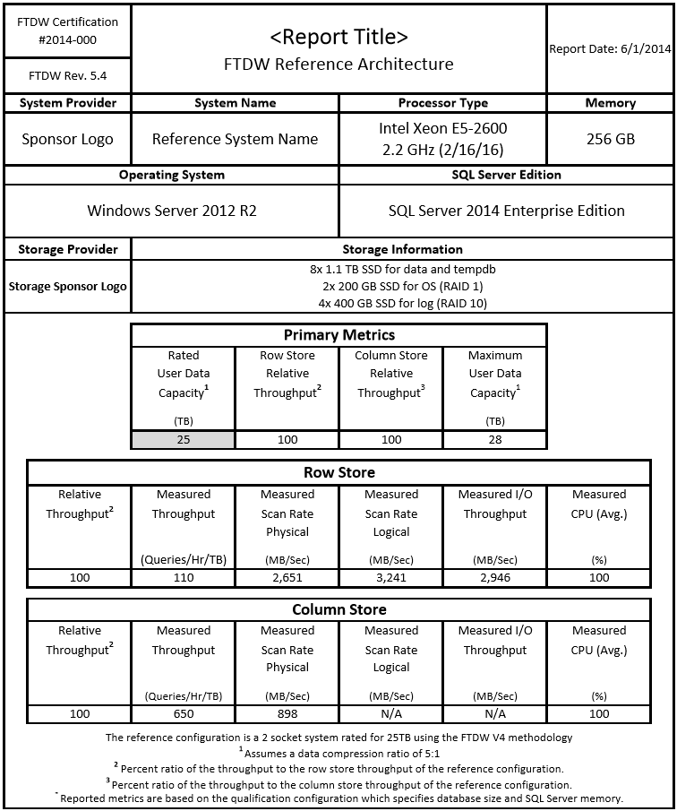
Reference
Configuration
Certificate

Slide 28
Reference Configuration Run Data

Slide 29
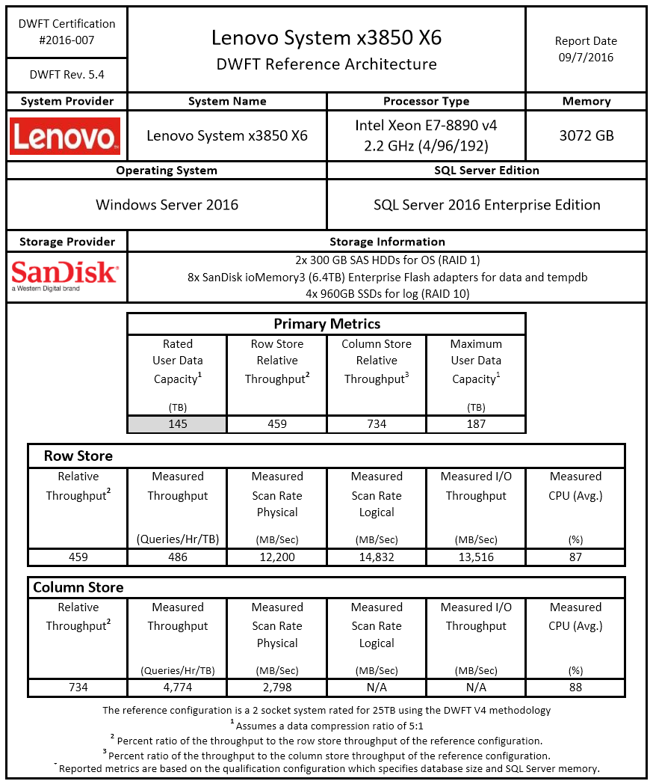
Published
DWFT
Certificate
For more information regarding Lenovo’s DWFT result, visit them in booth 1010

Slide 30
How Can You Use These Metrics?
  Assumptions: X and Y are similar in price while Z is more expensive
  If your compression ratio is lower than 5:1 then X would be a better option over Y
  X would accommodate future growth
  X would provide better CS throughput
  If your solution is row store based, then Y would provide better throughput
  Overall, Z delivers higher row store and column store performance but at a premium price
Configuration | Rated Capacity | Max User Data Capacity | Relative Row Store Throughput | Relative Column Store Throughput
X | 50 TB | 80 TB | 150 | 250
Y | 50 TB | 55 TB | 200 | 200
Z | 50 TB | 55 TB | 400 | 400

Slide 31











DWFT Program Partners
Traditional Hardware Partners
New Storage Partners

Slide 32
DWFT Published Documents
  42 using SQL Server 2014
  10 using SQL Server 2016 (published or in-flight)
  https://www.microsoft.com/en-us/cloud-platform/data-warehouse-fast-track

Slide 33
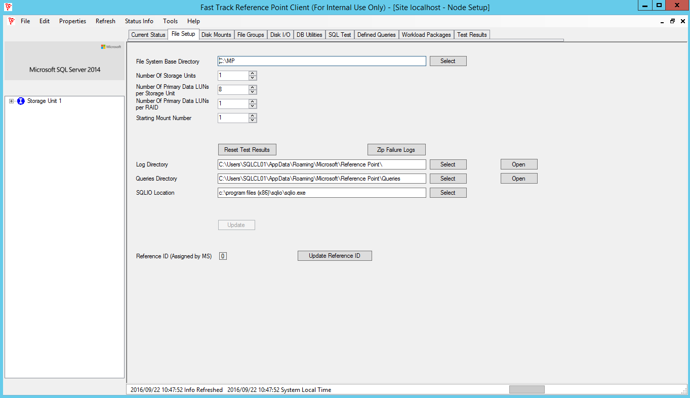
Microsoft DWFT Kit v5.4

Slide 34
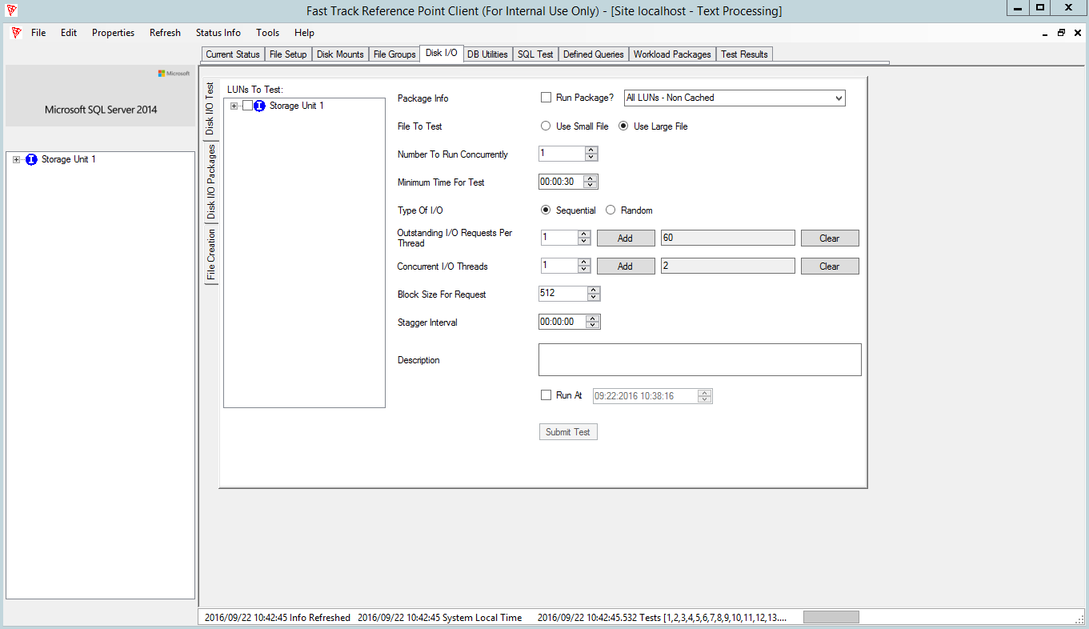
Microsoft DWFT Kit v5.4

Slide 35
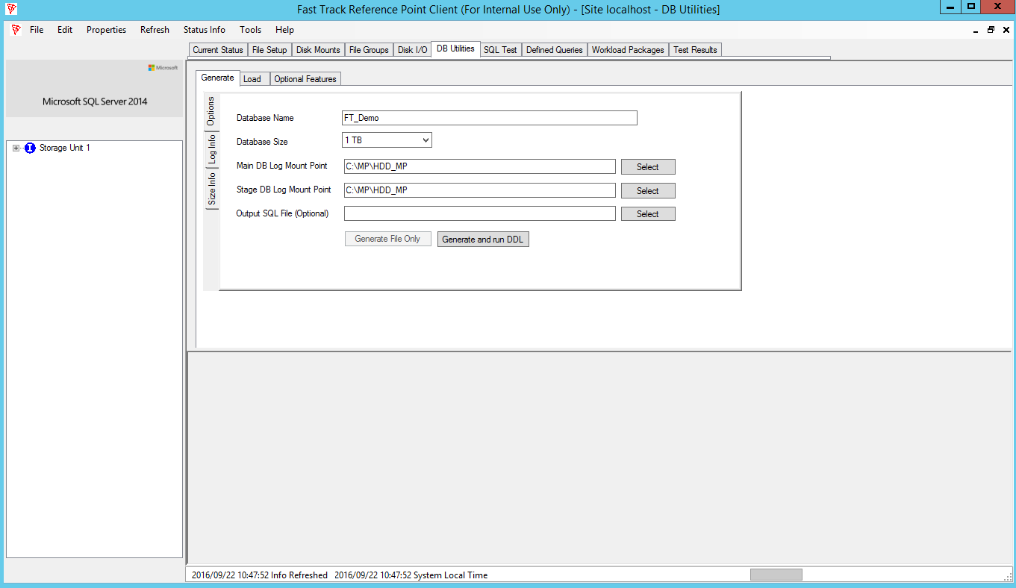
Microsoft DWFT Kit v5.4

Slide 36
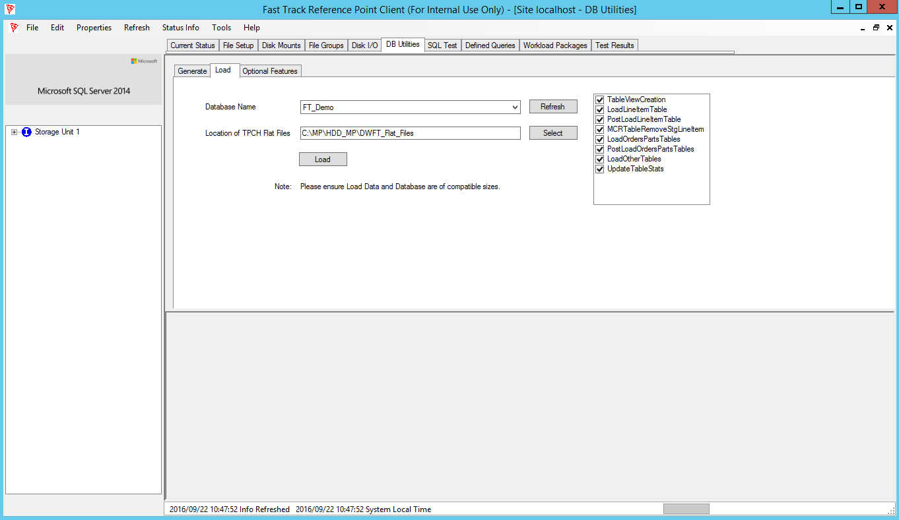
Microsoft DWFT Kit v5.4

Slide 37
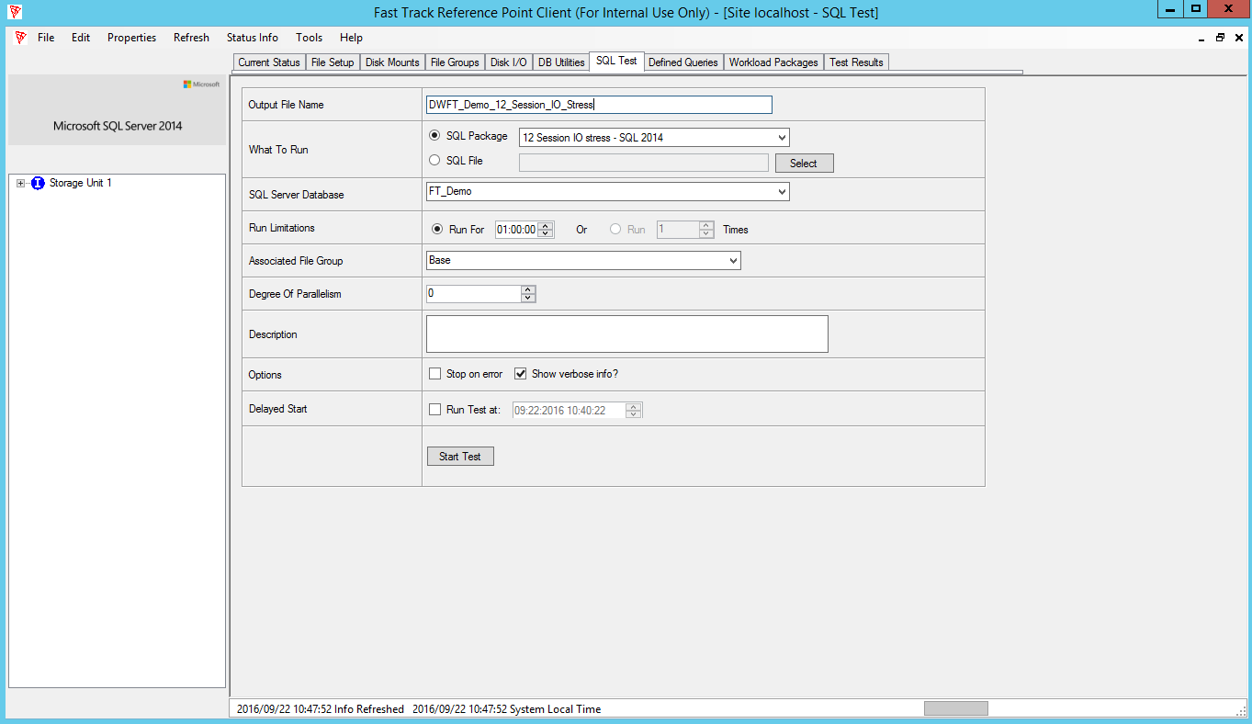
Microsoft DWFT Kit v5.4

Slide 38
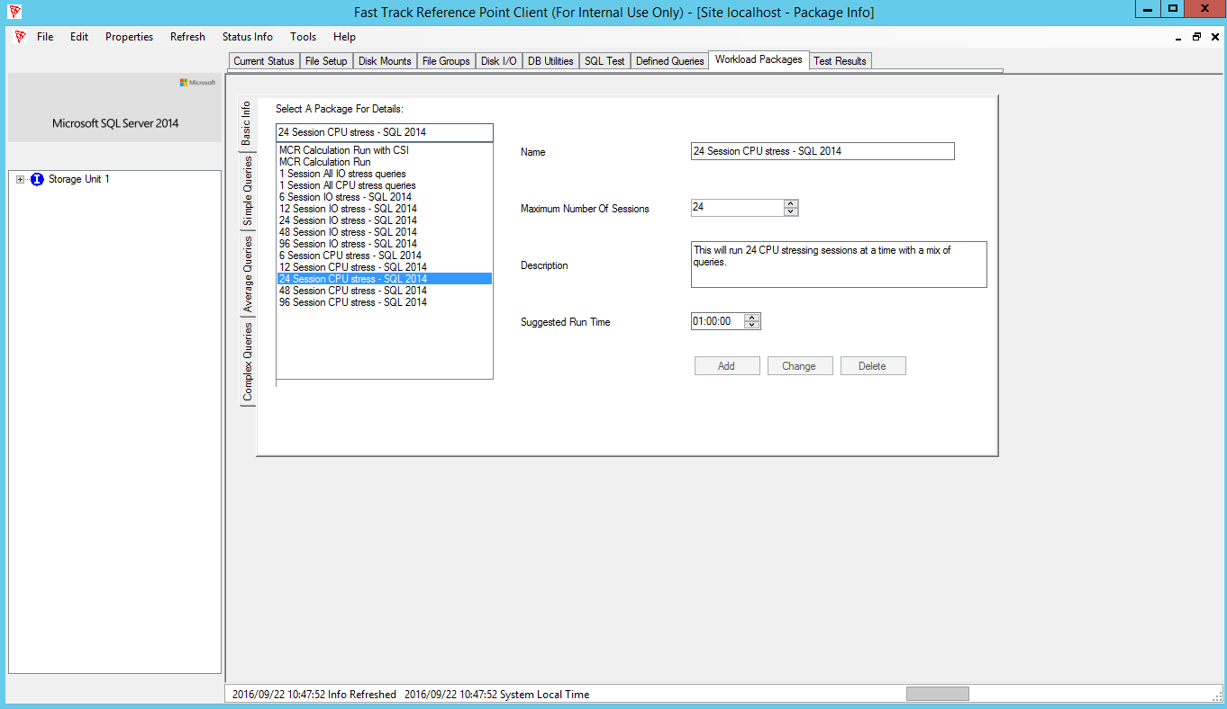
Microsoft DWFT Kit v5.4

Slide 39
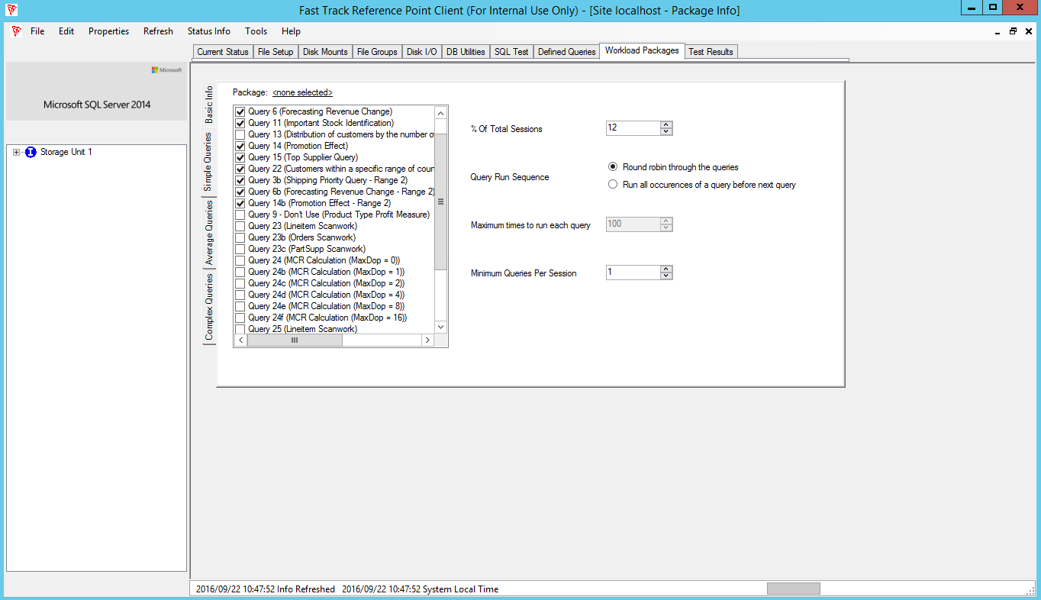
Microsoft DWFT Kit v5.4

Slide 40
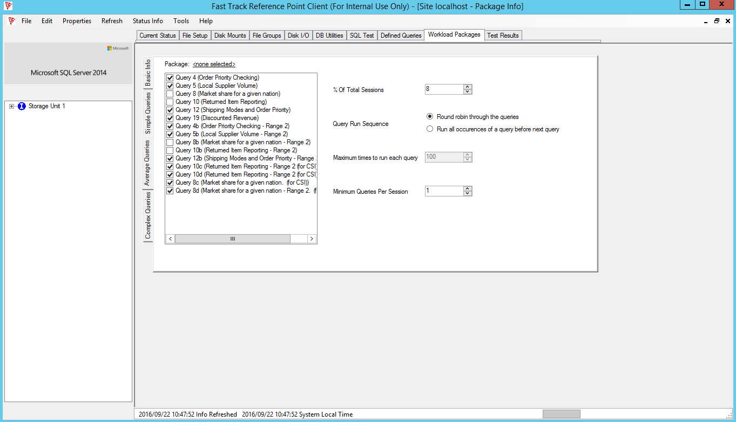
Microsoft DWFT Kit v5.4

Slide 41
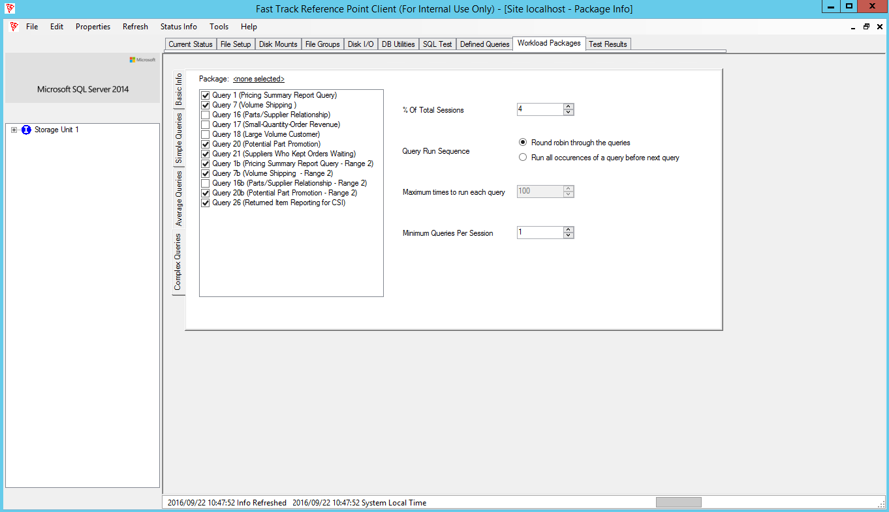
Microsoft DWFT Kit v5.4

Slide 42
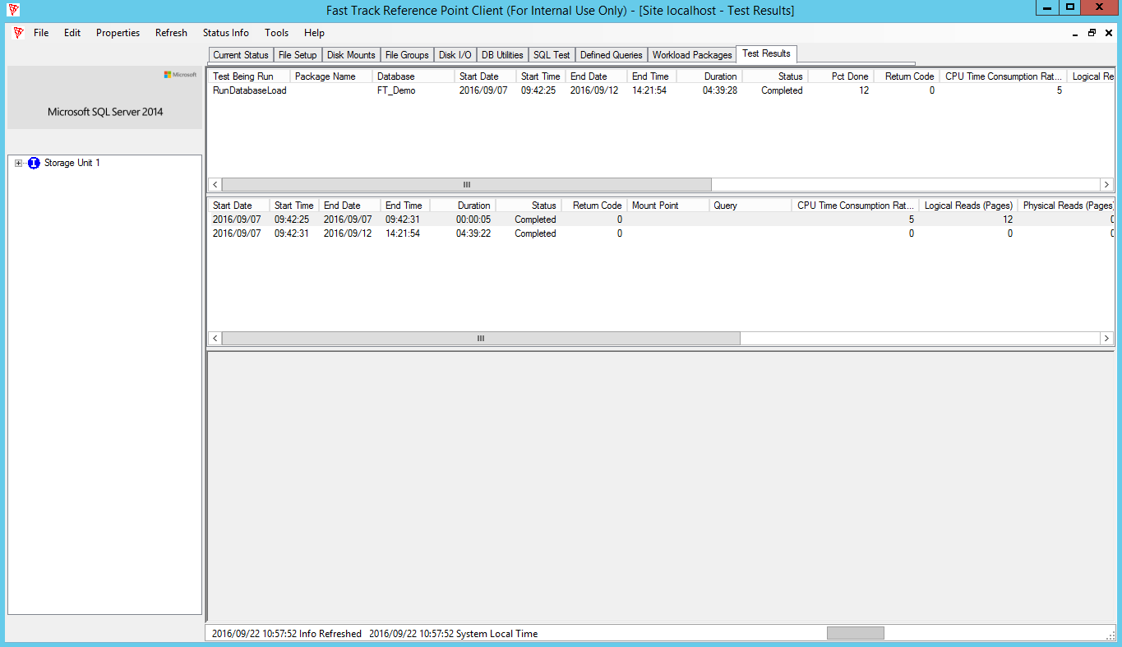
Microsoft DWFT Kit v5.4

Slide 43
DWFT Future Enhancements
  Support for running the workload in other environments:
  Virtual Machines
  Azure and other cloud offerings
  SQL Server on Linux
  R
  PolyBase
  Exploring expanding workload with Hybrid Transactional/Analytical Processing (HTAP)

Slide 44
Questions?

Slide 45
Free IT Pro resources
To advance your career in cloud technology
Plan your
career path
Cloud role mapping
Expert advice on skills needed
Self-paced curriculum by cloud role
$300 Azure credits and extended trials
Pluralsight 3 month subscription (10 courses)
Phone support incident
Weekly short videos and insights from Microsoft’s leaders and engineers
Connect with community of peers and Microsoft experts
Microsoft IT Pro Career Center
www.microsoft.com/itprocareercenter
Get started
with Azure
Microsoft IT Pro Cloud Essentials
www.microsoft.com/itprocloudessentials
Demos and
how-to videos
Microsoft Mechanics
www.microsoft.com/mechanics
Connect with peers and experts
Microsoft Tech Community
https://techcommunity.microsoft.com

Slide 46


Please evaluate this session
Your feedback is important to us!
From your PC or Tablet visit MyIgnite at http://myignite.microsoft.com
From your phone download and use the Ignite Mobile App by scanning the QR code above or visiting https://aka.ms/ignite.mobileapp

