Slide 1
Develop, debug and deploy containerized applications with Docker
BRK3189
Steve Lasker
Program Manager
Azure Developer Experiences
Glenn Condron
Program Manager
ASP.NET

Slide 2
Shipping Manifest
What containers can do for me… ^{(that’s you)}
Running code in a container
Building container images
How to build efficient docker images
Developing Containerized Apps
Visual Studio
Container Dev/Ops Workflow
CI/CD of containers

Slide 3
Why
Cloud Amortization
Fast Startup Time
Efficient Images at Rest
Package the Environment and your App

Slide 4
Amortizing Costs

Slide 5
– PC → Server Revolution
CIRCA 1990
$
$
$
$
$
$
$
$
$
$
$
$
$
$
$
$
$
$
$
$
$
$
$
$
$
$
$
$
$
$
$
$
$
$
$
$
$
$
$
$
$
$
$
$
$
$
$
$
$
$
$
$
$
$
$

Slide 6
– Server → VM Evolution
CIRCA 2000
Guest OS #5
Guest OS #6
Guest OS #7
Guest OS #8
Guest OS #5
Guest OS #6
Guest OS #7
Guest OS #8
Guest OS #5
Guest OS #6
Guest OS #7
Guest OS #8
Guest OS #5
Guest OS #6
Guest OS #7
Guest OS #8
Guest OS #5
Guest OS #6
Guest OS #7
Guest OS #8
Guest OS #1
Guest OS #2
Guest OS #3
Guest OS #4
Guest OS #1
Guest OS #2
Guest OS #3
Guest OS #4
Guest OS #1
Guest OS #2
Guest OS #3
Guest OS #4
Guest OS #1
Guest OS #2
Guest OS #3
Guest OS #4
Guest OS #1
Guest OS #2
Guest OS #3
Guest OS #4
Hyper Visor
Hyper Visor
Hyper Visor
Hyper Visor
Hyper Visor
$
$
$
$
$

Slide 7
– VM → Cloud Evolvement
CIRCA 2015
Guest OS #5
Guest OS #6
Guest OS #7
Guest OS #8
Guest OS #5
Guest OS #6
Guest OS #7
Guest OS #8
Guest OS #5
Guest OS #6
Guest OS #7
Guest OS #8
Guest OS #5
Guest OS #6
Guest OS #7
Guest OS #8
Guest OS #5
Guest OS #6
Guest OS #7
Guest OS #8
$
$
$
$
$
$
$
$
$
$
$
$
$
$
$
$
$
$
$
$
Guest OS #1
Guest OS #2
Guest OS #3
Guest OS #4
Guest OS #1
Guest OS #2
Guest OS #3
Guest OS #4
Guest OS #1
Guest OS #2
Guest OS #3
Guest OS #4
Guest OS #1
Guest OS #2
Guest OS #3
Guest OS #4
Guest OS #1
Guest OS #2
Guest OS #3
Guest OS #4
$
$
$
$
$
$
$
$
$
$
$
$
$
$
$
$
$
$
$
$
Hyper Visor
Hyper Visor
Hyper Visor
Hyper Visor
Hyper Visor

Slide 8
– Cloud → Containerization
CIRCA 2015
Guest OS #2
Guest OS #2
Guest OS #2
Guest OS #2
Guest OS #2
$
$
$
$
$
Guest OS #1
Guest OS #2
Guest OS #3
Guest OS #4
Guest OS #1
Guest OS #2
Guest OS #3
Guest OS #4
Guest OS #1
Guest OS #2
Guest OS #3
Guest OS #4
Guest OS #1
Guest OS #2
Guest OS #3
Guest OS #4
Guest OS #1
Guest OS #2
Guest OS #3
Guest OS #4
$
$
$
$
$
Hyper Visor
Hyper Visor
Hyper Visor
Hyper Visor
Hyper Visor

Slide 9
Docker Primitives
Start Speed
Mounted Volumes
Encapsulation

Slide 10
Startup Times
Demo Time

Slide 11
Docker API
Client
DOCKER_HOST
Registry
Docker pull
Docker daemon
Docker run
Containers
Images Cache
Dot Net
Dot Net
Dot Net
Dot Net

Slide 12
Free IT Pro resources To advance your career in cloud technology
Plan your career path
Cloud role mapping
Expert advice on skills needed
Self-paced curriculum by cloud role
$300 Azure credits and extended trials
Pluralsight 3 month subscription (10 courses)
Phone support incident
Weekly short videos and insights from Microsoft’s leaders and engineers
Connect with community of peers and Microsoft experts
Microsoft IT Pro Career Center
www.microsoft.com/itprocareercenter
Get started with Azure
Microsoft IT Pro Cloud Essentials
www.microsoft.com/itprocloudessentials
Demos and how-to videos
Microsoft Mechanics
www.microsoft.com/mechanics
Connect with peers and experts
Microsoft Tech Community
https://techcommunity.microsoft.com

Slide 13
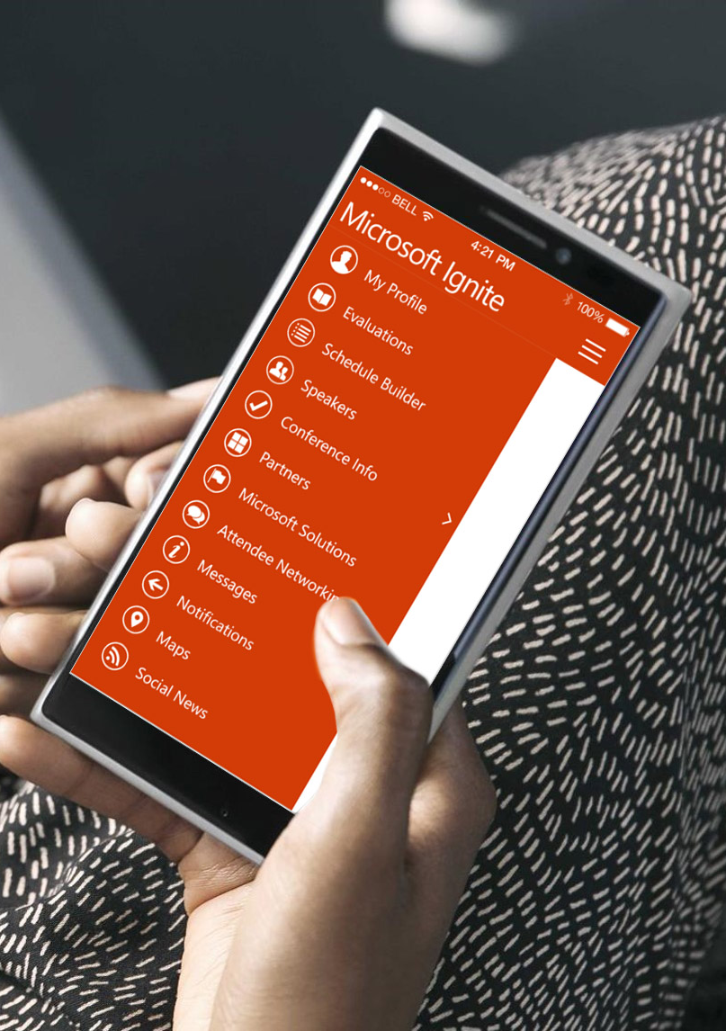
Please evaluate this session
Your feedback is important to us!
From your PC or Tablet visit MyIgnite at http://myignite.microsoft.com
From your phone download and use the Ignite Mobile App by scanning the QR code above or visiting https://aka.ms/ignite.mobileapp

