Slide 1
Dig into Cloud Networking Monitoring, Diagnostics, and Performance with
Time Sync Improvements
BRK3188
Paul Long Jason Messer Don Stanwyck
Senior Program Managers

Slide 2


Built-in layers
of security
Software-defined
datacenter
Cloud-ready
application platform
Windows Server 2016
Windows Server + System Center
session guide: aka.ms/WS2016Ignite

Slide 3
Agenda
Motivation for Software Defined Networking
What can we do with monitoring and diagnostics?
What about the network data plane?
Time-sync improvements in WS2016

Slide 4
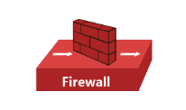
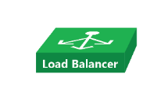
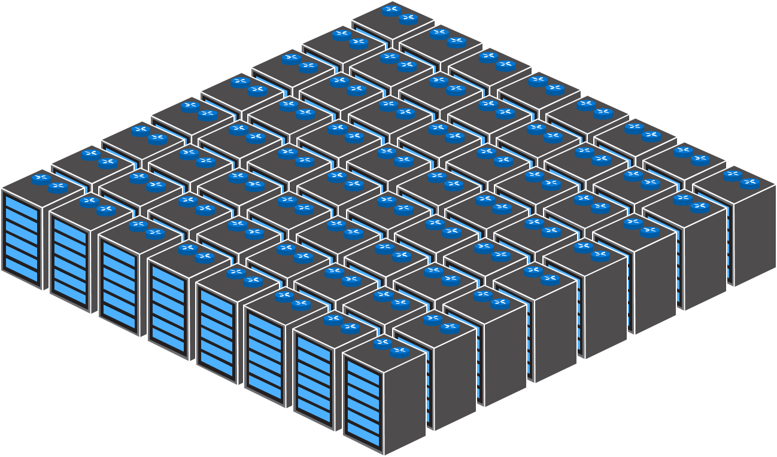
Datacenter Network
Edge Routers
Fixed-Function
Physical Appliances
Spine Switches/Routers
Compute/Storage
& TOR Switches
Datacenter

Slide 5
Challenges customers face
 | Increase agility “I need to onboard workloads with complex policies across my own datacenter and/or other clouds in days – not weeks – to remain competitive.”
 | Enhance security “I must be able to instantaneously react to evolving threats and stop an attack from spreading.”
 | Reduce costs “I need to reduce the number of operator interventions and efficiently meet network growth demands. Current practices just won’t scale.”

Slide 6
Foundations
Agility
Security
Costs
Reliability
Performance
Monitoring and Diagnostics

Slide 7
SDN Monitoring and Diagnostics

Slide 8
What happens when something goes wrong…
  Day 0: Initial Fabric Deployment
  Day 1: Tenant On-boarding
  Day 100+: Normal Usage
“We had a large power outage… UPS did not last as long as expected… connectivity is gone.”

Slide 9
In-Box SDN Diagnostics
Goal
Expose Actionable Error Messages to the Admin
Lessons learned from HNVv1 in WS2012R2
  Bugs are found in both the data-path and control-path
  Repros are hard and logs aren’t always available
  Bad Drivers can cause all sorts of problems
Class of Problems to Diagnose
  Configuration drift between what was originally specified and current state
  Error in the system’s application of valid configuration
  Invalid or unsupported configuration
  External Errors
  Driver Issues

Slide 10
Day 0: SDN Fabric Deployment Diagnosing the SDN Fabric

Slide 11


Top of Rack (Layer 3) Switches
NIC1
NIC2
NIC1
NIC2
NIC1
NIC2
NIC1
NIC1
NIC2
NIC2
NIC1
AD
NIC2
Compute Cluster
DNS
SQL
Fabric Mgmt Cluster

Slide 12

Mgmt
VMM Logical Networks
NIC1
NIC2
vSwitch
Mgmt
NIC1
NIC2
vSwitch
Mgmt
NIC1
NIC2
vSwitch
Mgmt
NIC1
NIC2
vSwitch
Mgmt
SCOM
SQL

Slide 13
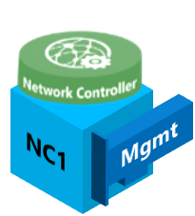

Mgmt
Network Controller
Managed Logical Networks
NIC1
NIC2
vSwitch
Mgmt
NIC1
VFP
NIC2
vSwitch
Mgmt
NIC1
VFP
NIC2
vSwitch
Mgmt
NIC1
VFP
NIC2
NC2
Mgmt
vSwitch
NC Host Agent
Mgmt
VFP
NC3
Mgmt
NC Host Agent
SCOM
SQL
NC Host Agent
NC Host Agent
Network Controller is now on-boarded

Slide 14
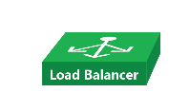
Mgmt
HNV
Network Controller
Managed Logical Networks
Transit
Private VIP
Public VIP
NIC1
BGP Peering (Transit)
vSwitch
NIC2
BGP Peering (Transit)
Mgmt
VFP
NIC1
MUX1
NIC2
BGP Peering (Transit)
Mgmt
vSwitch
HNV
Transit
NC2
NIC1
Mgmt
Mgmt
VFP
MUX2
NIC2
Mgmt
RDMA2
vSwitch
NC Host Agent
HNV
Transit
NC3
Mgmt
Mgmt
VFP
NIC1
SLB Host Agent
MUX3
NIC2
Mgmt
HNV
vSwitch
NC Host Agent
Transit
Mgmt
SLB Host Agent
VFP
SCOM
NC Host Agent
SQL
SLB Host Agent
NC Host Agent
SLB Host Agent
Software Load Balancer (SLB) Muxes are now on-boarded

Slide 15
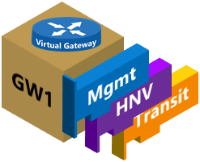
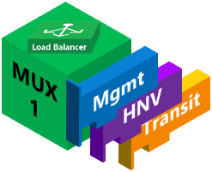
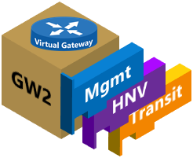


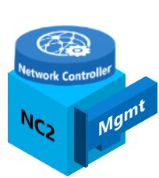
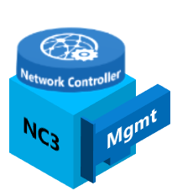

Mgmt
HNV
Network Controller
Managed Logical Networks
Transit
Private VIP
Public VIP
NIC1
NIC2
BGP Peering (Transit)
GRE VIP
vSwitch
BGP Peering (Transit)
Mgmt
VFP
NIC1
NIC2
BGP Peering (Transit)
vSwitch
Mgmt
VFP
NIC1
vSwitch
NIC2
NC Host Agent
Mgmt
VFP
NIC1
SLB Host Agent
NIC2
vSwitch
NC Host Agent
Mgmt
VFP
SLB Host Agent
SCOM
NC Host Agent
SQL
SLB Host Agent
NC Host Agent
SLB Host Agent
Gateways are now on-boarded

Slide 16
Mgmt
HNV
Network Controller
Managed Logical Networks
Transit
Private VIP
Public VIP
NIC1
NIC2
BGP Peering (Transit)
GRE VIP
vSwitch
BGP Peering (Transit)
Mgmt
VFP
NIC1
NIC2
BGP Peering (Transit)
vSwitch
Mgmt
VFP
NIC1
vSwitch
NIC2
NC Host Agent
Mgmt
VFP
NIC1
SLB Host Agent
NIC2
vSwitch
NC Host Agent
Mgmt
VFP
SLB Host Agent
SCOM
NC Host Agent
SQL
SLB Host Agent
NC Host Agent
SLB Host Agent

Slide 17
DEMO: Diagnosing the SDN Fabric

Slide 18
Day 1: Tenant Onboarding
Diagnosing Tenant Resources

Slide 19
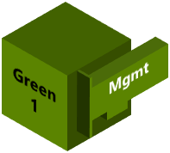
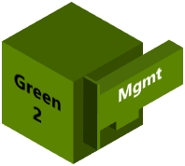
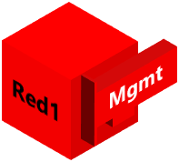

Mgmt
Red Tenant VM Network
HNV
Green Tenant VM Network
Network Controller
Managed Logical Networks
Network Controller Managed Virtual Networks
HNV Provider
Green Tenant VM Network
vSwitch
Red Tenant VM Network
HNV PA
HNV PA
VFP
vSwitch
HNV PA
VFP
HNV PA
vSwitch
HNV PA
HNV PA
VFP
vSwitch
VFP
Deploy VMs onto Hyper-V Hosts

Slide 20


Red Tenant VM Network
Green Tenant VM Network
External Client
HNV Provider
Network Controller Managed Virtual Networks
Public VIPs
Transit
Internal Client
BGP
Private VIPs
Green Tenant VM Network
Red Tenant VM Network
BGP
vSwitch
VFP
MUX1
Mgmt
HNV
vSwitch
Transit
VFP
MUX2
Mgmt
HNV
vSwitch
Transit
VFP
MUX3
Mgmt
vSwitch
HNV
Transit
VFP
Create Load Balancers for Tenant VIPs

Slide 21
Red Tenant VM Network
Green Tenant VM Network
HNV Provider
Internet
Network Controller Managed Virtual Networks
Public VIPs
Transit
Internal Client
Private VIPs
Green Tenant VM Network
vSwitch
Red Tenant VM Network
VFP
MUX1
Mgmt
HNV
vSwitch
Transit
VFP
MUX2
Mgmt
HNV
vSwitch
Transit
VFP
MUX3
Mgmt
vSwitch
HNV
Transit
VFP
Create Inbound and Outbound NAT Rules

Slide 22
Mgmt
Red Tenant VM Network
HNV
Green Tenant VM Network
Network Controller
Managed Logical Networks
Network Controller Managed Virtual Networks
HNV Provider
Green Tenant VM Network
vSwitch
Red Tenant VM Network
HNV PA
HNV PA
VFP
vSwitch
HNV PA
VFP
HNV PA
vSwitch
HNV PA
HNV PA
VFP
vSwitch
VFP
Tenant reports intermittent loss of connectivity…

Slide 23
DEMO: Diagnosing Tenant Connectivity

Slide 24
Day 100+: Normal Usage Monitoring

Slide 25
Monitoring SDN Deployments
Maintaining a Healthy System
  Goal: Catch problems before degradation or outages are reported*
Starts with Knowledge
What resources do I need to monitor?
What resources can I monitor?
  Fabric Health Monitoring
  Tenant Health Monitoring
Responding to Alerts
Need Actionable Information
*Actually, what we really want is to be warned about an impending problem before it occurs… Not there yet

Slide 26
System Center Operations Manager (SCOM)
Background
  Provides infrastructure monitoring that is flexible and cost-effective, helps ensure the predictable performance and availability of vital applications and offers comprehensive monitoring for your datacenter and cloud, both private and public.
  Monitoring Packs (MP)
  SDN Monitoring Pack
  Network Controller Monitoring Pack

Slide 27
Monitoring SDN with SCOM
Monitor-able resources
These resources have implemented configuration state in the Network Controller
Servers
Network Interfaces
Virtual Networks
Load Balancers
Gateways
Access Control Lists
Un-monitor-able resources
  These resources will need to be monitored using PowerShell or OOB
  Physical Switch
  Logical Networks

Slide 28
Handling SDN Monitoring MP Alerts
Where do I look?
Alerts View
Stamp View
Resource View
What do I do?
Change Resolution State
Forward
Close
Responding
Inspect Alert Description and Status
Product Knowledge lists possible causes and resolutions

Slide 29
DEMO: Monitoring SDN Framework and Tenant Resources using SCOM

Slide 30
Troubleshooting
Workflow
  Triage – Summarize the problem and collect data; narrow down failure component
  Root-Cause – Analyze the data to determine specific reason for failure
  Fix – Update configuration
  Monitor – Use SCOM
Tools
  In-box Diagnostic Cmdlets
  HNV Diagnostics: https://technet.microsoft.com/en-us/library/mt490472.aspx
  NC Diagnostics: https://technet.microsoft.com/en-us/library/mt490456.aspx
  GitHub diagnostic scripts
  Traces
https://github.com/Microsoft/SDN/tree/master/Diagnostics
Troubleshooting Guidance on TechNet:
https://technet.microsoft.com/en-us/windows-server-docs/networking/sdn/troubleshoot/troubleshoot-windows-server-2016-software-defined-networking-stack

Slide 31
Diagnostic PowerShell Scripts
Control-Plane
  Focused on the control paths including Network Controller to NC or SLB Host Agent Service
  Expose information through the Network Controller’s NorthBound API using “RunningState”
  Debug-NetworkController
  Debug-NetworkControllerConfigurationState
  Debug-ServiceFabricNodeStatus
  Get-NetworkControllerDeploymentInfo
  Get-NetworkControllerReplica

Slide 32
Diagnostic PowerShell Scripts (cont.)
Data-Plane
  Focused on the data path components on individual Hyper-V Hosts
  Debug-SlbDataPath
  Debug-VirtualMachineQueueOperation
  Enable/Disable-MuxEchoResponder
  Get-CustomerRoute
  Get-NetworkControllerVipResource
  Get-PACAMapping
  Get-ProviderAddress
  Get-VipHostMapping
  Get-VMNetworkAdapterPortId
  Get-VMSwitchExternalPortId
  Test-DipHostReachability
  Test-EncapOverheadSettings
  Test-LogicalNetworkConnection(SupportsJumboPacket)
  Test-VIPReachability
  Test-VirtualNetworkConnection

Slide 33
Performance: The Data Plane

Slide 34
Data plane components: offloads vs features
What are offloads?
How are those different from features?
Do all features use offloads?
Are all offloads parts of features?
Hardware accelerators
Features are in OS software
No, but many do
No, but many are

Slide 35
What are the common offloads in WS2016?
Address checksum offload group
Data Center Bridging (DCB)
Interrupt moderation (IM)
IPsec Task Offload (IPsecTO)
Jumbo frame
Large Send Offload (LSO)
NVGRE Task Offload
Receive Side Coalescing (RSC)
Receive Side Scaling (RSS)
Single Root I/O Virtualization (SR-IOV)
Remote Direct Access Memory (RDMA)
TCP Chimney Offload
Virtual LAN (VLAN) support
Virtual Machine Multi-Queue (VMMQ)
Virtual Machine Queues (VMQ)
VxLAN Task Offload
Key:
Feature-driven
Offload only
Sometimes feature driven

Slide 36
What are the data plane features of WS2016?
Access Control Lists (ACL, Extended ACLs, & SDN ACLs)
Bandwidth management (vmQoS, SDN QoS, & DCB)
Hyper-V Network Virtualization (HNVv1 and HNVv2)
NIC Teaming (LBFO and SET)
RDMA (including Converged NIC)
RSS
TCP Chimney Offload
Virtual RSS (vRSS)
VLANs (incl. PVLANs)
VMMQ
VMQ

Slide 37
Does it all work together? (Yes and No)
3 primary networking stacks:
  Native (bare metal);
  Hyper-V server with or without HNVv1
  Hyper-V server with SDNv2
  Some features only work in one of the networking stacks.
  Standby for more information later…

Slide 38
Overview
Windows Server has a lot of data plane features and supported offloads
Many of the features interact with and depend on NIC hardware
Hardware features (offloads) can be stateless or stateful
    Affects interactions with other features
Learnings from networking feature development
    Not all hardware features provide the results we hope for
      E.g., TCP Chimney
    Not all vendors are created equal
      No, we don’t publish competing performance numbers

Slide 39
WS2012 R2 Data Plane features
Hyper-V switch
    Extensible switch (Cisco, NEC, etc.)
    vmQoS
    ACLs and extended ACLs
    Hyper-V Virtual Networking (NV-GRE)
NIC Teaming
Software vRSS

Slide 40
WS2012 R2 Data Plane Offloads
Address checksum offloads
Receive Side Coalescing (RSC)
Receive Side Scaling (RSS)
Large Send Offload (LSO)
Virtual Machine Queues (VMQ)
Single-root I/O Virtualization (SR-IOV)
Remote Direct Memory Access (RDMA)
Hyper-V Network Virtualization (HNVv1 NV-GRE)
Datacenter Bridging (DCB)

Slide 41
WS2016 - Moving to the future
WS2016 has two networking stacks:
    One carries the WS2012 R2 stack forward with little change;
    One has the new SDN Switch Extension, high-performance VM support, and cost-reduction capabilities that are shared with Azure
      This is the SDNv2 feature set
WS2016 with SDNv2 features
WS2016 without SDNv2 features
WS2012 R2

Slide 42
WS2016 - Moving to the future
WS2016 base features are the WS2012 R2 features plus:
    Software vRSS extended to host vNICs
    Small enhancements to NIC Teaming
    Switch Embedded Teaming
    Virtual Machine MultiQueues (VMMQ)
    Converged NIC (RDMA to the host vNIC)
  WS2016 SDNv2 feature set is built on the SDN Switch Extension
    Integrated ACLs (Replaces and extends Hyper-V switch ACLs)
    HNVv2 TO (Replaces HNVv1, adds VxLAN)
    SDN QoS (Replaces and extends vmQoS)

Slide 43
Managing the network stack
WS2012 R2 and WS2016 continuation stack
    Managed by PowerShell or SCVMM
    NIC Teaming managed by PowerShell or lbfoadmin.exe (linked from Server Manager) or SCVMM
WS2016 SDNv2 stack (without MAS management)
    Fabric managed by SCVMM
    Physical and Virtual networks managed by Network Controller (NC)
        No UI for Tenant management or Switch Extension features

Slide 44
How do the new features work?
(and why do we have them)?
Improved Virtual Networking
    SDN Switch Extension a.k.a., Virtual Filtering Platform (VFP)
    Includes:
      Integrated ACLs
      HNVv2 (VxLAN, NV-GREv2)
      SDN QoS
Bandwidth to the VM
    VMMQ
RDMA Virtualized and extended
    Converged NIC
    Client RDMA
Teaming in the Hyper-V switch
    SET

Slide 45
SDN Switch Extension
Known in Azure as the Virtualization Filtering Platform (VFP)
Acts as a virtual switch inside the Hyper-V vmSwitch
Provides core SDN functionality for Azure networking services, including:
  Address Virtualization for VNET
  VIP -> DIP Translation for SLB
  ACLs, Metering, and Security Guards
  Bandwidth management/control
Uses programmable rule/flow tables to perform per-packet actions
Supports all data plane policy at 40GbE+ with offloads
Available to private cloud in Windows Server 2016
VM
VM
vNIC
vmNIC
vmNIC
VM Switch
VFP
ACLs, Metering, Security
VNET
SLB (NAT)

Slide 46
HNVv2 – VxLAN, NV-GRE
Customers asked for VxLAN – we delivered!!
    But we also do NV-GRE for those who like that option
All HNV policies are handled in the SDN Extension
Network Controller (NC) plumbs the policies to the gateways and hosts
  A semi-hidden feature automatically adjusts the MTU on the wire to accommodate the encapsulation overhead
    Better performance than splitting packets due to length of encapsulation

Slide 47
Virtual Machine MultiQueue (VMMQ)
VMQ allocated one queue per VM
    Each queue affinitized to a single CPU
    Each CPU capable of 3.5-5Gbps of packet processing
    One queue/one CPU for default queue processing
    vRSS allocates multiple software queues per VM
VMMQ allocates multiple hardware queues per VM
    Each queue still affinitized to a single CPU
    Each VM can have a different number of queues
    Default queue becomes a set of queues interrupting a set of CPUs
    Toeplitz hash spreading (RSS) used to spread traffic between queues for the same VM

Slide 48
Evolution step 1: RSS – Receive Side Scaling
Queue 0
Queue 1
Queue 2
Queue 3
Queue …
Queue N
Calculate Toeplitz hash
modulo # of queues
Distribute to queue,
interrupt processor
Packet
Arrival

Slide 49
Evolution step 2: VMQ – Virtual Machine Queues (filter)
VM1
VM2
VM3
VM …
VM N
Default
Select dest MAC+VLAN,
Compare to filters
Distribute to queue,
interrupt processor
Packet
Arrival

Slide 50
Evolution step 2b: VMQ – Virtual Machine Queues (switch)
Default
Port 1
Port 2
Port 3
Port 4
Port …
Port N
Packet
Arrival
Embedded NIC Switch with forwarding table
Fwd table
MAC+VLAN → Port #
MAC+VLAN → Port #
Else (Default)→ Port #

Slide 51
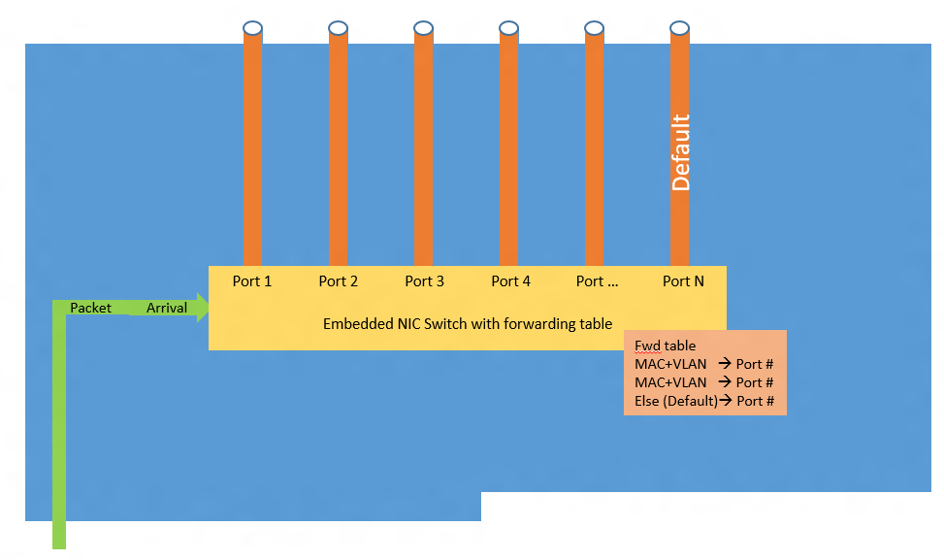
Evolution step 3: vRSS – Virtual RSS
Queue 0
Queue 1
Queue …
Queue N
vmBus sub-channels
vmNIC
vmBus
P1
P2
P3
P4
P…
Pn
Hyper-V switch
deMux
VMQ in
physical
NIC

Slide 52
Evolution step 3 to 4: vRSS – VMMQ
Queue 0
Queue 1
Queue …
Queue N
vmBus sub-channels
vmNIC
vmBus
Moves to
hardware
P1
P2
P3
P4
P…
Pn
Hyper-V switch
deMux
VMQ in
physical
NIC

Slide 53
Evolution step 4: VMMQ – Virtual Machine MultiQueue
Topl.Hash
Topl.Hash
Topl.Hash
Topl.Hash
Topl.Hash
Topl.Hash
Port 1
Port 2
Port 3
Port 4
Port …
Port N
Packet
Arrival
Embedded NIC Switch with forwarding table
Fwd table
MAC+VLAN → Port #
MAC+VLAN → Port #
Else (Default)→ Port #

Slide 54
VMQ to VMMQ Evolution Demo Introduction
Cavium/QLogic

Slide 55

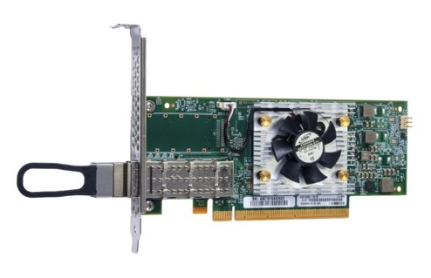
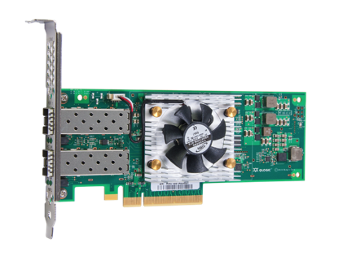


Cavium QLogic® FastLinQ™ Ethernet NICs
100GbE Intelligent Adapter
Direct Attach Copper
SR Optical
40GbE Intelligent Adapter
Direct Attach Copper
SR Optical
25GbE Intelligent Adapter
Direct Attach Copper
Active Optic Cables
10GbE Intelligent Adapter
10GBASE-T
DAC and SR
10GbE CNA
Direct Attach Copper
SR Optical
QL45611HLCU
QL45412HLCU
QL45212HLCU
QLE340X
QLE840X
Ports
1 | 2
√
Ports
1 | 2
√ | √
Ports
1 | 2
√ | √
Ports
1 | 2
√ | √
Ports
1 | 2
√ | √

Slide 56

Cavium QLogic Ethernet in Windows Server 2016
RoCE, RoCEv2, iWARP - Leverage and Scale Windows Server 2016 SMB Direct, Live Migration over RDMA
Converged NIC – Concurrent RDMA and Hyper-V support with Switch Embedded Teaming (SET)
New Ethernet Speeds: 10/25/40/50/100GbE Connectivity options enable highly available and scalable software-defined storage (SDS)
Scalable RDMA: Accelerate Storage Spaces and Storage Spaces Direct (S2D)
Scalable
Hyper-Convergence
Universal
RDMA
Virtualization
Optimized
Offloads
VXLAN and NVGRE Offload: Optimize Hyper-V Network Virtualization (HNV2) to scale the hybrid Cloud
iSCSI and FCoE Offloads: High performance storage without CPU burden
VMMQ: Accelerate Virtual Machine Networking Traffic
NIC Switch: Offload Virtual Switching w/o SR-IOV
SR-IOV – Direct access from VMs to NIC

Slide 57
VMQ to VMMQ Evolution Demo
Cavium/QLogic

Slide 58
Converged NIC
It’s about cost savings and ease of management
    Reduce by half the number of required NIC ports in the host
    Reduce by half the number of required switch ports in the rack
Enable the host vNICs to expose RDMA to the host
Manage bandwidth cooperatively with the vSwitch
So what really changed?

Slide 59
Converged NIC – the way we were
VM Storage
VM Storage
Host
partition
VM
VM
VM
Host partition
VM
VM
VM
Live Migration
Live Migration
SMB
SMB
Mgmt
Management/
Cluster
TCP/IP
Other Stuff
RDMA
vmNIC
vmNIC
Other Stuff
vmNIC
vmNIC
vmNIC
vmNIC
SMB Multichannel & SMB Direct
Hyper-V Switch
Hyper-V Switch (SDN)
NIC Team
With embedded teaming
NIC
NIC
NIC
NIC
NIC
NIC
DCB
DCB
DCB
DCB
Windows Server 2012 R2
Windows Server 2016

Slide 60
Converged NIC – the new way
VM Storage
VM Storage
Host
partition
VM
VM
VM
Host partition
VM
VM
VM
Live Migration
Live Migration
SMB
SMB
Mgmt
Management/
Cluster
TCP/IP
vmNIC
vmNIC
Other Stuff
RDMA
vmNIC
vmNIC
vmNIC
Other Stuff
vmNIC
SMB Multichannel & SMB Direct
Hyper-V Switch
Hyper-V Switch (SDN)
NIC Team
With embedded teaming
NIC
NIC
NIC
NIC
NIC
NIC
DCB
DCB
DCB
DCB
Windows Server 2012 R2
Windows Server 2016

Slide 61
Converged NIC – Bandwidth management
RDMA uses one traffic class (could use more)
vSwitch traffic uses one traffic class, the default class TC0 (by default – may use more)
vSwitch is aware of the bandwidth reservations of non-default traffic classes
SDN QoS manages the default class vSwitch traffic within the default class bandwidth
Bandwidth
managed per VM
SDN QoS
Normal VM traffic
Special, e.g., cluster traffic
RDMA
TC=0
3
7
Bandwidth on the wire
managed through DCB

Slide 62
Client RDMA
Windows 10 workstations get SMB-Direct
RDMA performance for
Large data sets
Video editing
CAD/CAM drawings
Any data that needs to get moved between a file server and the workstation

Slide 63
Why does the networking team like iWARP?
Perf
Uses existing infrastructure
Simple setup
Inexpensive
Stable - IETF 15 years iWARP, 45 years TCP
Scalable
Naturally long haul

Slide 64
Client RDMA
Demo introduction
Bob Dugan, Chelsio

Slide 65

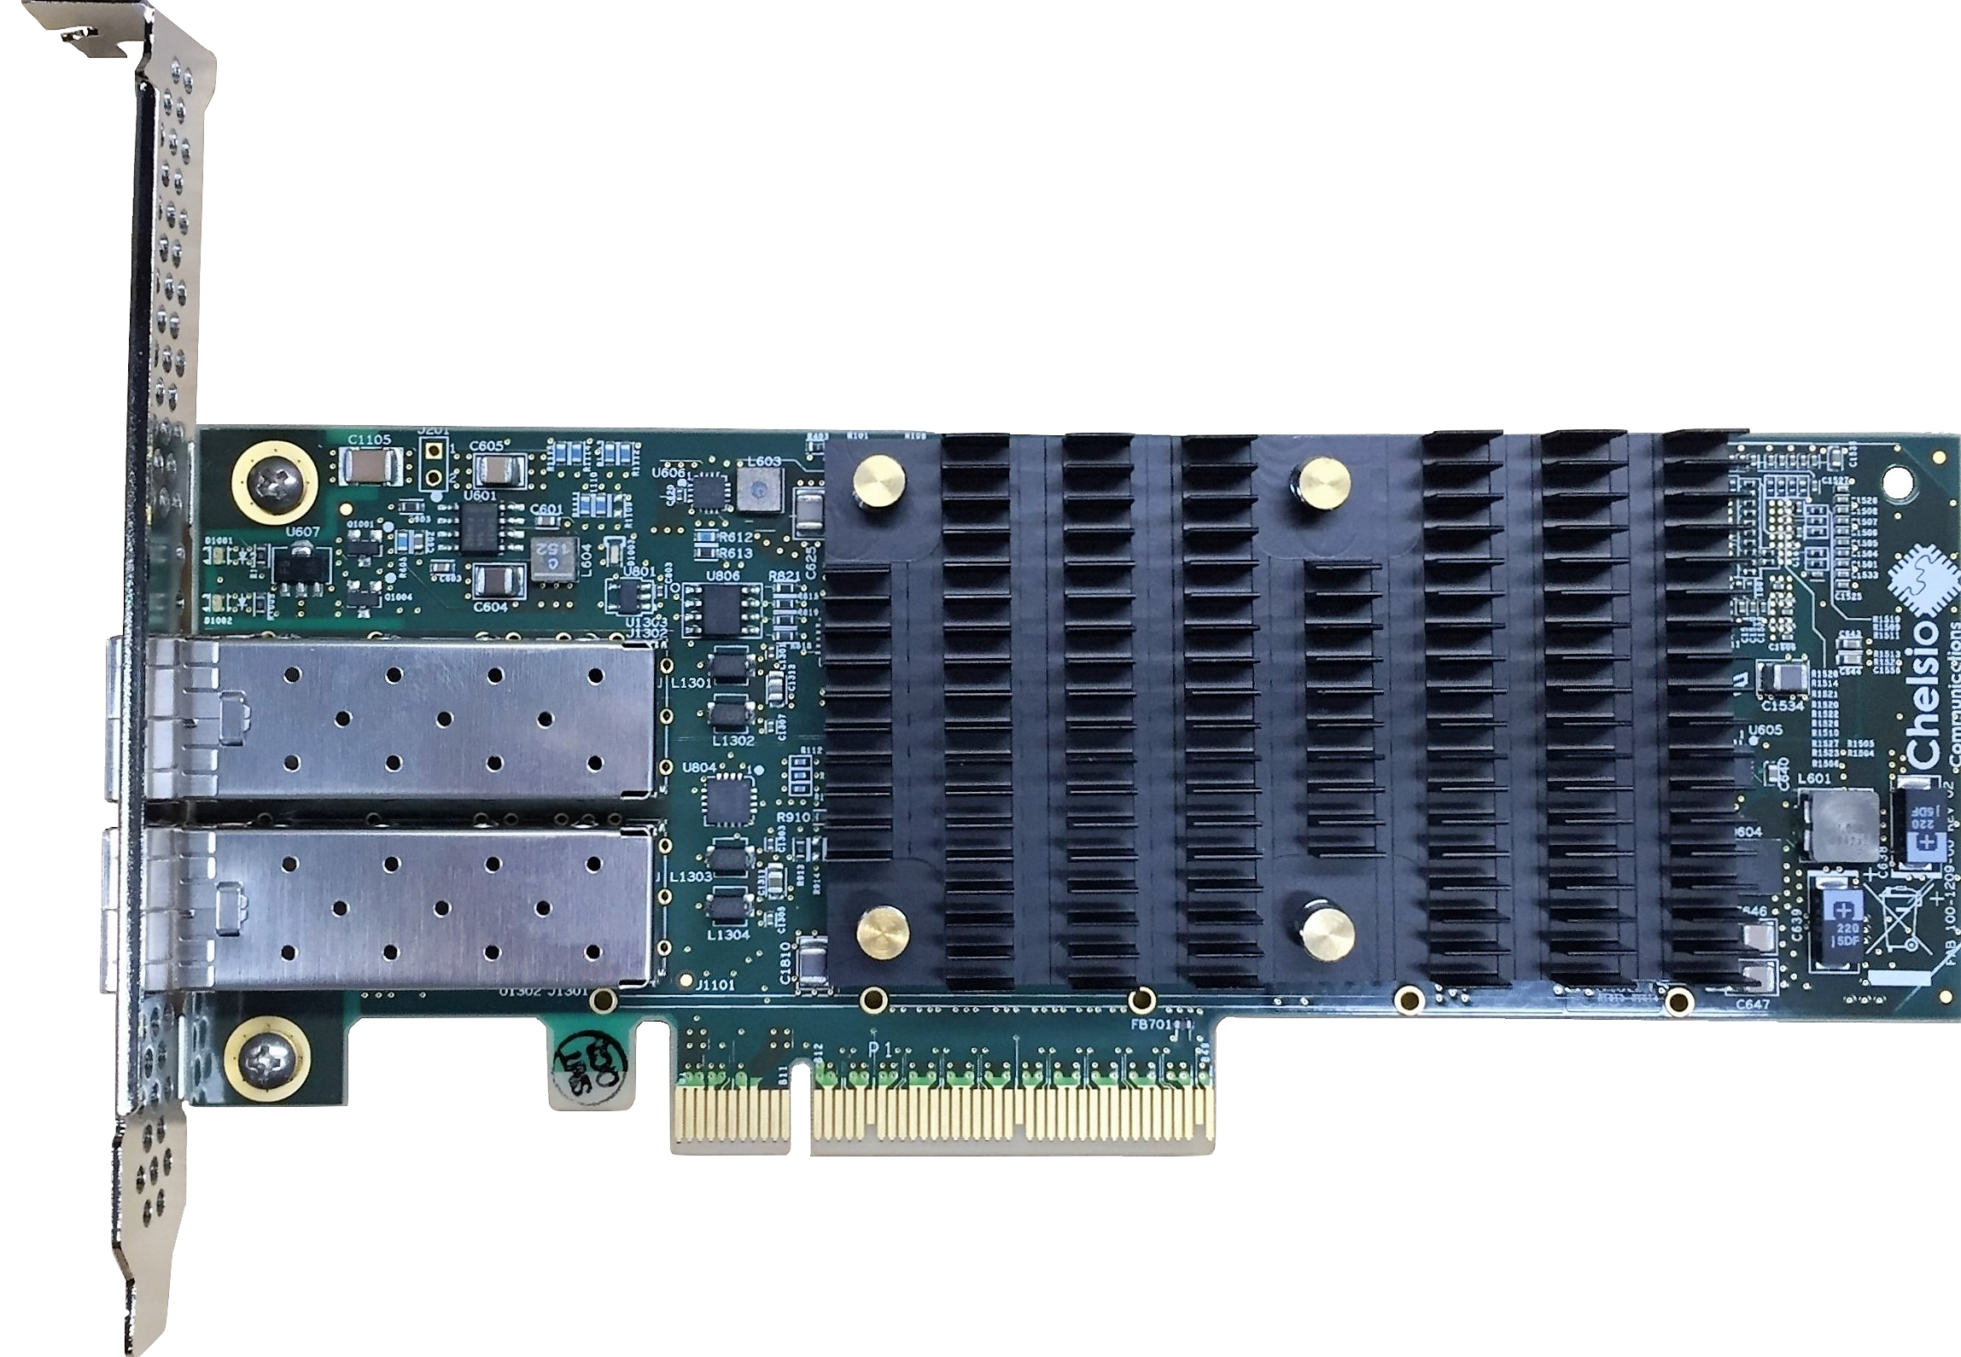
Leading Unified Wire™ Architecture
Converged Network Architecture with all-in-one Adapter and Software
Networking
Storage
Virtualization
10/25/40/50/100 GbE speeds
Full Protocol Offload
Data Center Bridging
Hardware Firewall
Wire Analytics
DPDK/Netmap
NVMe/Fabrics
SMB Direct
iSCSI and FCoE with T10-DIX
iSER and NFS over RDMA
pNFS (NFS 4.1) and Lustre
NAS Offload
Diskless boot
Replication and failover
Hypervisor offload
SR-IOV with embedded VEB
VEPA, VN-TAGs
VXLAN/NVGRE
NFV and SDN
OpenStack storage
Hadoop RDMA
Media Streaming
HPC
Traffic Management
Video segmentation Offload
Large stream capacity
iWARP RDMA over Ethernet
GPUDirect RDMA
Lustre RDMA
pNFS (NFS 4.1)
OpenMPI & MVAPICH
HFT
Encryption
WireDirect Technology
Ultra low latency
Highest messages/sec
Wire rate classification
IPsec/TLS/SSL Offload
SMB Direct AES Offload
Chelsio Unified Adapter
10/25/40/50/100 GbE
Single Qualification – Single SKU, Single FW
Concurrent Multi-Protocol Operation

Slide 66
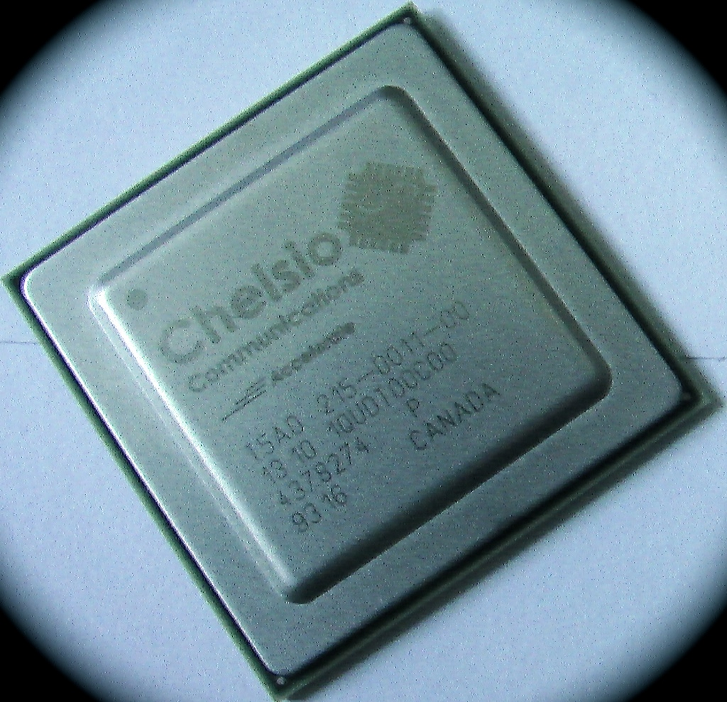
T6 ASIC Features
Chelsio’s T6 ASIC Provides
Two 10/25/40/50/100 Gb Ports
On-board Offload Crypto Engine
Ultra low latency and high IOPS
PCIe Gen3 x16
And much more..

Slide 67
Client RDMA
Demo
Bob Dugan, Chelsio

Slide 68
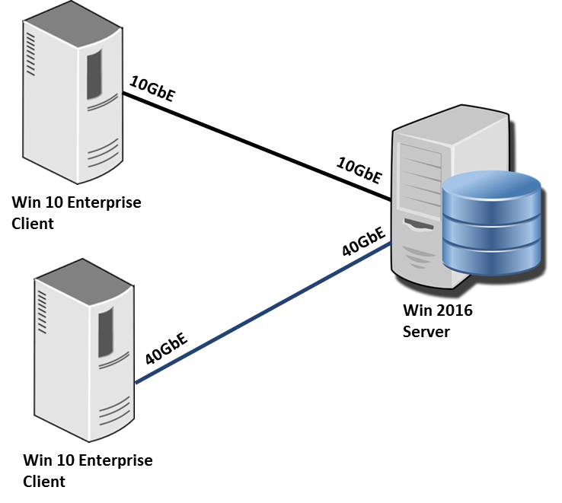
Client RDMA Demo Configuration
Using 10/40GbE iWARP (TCP/RDMA)

Slide 69
SDN QoS
A more reliable, more performant replacement for vmQoS
Compatible with RDMA work loads
Compatible with DCB
Handles
    Outbound reservations (minimum guaranteed bandwidth)
    Outbound limits (maximum permitted bandwidth)
    Inbound limits (maximum permitted bandwidth)
Works well even with very different policies for different VMs
Works on all vmSwitch ports (host or guest)
Managed by NC

Slide 70
SDN QoS Demo
Don Stanwyck, Microsoft

Slide 71
Switch Embedded Teaming (SET)
NIC Teaming isn’t going away
    But it isn’t compatible with the SDN switch extension
Long-term direction is to integrate full teaming functionality into the Hyper-V Switch
WS2016 is the v1 edition of integrated teaming
    Focused on the needs of the SDN Extension and Converged NIC
Has a number of limitations/restrictions in order to focus on doing the right things right

Slide 72
Switch Embedded Teaming (SET)
What it does:
    Switch independent teaming
    Dynamic or HyperVPort modes of load distribution
    RDMA/DCB aware
    SR-IOV teaming
    Teams of up to 8 ports
The limitations:
    All team members must be identical make/model/driver/features
    No LACP
    No Active/Passive teaming

Slide 73
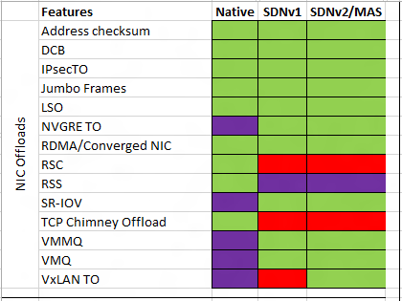
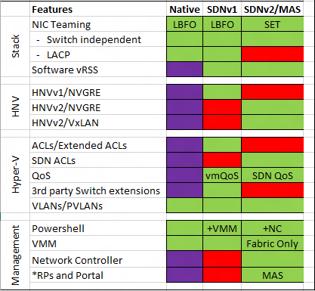
Which features in which technology?

Slide 74
Windows Server 2016 Time Improvements
Paul Long

Slide 75
Why Accurate Time Matters…
Financial and Banking
Regulations
UTC Time Accuracy
  EU - 1 ms
  US – 50 ms
UTC Traceability
Was your time accurate in the past?

Slide 76
Why Accurate Time Matters…
Information Technologies
Kerberos and DHCP
Cryptography Algorithms
Cluster/SQL/Exchange
AD Replication
Troubleshooting with Distributed Traces and Logs

Slide 77
Why Accurate Time Matters…
Manufacturing
Plant Monitoring and Diagnosis

Slide 78
Why Accurate Time Matters…
Healthcare
Medical Monitoring Systems
Government Compliance

Slide 79
Why Accurate Time Matters…
Retail
Credit Payment Industry
Online Sales

Slide 80
Why Accurate Time Matters…
Other
Document Sharing
Distributed Systems
Blockchain – bitcoin

Slide 81
Windows Server 2016 Time Improvements
Latest Generation NTP time synchronization
Better statistical processing
Improved error correction
Distribution of Precision Time in VM Guests
90μs skew/100μs RMS under load
Better Monitoring
New Performance Monitor Counters
Remote Monitoring
New version of VMIC protocol
Determine Accuracy
Transparent Stratum
500μs skew/200μs RMS

Slide 82

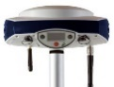

Windows Server 2016 Time Topology
Hex boxes represent accuracy compared to master clock
GPS
Stratum 0
PCIe
5us skew
10us RMS
VM can be DCs for the Host Partition OS, this can cause loops
WS2016
Time Master
NTP
500us skew
250us RMS
50 us skew
10us RMS
WS2016 Domain Member/Hyper-V Host
N Hops
WS2016 DC
OR
Non Domain Windows Client
500us skew
250us RMS
MS-NTP
Host Partition
WS1-VM
NTP
VMIC BUS
WS*-VM
N > 0,
N Affects Accuracy
*nix1-VM
520us skew
270us RMS
Hypervisor is just another VM; VMs get time sliced.

Slide 83
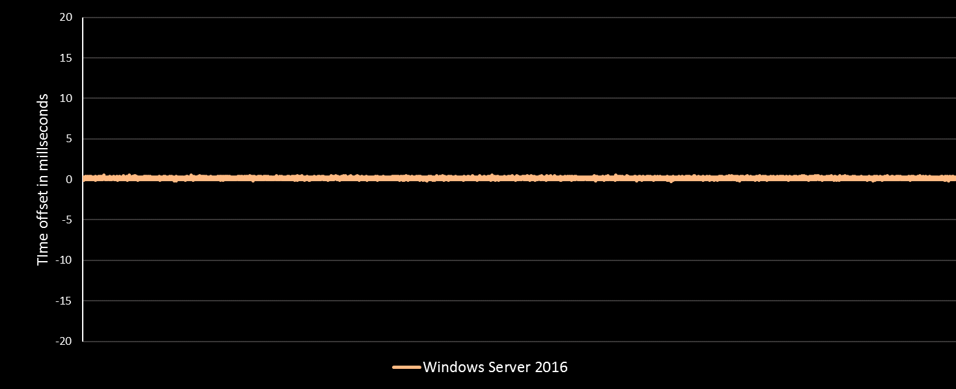
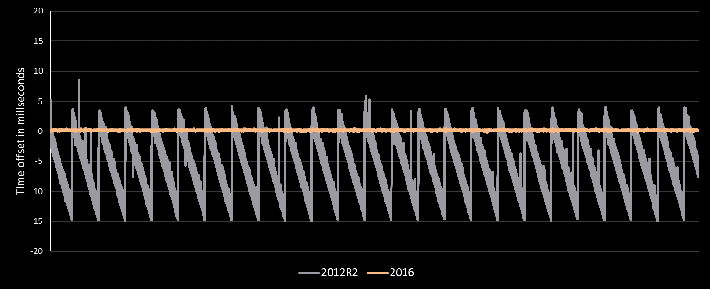
1ms Accuracy with Windows 2016
1 millisecond
regulatory requirement

Slide 84
More Information
Windows 2016 Accurate Time - aka.ms/WS2016Time
Windows Time Video – aka.ms/WS2016TimeVideo
W32Time Blog – blogs.msdn.com/W32Time
Contact PaulLo@Microsoft.com

Slide 85
Free IT Pro resources
To advance your career in cloud technology
Plan your
career path
Cloud role mapping
Expert advice on skills needed
Self-paced curriculum by cloud role
$300 Azure credits and extended trials
Pluralsight 3 month subscription (10 courses)
Phone support incident
Weekly short videos and insights from Microsoft’s leaders and engineers
Connect with community of peers and Microsoft experts
Microsoft IT Pro Career Center
www.microsoft.com/itprocareercenter
Get started
with Azure
Microsoft IT Pro Cloud Essentials
www.microsoft.com/itprocloudessentials
Demos and
how-to videos
Microsoft Mechanics
www.microsoft.com/mechanics
Connect with peers and experts
Microsoft Tech Community
https://techcommunity.microsoft.com

Slide 86


Please evaluate this session
Your feedback is important to us!
From your PC or Tablet visit MyIgnite at http://myignite.microsoft.com
From your phone download and use the Ignite Mobile App by scanning the QR code above or visiting https://aka.ms/ignite.mobileapp

Slide 87
Related sessions
1
Deploy Complex Workloads with Azure Agility: From Zero to SDN in 60 Minutes – Tuesday, 9/27 @ 10:45
2
Explore Windows Server 2016 Software Defined Datacenter – Tuesday, 9/27 @ 9:00
3
Microsegment and secure your networks with Azure Inspired SDN – Thursday, 9/29 @ 2:15
HOL: SDN Fabric (Network Controller, SLB Gateways) and Tenant Operations
Windows Server 2016
Windows Server + System Center
session guide: aka.ms/WS2016Ignite

