Slide 1
Speed up your Dynamics AX code upgrade: tips to stay continually current
BRK3174
Tariq Bell
Senior Program Manager

Slide 2
Why should I stay current?
Preventative Maintenance
vs.
Reactive Maintenance
More reliable
More secure
More performant

Slide 3
Agenda
Preparation
Get custom code into shape
Execution
Test the upgrade & merge code
Deployment
Roll out the upgrade

Slide 4
Preparation

Slide 5
Preparation
Write custom code right
Build this into your approach
Customisations are a big factor
Use extension paradigm
Minimise overlayers

Slide 6
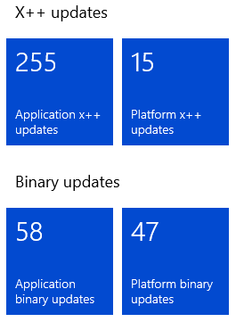
Preparation
Two types of update:
Platform
Binaries or Platform, Foundation & Test Essentials X++ packages
Application
Binaries or Application suite and all other X++ packages

Slide 7
Preparation – Platform updates
Remove overlayers
Enjoy hassle free platform updates!
Platform update will never modify existing API/contract/App functionality
Enjoy hassle free platform updates!

Slide 8
Preparation – Application updates
Reduce overlayers
Application update could change existing behaviour/API/contact
Utilise Code Upgrade Tool in LCS

Slide 9
Preparation – remove/reduce overlayers
Less work for updates – every update
Evolve approach to extension paradigm
Only overlayer to add delegates
Then add logic in event handler

Slide 10
Execution

Slide 11
Execution
Process overview: Application
Evaluate code impact
Perform code upgrade
Perform data upgrade
Deploy &
Validate results
Deploy packages to sandbox environment
User testing
Assess effort using Code Upgrade tool
Plan schedule and window
Coordinate with 3rd party solution owners
Deploy the DataUpgrade package
Address errors
Create custom scripts
Code upgrade tool creates branch & work items
Merge/adjust custom code

Slide 12
Execution
Process overview: Platform
Continuous update of
platform coming…
Perform data upgrade
Deploy &
Validate results
Deploy packages to sandbox environment
User testing
Deploy the DataUpgrade package
Address errors
Create custom scripts

Slide 13
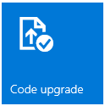
Execution - Code upgrade tool
How it works?
Microsoft Developer writes a code change
They also write a “Detector” script for the upgrade tool
Optionally they write a “Fixer” script for the upgrade tool

Slide 14
Execution - Code upgrade tool
Converts objects to metadata extensions
Fixes code where used-method changes
Fixes code where method signature changes
Fixes code where decorated attribute changes
Registers a conflict on objects that can’t be auto-fixed

Slide 15
Demo
Code upgrade tool

Slide 16
Deployment

Slide 17
Deployment
For developer environments, example:
Number of developer environments on RTW
Upgrading to May Release
RTW
May Release

Slide 18
Deployment
For developer environments, example:
Deploy new dev machine
Code upgrade tool to VSTS
Synch to VSTS
Fix/merge
Code upgrade complete
Deploy other dev machine
Synch to VSTS
Developer environment upgrades complete

Slide 19
Deployment
Advantages of redeploying are:
Machines are updated e.g. SQL 2016 RTM
Developer’s time is protected
Developer environments remain identical

Slide 20
Deployment
For Microsoft-managed environments:
Provide the finished packages
Arrange the downtime window
Microsoft deploy for you

Slide 21
Questions?

Slide 22
Additional references
Upgrade home page
https://ax.help.dynamics.com/en/wiki/upgrading-home-page/
Customising using extensions
https://ax.help.dynamics.com/en/wiki/technical-concepts-guide/#customizing-with-extensions-and-overlayering
Servicing environments
https://ax.help.dynamics.com/en/wiki/technical-concepts-guide/#servicing-environments

Slide 23
Related sessions
BRK3168 How to operate and service the Microsoft Dynamics AX Cloud
Robert Badawy, Clay Wesener
BRK4024 Develop, build, test and deploy your Dynamics AX applications
Robert Badawy

Slide 24
Free IT Pro resources To advance your career in cloud technology
Plan your career path
Cloud role mapping
Expert advice on skills needed
Self-paced curriculum by cloud role
$300 Azure credits and extended trials
Pluralsight 3 month subscription (10 courses)
Phone support incident
Weekly short videos and insights from Microsoft’s leaders and engineers
Connect with community of peers and Microsoft experts
Microsoft IT Pro Career Center
www.microsoft.com/itprocareercenter
Get started with Azure
Microsoft IT Pro Cloud Essentials
www.microsoft.com/itprocloudessentials
Demos and how-to videos
Microsoft Mechanics
www.microsoft.com/mechanics
Connect with peers and experts
Microsoft Tech Community
https://techcommunity.microsoft.com

Slide 25
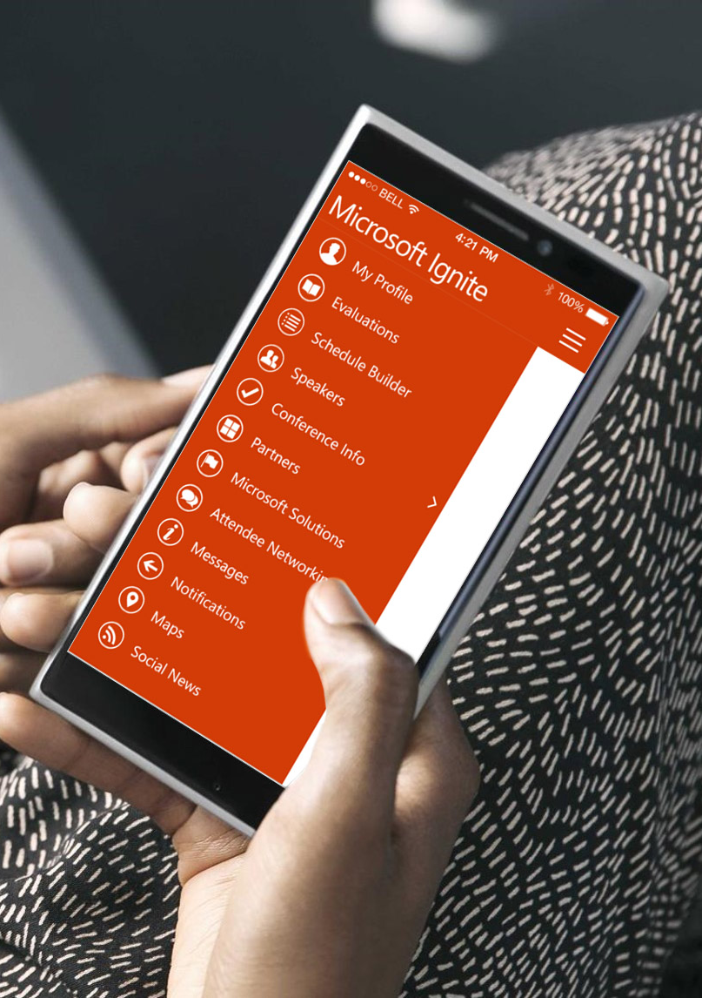
Please evaluate this session
Your feedback is important to us!
From your PC or Tablet visit MyIgnite at http://myignite.microsoft.com
From your phone download and use the Ignite Mobile App by scanning the QR code above or visiting https://aka.ms/ignite.mobileapp

