Slide 1
Automate tasks and gain efficiency for your hybrid environment
BRK3164
Chris Sanders and Jenny Hunter
Program Managers

Slide 2
Introduction to Automation

Slide 3

Azure Automation value
A platform for automating management of resources and apps
Azure, any cloud, and on-premises
Process and configuration automation (runbooks, DSC)
Change tracking and Update management
Windows and Linux
Eliminate time consuming, error prone, and repetitive tasks
Save time while lowering overhead costs
Deliver more reliable services, faster
Integrate with the services you depend on
Get easier configuration management with DSC
Manage system changes and updates

Slide 4
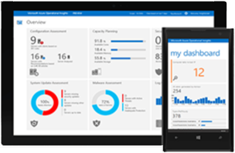
Operations Management and Security
Insight & Analytics
Gain visibility across workloads
Automation & Control
Enable consistent control and compliance
Security & Compliance
Respond faster to security threats
On-premises datacenter
Public and hosted clouds
Azure or AWS
Protection & Recovery
Ensure availability of apps and data

Slide 5

Automation & Control
Key Features
Manage any cloud & on premises
Process Automation
Configuration Management
Update Management
Windows & Linux
Process Automation
Author PowerShell, PowerShell workflow, Graphical runbooks
Hybrid Runbook Workers with Proxy support
Update Management
Insights across Windows & Linux
Orchestrated updates and troubleshooting
Configuration Management
DSC Configurations, Pull service
Node Management & Reporting
Change tracking
Easy Onboarding
RunAs account for Azure management
Gallery of runbooks and modules from Microsoft and community
Shared capabilities across features
Role Based Access Control
Secure, global store for variables, credentials, certificates, connections
Schedules
Modules
Source control support
Auditing
Tags
Integration
Full SDK with PowerShell, .Net, and REST
Webhooks to start runbook remotely
ITSM support
OMS
AWS & Service Providers
Azure
Automation & Control
Hybrid Worker
On-Premises
Hyper-V
VMWare
OpenStack
Reliable, highly available, scalable
Hybrid management Integrate existing systems

Slide 6

Automation & Control Scenarios
Build
Create VMs and Cloud infrastructure
Integrate into Dev tools
Configure
Update management
Configure cloud and VMs per application
Monitor
Identify changes causing issues
Integrate into ITSM solutions on Alerts
Protect
Recover application / VM from backup
Secure
Quarantine VM if exploited
Govern
Set up RBAC per user / group
Integrate into Site Recovery for fail over
Set policy for infrastructure and app
Recover unused resources
GOVERN
BUILD
Automation & Control
SECURE
CONFIG
PROTECT
MONITOR

Slide 7
Process, Configuration, & Update Automation
Automate management tasks with runbooks
Let runbooks handle the creation, deployment, monitoring, and maintenance of Azure resources and third-party applications.
Assure OS Configuration with PowerShell DSC
Consistently deploy, reliably monitor, and automatically update the desired state of your VMs
Pull service, Node Management, Reporting
Change Tracking
Identify software, file, registry, and service changes in your environment to help pinpoint operational issues.
Unified update management
Patch Insights – before, during, after, reliability, coordination
Patch Orchestration – sequencing, pre & post steps

Slide 8
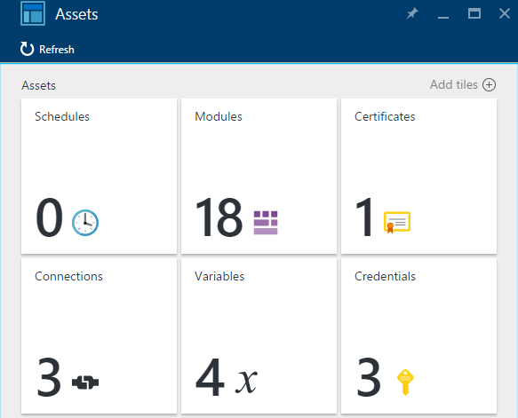
Assets
Secure, global store
  Variables
  Credentials
  Connections
  Certificates
  Modules
  Schedules
Reuse across runbooks
  Manage in a central location (create/edit/delete)
  Use within runbooks (e.g., Get-AutomationCredential)
  Secrets encrypted
  Automatic encryption (e.g., credential password)
  User-selected encryption (e.g., my encrypted variable)

Slide 9
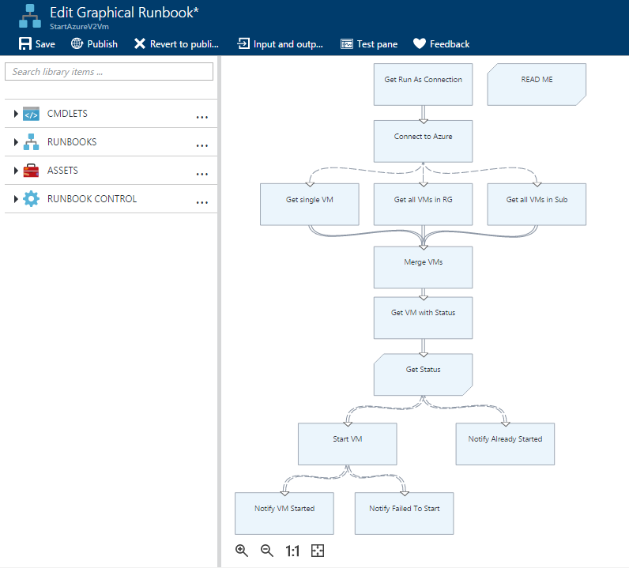
Runbooks and Authoring
Runbooks
  PowerShell
  Graphical
  PowerShell Workflow (textual and graphical)
  Bash, Python (2, 3) – coming soon
Authoring
  Textual and Graphical authoring/testing within the Automation service
  On-premises textual authoring with PowerShell ISE add-on

Slide 10
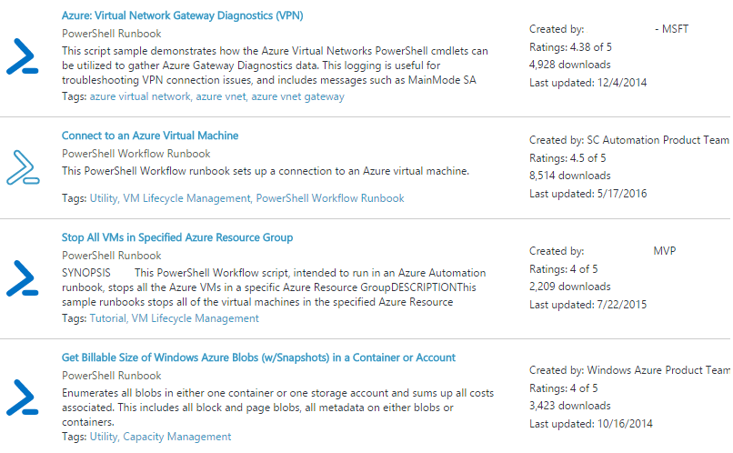
Integration & Hybrid
Integration Modules
PowerShell modules available to integrate with most important systems
Leverage existing PowerShell modules for Microsoft and 3rd-party systems
Create your own PowerShell modules to integrate with additional systems
Gallery
Public gallery of Microsoft and customer runbooks for common tasks
Get started automating quickly
Hybrid Runbook Workers
Run runbooks directly in your VMs – Azure-based, other cloud, or on-premises

Slide 11
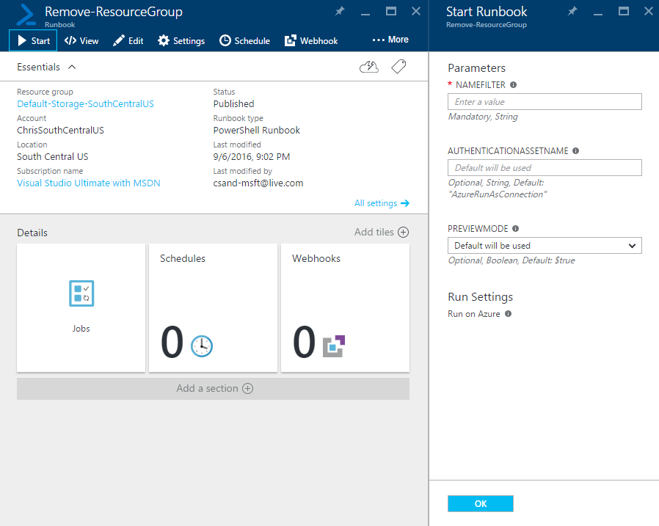
Execute Runbooks
UX
  Manually kick off workflows
Schedule
  Perform tasks on recurring schedules
Webhook
Start runbook from other services
(ITSM, GitHub, …)
REST API
Integrate from 3rd-party systems / web portals
PowerShell Module
AzureRm.Automation

Slide 12
Run As accounts
Easily authenticate to manage Azure resources
  Get started quickly.
  When you create a new Automation account you can have Run As accounts created too.
  Soon from the UX you will be able to manage creation and deletion of Run As accounts.
Azure Run As
  Service principal with certificate
  Contributor role
  Manage ARM resources from runbooks
  Assets: AzureRunAsCertificate, AzureRunAsConnection
Azure Classic Run As
  Certificate
  Manage ASC resources from runbooks
  Assets: AzureClassicRunAsCertificate, AzureClassicRunAsConnection

Slide 13
Demo: Automation Onboarding and Introduction
Chris

Slide 14
Scheduling

Slide 15
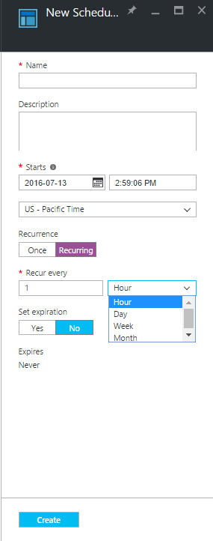
Automation Scheduling
  Take control of your automated resource management with scheduling
  Configure, start, stop, and manage resources even when you aren’t there
  Previously, scheduling offered daily and hourly schedules
  New Features:
  Weekly – day of week
  Monthly – days of the month
  Time zone support – allows adjustment for daylight savings

Slide 16
Gallery

Slide 17
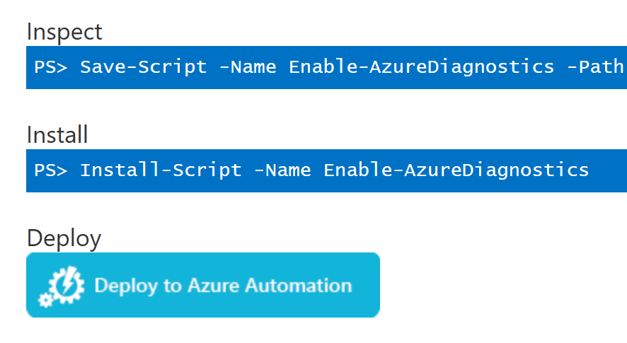
New Gallery features
Find Microsoft & community examples that you can use to get started on new Automation tasks
Automation runbook gallery
  PowerShell Gallery support
  Additional filtering capabilities
Import modules from
PowerShell Gallery
  Browse from Automation
  Improved deployment from PowerShell Gallery
More Gallery runbooks
  We and the community continue to add useful runbooks to the gallery

Slide 18
Hybrid Runbook Workers

Slide 19

Public clouds
Hybrid Automation Overview
AWS
Service Providers
Other clouds
Automation
Azure resources
Runbooks delivered to on-premises machines
Enterprise
Private clouds
Hyper-V
VMWare
OpenStack
Heterogeneous (e.g. Linux)
And many more…
Other providers
Automation Hybrid Runbook Workers

Slide 20
Hybrid Runbook Workers
What is a hybrid runbook worker?
  Hybrid Runbook Workers in Automation allow you to run runbooks on machines located in your data center in order to manage local resources
  Runbooks are stored and managed in Azure Automation and delivered to one or more on-premises machines where they are run
Why use a hybrid runbook worker?
  Allows for management of on-premises resources from Azure Automation
  Removes the need to deploy, maintain and upgrade an Azure Pack / SMA environment
How do you use a hybrid runbook worker?
  Install and configure Hybrid Runbook Worker(s)
  When starting a runbook, select the hybrid runbook worker group to run the runbook

Slide 21
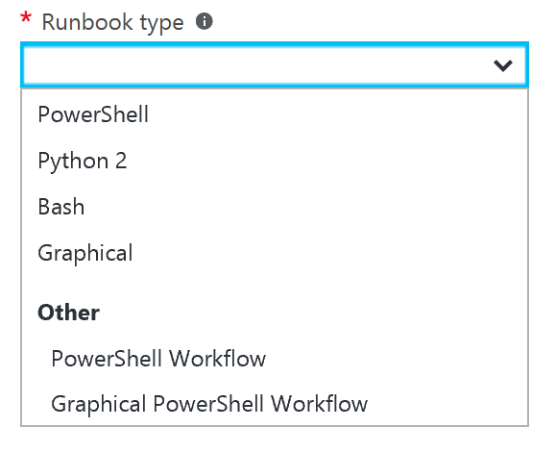
Coming Soon
Linux Hybrid Workers
  Run runbooks on your local Linux machines
Python & Bash Runbooks for Linux
  Manage Linux machines through the use of Python and Bash runbooks
  Utilize the same portal experience to manage runbooks
  You can request to join the private preview cohort for this
  and other OMS features at aka.ms/myoms.

Slide 22
Demo: Schedules, Gallery, Hybrid Runbook Workers
Jenny

Slide 23
Enterprise example: Continuous Deployment Orchestration

Slide 24
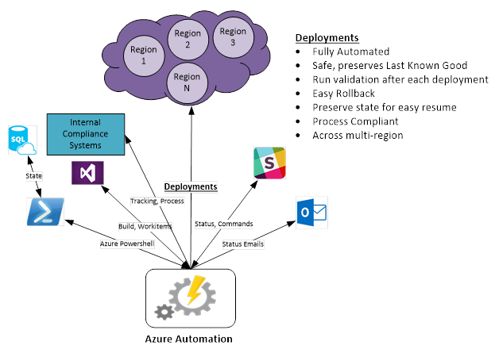
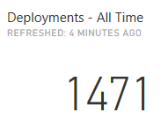
Automation service uses Automation
  Continuous deployment
  Orchestrate the deployment of services and databases, configure monitoring and alerting across different Azure regions.
  Handle complex orchestration reliably and in compliant manner.
  What’s in the solution
  Powershell scripts and workflows
  Azure modules
  Scheduling, Webhooks
  Hybrid runbook workers
  Assets (Credentials, Variables, …)
  Service Principals and RBAC
  Azure SQL DB
  Integration with Slack, TFS, email, compliance systems
  Free up staff for work that increases business value

Slide 25
Authoring

Slide 26
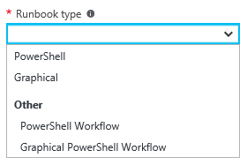
Authoring updates
Graphical runbooks
  New type of graphical runbook based on native PowerShell
  Improvements to graphical authoring and runbook capabilities
PowerShell ISE add-on
  Author textual runbooks (PowerShell, PowerShell Workflow)
  Continued improvements in response to feedback
Start-AzureRmAutomationRunbook cmdlet
  Added –Wait and –MaxWaitSeconds parameters
  Parent runbook can now wait for child runbook to finish and send back output
  Enables any runbook type to call any runbook type and get back results
More Gallery runbooks
  We and the community continue to add useful runbooks to the gallery

Slide 27
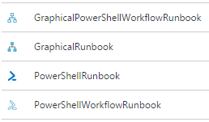
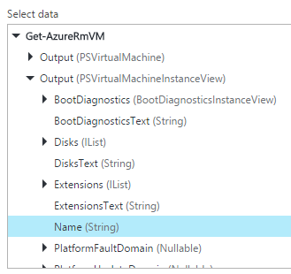
Graphical authoring updates
Graphical PowerShell runbook
  New type of graphical runbook based on native PowerShell
  All advantages of native PowerShell over PowerShell Workflow
  Starts fast, full objects, simpler authoring
Graphical authoring improvements
  Object output properties available at design time
  Error links & convert exception to error
  Canvas restyle for readability
  Warnings for common design requirements
Graphical runbook SDK update
  Release latest version of the public-preview SDK

Slide 28
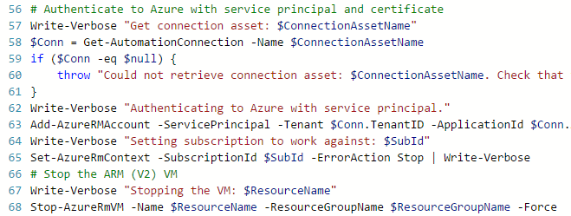
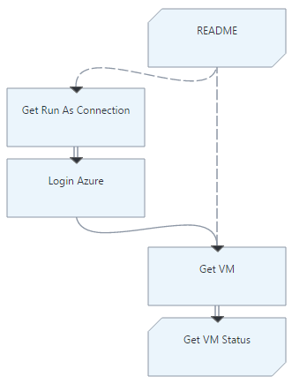
Uses for different runbook types
  Textual runbooks
  Distinct programming model
  Script authoring model
  Lower-level language, so more versatile
  Can use existing scripts
  Familiar to PowerShell (Python, Bash) users
  Designer is cloud based or client (ISE)
  Graphical runbooks
  Distinct programming model
  Visual insert-link-configure authoring model
  Focus on how data flows through the process
  Can visualize IT processes and systems affected
  Higher-level language, can increase productivity
  Include PowerShell script as needed
  Encourages modular programming
  Designer is cloud based

Slide 29
Demo: Authoring
Chris

Slide 30
Integration: Automation logs in OMS

Slide 31
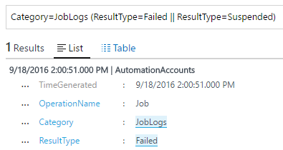
Automation logs in OMS
Log Types
  Job Status (e.g., Completed, Failed, Suspended)
  Job Streams (e.g., Output, Verbose, Error, Warning)
Scenarios in OMS
  Get insight into aggregate of your Automation jobs (single or multiple accounts)
  Set up alerts for failed or suspended jobs
  Find completed jobs that had non-terminating errors
  Write advanced queries over your job streams and accounts (use streams to send diagnostic info)
  Visualize job history over time
  Enable
  How To: https://azure.microsoft.com/en-us/documentation/articles/automation-manage-send-joblogs-log-analytics/
  Script: https://www.powershellgallery.com/packages/Enable-AzureDiagnostics/1.0/DisplayScript
  Blog: https://azure.microsoft.com/en-us/updates/send-your-runbook-job-status-and-job-streams-from-automation-to-log-analytics-oms/

Slide 32
Integration: Remediate OMS Alert with Automation Runbook

Slide 33
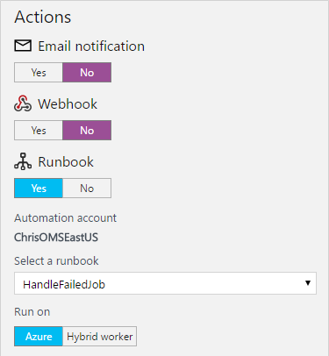
Remediate OMS alert with Automation
Automate IT Management
  Logs ingested by OMS from managed systems
  Log search to monitor system state information
  Alert triggered when issue found in search
  Start runbook from alert and pass search results
  Runbook performs reporting, troubleshooting, remediation

Slide 34
Integration: Take Action Now on OMS search result with Automation Runbook

Slide 35
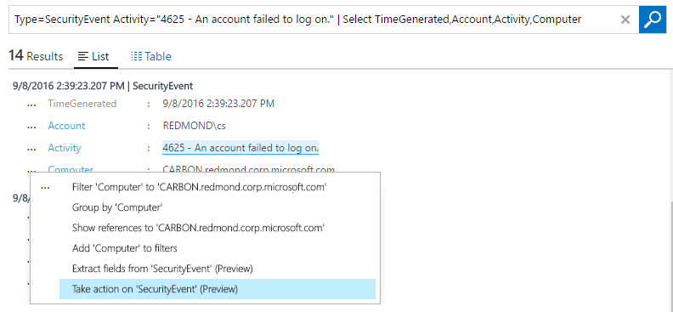
Take Action in OMS to remediate issue now
Start a runbook now from log search result
  Logs ingested by OMS from managed systems
  Operator runs log search, and based on results decides to take action
  Selects a runbook to run and sets input parameters from search result fields
  Runbook performs reporting, troubleshooting, remediation, etc.

Slide 36
Real-world example – MSIT IoT management
  Unified Real-time Monitoring, Alerting, Diagnostics and Corrective actions of IoT devices
  Goal: manage all of the devices in all Microsoft meeting rooms around the world
  How: use OMS Log Analytics, OMS Automation and Azure IoT Suite
  What is the challenge?
  Huge challenge to manage large number of different devices in thousands of conference rooms
  Phones, screens, conference devices, etc. (5+ in each room)
  Run various OS, talk various protocols, emit various levels of instrumentation with various schemas
  Solution
  Unify the date pipeline -> all data from all devices into OMS
  Unify real-time monitoring, alerting and diagnostic to single pane of glass -> OMS Log Analytics
  Unify corrective actions -> OMS Automation for operator-assisted and fully-automated corrective actions

Slide 37

Hybrid scenario
OMS
Log Search
Alert
Azure
Handle Alert Runbook
webhook
Azure Automation
logs
On-premises machine
MMA agent
Services
Restart Service Runbook
Hybrid runbook worker

Slide 38
Demo: OMS Alert Remediation & Take Action Now
Chris

Slide 39
Watchers (coming soon)

Slide 40
Watchers
Well-known paradigm: event-driven automation
System Center Orchestrator (SCO)
AWS Lambda
StackStorm
IFTTT
  Monitor then take action
  Watcher runbook
  Runs on periodic schedule, 24x7
  Has code to interrogate some system on-premises or in cloud
  Runs only on hybrid runbook worker for now (watcher jobs are free)
  Action runbook
  Kicked off when watcher returns event
  Performs work in response to the event
  Runs in Azure or on hybrid runbook worker

Slide 41
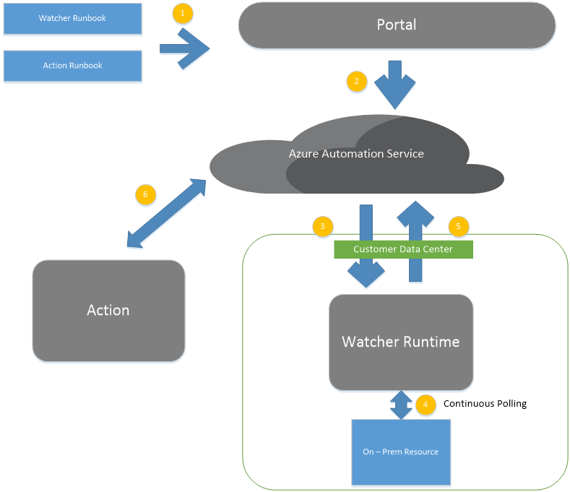

Slide 42
Demo: Watchers
Chris

Slide 43
Thank you!

Slide 44
Operations Management Suite Sessions at #MSIgnite
Day | Time | Code | Room | Title | Focus Topics
Monday | 2:15-3:30 | BRK1017 | C202-204 | Take your management and security strategy to the cloud with Operations Management Suite (OMS) | Top-line breakout
Tuesday | 9:00-9:45 | BRK2198 | B206 | Protect your data with a modern backup, archive and disaster recovery solution | Protection & Recovery
Tuesday | 10:45-12:00 | BRK3063 | C302 | Back up born-in-the-cloud and hybrid applications with Operations Management Suite and Azure Backup | Protection & Recovery
Tuesday | 12:30-1:45 | BRK2001 | B405-407 | Get control over your datacenter with security monitoring using Operations Management Suite | Security & Compliance
Tuesday | 11:30-12:15 | BRK1018 | C114 | Discover how Manulife and Rackspace manage their hybrid environments today | Overview
Tuesday | 12:30-1:45 | BRK2001 | B405-407 | Get control over your datacenter with security monitoring using Operations Management Suite | Security & Compliance
Tuesday | 4:00-5:15 | BRK3163 | B401-402 | Manage and troubleshoot infrastructure and application issues using Operations Management Suite | Insights & Analytics
Wednesday | 9:00-10:15 | BRK2178 | Thomas Murphy Ballroom 1 | Dive deep into Operations Management Suite for applications and infrastructure | Overview
Wednesday | 10:45-12:00 | BRK3328 | C112 | Assess security posture of your datacenter in under one hour using Operations Management Suite | Security & Compliance
Wednesday | 12:30-1:45 | BRK2181 | C202-204 | Protect every app: transform disaster recovery with Operations Management Suite | Protection & Recovery
Wednesday | 2:15-3:30 | BRK2180 | B213-B214 | Monitor Linux in any cloud with Operations Management Suite | Insights & Analytics
Wednesday | 4:40-5:15 | BRK1000 | B206 | Discover how Accenture and Time Warner manage hybrid environments today | Overview
Thursday | 9:00-10:15 | BRK3042 | C112 | Migrate and disaster recover Azure workloads using Operations Management Suite | Protection & Recovery
Thursday | 11:30am - 12:15pm | BRK2293 | C114 | Mitigate datacenter security threats with guided investigation using Operations Management Suite | Security & Compliance
Thursday | 12:30-1:45 | BRK2179 | C113 | Manage your Azure Resources at scale with Operations Management Suite | Overview
Thursday | 4:00-5:15 | BRK3164 | Sidney Marcus Auditorium | Automate tasks and gain efficiency for your hybrid environment | Automation & Control
Friday | 9:00-10:15 | BRK2095 | C112 | Uncover system and service issues of any app with Operations Management Suite | Insights & Analytics
Friday | 10:45-12:00 | BRK2091 | A411-412 | Manage updates across on-premises and clouds for Windows Server & Linux | Automation & Control
Friday | 12:30-1:45 | BRK2092 | Thomas Murphy Ballroom 2&3 | Explore configuration and change management in Operations Management Suite | Automation & Control

Slide 45
System Center sessions at #MSIgnite
Day | Time | Code | Room | Title | Focus Topics
Monday | 2:15-3:30 | BRK2204 | B312-314 | Meet Windows Server 2016 and System Center 2016! | Top-line breakout
Tuesday | 9:00-10:15 | BRK2159 | Georgia Ballroom | Take advantage of new capabilities in System Center 2016 | Top-line breakout
Tuesday | 4:00-5:15 | BRK3166 | Thomas Murphy Ballroom 2&3 | Manage your software-defined datacenter using System Center 2016 Virtual Machine Manager | System Center
Thursday | 2:15-3:30 | BRK3165 | Georgia Ballroom | Monitor your changing datacenter using Microsoft System Center 2016 Operations Manager | System Center
Management theater sessions at #MSIgnite
Day | Time | Code | Room | Title | Focus Topics
Monday | 1:00-1:20 | THR3028 |  | Build solutions with Operations Management Suite extensions and integration | OMS
Tuesday | 10:20-10:40 | THR3023 | Microsoft Theater 1 | Witness cloud attacks illustrated: insights from Operations Management Suite and Security | Security & Compliance
Wednesday | 10:20-10:40 | THR3029 | Microsoft Theater 1 | Learn lessons and notes from the field - Operations Management Suite Site Recovery and Backup | Protection & Recovery
Wednesday | 2:10-2:30 | THR3024 |  | Evolve your automation strategy with Operations Management Suite | Automation & Control
Thursday | 12:05-12:25 | THR3022 | Microsoft Theater 1 | Evolve your MP experience in System Center Operations Manager 2016 | System Center

Slide 46


Please evaluate this session
Your feedback is important to us!
From your PC or Tablet visit MyIgnite at http://myignite.microsoft.com
From your phone download and use the Ignite Mobile App by scanning the QR code above or visiting https://aka.ms/ignite.mobileapp

Slide 47
Free IT Pro resources
To advance your career in cloud technology
Plan your
career path
Cloud role mapping
Expert advice on skills needed
Self-paced curriculum by cloud role
$300 Azure credits and extended trials
Pluralsight 3 month subscription (10 courses)
Phone support incident
Weekly short videos and insights from Microsoft’s leaders and engineers
Connect with community of peers and Microsoft experts
Microsoft IT Pro Career Center
www.microsoft.com/itprocareercenter
Get started
with Azure
Microsoft IT Pro Cloud Essentials
www.microsoft.com/itprocloudessentials
Demos and
how-to videos
Microsoft Mechanics
www.microsoft.com/mechanics
Connect with peers and experts
Microsoft Tech Community
https://techcommunity.microsoft.com

