Slide 1
Manage and troubleshoot infrastructure and application issues using Operations Management Suite
BRK3163
Richard Rundle
Liz Kim
Evan Hissey
Program Managers
Microsoft

Slide 2
Insight & Analytics
Transform machine data
Gain immediate insight
Resolve incidents faster
This talk →
Automation & Control
Enable responsive IT operations
Use across on-premises and the cloud
Maintain compliant IT resources
What is Operations Management Suite
Security & Compliance
Analyze and investigate incidents
Detect threats before they happen
Streamline security audits
Protection & Recovery
Protect your critical assets wherever they are
Simplify disaster recovery across your entire environment
Free up resources on-premises with cloud backup

Slide 3
Agenda
Log Analytics overview
Ready made operational intelligence
Azure Monitoring
Collect any machine data
Correlate and visualize data
Be alerted and take action

Slide 4
What is OMS Log Analytics?
Collect, search and visualize machine data from cloud and on-premises
1
Hyper-scale machine data analytics platform
2
Provide out of the box application and workload insights
3
Robust hybrid monitoring solution
microsoft.com/oms

Slide 5
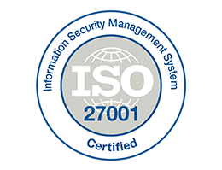
Production Ready
Global Availability
ISO 27001
SOC 1,2 Type 1
PCI-DSS
East US
West Europe
Southeast Asia
Australia Southeast
US Government
New

Slide 6
Ready Made Operational Intelligence
25+solutions available
Built by experts, including Customer Support & Services and product groups
Monday THR3028 Build solutions with Operations Management Suite extensions and integration
Infrastructure and applications
Assessments, Analytics, Monitoring
Hybrid
Heterogeneous
Wednesday 2:15-3:30 BRK2180 Monitor Linux in any cloud with Operations Management Suite
Powered by search

Slide 7
Office365 Application Insights
https://azure.microsoft.com/documentation/articles/log-analytics-add-solutions/

Slide 8
Azure Monitoring
Liz Kim

Slide 9
Pre-Ignite Azure monitoring
WAD table storage
IIS, Windows Event, ETW, Syslog
WAD blob storage
Key Vault, NSG, Application Gateway, Automation
VM agents
Linux and Windows
Solutions
Service Fabric, Key Vault, Azure Network Analytics, Automation

Slide 10
Platform data ingestion
Going forward
UX integration
Azure-specific solutions

Slide 11
Platform data ingestion
Activity Log
Metrics
Diagnostic log
1st-party integration for low-latency
No customer storage/ EH required
Multiple subscription, cross-resource

Slide 12
List of services available through
Metrics
Logs
Network Security Groups
Application Gateways
Load Balancers
Key Vault
Search
Data Lake Store
Data Lake Analytics
Logic Apps
Batch
Automation
Batch
Event Hub namespace
Service Bus namespace
SQL (v12)
Elastic SQL Pool
Web Sites
Web Server Farms
Logic Apps
IoT Hubs
Redis Cache
Application Gateways
Redis Cache
Search

Slide 13
Platform data

Slide 14
UX integration
Centralized view through Azure Monitor
Log Analytics integration to Azure portal
Easy onboarding from Azure portal

Slide 15
Azure Monitor

Slide 16
Azure-specific solutions
Easy-to-use dashboards
Visibility into PaaS services
Cohesive solutions

Slide 17
Azure-specific solutions
Upcoming solutions (FY17)
HD Insights
Logic Apps
Azure Storage
Active Directory
Service Bus
DocumentDB
WebApps
VPN Gateway
Redis Cache
Current solutions
Service Fabric
Key Vault
Azure Network Analytics
Automation
Application Insights
Azure Activity Log Analytics
Azure SQL Analytics

Slide 18
Azure Solutions

Slide 19
Log Analytics for Azure monitoring
Azure Service
Platform Telemetry
Log Analytics
Search & Analytics
Diagnostics Logs | Metrics | Activity
Cloud
Azure Service
OOB Solutions
Azure Portal
Azure Service

Slide 20
Log Analytics for Azure - industry differentiator
Direct pipeline from Azure platform data
Multi-subscription, cross resource
Out of the box solutions
Hyper-Scale and Hybrid
Long term data store

Slide 21
Next steps
Activity Log Analytics
Enable data: Set-AzureRmDiagnosticSetting -ResourceId -WorkspaceId -Enabled $true
VM agent extensions

Slide 22
Collect any machine data
Operations Manager
Windows agents
Linux / FluentD
Search & Analytics
HTTP Data Collector API
Solutions
Azure Portal
…sample list of log/metrics that OMS collects:
Custom Application/Infra logs
Azure Platform telemetry
Windows event logs
Window performance counters
Security Event Logs
IIS Logs
ETW logs
Azure Metrics, Diagnostic Log, Activity Log
Linux Syslog
Linux system metrics
Firewall Logs
Networking Syslog
JSON doc
O365 Activity Events
Log Stash
SaaS services
O365
AppInsights

Slide 23
Using the HTTP Data Collector API
Post json document to HTTPS endpoint
Ensure json is flattened and not nested
$json = @"
[{ "slot_ID": 12345,
"ID": "5cdad72f-c848-4df0-8aaa-ffe033e75d57",
"availability_Value": 100,
"measurement_Name": "last_one_hour",
"duration": 3600,
"ExecutionTime": "2016-05-12T20:00:00.625Z"
},
{ … }]
"@
Authenticated using workspace key to hash content

Slide 24
HTTP Data Collector API View Designer Alerts and Automation
https://azure.microsoft.com/documentation/articles/log-analytics-data-collector-api/
https://azure.microsoft.com/documentation/articles/log-analytics-view-designer/
https://azure.microsoft.com/documentation/articles/log-analytics-alerts/

Slide 25
Summary
Log Analytics overview
Hybrid, Heterogenous
Ready made operational intelligence
Assessments, Analytics, Monitoring
Azure Monitoring
Logs, Metrics, Activities
Collect any machine data
Built-in collectors, Data collector API
Correlate and visualize data
View designer
Be alerted and take action
Webhooks - Slack, Pagerduty; Azure Automation runbooks

Slide 26
Operations Management Suite Sessions at #MSIgnite
Day | Time | Code | Room | Title | Focus Topics
Monday | 2:15-3:30 | BRK1017 | C202-204 | Take your management and security strategy to the cloud with Operations Management Suite (OMS) | Top-line breakout
Tuesday | 9:00-9:45 | BRK2198 | B206 | Protect your data with a modern backup, archive and disaster recovery solution | Protection & Recovery
Tuesday | 10:45-12:00 | BRK3063 | C302 | Back up born-in-the-cloud and hybrid applications with Operations Management Suite and Azure Backup | Protection & Recovery
Tuesday | 12:30-1:45 | BRK2001 | B405-407 | Get control over your datacenter with security monitoring using Operations Management Suite | Security & Compliance
Tuesday | 11:30-12:15 | BRK1018 | C114 | Discover how Manulife and Rackspace manage their hybrid environments today | Overview
Tuesday | 12:30-1:45 | BRK2001 | B405-407 | Get control over your datacenter with security monitoring using Operations Management Suite | Security & Compliance
Tuesday | 4:00-5:15 | BRK3163 | B401-402 | Manage and troubleshoot infrastructure and application issues using Operations Management Suite | Insights & Analytics
Wednesday | 9:00-10:15 | BRK2178 | Thomas Murphy Ballroom 1 | Dive deep into Operations Management Suite for applications and infrastructure | Overview
Wednesday | 10:45-12:00 | BRK3328 | C112 | Assess security posture of your datacenter in under one hour using Operations Management Suite | Security & Compliance
Wednesday | 12:30-1:45 | BRK2181 | C202-204 | Protect every app: transform disaster recovery with Operations Management Suite | Protection & Recovery
Wednesday | 2:15-3:30 | BRK2180 | B213-B214 | Monitor Linux in any cloud with Operations Management Suite | Insights & Analytics
Wednesday | 4:40-5:15 | BRK1000 | B206 | Discover how Accenture and Time Warner manage hybrid environments today | Overview
Thursday | 9:00-10:15 | BRK3042 | C112 | Migrate and disaster recover Azure workloads using Operations Management Suite | Protection & Recovery
Thursday | 11:30am - 12:15pm | BRK2293 | C114 | Mitigate datacenter security threats with guided investigation using Operations Management Suite | Security & Compliance
Thursday | 12:30-1:45 | BRK2179 | C113 | Manage your Azure Resources at scale with Operations Management Suite | Overview
Thursday | 4:00-5:15 | BRK3164 | Sidney Marcus Auditorium | Automate tasks and gain efficiency for your hybrid environment | Automation & Control
Friday | 9:00-10:15 | BRK2095 | C112 | Uncover system and service issues of any app with Operations Management Suite | Insights & Analytics
Friday | 10:45-12:00PM | BRK2091 | A411-412 | Manage updates across on-premises and clouds for Windows Server & Linux | Automation & Control
Friday | 12:30-1:45 | BRK2092 | Thomas Murphy Ballroom 2&3 | Explore configuration and change management in Operations Management Suite | Automation & Control

Slide 27
System Center sessions at #MSIgnite
Day | Time | Code | Room | Title | Focus Topics
Monday | 2:15-3:30 | BRK2204 | B312-314 | Meet Windows Server 2016 and System Center 2016! | Top-line breakout
Tuesday | 9:00-10:15 | BRK2159 | Georgia Ballroom | Take advantage of new capabilities in System Center 2016 | Top-line breakout
Tuesday | 4:00-5:15 | BRK3166 | Thomas Murphy Ballroom 2&3 | Manage your software-defined datacenter using System Center 2016 Virtual Machine Manager | System Center
Thursday | 2:15-3:30 | BRK3165 | Georgia Ballroom | Monitor your changing datacenter using Microsoft System Center 2016 Operations Manager | System Center
Wednesday | 12:30pm - 1:45pm | BRK 2121 | B213-214 | Monitor and diagnose web apps & services with Application Insights & SCOM | System Center
Management theater sessions at #MSIgnite
Day | Time | Code | Room | Title | Focus Topics
Monday | 1:00-1:20 | THR3028 |  | Build solutions with Operations Management Suite extensions and integration | OMS
Tuesday | 10:20-10:40 | THR3023 | Microsoft Theater 1 | Witness cloud attacks illustrated: insights from Operations Management Suite and Security | Security & Compliance
Wednesday | 10:20-10:40 | THR3029 | Microsoft Theater 1 | Learn lessons and notes from the field - Operations Management Suite Site Recovery and Backup | Protection & Recovery
Wednesday | 2:10-2:30 | THR3024 |  | Evolve your automation strategy with Operations Management Suite | Automation & Control
Thursday | 12:05-12:25 | THR3022 | Microsoft Theater 1 | Evolve your MP experience in System Center Operations Manager 2016 | System Center

Slide 28
Free IT Pro resources To advance your career in cloud technology
Plan your career path
Cloud role mapping
Expert advice on skills needed
Self-paced curriculum by cloud role
$300 Azure credits and extended trials
Pluralsight 3 month subscription (10 courses)
Phone support incident
Weekly short videos and insights from Microsoft’s leaders and engineers
Connect with community of peers and Microsoft experts
Microsoft IT Pro Career Center
www.microsoft.com/itprocareercenter
Get started with Azure
Microsoft IT Pro Cloud Essentials
www.microsoft.com/itprocloudessentials
Demos and how-to videos
Microsoft Mechanics
www.microsoft.com/mechanics
Connect with peers and experts
Microsoft Tech Community
https://techcommunity.microsoft.com

Slide 29
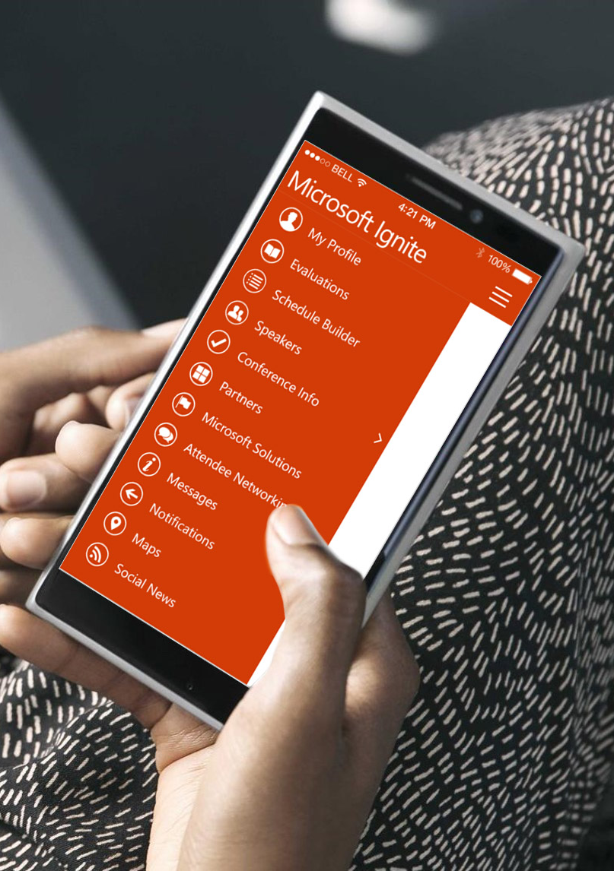
Please evaluate this session
Your feedback is important to us!
From your PC or Tablet visit MyIgnite at http://myignite.microsoft.com
From your phone download and use the Ignite Mobile App by scanning the QR code above or visiting https://aka.ms/ignite.mobileapp

Slide 30
Q&A Richard.Rundle@microsoft.com elkim@microsoft.com evanhi@microsoft.com

