Slide 1
Uncover data protection in the world of Panama Papers
BRK3162
Subhra Bose
CEO, Financial Fabric
Paul Stirpe
CTO, Financial Fabric
Jakub Szymaszek
Program Manager, Microsoft

Slide 2
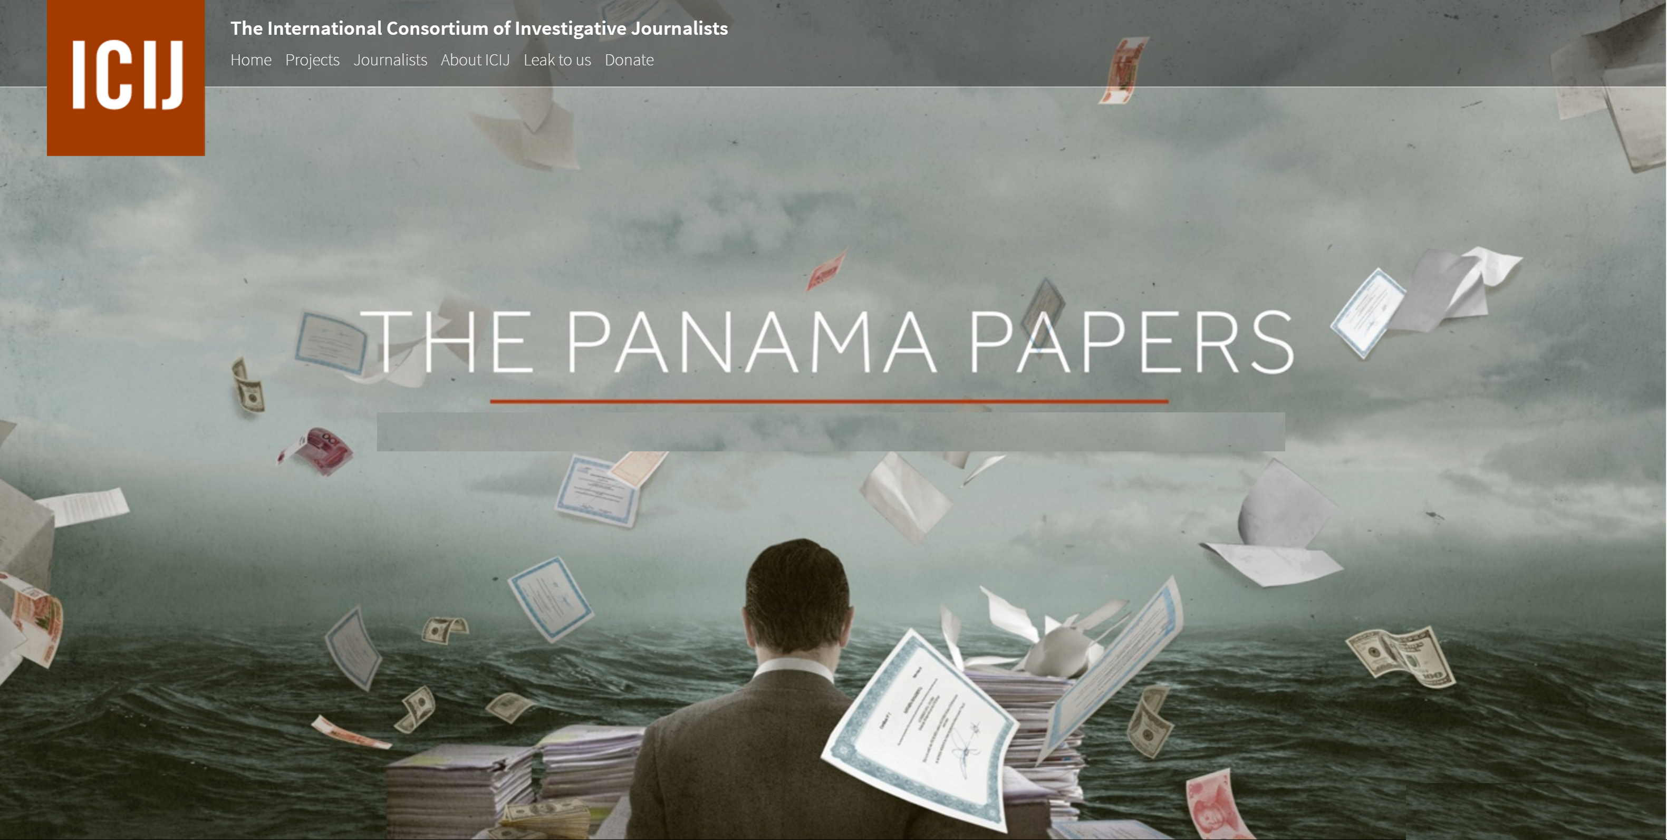
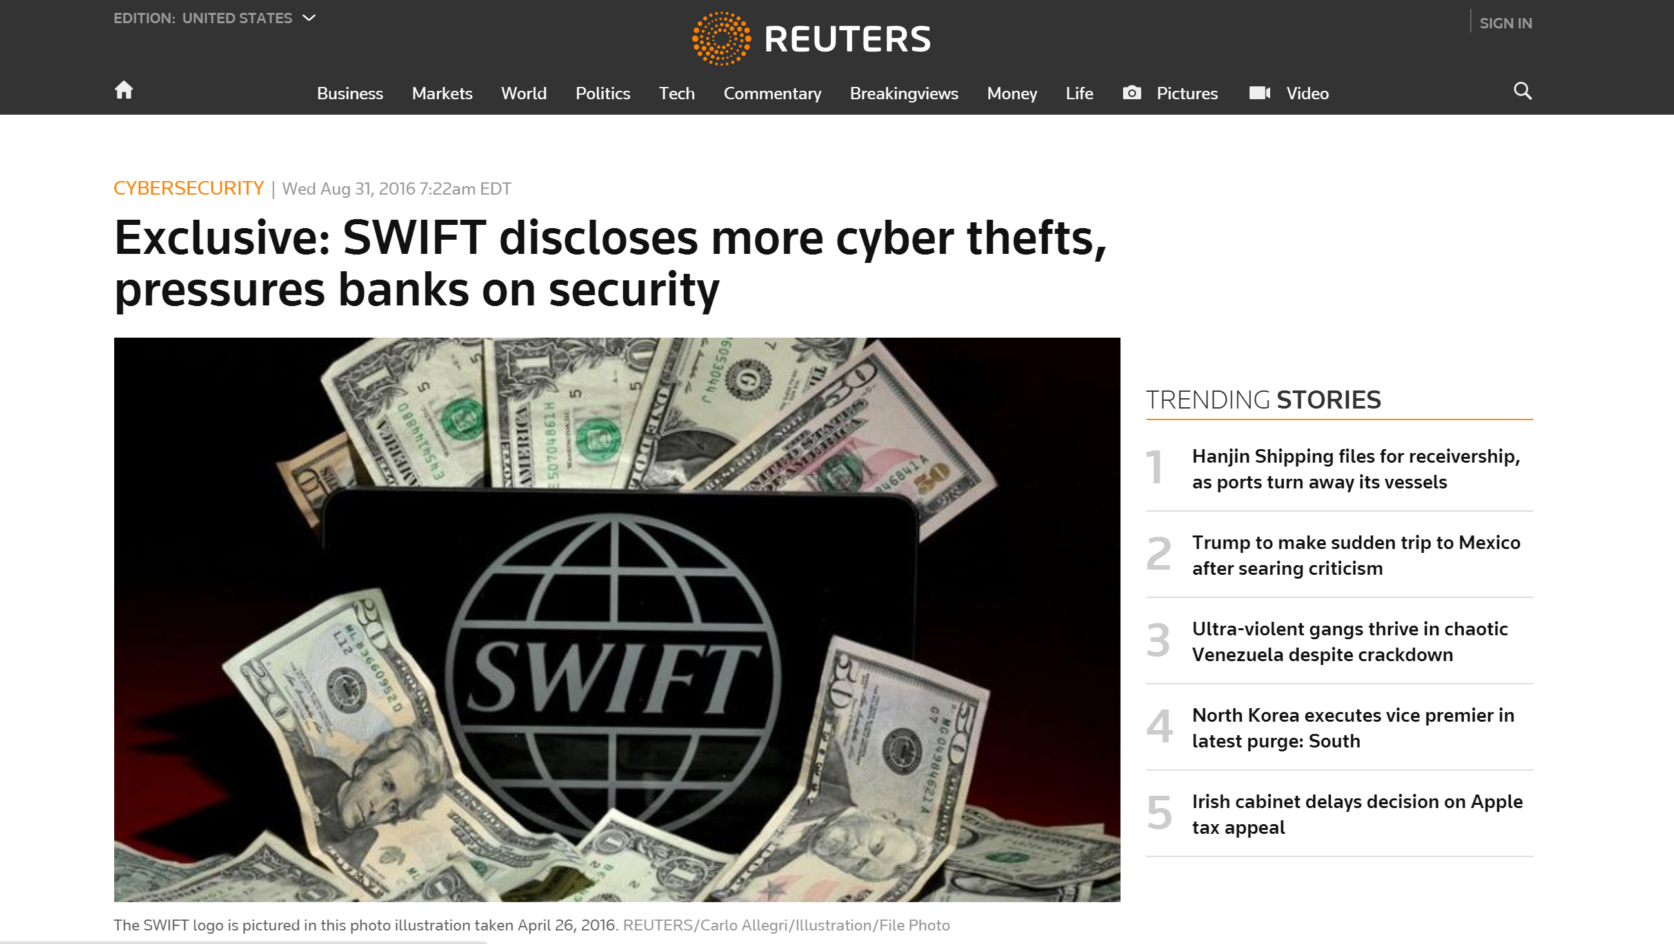
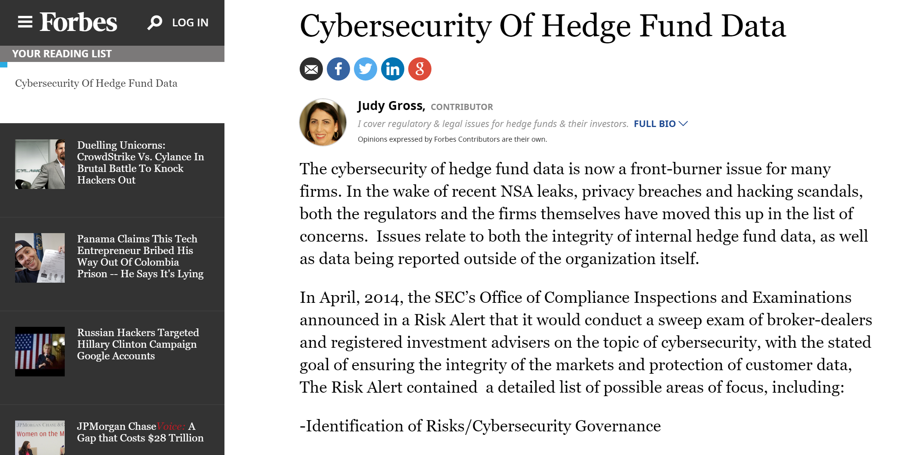
Data Security and Secrecy in Financial Services
What we are saying
Data security and secrecy are topical for Financial Services
What we are NOT saying
Legality and Ethics of data security and secrecy in any given scenario

Slide 3
The “data” quandary
2020
Global Alternative Assets is projected to grow from
USD 8 Trillion to USD 15 Trillion
[source: PwC]
Period of transformation as firms look to calibrate their businesses and operations
Transition from Institutional Quality to Industrial Strength
Data-driven decision making is the key
ARE YOU READY?
Data-driven Business
Data Secrecy
Effective data solution is to enable data driven business without compromising data security and secrecy

Slide 4
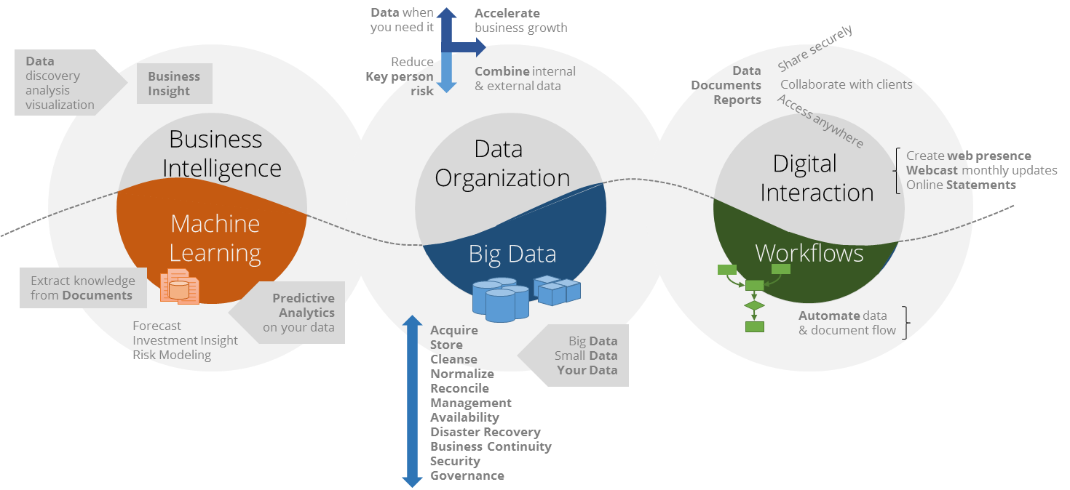
Financial Fabric DataHub on Azure
Enabling data driven business for Investment Managers

Slide 5
Our Approach to Data Security and Privacy
Assume data breach will happen
Separation of service accounts and encryption keys on a per client basis minimize hacker and whistleblower exposure.
Use data in its encrypted form when possible
We used Always Encrypted in Azure SQL Database to enable data scientists for analysis without revealing sensitive fields, such as investor name, social security etc.
Enforce secure authentication policies
Multi-factor authentication for end-users
Integrated authentication (no passwords) for services

Slide 6
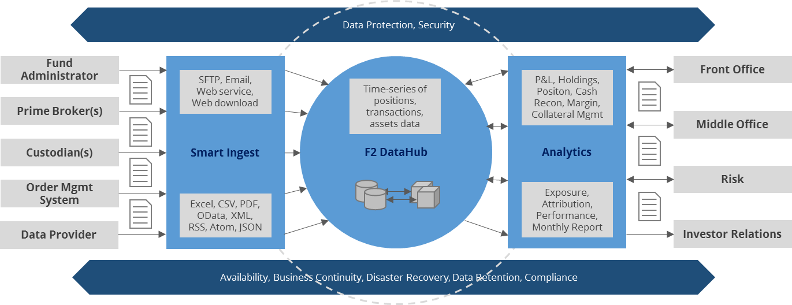
Financial Fabric DataHub for
Investment Managers, Institutional Investors

Slide 7
Financial Fabric Global Infrastructure
Leverages Microsoft Azure Cloud IaaS and PaaS Capabilities
Infrastructure, Security Controls & Operational Controls
Fully Hosted within Microsoft Azure Data Centers
Extended with the Financial Fabric Overlay Architecture & Capabilities
Infrastructure Architecture
Security Architecture and Controls
Operational Controls
Disaster Recovery & Business Continuity Plan
Near real-time replication from Primary to DR data centers,
Microsoft Always On DB replication technology.
Americas
EMEA
Jurisdictional Boundaries
Primary
DR
Primary
DR
Secure
Channel
Secure
Channel
APAC
Secure Channel
Primary
DR
Secure
Channel
Global Infrastructure: leverages Microsoft Azure worldwide datacenters certified or compliant with:
Safe Harbor
ISO 27001
SSAE 16
FISMA

Slide 8
Financial Fabric Architecture
Office 365
inbox
Data Providers
(Brokers, Admins…)
Public
Sources
Web Portal
Always Encrypted – point of decryption
Ingress Files
Smart Loader
Always Encrypted – point of encryption
Azure SQL Database
Encryption at-rest via Transparent Database Encryption (TDE)

Slide 9
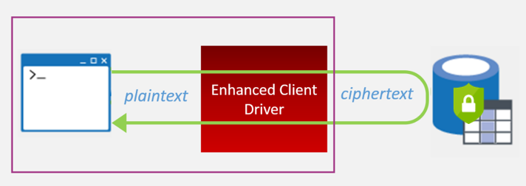
Always Encrypted – What Is it?
Client-side encryption
Client-side encryption using keys that are never given to the database system
Queries on encrypted data
Support for GROUP BY, point lookups, equality joins via deterministic encryption
Application transparency
Minimal application changes via server and client driver enhancements

Slide 10
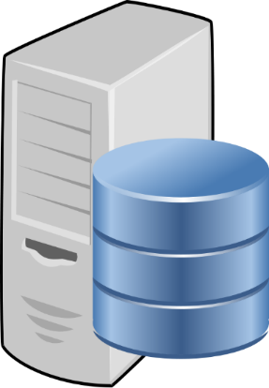
Always Encrypted - How Does It Work?
Only applications/users with access to the keys can encrypt/decrypt data
Encrypted sensitive data are never revealed to DBAs and host admins
trust boundary
SQL Server or SQL Database
Client
"SELECT Name FROM Customers WHERE SSN = @SSN",
"111-22-3333"
"SELECT Name FROM Customers WHERE SSN = @SSN",
0x7ff654ae6d
ADO .NET
ciphertext
Result Set
Result Set
Name
Wayne Jefferson
Name
0x19ca706fbd9a
ciphertext
dbo.Customers
Name | SSN | Country
0x19ca706fbd9a | 0x7ff654ae6d | USA

Slide 11
Computation without Revelation
Encrypt identifying data on ingestion
Using Always Encrypted in Azure SQL Database
Sensitive data never stored in the database in plaintext
Use deterministic encryption to enable:
Account value aggregation
Performance, exposure and attribution calculations
Time series analytics
Name | SSN | BirthDate | Balance
John Smith | 678-13-7865 | 10/28/1965 | 7,034,905
Name | SSN | BirthDate | Balance
0xA07E47… | 0x018C88... | 0x45C5B… | 7,034,905

Slide 12
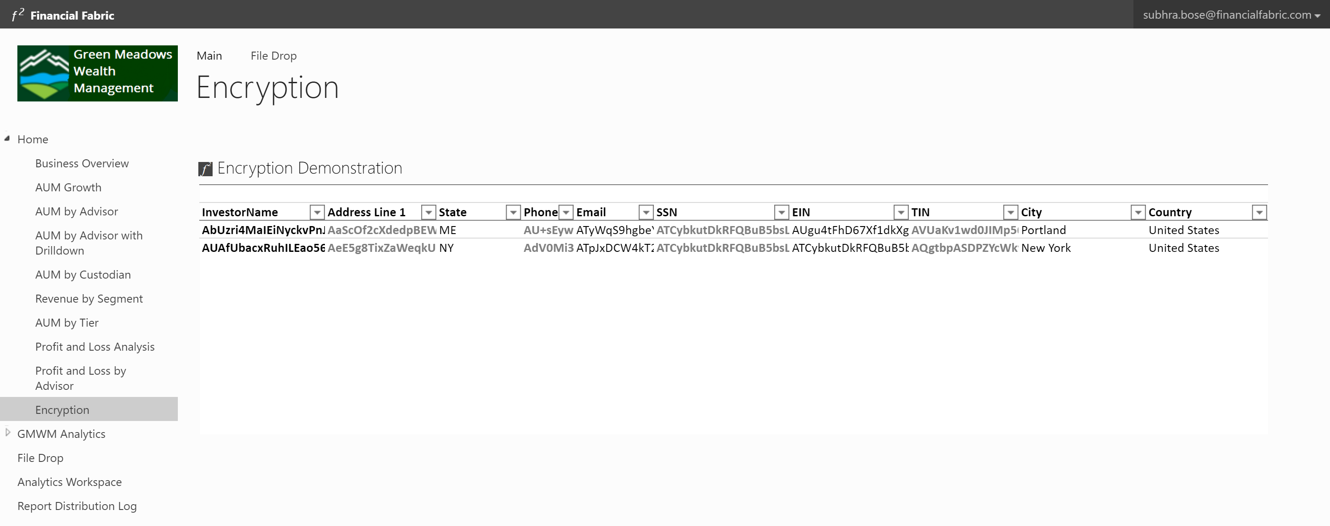
Demo: Analytics on Always Encrypted columns
Financial Fabric

Slide 13
Financial Fabric Architecture
Office 365
inbox
Data Providers
(Brokers, Admins…)
Public
Sources
Web Portal
Azure AD
Always Encrypted – point of decryption
Ingress Files
On premises AD federated with Azure AD
Smart Loader
Always Encrypted – point of encryption
Integrated authentication using Active Directory Authentication
Azure SQL Database
ADFS/MFA
Azure AD Connect
Encryption at-rest via Transparent Database Encryption (TDE)
Active Directory (AD)

Slide 14
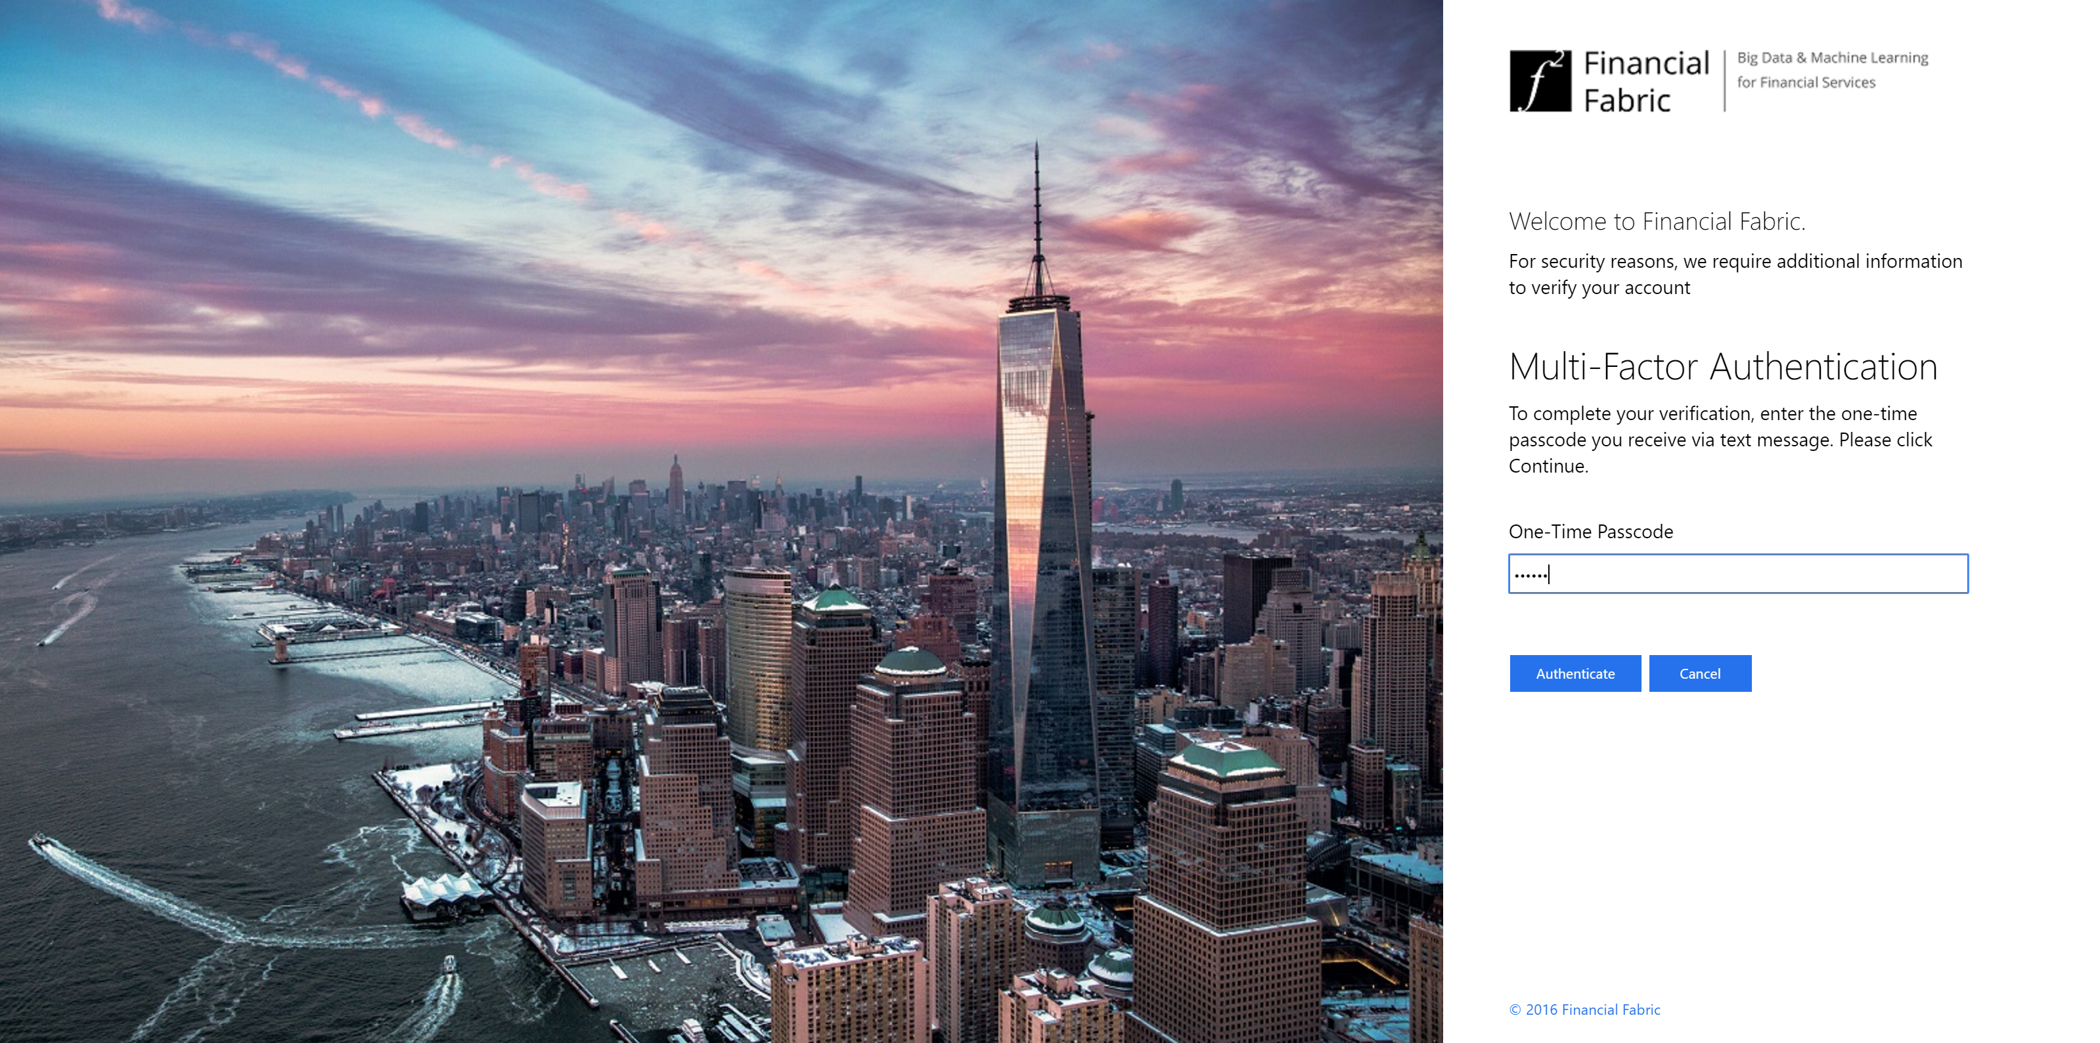
Demo: Multi factor Authentication must have for financial services
Financial Fabric

Slide 15
Always Encrypted & AD Authentication Business Benefits in our Architecture
Clients can share data, but keep sensitive data private
Enables business growth through transparency, e.g. Financial Fabric Data Science team
Stronger controls for accessing sensitive data
Provides stronger controls with respect to who is permitted to read sensitive data
Azure Operations, SaaS Operations staff are further constrained from accessing sensitive data
Active Directory Integrated Authentication
Provides Enterprise strong authentication for hybrid and Azure environments

Slide 16
Next Steps and Goals
Enable owners of data to control data access
We are working with Microsoft Azure SQL Database team to enable storage of Always Encrypted master keys within client’s direct control, although the database is completely managed by us.
Nirvana: practical homomorphic encryption
Computations are limited with Deterministic Encryption
Would like to see enhancements to provide:
Top ‘n’ calculations on encrypted data
Aggregate and statistical computations of encrypted data

Slide 17
Resources
Financial Fabric DataHub
http://www.financialfabric.com/
Step-by-step Tutorial on Always Encrypted
https://azure.microsoft.com/en-us/documentation/articles/sql-database-always-encrypted-azure-key-vault/
Always Encrypted Samples at GitHub
https://github.com/Microsoft/azure-sql-security-sample
Securing your SQL Database
https://azure.microsoft.com/en-us/documentation/articles/sql-database-security/
SQL Server Security Blog
http://blogs.msdn.com/b/sqlsecurity/

Slide 18
Free IT Pro resources To advance your career in cloud technology
Plan your career path
Cloud role mapping
Expert advice on skills needed
Self-paced curriculum by cloud role
$300 Azure credits and extended trials
Pluralsight 3 month subscription (10 courses)
Phone support incident
Weekly short videos and insights from Microsoft’s leaders and engineers
Connect with community of peers and Microsoft experts
Microsoft IT Pro Career Center
www.microsoft.com/itprocareercenter
Get started with Azure
Microsoft IT Pro Cloud Essentials
www.microsoft.com/itprocloudessentials
Demos and how-to videos
Microsoft Mechanics
www.microsoft.com/mechanics
Connect with peers and experts
Microsoft Tech Community
https://techcommunity.microsoft.com

Slide 19
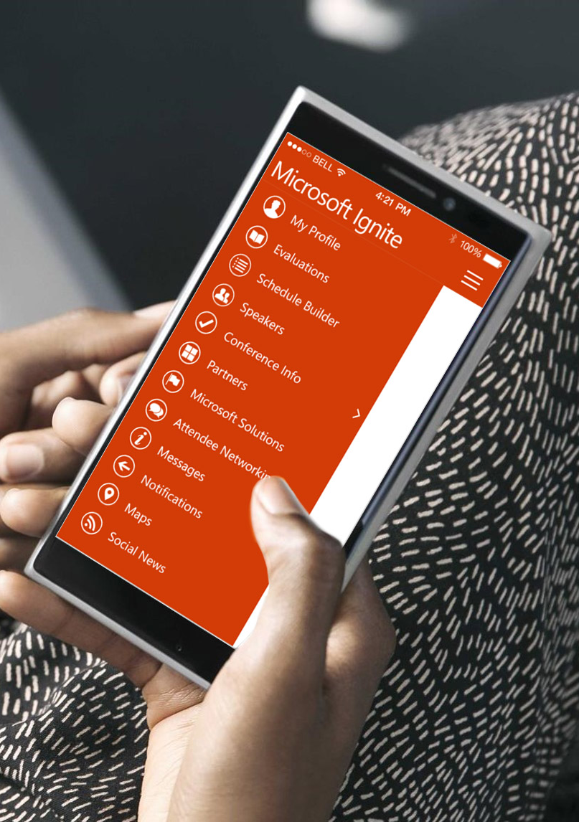
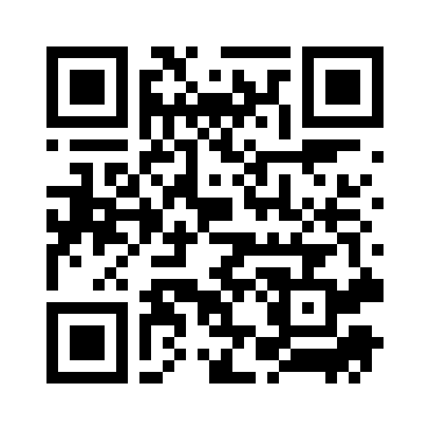
Please evaluate this session
Your feedback is important to us!
From your PC or Tablet visit MyIgnite at http://myignite.microsoft.com
From your phone download and use the Ignite Mobile App by scanning the QR code above or visiting https://aka.ms/ignite.mobileapp

