Slide 1
Manage your cold data with SQL Server Stretch database
BRK3159
Anthony van Gemert
Program Manager

Slide 2
Agenda
What is Stretch Database?
How does it work?
How can it work for me?

Slide 3
Session take away
At the end of this session, you should
have a clear understanding of hybrid vision and benefits of Stretch database

Slide 4
…so what do we mean by Hybrid?

Slide 5
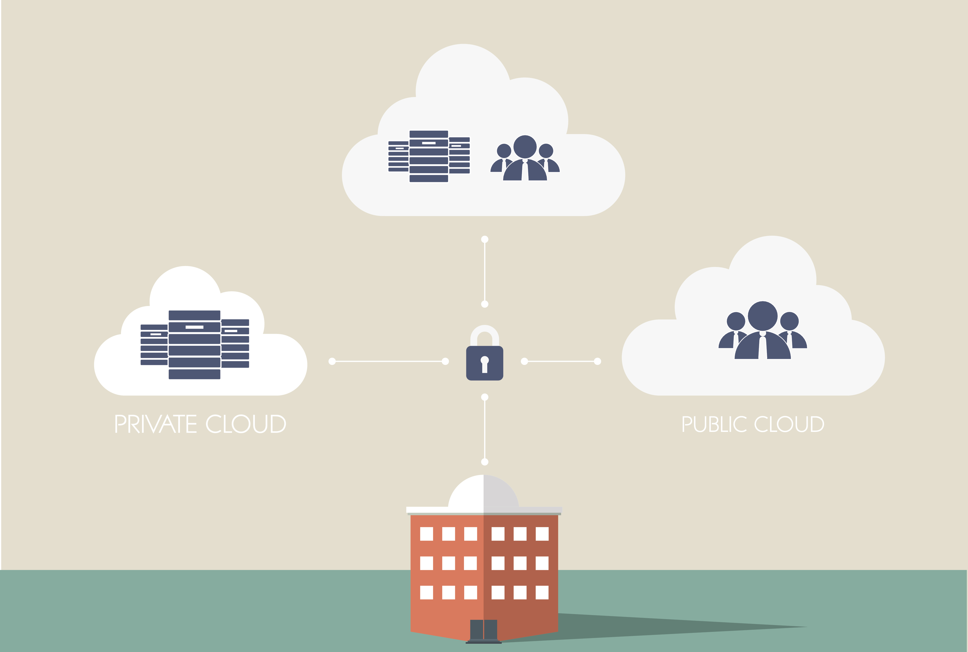
What I think ‘Hybrid’ is

Slide 6


What our customers think ‘Hybrid’ is

Slide 7

What my parents think ‘Hybrid’ is…

Slide 8

What my friends think ‘Hybrid’ is…

Slide 9
What we all think aside, HYBRID is where we are right now…

Slide 10
SQL Server Stretch DB with Azure, makes ‘Hybrid’ as simple as it gets…

Slide 11
What is Stretch?
SQL Stretch Database is a hybrid solution for securely migrating cold data to Azure, with remote query processing abilities
Cost effective online cold data
Reduced local storage and maintenance costs
Entire table always online and accessible
No application changes
Supports Always Encrypted and Row-Level Security

Slide 12
Why did we create Stretch?

Slide 13
Up to 85% of enterprise data is considered cold or historical …sometimes more.

Slide 14
What is this cold data…?

Slide 15
It’s a lot of things…
Order history
Medical records
Bank or credit card statements
…

Slide 16
…What Stretch Database is NOT

Slide 17
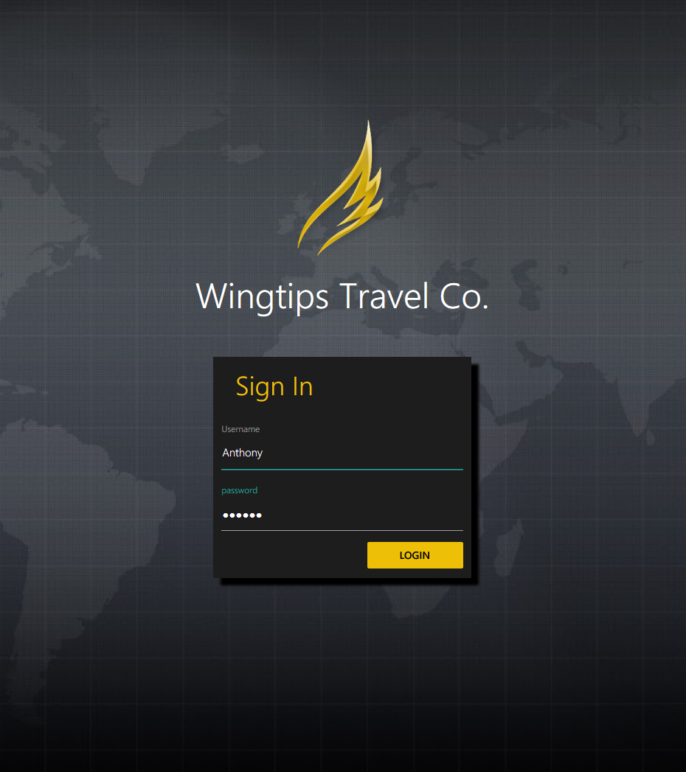
Demo
Wingtips travel concierge service

Slide 18
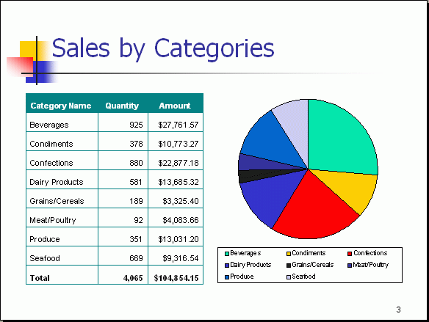

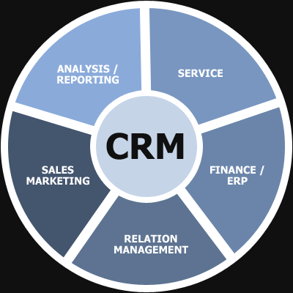
How does Stretch work?
Creates a secure connection between the Source SQL Server and Azure
Provisions remote instance and begins migration
Apps and Queries continue to run for both the local database and remote endpoint
Security controls and maintenance remain local
Available in all versions of SQL Server 2016
On-premises network
Azure PaaS
SQL
2016
SQL
Stretch Database
Users continue to access data thru local instance
Cold Data
Hot data
Cold data
Trickle migration

Slide 19
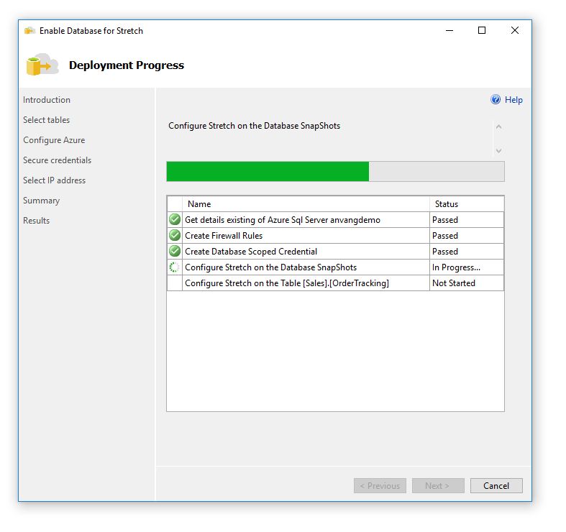
Using Stretch?
Demo
Enabling
Supported scenarios
Queries
Migration management
Monitoring
Disabling

Slide 20
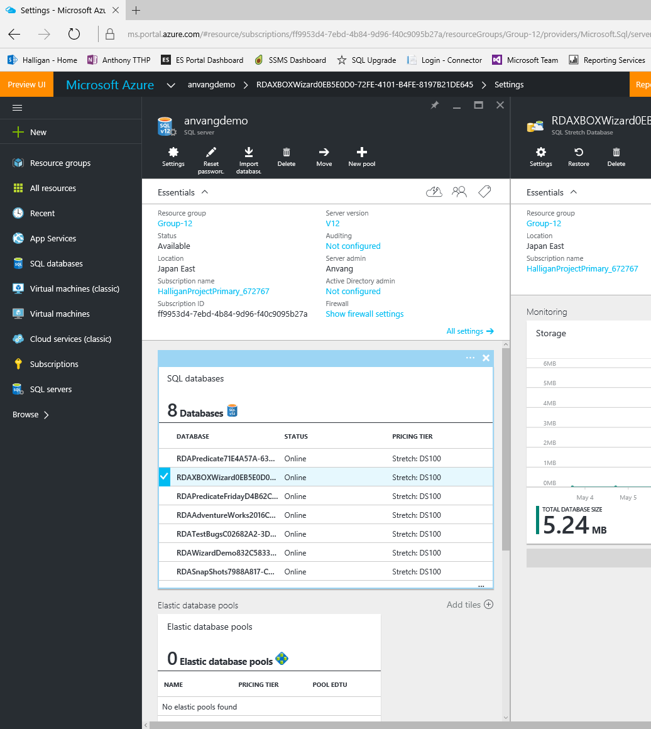
What about the backend?
Demo
Stretch service in Azure

Slide 21
…is my data secure?

Slide 22
Security
Support for AAD authentication
Data in motion always via secure channels (TLS1.1 / 1.2)
Always Encrypted supported if enabled by user
Encryption key remains on the source SQL server
Support for row level security
Supports SQL Server and SQL Azure audit
On-premises network
Azure PaaS
Smart query
processing
SQL
2016
SQL
Stretch Database
Eligible Data
Trickle migration
Hot and Cold data
Cold Data

Slide 23
…so I just need to backup hot data now?

Slide 24
Backup and restore
On-premises network
Azure PaaS
DBAs only handle backup/restore of local hot data
Stretch ensures remote and local data is transactionally-consistent
Upon completion of local restore, Stretch database reconciles with the remote data
Time of restore for remote not dependent on size of data
Smart query
processing
DBA
SQL
2016
SQL
Stretch Database
Eligible Data
Trickle migration
Hot data
Cold Data
Cold data
Auto reconcile

Slide 25
…what about availability groups?

Slide 26
Always on
On-premises network
It just works!
Seeding of secondary's is much quicker
Data savings are multiplied across replicas
SQL
2016
SQL
App
Primary
Remote database
SQL
2016
Secondary

Slide 27
What’s coming next?
New lower entry point DSU endpoint

Slide 28
Key takeaways
Gives enterprise customers the advantages of cloud database economics and management. Without having to move an entire database and its applications to the cloud
Enables on-premises databases to offload storage and query processing for cold/archival data to Azure

Slide 29
Call to action
Contact: StretchData@Microsoft.com to find more about the exciting customer incentives we’re offering.
Make sure to catch to session BRK3151
Make it real with Always Encrypted, Stretch Database and Temporal Tables

Slide 30
QA

Slide 31
Free IT Pro resources
To advance your career in cloud technology
Plan your
career path
Cloud role mapping
Expert advice on skills needed
Self-paced curriculum by cloud role
$300 Azure credits and extended trials
Pluralsight 3 month subscription (10 courses)
Phone support incident
Weekly short videos and insights from Microsoft’s leaders and engineers
Connect with community of peers and Microsoft experts
Microsoft IT Pro Career Center
www.microsoft.com/itprocareercenter
Get started
with Azure
Microsoft IT Pro Cloud Essentials
www.microsoft.com/itprocloudessentials
Demos and
how-to videos
Microsoft Mechanics
www.microsoft.com/mechanics
Connect with peers and experts
Microsoft Tech Community
https://techcommunity.microsoft.com

Slide 32


Please evaluate this session
Your feedback is important to us!
From your PC or Tablet visit MyIgnite at http://myignite.microsoft.com
From your phone download and use the Ignite Mobile App by scanning the QR code above or visiting https://aka.ms/ignite.mobileapp

