Slide 1
Achieve great performance with Azure SQL Database using built-in intelligence
BRK3153
Vladimir Ivanovic & Drazen Sumic
Microsoft SQL Product Team

Slide 2







DBaaS Evolution
User can focus on the app
Scale Out
Intelligent DBaaS capabilities
Backups
Scale Up/Down
Patching
Easy to achieve the performance I need
I’m efficiently using my cloud resources
I can easily manage hundreds of DBs
Index/Schema Mgmt.
Monitoring
HA/DR
In Memory
Azure SQL Database Service
Hardware
DBaaS v2.0 - Intelligent Database Service
Platform manages all aspects of running and tuning the DB

Slide 3
Azure SQL Database performance
powered by built-in intelligence
Insights into DB
Performance
Query Store for tracking query perf
Query Insights for monitoring & tuning
Tailored Tuning
Recommendations
Adjusted as your app evolves over time
Easy to implement and validate
Automatic Tuning
No human intervention needed
Easily scales to 1000s of DBs

Slide 4
Case Study
  Imaginary customer similar to real ones

Slide 5
Model customer – “Rimini”
ERP software provider for SMB, moving to SaaS
Database-per-customer, 1000s of DBs
Peak and valley usage patterns (unpredictable)
Cost-sensitive

Slide 6
Running apps with many DBs cost-effectively
Elastic Database Pools
Perfect solution for multi-tenant apps
Cap your spending
Share resources, maximize utilization
Gain customer isolation
Easy management at-scale
Tailored recommendations on when to use and how to configure Elastic Pools
Customer
1
Customer
2
…
Customer N
Basic | Standard | Premium
Min/max DTUs per second per DB
125 | 200 | 400 | 1,000 | 1,200

Slide 7
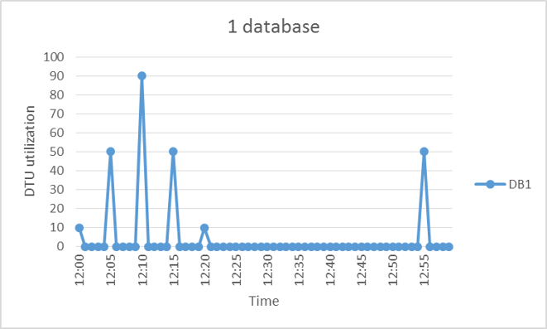
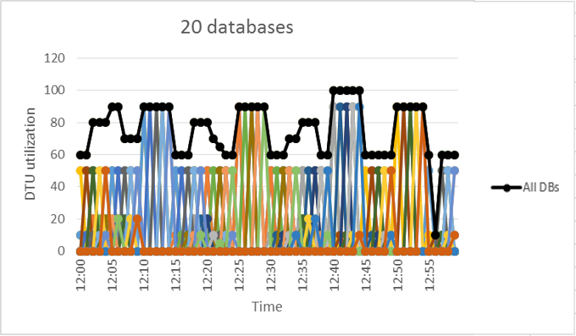
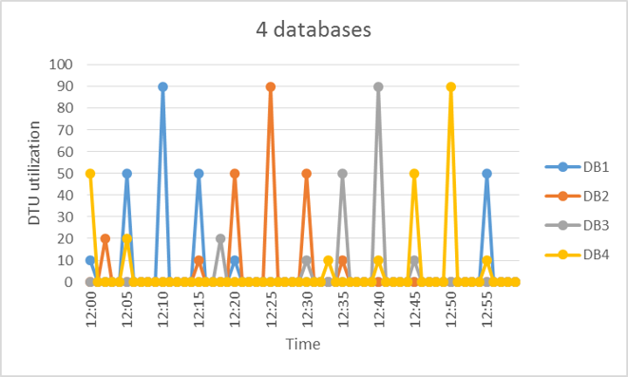
Why do recommendations matter?
Databases in the pool share resources
How do you know which databases would not be active at the same time?
How large pool is enough?
What parameters of the pool are optimal?

Slide 8
Demo
  SQL Database Elastic Pools
  Setting up automated tuning

Slide 9
Insights into DB Performance
  Query Performance Insights

Slide 10
“Rimini”- Monitoring & troubleshooting
Are there any performance issues with my DBs?
How do I minimize my TTD/TTM when there is a problem?
What is causing the problems?
What are my top resource usage queries/workflows?
From database performance issue to the application component

Slide 11
Optimizing query performance and costs
Query Store = flight data recorder for databases
  Built-in query monitoring
  Negligible perf & storage overhead
  Survives failover, memory pressure, …
  Data ready when that incident happens
  T-SQL interface and SSMS UX
  Top insights into your workload
  Query and resource stats
  Query plans
Customer reports the issue
(app is slow/unresponsive)
App User
Web Application
Database
Developer needs to find and fix the underlying problem, ASAP
Developer
BRK3282: Dive deep into application performance using Query Store

Slide 12
Optimizing query performance and costs
Query Performance Insights
  Works on top of Query Store
  Easy to use UX in Azure portal
  Top insights into your workload
  Database Transaction Units (DTUs),
  Resource breakdown (CPU, I/O,…),
  Query duration and execution counts
System analyzes the usage and provides the insights
Query
Perf.
Insights
Web Application
Azure SQL DB
Developer identifies bad queries and improves the app
Developer

Slide 13
Demo - Insights into DB Performance
  Query Performance Insights
  Query Store

Slide 14
Perf Tuning Recommendations
  SQL Database Advisor

Slide 15
“Rimini”- Perf tuning challenges
Requires deep SQL expertise and domain knowledge
Many customers don’t have a DBA – often only “accidental DBA” exists
Requires significant time & effort
As a result, most customers do perf tuning rarely and reactively
Hard to scale for many DBs and varied usage patterns

Slide 16
Easily improve your application performance
SQL Database Advisor
Perf tuning recommendations tailored to each DB
Based on actual usage, adjusted automatically as the app evolves
Service does all the heavy lifting (implement, measure, revert)
System produces the recommendations
SQL Database Advisor
App User
Web Application
Azure SQL DB
Developer chooses which recommendations to apply
Developer

Slide 17
Demo - Perf Tuning Recommendations
  SQL Database Advisor

Slide 18
Automatic Performance Tuning
  SQL Database Advisor

Slide 19
“Rimini”- DevOps challenges
Need to manage 1000s of databases
Need to react quickly 24/7/365
Need to support different usage patterns
No two customers use the app in the same way

Slide 20
Continuously tune your DB as your app evolves
Automatic Performance Tuning
Automated tuning - no action needed on users part
Efficient tuning, round the clock, easily scales to 1000s of DBs
Full tuning history available for review
System produces and automatically applies the recommendations
SQL Database Advisor
Web Application
Azure SQL DB
Developer focuses on the app while the service auto-tunes
Developer

Slide 21
Demo - Automatic Performance Tuning
  SQL Database Advisor

Slide 22
Customer Testimonials
  What do our customers say

Slide 23
“Rimini”- Summary & benefits
SaaS that scales on demand, handles peak loads
Perf monitoring: proactive & easy-to-use
Built-in intelligence recommends how to tune perf
Automatic tuning takes burden away from DevOps

Slide 24



Decreasing the database resource utilization
A US-based company that builds Loupe, a logging & monitoring system for .NET applications
Uses SQL Database as the back end for their SaaS application
Uses Database Advisor to transform their “very expensive” queries into “cheap and fast” queries.
“Database Advisor identified an issue in our application and provided the correct fix”
– Kendall Miller, CEO, Gibraltar Software

Slide 25


Tuning performance for 1000s of cloud DBs
Builds document lifecycle management systems for global markets
Uses SQL Database as a back end for their SaaS application
Uses Database Advisor to keep their application running at max speed
“We find Database Advisor very useful for tuning DB performance”
Christoph Weidling, Director R&D

Slide 26

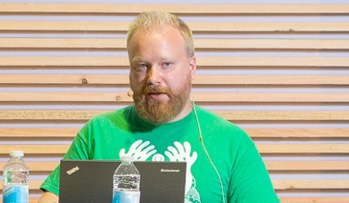
Improving cloud and on-prem performance
Umbraco is a CMS used by 350K websites
Umbraco as a service provides unlimited hosting, smooth deployments, and automated upgrades. They’re using Elastic Pools.
Uses Database Advisor recommendations to improve their application running both on Azure SQL DB and on-premises.
Public case study
“Learnings from Database Advisor give us insight into possible performance improvements of our application, which benefits all customers no matter where they are hosted.”
Morten Christensen, Tech Lead, Umbraco

Slide 27
How does it work?

Slide 28

Recommendations / Automatic Tuning
On Demand Insights
Azure Portal or Power Shell or REST API
Expose with customer facing interface
Apply
Execution Service
Insights Store
Fetch query perf insights
Service Fabric
Publish to internal store
Execute
Tuning Models
Customer DB
On Demand
Models
Usage
Telemetry
Direct
query
Scale out processing
Query Store
Usage
Telemetry

Slide 29
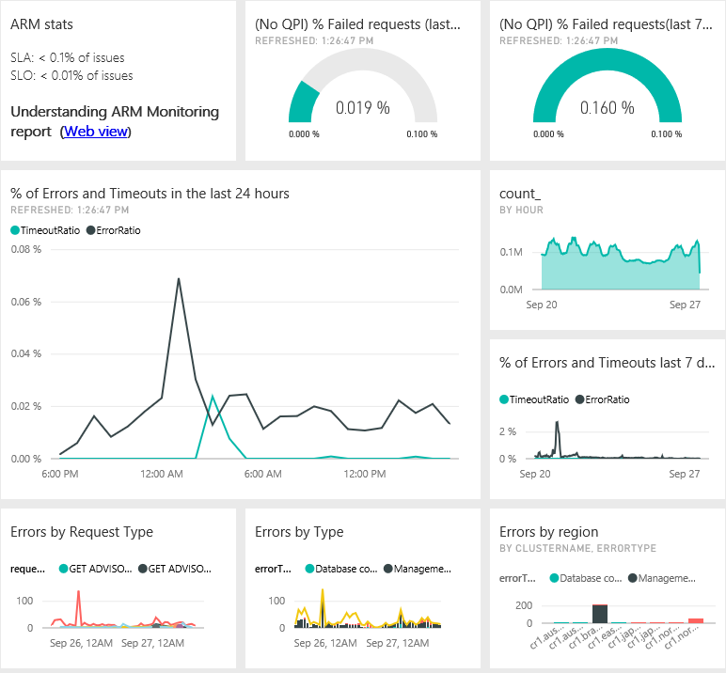
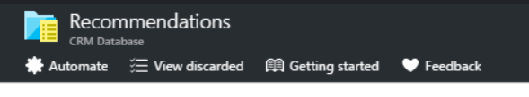
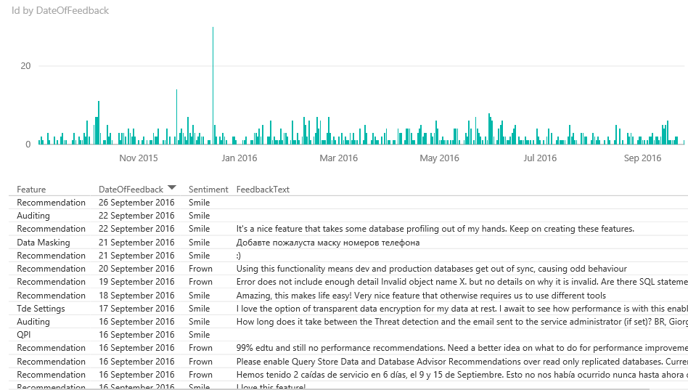
Accelerated Learning, powered by the Cloud
Customer Feedback
+
Real-Time Telemetry

Slide 30
Automatic tuning demo
What happened in the meantime?
  SQL Database Advisor

Slide 31








Intelligent cloud database Insights
Available Anywhere
Azure Portal
Azure REST API
PowerShell
Azure Security Center
Application
Insights
The intelligent cloud database
for app developers

Slide 32
Achieve great performance with Azure SQL Database using built-in intelligence
    Built-in intelligence tunes your DB perf
    Actionable Recommendations
    Automatic Tuning
Saves you time &
effort
Simple to use
Works 24/7/365, reacts quickly
Adapts with your app
Any Application Can Benefit
Works in your own environment
1 DB -> 1000s of DBs
You don’t need to change your app

Slide 33
Thank you!

Slide 34
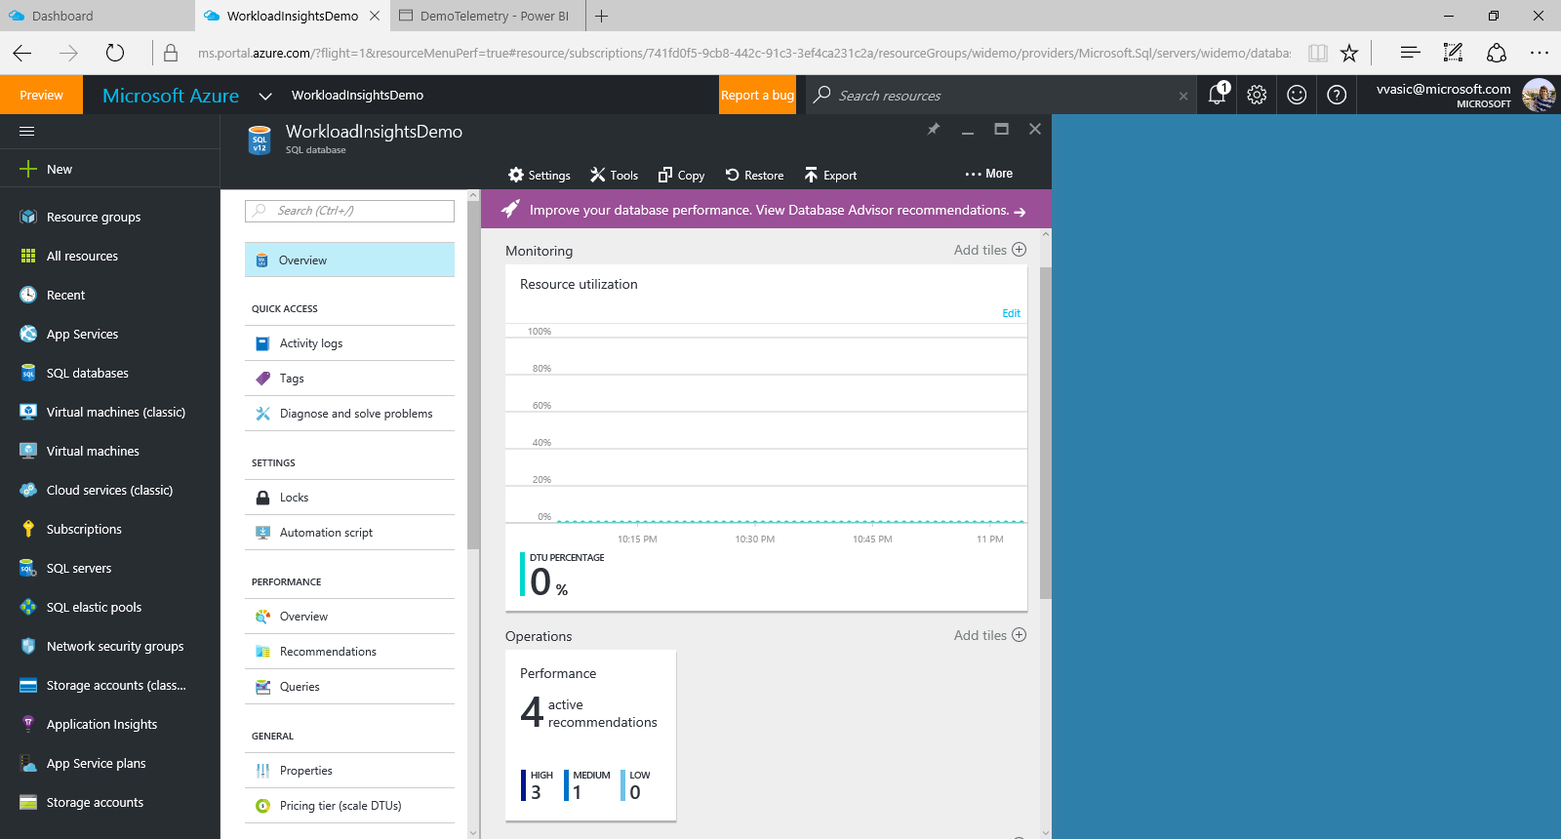

Slide 35
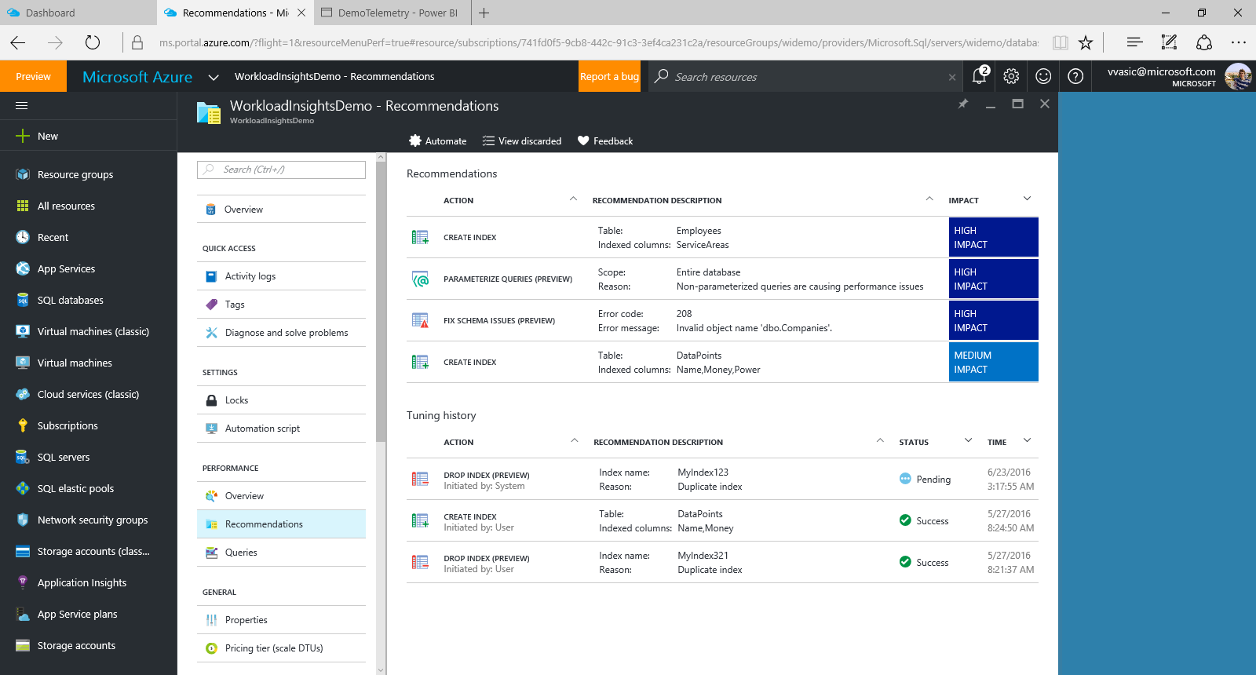

Slide 36
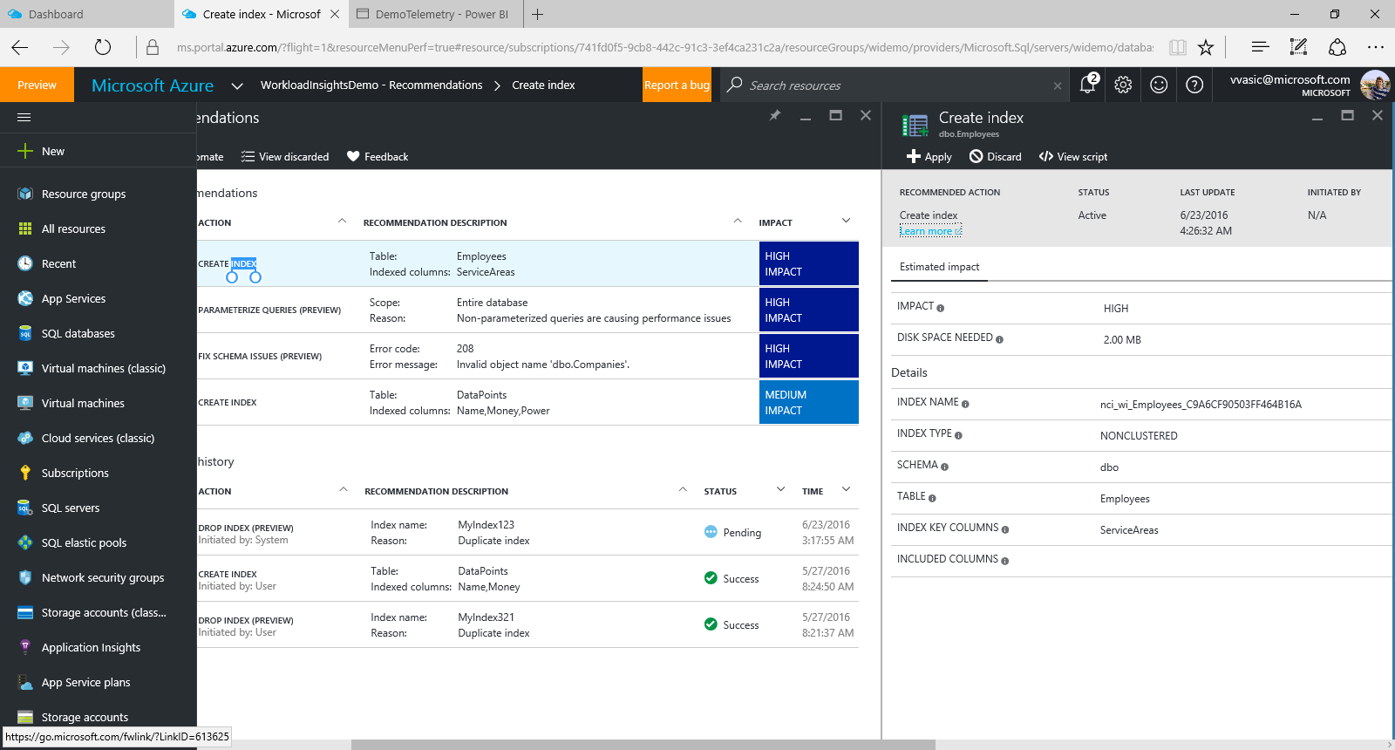

Slide 37
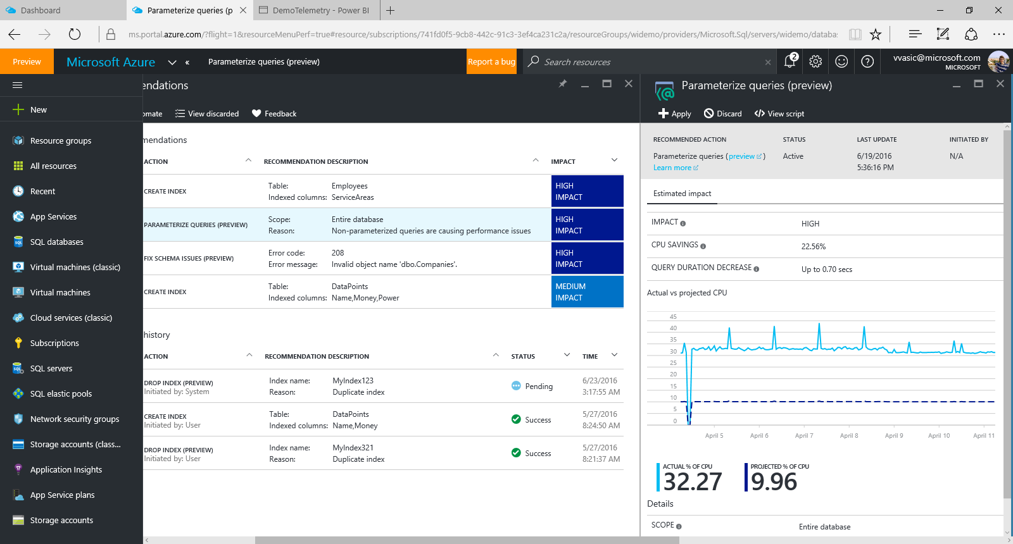

Slide 38
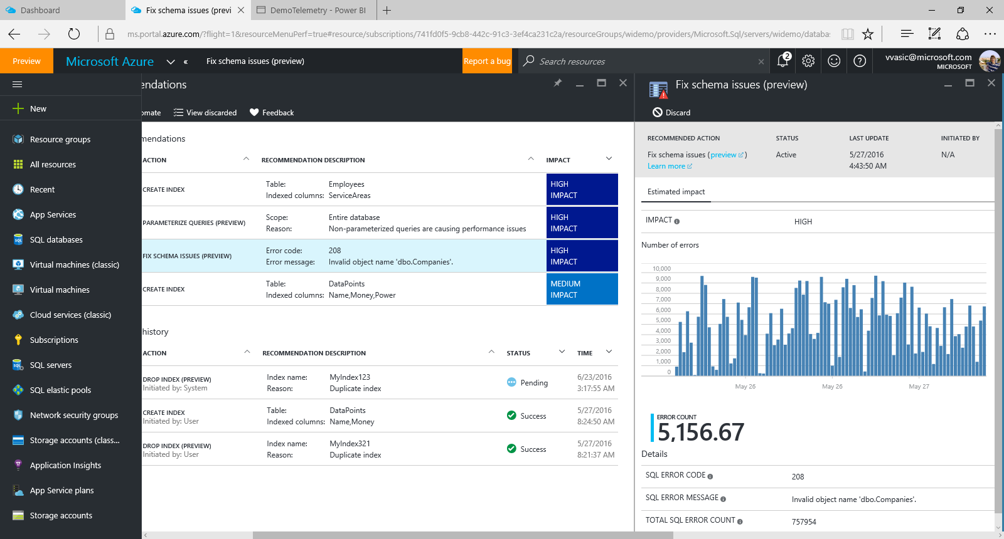

Slide 39
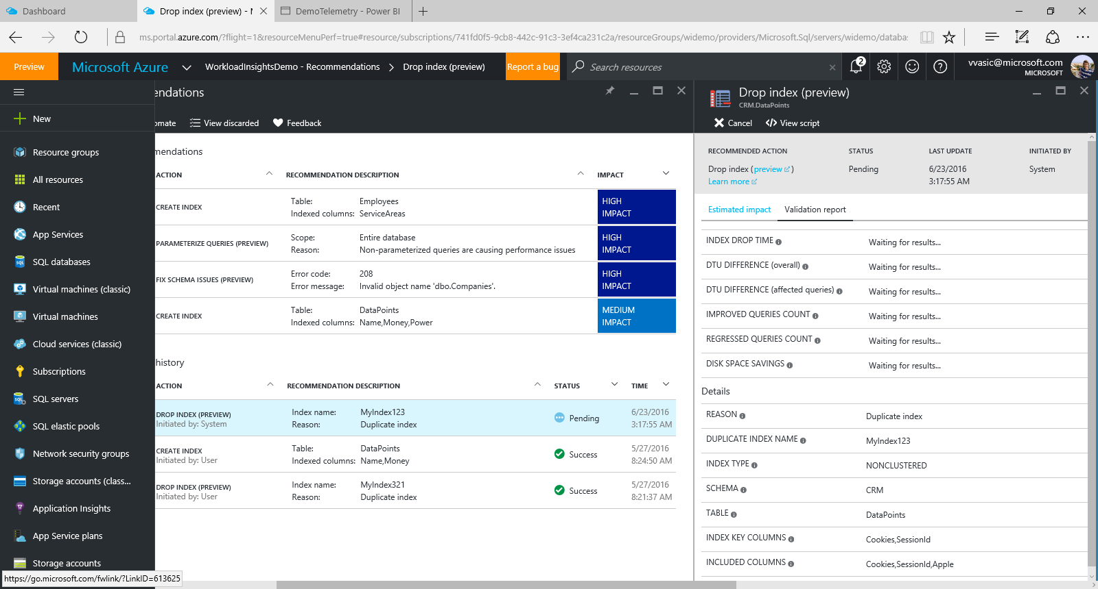

Slide 40
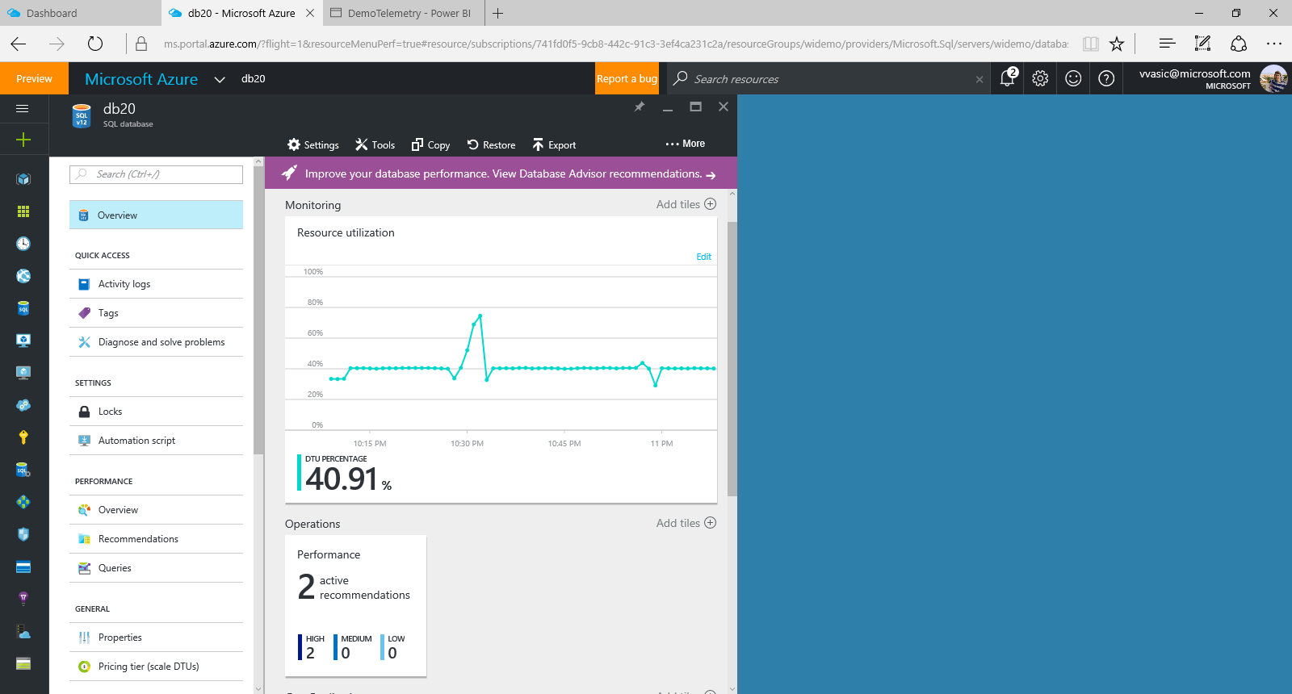

Slide 41
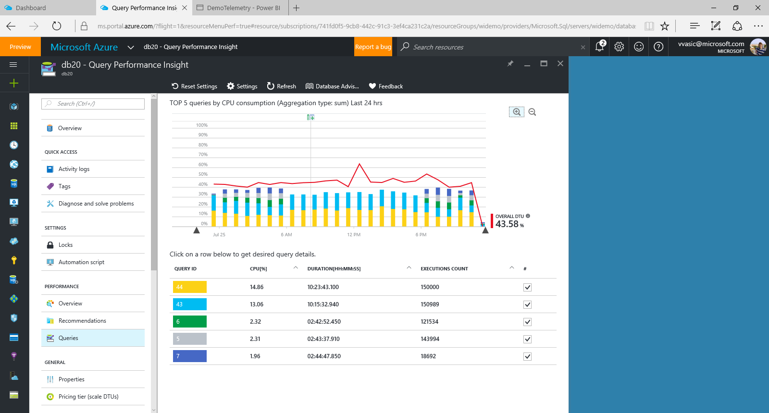

Slide 42
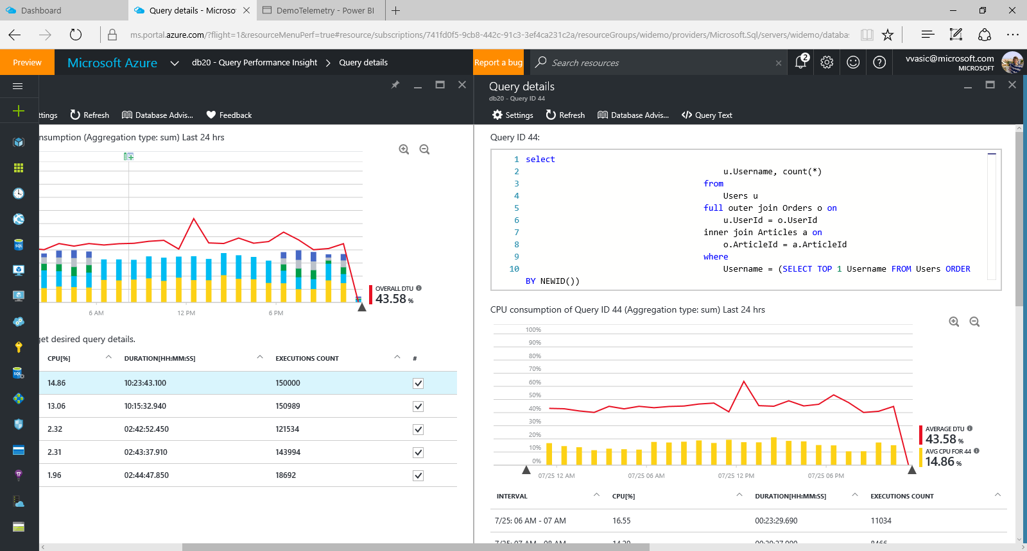

Slide 43
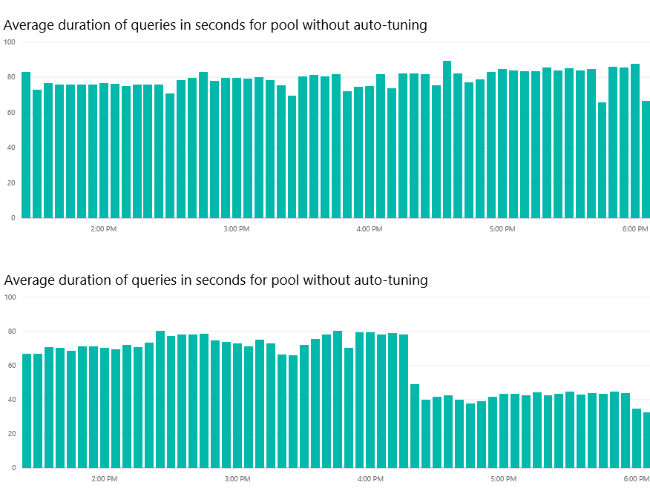
Auto-tuning demo results
indexes
created

Slide 44
Free IT Pro resources
To advance your career in cloud technology
Plan your
career path
Cloud role mapping
Expert advice on skills needed
Self-paced curriculum by cloud role
$300 Azure credits and extended trials
Pluralsight 3 month subscription (10 courses)
Phone support incident
Weekly short videos and insights from Microsoft’s leaders and engineers
Connect with community of peers and Microsoft experts
Microsoft IT Pro Career Center
www.microsoft.com/itprocareercenter
Get started
with Azure
Microsoft IT Pro Cloud Essentials
www.microsoft.com/itprocloudessentials
Demos and
how-to videos
Microsoft Mechanics
www.microsoft.com/mechanics
Connect with peers and experts
Microsoft Tech Community
https://techcommunity.microsoft.com

Slide 45


Please evaluate this session
Your feedback is important to us!
From your PC or Tablet visit MyIgnite at http://myignite.microsoft.com
From your phone download and use the Ignite Mobile App by scanning the QR code above or visiting https://aka.ms/ignite.mobileapp

