Slide 1
Reduce the network impact of Windows 10 feature and quality updates using peer-to-peer
BRK3145
Michael Niehaus
Director of Product Marketing
mniehaus@microsoft.com

Slide 2
Introducing Windows as a Service
A brand new way of building, deploying, and servicing Windows
Building
Deploying
Servicing
Continual, ongoing development
Deliver new features twice per year
In the open, to enable and encourage feedback
Stay current with simple, automated update process
Unmatched application compatibility
Flexible timelines, methods, tools
Simplified process, to ensure consistency, stability and reliability
Delivered using cumulative updates
Eliminate platform fragmentation for all Windows-based devices

Slide 3
Windows as a service: Servicing Windows
With Windows 10 servicing, consistency and simplicity are paramount
Quality Updates
Feature Updates
A single cumulative update each month
Security fixes, reliability fixes, bug fixes, etc.
Supersedes the previous month’s update
No new features
Try them out with Security Update Validation Program (SUVP), other
Targeting twice per year with new capabilities
Very reliable, with built-in rollback capabilities
Simple deployment using in-place upgrade, driven by existing tools
Try them out with Insider Preview
Changes being implemented for older Windows releases as well

Slide 4
Windows 10 Feature Updates

Slide 5
Windows 10 Quality Updates Windows 10 1511

Slide 6
Windows 10 Size Challenge Two-year view
Quality Updates
Feature Updates
1GB per month (on average)
24 months
24GB traffic per PC
Spread over about 36 days (assuming 3 days to deploy each security update)
3.5GB for each feature update
4 feature updates in 24 months (eventually)
14GB traffic per PC
Spread over 24 months
Which is the bigger challenge?
p.s. Think about LTSB too

Slide 7
Windows 10 Size Solutions
Quality Updates
Feature Updates
Express packages
Peer-to-peer distribution
Bandwidth throttling
Scheduled distribution
Peer-to-peer distribution
Limited delta upgrade technology (future)
Bandwidth throttling
Scheduled distribution

Slide 8
Windows Update Express Packages
Windows Update CAB/MSU Month 1
Windows Update CAB/MSU Month 2
Component 5 v5
Component 1 v4
Update packages contain multiple components
Each new cumulative update adds some new components, keeps some older ones
Windows Update agent is smart enough to only download the CAB file “chunks” for components that need to be updated
Month 1: Grab everything
Month 2: Grab new components updated since month 1
Separate CAB files built specifically for this; patching tools need to know how to use them
Component 7 v2
Component 5 v4
Component 9 v3
Component 9 v3
Component 3 v8
Component 3 v8
Component 2 v2
Component 2 v2
Component 1 v3

Slide 9
Distributing content using peer-to-peer
The server and data center are bottlenecks
The edges of the network have more capacity
Using peer-to-peer technologies shifts the traffic to the edges
BranchCache (with WSUS, ConfigMgr)
Delivery Optimization (with WU, WU for Business)
ConfigMgr Peer Cache (future)
90% or more of the traffic can be shifted
Simple to implement, great for large and small offices
Immediate return on investment
Wireless Access Point
Wireless Access Point
Router
Switches
Router
Switches
Data Center Server
Data Center Server
Without peer-to-peer
With peer-to-peer

Slide 10
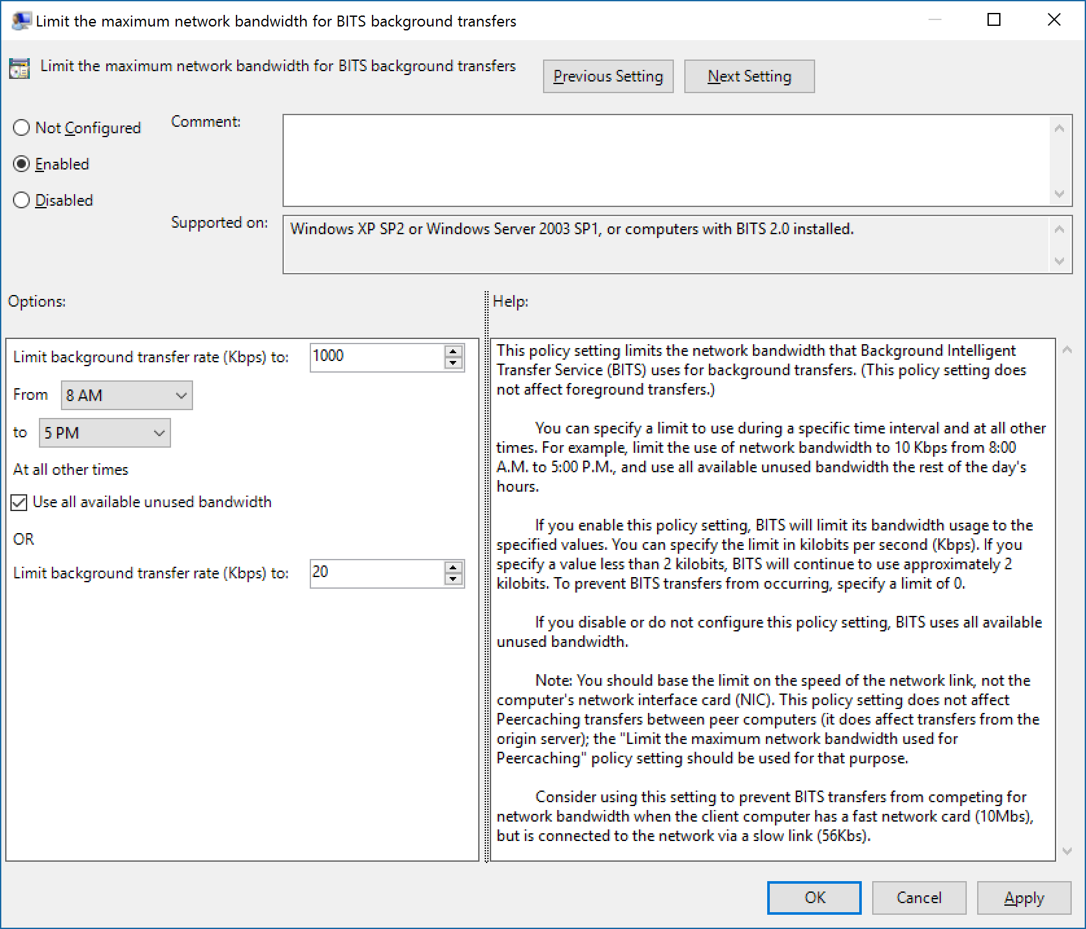
BITS Throttling
Limit the amount of network bandwidth that each PC can consume
Distribute content to PCs over a period of days or weeks
Combine with BranchCache to throttle from the server, but go full speed from peers
Can be challenging due to BITS being used for other purposes

Slide 11
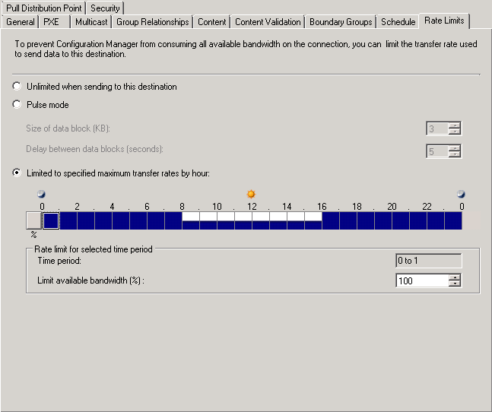
Scheduled Distribution
Control how content is distributed from server to server (distribution points), and from server to client
Bandwidth usage can be limited/throttled
Restrict based on time of day
Servers or PCs can often be used to hold content (distribution points)

Slide 12
Delivery Optimization
Windows update
Content Servers
Peer-to-peer distribution mechanism that works in conjunction with the Windows Update service
Reduces the need for multiple PCs to download content from the internet – they can share across a private network
Peers are identified based on internet IP, with additional policy options
D
1
2
5
3
4
B
Client A checks for updates
Windows Update service returns update information
Client A asks Windows Update service for download sources
Service provides Windows Update Content Server D and clients B and C
Client A requests specific small pieces of the update file from Windows Update Content Server D and clients B, C
Sources B, C, D fulfill the download requests
Client A checks the hash of each piece of the update file, discards pieces where hashes don’t match
Client A checks the hash of the entire file before installing
A
5
5
C

Slide 13
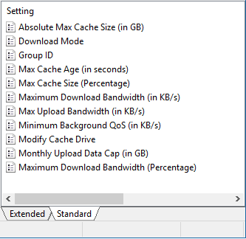
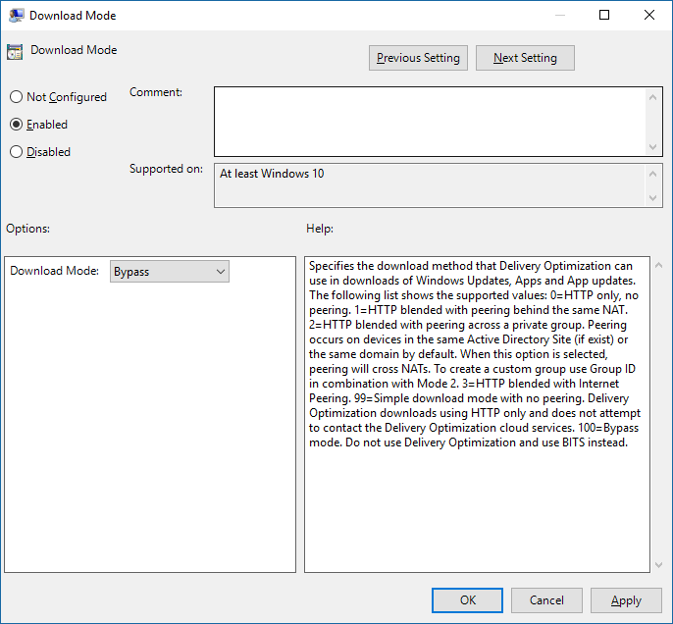
Delivery Optimization
Policies available for IT administrators:
Group PCs by location (default is based on NAT external IP)
Control bandwidth limits
Configure cache size
With Windows 10 1511 and 1607, used by default even with WSUS
Client asks DO service for available peers before grabbing content from WSUS
Policy available to disable (e.g. to use BITS and BranchCache instead)
Superset of configuration options available in Settings app

Slide 14
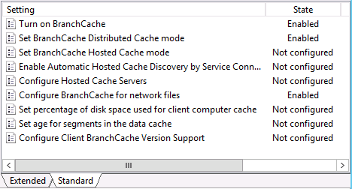
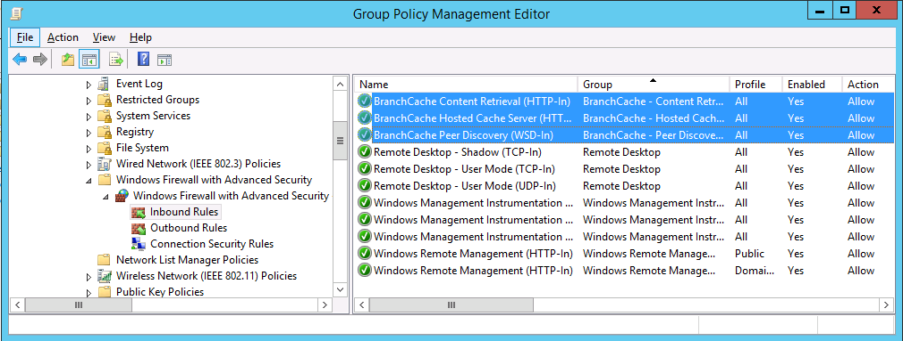
BranchCache
Existing, well-known feature
Available in Windows 10 Pro (for HTTP/BITS), Enterprise, and Education
Easy to use in “distributed cache” mode, no infrastructure required
Sharing content with other PCs on the same network segment
Simple configuration via Group Policy
Turn on for clients, configure firewall
Add BranchCache feature on servers

Slide 15
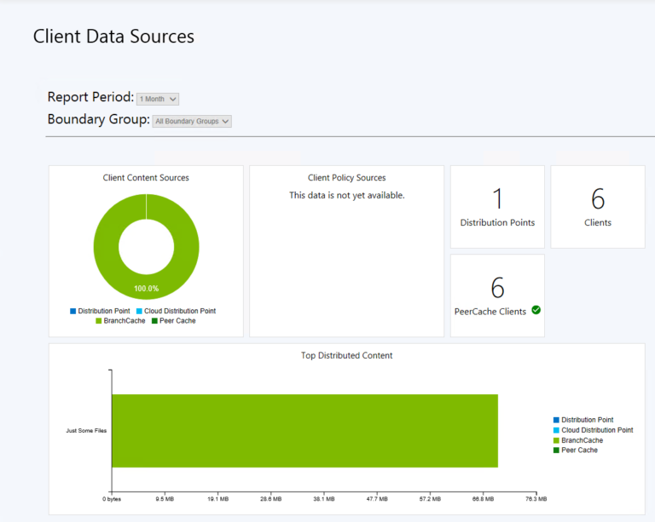
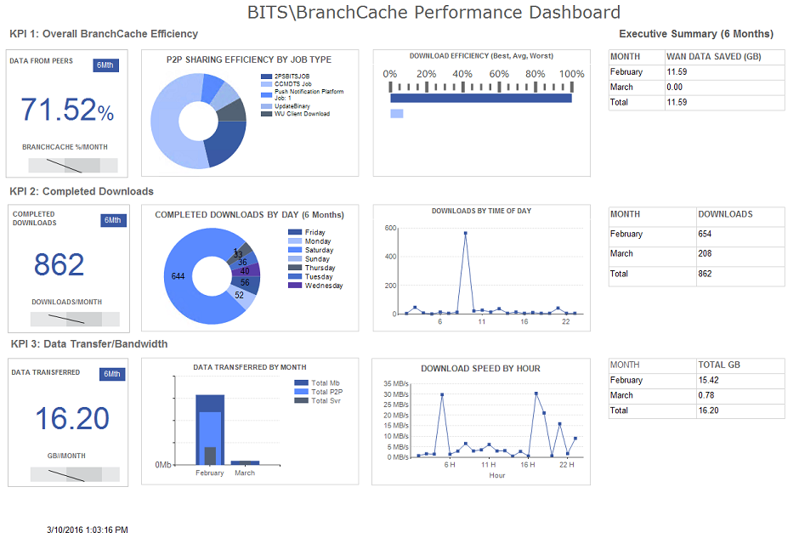
BranchCache
Improvements in Windows 10 for monitoring:
Event log entries indicate how much traffic came from peers vs. server
Improvements coming in ConfigMgr current branch (in preview now):
Dashboard showing traffic from peers vs. server
Great third-party resource for additional information and tools:
http://2pintsoftware.com/2psfaqs/

Slide 16
Updating Tools
System Center Configuration Manager
Windows Update for Business
Windows Server Update Services
Windows Update
Third-Party Tools
Express packages
Yes
Yes
Yes (BITS)
No
Yes
Yes
Yes (BITS)
No
Yes (optional)
Yes (choices)
Yes (BITS)
No
Future
Yes (choices)
Yes (BITS)
Yes
Alternate Content Provider
???
???
???
???
Peer-to-peer
Throttling
Scheduled distribution
Advanced capabilities

Slide 17
Windows Update for Business
Express | Yes
Peer to peer | Delivery Optimization
Throttling | Yes (BITS)
Scheduling | Active Hours
Policies implemented in Windows 10 1511, effective for the next feature upgrade deployment
Now targeting KMS-activated PCs
Not applicable for LTSB
Capabilities
Time to test and validate feature updates
Summer ‘15
Ability to create internal deployment groups
Fall ‘15
Active Hours maintenance windows
Summer ‘16
Peer to peer delivery to optimize for bandwidth
Summer ‘15
Integration with your existing tools like System Center
Coming soon
Access to Current branch and Current branch for Business
Summer ‘15
New policies for Windows 10 1607

Slide 18
Windows Server Update Services
Express | Yes
Peer to peer | Delivery Optimization, BranchCache
Throttling | Yes (BITS)
Scheduling | Active Hours
Updated to support Windows 10 feature upgrades, including upgrades from downlevel OSes
Requires WSUS 4.0 (Windows Server 2012 or above) with KB3095113
See http://blogs.technet.com/b/wsus/archive/2015/12/04/important-update-for-wsus-4-0-kb-3095113.aspx for an important note
Not applicable for LTSB

Slide 19
System Center Configuration Manager
Express | Future
Peer to peer | BranchCache, Peer Cache (future)
Throttling | Yes (BITS)
Scheduling | Maintenance windows, deployment scheduling
System Center Configuration Manager 1602 or later needed to support Windows 10 1607
Requires WSUS 4.0 (Windows Server 2012 or above) with KB3095113
Windows 10 Servicing Plans provide automation
Task sequences can still be used (required for LTSB)

Slide 20
Futures
Limited delta upgrade technology
Expanded support for express updates
Configuration Manager peer caching

Slide 21
For more information
Configure Delivery Optimization for Windows 10 updates
https://technet.microsoft.com/en-us/itpro/windows/manage/waas-optimize-windows-10-updates
Configure BranchCache for Windows 10 updates
https://technet.microsoft.com/en-us/itpro/windows/manage/waas-branchcache
Manage updates using Windows Update for Business
https://technet.microsoft.com/en-us/itpro/windows/manage/waas-manage-updates-wufb
Manage Windows 10 updates using Windows Server Update Services (WSUS)
https://technet.microsoft.com/en-us/itpro/windows/manage/waas-manage-updates-wsus
Manage Windows 10 updates using System Center Configuration Manager
https://technet.microsoft.com/en-us/itpro/windows/manage/waas-manage-updates-configuration-manager

Slide 22
For more information
BRK4022 Dig deeply into BranchCache: learning from the experts
Friday, September 30, 10:45am - 12:00pm, B312 - B314
BRK3173 Upgrade to Windows 10: in depth
Wednesday, September 28, 12:30pm - 1:45pm, SIDNEY MARCUS AUDITORIUM
BRK3140 Ask the experts – Windows 10 deployment, servicing, and provisioning
Wednesday, September 28, 2:15pm - 3:30pm, SIDNEY MARCUS AUDITORIUM
BRK3143 Implement Windows as a Service: how Microsoft IT does it
Thursday, September 29, 10:45am - 12:00pm, A1
BRK3136 Implement Windows as a Service: understanding how to do it
Thursday, September 29, 9:00am - 10:15am, C1

Slide 23
Q&A

Slide 24
Call to action
Implement a peer-to-peer distribution technology
Use express updates (when possible) to reduce quality update size
Help customers solve the size problem for most of their PCs
Check out http://aka.ms/Waas for all the latest information on Windows as a service

Slide 25
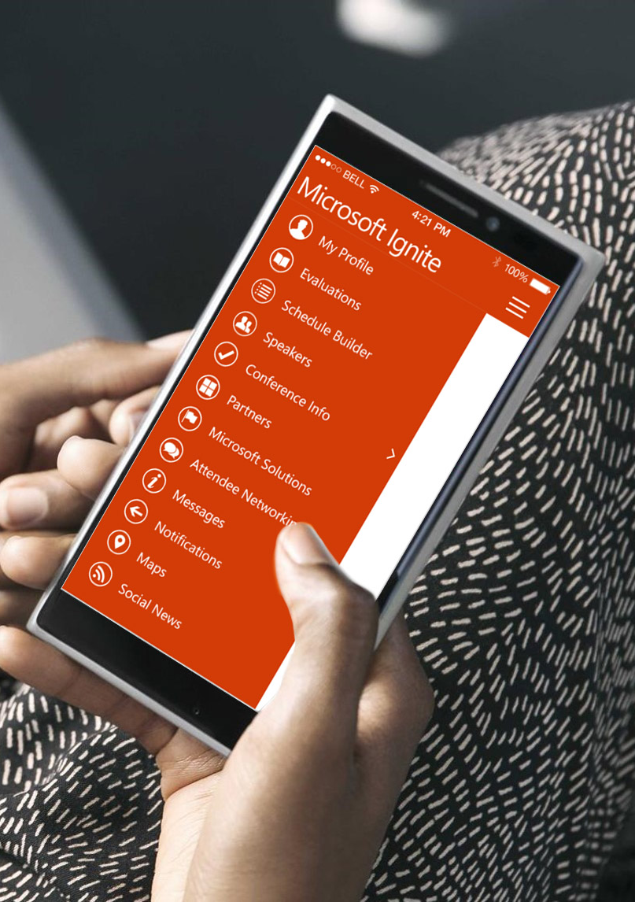
Please evaluate this session
Your feedback is important to us!
From your PC or Tablet visit MyIgnite at http://myignite.microsoft.com
From your phone download and use the Ignite Mobile App by scanning the QR code above or visiting https://aka.ms/ignite.mobileapp

