Slide 1
Implement Windows as a Service:
Understand how to do it
BRK3136
Michael Niehaus
Director of Product Marketing
mniehaus@microsoft.com
Brian McNeill
Principal PM Manager
brianm@microsoft.com

Slide 2
Why Windows as a service?

Slide 3

What customers are telling us
Passwords are no longer sufficient
My users
need access
to their apps and data anywhere, anytime
How do I protect my corporate data
We want more transparency and an open dialogue
with Microsoft
We need to be adopting new technologies as fast as our customers
No more big deployments
Security of our mobile devices is a top concern
IT Budgets are under pressure. Show us how we can cut
IT costs
Too many tools and
too much fragmentation

Slide 4
What we hear from you
        200+ Days
        Median # of days attackers are present before detection
        Decade-old PC tech, infrastructure, and processes drive up IT costs and slow business agility.
        $146-$188 per device
        Cost of keeping user devices up to date and secure
        I’m worried about security threats and managing the risk to my business.
        $3.5M
        Average cost of data breach (15% YoY increase)
        $1,930 per PC
        Cost of upgrading Windows XP to Windows 7
        80% of workers
        spend a portion of their time working outside the office
        41% of CEOs
        Expect digital revenue to double over the next 5 years
        My employees need to be productive on every device they use.
        We need to capitalize on new business opportunities quickly.
        38% of Millennials
        feel outdated collaboration tools hinder innovation
        47% of existing revenue
        considered to be under threat in the next 5 years
Sources: Gartner, Ponemon Institute, IdeaPaint, MIT Center for IS Research

Slide 5

DESIGNED FOR DIGITAL TRANSFORMATION
The most trusted platform
More productive
More personal
The most versatile devices

Slide 6
What is Windows as a service?

Slide 7

Introducing Windows as a Service
A brand new way of building, deploying, and servicing Windows
Building
Deploying
Servicing
Continual, ongoing development
Deliver new features
twice per year
In the open, to enable
and encourage feedback
Stay current with simple, automated update process
Unmatched application compatibility
Flexible timelines,
methods, tools
Simplified process,
to ensure consistency,
stability and reliability
Delivered using cumulative updates
Eliminate platform fragmentation for all Windows-based devices

Slide 8
Windows as a service: Deploying Windows
Unmatched flexibility and control, depending on needs
Windows Insider Preview Branch
Current Branch
Current Branch for Business
Long Term Servicing Branch
Specific feature and performance feedback
Application compatibility validation
Deploy to appropriate audiences
Test and prepare for broad deployment
Information workers
General population
Specialized systems
Early adopters, initial pilots,
IT devices
Deploy for mission
critical systems
No need for frequent new features (or any sort of change)
Too expensive for
general population
Test machines, small pilots
Benefits from new features
Begins broad deployment
NUMBER OF DEVICES
STAGE
Release

Slide 9
Windows as a service: Deploying Windows
Hundreds
of millions
Several Million
10’s of
thousands
Users
Microsoft Insider Preview Branch
Pilot
Engineering builds
Broad Microsoft internal validation
Broad Deployment
Time
Pilot Ring
IT
Pilot Ring
QA
Pilot Ring
Early Adopters
Broad Deployment Ring I
Broad Deployment Ring II
Broad Deployment Ring III
~6 months
Broad Deployment Ring IV
16 + months
*Conceptual illustration only

Slide 10
Windows as a service: Servicing Windows
With Windows 7 and 8, servicing choices added complexity and cost,
increased fragmentation, and reduced quality
What customers are running
What we
are testing
 |  |  |  |  |  |  |  |  |  |  |  |  |  |  |  |  |  |  |  |  |  | Y
 |  |  |  |  |  |  |  |  |  |  |  |  |  |  |  |  |  |  |  |  |  | YY
Typical Windows 7 PC:
Selectively Patched
Windows 7 Test Lab PC:
Fully Patched

Slide 11
Windows as a service: Servicing Windows
With Windows 10 servicing, consistency and simplicity are paramount
Quality Updates
Feature Updates
A single cumulative update each month
Security fixes, reliability fixes, bug fixes, etc.
Supersedes the previous month’s update
No new features
Try them out with Security Update Validation Program (SUVP), other
Targeting twice per year with new capabilities
Very reliable, with built-in rollback capabilities
Simple deployment using in-place upgrade,
driven by existing tools
Try them out with Insider Preview
Changes being implemented for older Windows releases as well

Slide 12
Windows as a service: timelines
Windows Insider Preview Branch
New Windows 10 Release
Specific feature and
performance feedback
Application compatibility validation
Deploy to pilot audiences
Validate and prepare
for broad deployment
Deploy to all audiences,
in waves to reduce risk
Plan & Prepare
Pilot
Deploy / Use
Grace
6+ months of active development
~4 months
12+ months
60 days
18+ months to pilot, deploy, and use each release
The process repeats…
Plan & Prepare
Pilot
Deploy / Use

Slide 13
Windows as a service: Establishing a rhythm
Two releases supported in market
2016
2017
2018
July
Nov
Feb
July
Nov
Feb
July
Nov
Feb
1507
Plan & Prepare
Pilot
Deploy / Use
(done)
4 months
12 months
60 days
1511
Plan & Prepare
Pilot
Deploy / Use
4 months
4 months
~ 20 months
60 days
1607
Plan & Prepare
Pilot
Deploy / Use
~8 months
4 months
~16 months
60 days
Example 2017 Release
(Hypothetical date)
Plan & Prepare
Pilot
Deploy / Use
~8 months
~4 months

Slide 14
How to do Windows as a service

Slide 15
What needs to change

Slide 16
What needs to change
Total costs over three years of WaaS needs to be the same or better than the traditional deployment project cost
  Application testing and validation
  Infrastructure remediation, upgrades
  Deployment itself
All need to be reduced by nearly an order of magnitude
Imaging costs can be eliminated
Customers want proof

Slide 17
Thinking through deployment strategy
1
  Configure Insider PCs
  Lab or secondary PCs
  Enough to explore new features, measure compatibility
2
  Identify special PCs
  Deploy Windows 10 Enterprise LTSB
  Limited numbers (we hope)
3
  Recruit volunteers for pilots
  Willing participants who will provide feedback
  Cover the broadest set of apps and devices possible
4
  Divide broad population of PCs
  Standard deployment best practice
  Focus on risk reduction, minimizing disruption

Slide 18
Windows 10: Comparing Servicing Choices
Differentiator | Current Branch | Current Branch for Business | Long Term Servicing Branch
Primary purpose | Pilot Deployments | Broad Deployment | Special Devices
Deployment timeline | Soon after release | About 4 months (or more) after release | Any time during lifecycle
Release frequency | About every six months |  | Approximately every 2-3 years
Updates | All security fixes, moderate bar for other fixes |  | All security fixes, high bar for other fixes
Apps | All in-box apps |  | No in-box apps (except system apps)
Browser | Edge and Internet Explorer 11 |  | Internet Explorer 11
Windows features | All |  | Excludes Cortana, Windows Store
Platform features | Win32, Universal Windows Platform |  | Win32, Universal Windows Platform

Slide 19
Windows 10: Quality update breakdown
Current Branch / Current Branch for Business | Long Term Servicing Branch

Slide 20
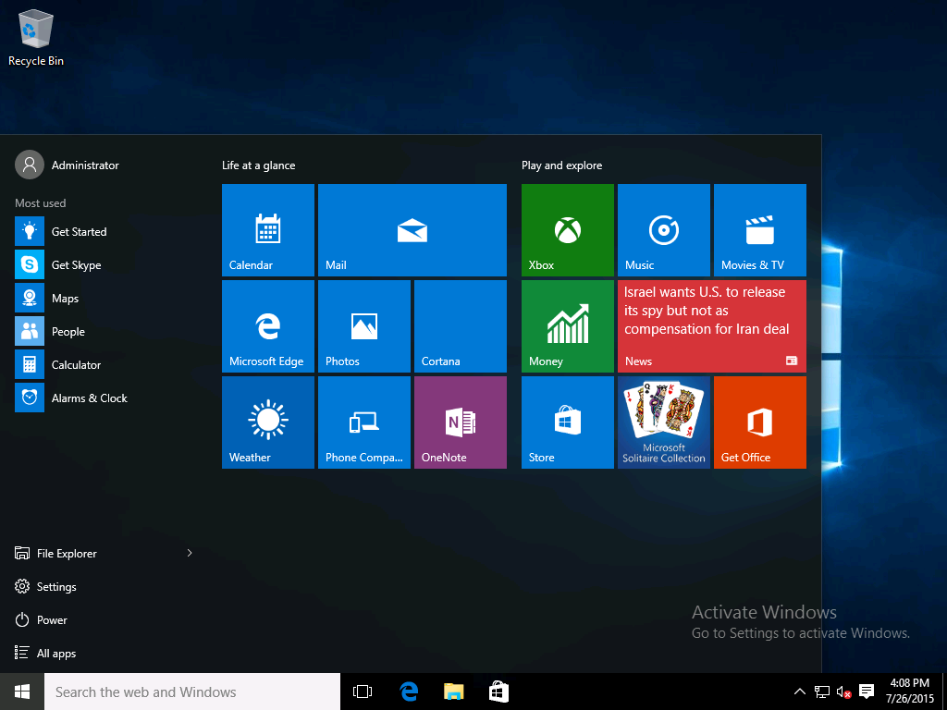
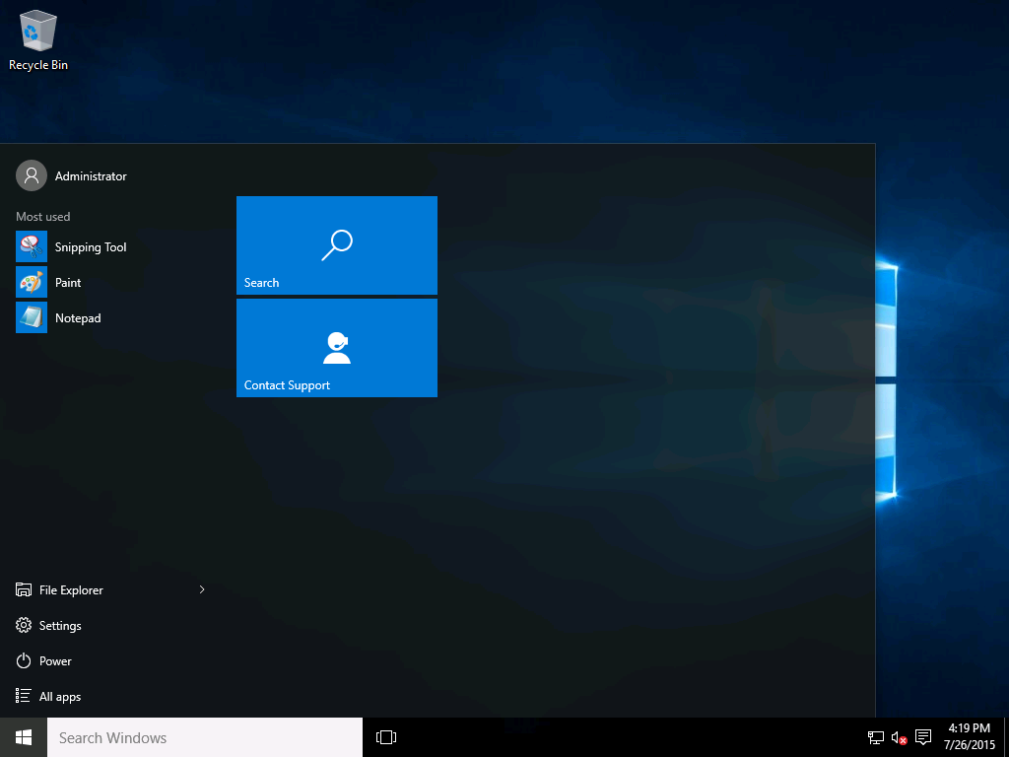
Understand the differences with Windows 10 LTSB
Microsoft Windows 10 Enterprise
(Current Branch, Current Branch for Business)
Microsoft Windows 10 Enterprise 2015 LTSB

Slide 21
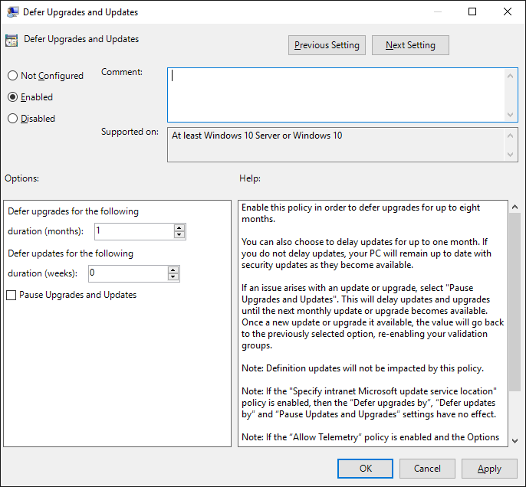
Windows 10: Specifying a preference for what comes next
Devices are not considered CB or CBB
Windows 10 releases transition from one stage to the next
  Starts as Current Branch, progresses to Current Branch for Business
Devices specify when they prefer to move to the next feature update
  Specify to “Defer” when you want to wait for Current Branch for Business
Each deployment or management tool can implement this idea differently

Slide 22
Implementing a deployment process
1
  Validate critical apps and infrastructure
  Ensure new release works with business-critical apps, core infrastructure tools
2
  Begin pilot deployments
  Start with IT, expand to broader volunteer audience, for app and hardware validation
3
  React as needed to feedback
  A few issues are expected, have a remediation plan in place.
4
  Deploy to the broad population
  Focus on risk reduction, minimizing disruption through scheduling, segmentation

Slide 23
Compatibility in Windows 10
Outstanding compatibility means a smooth migration from Windows 7 or Windows 8.1
Desktop apps
Web sites
Modern apps
Hardware
Organizations are observing compatibility rates above 99%
High compatibility achieved through:
Minimal changes
to Win32 APIs
Insider feedback during development
Telemetry
Internet Explorer 11 included (unchanged) for backwards compatibility
New Microsoft Edge browser for modern HTML5-based web sites
Enterprise Mode features to ensure proper use
High compatibility achieved through:
Validation of
Windows Store apps
Insider feedback during development
Telemetry
Significant investments, enhancements in each release
Windows 10 supports all devices capable of running Windows 7 and above
Identical hardware minimum requirements
as Windows 7
Strong driver compatibility, with updates delivered as needed through
Windows Update

Slide 24
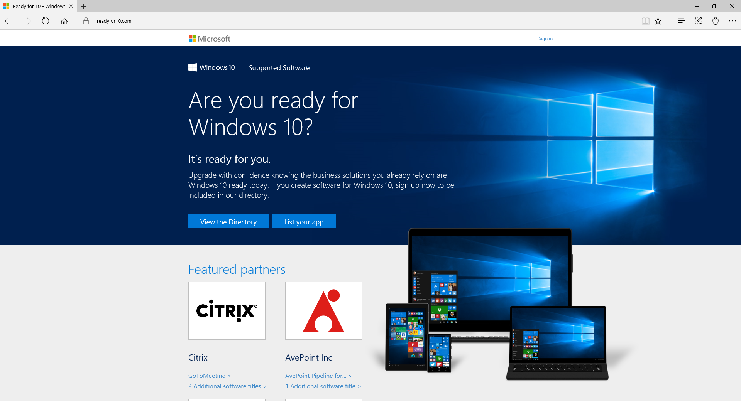
Compatibility in Windows 10
Get links to Windows 10 ISV support statements
http://www.readyforwindows.com
We are actively engaged with ISVs, to ensure full support for Windows as a service

Slide 25
How to validate applications
Create and maintain an
app portfolio
Prioritize, identifying
critical apps
Validate
business-critical apps
Leverage pilots for broader validation
Complete list of apps
and web pages used throughout the organization
Business and IT experts identified
IT works with the business to eliminate duplicates, define supported versions
Business critical
Managed
Supported
Unsupported
Blocked
Structured testing, using predefined test plans executed with business and IT experts
Automated if possible
Target small percentage
of apps
IT pilot, to gauge infrastructure, environment, and business productivity app readiness
Business pilot, targeting the broadest set of applications possible
Broad deployment using rings, to minimize risk

Slide 26
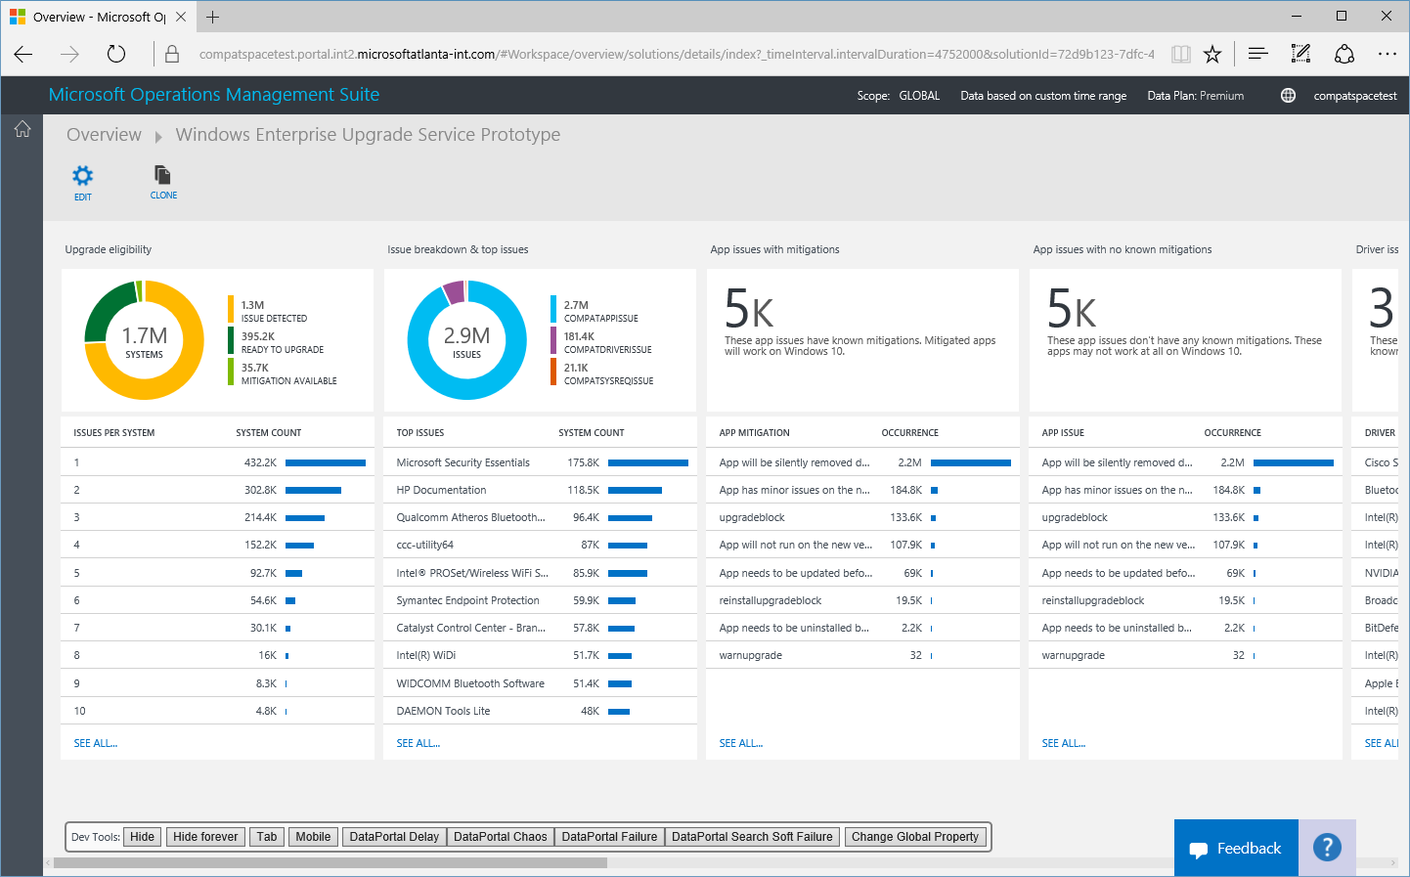
Coming soon: Windows Upgrade Analytics
Track upgrade readiness
  Leverage telemetry to see what’s
  happening in your organization
Identify app and driver issues
  See app and device details, known issues
Remediate
  Implement suggestions to resolve issues
Drive deployment
Sign up via http://www.microsoft.com/en-us/WindowsForBusiness/upgrade-analytics

Slide 27
Demo
Windows Upgrade Analytics

Slide 28
Distributing content using peer-to-peer
The server and data center are bottlenecks
The edges of the network have
more capacity
Using peer-to-peer technologies
shifts the traffic to the edges
  BranchCache (with WSUS, ConfigMgr)
  Delivery Optimization (with WU, WU for Business)
90% or more of the traffic can be shifted
Simple to implement, great for large
and small offices
Immediate return on investment
Wireless Access Point
Wireless Access Point
Router
Switches
Router
Switches
Data Center Server
Data Center Server
Without peer-to-peer
With peer-to-peer

Slide 29

Identifying a tool to use
Windows Update for Business
Windows Server Update Services
System Center Configuration Manager
Windows Update
Cloud
Upgrades installed as they are released (subject to throttling)
Delivery optimization for peer-to-peer distribution
Only option for Windows 10 Home
Cloud
Upgrades can be deferred
Builds on top of Windows Update
Uses Windows Update for content
On-Prem
Upgrades are deployed when you approve them
Content distributed from WSUS servers
Requires KB3095113
BranchCache to reduce bandwidth
On-Prem
Choice of task sequence-based upgrades or (with vNext) software update capabilities
Content distributed from ConfigMgr DPs
BranchCache to reduce bandwidth

Slide 30

Windows Update for Business
Agility
Get access to the latest technology and value sooner and easier. Quick “hands-free” deployment of the latest security updates.
Control
Time to plan and test updates after they have been released to the broad market. Control update rollout with custom rings based on business needs and rhythm.
Simplicity
Reduce infrastructure and workflow complexity. Leverage inbox update management and network optimization tools with integration into existing tools.

Slide 31
What’s new in WU for Business
Windows 10, version 1511 | Windows 10, version 1607
Ability to defer Quality updates Deferrals in weekly increments, up to 4 weeks | Increased control over Quality update deferrals Deferral periods set in days, up to 30 days Drivers can be optionally excluded quality update WU payloads
Ability to defer Upgrades Deferrals in monthly increments, up to 8 months | Increased control over Feature update rollout Deferral periods set in days, up to 180 days Feature updates can be paused for up to 60 days
Deferrals only for systems on the CBB branch | Deferrals can now be applied to both CB & CBB branches
No WSUS integration | WSUS, WUfB reporting and dual scan capability

Slide 32
Windows as a service: Deploying Windows
Unmatched flexibility and control, depending on needs
Windows Insider Preview Branch
Current Branch
Current Branch for Business
Long Term Servicing Branch
Specific feature and performance feedback
Application compatibility validation
Deploy to appropriate audiences
Test and prepare for broad deployment
Information workers
General population
Specialized systems
Early adopters, initial pilots,
IT devices
Deploy for mission
critical systems
No need for frequent new features (or any sort of change)
Too expensive for
general population
Test machines, small pilots
Benefits from new features
Begins broad deployment
NUMBER OF DEVICES
STAGE
Release

Slide 33

Windows Update for Business Workflow
Create Deployment Groups
Set deployment groups of Win10 devices to consume Security and Feature Updates at staggered intervals
Maintain control as updates deploy
Feature and Quality updates can be paused, allowing time to address any issues identified
Scale with network optimizations
Delivery Optimization (DO) allows for smart peer-to-peer download of updates. Dual Scan allows for integration with existing WSUS infrastructure
Microsoft Confidential

Slide 34
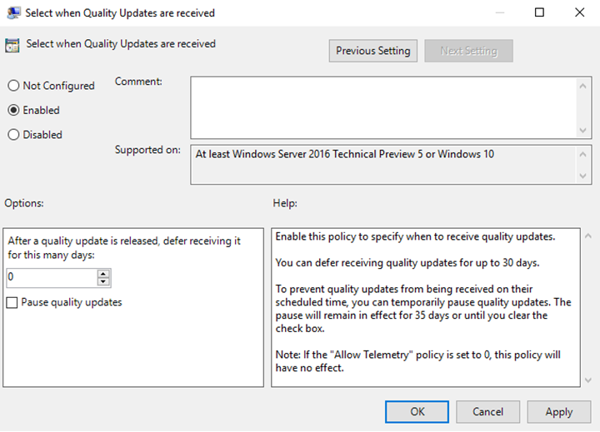



Windows Update for Business Workflow
Initial Pilots
No Deferral
Fast Ring
5 day deferral
Windows Update
Slow Ring
10 Day deferral

Slide 35
Windows Update for Business Workflow
Initial Pilots
No Deferral
Fast Ring
5 day deferral
Windows Update
Slow Ring
10 Day deferral

Slide 36
Windows Update for Business Workflow
Initial Pilots
No Deferral
Fast Ring
5 day deferral
Windows Update
Slow Ring
10 Day deferral

Slide 37

Windows Update for Business Workflow
Initial Pilots
No Deferral
Fast Ring
5 day deferral
Windows Update
Slow Ring
10 Day deferral

Slide 38
Windows Update for Business Workflow
Initial Pilots
No Deferral
Fast Ring
5 day deferral
Windows Update
Slow Ring
10 Day deferral

Slide 39
Windows Update for Business Workflow
Initial Pilots
No Deferral
Fast Ring
5 day deferral
Windows Update
Slow Ring
10 Day deferral

Slide 40
Windows Update for Business Workflow
Initial Pilots
No Deferral
Fast Ring
5 day deferral
Windows Update
Slow Ring
10 Day deferral

Slide 41
Windows Update for Business Workflow
Initial Pilots
No Deferral
Fast Ring
5 day deferral
Windows Update
Slow Ring
10 Day deferral

Slide 42
Addressing deployment issues
Windows Update for Business

Slide 43
Addressing deployment issues
Windows Update for Business
Initial Pilots
No Deferral
Fast Ring
5 day deferral
Windows Update
Slow Ring
10 Day deferral

Slide 44
Addressing deployment issues
Windows Update for Business
Initial Pilots
No Deferral
Fast Ring
5 day deferral
Windows Update
Slow Ring
10 Day deferral

Slide 45

Addressing deployment issues
Windows Update for Business
Initial Pilots
No Deferral
Fast Ring
5 day deferral
Windows Update
Slow Ring
10 Day deferral

Slide 46
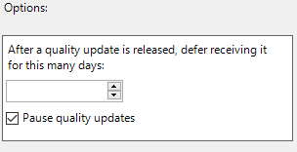

Addressing deployment issues
Windows Update for Business
Initial Pilots
No Deferral
0
Fast Ring
5 day deferral
Windows Update
5
Slow Ring
10 Day deferral
10

Slide 47
Addressing deployment issues
Windows Update for Business
Initial Pilots
No Deferral
Fast Ring
5 day deferral
Windows Update
Slow Ring
10 Day deferral

Slide 48
Addressing deployment issues
Windows Update for Business
Initial Pilots
No Deferral
Fast Ring
5 day deferral
Windows Update
Slow Ring
10 Day deferral

Slide 49
Addressing deployment issues
Windows Update for Business
Initial Pilots
No Deferral
Fast Ring
5 day deferral
Windows Update
Slow Ring
10 Day deferral

Slide 50
Addressing deployment issues
Windows Update for Business
Initial Pilots
No Deferral
Fast Ring
5 day deferral
Windows Update
Slow Ring
10 Day deferral

Slide 51
Addressing deployment issues
Windows Update for Business
Initial Pilots
No Deferral
Fast Ring
5 day deferral
Windows Update
Slow Ring
10 Day deferral

Slide 52
Addressing deployment issues
Windows Update for Business
Initial Pilots
No Deferral
Fast Ring
5 day deferral
Windows Update
Slow Ring
10 Day deferral

Slide 53
More Info
Start Here:
https://technet.microsoft.com/en-us/windows/mt763932
https://technet.microsoft.com/en-us/itpro/windows/manage/waas-manage-updates-wufb

Slide 54
Try it with a little help from your friends
WUfBInfo@Microsoft.com
Find out where to get information on WUFB, including white papers, etc.
in an auto-response email.
WUfBIdeas@Microsoft.com
Are there features that you need to make WUfB better? Let us know here.
WUfBQuestions@Microsoft.com
Not finding what you need to know? Put your question in the email and
we’ll help you find the answer.

Slide 55
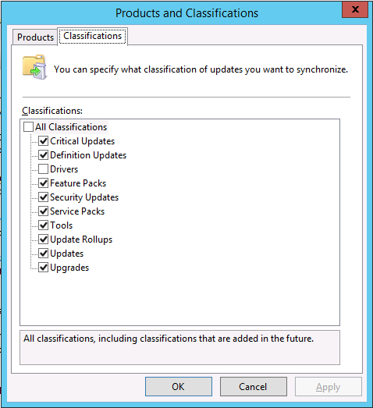
Windows Server
Update Services
Enabling upgrades
Updated to support Windows 10 feature upgrades, including upgrades from downlevel OSes
Requires WSUS 4.0 (Windows Server 2012 or above)
with KB3095113
See http://blogs.technet.com/b/wsus/archive/2015/12/04/important-update-for-wsus-4-0-kb-3095113.aspx for an important note
Windows 10 1607 will be published on 8/16

Slide 56
Demo
Windows Server Update Services

Slide 57
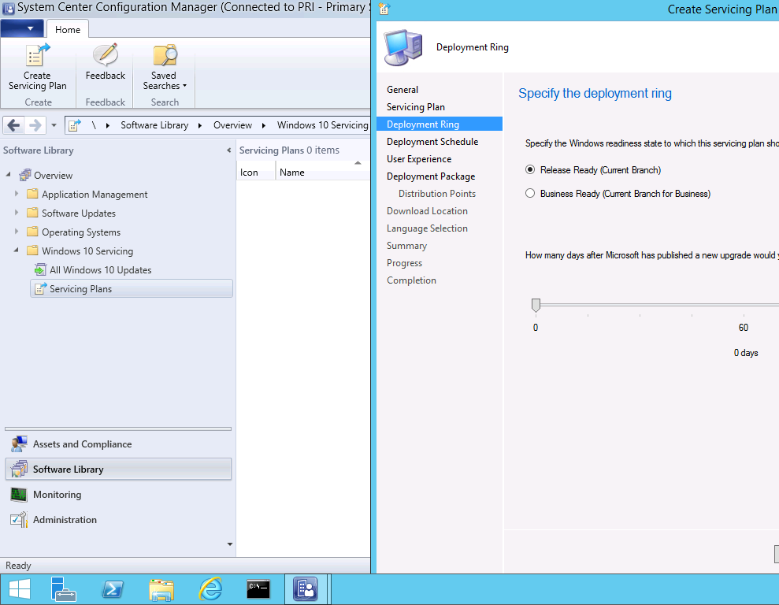
System Center
Configuration
Manager
Servicing Plans
System Center Configuration Manager 1602 or later needed to support Windows 10 1607
Requires WSUS 4.0 (Windows Server 2012 or above) with KB3095113
Windows 10 Servicing Plans provide automation

Slide 58
Demo
System Center Configuration Manager

Slide 59
Q&A

Slide 60


Please evaluate this session
Your feedback is important to us!
From your PC or Tablet visit MyIgnite at http://myignite.microsoft.com
From your phone download and use the Ignite Mobile App by scanning the QR code above or visiting https://aka.ms/ignite.mobileapp

