Slide 1
Adding intelligence to your LOB applications using Power BI Embedded
BRK3130
Josh Caplan
Senior Program Manager
Jono Luk
Group Program Manager

Slide 2
Nearly everyone engages with software

Slide 3
Nearly everyone engages with software
Yet fewer than 25% of employees have access to analytical insights
http://www.biscorecard.com/bi-adoption-flat/

Slide 4
Providing contextual insights where and when users need them is challenging
Nearly all apps have reporting capabilities
DEVICE-AGNOSTIC CONSUMPTION
DISPERSED AND COMPLEX DATA
SHRINKING ATTENTION SPANS

Slide 5
Power BI Embedded
Virtual Machines
Web + Mobile
Data + Storage
Data + Analytics
Internet of Things
Networking
Media + CDN
Hybrid Integration
Security + Identity
Developer Services
Management
Intelligence
Containers
Power BI Embedded
Cognitive Services APIs
Data Catalog
HDInsight
Data Lake Analytics
Machine Learning
Data Factory
Event Hub
Stream Analytics job
Cloudera Enterprise Data Hub
Hortonworks Sandbox with HDP 2.4
Your app
PREVIEW
A core component for Azure Analytics services

Slide 6
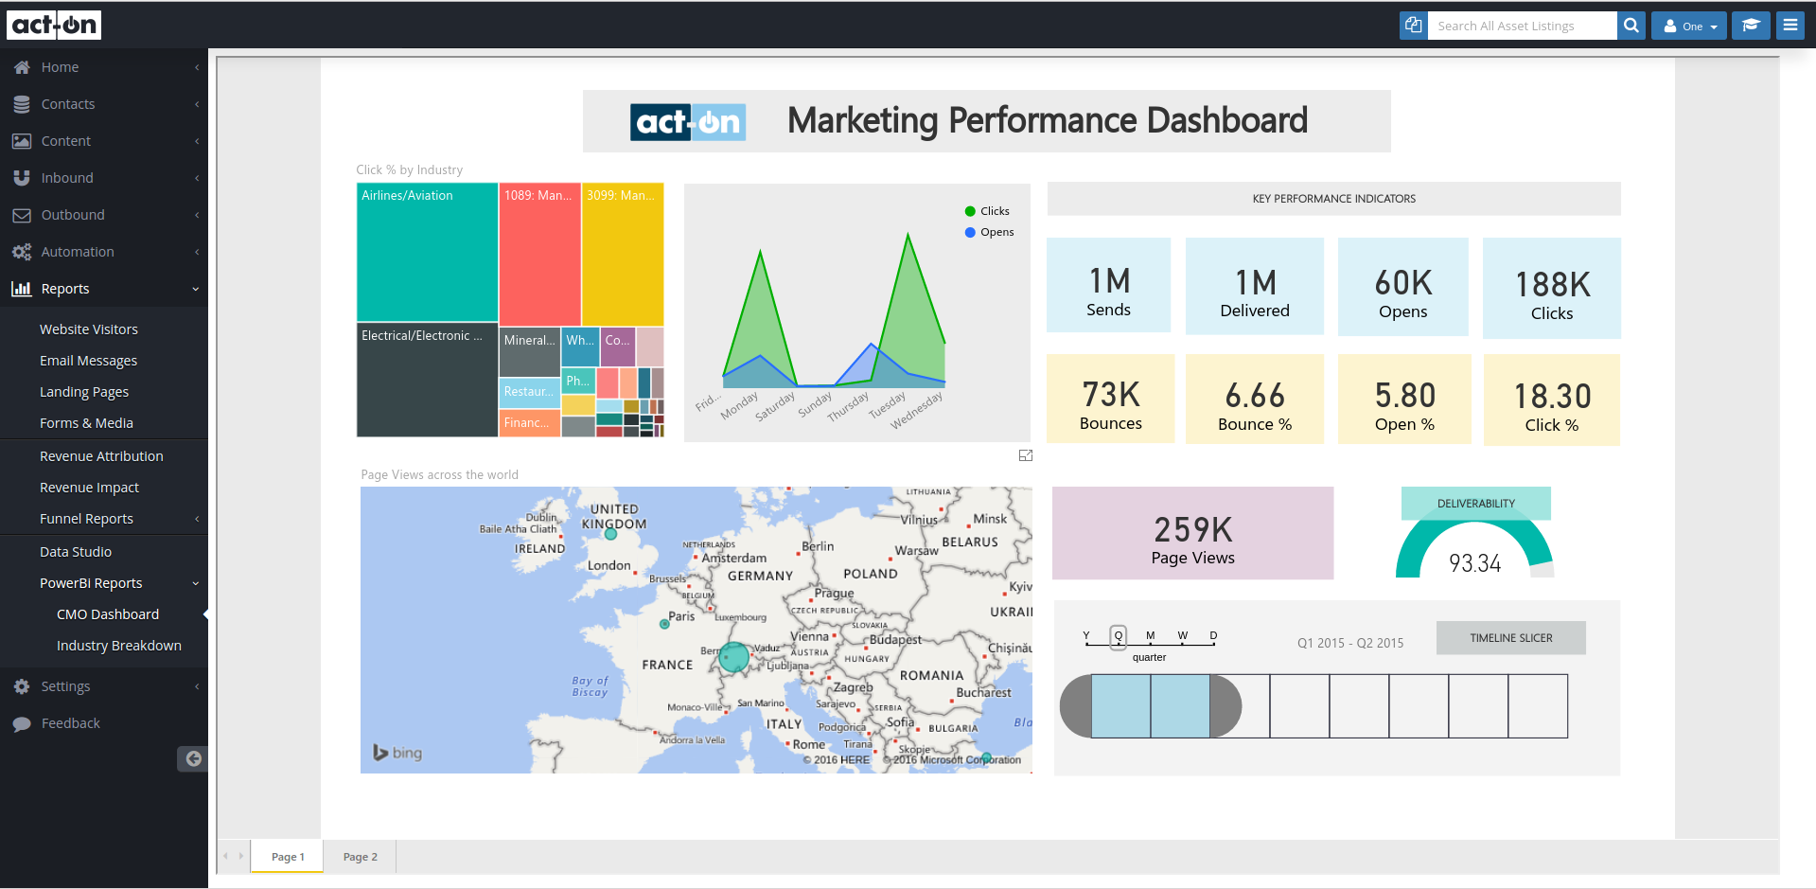
Demo Nintex Hawkeye

Slide 7
Only Microsoft has all the solutions to help your customers realize digital transformation
Microsoft AppSource
Office 365
Power BI
Cortana intelligence
Azure IoT
Dynamics 365
Third party business applications
Sales
Customer Service
Field Service
Project Service Automation
Marketing
Operations
Application platform (PowerApps, Power BI Embedded, Flow) & Common Data Model
Azure

Slide 8
Power BI Embedded Conceptual Model
1,N
Microsoft Azure subscription
Developer
1,N
Workspace collection
Name
Admin Users
Endpoints
Keys
Gateways
Credentials
Geo Location
Tags
Azure SQL Database
Azure SQL Data Warehouse
1,N
Workspace
Name
Reports
Datasets
Tags
Embed
Your app
End users

Slide 9
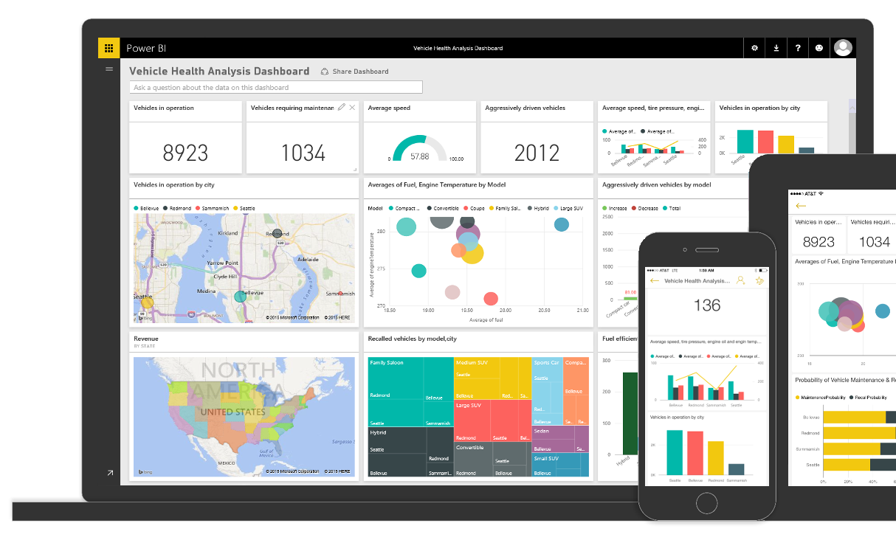
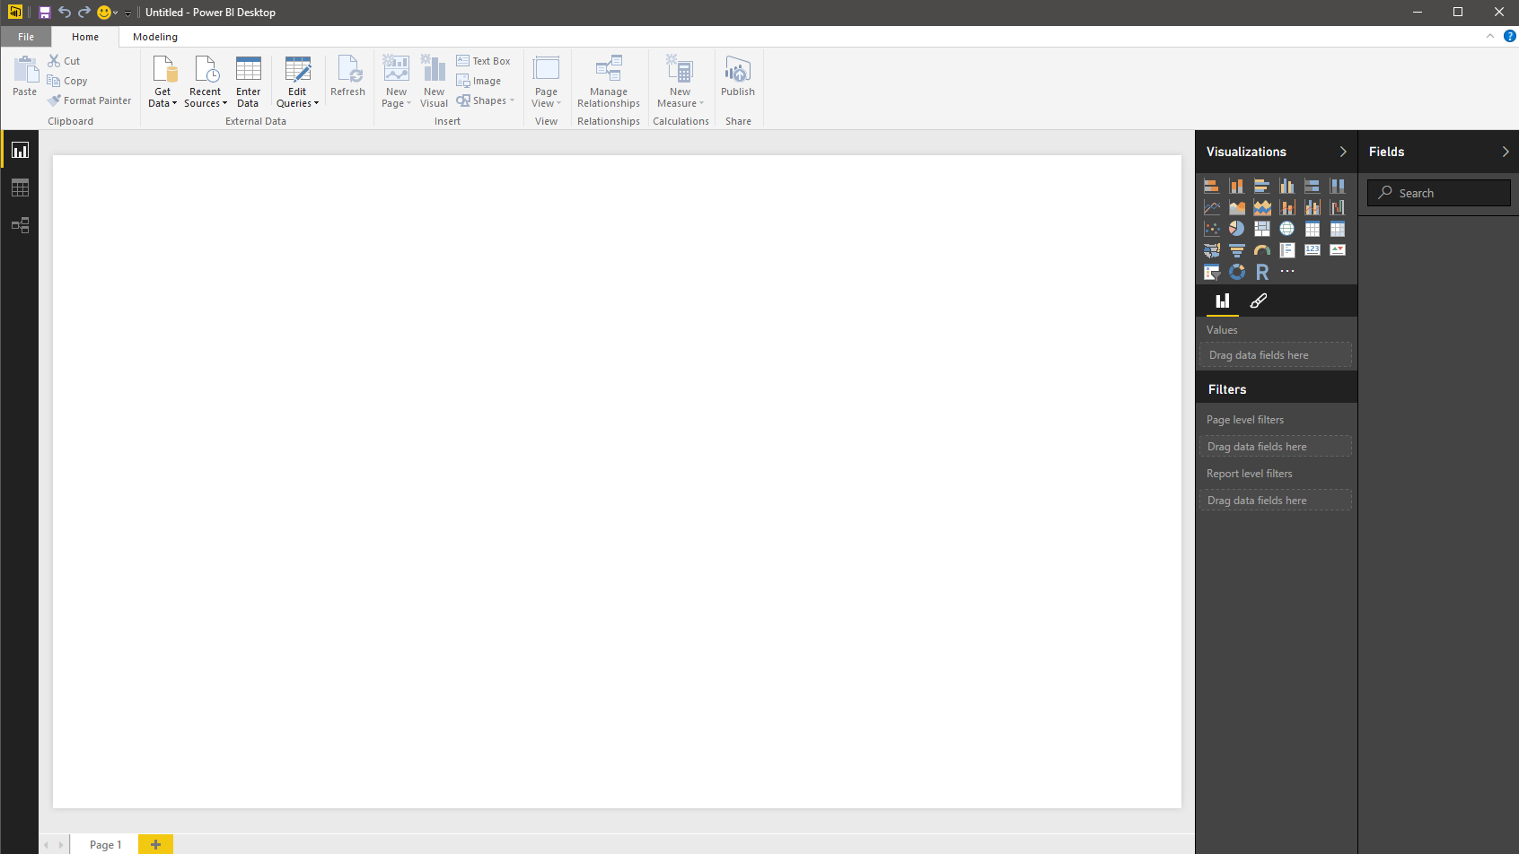
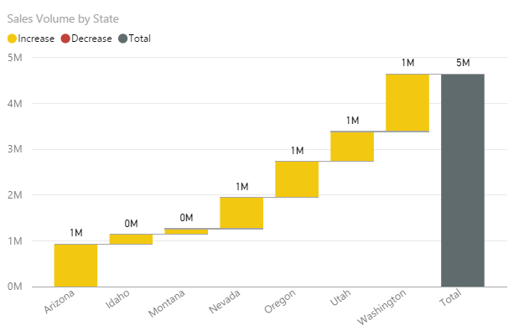
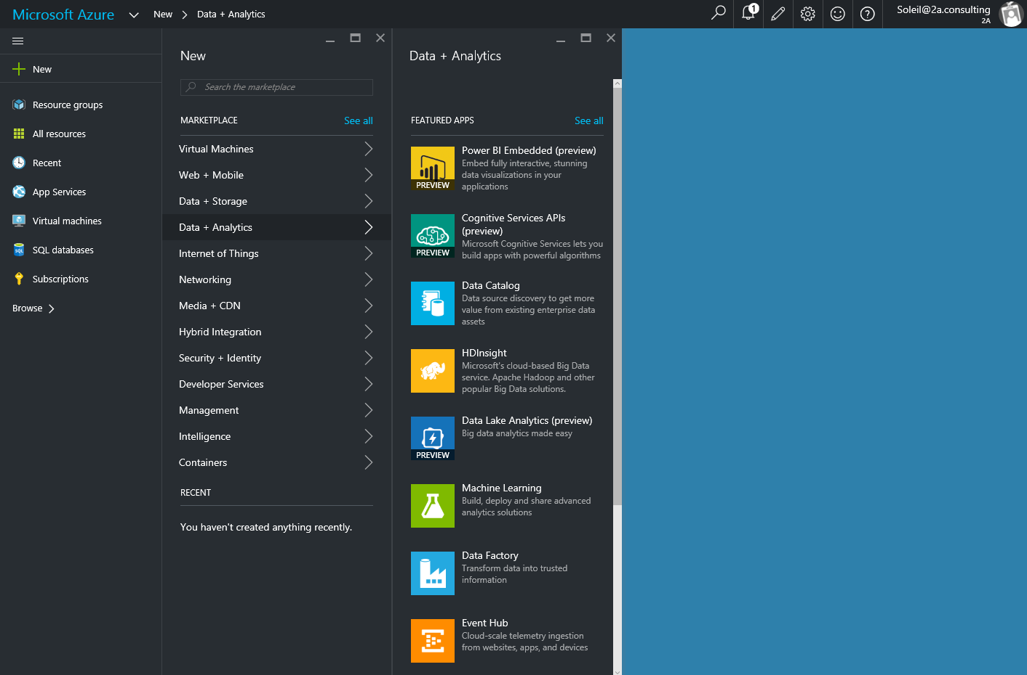
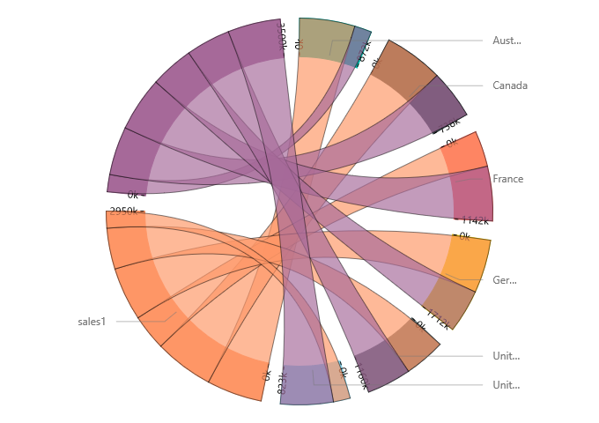
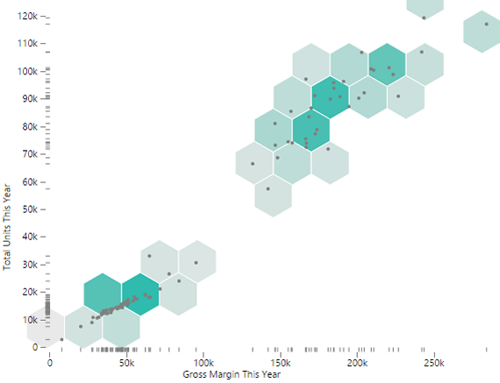
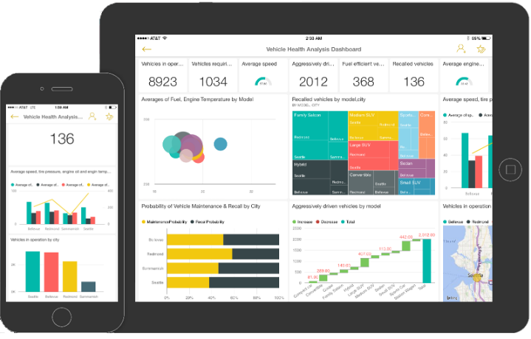
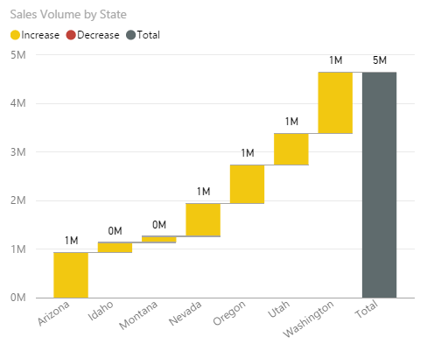
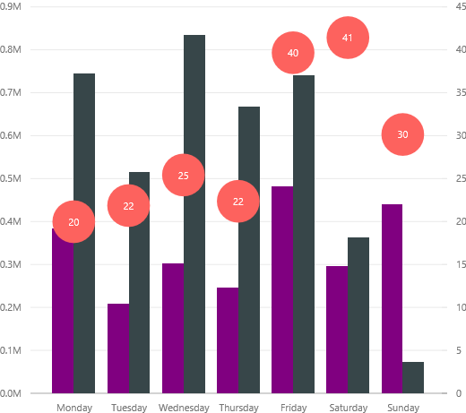
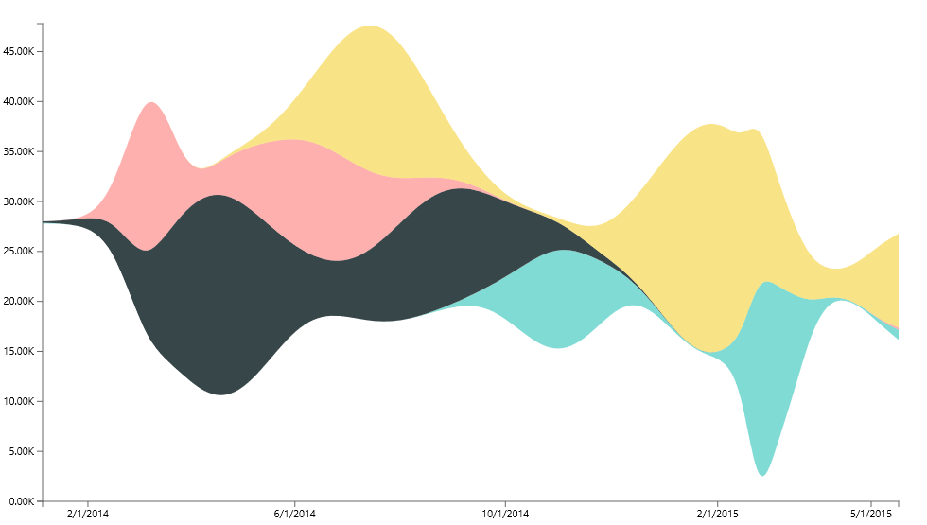
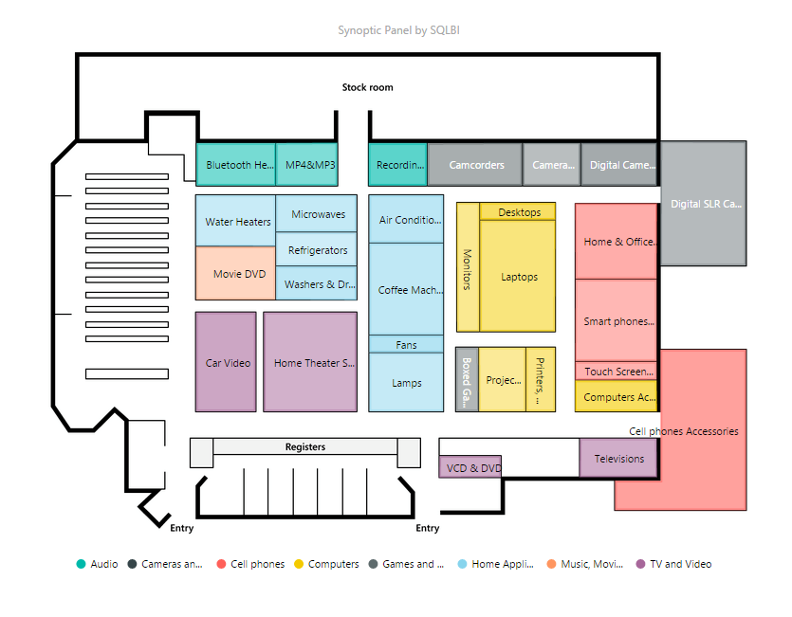
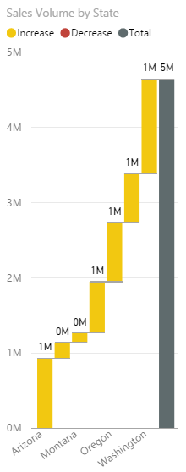
You have the app. You have the data. Bring data to life inside your app with Power BI Embedded
Create compelling interactive reports
Embed easily for faster time to value
Deploy quickly and manage with ease

Slide 10
Go live in <10 minutes

Slide 11
Power BI Embedded API surface
Your app
Power BI APIs
Discovery: Enumerate datasets and reports
Content Creation: Provision datasets and reports
Embed: Embed reports
Utility: Set connection strings and credentials
Programmatic
REST APIs
Azure Resource Manager API
Azure APIs for automation
Microsoft Azure
Power BI Embedded
Platform
Provision workspace collections
De-provision workspace collections
Manage API keys
Azure SQL Database
Azure SQL Data Warehouse
Spark on Azure HDInsight
Data

Slide 12
Authentication and Authorization

Slide 13
App Tokens

Slide 14
App Tokens
Application
AuthN
AuthZ
Power BI
Workspace Collection

Slide 15
Provide seamless authentication experiences
Application
Power BI
Users
Workspace
Auth. providers
Token
+ Claim: Can view Report 1
+ Expiration: 5 minutes
Report 1
Permissions
Report 2
Sign token
API keys
API keys
Copy API keys to your application

Slide 16
Provide seamless authentication experiences
Application
Power BI
User requests to view Report 1
Users
Workspace
Auth. providers
Token
+ Claim: Can view Report 1
+ Expiration: 5 minutes
Report 1
Permissions
Report 2
Validate token
API keys
API keys

Slide 17
Provide seamless authentication experiences
Application
Power BI
Users
Workspace
Auth. providers
Report 1
Report 1
Permissions
Report 2
API keys
API keys

Slide 18
Row Level Security

Slide 19
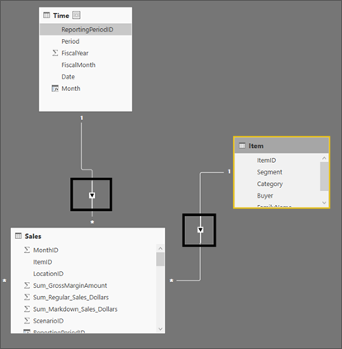
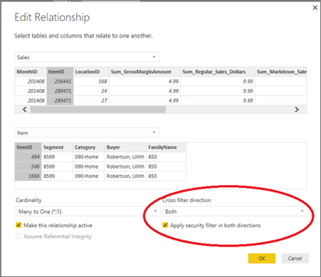

Slide 20
Provide seamless authentication experiences
Application
Power BI
Users
Workspace
Auth. providers
Token
+ Claim: Can view Report 1
+ Expiration: 5 minutes
Report 1
Permissions
Report 2
Sign token
API keys
API keys
Copy API keys to your application

Slide 21
Provide seamless authentication experiences
Application
Power BI
Users
Workspace
Token
+ Claim: Can view Report 1
+ Expiration: 5 minutes
+ username: “user1”
+ roles: “sales”
Auth. providers
Report 1
Permissions
Report 2
Sign token
API keys
API keys
Copy API keys to your application

Slide 22
Demo: Row Level Security

Slide 23
Bi-directional Communication

Slide 24
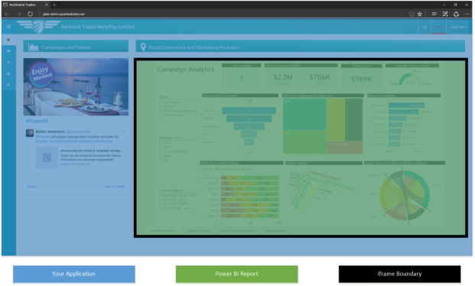
JavaScript API

Slide 25
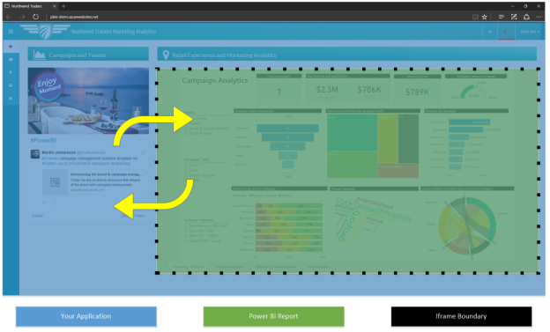
JavaScript API

Slide 26
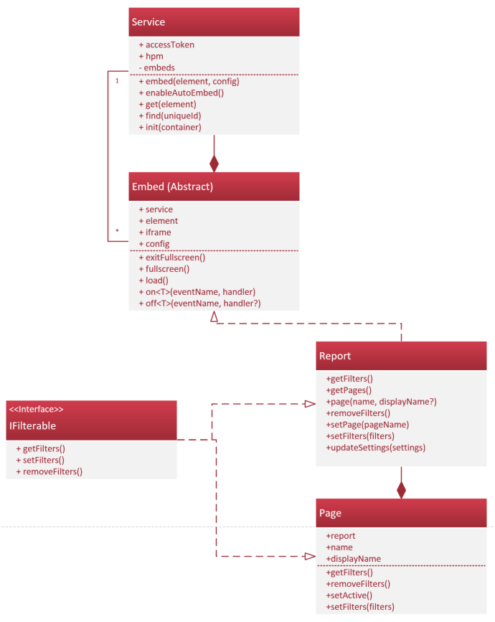
JavaScript API
Try

Slide 27
Custom Visuals

Slide 28
Custom Visuals can help make your data even easier to consume
In-context, domain-specific data visualization is key to unlock insights
Custom Visualizations framework allows customers and partners to build visuals that make sense for their business domain
All in-box & community visuals are open sourced on GitHub
Built using D3 & TypeScript, but can use any web technologies
Behaves like any other visual in your reports
Use ones from the community, or build your own*

Slide 29
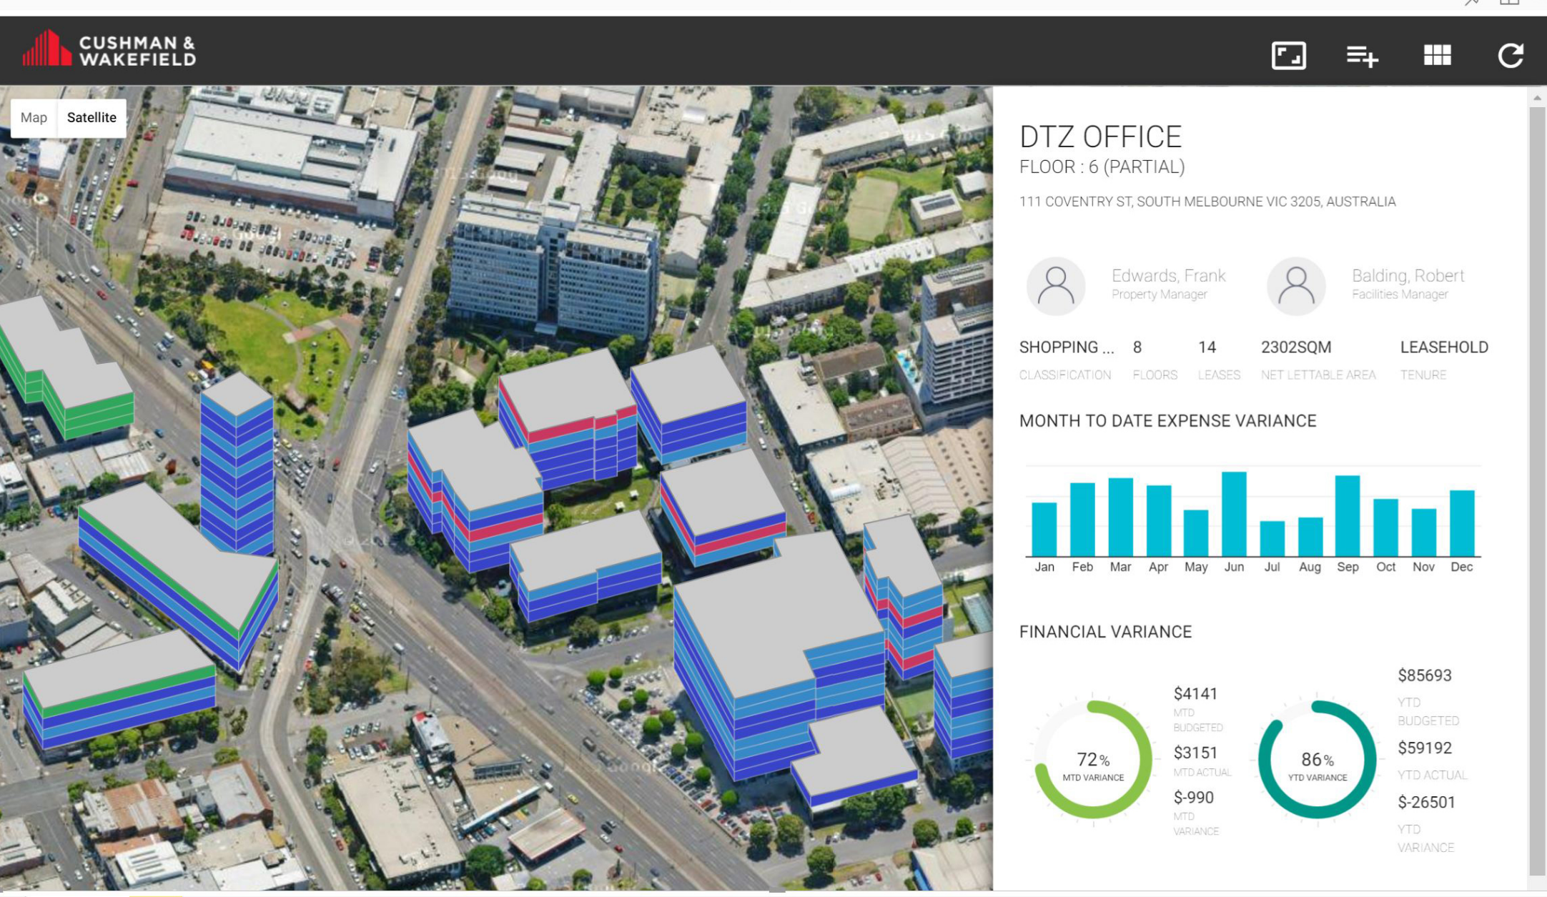
Demo Cushman & Wakefield

Slide 30
Case study: Narratives for Power BI
Narratives for Power BI is a custom visual for Power BI users that automatically transforms data into insightful narratives
Intelligent
Intuitive
Insightful
Surface hidden insights within data & visualizations, accelerating time to understanding
Generate dynamic narratives while interacting with data & visualizations, gaining real-time insights
Identify relationships in data not obvious in data & visualization alone, reducing the hypothesis phase

Slide 31
Pricing

Slide 32
Control costs with pay-as-you-go consumption-based pricing
Price per report session, per month in effect September 1st, 2016
0-100 sessions | Free
100+ sessions | $0.05/report session
What is one report session?
Every time a Power BI report is loaded inside your app.
Author interactive reports in Power BI Desktop for free
Provide Power BI visualizations— free for your external app users
Query
Your data
Your users
Cache

Slide 33
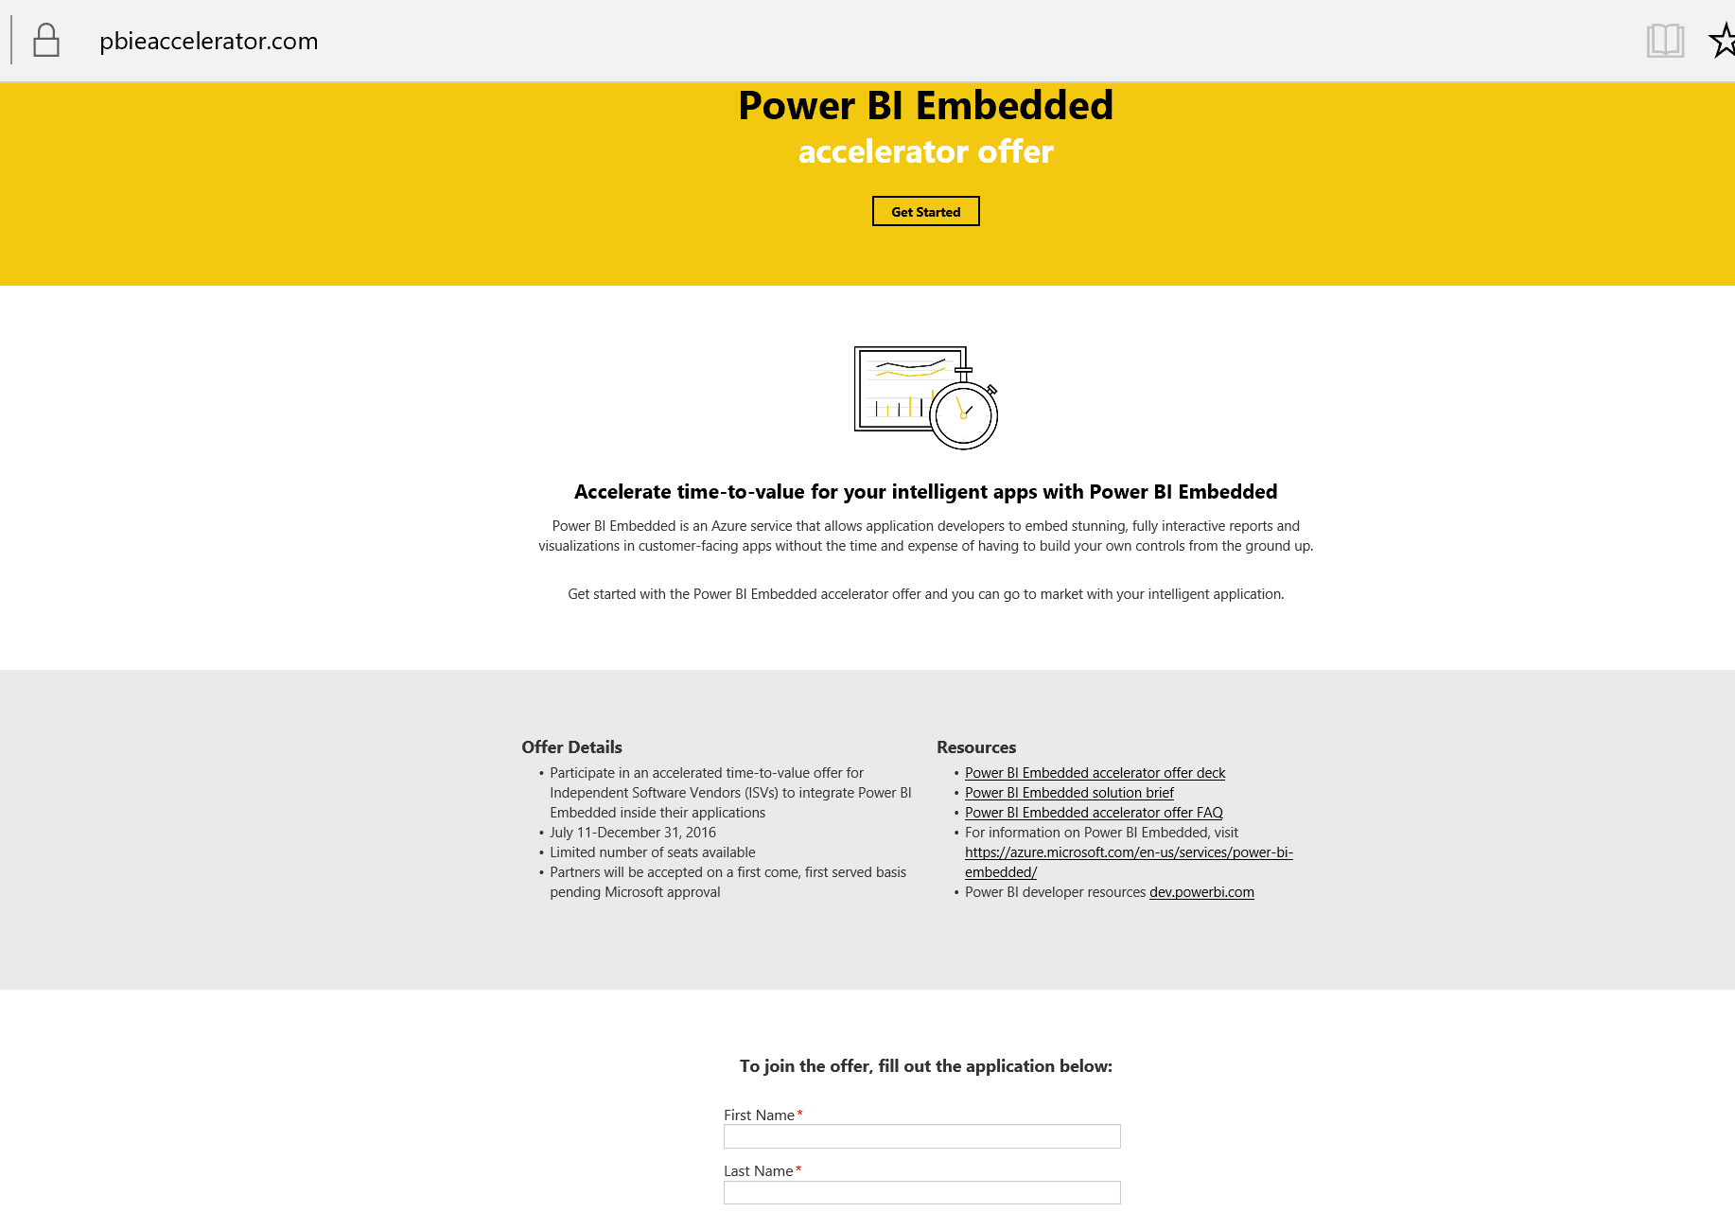
Join Power BI Embedded accelerator offer now!
https://www.pbieaccelerator.com/

Slide 34
Get started for free, today
https://azure.microsoft.com/services/power-bi-embedded/
Stay up-to-date with Power BI developer news
dev.powerbi.com

Slide 35
Free IT Pro resources To advance your career in cloud technology
Plan your career path
Cloud role mapping
Expert advice on skills needed
Self-paced curriculum by cloud role
$300 Azure credits and extended trials
Pluralsight 3 month subscription (10 courses)
Phone support incident
Weekly short videos and insights from Microsoft’s leaders and engineers
Connect with community of peers and Microsoft experts
Microsoft IT Pro Career Center
www.microsoft.com/itprocareercenter
Get started with Azure
Microsoft IT Pro Cloud Essentials
www.microsoft.com/itprocloudessentials
Demos and how-to videos
Microsoft Mechanics
www.microsoft.com/mechanics
Connect with peers and experts
Microsoft Tech Community
https://techcommunity.microsoft.com

Slide 36
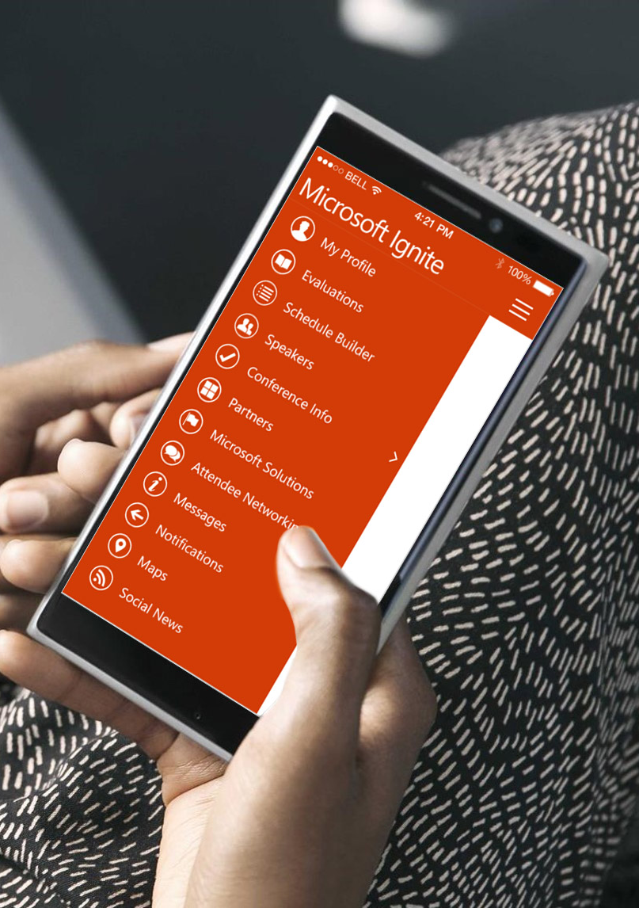
Please evaluate this session
Your feedback is important to us!
From your PC or Tablet visit MyIgnite at http://myignite.microsoft.com
From your phone download and use the Ignite Mobile App by scanning the QR code above or visiting https://aka.ms/ignite.mobileapp

