Slide 1
Query Big Data using the Expanded T-SQL footprint with PolyBase in SQL Server 2016
BRK3129
Casey Karst
Program Manager II

Slide 2
Session objectives and takeaways
Session objectives:
Overview PolyBase functionality
See PolyBase in action
Review common scenarios
Key Takeaways:
PolyBase connects HDFS and SQL Server
T-SQL is converted to MapReduce jobs for large data processing
PolyBase in SQL 16 is a multifaceted tool

Slide 3
Agenda
Why did we build it?
What is PolyBase?
SQL 16 Querying WASB/ Hadoop
Common Scenarios

Slide 4
Why did we build it?

Slide 5


There’s a lot of data in the world…
And it’s only getting BIGGER!

Slide 6
The nature of data is changing.
Relational Semi-Structured
Id | Sale_id | Value
1 | 12 | $1.54
2 | 215 | $2.21

Slide 7
What is PolyBase?

Slide 8
Big Picture
RDBMS
HDFS
PolyBase
Provides a scalable, T-SQL language extension for combining data from both universes

Slide 9
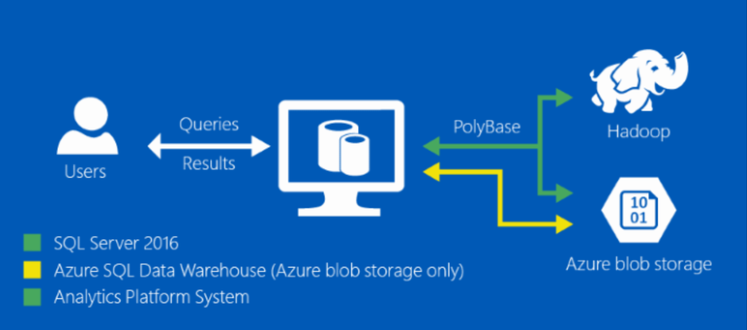
A little deeper understanding

Slide 10
PolyBase Scenarios
Import
Export
Queries
Reporting

Slide 11
PolyBase in SQL 2016

Slide 12
SQL Server 2016
SQL Server 2016
SQL Server 2016 Enterprise Edition
PolyBase
Engine
Windows Service responsible for distributed query processing.
PolyBase DMS
Windows Service responsible for reading, writing data from HDFS to SQL Server.

Slide 13
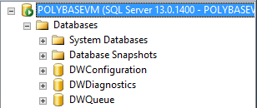
PolyBase Internal Databases
DWConfiguration- Holds configuration information for the PolyBase engine and DMS services
DWDiagnostics- Contains diagnostics of distributed query system
DWQueue- Contains information needed for rollback.
DO NOT ALTER THESE!

Slide 14
SQL Server Scale-Out Group
Head Node
Why did we build this?
Moving data takes time. All queries move some data (even pushdown).
What does this do?
Creates parallel reads across compute nodes for faster throughput.
How?
Each SQL Node connects to each HDFS datanode. Query is distributed to compute nodes from head node and results are funneled to head node for presentation
SQL16
SQL16
SQL16
SQL16
PolyBase
Engine
PolyBaseDMS
PolyBaseDMS
PolyBaseDMS
PolyBaseDMS
Compute Nodes

Slide 15
Data moves between clusters in parallel
Head Node
SQL16
SQL16
SQL16
SQL16
SQL16
PolyBase
Engine
PolyBase
DMS
PolyBase
DMS
PolyBase
DMS
PolyBase
DMS
Namenode
(HDFS)
Data Node
Data Node
Data Node
Data Node
Hadoop
Cluster
File
System
File
System
File
System
File
System

Slide 16
PolyBase Querying WASB

Slide 17
PolyBase Scale-out Group Deep Dive

Slide 18
Anatomy of a PolyBase Scaleout Group
Head Node
SQL16
SQL16
SQL16
SQL16
PolyBase
Engine
PolyBaseDMS
PolyBaseDMS
PolyBaseDMS
PolyBaseDMS
Compute Nodes
HDFS

Slide 19
PolyBase Query Life Cycle
Query comes into head node referencing External Table.
Create temp table on head node to land HDFS data.
Assign extended properties to table.
Update statistics with known statistics of external data.
SQL16
SQL16
SQL16
SQL16
PolyBase
Engine
PolyBaseDMS
PolyBaseDMS
PolyBaseDMS
PolyBaseDMS
HDFS

Slide 20
PolyBase Query Life Cycle
Head Node delegates to Compute nodes via DMS.
Create temp table on compute nodes.
Distribute query
SQL16
SQL16
SQL16
SQL16
PolyBase
Engine
PolyBaseDMS
PolyBaseDMS
PolyBaseDMS
PolyBaseDMS
HDFS

Slide 21
PolyBase Query Life Cycle
Round Robin Import of Data into Temp Table using HDFS bridge.
Filter columns after data is in PolyBase DMS.
Write data to temp tables or in memory.
SQL16
SQL16
SQL16
SQL16
PolyBase
Engine
PolyBaseDMS
PolyBaseDMS
PolyBaseDMS
PolyBaseDMS
HDFS

Slide 22
PolyBase Query Life Cycle
Combine data for computation in head node.
Stream data back from compute node temp tables to head node temp table
Compute aggregates and select filters.
SQL16
SQL16
SQL16
SQL16
PolyBase
Engine
PolyBaseDMS
PolyBaseDMS
PolyBaseDMS
PolyBaseDMS
HDFS

Slide 23
PolyBase Query Life Cycle
Present results and clean up.
Show results to the user.
Delete compute node temp tables
Delete head node temp table.
SQL16
SQL16
SQL16
SQL16
PolyBase
Engine
PolyBaseDMS
PolyBaseDMS
PolyBaseDMS
PolyBaseDMS
HDFS

Slide 24
Data moves between clusters in parallel
Head Node
SQL16
SQL16
SQL16
SQL16
SQL16
PolyBase
Engine
PolyBase
DMS
PolyBase
DMS
PolyBase
DMS
PolyBase
DMS
Namenode
(HDFS)
Data Node
Data Node
Data Node
Data Node
Hadoop
Cluster
File
System
File
System
File
System
File
System

Slide 25
Common Scenarios

Slide 26
Expanding reach of Analysts
SQL

Slide 27
Expanding reach of Analysts
Azure Storage
SQL
Hadoop

Slide 28
PolyBase Querying Hadoop

Slide 29
Dashboarding
SQL
Hadoop
Business Logic and Joins in the dashboard

Slide 30
Dashboarding
SQL
Hadoop
Business Logic and Joins in the database. Simple views.

Slide 31
Data Movement for…
SQL
Azure Storage

Slide 32
Data Movement for Dev/Test
SQL Dev/Test
SQL
Azure Storage
SQL Dev/Test
SQL Dev/Test

Slide 33
Data Movement for DR
SQL
Azure Storage
SQL DW
APS

Slide 34
Data Movement for Cloud Data Warehousing
Azure Storage
SQL DW

Slide 35
PolyBase Going Forward

Slide 36
Call to Action
Try PolyBase
  SQL 16 Evaluation Download
Let us know features we are missing!
SQL Server Feedback
SQL DW Feedback
If you get stuck, Just ask!
SQL Server Forum
SQL DW Forum

Slide 37
Appendix

Slide 38
Key Take Away – Number of Files
Node Count | 1 | 2 | 3 | 4 | 5
Readers | 8 | 16 | 24 | 32 | 40
Converters | 8 | 16 | 24 | 32 | 40
Writers | 8 | 16 | 24 | 32 | 40
Optimal minimum number of files
Next Optimal
Equation

Slide 39
Key Take Away – Number of Files
Node Count | 1 | 2 | 3 | 4 | 5
Readers | 8 | 16 | 24 | 32 | 40
Converters | 8 | 16 | 24 | 32 | 40
Writers | 8 | 16 | 24 | 32 | 40
Optimal minimum number of files | 8 | 16 | 24 | 32 | 40
Next Optimal
Equation

Slide 40
Key Take Away – Number of Files
Node Count | 1 | 2 | 3 | 4 | 5
Readers | 8 | 16 | 24 | 32 | 40
Converters | 8 | 16 | 24 | 32 | 40
Writers | 8 | 16 | 24 | 32 | 40
Optimal minimum number of files | 8 | 16 | 24 | 32 | 40
Next Optimal | 16 | 32 | 48 | 64 | 80
Equation | n*8 | n*16 | n*24 | n*32 | n*40

Slide 41
Key Take Away – File size Skew impacts Perf
1536 MB
1024 MB
512 MB
1
2
3
4
5
6
Files

Slide 42
Key Take Away – File size Skew impacts Perf
1536 MB
1024 MB
512 MB
1
2
3
4
5
6
1*
Files

Slide 43
Key Take Away – File size Skew impacts Perf
1536 MB
1024 MB
512 MB
1
2
3
Files

Slide 44
Key Take Away – File size Skew impacts Perf
1536 MB
1024 MB
512 MB
1
Files

Slide 45
Key Take Away – File size Skew impacts Perf
1536 MB
1024 MB
512 MB
1
1*
1*
Files

Slide 46
Key Take Away – File size Skew impacts Perf
1536MB
1024 MB
512 MB
1
2
1*
1*
Files

Slide 47
Key Take Away – File size Skew impacts Perf
1536MB
1024 MB
512 MB
1
2
1*
1*
2*
Files

Slide 48
Key Take Away – File size Skew impacts Perf
1536MB
1024 MB
512 MB
1
2
3
1*
1*
2*
Files

Slide 49
Key Take Away – File size Skew impacts Perf
1536MB
1024 MB
512 MB
1
2
3
1*
1*
2*
3*
3*
Files

Slide 50
Free IT Pro resources
To advance your career in cloud technology
Plan your
career path
Cloud role mapping
Expert advice on skills needed
Self-paced curriculum by cloud role
$300 Azure credits and extended trials
Pluralsight 3 month subscription (10 courses)
Phone support incident
Weekly short videos and insights from Microsoft’s leaders and engineers
Connect with community of peers and Microsoft experts
Microsoft IT Pro Career Center
www.microsoft.com/itprocareercenter
Get started
with Azure
Microsoft IT Pro Cloud Essentials
www.microsoft.com/itprocloudessentials
Demos and
how-to videos
Microsoft Mechanics
www.microsoft.com/mechanics
Connect with peers and experts
Microsoft Tech Community
https://techcommunity.microsoft.com

Slide 51


Please evaluate this session
Your feedback is important to us!
From your PC or Tablet visit MyIgnite at http://myignite.microsoft.com
From your phone download and use the Ignite Mobile App by scanning the QR code above or visiting https://aka.ms/ignite.mobileapp

