Slide 1
Power BI for the Enterprise
BRK3128
Adam Wilson
Dimah Zaidalkilani

Slide 2
Agenda
Connecting to enterprise data
Building and managing content
Security and compliance

Slide 3
Connecting to Enterprise Data

Slide 4
Data refresh in Power BI
Where is your data?
Cloud
On-premises
How do you connect?
Import data
Direct Query
How do you refresh?
Personal Gateway
On-premises data gateway

Slide 5
Data refresh in Power BI
Where is your data?
Cloud
On-premises
How do you connect?
Import data
Direct Query
How do you refresh?
Personal Gateway
On-premises data gateway

Slide 6
Data in the cloud
Access/refresh the data through
Direct Query (Azure SQL, DW and Spark HDInsight)
Import data - scheduled refresh
Rest APIs to stream data
Supported cloud sources
SaaS sources
Azure – SQL, DW, Blob, Table, HDInsight, Marketplace
SharePoint, web sources, OData
OneDrive

Slide 7
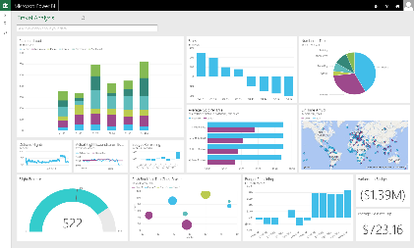
Data on-premises
Live Power BI reports & dashboards
Live query
Direct query
Scheduled refresh
Cloud
On-premises
SQL Server Analysis Services
Data Source
Data Source

Slide 8
Supported on-prem data sources
SQL Server, Teradata, Oracle, DB2, MySQL, PostgreSQL, Sybase, SAP HANA, Access, Custom SQL, Custom ODBC Drivers
SQL Server Analysis Services (tabular and multi-dimensional)
Files/folder, SharePoint on-premises
ODBC driver based connections

Slide 9
Data refresh in Power BI
Where is your data?
Cloud
On-premises
How do you connect?
Import data
Direct Query
How do you refresh?
Personal Gateway
On-premises data gateway

Slide 10
How do you want to refresh data?
 | Import (cached mode) | Direct query or Live connection
Refresh frequency | Scheduled - hourly or daily | Real-time
Performance | No noticeable delay since data is already cached | Depends on how fast the data source is as queries are executed in real-time
Data storage in Power BI | Since it is cached mode, data is stored in the cloud | No data is stored in Power BI. Data is always on-premises*
Data size | Current limit of 1 GB (compressed) per model | The on-premises database is the limit; no Power BI limitation
Security | Can create row-level security on the PBI dataset (import only) | Re-use on-prem row level security for Analysis Services
*Some data is cached for optimizing first-time load performance

Slide 11
Data refresh in Power BI
Where is your data?
Cloud
On-premises
How do you connect?
Import data
Direct Query
How do you refresh?
Personal Gateway
On-premises data gateway

Slide 12
On-premises data gateway
Cloud services
Power BI
Read access, scheduled refresh, live connection
Gateway Cloud Service Data source connection credentials are encrypted
Azure Service Bus
Application Gateway
Data source connection credentials can only be decrypted by the gateway
On-premises data sources
SQL Server
SQL Server Analysis Services
Other data sources
Files, SharePoint

Slide 13
On-premises data gateway One gateway for multiple cloud services and experiences
Cloud services
Power BI
Preview PowerApps
Preview Microsoft Flow
Azure Logic Apps
Read access, scheduled refresh, live connection
Live connection, CRUD support (create, read, update and delete)
Gateway Cloud Service Data source connection credentials are encrypted
Azure Service Bus
Application Gateway
Data source connection credentials can only be decrypted by the gateway
On-premises data sources
SQL Server
SQL Server Analysis Services
Other data sources
Files, SharePoint

Slide 14
Personal v/s On-premises data gateway
 | Personal Gateway | On-premises data gateway (Enterprise gateway)
Target Persona | Business analyst sets up and uses the gateway for her data sources | BI Admins set up the gateway for their department/ company Multiple users use the gateway setup by the admins
Usage | Directly by analysts | BI Admin
Features | Import with scheduled refresh | Direct query and scheduled refresh
 | Data source connections managed per user | Central data source mgmt. and access control
 | No central monitoring/control | Central monitoring and control
Services supported | Power BI | Power BI, PowerApps, Microsoft Flow, and Azure Logic Apps

Slide 15
Demo: On-premises data gateway

Slide 16
Architecture: Refresh with Gateways
Power BI
cred
Gateway is installed & configured. During configuration, a corresponding service bus instance is also configured.
Credentials entered for the data source in Power BI are encrypted then stored in the cloud. Only the gateway can decrypt the credentials. Personal Gateway windows credentials is stored in the Gateway only.
Power BI kicks off a refresh
Data Movement Service analyzes the query and pushes to appropriate service bus instance
Gateway polls bus for pending requests. It takes the pending request
Gateway gets the query, decrypts the credentials, sends query to the data source for execution
After execution, gateway securely pushes the data to Power BI
2
Scheduler service
3
Data Movement Service
4
Cloud
Service bus
On-premises
7
5
Gateway
1
cred
2
6
DB

Slide 17
Security in Gateway
Encryption key based on recovery key never leaves On-Prem infrastructure
symmetric key is what encrypts all creds and never leaves the gateway
Power BI service never knows the on-prem credential values encrypted / cannot intercept credentials (web client encrypts the credential with a public key associated with the specific gateway it is communicating with)

Slide 18
Troubleshooting tips and tools
Cannot create a data source on the gateway
Try connecting to the data source from a different client
Sometimes the data source is really unreachable
Take a look at the gateway service logs
Data stopped refreshing
Take a look at the refresh history
Ensure Data source is still accessible
Look at the gateway service logs and configuration logs
Open fiddler and ensure the right request is being sent to the gateway
Source: https://powerbi.microsoft.com/en-us/documentation/powerbi-gateway-onprem-tshoot/

Slide 19
Disaster recovery and gateway restore
Gateway admin can use the recovery key to restore a gateway to a different machine
Once a gateway is restored, all data sources and credentials will continue to work through the new gateway
Restored gateway will have the same name, so no need for re-publish

Slide 20
Disaster recovery and gateway restore

Slide 21
“Where to install the gateway?”
It always depends on the usage for the gateway
Machine specs needed for a heavily used Direct Query report is different than a dataset that is set to refresh once a day with small amounts of data
- Recommendation:
Start with an 8 core machine
Keep an eye on your performance counters
Depending on your usage, you can decide to scale up or down

Slide 22
Tips and Best practices
Monthly updates: Always update to the latest version
Keep it always on and credentials up-to-date
Outbound ports to be opened on the gateway computer (only if needed)
443, 9350-9353
Can be installed on Windows Server or client OS
Cannot be installed on the same machine with a local domain controller
Installing multiple gateways on the same computer
Enterprise Gateway can be installed alongside Personal Gateway
Visit the FAQ and troubleshooting section in our documentation, leave comments/questions

Slide 23
Building and Managing Content

Slide 24
Building and Managing Content
The content distribution lifecycle
Collaboration tips and tricks

Slide 25
Content Distribution Lifecycle
Create
Collaborate
Distribute

Slide 26
Content Distribution Lifecycle
Create
Collaborate
Distribute

Slide 27
Creating Content
Reports in Power BI Desktop
Dashboards in the Power BI service
Choose based on capabilities you need

Slide 28
Dashboards
Tiles
Report Tile
Direct or live connection
Cloud Model
Excel Tiles
Excel Charts and visuals
Excel ranges
Widgets
Videos & Images
Web
Text
SSRS
Q&A and Insights
Real-time streaming
Tile Types
Report tiles
Excel tiles
Widgets
Navigational apps
Tile Actions
Entry into Focus mode
Navigate to source asset or custom URL
Export tile data to .csv
Insights
Alerting

Slide 29
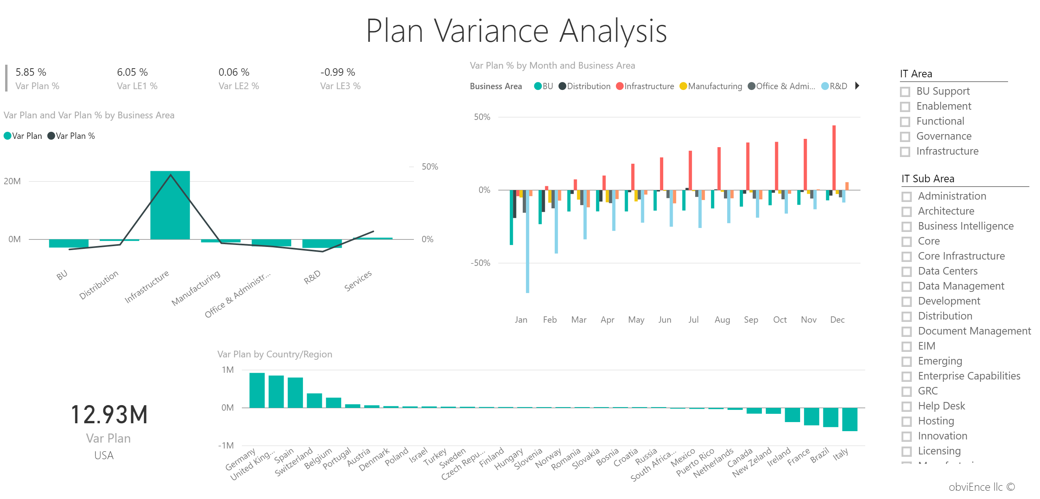
Reports
Interactivity
Cross-filtering
Slicers
Detailed control of layout and styling

Slide 30
Content Distribution Lifecycle
Create
Collaborate
Distribute

Slide 31
Collaborating with Power BI
Manage artifacts within a workspace or group
Set up data refresh per workspace or group
Co-create artifacts in Group workspaces
User acceptance testing
My Workspace
Group Workspaces
Dashboards
Reports
Datasets
Content packs
Co-owned Dashboards
Co-owned Reports
Co-owned Datasets
Co-owned Content packs

Slide 32
Collaboration Best Practices
When in doubt, start with a group workspace
OneDrive for Business for versioning PBIX
Great recap of the process: https://aka.ms/usingpbiworkspaces
Complete governance/deployment whitepaper: https://aka.ms/pbideploywhitepaper

Slide 33
Content Distribution Lifecycle
Create
Collaborate
Distribute

Slide 34
Distribution Options
Sharing
Broad distribution with content packs
Embedding and linking in portals
Publish to Web
Static consumption
Mobile
Cortana

Slide 35
Sharing
For limited, ad-hoc distribution
Sharing one dashboard at a time
Changes visible immediately
Can share outside organization

Slide 36
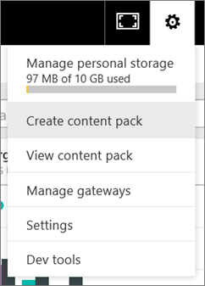
Content Packs
Many reports and dashboards
Control who can access
Stage changes and only republish when ready

Slide 37
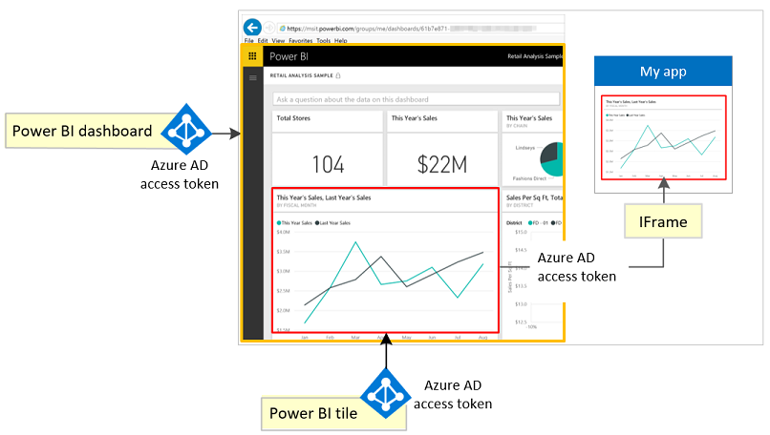
Embedding and linking
Embed report or dashboard tile into portal or app
Still uses same user security and authorization as in the Power BI service

Slide 38
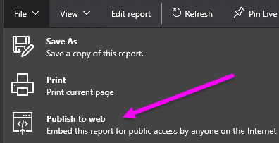
Publish to Web
True public embedding (think blog or public company web site)

Slide 39
Static
Print
Alerts
Export to PowerPoint (coming in October)
Email subscriptions (coming this year)

Slide 40
Mobile
View reports and dashboards
Mobile-optimized dashboards available

Slide 41
Cortana
She can return answers and report sheets from Power BI
Enabling Cortana in Windows 10
Enable dataset for Cortana in Power BI
Share a dashboard or republish a content pack to users who you want to have access to Cortana
Add your work or school account in Windows 10 (if you’re not running the Anniversary Update, also add a Microsoft Account)
https://aka.ms/pbicortanasetup
Optionally create Cortana-optimized report sheets in Power BI Desktop

Slide 42
Demo: Collaboration

Slide 43
Security and Compliance

Slide 44
Data Security
How Power BI secures your data
User authentication
Encryption of data at rest
How you configure and restrict access
Data authorization
Row-level security
Transport encryption
Policy controls
https://aka.ms/pbisecuritywhitepaper

Slide 45
User Authentication
Power BI uses Azure Active Directory (AAD)
Supports managed and unmanaged directories
AAD features and policy apply to Power BI
Authentication type (AAD-managed passwords vs. federated)
Password and self-service password reset policies
Conditional access policies
Same tenant infrastructure across all services that use AAD
Sign in once, signed in everywhere
Same security groups can be leveraged across services

Slide 46
Data Authorization
1
Reporting authorization
Users have access to dashboards, reports via sharing or organizational content packs
Scoped to user accounts, AAD security groups, or O365 modern groups (content packs only)
Power BI
1
2
Data source authorization
(a) Calls to data sources are made using service-level credentials in the case of cached and Direct Query sources. Authorization in the data source is done using the single service credentials.
(b) for Analysis Services Live Connect, the user’s credentials are used and user authorization is performed in Analysis Services (and RLS can be applied).
3
2b
2a
3
Row-level security (RLS) in Power BI
Row filters can be applied in the Power BI service for cached data.
SQL Server Analysis Services
data sources

Slide 47
Policy Controls
Scenario | How to achieve with Power BI | Who can do it
Prevent certain users from accessing Power BI | Assign licenses in Office 365 portal only to authorized users and disable automatic license assignment. https://aka.ms/m2g7wu | Global Administrator or User Administrator
Prevent access off corporate networks | Configure Azure Active Directory Conditional Access https://aka.ms/nw75r3 | Global Administrator or User Administrator
Control use of features like data export, anonymous access, external sharing | Set enterprise controls in the Power BI Admin Portal | Global Administrator or Power BI Administrator*
Control use of mobile features (PIN code, share sheet restrictions) | Set up Intune Mobile Application Management https://aka.ms/wenojj | Global Administrator
Audit Power BI activity | Enable Power BI Auditing in both the Power BI Admin Portal and the Office 365 Security and Compliance Portal https://aka.ms/nw75r3 | Global Administrator or user that is both a Office 365 Compliance Administrator and Power BI Administrator *
* Power BI Administrator role is available mid-October via PowerShell and soon after in the Office 365 Admin Center

Slide 48
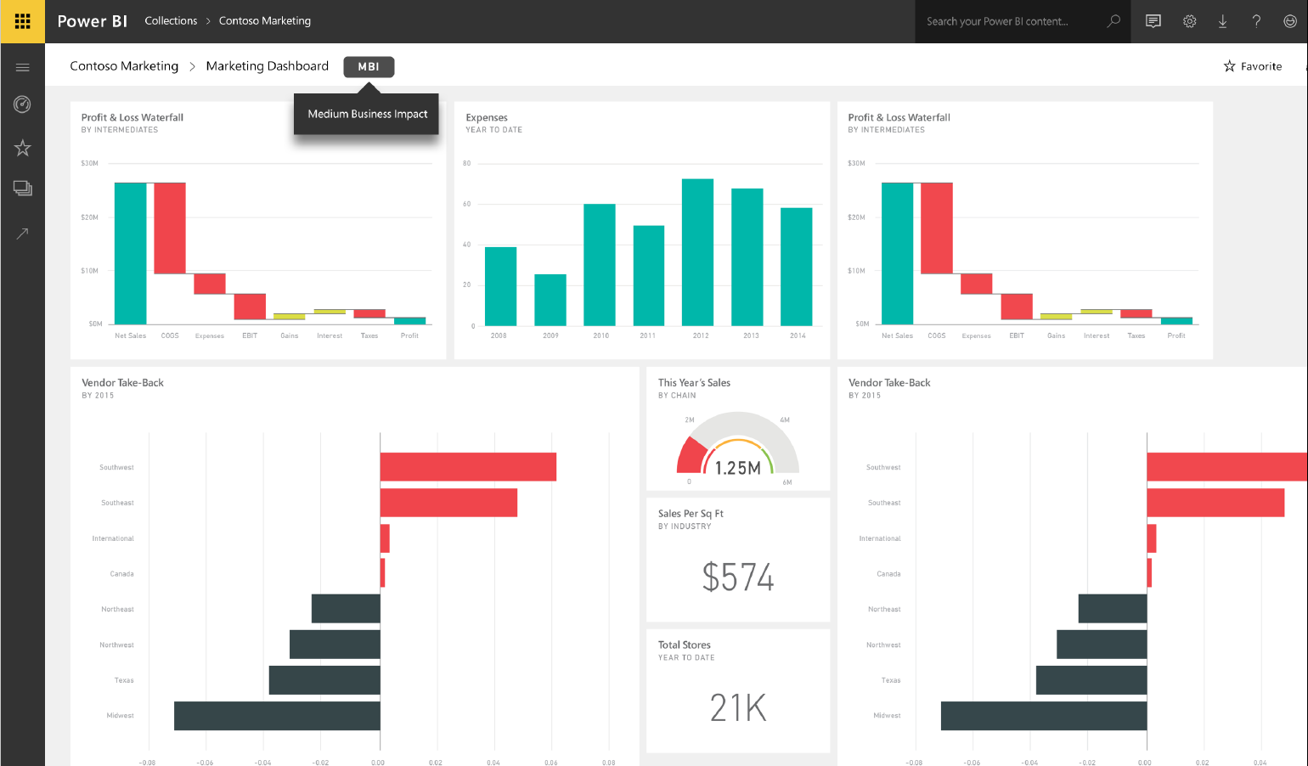
Data Classification
Tags defined by admin and set by each dashboard owner
Customizable links
Not just for compliance!

Slide 49
Demo: Security and Controls
Row-level Security (RLS)
Azure Active Directory Conditional Access
Power BI Auditing

Slide 50
Learn more Attend the following BI sessions
Session | Title | Time | Location
BRK3251 | Dive into effective report authoring using Power BI Desktop
Boost your business insights by using Excel with Power BI
Session: BRK3134
Tuesday, Sept. 27 – 10:45 am
Room A313 – A314
Modern enterprise reporting and mobile BI with SQL Server 2016
Session: BRK3132
Tuesday, Sept. 27 – 12:30 pm
Room B207 – B208
See what’s new in SQL Server Analysis Services 2016 Tabular Models
Session: BRK3289
Tuesday, Sept. 27 – 4:00 pm
Room A313 – A314
Probe Microsoft Power BI for Enterprise
Session: BRK3128
Wednesday, Sept. 28 – 10:45 am
Room A313 – A314
Dive into effective report authoring using Power BI Desktop
Session: BRK3251
Wednesday, Sept. 28 – 12:30 pm
Room A302
Model complex data easily with SQL Server 2016 Analysis Services
Session: BRK3133
Wednesday, Sept. 28 – 4:00 pm
Room B304 - 305
Dive into Power BI Industry solutions with customer scenarios
Session: BRK3135
Thursday, Sept. 29 – 10:45 am
Thomas Murphy Ballroom 4
Get your LOB application data into Microsoft Power BI
Session: BRK3131
Friday, Sept. 31 – 9:00 am
Room A311 – A312
Visit our booths!
MS 46 and MS 47

Slide 51
Free IT Pro resources To advance your career in cloud technology
Plan your career path
Cloud role mapping
Expert advice on skills needed
Self-paced curriculum by cloud role
$300 Azure credits and extended trials
Pluralsight 3 month subscription (10 courses)
Phone support incident
Weekly short videos and insights from Microsoft’s leaders and engineers
Connect with community of peers and Microsoft experts
Microsoft IT Pro Career Center
www.microsoft.com/itprocareercenter
Get started with Azure
Microsoft IT Pro Cloud Essentials
www.microsoft.com/itprocloudessentials
Demos and how-to videos
Microsoft Mechanics
www.microsoft.com/mechanics
Connect with peers and experts
Microsoft Tech Community
https://techcommunity.microsoft.com

Slide 52
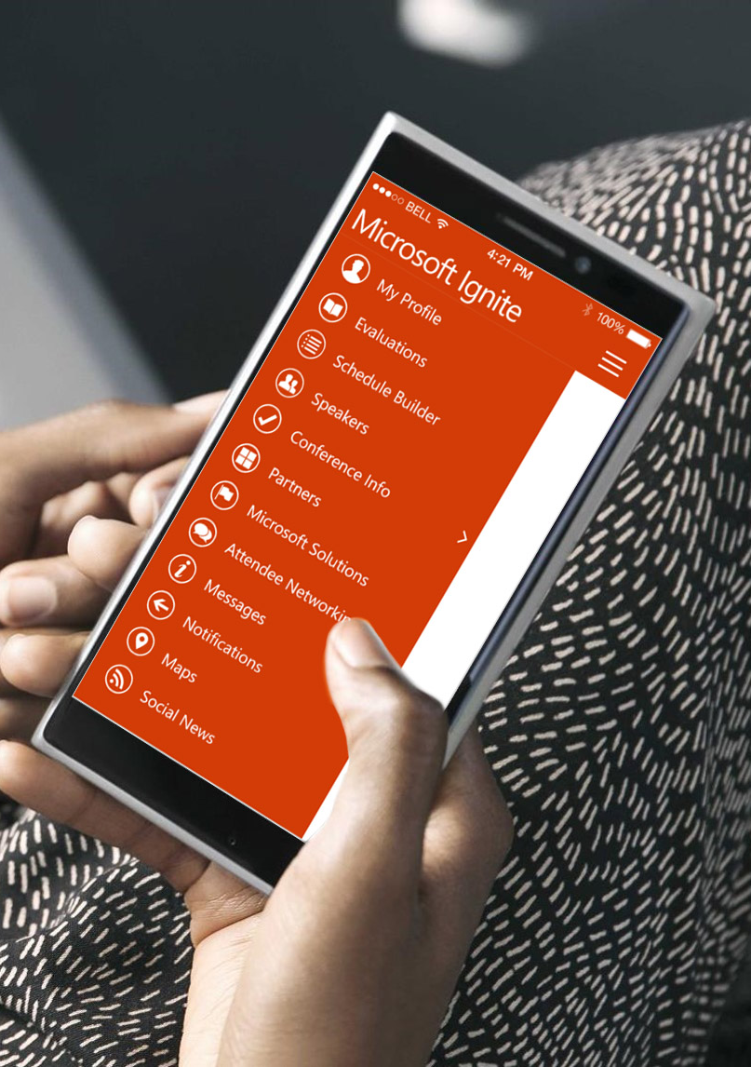
Please evaluate this session
Your feedback is important to us!
From your PC or Tablet visit MyIgnite at http://myignite.microsoft.com
From your phone download and use the Ignite Mobile App by scanning the QR code above or visiting https://aka.ms/ignite.mobileapp

