Slide 1
Examine information management in Cortana Intelligence
BRK3127
Matthew Roche
Senior Program Manager

Slide 2
I Have a Recurring Nightmare

Slide 4
I Have a Recurring Nightmare

Slide 6
I Have a Recurring Nightmare

Slide 8
That Nightmare is Our Reality

Slide 9
Examine information management in Cortana Intelligence
Matthew Roche
Senior Program Manager

Slide 10
Cortana Intelligence Solutions: End To End Flow
DATA SOURCES
INGEST
PREPARE
ANALYZE
PUBLISH
CONSUME
Diagnostic streaming
Event Hubs
Stream Analytics
Power BI
Sensors and devices
Machine Learning
Stream Analytics
Cortana
HDInsight
HDInsight, Machine Learning
Business apps
Azure Blob
Azure Data Lake
Azure SQL DW
Azure Data Factory: move, orchestrate, schedule, and monitor
Azure Data Catalog: register, annotate, understand, discover data sets
Enterprise data sources

Slide 11
Rolls-Royce
Filtering the signal from the noise
Objectives
Connect Rolls-Royce jet engine data to Microsoft's intelligent cloud for insights to improve aircraft performance, safety and maintenance.​
Tactics
Use Cortana Intelligence to scale quickly and efficiently, aggregate data across customer fleets and process data in real time.
Results
More efficient flight and maintenance plans
Targeted and actionable fuel efficiency insights
Quickly-generated reports and dashboards that tell compelling stories and deliver high-quality insights
“Our goal is not data for the sake of data, but to embrace the cloud and analytical technologies to deliver more expert insights to the right stakeholders at the right time.“
Nick Farrant Senior Vice President
ROLLS-ROYCE

Slide 12
Demo
Predictive Maintenance for Aerospace

Slide 13
Demo Environment
DATA SOURCES
INGEST
PREPARE
ANALYZE
PUBLISH
CONSUME
Diagnostic streaming
Event Hubs
Stream Analytics
Power BI
Sensors and devices
Machine Learning
Stream Analytics
Cortana
HDInsight
HDInsight, Machine Learning
Business apps
Azure Blob
Azure Data Lake
Azure SQL DW
Azure Data Factory: move, orchestrate, schedule, and monitor
Azure Data Catalog: register, annotate, understand, discover data sets
Enterprise data sources

Slide 14
Demo Environment
DATA SOURCES
INGEST
PREPARE
ANALYZE
PUBLISH
CONSUME
Diagnostic streaming
Event Hubs
Stream Analytics
Power BI
Engine Sensor Data
Machine Learning
Stream Analytics
Azure Blob
Azure SQL DB
Azure Data Factory: move, orchestrate, schedule, and monitor
Azure Data Catalog: register, annotate, understand, discover data sets

Slide 15
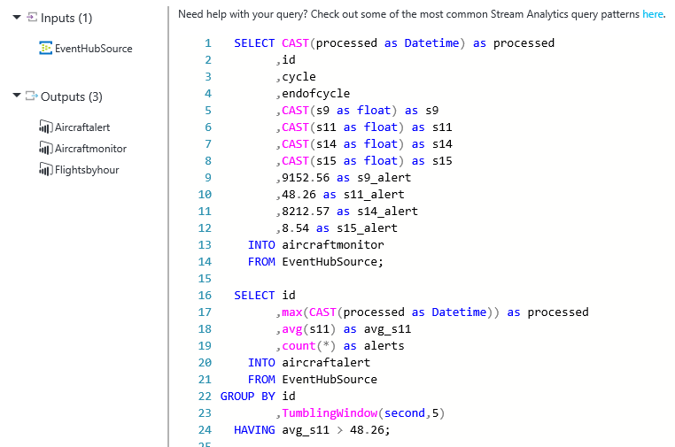
Azure Stream Analytics
Consume millions of events per second
Data from sensors, infrastructure, application
Use Event Hubs or IoT Hub for ingress
Time-sensitive analysis using SQL-like queries
Multiple real-time streams
Reference data
Configurable outputs
Output to databases, blob stores, dashboards
Output back to devices

Slide 16
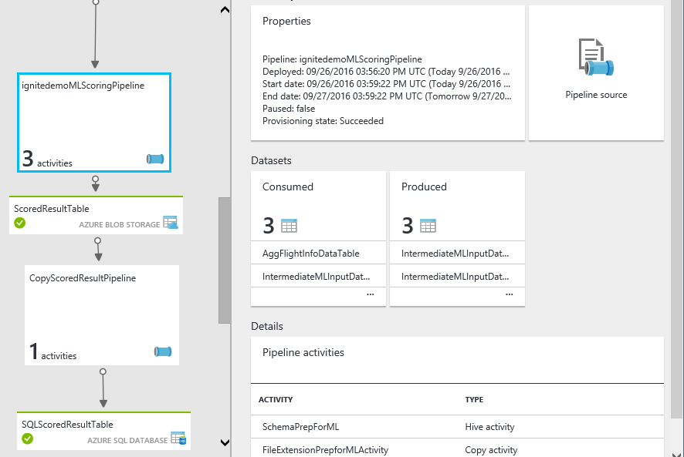
Azure Data Factory
Data composition and orchestration at Scale
Fully managed service to support orchestration of data movement and processing
Support for heterogenous data sources
On-premises and cloud
Structured and unstructured
Monitoring and management
Track data lineage and relationships
View pipeline health and history

Slide 17
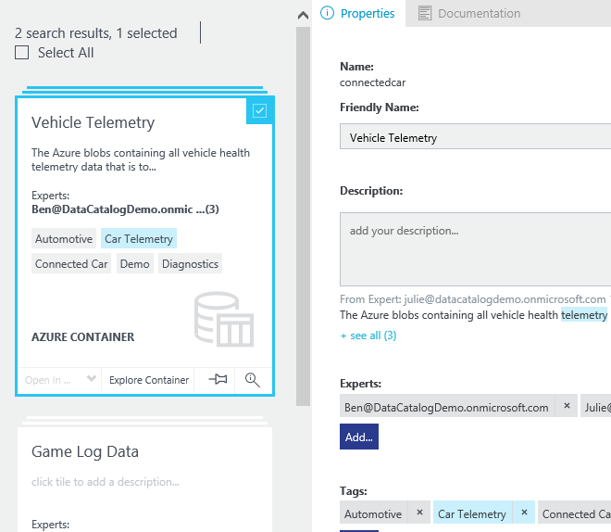
Azure Data Catalog
Data source discovery
An enterprise-wide catalog in Azure that enables self-service discovery of data from any source
Crowdsourced metadata
A metadata repository that allow users to register, annotate, discover, understand, and consume data sources
Open and extensible
A platform with open REST APIs that allow developers to integrate data discovery capabilities into their applications and processes

Slide 18
Related Resources
Predictive Maintenance @ Cortana Intelligence gallery
https://gallery.cortanaintelligence.com/Solution/Predictive-Maintenance-for-Aerospace-4
Key Information Management Services
Event Hubs: https://azure.microsoft.com/en-us/services/event-hubs/
IoT Hub: https://azure.microsoft.com/en-us/services/iot-hub/
Stream Analytics: https://azure.microsoft.com/en-us/services/stream-analytics/
Data Factory: https://azure.microsoft.com/en-us/services/data-factory/
Data Catalog: https://azure.microsoft.com/en-us/services/data-catalog/
Breakout Sessions
Thursday 2:15 PM: BRK2254: Leverage Cortana Intelligence Suite to build your modern data warehouse
Friday 12:30 PM BRK3106: Dive into Predictive Maintenance using Cortana Intelligence Suite
Friday 12:30 PM BRK3208: Explore case studies of real-world messaging with Service Bus and Event Hubs
On-Demand IDL3020: Deploy a predictive model with Microsoft Azure Machine Learning

Slide 19
Free IT Pro resources To advance your career in cloud technology
Plan your career path
Cloud role mapping
Expert advice on skills needed
Self-paced curriculum by cloud role
$300 Azure credits and extended trials
Pluralsight 3 month subscription (10 courses)
Phone support incident
Weekly short videos and insights from Microsoft’s leaders and engineers
Connect with community of peers and Microsoft experts
Microsoft IT Pro Career Center
www.microsoft.com/itprocareercenter
Get started with Azure
Microsoft IT Pro Cloud Essentials
www.microsoft.com/itprocloudessentials
Demos and how-to videos
Microsoft Mechanics
www.microsoft.com/mechanics
Connect with peers and experts
Microsoft Tech Community
https://techcommunity.microsoft.com

Slide 20
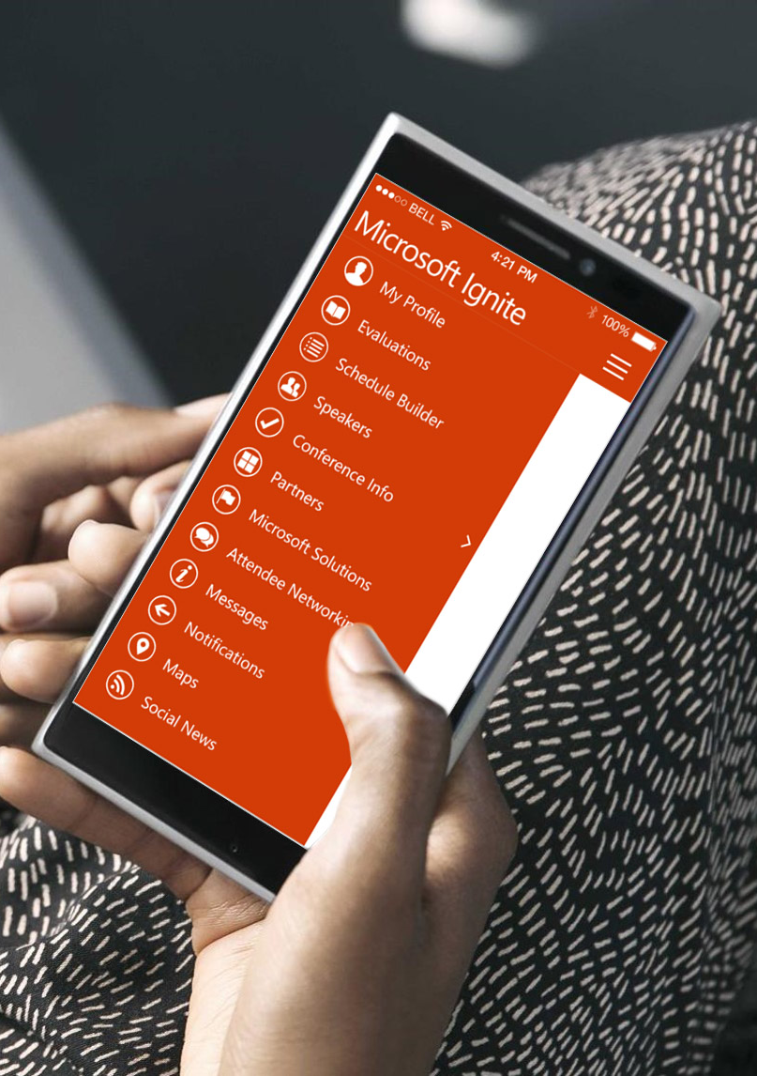
Please evaluate this session
Your feedback is important to us!
From your PC or Tablet visit MyIgnite at http://myignite.microsoft.com
From your phone download and use the Ignite Mobile App by scanning the QR code above or visiting https://aka.ms/ignite.mobileapp

