Slide 1
Deploy Complex Workloads with Azure Agility: from Zero to SDN in under 60 minutes
BRK3123
Jason Messer
Senior Program Manager
Cristian Edwards Sabathe
PFE Datacenter & Cloud
Technology Manager

Slide 2


Built-in layers
of security
Software-defined
datacenter
Cloud-ready
application platform
Windows Server 2016
Windows Server + System Center
session guide: aka.ms/WS2016Ignite

Slide 3
Motivation

Slide 4
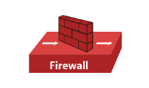
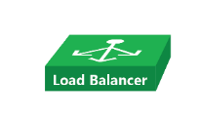
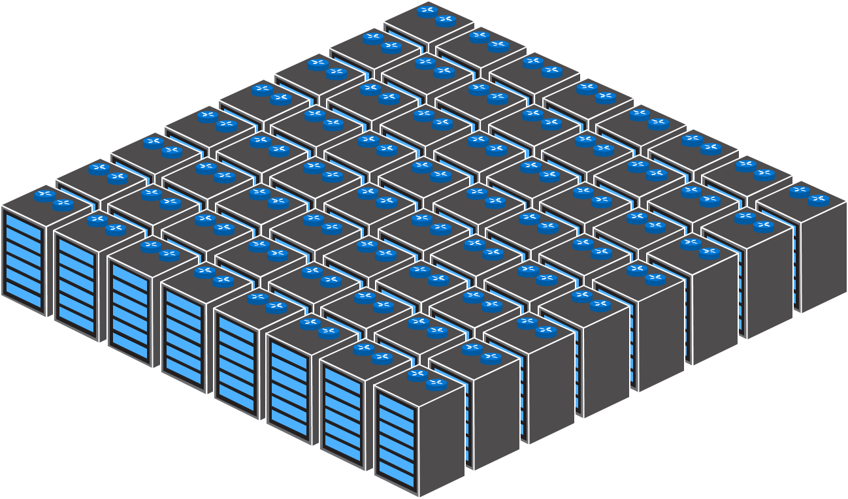
Datacenter Network
Edge Routers
Fixed-Function
Physical Appliances
Spine Switches/Routers
Compute/Storage
& TOR Switches
Datacenter

Slide 5

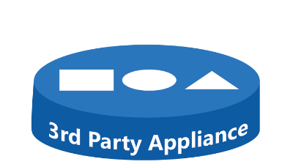
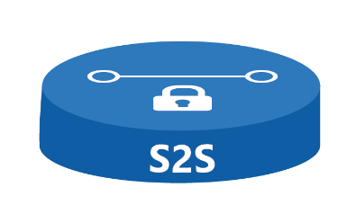


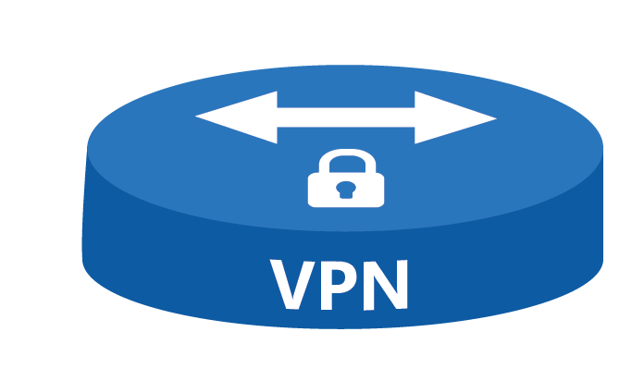


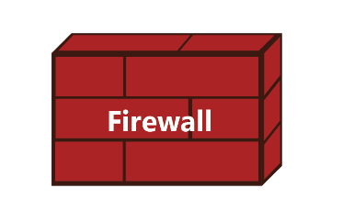
How can I manage all of the network services found in my Data Center?!
Virtual Networks
Network Services
Physical Infrastructure
Datacenter

Slide 6
Challenges customers face
 | Increase agility “I need to onboard workloads with complex policies across my own datacenter and/or other clouds in days – not weeks – to remain competitive.”
 | Enhance security “I must be able to instantaneously react to evolving threats and stop an attack from spreading.”
 | Reduce costs “I need to reduce the number of operator interventions and efficiently meet network growth demands. Current practices just won’t scale.”

Slide 7



Management
Portal
Azure-Inspired
Software Defined Networking
Virtual Networks
Network Services
Physical Infrastructure
Datacenter
Available now in Windows Server 2016

Slide 8
Ready… Set… Go!

Slide 9
DEMO: Deploy Microsoft Network Controller
SDN Fabric Deployment

Slide 10
“Software Defined Networking Is…”
Too Time-Consuming
Too Complex
Too Difficult
Too …

Slide 11
But What If You Could…
Deploy New Tenant Workloads Quickly
Increase Network Security Easily
Move Workloads Simply
  Be the HERO!

Slide 12
Hero Scenarios
  Enterprise: The engineering department needs an isolated network with custom security policy and guaranteed bandwidth created by this afternoon
  Datacenter: A new tenant needs to host a SharePoint workload in the cloud for increased flexibility and scale
  Hybrid Cloud: A tenant needs to use Azure Public Cloud Services

Slide 13
Core SDN Terms and Concepts

Slide 14
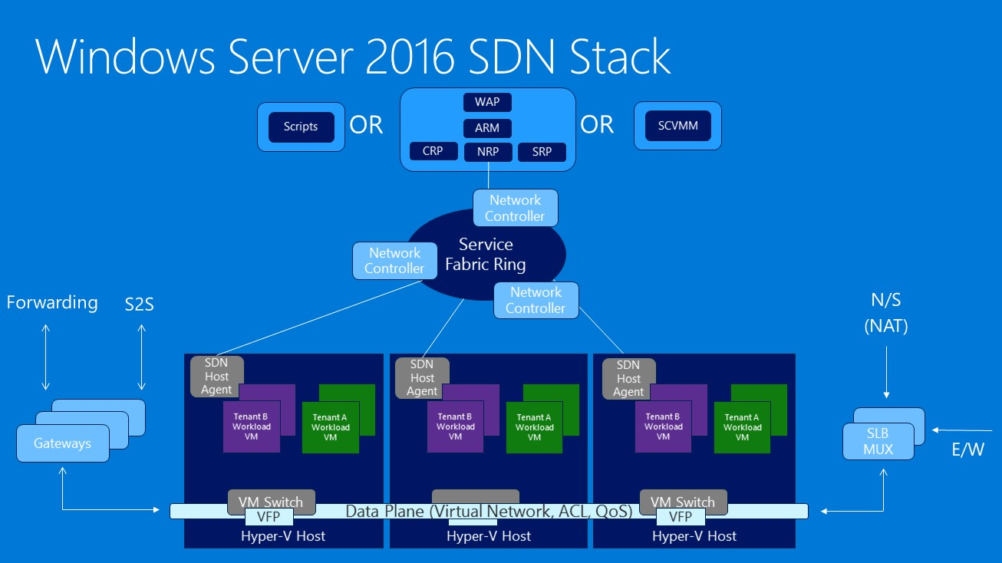
Management Plane
Control Plane
GOAL: Scale-out via Host-based Networking by separating Control-plane decisions from Data-plane traffic flow

Slide 15
Comparison with Industry Terminology
Microsoft | Generic
System Center Virtual Machine Manager | Manager
Microsoft Network Controller | Controller
Hyper-V Virtual Switch | vSwitch
(Multi-tenant) Hybrid SDN Gateway - Layer-3 Forwarding - Site-to-Site IPSec, GRE | Edge or Gateway
Virtual Network / VM Network (SCVMM) | Logical Network
Logical Switch / Virtual Subnet | Distributed Logical Switch
Distributed Router | Distributed Logical Router
HNV Provider Logical Network | Transport Network
Distributed Firewall / Network Security Groups | Access Control List
User-Defined Routing | Network Extensibility / Service Insertion

Slide 16
Convincing a Network Administrator
Blurring roles and responsibilities
  Network Admins and IT Admins are both…
  concerned with security
  unable to afford system down-time
  required to deploy services quickly… as in, yesterday!
Understanding and Discussing Requirements
  Network Infrastructure
  Layer 2 Reachability
    Port configuration
    VLAN access
  Layer 3 Routing
    Static and Dynamic Routes
    BGP peering (Autonomous System Numbers – ASN)
  Latency, Tolerance for Loss, Firewall policy

Slide 17
Start with a Plan!
Physical Network
  Hyper-V Hosts and NICs
  Physical Switch Configuration
  Subnets and VLANs
  IP Pools
  NIC Teaming
  Routes
  Static
  Dynamic (BGP, OSPF)
  Firewall Rules
  https://technet.microsoft.com/windows-server-docs/networking/sdn/plan/plan-a-software-defined-network-infrastructure
Network | Purpose | IP Prefix | VLAN | Gateway | IP Pool
Management | Management | TBD | TBD | TBD | TBD
HNV Provider | Encapsulation | TBD | TBD | TBD | TBD
Transit | N/S Traffic and BGP Peering | TBD | TBD | TBD | TBD
Public / Private VIP | Accessibility | TBD | TBD | TBD | TBD

Slide 18
System Requirements
SDN Infrastructure
  Network Controller (NC)
  Software Load Balancer (SLB)
  Hybrid SDN Gateway
  https://technet.microsoft.com/windows-server-docs/networking/sdn/plan/plan-a-software-defined-network-infrastructure
Role | vCPU Requirements | Memory requirements | Disk requirements
Network controller (three node) | 4 vCPUs | 4 GB min (8 GB recommended) | 75 GB for the OS drive
SLB (three node) | 8 vCPUs | 8 GB recommended | 75 GB for the OS drive
Hybrid SDN Gateway (2:1) Redundancy (single pool of three node gateways, two active, one passive) | 8 vCPUs | 8 GB recommended | 75 GB for the OS drive

Slide 19
Workflow: Deploy SDN Fabric and Tenants
Step 0. Deploy Fabric Infrastructure
Step 1. Deploy Network Controller
Step 2. Create Tenant VM Networks and Deploy VMs
Step 3. Deploy Software Load Balancer
Step 4. Create Load-Balanced Tenant VIPs
Step 5. Configuring Inbound and Outbound NAT
Step 6. (Opportunistic) Deploy Gateways
Step 7. (Opportunistic) Create S2S VPN Tunnel

Slide 20
Workflow: Deploy SDN Fabric and Tenants
Step 0. Deploy Fabric Infrastructure
Step 1. Deploy Network Controller
Step 2. Create Tenant VM Networks and Deploy VMs
Step 3. Deploy Software Load Balancer
Step 4. Create Load-Balanced Tenant VIPs
Step 5. Configuring Inbound and Outbound NAT
Step 6. (Opportunistic) Deploy Gateways
Step 7. (Opportunistic) Create S2S VPN Tunnel

Slide 21
Workflow: Deploy SDN Fabric and Tenants
Step 0. Deploy Fabric Infrastructure
Step 1. Deploy Network Controller
Step 2. Create Tenant VM Networks and Deploy VMs
Step 3. Deploy Software Load Balancer
Step 4. Create Load-Balanced Tenant VIPs
Step 5. Configuring Inbound and Outbound NAT
Step 6. (Opportunistic) Deploy Gateways
Step 7. (Opportunistic) Create S2S VPN Tunnel

Slide 22
Workflow: Deploy SDN Fabric and Tenants
Step 0. Deploy Fabric Infrastructure
Step 1. Deploy Network Controller
Step 2. Create Tenant VM Networks and Deploy VMs
Step 3. Deploy Software Load Balancer
Step 4. Create Load-Balanced Tenant VIPs
Step 5. Configuring Inbound and Outbound NAT
Step 6. (Opportunistic) Deploy Gateways
Step 7. (Opportunistic) Create S2S VPN Tunnel

Slide 23
Workflow: Deploy SDN Fabric and Tenants
Step 0. Deploy Fabric Infrastructure
Step 1. Deploy Network Controller
Step 2. Create Tenant VM Networks and Deploy VMs
Step 3. Deploy Software Load Balancer
Step 4. Create Load-Balanced Tenant VIPs
Step 5. Configuring Inbound and Outbound NAT
Step 6. (Opportunistic) Deploy Gateways
Step 7. (Opportunistic) Create S2S VPN Tunnel

Slide 24
Workflow: Deploy SDN Fabric and Tenants
Step 0. Deploy Fabric Infrastructure
Step 1. Deploy Network Controller
Step 2. Create Tenant VM Networks and Deploy VMs
Step 3. Deploy Software Load Balancer
Step 4. Create Load-Balanced Tenant VIPs
Step 5. Configuring Inbound and Outbound NAT
Step 6. (Opportunistic) Deploy Gateways
Step 7. (Opportunistic) Create S2S VPN Tunnel

Slide 25
Workflow: Deploy SDN Fabric and Tenants
Step 0. Deploy Fabric Infrastructure
Step 1. Deploy Network Controller
Step 2. Create Tenant VM Networks and Deploy VMs
Step 3. Deploy Software Load Balancer
Step 4. Create Load-Balanced Tenant VIPs
Step 5. Configuring Inbound and Outbound NAT
Step 6. (Opportunistic) Deploy Gateways
Step 7. (Opportunistic) Create S2S VPN Tunnel

Slide 26
Workflow: Deploy SDN Fabric and Tenants
Step 0. Deploy Fabric Infrastructure
Step 1. Deploy Network Controller
Step 2. Create Tenant VM Networks and Deploy VMs
Step 3. Deploy Software Load Balancer
Step 4. Create Load-Balanced Tenant VIPs
Step 5. Configuring Inbound and Outbound NAT
Step 6. (Opportunistic) Deploy Gateways
Step 7. (Opportunistic) Create S2S VPN Tunnel

Slide 27
Step 0. Deploy Fabric Infrastructure

Slide 28
Review the Physical Network Plan
Top of Rack (ToR) Switch
One Management IP Address per Hyper-V Host (Static or DHCP)
Physical Network Adapters
  (Optional Two) NIC(s) teamed into Hyper-V Virtual Switch using Switch Embedded Teaming (SET)
  Assign IP addresses and set VLAN isolation (on management vNICs)
Network | IP Prefix | VLAN | Default Gateway | IP Pool
Management | 10.127.132.128/25 | 7 | 10.127.132.129 | *.152 – *.155
HNV Provider
Transit
Public VIP
Private VIP

Slide 29


Top of Rack (Layer 3) Switches
NIC1
NIC2
NIC1
NIC2
NIC1
NIC2
NIC1
NIC1
NIC2
NIC2
NIC1
AD
NIC2
Compute Cluster
DNS
SQL
Fabric Mgmt Cluster

Slide 30
Top of Rack (Layer 3) Switches
NIC1
NIC2
NIC1
NIC2
NIC1
NIC2
NIC1
NIC2
System Center Virtual Machine Manager (SCVMM)
Let’s focus on the Compute Cluster
SCOM
SQL

Slide 31
Mgmt Logical Network
Storage Logical Network(s)
NIC1
NIC2
NIC1
NIC2
NIC1
NIC2
NIC1
NIC2
Create Mgmt (and Storage) Logical Networks in VMM
SCOM
SQL

Slide 32
Mgmt
VMM Logical Networks
NIC1
NIC2
NIC1
NIC2
NIC1
NIC2
vSwitch
NIC1
vSwitch
vSwitch
vSwitch
NIC2
SCOM
Create a Logical Switch, ready to use Switch Embedded Teaming (SET)
SQL

Slide 33
Mgmt
VMM Logical Networks
NIC1
NIC2
vSwitch
NIC1
NIC2
vSwitch
NIC1
NIC2
vSwitch
NIC1
NIC2
vSwitch
SCOM
SQL
And deploy it to the Hyper-V Hosts

Slide 34
Mgmt
VMM Logical Networks
NIC1
NIC2
vSwitch
NIC1
NIC2
vSwitch
NIC1
NIC2
vSwitch
NIC1
NIC2
vSwitch
Mgmt
SCOM
Mgmt
Mgmt
SQL
Mgmt
Attach Mgmt Host vNICs to the vSwitch

Slide 35
Mgmt
VMM Logical Networks
NIC1
NIC2
vSwitch
Mgmt
NIC1
NIC2
vSwitch
Mgmt
NIC1
NIC2
vSwitch
Mgmt
NIC1
NIC2
vSwitch
Mgmt
SCOM
SQL

Slide 36
Management (10.127.132.128/25, VLAN 7)
Logical Network Diagram
Compute
Cluster

Slide 37
DEMO: Review Compute Cluster Fabric

Slide 38
Step 1. Deploy Network Controller

Slide 39
Review the Physical Network Plan
Top of Rack (ToR) Switch
One Management IP Address per Network Controller Node VM
(Optional) One Management IP Address for Network Controller REST Endpoint
Network | IP Prefix | VLAN | Default Gateway | IP Pool
Management | 10.127.132.128/25 | 7 | 10.127.132.129 | *.211 – *.224
HNV Provider
Transit
Public VIP
Private VIP

Slide 40
Mgmt
VMM Logical Networks
Download the Network Controller
Service Template from GitHub
NIC1
NIC2
vSwitch
Mgmt
NIC1
NIC2
vSwitch
Mgmt
NIC1
NIC2
vSwitch
Mgmt
NIC1
NIC2
vSwitch
Mgmt
SCOM
SQL
  https://github.com/microsoft/SDN/VMM/Templates

Slide 41
Mgmt
VMM Logical Networks
NIC1
NIC2
vSwitch
Mgmt
NIC1
NIC2
vSwitch
Mgmt
NIC1
NIC2
vSwitch
Mgmt
NIC1
NIC2
vSwitch
Mgmt
SCOM
SQL
Import it into VMM

Slide 42
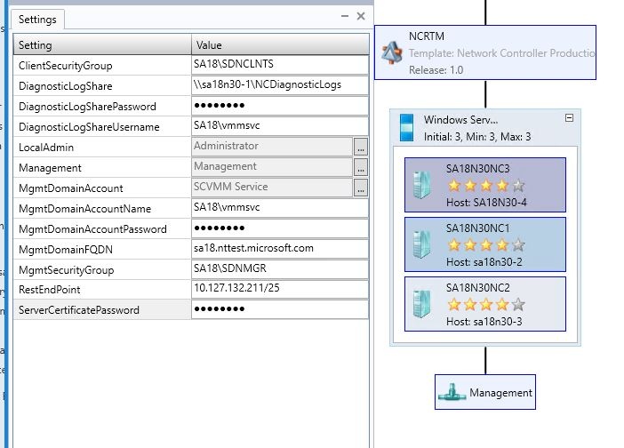
Mgmt
VMM Logical Networks
NIC1
NIC2
vSwitch
Mgmt
NIC1
NIC2
vSwitch
Mgmt
NIC1
NIC2
vSwitch
Mgmt
NIC1
NIC2
vSwitch
Mgmt
NC1
SCOM
NC2
SQL
NC3
Customize the Template (Production – 3 Network Controller Node VMs for High Availability)
Each Virtual Machine is a Network Controller (NC) node running on a Service Fabric Cluster

Slide 43
NC Service Template Configuration Example

Slide 44
Mgmt
VMM Logical Networks
NIC1
NIC2
Ideally, each NC node VM should run
on a different Hyper-V host
vSwitch
Mgmt
NIC1
NIC2
vSwitch
Mgmt
NIC1
NC1
NIC2
vSwitch
Mgmt
NIC1
NC2
NIC2
vSwitch
Mgmt
NC3
SCOM
SQL

Slide 45
Mgmt
VMM Logical Networks
NIC1
NIC2
Network Controllers are Connected to Management Network
vSwitch
Mgmt
NIC1
NIC2
vSwitch
Mgmt
NIC1
NC1
Mgmt
NIC2
vSwitch
Mgmt
NIC1
NC2
Mgmt
NIC2
vSwitch
Mgmt
NC3
Mgmt
SCOM
SQL

Slide 46
Mgmt
Network Controller
Managed Logical Networks
NIC1
NIC2
vSwitch
Mgmt
NIC1
VFP
NIC2
vSwitch
Mgmt
NIC1
VFP
NC1
Mgmt
NIC2
vSwitch
Mgmt
NIC1
VFP
NIC2
NC2
Mgmt
vSwitch
NC Host Agent
Mgmt
VFP
NC3
Mgmt
Azure VFP Extension (Flow Engine)
installed in V-Switch
NC Host Agent
SCOM
SQL
NC Host Agent
NC Host Agent
NC Host agents configured and started

Slide 47
Mgmt
VMM Logical Networks
NIC1
NIC2
vSwitch
Mgmt
VFP
NIC1
NIC2
vSwitch
Mgmt
VFP
NIC1
NC1
Mgmt
NIC2
vSwitch
Mgmt
NIC1
VFP
NIC2
NC2
Mgmt
vSwitch
Mgmt
NC3
VFP
Mgmt
SCOM
SQL
NC must be on boarded into VMM as a Network Service

Slide 48
Management (10.127.132.128/25, VLAN 7)
Logical Network Diagram
Infrastructure
VMs
NC1
NC2
NC3
Compute
Cluster

Slide 49
DEMO: Onboard Microsoft Network Controller in SCVMM
SDN Fabric Deployment

Slide 50
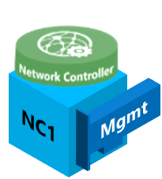
Mgmt
Network Controller
Managed Logical Networks
NIC1
NIC2
vSwitch
Network Controller REST API service is Primary on one NC
Node VM
Mgmt
NIC1
VFP
NIC2
vSwitch
Mgmt
NIC1
VFP
NIC2
vSwitch
Mgmt
NIC1
VFP
NIC2
NC2
Mgmt
vSwitch
NC Host Agent
Mgmt
VFP
NC3
Mgmt
NC Host Agent
SCOM
SQL
NC Host Agent
NC Host Agent
Through VMM communicating with the NC service we can now Create, Manage and Delete policy and resources such Logical Networks, Virtual Networks, Access Control Lists, Load Balancers…

Slide 51
Step 2. Create Tenant VM Networks and Deploy VMs

Slide 52
Review the Physical Network Plan
Create the HNV Provider Logical Network
Top of Rack (ToR) Switch
One Management IP Address per Network Controller Node VM
(Optional) One Management IP Address for Network Controller REST Endpoint
Two HNV Provider IP Addresses per Hyper-V Host
Network | IP Prefix | VLAN | Default Gateway | IP Pool
Management | 10.127.132.128/25 | 7 | 10.127.132.129 | *.211 – *.221
HNV Provider | 10.10.182.0/25 | 11 | 10.10.182.1 | *.64 - *.78
Transit
Public VIP
Private VIP

Slide 53
Mgmt
Network Controller
Managed Logical Networks
NIC1
NIC2
vSwitch
Mgmt
NIC1
VFP
NIC2
vSwitch
Mgmt
NIC1
VFP
NIC2
vSwitch
Mgmt
NIC1
VFP
NIC2
NC2
Mgmt
vSwitch
NC Host Agent
Mgmt
VFP
NC3
Mgmt
NC Host Agent
SCOM
SQL
NC Host Agent
NC Host Agent
Let’s use the Microsoft Network Controller to create some Tenant Virtual Networks!!

Slide 54
Mgmt
HNV
Network Controller
Managed Logical Networks
NIC1
vSwitch
NIC2
Mgmt
VFP
NIC1
vSwitch
NIC2
Mgmt
VFP
NIC1
vSwitch
NIC2
NC2
Mgmt
Mgmt
VFP
NIC1
NC Host Agent
vSwitch
NIC2
NC3
Mgmt
Mgmt
VFP
NC Host Agent
SCOM
SQL
NC Host Agent
NC Host Agent
Start by creating an HNV Provider Logical Network and IP Pool for carrying encapsulated tenant traffic

Slide 55
HNV (10.10.182.0/25, VLAN 11)
Management
Management (10.127.132.128/25, VLAN 7)
Logical Network Diagram
Infrastructure
VMs
NC1
NC2
NC3
Compute
Cluster

Slide 56
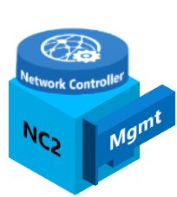
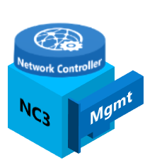
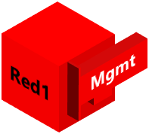



Mgmt
HNV
Network Controller
Managed Logical Networks
NIC1
vSwitch
NIC2
Mgmt
VFP
NIC1
Red Tenant VM Network
HNV PA
HNV PA
Green Tenant VM Network
vSwitch
NIC2
Virtual Networks
Mgmt
VFP
NIC1
HNV PA
HNV PA
NIC2
vSwitch
Mgmt
VFP
NIC1
HNV PA
HNV PA
NIC2
Red Tenant VM Network
HNV
Green Tenant VM Network
vSwitch
Mgmt
VFP
SCOM
SQL
HNV PA Host vNICs used for constructing the encapsulated packet header
Create Tenant VM Networks on top of HNV Provider Network

Slide 57
Mgmt
Red Tenant VM Network
HNV
Green Tenant VM Network
Network Controller
Managed Logical Networks
Network Controller Managed Virtual Networks
HNV Provider
Green Tenant VM Network
vSwitch
Red Tenant VM Network
HNV PA
HNV PA
VFP
vSwitch
HNV PA
VFP
HNV PA
vSwitch
HNV PA
HNV PA
VFP
vSwitch
VFP
Deploy VMs onto Hyper-V Hosts

Slide 58
HNV Provider Logical Network
HNV (10.10.182.0/25, VLAN 11)
Management
Management (10.127.132.128/25, VLAN 7)
Logical Network Diagram
Web Subnet (192.168.1.0/24)
Tenant
VMs
Web Subnet (192.168.1.0/24)
DB Subnet (192.168.2.0/24
Infrastructure
VMs
NC1
NC2
NC3
Compute
Cluster

Slide 59
DEMO: Deploy Virtual Networks and VMs
SDN Tenant Deployment

Slide 60
Workflow: Deploy SDN Fabric and Tenants
Step 0. Deploy Fabric Infrastructure
Step 1. Deploy Network Controller
Step 2. Create Tenant VM Networks and Deploy VMs
Step 3. Deploy Software Load Balancer
Step 4. Create Load-Balanced Tenant VIPs
Step 5. Configuring Inbound and Outbound NAT
Step 6. (Opportunistic) Deploy Gateways
Step 7. (Opportunistic) Create S2S VPN Tunnel

Slide 61
Time Check

Slide 62
Step 3. Deploy Software Load Balancer

Slide 63
Review the Physical Network Plan
Create the Transit Logical Network
Top of Rack (ToR) Switch
One Management IP Address per Software Load Balancer Mux VM
One HNV Provider IP Address per Software Load Balancer Mux VM
One Transit IP Address per Software Load Balancer Mux VM
Network | IP Prefix | VLAN | Default Gateway | IP Pool
Management | 10.127.132.128/25 | 7 | 10.127.132.129 | *.211 – *.221
HNV Provider | 10.10.182.0/25 | 11 | 10.10.182.1 | *.64 - *.78
Transit | 10.10.181.128/26 | 10 | 10.10.181.129 | *.160 - *.166
Public VIP
Private VIP

Slide 64
DEMO: Deploy Software Load Balancer
SDN Fabric Deployment

Slide 65
Mgmt
HNV
Network Controller
Managed Logical Networks
Transit
NIC1
vSwitch
NIC2
Mgmt
VFP
NIC1
vSwitch
NIC2
Mgmt
VFP
NIC1
vSwitch
NIC2
NC2
Mgmt
Mgmt
VFP
NIC1
NC Host Agent
vSwitch
NIC2
NC3
Mgmt
Mgmt
VFP
NC Host Agent
SCOM
SQL
NC Host Agent
NC Host Agent
Create Transit Logical Network to carry North-South Traffic and BGP Route Advertisements

Slide 66
Mgmt
HNV
Download the SLB
Service Template from GitHub
Network Controller
Managed Logical Networks
Transit
NIC1
NIC2
vSwitch
Mgmt
VFP
NIC1
NIC2
vSwitch
Mgmt
VFP
NIC1
vSwitch
NIC2
NC2
Mgmt
Mgmt
VFP
NIC1
NC Host Agent
vSwitch
NIC2
NC3
Mgmt
Mgmt
VFP
NC Host Agent
SCOM
SQL
NC Host Agent
NC Host Agent
  https://github.com/microsoft/SDN/VMM/Templates

Slide 67

Mgmt
HNV
Network Controller
Managed Logical Networks
Transit
NIC1
vSwitch
NIC2
Mgmt
VFP
NIC1
NIC2
vSwitch
Mgmt
VFP
NIC1
vSwitch
NIC2
NC2
Mgmt
Mgmt
NIC1
NC Host Agent
VFP
vSwitch
NIC2
NC3
Mgmt
Mgmt
VFP
NC Host Agent
SCOM
SQL
NC Host Agent
NC Host Agent
Import the SLB Service Template to VMM

Slide 68
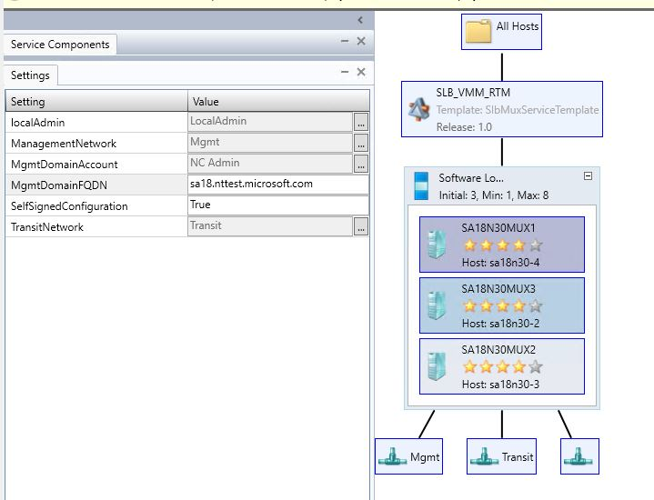

Mgmt
HNV
Network Controller
Managed Logical Networks
Transit
NIC1
NIC2
vSwitch
Mgmt
VFP
NIC1
vSwitch
NIC2
Mgmt
VFP
NIC1
vSwitch
NIC2
NC2
Mgmt
Mgmt
NC Host Agent
VFP
NIC1
vSwitch
NIC2
NC3
Mgmt
Mgmt
NC Host Agent
VFP
SCOM
SQL
NC Host Agent
MUX1
MUX2
NC Host Agent
MUX3
SLB (Production) Service Template creates 3 SLB Mux VMs

Slide 69
SLB Service Template Configuration Example

Slide 70
Mgmt
HNV
Network Controller
Managed Logical Networks
Transit
NIC1
NIC2
vSwitch
Mgmt
VFP
NIC1
MUX1
vSwitch
NIC2
Mgmt
NIC1
NC2
Mgmt
VFP
MUX2
vSwitch
NIC2
Mgmt
VFP
NIC1
NC Host Agent
NC3
Mgmt
MUX3
vSwitch
NIC2
Mgmt
VFP
NC Host Agent
SCOM
SQL
NC Host Agent
Ideally, each Mux VM should run on a different Hyper-V host
NC Host Agent

Slide 71
Mgmt
HNV
Network Controller
Managed Logical Networks
Transit
NIC1
NIC2
vSwitch
Mgmt
VFP
NIC1
MUX1
NIC2
vSwitch
Mgmt
NIC1
NC2
Mgmt
VFP
MUX2
vSwitch
NIC2
Mgmt
NIC1
NC Host Agent
NC3
Mgmt
VFP
MUX3
vSwitch
NIC2
Mgmt
VFP
NC Host Agent
SCOM
SQL
NC Host Agent
Each Mux will have 3 vNICs.
Management
HNV
Transit
NC Host Agent
Mgmt
Mgmt
Mgmt
Mgmt
HNV
Mgmt
HNV
HNV
Transit
HNV
Transit
Transit
HNV
Transit
Transit

Slide 72
Mgmt
HNV
Network Controller
Managed Logical Networks
Transit
NIC1
NIC2
vSwitch
Mgmt
VFP
NIC1
Mgmt
NIC2
MUX1
HNV
vSwitch
Transit
NC2
Mgmt
NIC1
Mgmt
VFP
MUX2
vSwitch
NIC2
Mgmt
RDMA2
HNV
Transit
NC3
Mgmt
Mgmt
VFP
NIC1
NC Host Agent
MUX3
vSwitch
NIC2
Mgmt
HNV
Transit
Mgmt
NC Host Agent
VFP
SCOM
SQL
NC Host Agent
Each Mux will have 3 vNICs
Management
HNV
Transit
NC Host Agent

Slide 73
HNV Provider Logical Network
HNV (10.10.182.0/25, VLAN 11)
Management (10.127.132.128/25, VLAN 7)
Logical Network Diagram
Web Subnet (192.168.1.0/24)
Transit (10.10.181.128/26, VLAN 10)
Tenant
VMs
Web Subnet (192.168.1.0/24)
DB Subnet (192.168.2.0/24
Infrastructure
VMs
NC1
MUX1
NC2
MUX2
NC3
MUX3
Compute
Cluster

Slide 74
Review the Physical Network Plan
Create the Private and Public Virtual IP (VIP) Logical Networks
Top of Rack (ToR) Switch
Public and Private VIPs will be provided for external connectivity
One Private VIP IP Address will be used by the SLB Manager for communication with Hyper-V Hosts
*SCVMM currently requires that the first IP in any IP Pool be reserved for a gateway (even though no gateway is used by VIPs)
Network | IP Prefix | VLAN | Default Gateway | IP Pool
Management | 10.127.132.128/25 | 7 | 10.127.132.129 | *.211 – *.221
HNV Provider | 10.10.182.0/25 | 11 | 10.10.182.1 | *.64 - *.78
Transit | 10.10.181.128/26 | 10 | 10.10.181.129 | *.160 - *.166
Public VIP | 10.127.132.32/29 | NA | 10.127.132.33* | *.34 - *.38
Private VIP | 10.10.183.32/29 | NA | 10.10.183.33* | *.34 - *.38
Public VIPs should be routable outside the datacenter
Private VIPs only need to be routable inside the datacenter

Slide 75
DEMO: Create Public and Private VIP Networks
SDN Fabric Deployment

Slide 76
Mgmt
HNV
Private and Public VIPs Subnets should be reachable and routed through the ToR
Public VIPs
Network Controller
Managed Logical Networks
Private VIPs
Transit
Private VIP
Public VIP
NIC1
vSwitch
NIC2
Mgmt
VFP
NIC1
MUX1
Mgmt
NIC2
HNV
vSwitch
Transit
NC2
NIC1
Mgmt
Mgmt
VFP
MUX2
NIC2
Mgmt
RDMA2
vSwitch
HNV
Transit
NC3
Mgmt
Mgmt
VFP
NIC1
NC Host Agent
Private VIPs LN
Public VIPs LN
NIC2
MUX3
Mgmt
HNV
vSwitch
Transit
Mgmt
NC Host Agent
VFP
SCOM
SQL
NC Host Agent
Private and Public VIPs Logical and VM Networks definition in VMM
Reserve IP Range for Load Balanced VIPs in IP Pool configuration
NC Host Agent

Slide 77
Mgmt
HNV
Advertise Routes to VIP Prefixes from Mux VMs to ToRs using BGP Peering
Network Controller
Managed Logical Networks
Transit
Private VIP
Public VIP
NIC1
BGP Peering (Transit)
vSwitch
NIC2
BGP Peering (Transit)
Mgmt
VFP
NIC1
MUX1
NIC2
BGP Peering (Transit)
Mgmt
vSwitch
HNV
Transit
NC2
NIC1
Mgmt
Mgmt
VFP
MUX2
NIC2
Mgmt
RDMA2
vSwitch
NC Host Agent
HNV
Transit
NC3
Mgmt
Mgmt
VFP
NIC1
SLB Host Agent
MUX3
NIC2
Mgmt
HNV
vSwitch
NC Host Agent
Transit
Mgmt
SLB Host Agent
VFP
SCOM
NC Host Agent
SQL
SLB Host Agent
NC Host Agent
SLB Host Agent
SLB Host Agents get configured and started on each NC managed host

Slide 78
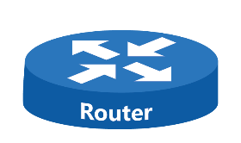
A note about BGP Peering
Autonomous System Numbers (ASN)
Routes Advertised by SLB Mux
Device | ASN | Transit IP Addresses
Layer-3 ToR Switch | 64623 | 10.10.181.129
SLB Mux | 64628 | 10.10.181.162, *.160, *.161
Public
Internet
ToR
ASN: 64623
ECMP
Transit Network
Route | IP Prefix | Next-Hop
SLBM VIP | 10.10.183.33/32 | 10.10.181.160
 |  | 10.10.181.161
 |  | 10.10.181.162
Tenant VIP | 10.127.132.X | 10.10.181.160
 |  | 10.10.181.161
 |  | 10.10.181.162
eBGP
eBGP
eBGP
MUX1
ASN: 64628
MUX2
ASN: 64628
MUX3
ASN: 64628

Slide 79
HNV Provider Logical Network
HNV (10.10.182.0/25, VLAN 11)
Management (10.127.132.128/25, VLAN 7)
Logical Network Diagram
Web Subnet (192.168.1.0/24)
Transit (10.10.181.128/26, VLAN 10)
Tenant
VMs
Web Subnet (192.168.1.0/24)
DB Subnet (192.168.2.0/24
Infrastructure
VMs
NC1
MUX1
NC2
MUX2
NC3
MUX3
Public VIP (10.127.132.32/29)
Compute
Cluster
Private VIP (10.10.183.32/29)

Slide 80
DEMO: Add SLB Fabric Role and Configure BGP
SDN Fabric Deployment

Slide 81
Step 4. Create Load-Balanced Tenant VIPs

Slide 82
Mgmt
HNV
Public VIPs
Network Controller
Managed Logical Networks
Private VIPs
Transit
Private VIP
Public VIP
NIC1
BGP Peering (Transit)
vSwitch
NIC2
NC1
BGP Peering (Transit)
Mgmt
NIC1
Mgmt
VFP
MUX1
NIC2
BGP Peering (Transit)
Mgmt
vSwitch
HNV
Transit
NC2
NIC1
Mgmt
Mgmt
VFP
MUX2
NIC2
Mgmt
RDMA2
vSwitch
NC Host Agent
HNV
Transit
NC3
Mgmt
Mgmt
VFP
NIC1
SLB Host Agent
MUX3
NIC2
Mgmt
HNV
vSwitch
NC Host Agent
Transit
Mgmt
SLB Host Agent
VFP
SCOM
NC Host Agent
SQL
SLB Host Agent
NC Host Agent
SLB Host Agent

Slide 83

Red Tenant VM Network
Green Tenant VM Network
External Client
HNV Provider
Network Controller Managed Virtual Networks
Public VIPs
Transit
Internal Client
BGP
Private VIPs
Green Tenant VM Network
Red Tenant VM Network
BGP
vSwitch
VFP
MUX1
Mgmt
HNV
vSwitch
Transit
VFP
MUX2
Mgmt
HNV
vSwitch
Transit
VFP
MUX3
Mgmt
vSwitch
HNV
Transit
VFP
Create VIP Template through VMM
Create Tenant VIP via PowerShell

Slide 84
DEMO: Create Tenant VIP
SDN Tenant Deployment

Slide 85
Step 5. Configure Inbound and Outbound NAT

Slide 86
Red Tenant VM Network
Green Tenant VM Network
HNV Provider
Internet
Network Controller Managed Virtual Networks
Public VIPs
Transit
Internal Client
Private VIPs
Green Tenant VM Network
vSwitch
Red Tenant VM Network
VFP
MUX1
Mgmt
HNV
vSwitch
Transit
VFP
MUX2
Mgmt
HNV
vSwitch
Transit
VFP
MUX3
Mgmt
vSwitch
HNV
Transit
Create Outbound NAT (internet) for Green Tenant
VFP
Create Inbound NAT Rule (RDP In) for Red Tenant

Slide 87
Workflow: Deploy SDN Fabric and Tenants
Step 0. Deploy Fabric Infrastructure
Step 1. Deploy Network Controller
Step 2. Create Tenant VM Networks and Deploy VMs
Step 3. Deploy Software Load Balancer
Step 4. Create Load-Balanced Tenant VIPs
Step 5. Configuring Inbound and Outbound NAT
Step 6. (Opportunistic) Deploy Gateways
Step 7. (Opportunistic) Create S2S VPN Tunnel

Slide 88
Massive Policy Deployment!!!!

Slide 89
Red Tenant VM Network
Transit
Green Tenant VM Network
Network Controller Managed Virtual Networks
Access Control Lists
Load Balancers
Virtual Machines
Tenant VM Network 5
Public VIPs
Web Tier ACL
LB 1
Tenant VM
Tenant VM Network 1
LB 2
Private VIPs
DB Tier ACL
Tenant VM Network 2
LB 3
Tenant VM Network 2
Tenant VM Network 3
Allow All ACL
Tenant VM Network 1
Tenant VM Network 4
LB 4
Green Tenant VM Network
VM NIC ACL
Tenant VM Network 4
Tenant VM Network 5
Tenant VM Network 3
VM NIC ACL
vSwitch
Red Tenant VM Network
VM NIC ACL
Tenant VM
VFP
vSwitch
Tenant VM
VFP
Tenant VM
vSwitch
Tenant VM
VFP
Tenant VM
vSwitch
Tenant VM
1. Create Multiple Tenant VNets
VFP
Tenant VM
2. Create ACLs
3. Create VMs
Tenant VM
Tenant VM
4. Create Load Balancers

Slide 90
Time Check

Slide 91
Step 6. Deploy Gateways

Slide 92
Review the Physical Network Plan
Create the GRE Virtual IP (VIP) Logical Network
Top of Rack (ToR) Switch
One GRE VIP IP Address will be used by the Gateway Nodes for Site-to-Site GRE Tunnels
One Public VIP Address will be used as the Endpoint to Site-to-Site IPSec Tunnels
Network | IP Prefix | VLAN | Default Gateway | IP Pool
Management | 10.127.132.128/25 | 7 | 10.127.132.129 | *.211 – *.221
HNV Provider | 10.10.182.0/25 | 11 | 10.10.182.1 | *.64 - *.78
Transit | 10.10.181.128/26 | 10 | 10.10.181.129 | *.160 - *.166
Public VIP | 10.127.132.32/29 | NA | 10.127.132.33* | *.34 - *.38
Private VIP | 10.10.183.32/29 | NA | 10.10.183.33* | *.34 - *.38
GRE VIP | 10.127.133.0/29 | NA | 10.127.133.1 | *.2 - *.6
Site-to-Site (S2S) Tunnel Endpoint accessible through SLB Mux

Slide 93
Mgmt
HNV
Download the Gateways
Service Template from GitHub
Network Controller
Managed Logical Networks
Transit
Private VIP
Public VIP
NIC1
vSwitch
NIC2
Mgmt
VFP
NIC1
MUX1
Mgmt
vSwitch
NIC2
HNV
Transit
NIC1
Mgmt
VFP
MUX2
NIC2
Mgmt
vSwitch
NC Host Agent
HNV
Transit
Mgmt
NIC1
VFP
SLB Host Agent
MUX3
NIC2
Mgmt
vSwitch
HNV
NC Host Agent
Transit
Mgmt
VFP
SLB Host Agent
SCOM
NC Host Agent
SQL
SLB Host Agent
NC Host Agent
SLB Host Agent

Slide 94

Mgmt
HNV
Network Controller
Managed Logical Networks
Transit
Private VIP
Public VIP
NIC1
vSwitch
NIC2
Mgmt
VFP
NIC1
MUX1
Mgmt
vSwitch
NIC2
HNV
Transit
NIC1
Mgmt
VFP
MUX2
NIC2
Mgmt
vSwitch
NC Host Agent
HNV
Transit
Mgmt
NIC1
Import the Gateway Service Template to VMM
VFP
SLB Host Agent
MUX3
NIC2
Mgmt
vSwitch
HNV
NC Host Agent
Transit
Mgmt
VFP
SLB Host Agent
SCOM
NC Host Agent
SQL
SLB Host Agent
NC Host Agent
SLB Host Agent

Slide 95
Mgmt
HNV
Network Controller
Managed Logical Networks
Transit
Private VIP
Public VIP
NIC1
GRE VIP
vSwitch
NIC2
Mgmt
VFP
NIC1
MUX1
Mgmt
vSwitch
NIC2
HNV
Transit
NIC1
Mgmt
VFP
MUX2
vSwitch
NIC2
Mgmt
NC Host Agent
HNV
Transit
Mgmt
NIC1
VFP
SLB Host Agent
MUX3
vSwitch
NIC2
Mgmt
HNV
NC Host Agent
Transit
Mgmt
VFP
SLB Host Agent
SCOM
NC Host Agent
SQL
SLB Host Agent
NC Host Agent
SLB Host Agent
Create GRE VIP Logical Network for S2S GRE Tunnel Endpoints

Slide 96
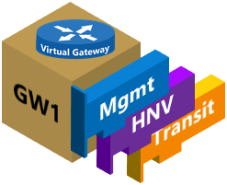
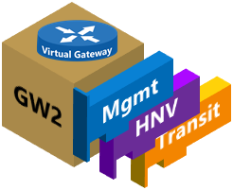

Mgmt
HNV
Network Controller
Managed Logical Networks
Transit
Private VIP
Public VIP
NIC1
GRE VIP
NIC2
vSwitch
Mgmt
VFP
NIC1
MUX1
Mgmt
NIC2
HNV
vSwitch
Transit
Mgmt
NIC1
VFP
MUX2
NIC2
Mgmt
vSwitch
NC Host Agent
HNV
Transit
Mgmt
NIC1
VFP
SLB Host Agent
MUX3
NIC2
Mgmt
vSwitch
HNV
NC Host Agent
Transit
Mgmt
VFP
SLB Host Agent
SCOM
NC Host Agent
SQL
SLB Host Agent
NC Host Agent
SLB Host Agent
Gateway Edge (Production) Service Template creates 3 Gateway VMs

Slide 97
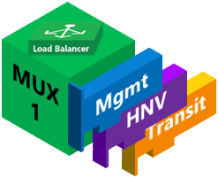


Mgmt
HNV
Network Controller
Managed Logical Networks
Transit
Private VIP
Public VIP
NIC1
GRE VIP
vSwitch
NIC2
Mgmt
VFP
NIC1
vSwitch
NIC2
RDMA2
Mgmt
VFP
NIC1
NIC2
RDMA2
vSwitch
NC Host Agent
Mgmt
NIC1
VFP
SLB Host Agent
NIC2
vSwitch
NC Host Agent
Mgmt
VFP
SLB Host Agent
SCOM
NC Host Agent
SQL
SLB Host Agent
NC Host Agent
SLB Host Agent
Ideally, each GW VM should run on separate Hyper-V Hosts

Slide 98
Mgmt
HNV
Advertise Route to S2S VPN Endpoints / Virtual Gateways through SLB Mux
Network Controller
Managed Logical Networks
Transit
Private VIP
Public VIP
NIC1
NIC2
BGP Peering (Transit)
GRE VIP
vSwitch
BGP Peering (Transit)
Mgmt
VFP
NIC1
NIC2
BGP Peering (Transit)
vSwitch
Mgmt
VFP
NIC1
vSwitch
NIC2
NC Host Agent
Mgmt
VFP
NIC1
SLB Host Agent
NIC2
vSwitch
NC Host Agent
Mgmt
VFP
SLB Host Agent
SCOM
Exchange Dynamic Routes for Remote Sites using BGP
NC Host Agent
SQL
SLB Host Agent
NC Host Agent
SLB Host Agent
During the GWs onboarding to NC we will need to specify:
1. ASN Number for ToR and GWs
2. ToR IP Address on the Transit Subnet for BGP Peering

Slide 99
HNV Provider Logical Network
HNV (10.10.182.0/25, VLAN 11)
Management (10.127.132.128/25, VLAN 7)
Web Subnet (192.168.1.0/24)
Logical Network Diagram
Tenant
VMs
Web Subnet (192.168.1.0/24)
Transit (10.10.181.128/26, VLAN 10)
DB Subnet (192.168.2.0/24
Infrastructure
VMs
NC1
MUX1
GW
1
NC2
MUX2
GW
2
NC3
MUX3
GW
3
Public VIP (10.127.132.32/29)
Compute
Cluster
Private VIP (10.10.183.32/29)

Slide 100
Step 7. Create S2S VPN Tunnel

Slide 101
Mgmt
HNV
Network Controller
Managed Logical Networks
Transit
Private VIP
Public VIP
NIC1
BGP Peering (Transit)
GRE VIP
NIC2
vSwitch
BGP Peering (Transit)
Mgmt
VFP
NIC1
NIC2
BGP Peering (Transit)
vSwitch
Mgmt
VFP
NIC1
vSwitch
NIC2
Mgmt
VFP
NIC1
vSwitch
NIC2
Mgmt
VFP
SCOM
SQL

Slide 102


Mgmt
Green Tenant S2S IKEv2 Tunnel
HNV
Network Controller
Managed Logical Networks
Transit
Private VIP
Public VIP
Public VIP
GRE VIP
Remote Enterprise Site
or Azure
Internet
BGP Customer Address Space Routes
vSwitch
Mgmt
VFP
BGP
S2S VPN
Endpoint
vSwitch
Mgmt
VFP
vSwitch
Mgmt
VFP
vSwitch
Mgmt
VFP

Slide 103
Mgmt
Green Tenant S2S IKEv2 Tunnel
HNV
Network Controller
Managed Logical Networks
Transit
Private VIP
Public VIP
Public VIP
Red Tenant S2S IKEv2 Tunnel
GRE VIP
Remote Enterprise Site
or Azure
Internet
BGP Customer Address Space Routes
vSwitch
Mgmt
VFP
BGP Customer Address Space Routes
BGP
S2S VPN
Endpoint
vSwitch
Mgmt
VFP
vSwitch
Mgmt
BGP
S2S VPN
Endpoint
VFP
vSwitch
Mgmt
VFP

Slide 104
What Just Happened?!
We Deployed the SDN Fabric using SCVMM 2016
Network Controller
Software Load Balancer
Hybrid SDN Gateway (Began Deployment)
We Created Tenant Virtual Networks with
ACLs
Load Balancers
S2S VPN Tunnels
All in under 60 minutes! Hopefully… ☺

Slide 105
Cloud inspired networking for your datacenter
Deploy faster
VXLAN-based virtual networking
Hybrid SDN gateways for cross-cloud deployment
External and internal software load balancing
Enhance network security
Distributed firewall
Network Security Groups for microsegmentation
Routing and mirroring to specialized virtual appliances
Reduce costs and increase perf
Ability to converge RDMA and Ethernet traffic on the same teamed NICs
QoS for predictable performance
Monitoring and automation to reduce OpEx

Slide 106
SDN Capabilities in WS 2016
Network controller
  Central control plane
  Fault tolerant
Virtual Networking
  BYO address space
  Distributed routing
  VXLAN and NVGRE
Network Security
  Distributed Firewall
  Network Security Groups
  BYO Virtual Appliances
Robust Gateways
  M:N availability model
  Multi-tenancy for all modes of operation
  BGP Transit Routing
Software Load Balancing
  L4 load balancing (N-S and E-W) with DSR
  NAT
  For tenants and cloud based infrastructure
Data Plane Advancements
  Performance: 10G, 40G and beyond!
  RDMA over Virtual Switch
Consistency with Azure in UI, API and Services

Slide 107
Resources
Documentation
https://technet.microsoft.com/windows-server-docs/networking/sdn/plan/plan-a-software-defined-network-infrastructure
https://technet.microsoft.com/system-center-docs/vmm/Manage/Deploy-a-Network-Controller-using-VMM
https://technet.microsoft.com/system-center-docs/vmm/Manage/deploy-a-software-load-balancer-using-vmm
https://technet.microsoft.com/en-us/system-center-docs/vmm/manage/deploy-a-ras-gateway-using-vmm
Blogs
  https://blogs.technet.microsoft.com/windowsserver/2015/11/04/4-datacenter-challenges-and-how-windows-server-2016-software-defined-networking-can-help/
  https://blogs.technet.microsoft.com/windowsserver/2016/02/04/zero-to-sdn-in-under-five-minutes/
  GitHub
  https://github.com/Microsoft/sdn

Slide 108
Free IT Pro resources
To advance your career in cloud technology
Plan your
career path
Cloud role mapping
Expert advice on skills needed
Self-paced curriculum by cloud role
$300 Azure credits and extended trials
Pluralsight 3 month subscription (10 courses)
Phone support incident
Weekly short videos and insights from Microsoft’s leaders and engineers
Connect with community of peers and Microsoft experts
Microsoft IT Pro Career Center
www.microsoft.com/itprocareercenter
Get started
with Azure
Microsoft IT Pro Cloud Essentials
www.microsoft.com/itprocloudessentials
Demos and
how-to videos
Microsoft Mechanics
www.microsoft.com/mechanics
Connect with peers and experts
Microsoft Tech Community
https://techcommunity.microsoft.com

Slide 109


Please evaluate this session
Your feedback is important to us!
From your PC or Tablet visit MyIgnite at http://myignite.microsoft.com
From your phone download and use the Ignite Mobile App by scanning the QR code above or visiting https://aka.ms/ignite.mobileapp

Slide 110
Related sessions
1
Explore Windows Server 2016 Software Defined Datacenter – Tuesday, 9/27 @ 9:00
2
Microsegment and secure your networks with Azure Inspired SDN – Thursday, 9/29 @ 2:15
3
Dig into Cloud Networking Performance, Monitoring, and Diagnostics – Friday, 9/30 @ 12:30
HOL: SDN Fabric (Network Controller, SLB Gateways) and Tenant Operations
Windows Server 2016
Windows Server + System Center
session guide: aka.ms/WS2016Ignite

Slide 112
Backup

Slide 113
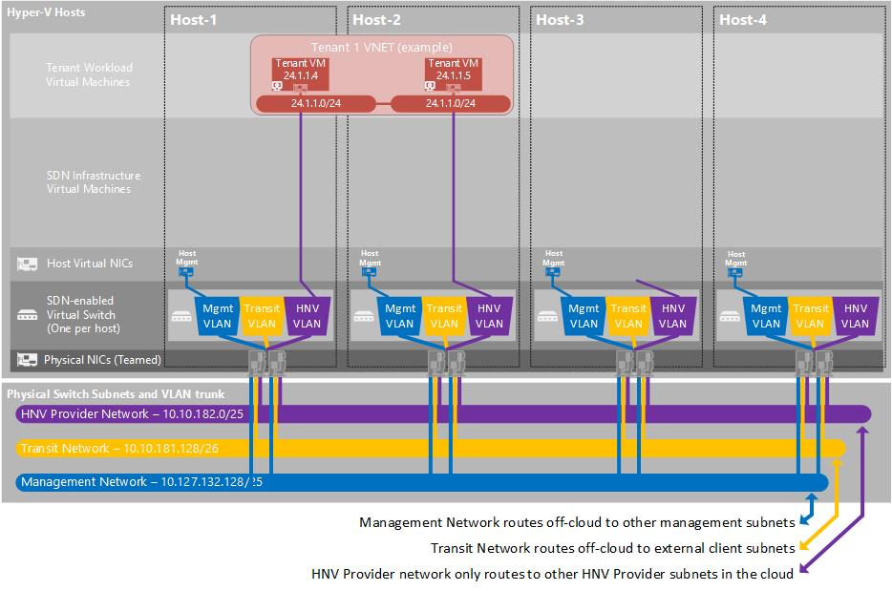
Tenant VMs Deployed

Slide 114
SLB Service Template Configuration Example

Slide 115
Deploy Software Load Balancer (SLB) Template
Create Logical Networks and IP Pools
Transit (Front-End)
Public / Private VIP
Mark all IP Addresses (except Gateway IP) as reserved
Add Transit Logical Network to Management Uplink Port Profile
Re-use Certificates
  Export Network Controller certificate in *.cer format
  No need to export private key
  Save in VMM Template Library
  https://technet.microsoft.com/en-us/system-center-docs/vmm/manage/deploy-a-software-load-balancer-using-vmm

Slide 116
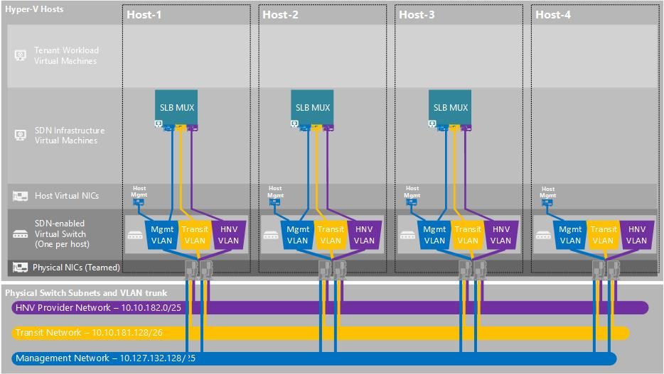
SLB Muxes Deployed

Slide 117
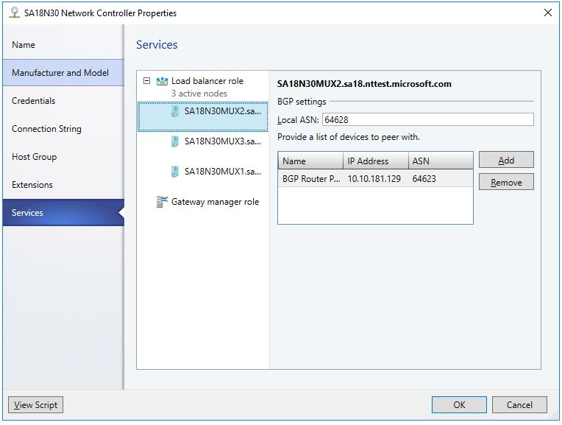
Configure Software Load Balancer Instance
Associate SLB Instance
Load Balancer Role under Network Controller Service
BGP Peering
Specify Local ASN of SLB Muxes
Specify BGP Peer (Router) information
Use Transit Network’s IP Gateway as IP address
Routing information exchanged for Public VIP reachability only

Slide 118
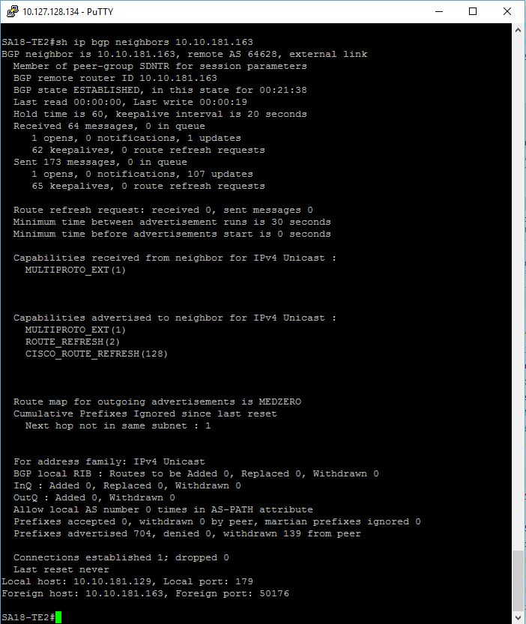
Validation: Check BGP Peering
BGP Neighbors
Tenant VIPs

Slide 119
Tenant VIP
Create VIP Template
Specify Virtual IP Port and Backend Port
Specify protocol (e.g. TCP)
(Optional) Health Monitors
Create Tenant VIP
  Run PowerShell Script
  Specify
  Load Balancer Service Name
  Dynamic IP (DIP) VMs
  VIP Address (from Public VIP Pool)
  VIP Template

Slide 120
Deploy Network Controller Service Template
Create Management Logical Network
Attach Management logical network to Switch Embedded Team (SET)-enabled vSwitch uplink
Create IP Address Pool for Management Network
Create Management Logical Switch
Create Certificates
  Self-Signed or CA-Signed
  Export Certificate
Network Controller Service Template
Prepare the virtual hard disk for the Network Controller Virtual Machine
Import Network Controller Service Template (Found on GitHub)
Configure and Deploy the Service
https://technet.microsoft.com/system-center-docs/vmm/Manage/Deploy-a-Network-Controller-using-VMM

Slide 121
Add Network Controller Service
Add Network Controller Service
Reference credentials of Network Controller service account
Specify connection string
Provide certificate
  Validation: Access Network Controller REST API and check Server resources

Slide 122
NC Service Template Configuration Example

