Slide 1
Exploit the Microsoft Graph API to supercharge your line-of-business applications
BRK3133
Gareth Jones
API Architect, Microsoft Graph

Slide 2
Agenda
Microsoft Graph overview
What’s now and what’s new in GA and Preview
Line-of-business app viewpoint on Microsoft Graph
Code and demos

Slide 3
Microsoft Graph Overview

Slide 4
Office Platform
WHAT CAN I BUILD?
ADD-INS AND WEB PARTS:
Make your solution a native part of the modern Office
WEB AND DEVICE APPS:
Build smarter apps by connecting to Office services
VOICE, VIDEO, CONNECTORS, AND BOTS:
Create the next generation of productivity solutions

Slide 5
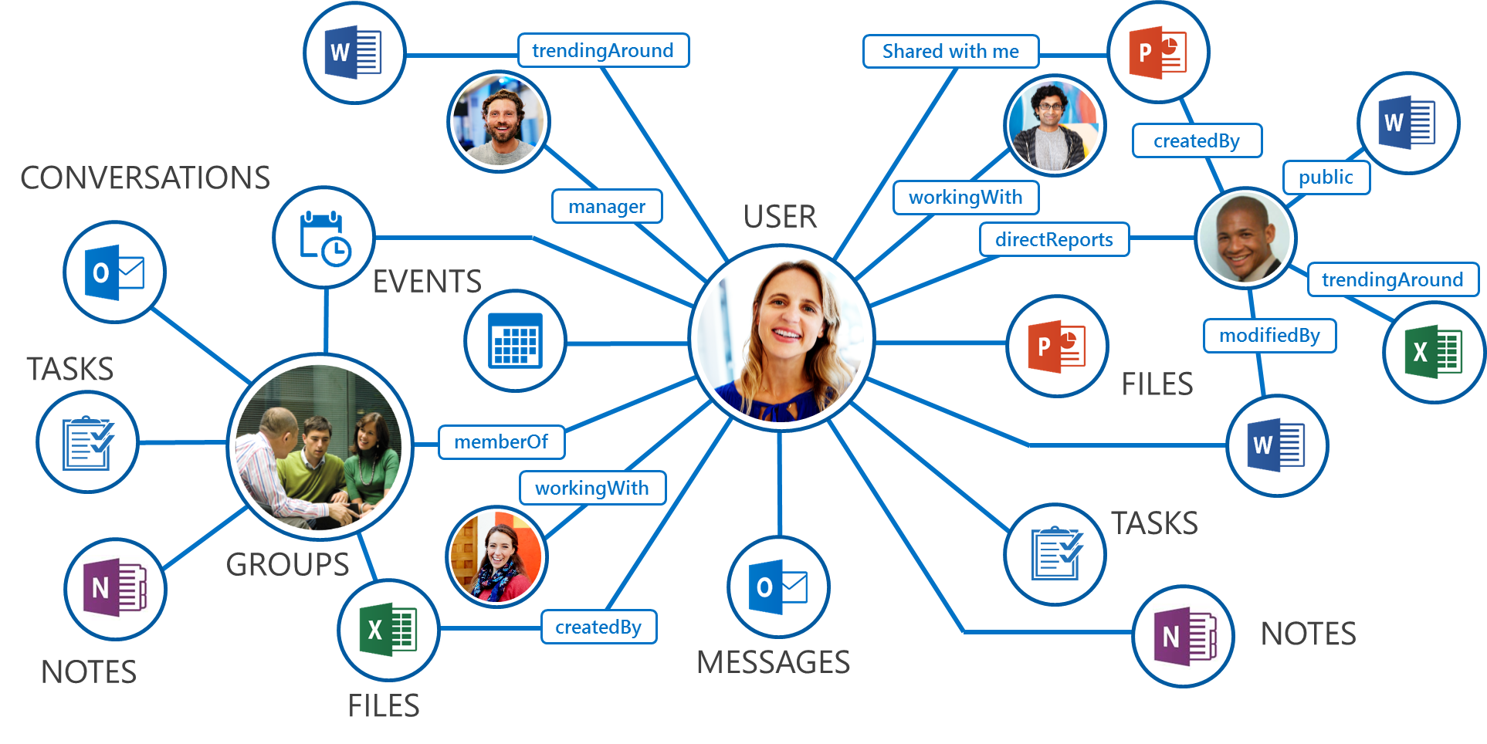
What is Microsoft Graph?
Single API for:
Accessing data
/me, /users, /groups, /messages, /drive, ….
Traversing data
/drive/items/<id>/lastmodifiedByUser
Accessing insights
/insights/trending
Work/School and Personal
https://graph.microsoft.com/

Slide 6
State of the world before Microsoft Graph
Work and school
Personal
Many different APIs to access data
Separate auth stacks for work and personal

Slide 7
Today’s world with Microsoft Graph
Microsoft Graph
https://graph.microsoft.com
Work and school
Personal
…

Slide 8
Diverse API styles and endpoints
Azure Active Directory Graph API
https://graph.windows.net/contoso.com/users
https://graph.windows.net/contoso.com/groups
Windows Live profile API
https://apis.live.net/v5.0/me
SharePoint User Profile API
https://contoso.sharepoint.com/_api/SP.UserProfiles.PeopleManager/GetMyProperties
Exchange HD Picture API
https://graph.microsoft.com/v1.0/me/photo
Outlook REST API
https://outlook.office.com/api/v2.0/me/Messages
https://outlook.office.com/api/v2.0/me/Events
Office Graph in SharePoint Online
https://contoso.sharepoint.com/_api/search/query?Querytext='*'&Properties='GraphQuery:actor(ME,action\:1020,or(action\:1020\,action\:1003,action\:1001,action\:1024,action\:1005,action\:1037,action\:1039,action\:1036)'&SelectProperties='Docid,Title
OneDrive for Business API
https://contoso-my.sharepoint.com/personal
/yina_contoso_com/_api/v2.0/drive
https://contoso.sharepoint.com/sites
/designCouncil/_api/v2./drive
OneDrive API
https://api.onedrive.com/v1.0/drive

Slide 9
Unified API style – single endpoint
https://graph.microsoft.com
Operation | Service endpoint
GET my profile | https://graph.microsoft.com/v1.0/me
GET my files | https://graph.microsoft.com/v1.0/me/drive/root/children
GET my photo | https://graph.microsoft.com/v1.0/me/photo/$value
GET my mail | https://graph.microsoft.com/v1.0/me/messages
GET my calendar | https://graph.microsoft.com/v1.0/me/calendar
GET my manager | https://graph.microsoft.com/v1.0/me/manager
GET last user to modify file foo.txt | https://graph.microsoft.com/v1.0/me/drive/root/children/foo.txt/lastModifiedByUser
GET users in my organization | https://graph.microsoft.com/v1.0/users
GET group conversations | https://graph.microsoft.com/v1.0/groups/<id>/conversations
GET people related to me | https://graph.microsoft.com/beta/me/people
GET my tasks | https://graph.microsoft.com/beta/me/tasks
GET my notes | https://graph.microsoft.com/beta/me/notes/notebooks
GET files trending around me | https://graph.microsoft.com/beta/me/insights/trending

Slide 10
Demo
APIs in practice: Property Manager

Slide 11
What’s New?

Slide 12
What’s been GA over the last year?
Azure Active Directory
Outlook mail, calendar and contacts
Office 365 groups and conversations
OneDrive drives and files
WebHooks for Outlook data
SharePoint & LiveID profiles

Slide 13
What’s new in GA?
Excel API
WebHooks for OneDrive
Extend Graph with your own LOB info for Outlook
FindMeetingTimes scheduling API

Slide 14
What’s new in preview?
SharePoint Sites and Lists*
Hybrid on-premise support for Outlook
@mentions social gestures
Simpler query syntax without $
OneDrive large file upload
Azure AD
Administrative Units
Invitation Manager
Privileged Identity Management
Identity Protection
Application proxy
Coming soon
Delta queries for Outlook and Azure AD
Intune API*
Office 365 Reports

Slide 15
Microsoft Graph Sessions at Ignite
BRK3306 | Power your applications with Excel Workbooks as a Service | Yina Arenas, Yu Liu
BRK3046 | Build intelligent line-of-business applications leveraging the Outlook REST APIs | Venkat Ayyadevara
BRK4016 | Access SharePoint files and lists using SharePoint API in Microsoft Graph API | Ryan Gregg, Luca Bandinelli
BRK3082 | Build solutions and apps with Microsoft OneDrive API and Microsoft Graph API | Jonathan Herbach, Ryan Gregg
BRK3045 | Use Microsoft Graph to reach users on hybrid Exchange 2016 | Venkat Ayyadevara
BRK3199 | Access intelligence in the Microsoft Graph and API | Jon Meling, Andreas Eide
THR3039 | Build real business solutions with Office 365 and OfficeDev PnP | Paolo Pialorsi
BRK2008 | Understand your users: what’s new in Office 365 Usage Reporting | Shilpi Sinha, Anne Michels
BRK3114 | Create cross-platform mobile apps with Xamarin that connect to Office Services | Fabian Williams

Slide 16
Viewpoint: Line Of Business App

Slide 17
App setup and configuration
Defines structure of installation environment explicitly
Create and populate sites, groups (Office 365 + DL)
Hybrid Graph/legacy APIs today

Slide 18
Provisioning Sites with CSOM
var tenant = new Tenant(clientContext);
var spoOperation = tenant.CreateSite(new SiteCreationProperties {
Url ="https://<tenant>.sharepoint.com/sites/<siteName>", Owner = "user@tenant.com", Template = "BLANKINTERNETCONTAINER#0", Title = "Contoso Property Management Dashboard", StorageMaximumLevel = 1000, StorageWarningLevel = 750, TimeZoneId = 7, UserCodeMaximumLevel = 550, UserCodeWarningLevel = 500
});
clientContext.Load(spoOperation);
clientContext.ExecuteQuery();

Slide 19
Provisioning Groups with Graph
var g = new Group {
DisplayName = "My Group",
MailNickname = "MyGroup",
SecurityEnabled = false,
MailEnabled = true,
Description = "A nice group",
GroupTypes = new[] { "Unified" },
};
g = await graphService.Groups.Request().AddAsync(g);

Slide 20
Demo
Property Manager Provisioning

Slide 21
Automate your organization’s workflows
Translate your internal processes
Assign enterprise resources, such as licenses.
Assume existence of infrastructure
HR Professional
Master SharePoint Task List
New user
Planner tasks to get started
Close a deal
Groups with Project plans
Time mgmt spreadsheets

Slide 22
Read data from existing SharePoint site
GET https://graph.microsoft.com/beta/sites/ {siteId}/lists/{listId}/items?expand=columnSet
{ "value":[ {
"createdBy": { "user" : {"id":"d54e4cdd-d2ca-4c39-bfa5-35895bca12f0","displayName":"Gareth"}},
"createdDateTime":"2016-09-20T08:16:21Z",
"eTag":"1610ac6a-24f6-4458-9733-1e5977c63caa,1",
"id":"1610ac6a-24f6-4458-9733-1e5977c63caa",
"lastModifiedBy":{"user":{"id":"d54e4cdd-d2ca-4c39-bfa5-35895bca12f0","displayName":"Gareth"}},
"lastModifiedDateTime":"2016-09-0T08:16:21Z",
"webUrl":"https://site.sharepoint.com/sites/SuiteLevelAppDemo/Lists/NewHireTasks/1_.000",
"listItemId":1,
"columnSet":{
"Title":"Set up payroll details",
"Description":"Set up your payroll details for direct payment of your salary.",
"id":"1",
...
} }]}

Slide 23
Create a plan for new employee tasks
POST https://graph.microsoft.com/beta/plans
{
"title" : "My plan with Bob",
"owner" : "<groupIdGuid>"
}
POST https://graph.microsoft.com/beta/buckets
{
"name" : "Urgent",
"planId" : "<planId>" // From response to previous call
}

Slide 24
Update latest timesheet data
GET https://graph.microsoft.com/1.0/me/drive/
items/<id>/workbook/worksheets
PATCH https://graph.microsoft.com/beta/me/drive/
items/{itemId}/workbook/worksheets('Time')/ range(address='a2:c2')
{
…
"values": [ ["EmployeeHours", "March", "32.0"]],
"valueTypes": [ ["String", "String", "Double"]],
…
}

Slide 25
Demo
New User Provisioning

Slide 26
Data quality makes LOB apps shine
Sample the quality of your enterprise data
Many apps rely on good directory data
Code defensively against holes

Slide 27
hyperfish and Microsoft Graph
Microsoft Active Directory (AD) is a foundation for businesses around the world, but most are missing critical business information. To the organization, the AD is a faceless list of names, and many IT projects fail due to insufficient people and profile information.
“The Microsoft Graph saved us serious time bringing hyperfish to market, that would have taken many more months in the past.”
– Chris Johnson, CTO

Slide 28
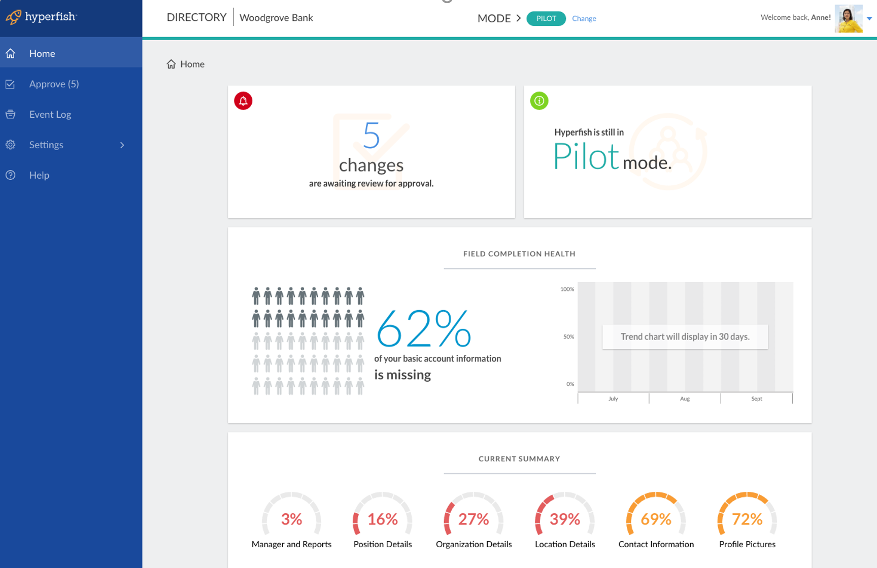

Slide 29
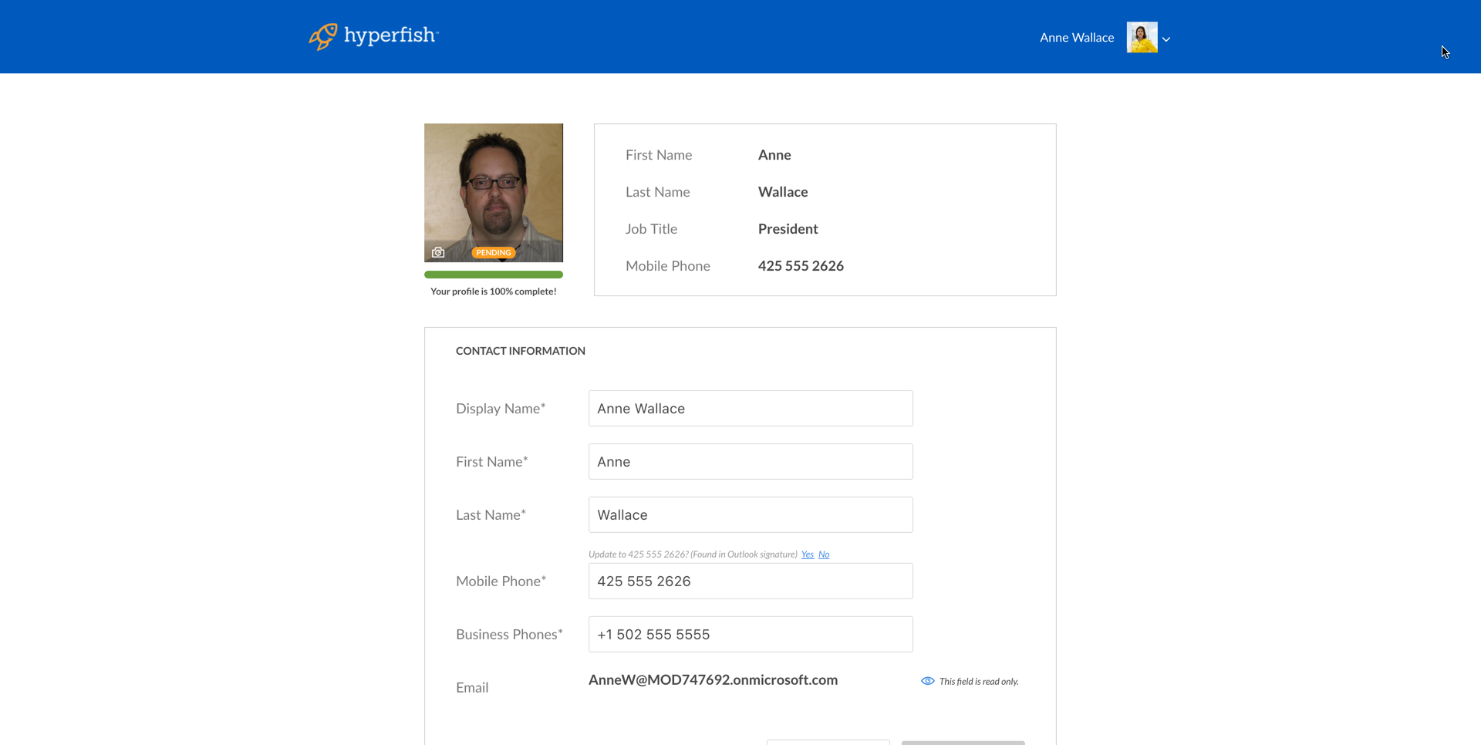

Slide 30
Exploit organizational technology choices
Make deeper connections than simple ‘connectors’
Lower training costs
e.g. let LOB administrators pick Enterprise Mobility Management policies
Tune your apps for your organization
Practice loose coupling

Slide 31
Intune app provisioning code
POST https://graph.microsoft.com/beta/mobileApps
{
"@odata.type": "#microsoft.graph.iosStoreApp",
"description":"Contoso inspection app is the premium home inspection app for iPhone.",
"displayName": "Contoso Inspection",
"isFeatured": false,
"publisher": "Contoso Corporation",
"appStoreUrl": "https://itunes.apple.com/us/app/contoso_insp/id586683407?mt=8&uo=4",
"applicableDeviceType": {
"iPad": true,
"iPhoneAndIPod": true
},
"minimumSupportedOperatingSystem": {
"v7_1": false,
"v8_0": true,
"v9_0": false
}
}
{
"@odata.type": "#microsoft.graph.iosGeneralDeviceConfiguration",
"id": "c7d530ac-f700-401e-b77c-3e686814f654",
...
}

Slide 32
Intune app-assignment code
POST https://graph.microsoft.com/beta/mobileApps/{appIdGuid}/updateAppAssignments
{
"mobileAppGroupAssignments": [
{
"targetGroupId": "{GuidOfInspectorsO365Group}",
"installIntent": "required"
}
]
}

Slide 33
Demo
Intune App Provisioning

Slide 34
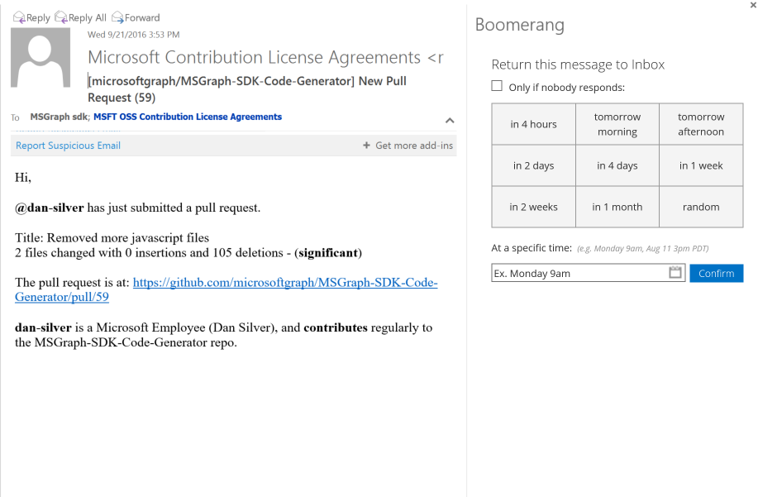
Extend Graph with LOB data
Reverse links from cloud to corporate data
Improve performance
Handle unstable cloud IDs
Broad extensibility support coming across Graph

Slide 35
Extend Graph with LOB data
Reverse links from cloud to corporate data
Improve performance
Handle unstable cloud IDs
Broad extensibility support coming across Graph

Slide 36
Using Graph extensibility
POST https://graph.microsoft.com/v1.0/me/contacts/<contactId>/extensions {
"@odata.type": "microsoft.graph.openTypeExtension",
"ExtensionName": "Com.Contoso.OpportunityManager",
"CompanyName": "Alpine Skis",
"URL": "https://contoso.sales.com/opportunities/6389346343848"
}
GET https://graph.microsoft.com/v1.0/me/contacts/<contactId>/
extensions/Com.Contoso.OpportunityManager

Slide 37
Summary

Slide 38
Microsoft Graph Sessions at Ignite
BRK3306 | Power your applications with Excel Workbooks as a Service | Yina Arenas, Yu Liu
BRK3046 | Build intelligent line-of-business applications leveraging the Outlook REST APIs | Venkat Ayyadevara
BRK4016 | Access SharePoint files and lists using SharePoint API in Microsoft Graph API | Ryan Gregg, Luca Bandinelli
BRK3082 | Build solutions and apps with Microsoft OneDrive API and Microsoft Graph API | Jonathan Herbach, Ryan Gregg
BRK3045 | Use Microsoft Graph to reach users on hybrid Exchange 2016 | Venkat Ayyadevara
BRK3199 | Access intelligence in the Microsoft Graph and API | Jon Meling, Andreas Eide
THR3039 | Build real business solutions with Office 365 and OfficeDev PnP | Paolo Pialorsi
BRK2008 | Understand your users: what’s new in Office 365 Usage Reporting | Shilpi Sinha, Anne Michels
BRK3114 | Create cross-platform mobile apps with Xamarin that connect to Office Services | Fabian Williams

Slide 39
Office Platform
Engage
Join the Office 365 Developer Program - http://dev.office.com
Follow us on Twitter - @OfficeDev
Code in our upcoming hackathon - http://hackproductivity.devpost.com
Provide feedback at User Voice - https://officespdev.uservoice.com
Interact on Stack Overflow - office-js, microsoftgraph, office365api, office365connectors, excel-addins, outlook-web-addins, sharepoint-api

Slide 40
Deploy, ramp-up on new services and onboard new users with Microsoft FastTrack: http://fasttrack.microsoft.com/

Slide 41
Join the Microsoft Tech Community to collaborate, share, and learn from the experts: http://techcommunity.microsoft.com

Slide 42
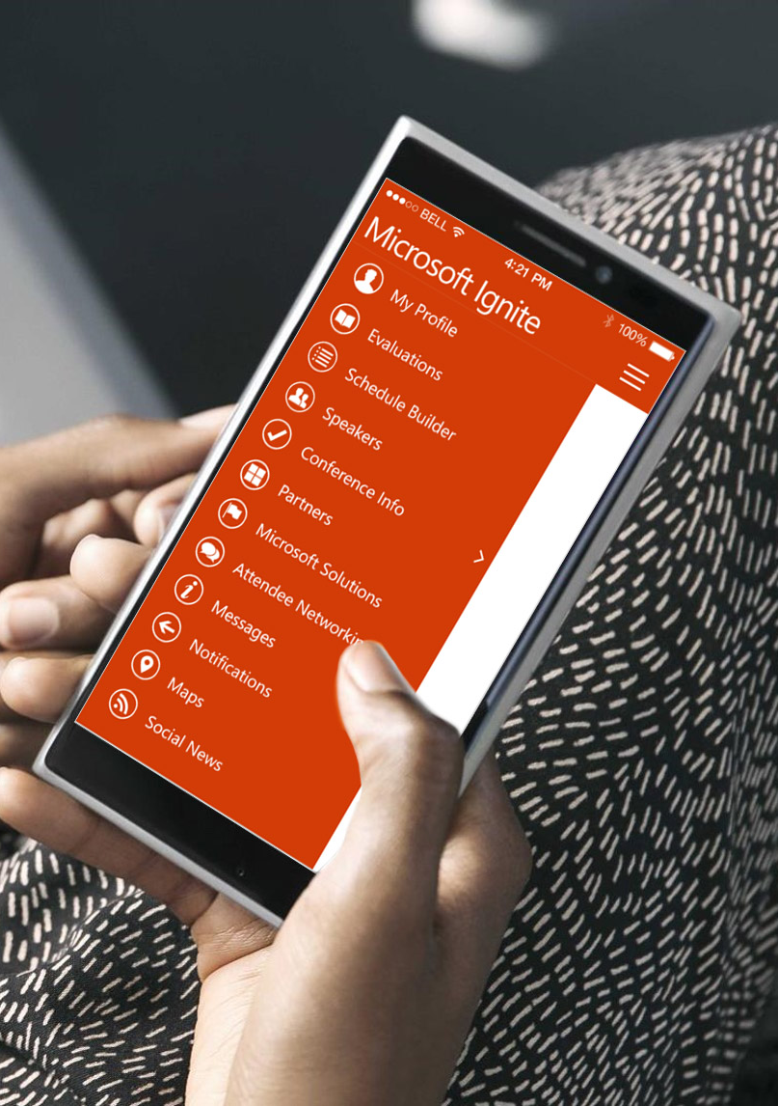
Please evaluate this session
Your feedback is important to us!
From your PC or Tablet visit MyIgnite at http://myignite.microsoft.com
From your phone download and use the Ignite Mobile App by scanning the QR code above or visiting https://aka.ms/ignite.mobileapp

Slide 43
Microsoft Graph Sessions at Ignite
BRK3306 | Power your applications with Excel Workbooks as a Service | Yina Arenas, Yu Liu
BRK3046 | Build intelligent line-of-business applications leveraging the Outlook REST APIs | Venkat Ayyadevara
BRK4016 | Access SharePoint files and lists using SharePoint API in Microsoft Graph API | Ryan Gregg, Luca Bandinelli
BRK3082 | Build solutions and apps with Microsoft OneDrive API and Microsoft Graph API | Jonathan Herbach, Ryan Gregg
BRK3045 | Use Microsoft Graph to reach users on hybrid Exchange 2016 | Venkat Ayyadevara
BRK3199 | Access intelligence in the Microsoft Graph and API | Jon Meling, Andreas Eide
THR3039 | Build real business solutions with Office 365 and OfficeDev PnP | Paolo Pialorsi
BRK2008 | Understand your users: what’s new in Office 365 Usage Reporting | Shilpi Sinha, Anne Michels
BRK3114 | Create cross-platform mobile apps with Xamarin that connect to Office Services | Fabian Williams

