Slide 1
Respond to advanced threats before they start - identity protection at its best!
BRK3110
Mark Wahl
Principal Program Manager
Nitika Gupta
Program Manager

Slide 2


Identity as the core of enterprise mobility
Simple connection
Windows Server
Active Directory
Other
directories
Self-service
Single sign-on
Azure
SaaS
Public
cloud
On-premises
Microsoft Azure Active Directory
Cloud

Slide 3
Identity and access management in the cloud
Azure Active Directory. Identity at the core of your business
1000s of apps,
1 identity
Enable business without borders
Manage access
at scale
Cloud-powered protection
Provide one persona to the workforce for SSO to 1000s of cloud and on-premises apps
Stay productive with universal access to every app and collaboration capability
Manage identities and access at scale in the cloud and on-premises
Ensure user and admin accountability with better security and governance

Slide 4




The Cloud & Mobile Promise
Agility
Reduced friction
Flexibility
Global reach
Easy access
24x7 connectivity
Seamless collaboration
23% greater productivity, 100% higher employee satisfaction
Is mobility the answer to better employee productivity?, Forbes Magazine, 3.29.2016
But what about Auditing? Security? Compliance & Assurance?

Slide 5
The Cloud & Mobile Promise
Agility
Reduced friction
Flexibility
Global reach
Easy access
24x7 connectivity
Seamless collaboration
But what about Auditing? Security? Compliance & Assurance?
But what about Auditing? Security? Compliance & Assurance?

Slide 6

Mobile-first, cloud-first reality
63%
80%
0.6%
Data breaches
  63% of confirmed data breaches involve weak, default, or stolen passwords.
Shadow IT
  More than 80 percent of employees admit to using non-approved software as a service (SaaS) applications in their jobs.
IT budget growth
  Gartner predicts global IT spend will grow only 0.6% in 2016.

Slide 7









Is it possible to keep up?
Is it possible to stay secure?
Presidential Email Hack
DNC Hack
DCCC Hack
Election System Hacks
Lost device
Data leaks
Users
Business partners
Data
Compromised identity
Customers
Apps
Employees
Stolen credentials
Devices

Slide 8




Sobering statistics
200+
75%+
$500B
$3.5M
median # days attackers reside within a victim’s network before detection
network intrusions due to compromised user credentials
total potential cost
of cybercrime to the
global economy
average cost of a data breach to a company
The frequency and sophistication of cybersecurity attacks are escalating

Slide 9
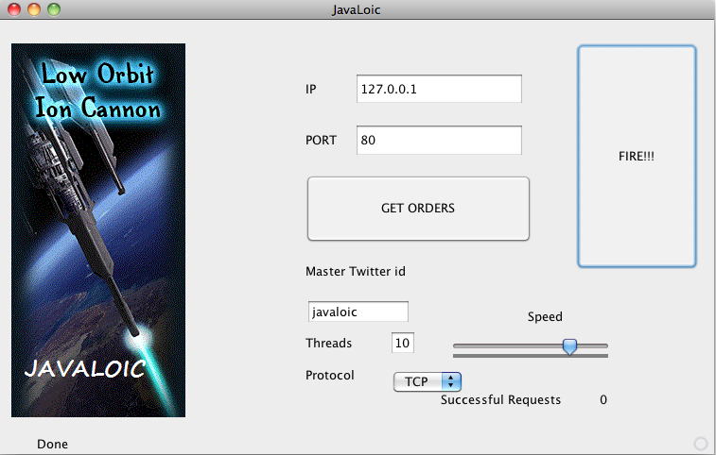
Industrialized Digital Crime
Cybercrime Supply Chain
SDKs & Toolkits
SaaS (social graph!)
IaaS (botnets!)
Phone support!

Slide 10
Mission: Protect our users
Every day we:
Process
> 14B sign-ins
Analyze
> 10 terabytes of data
Deflect 1.5 million attacks
World class signal due to massive amount of relevant data
  One of the world’s largest consumer identity services (the Microsoft Account service)
  One of the world’s large enterprise identity services (the Azure AD service)
  One of the world’s largest consumer email services (Outlook.com)
  One of the world’s largest enterprise email services (Office 365)
  One of the world’s largest online gaming services (Xbox Live)
  Signals from services like SharePoint Online, Skype and OneDrive to strengthen our analysis
  Feeds from Microsoft Digital Crime Unit and Microsoft Security Response Center
  Partnering with Law Enforcement, Security Researchers, Industry further enhances signal
Source: https://www.microsoft.com/sir

Slide 11

Machine
Learning for security

Slide 12
Azure Active Directory

Slide 13
Azure Active Directory

Slide 14
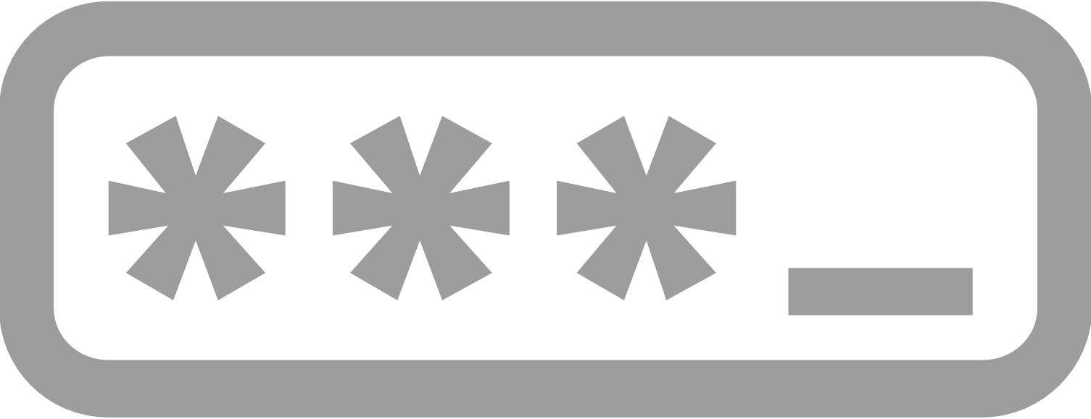
manual learning: step 2
Azure Active Directory
Credentials

Slide 15
Schroedinger's
User
Azure Active Directory
?
Credentials

Slide 16
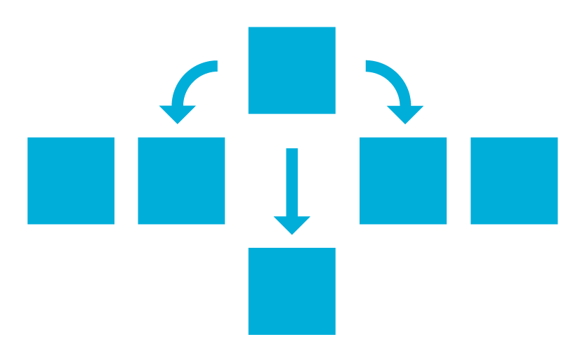
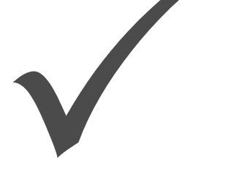
Schroedinger's
User
Azure Active Directory
?
Credentials
Classifier
Rules
Seems
Good
Seems
Bad
Coder

Slide 17

Schroedinger's
User
Azure Active Directory
?
Credentials
Classifier
Seems
Good
Seems
Bad
Analysis
10+ TB Logs
Relying parties
Self-reporting
Threat data
Behavior

Slide 18
Schroedinger's
User
Azure Active Directory
?
Credentials
Classifier
Seems
Good
Seems
Bad
Analysis
10+ TB Logs
Relying parties
Self-reporting
Threat data
Behavior

Slide 19
Schroedinger's
User
Azure Active Directory
?
Credentials
Classifier
Seems
Good
Seems
Bad
Analysis
10+ TB Logs
Relying parties
Self-reporting
Threat data
Behavior
True
Negative
True
Positive
Label
Data
We were right!

Slide 20
Schroedinger's
User
Azure Active Directory
?
Credentials
Classifier
Seems
Good
Seems
Bad
Analysis
10+ TB Logs
Relying parties
Self-reporting
Threat data
Behavior
True
Negative
True
Positive
Label
Data
We were right!
False
Negative
False
Positive
We were wrong!

Slide 21

Schroedinger's
User
Azure Active Directory
?
Credentials
Classifier
Seems
Good
Seems
Bad
Analysis
10+ TB Logs
Relying parties
Self-reporting
Threat data
Behavior
True
Negative
True
Positive
Security
Analyst
Label
Data
We were right!
False
Negative
False
Positive
We were wrong!

Slide 22


Schroedinger's
User
Azure Active Directory
?
Credentials
Classifier
Seems
Good
Seems
Bad
Analysis
10+ TB Logs
Relying parties
Self-reporting
Threat data
Behavior
Code updates
to Classifier
True
Negative
True
Positive
Security
Analyst
Label
Data
We were right!
False
Negative
False
Positive
We were wrong!

Slide 23


Schroedinger's
User
Azure Active Directory
?
Credentials
Classifier
Seems
Good
Seems
Bad
Analysis
Deploy new
Classifier
10+ TB Logs
Relying parties
Self-reporting
Threat data
Behavior
Code updates
to Classifier
True
Negative
True
Positive
Security
Analyst
Label
Data
We were right!
False
Negative
False
Positive
We were wrong!

Slide 24


Schroedinger's
User
Azure Active Directory
?
Credentials
Classifier
Seems
Good
Seems
Bad
Analysis
Deploy
10+ TB Logs
Relying parties
Self-reporting
Threat data
Behavior
Update
True
Negative
True
Positive
Analyze
Label
Data
We were right!
False
Negative
False
Positive
We were wrong!

Slide 25

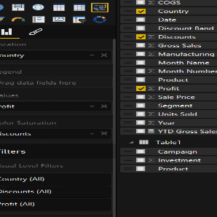
Schroedinger's
User
Azure Active Directory
?
Credentials
Classifier
Learner
Seems
Good
Seems
Bad
Analysis
Deploy
10+ TB Logs
Relying parties
Self-reporting
Threat data
Behavior
Update
True
Negative
True
Positive
Analyze
Label
Data
We were right!
False
Negative
False
Positive
We were wrong!

Slide 26

Identity Protection in Action: EDU Attack
1,750 of 8,000
accounts
compromised

Slide 27
We noticed a sharp increase in password lockouts
Users
Locked Out
Per Day
Large elevation in user lockouts. Inspection show lockout increase from single org.

Slide 28
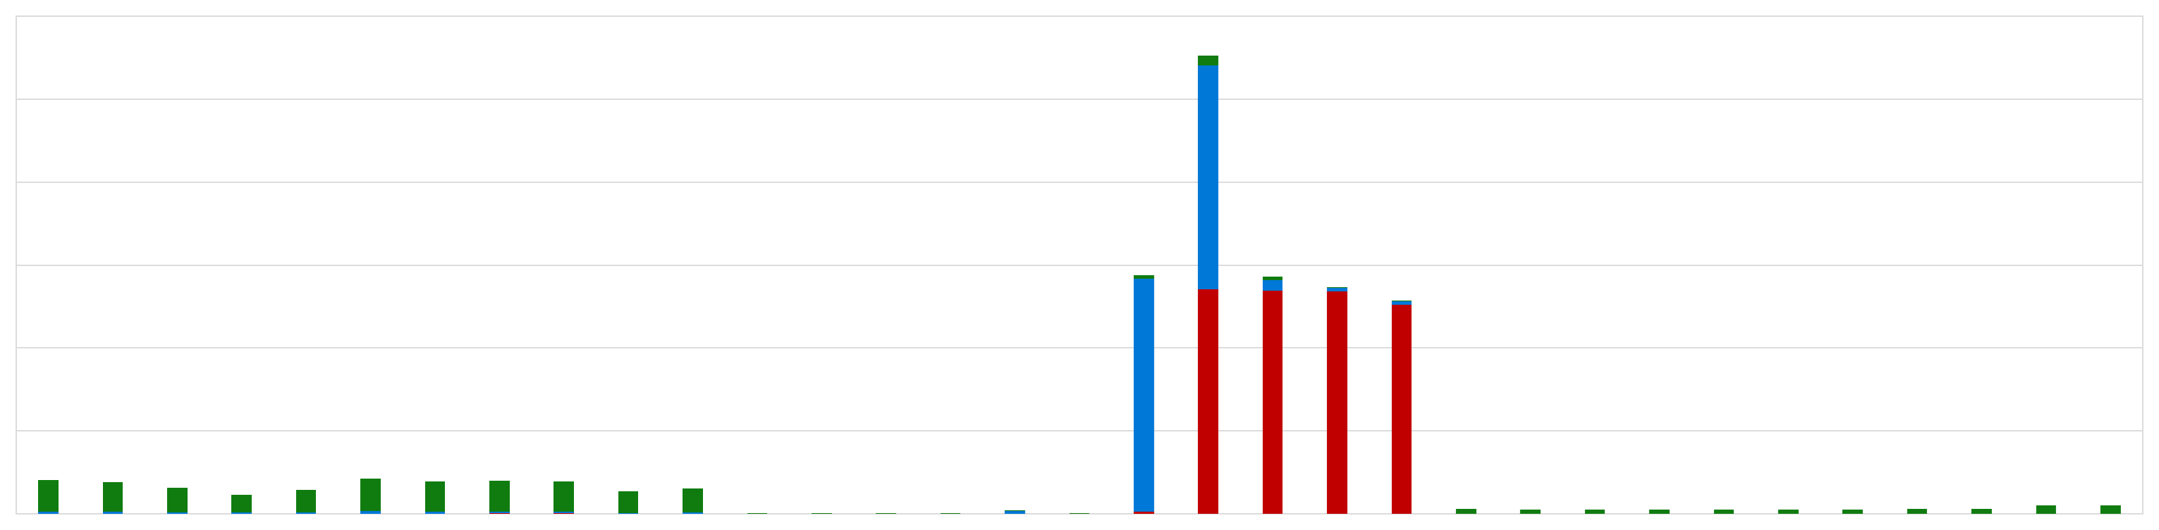
Suspicious IP activity very different from in-country IPs
In-
Country
Traffic
Mostly failure traffic
Single UserAgent
Suspect
IP
Generally lower user volume
Generally successful

Slide 29
Detailed suspicious IP view showed automated attacks
Accounts
Accessed
Per-Minute,
Suspect IP
Initial bad guy test run
Large scale account failures/minute

Slide 30
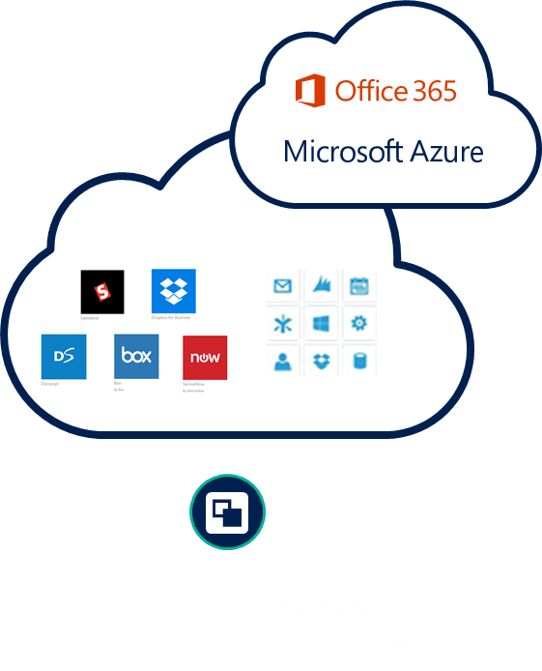
Identity-driven security
CLOUD-POWERED PROTECTION
Actions
Conditions
User, Group, App sensitivity
Allow access or
Device state
User
Location
Enforce MFA per user/per app
Risk
Block access
MFA
NOTIFICATIONS, ANALYSIS, REMEDIATION, RISK-BASED POLICIES
CLOUD APP DISCOVERY
PRIVILEGED IDENTITY MANAGEMENT
IDENTITY PROTECTION

Slide 31
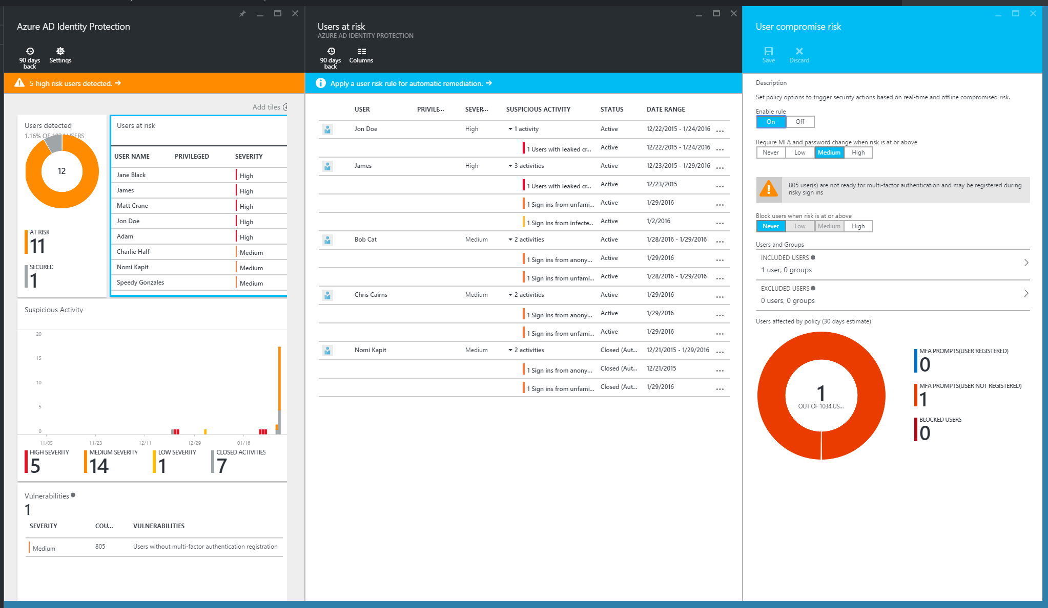
Azure Active Directory Identity Protection
CLOUD-POWERED PROTECTION
Identity Protection at its best
Gain insights from a consolidated view of machine learning based threat detection
Infected devices
Leaked credentials
Configuration vulnerabilities
Brute force attacks
Suspicious sign-in activities
Remediation recommendations
Risk-based policies
Risk severity calculation
Machine-Learning Engine
MFA Challenge Risky Logins
Risk-based conditional access automatically protects against suspicious logins and compromised credentials
Change bad credentials
Block attacks

Slide 32
Azure Active Directory Identity Protection
CLOUD-POWERED PROTECTION
Use the power of Identity Protection in PowerBI, SIEM and other monitoring tools
Infected devices
Leaked credentials
Configuration vulnerabilities
Brute force attacks
Suspicious sign-in activities
Security/Monitoring/Reporting SOLUTIONS
Events
Query
PowerBI
SIEM
Monitor Tools
Reporting API
Apply Microsoft learnings to your existing security tools
Microsoft Machine - learning Engine

Slide 33
Demo

Slide 34
Increased risk to administrative privileges
All the commonplace attacks exploit privileged accounts:
  Stolen admin
  credentials
Malicious service
provider staff
  Insiders
❶
❷
  Administrator privileges will be compromised:
  social engineering, bribery, private initiative
  20 years ago we gave
  the administrator
  the keys to the kingdom; we can’t just take it away

Slide 35
Admin accounts historically on-premises
Joe needs permissions to manage Exchange
Someone adds Joe’s account to the “Domain Admins” group in AD
Joe logs in, is a “Domain Admins”
Joe completes task
Joe’s account remains in “Domain Admins” group indefinitely.

Slide 36
What about in the cloud?
Joe needs permissions to manage Exchange
Someone adds Joe’s account to the “Domain Admins” group in AD
Joe logs in, is a “Domain Admins”
Joe completes task
Joe needs permissions to manage Exchange Online
Someone adds Joe’s account to the
“Global Administrator” role in Azure AD
Joe logs in, is a “Global Administrator”
Joe completes task
Joe’s account remains in “Domain Admins” group indefinitely.
Joe’s account remains in “Global Administrator” role indefinitely.

Slide 37
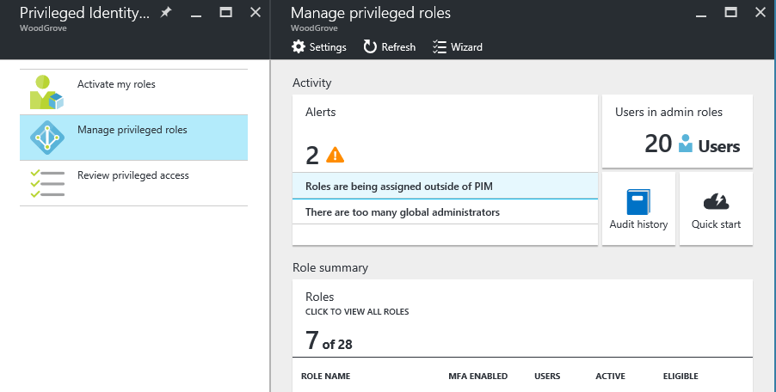

Privileged Identity Management
How time-limited activation of privileged roles works
SECURITY ADMIN
Users need to activate their privileges to perform a task
ALERT
MFA is enforced during the activation process
Configure Privileged
Identity Management
Alerts inform administrators about out-of-band changes
Identity
verification
Monitor
ADMIN PROFILES
Users will retain their privileges for a pre-configured amount of time
Billing Admin
Global Admin
Audit
USER
MFA
Security Reader
Service Admin
Access reports
Security admins can discover all privileged identities, view audit reports and review everyone who has is eligible to activate via access reviews
PRIVILEGED IDENTITY MANAGEMENT

Slide 38
Demo

Slide 39
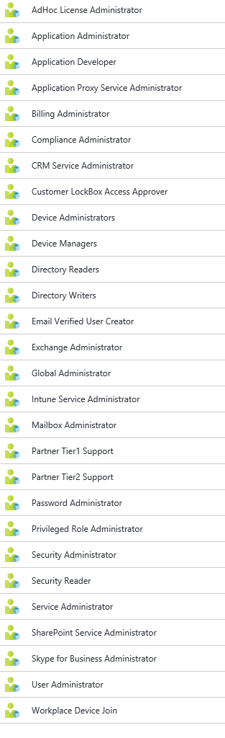
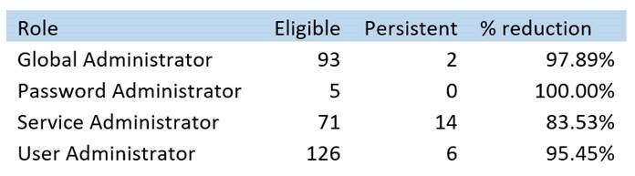
Privileged Identity Management
Enabling “just in time” activation
Require MFA for login, or if can’t for all apps, at least for role activation
Ask users to provide justification – why are they using this role?
Remove users from roles if they’re not needing them
Fewer permanent privileged admins

Slide 40









Microsoft Cloud App Security
Secure the Enterprise
Extending visibility and control to cloud apps
Create policies for access, activities, and data sharing
Automatically identify risky activities, abnormal behaviors, and threats
Prevent data leakage (DLP)
Minimize risk and automated threat prevention and policy enforcement

Slide 41

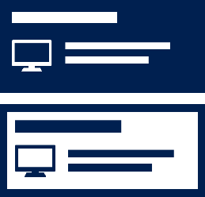
Microsoft Advanced Threat Analytics
Detect threats fast with behavioral analytics
Adapt as fast as your enemies
Focus on what is important fast using the simple attack timeline
Reduce the fatigue of false positives
No need to create rules or policies, deploy agents, or monitor a flood of security reports. The intelligence needed is ready to analyze and is continuously learning.
ATA continuously learns from the organizational entity behavior (users, devices, and resources) and adjusts itself to reflect the changes in your rapidly evolving enterprise.
The attack timeline is a clear, efficient, and convenient feed that surfaces the right things on a timeline, giving you the power of perspective on the “who, what, when, and how” of your enterprise. It also provides recommendations for next steps.
Alerts only happen once suspicious activities are contextually aggregated; not only comparing the entity’s behavior to its own behavior, but also to the profiles of other entities in its interaction path.

Slide 42
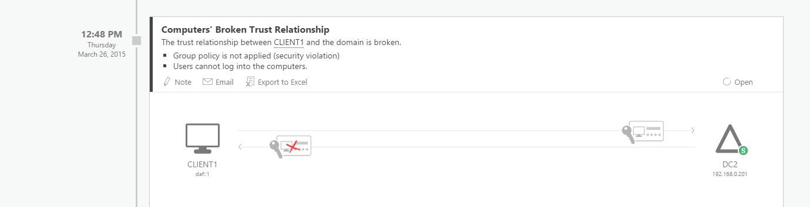
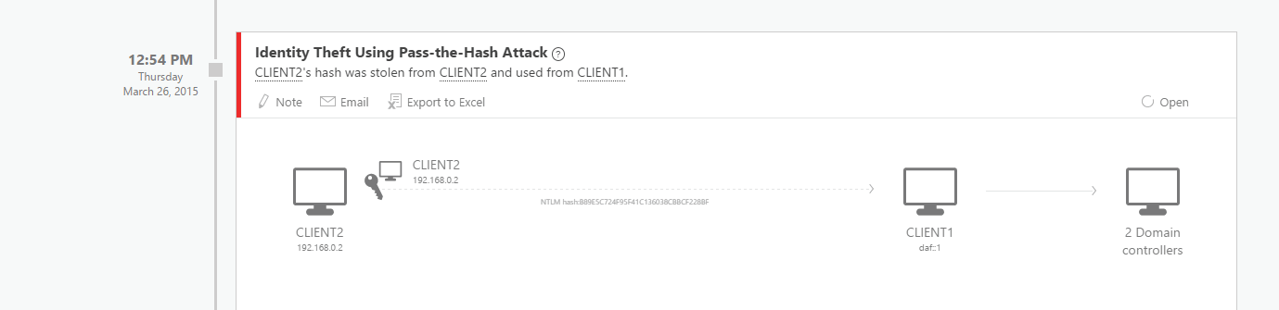
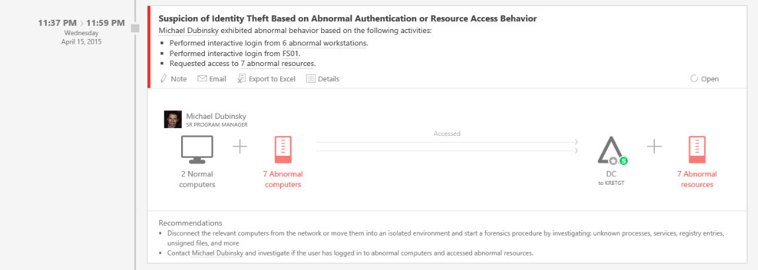
Microsoft Advanced Threat Analytics detection
Security issues and risks
Broken trust
Weak protocols
Known protocol vulnerabilities
Malicious attacks
Pass-the-Ticket (PtT)
Pass-the-Hash (PtH)
Overpass-the-Hash
Forged PAC (MS14-068)
Golden Ticket
Skeleton key malware
Reconnaissance
Brute force
Abnormal Behavior
Anomalous logins
Remote execution
Suspicious activity
Unknown threats
Password sharing
Lateral movement

Slide 43
Privileged Access Management for AD DS
Joe requests to have Domain Admin rights on his admin account for 1 hour
Approver approves the request
Joe can manage through the “Domain Admins” shadow principal group for 1 hour
An hour later, privileged admin right expires, shadow membership removed, tickets expire
Bastion forest
Approver
Admin
MIM PAM Portal

Slide 44





Securing privileged access on-premises
Build visibility and control of administrator activity, increase protection against typical follow-up attacks
http://aka.ms/privsec
6. Attack Detection
http://aka.ms/ata
2. Time-bound privileges (no permanent admins)
http://aka.ms/PAM http://aka.ms/AzurePIM
3. Multi-factor for elevation
Active
Directory
9872521
Azure Active Directory
1. Privileged Access Workstations (PAWs)
Phases 2 and 3 –All Admins and additional hardening (Credential Guard, RDP Restricted Admin, etc.)
http://aka.ms/CyberPAW
4. Just Enough Admin (JEA) for DC Maintenance
http://aka.ms/JEA
5. Lower attack surface of Domain and DCs http://aka.ms/HardenAD

Slide 45

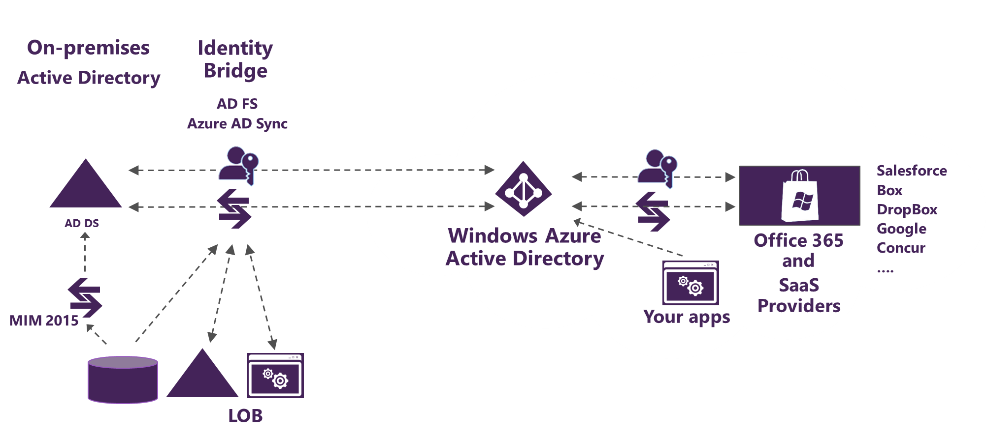






Automate and protect
Manage identity with hybrid integration to protect application access from identity attacks
Reduce risks of attacks targeting admins with ‘just in time’ access rights
On-premises and private cloud
Detect problems early with visibility and threat analytics
Azure Active Directory Identity Protection
Azure Active Directory
Privileged Identity Mgmt.
Advanced Threat Analytics
Privileged Identity Mgmt.
Azure AD Connect
Azure MFA and
Conditional access
Ensure access is
suitably authenticated
Azure
Active Directory
Microsoft Cloud App Security
Privileged Access Mgmt.
Extend enterprise-grade security to your cloud and SaaS apps
Azure AD App Proxy
MIM
Cloud-hosted apps
Azure Information Protection
On-prem HR
On-prem apps
Protect your data, everywhere

Slide 46
Learn more
Identity Protection
Overview https://aka.ms/AADIP
Graph API https://aka.ms/AADIPGraphAPI
Privileged Identity Management
Overview https://aka.ms/AADPIM
PowerShell https://aka.ms/AADPIMPowerShell
Graph API https://aka.ms/AADPIMGraphAPI
Azure AD Premium P2
Trial license http://aka.ms/AADP2Trial

Slide 47



















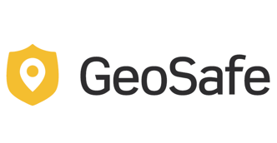






















Customer Stories
Transportation, Logistics, Oil-Gas
Retail, Hospitality and Travel
Government, Banking, Insurance
Construction, Professional Services
Education – Nonprofit
Health

Slide 48
Identity and Access Management Sessions
Monday
  02:15: BRK2139 Protect your business and empower your users with cloud Identity and Access Management
Tuesday
  12:30: BRK3107 Connect your on-premises directories to Azure AD and use one identity for all your apps
  02:15: BRK3225 Secure access to Office 365, SaaS, and on-premises apps and files with Azure AD and Intune
  04:30: BRK3109 Deliver management and security at scale to Office 365 with Azure Active Directory
Wednesday
  09:00: BRK3111 Manage productivity at scale with Azure Active Directory
  11:30: BRK2210 Learn how Unilever modernized IT with Azure Active Directory at the core
  02:15: BRK3139 Throw away your DMZ – Azure Active Directory Application Proxy deep-dive
  04:00: BRK3181 Secure your web applications with Microsoft identity
Thursday
  09:00: BRK3252 Use managed domain services on Microsoft Azure
  12:30: BRK3182 Secure your native and mobile applications with Microsoft identity and application management
  02:15: BRK3110 Respond to advanced threats before they start - identity protection at its best!
  04:00: BRK3179 Modernize your app’s consumer identity management with Azure AD B2C
  04:30: BRK2067 Manage access to SaaS Applications With Azure Active Directory
Friday
  09:00: BRK3074 Discover what’s new in Active Directory Federation and Domain Services in Windows Server 2016
  10:45: BRK3108 Share corporate resources with your partners using Azure AD B2B collaboration
  12:30: BRK3330 Join your Windows 10 devices to Azure AD for anywhere, anytime productivity

Slide 49
Keep going…
Try Enterprise Mobility + Security for free, today:
https://aka.ms/EMSTrial
Read the CIO’s guide to Azure Active Directory
https://aka.ms/AzureADCIOGuide
Explore Identity + Access Management
www.microsoft.com/identity
Learn more from the Azure AD documentation library
https://aka.ms/AzureADDoc
Discover Password best practices
https://aka.ms/PasswordBestPractices
Check out the new Azure AD webinars
https://aka.ms/AADWebinars
Microsoft is a leader in Gartner's IDaaS MQ 2016
https://aka.ms/GartnerIDaaSMQ2016
Review design considerations for your hybrid Azure AD
https://aka.ms/HybridAzureADConsiderations

Slide 50
Free IT Pro resources
To advance your career in cloud technology
Plan your
career path
Cloud role mapping
Expert advice on skills needed
Self-paced curriculum by cloud role
$300 Azure credits and extended trials
Pluralsight 3 month subscription (10 courses)
Phone support incident
Weekly short videos and insights from Microsoft’s leaders and engineers
Connect with community of peers and Microsoft experts
Microsoft IT Pro Career Center
www.microsoft.com/itprocareercenter
Get started
with Azure
Microsoft IT Pro Cloud Essentials
www.microsoft.com/itprocloudessentials
Demos and
how-to videos
Microsoft Mechanics
www.microsoft.com/mechanics
Connect with peers and experts
Microsoft Tech Community
https://techcommunity.microsoft.com

Slide 51


Please evaluate this session
Your feedback is important to us!
From your PC or Tablet visit MyIgnite at http://myignite.microsoft.com
From your phone download and use the Ignite Mobile App by scanning the QR code above or visiting https://aka.ms/ignite.mobileapp

Slide 53
Appendix – More Details

Slide 54
Windows Server 2016 new features
PIM trust bit
In receiving domain, prevents low-RID groups from being filtered out
Time limited memberships
Users can be added to a security group with time-to-live (TTL)
When the TTL expires, the user’s membership in that group disappears
Kerberos token lifetime will be determined by TTL of the memberships
  TGT based on shortest group membership
  ST based on TGT and resource local domain group membership
Shadow principal groups
  Add shadow admin user to that group, and their Kerberos ticket takes on the group SID
  Improves the semantics so that "SIDHistory" is no longer overloaded
Member: <TTL,user-DN>
TGT: Shortest group
lifetime
ST: Shortest of TGT and resource local domain group

