Slide 1
Dive into Predictive Maintenance using Cortana Intelligence Suite
BRK3106
Katherine Zhao
Data Scientist
Microsoft

Slide 2
Advanced Analytics from Microsoft
Two offers
Advanced Analytics
In the Cloud
Advanced Analytics
On-Premises
Cortana Intelligence Suite
SQL Server 2016
R Services

Slide 3



Predictive Maintenance problems can be solved

Slide 4











Cortana Intelligence Suite
Transform data into intelligent action
Information Management
Big Data Stores
Machine Learning
and Analytics
Dashboards and Visualizations
Data sources
Power BI
Azure
Data Factory
Azure
Data Lake Store
Azure
Machine Learning
People
Personal Digital Assistant
Azure
Data Catalog
Azure
SQL Data Warehouse
Azure Data Lake Analytics
Cortana
Custom
apps
Perceptual Intelligence
Apps
Azure
Event Hub
Azure
HDInsight (Hadoop, Spark)
Bot Framework
Azure
Stream Analytics
Business Scenarios
Sensors
and devices
Recommendations,
customer churn,
forecasting, etc.
Automated
Systems
DATA
INTELLIGENCE
ACTION

Slide 5
Agenda
Predictive Maintenance concept
Aircraft Engine demo: delivers real-time and predictive intelligence
Demo: End-to-end deployment with Cortana Intelligence Solutions
How Machine Learning can help your businesses?

Slide 6
Important task in Internet of Things applications
Traditional Predictive Maintenance
Predictive Maintenance in IoT

Slide 7
Aircraft Engine Demo

Slide 8
Scenario

Slide 9
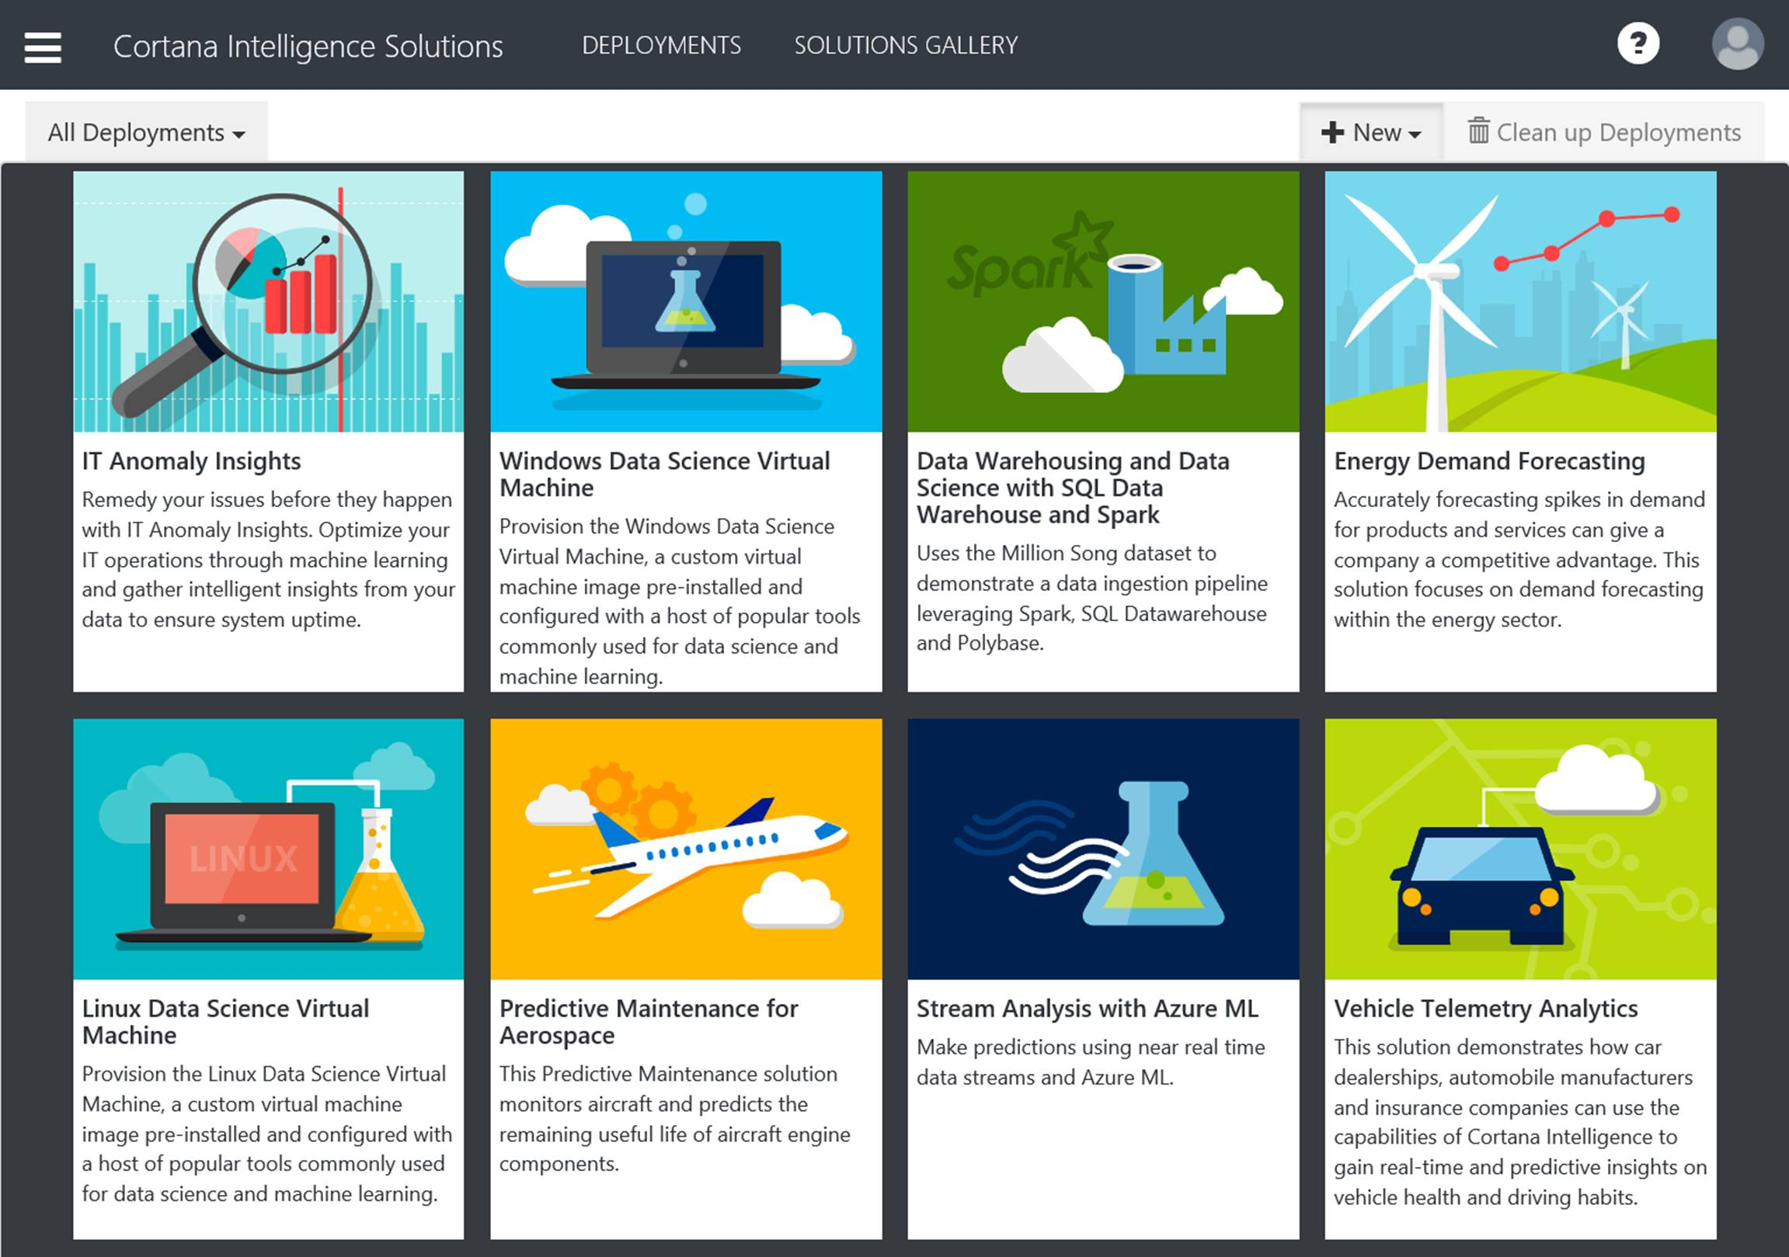
Cortana Intelligence Solutions Demo aka.ms/CIQSPdM

Slide 10



Cortana Intelligence to the Rescue
1
3
HDInsight
2
Blob
Storage
4
Machine Learning
5
Data Factory
Real-time Aircraft Engine data
Event Hub
Stream
Analytics
Database
Real-time
Batch updates
Power BI
Reference: “A. Saxena and K. Goebel (2008). “PHM08 Challenge Data Set”, NASA Ames Prognostics Data Repository, NASA Ames Research Center, Moffett Field, CA.”

Slide 11

Conclusion
Kyle is a happy man!
…

Slide 12
Qualification Criteria for ML-based solutions
The better the raw materials, the better the product.
Predictable
Identifier
Accuracy
Connection
Size

Slide 13
Data Sources
FAILURE HISTORY
REPAIR
HISTORY
MACHINE CONDITIONS
MACHINE FEATURES
OPERATING CONDITIONS
OPERATOR ATTRIBUTES

Slide 14
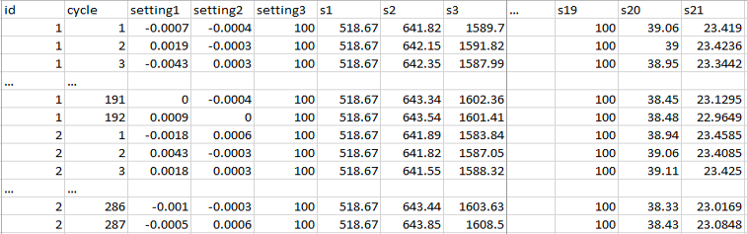
Feature Engineering
The process of creating features that provide better or additional predictive power to the learning algorithm.
a1 | a2 | … | a21 | sd1 | sd2 | … | sd21 | RUL | label1 | label2
40+ engineered features
  Other potential features: velocity of change and frequency count over a predefined threshold

Slide 15
Example Feature Engineering Methods
1 - Rolling aggregates
Capture
degradation over time
2 - Lag features for short term
3 - Lag features for long term

Slide 16
Modelling Techniques
Binary Classification
Regression/
Survival Analysis
Multi-class Classification
Anomaly Detection

Slide 17
Data Labeling
id | cycle | … | RUL | label1 | label2
1 | 1 |  | 191 | 0 | 0
1 | 2 |  | 190 | 0 | 0
1 | 3 |  | 189 | 0 | 0
1 | 4 |  | 188 | 0 | 0
… |  |  | … | … | …
1 | 160 |  | 32 | 0 | 0
1 | 161 |  | 31 | 0 | 0
1 | 162 |  | 30 | 1 | 1
1 | 163 |  | 29 | 1 | 1
1 | 164 |  | 28 | 1 | 1
1 | 165 |  | 27 | 1 | 1
1 | 166 |  | 26 | 1 | 1
1 | 167 |  | 25 | 1 | 1
1 | 168 |  | 24 | 1 | 1
1 | 169 |  | 23 | 1 | 1
1 | 170 |  | 22 | 1 | 1
1 | 171 |  | 21 | 1 | 1
1 | 172 |  | 20 | 1 | 1
1 | 173 |  | 19 | 1 | 1
1 | 174 |  | 18 | 1 | 1
1 | 175 |  | 17 | 1 | 1
1 | 176 |  | 16 | 1 | 1
1 | 177 |  | 15 | 1 | 2
1 | 178 |  | 14 | 1 | 2
1 | 179 |  | 13 | 1 | 2
1 | 180 |  | 12 | 1 | 2
1 | 181 |  | 11 | 1 | 2
1 | 182 |  | 10 | 1 | 2
1 | 183 |  | 9 | 1 | 2
1 | 184 |  | 8 | 1 | 2
1 | 185 |  | 7 | 1 | 2
1 | 186 |  | 6 | 1 | 2
1 | 187 |  | 5 | 1 | 2
1 | 188 |  | 4 | 1 | 2
1 | 189 |  | 3 | 1 | 2
1 | 190 |  | 2 | 1 | 2
1 | 191 |  | 1 | 1 | 2
1 | 192 |  | 0 | 1 | 2
Predefined window size for classification models
w1 = 30
w0 = 15
Regression
Binary classification
w1
Multi-class classification
w0

Slide 18
ML Process
Historical Data
Future Data
Define Objective
Split
Training
Test
Access and Understand the data
Train Model
Score Model
*
Score Model
Pre-processing
Prediction Results
Evaluate Model
* Depending largely on size/complexity, may want to do pre-processing and/or feature/target construction before ingesting into AML Studio / AML API.

Slide 19
“Most IoT data are not used currently…
the data that are used today are mostly for anomaly detection and control, not optimization and prediction, which provide the greatest value.” *
* The Internet of Things: mapping the value beyond the hype, by McKinsey & Company June 2015

Slide 20
Resources to learn and adapt
Try Cortana Intelligence Solutions – Predictive Maintenance for Aerospace for advanced analytics in the cloud
Explore Predictive Maintenance Template for detail explanation of the machine learning model used for this solution
Read the Predictive Maintenance Playbook for more details on how to approach these problems
Learn Predictive Maintenance Template with SQL Server R Services for an on-promises solution

Slide 21
Thank you

Slide 22
Free IT Pro resources
To advance your career in cloud technology
Plan your
career path
Cloud role mapping
Expert advice on skills needed
Self-paced curriculum by cloud role
$300 Azure credits and extended trials
Pluralsight 3 month subscription (10 courses)
Phone support incident
Weekly short videos and insights from Microsoft’s leaders and engineers
Connect with community of peers and Microsoft experts
Microsoft IT Pro Career Center
www.microsoft.com/itprocareercenter
Get started
with Azure
Microsoft IT Pro Cloud Essentials
www.microsoft.com/itprocloudessentials
Demos and
how-to videos
Microsoft Mechanics
www.microsoft.com/mechanics
Connect with peers and experts
Microsoft Tech Community
https://techcommunity.microsoft.com

Slide 23


Please evaluate this session
Your feedback is important to us!
From your PC or Tablet visit MyIgnite at http://myignite.microsoft.com
From your phone download and use the Ignite Mobile App by scanning the QR code above or visiting https://aka.ms/ignite.mobileapp

Slide 25
Appendix

Slide 26
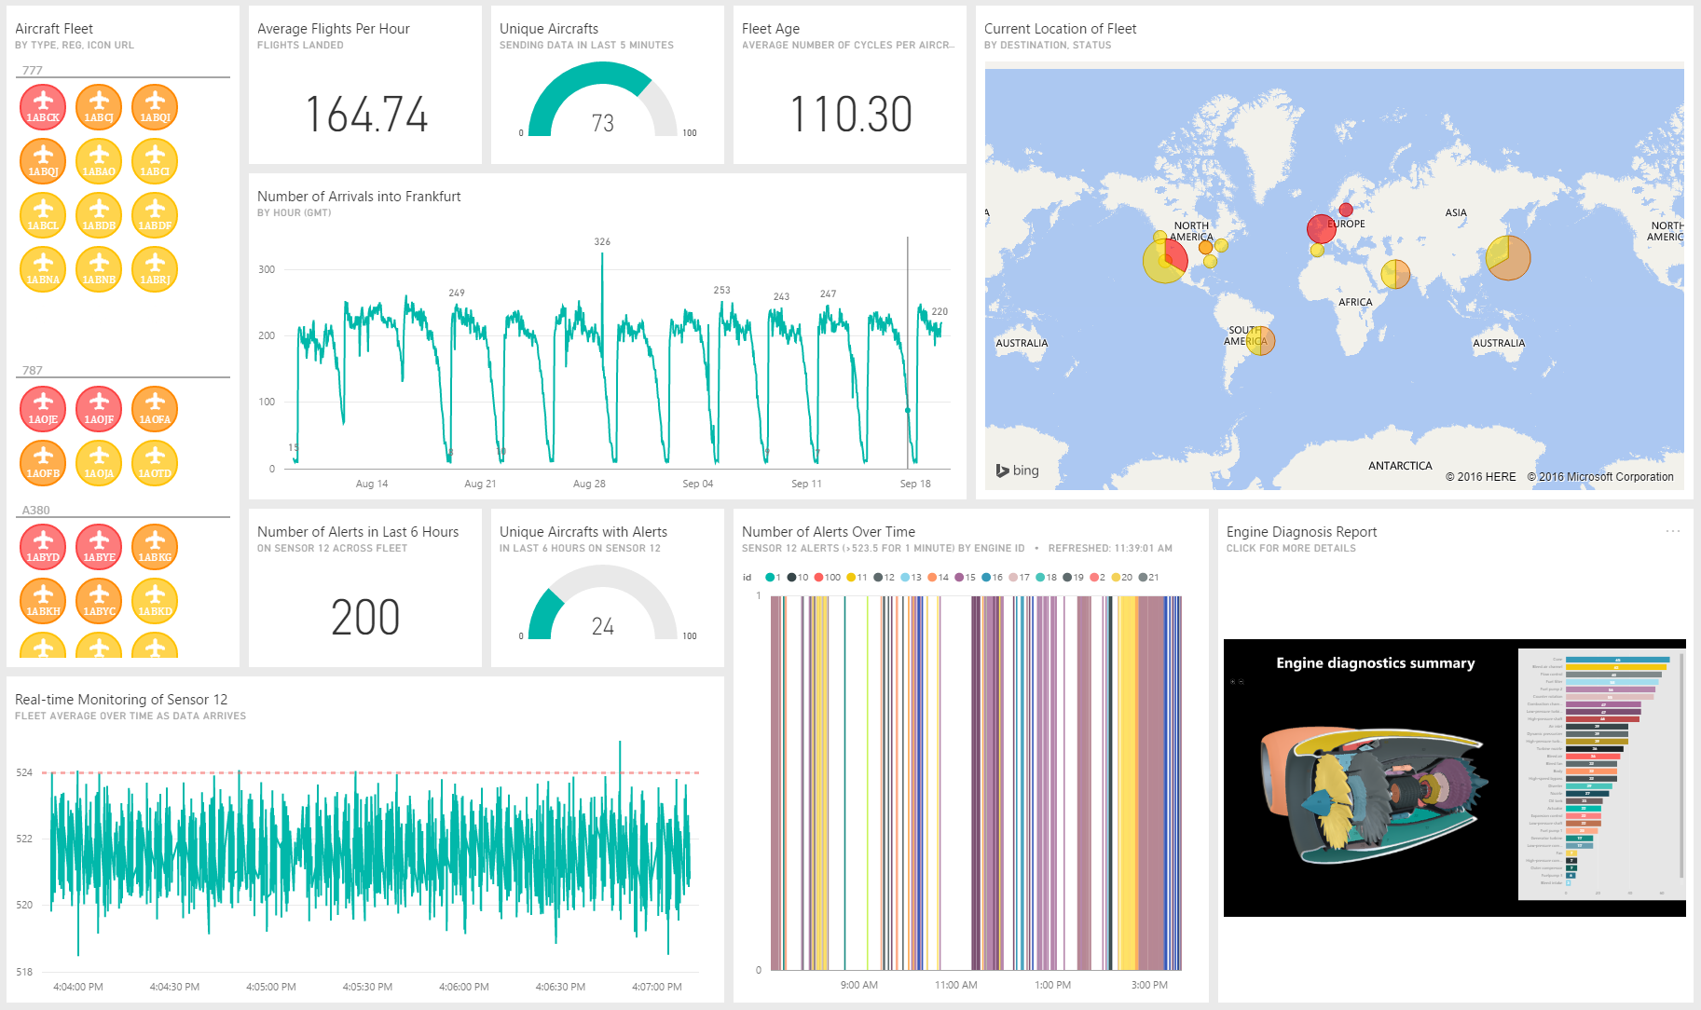

Slide 27
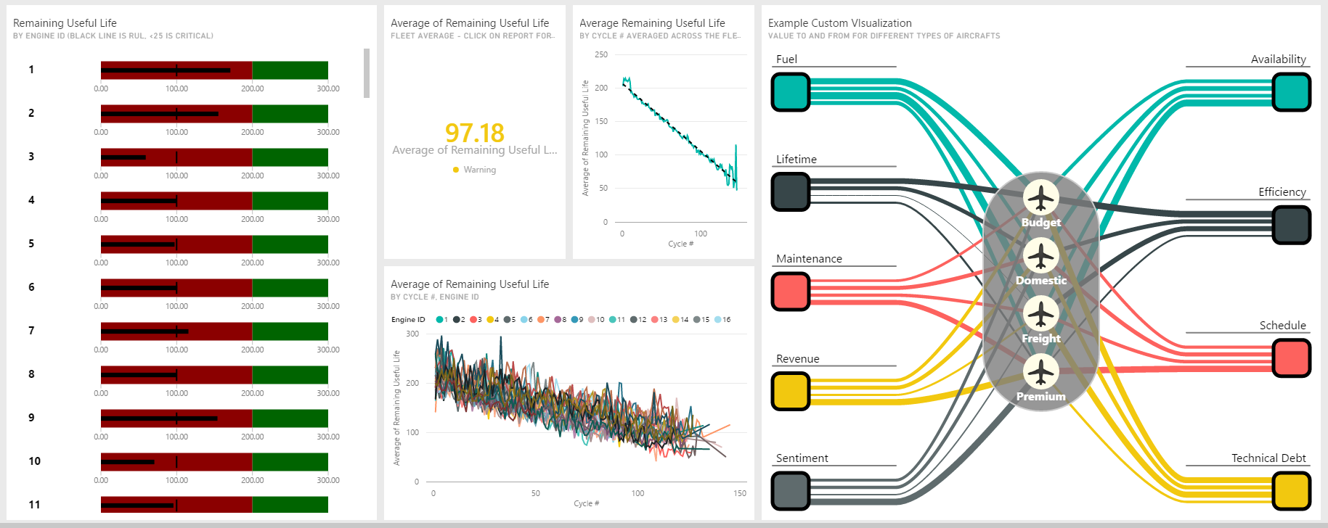

Slide 28
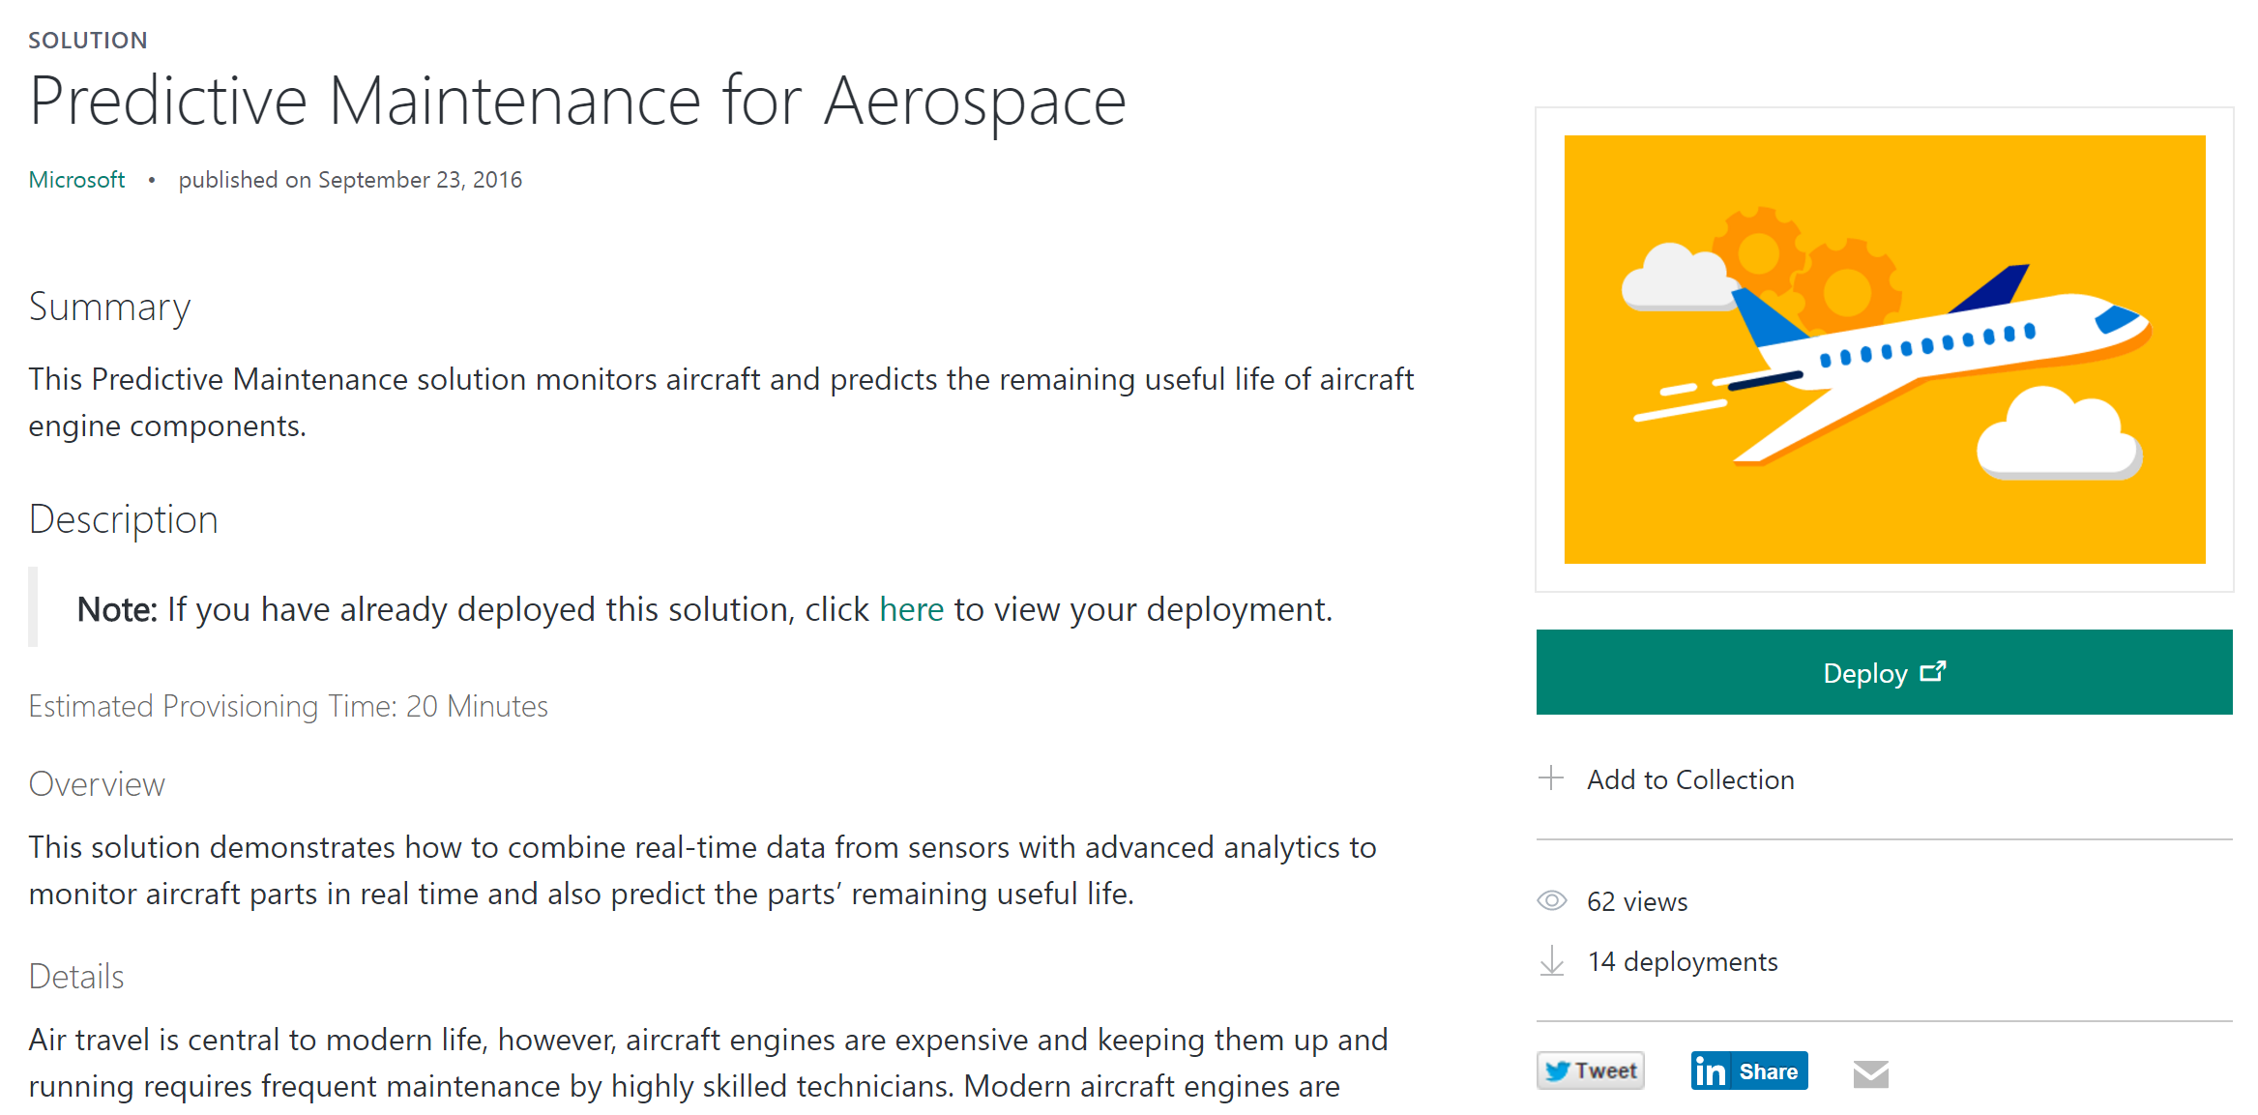

Slide 29
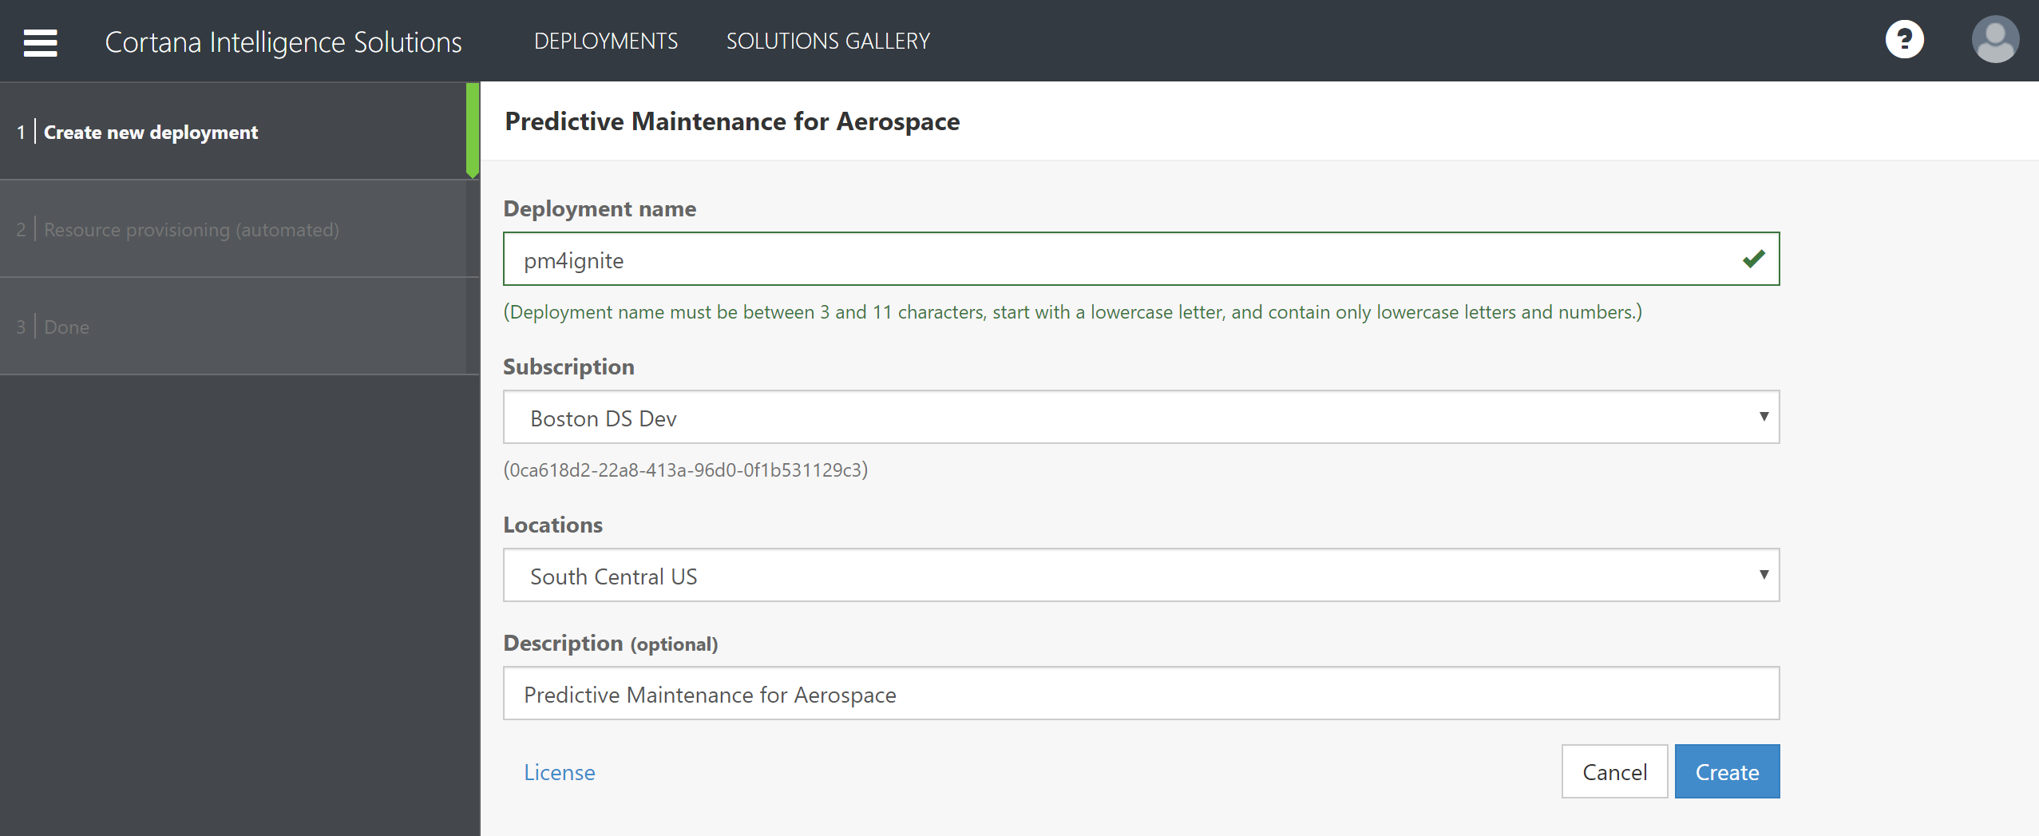

Slide 30
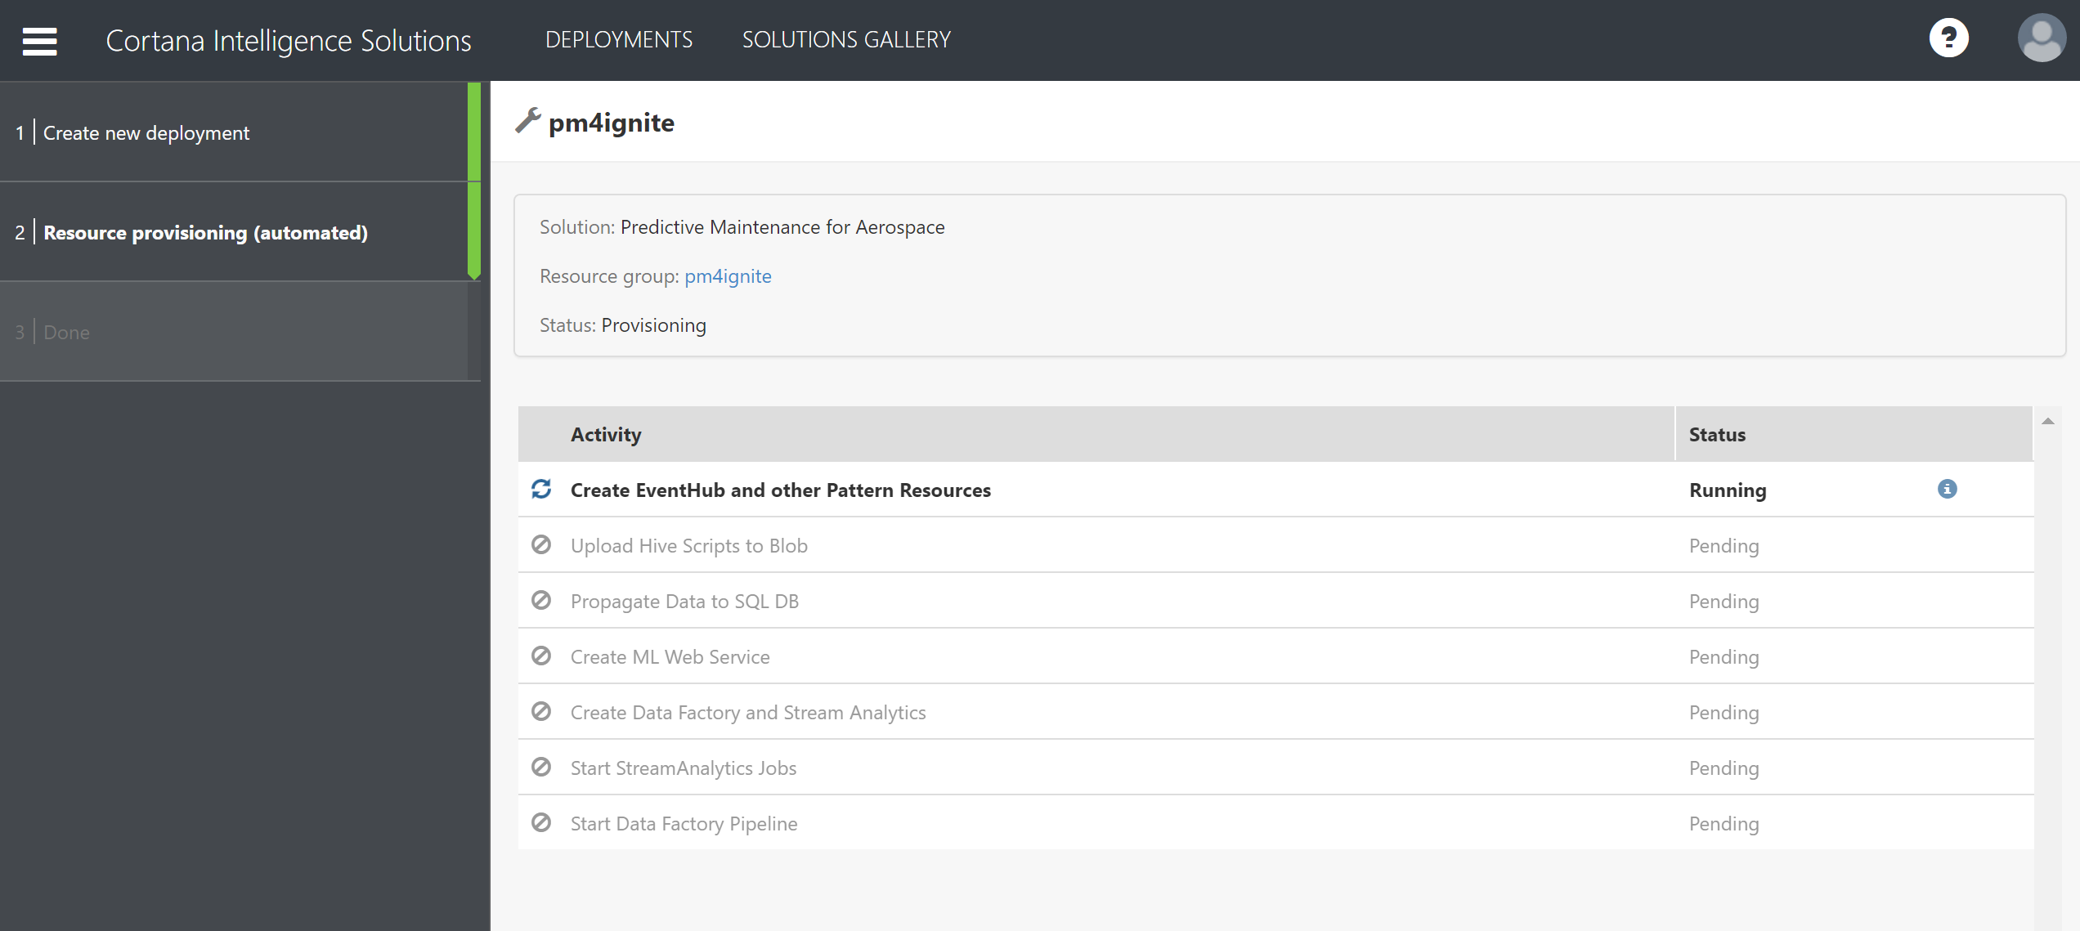

Slide 31
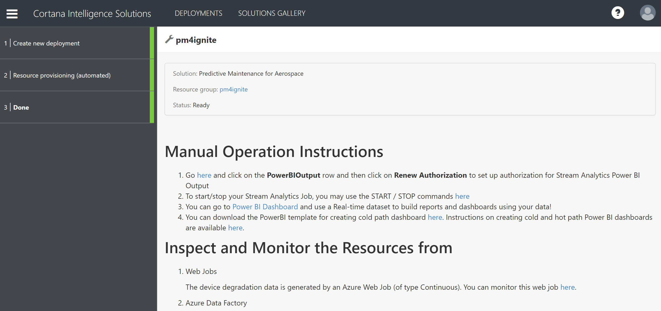

Slide 32
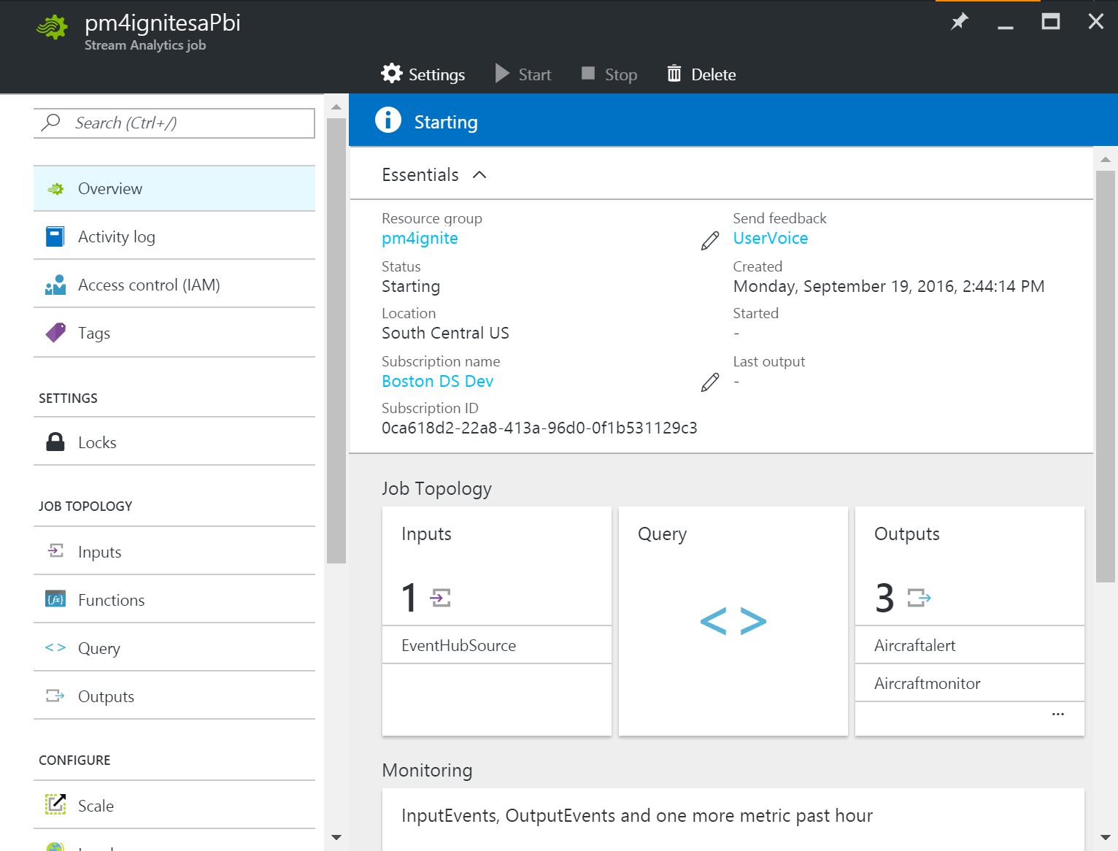

Slide 33
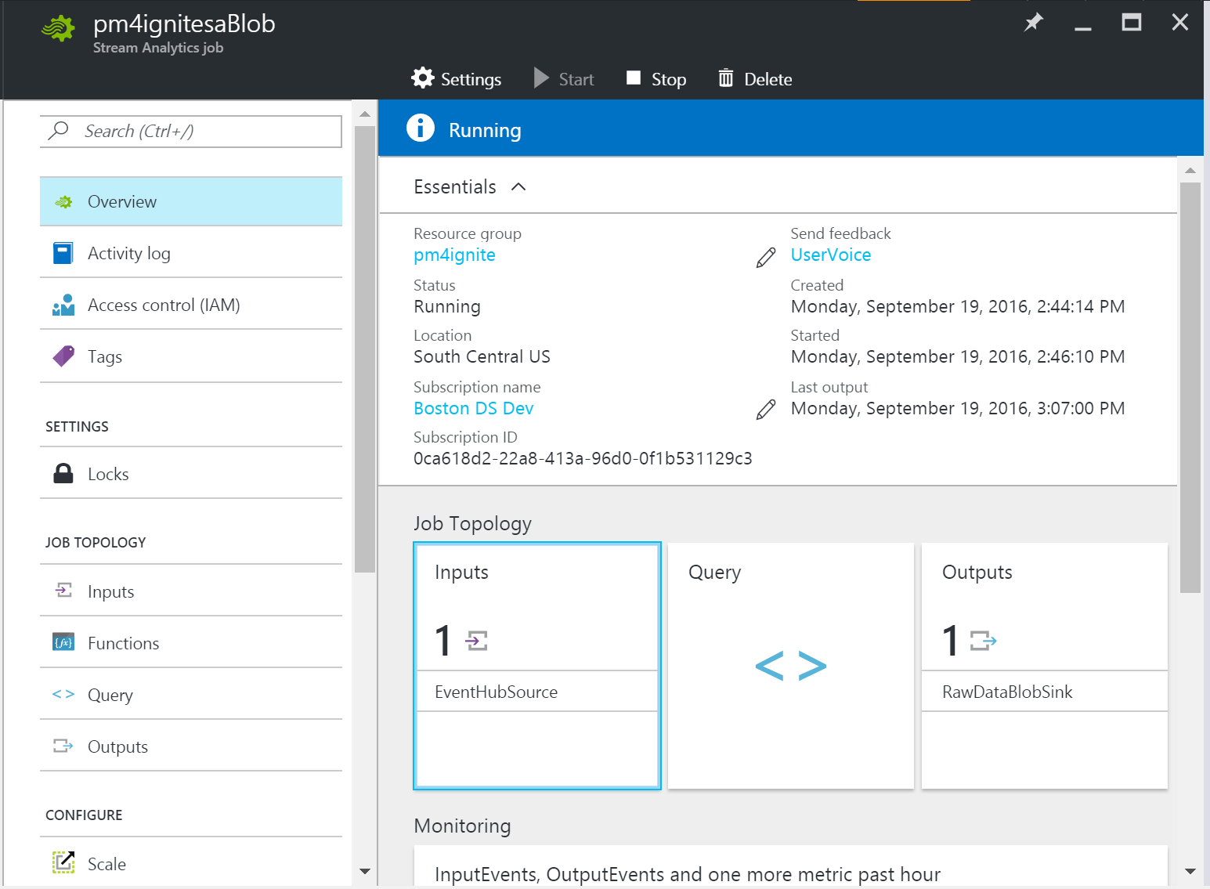

Slide 34
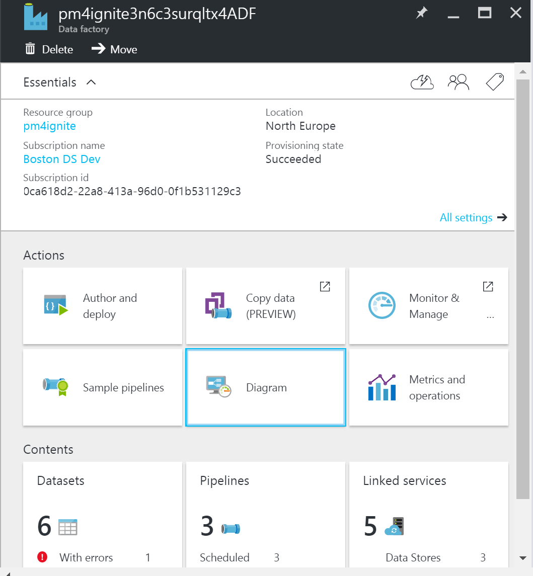

Slide 35
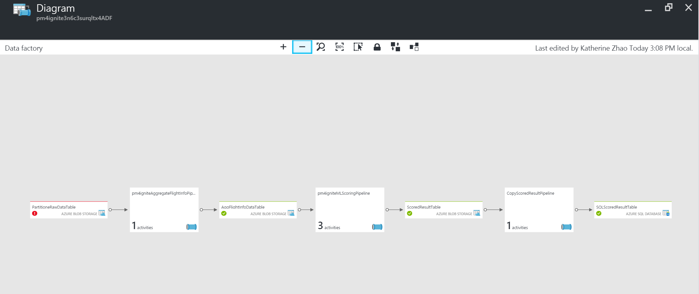

Slide 36
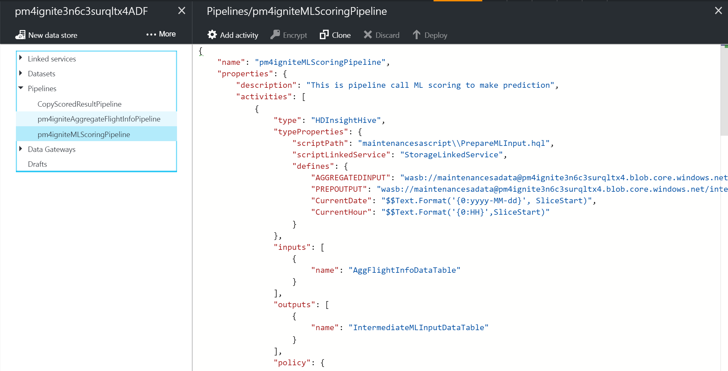

Slide 37
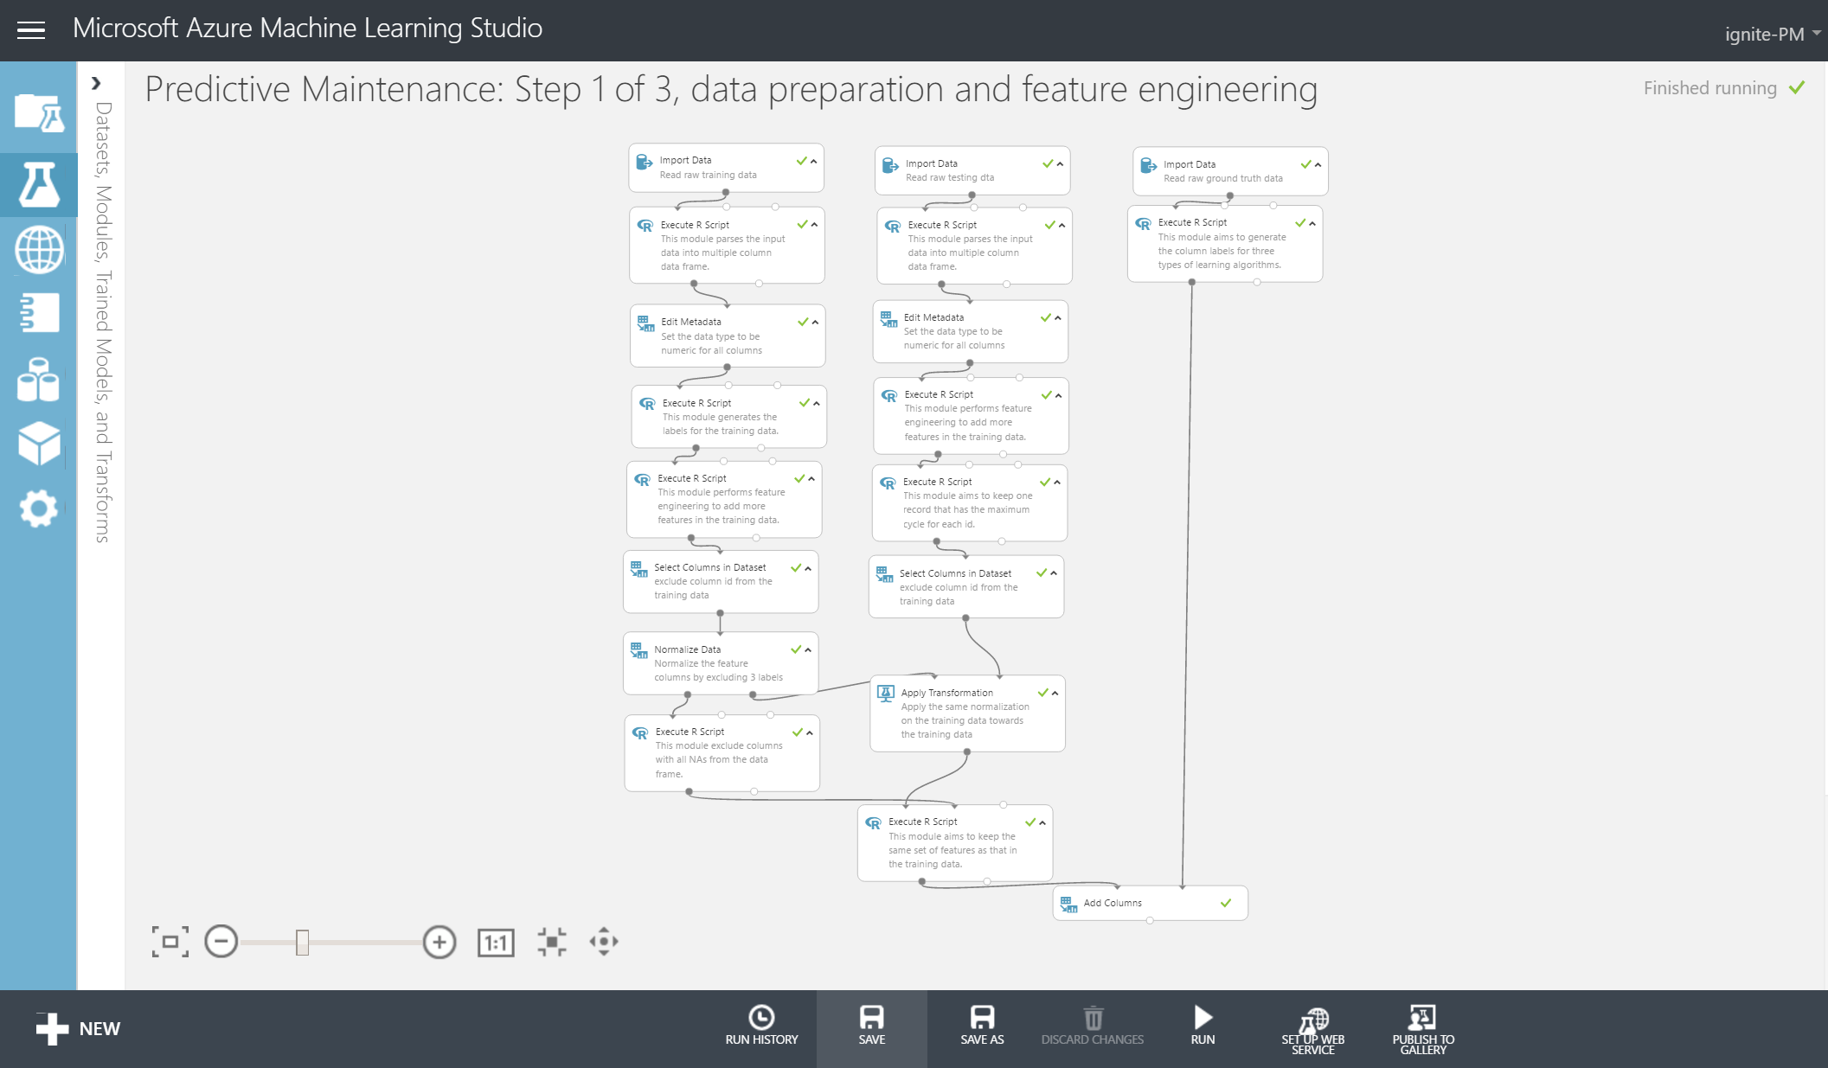

Slide 38
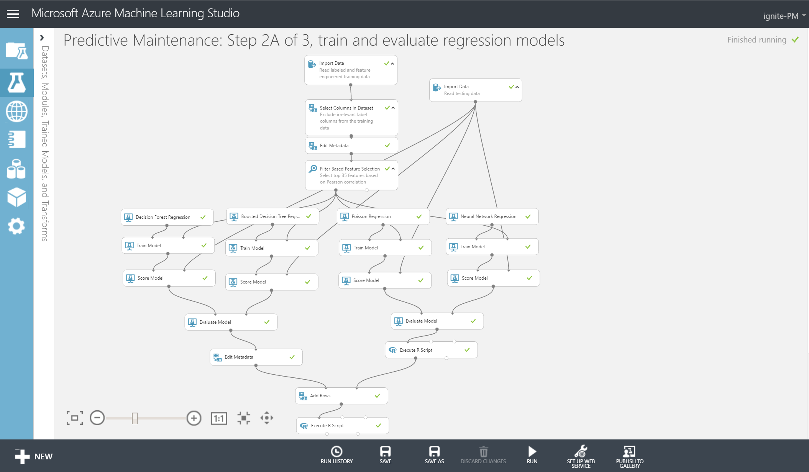

Slide 39
