Slide 1
Manage and secure iOS and Mac devices in your organization with Microsoft Intune
BRK3101
Ele Ocholi
Program Manager
Microsoft Intune

Slide 2


Enterprise mobility vision
Enterprise mobility vision
Enable
your users
Protect
your data
Devices
Apps
Data
User
IT
User
IT
Unify your environment
Help organizations enable their users to be productive on the devices they love while helping ensure corporate assets are secure.

Slide 3
Devices in the Enterprise
IT managed
Information worker
Employee managed
Contractor
Companion
Foreign managed
Primary
Public kiosk
Shared
Corporate managed devices only
All devices/PCs are enrolled in the company MDM and managed the same
Companion devices allowed
Employee managed devices allowed as companions to corporate managed devices
Corporate apps and data focused
Devices are not enrolled in MDM at all; rather, the apps and data are managed

Slide 4

Devices in the Enterprise
Device Management level
?
Little to No device management
App & Data management focus
Low device trust
Full device management
Some App & Data management
High device trust
Corporate
BYO

Slide 5




Agenda
Intune + Apple
Recent + Upcoming
App Management

Slide 6


Intune + Apple
Recent + Upcoming
App Management

Slide 7
Corporate
BYO
Full management
  Pre-enroll / out-of-box enrollment (DEP)
  Supervised
  Apps deployed via VPP
  User-less based enrollment
  Device enrollment manager
  User-based enrollment + Company Portal
  Examples: kiosk, retail, work device
Lightweight management
  User-based enrollment via Company Portal
  Install App Store apps using Apple ID
  Conditional Access/Compliance
  More App based management
  Example: BYOD, Contractors
Out-of-box enrollment
Apply policy + configuration
Install Comp. Portal (user)
Users brings device
Install Comp. Portal + Enroll
Apply policy + configuration
+ lock MDM profile to device
+ enable Supervised mode
+ jailbreak detection
+ AAD device registration
+ SSO and selective wipe with managed apps

Slide 8
Demo
DEP in Intune

Slide 9
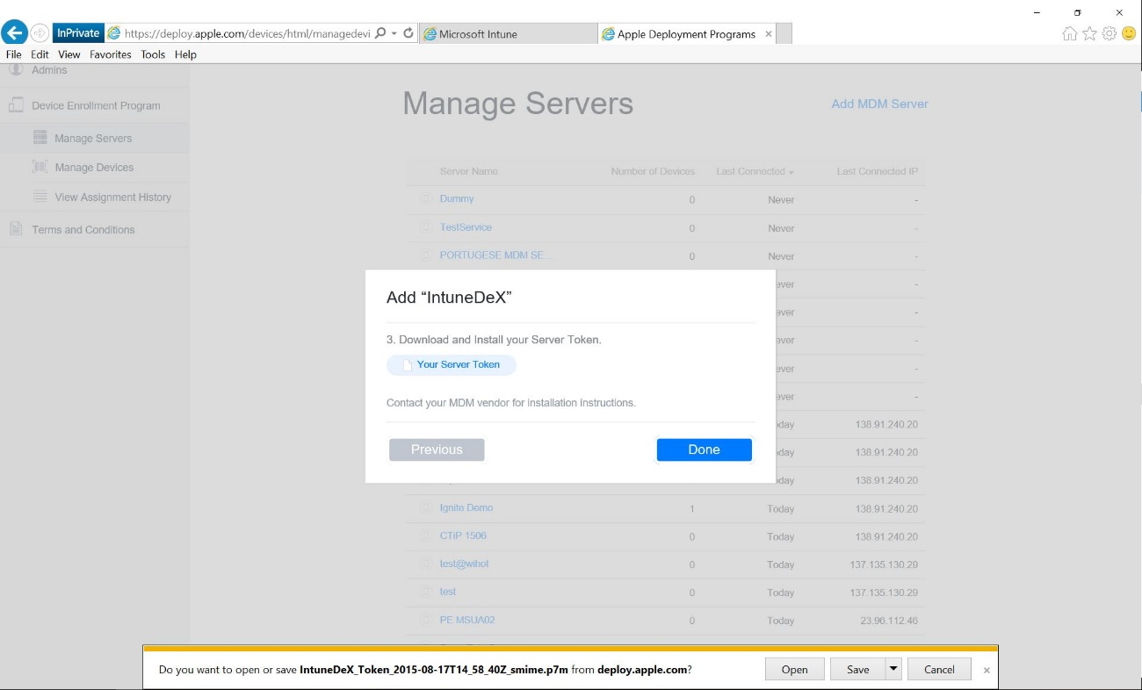

Slide 10
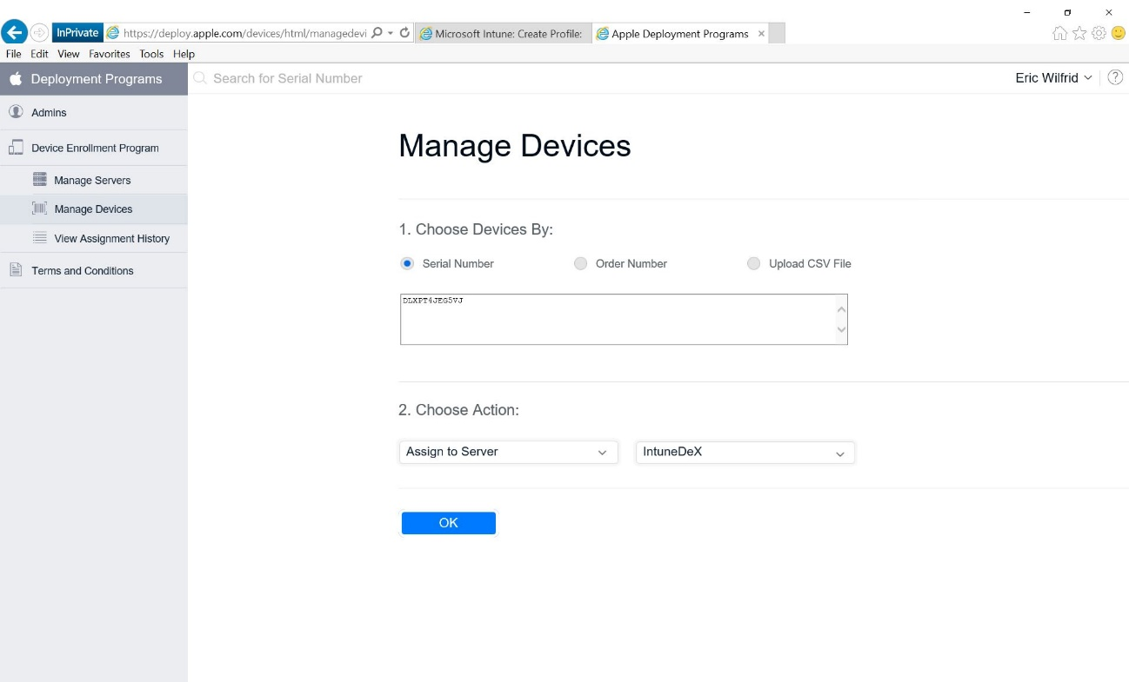

Slide 11
Demo
DEP in Intune

Slide 12
Apple Cloud Services
Microsoft Intune
DEP, VPP
LOB apps
App Store apps
Inventory
Enrollment
Remote commands Policies
Config Profiles
Retire
Device
check-in
Apple
MDM Agent
Microsoft Intune Company Portal

Slide 13
Apple Cloud Services
Microsoft Intune
DEP, VPP
LOB apps
App Store apps
Inventory
Enrollment
Remote Commands
Policies
Config Profiles
Retire
Device
check-in
Apple
MDM Agent
Microsoft Intune Company Portal

Slide 14

Apple Device Enrollment Program (DEP)
Benefits with Intune and DEP
  Wirelessly preconfigure and enroll devices
Streamline Setup Assistant
Lock management profile to device
  Requirement
  Devices must be purchased from Apple or an authorized DEP reseller

Slide 15


Supervised Mode - iOS
Why?
  Allows additional MDM restrictions
  Fewer prompts to end users
Examples
  Supervised only: Kiosk (Single App Mode), disable AirDrop
  Silent app install
How?
  Wirelessly via DEP
  Prepare new or factory reset iOS device via Apple Configurator

Slide 16

Apple Configurator and custom policies
Why?
  Use to set up and configure multiple devices at a time via USB, before giving them to users.
  Configure device settings and restrictions, and install apps and other content.
  Restore devices from a backup.
  Create and export custom policies that can be imported into Intune.
Examples
  Provide a lock Screen message for devices
  Set up certain VPN profiles
  Web content filtering

Slide 17
Demo
Apple Configurator

Slide 18
Jailbreak detection
Symptoms
Look for symptoms
Changes in OS behavior
Binaries, config files
Presence of certain apps/libraries
Future Proof
Detection logic not tied to any specific jailbreak kit or version
Testing
Regularly verify against latest jailbreak kits

Slide 19

iOS Volume Purchase Program (VPP)
For Business App Deployment
  Makes it easy to discover, purchase, and distribute iOS and Mac apps in volume
  Custom iOS apps can also be deployed through VPP channels
  volume.itunes.apple.com
IT ADMINISTRATOR
Enroll
Sync
Deploy
Compliance

Slide 20
Demo
VPP

Slide 21
macOS Management
Secure
Web-based enrollment
Passcode policies
Disk encryption
Configure
Push Wi-Fi/VPN profiles
Push custom policies
Push certificates
Audit
Hardware inventory
Software inventory
Device reports

Slide 22


Intune + Apple
Recent + Upcoming
App Management

Slide 23
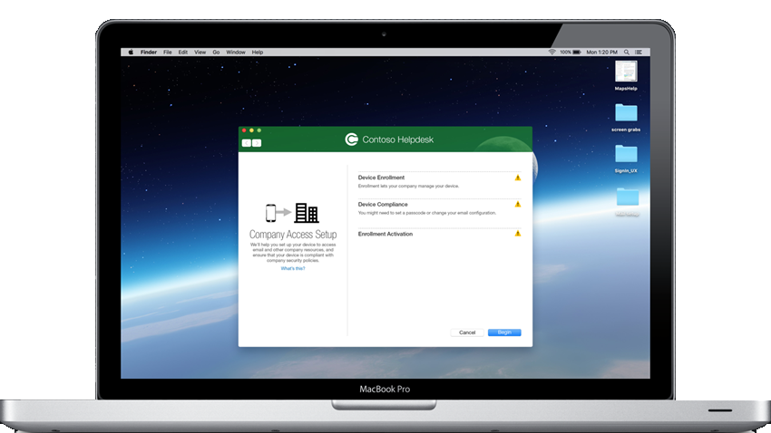
macOS
Secure
Web-based enrollment
Passcode policies
Disk encryption
Conditional Access

Slide 24
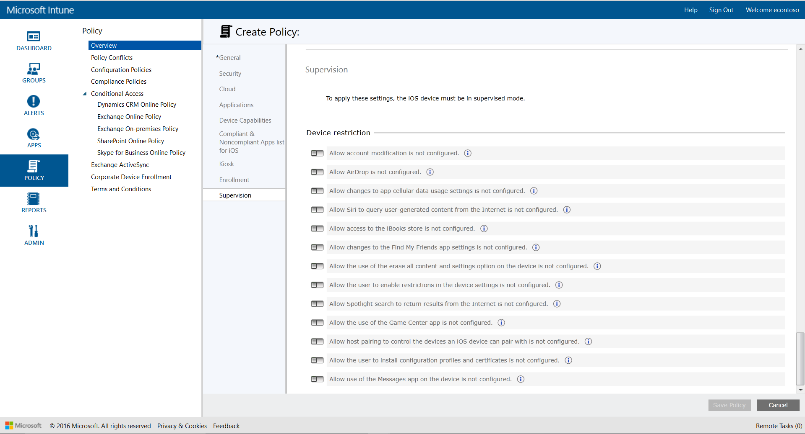
Device Restrictions
Functionality
  Added restrictions settings (general and supervised)
Requirements
  iOS version varies
  Some settings require supervision

Slide 25
Added restrictions in configuration profile
General
  Airplay passwords
  Shared photo stream
  Managed apps cloud sync
  Activity continuation
  Siri filter
  TouchID unlock
  iBook store adult content
  iCloud Photo sharing
  iCloud Photo Library
  Trust enterprise apps
  Media Content Controls on device for 9 regions
  Apple Watch wrist detection
  Airdrop from managed apps
Supervised
  Account modification
  Airdrop
  Cellular data modification
  Siri querying user generated content
  iBook store
  Find my friends settings modification
  Erase all content and settings option
  Enable restrictions option
  Spotlight internet search results
  Game Center
  Host pairing
  User interactive Configuration profile installation
  Chat

Slide 26
Added Restrictions in configuration profile
Supervised
  Device name modification
  Passcode modification
  Podcasts
  Wallpaper modification
  Siri Profanity filter
  Word definition lookup
  Predictive keyboards
  Auto-correction
  Keyboard spell-check
  Keyboard shortcuts
  Enterprise app trust settings modification
  Install apps using AC2 or iTunes only
  Automatic app downloads
  Apple watch pairing
  Apple News
  Music Service
  iTunes Radio
  Notification settings modification
  Hide/Show apps

Slide 27
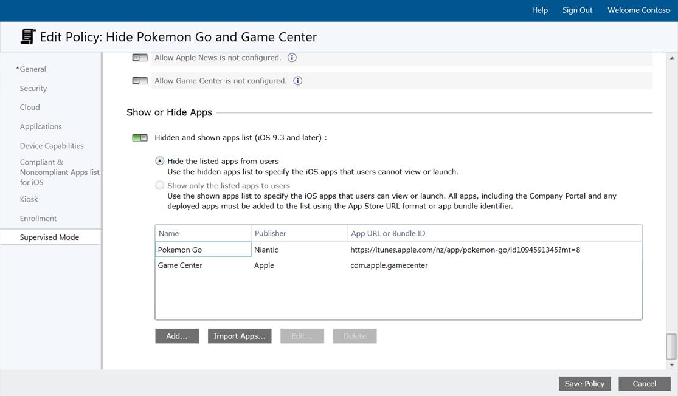
Hide and Show Apps
Functionality
  Hide list: Hide specific apps (all apps, except Settings app)
  Show list: Shows only apps specified and hides all others (except Settings app)
Requirements
  iOS 9.3 or later
  Supervised

Slide 28
Demo
Hide and Show Apps

Slide 29
iOS 10
  VPN: PPTP has been removed from iOS 10
  Added Restrictions e.g. Modify Bluetooth (Supervised)
Coming Up…
  Azure based console
  Device based VPP
  Multi-token support
  iOS education features
  Lost mode
  More restrictions

Slide 30
Demo
Azure based console

Slide 31
Intune + Apple
Recent + Upcoming
App Management

Slide 32














Mobile application management
Multi-identity policy
Managed apps
Managed apps
Corporate
data
Personal
data
Deploy policies for app-layer protection per user, per app
Maximize mobile productivity and protect corporate resources with Office mobile apps, App Store and LOB Apps including multi-identity support
Manage only corporate data and leave personal alone on multi-identity supported apps
Personal apps
Personal apps
Enable secure viewing of content using the Managed Browser, PDF Viewer, AV Player, and Image Viewer apps

Slide 33
Demo
App Policy

Slide 34








Manage mobile productivity without device enrollment
MAM
policies
Corporate apps
MDM – optional
(Intune or 3rd-party)
Personal apps
MDM
policies

Slide 35
App restriction policies
Enforce corporate data access requirements
Prevent data leakage on the device
  Enforce encryption of app data at rest
  App-level selective wipe

Slide 36
Enabling Protection for Apps
Paths to MAM
Microsoft Applications
Microsoft Office and Productivity Apps
Natively manageable with Intune MAM
Intune Companion Apps
Support protected web browsing and content viewing
App Wrapping Tool
Enables protection for LOB apps
Same App Store Apps for Personal and Corporate
No code changes required, targeted for IT Pros
App SDK
Enables full DLP for any app, including Store Apps
Requires app participation, targeted for Developers
Xamarin and Cordova Support

Slide 37
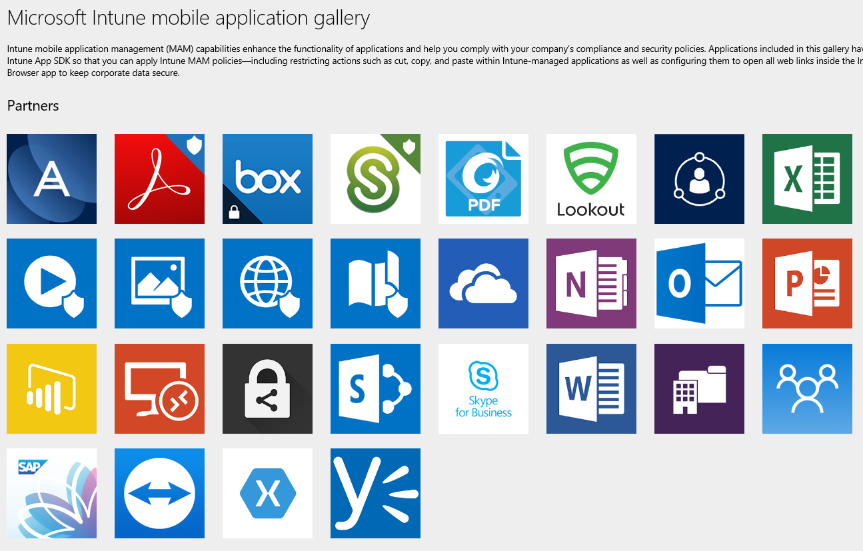
Expanding App ecosystem
https://www.microsoft.com/en-us/server-cloud/products/microsoft-intune/partners.aspx

Slide 38


Devices in the Enterprise
Device Management level
Full device management
App level management
high device trust
?
Little to No device management
App & Data management focus
Low device trust
Corporate
BYO

Slide 39
Check out other sessions
BRK3149 - Learn what's new with OSD in System Center Configuration Manager and Microsoft Deployment Toolkit (Tuesday 9 A.M.)
BRK2138 – Intune and Configuration Manager overview (Tuesday 10:45 A.M.)
BRK3225 - Secure access to Office 365, SaaS, and on-premises apps and files with Azure AD and Intune (Tuesday 2:15 P.M.)
BRK2273 - Secure Android devices and apps with Intune (Wednesday 10:45 A.M.)
BRK3101 - Manage and secure iOS and Mac devices in your organization with Intune (Wednesday 2:15 P.M.)
BRK2120 - Manage modern enterprise applications with Microsoft Intune & HockeyApp (Wednesday 4 P.M.)
BRK3012 - Enhance Windows 10 security and management with ConfigMgr, Intune, and new cloud services (Wednesday 4 P.M.)
BRK3093 - Accelerate your Microsoft Enterprise mobility and security deployment with FastTrack (Thursday 9 A.M.)
BRK3102 - Conduct a successful pilot deployment of Microsoft Intune (Thursday 10:45 A.M.)
BRK2292 - Learn how Intune helped Avanade’s global workforce get more productive (Thursday, 12:45 P.M.)
BRK2137 - Align your Windows 10 management strategy to end-user and IT needs (Thursday 4 P.M.)
BRK3281 - Deliver a BYOD program that employees and security teams will love with Intune (Friday 12:30 P.M.)

Slide 40
Thank You!
Any Questions?

Slide 41
Free IT Pro resources
To advance your career in cloud technology
Plan your
career path
Cloud role mapping
Expert advice on skills needed
Self-paced curriculum by cloud role
$300 Azure credits and extended trials
Pluralsight 3 month subscription (10 courses)
Phone support incident
Weekly short videos and insights from Microsoft’s leaders and engineers
Connect with community of peers and Microsoft experts
Microsoft IT Pro Career Center
www.microsoft.com/itprocareercenter
Get started
with Azure
Microsoft IT Pro Cloud Essentials
www.microsoft.com/itprocloudessentials
Demos and
how-to videos
Microsoft Mechanics
www.microsoft.com/mechanics
Connect with peers and experts
Microsoft Tech Community
https://techcommunity.microsoft.com

Slide 42


Please evaluate this session
Your feedback is important to us!
From your PC or tablet, visit MyIgnite at http://myignite.microsoft.com
On your phone, download and use the Ignite Mobile App by scanning the QR code above or by visiting https://aka.ms/ignite.mobileapp

