Slide 1
Create New Tools in Dynamics CRM 2016
BRK2284
Curt Spanburgh
Solutions Architect
Magenium Solutions
By Jeff Kubina from Columbia, Maryland ([1]) [CC BY-SA 2.0 (http://creativecommons.org/licenses/by-sa/2.0)], via Wikimedia Commons

Slide 2
Tool Making
We have always made tools from other tools.
Most of us have been in a Home Center.
Aisles and aisles of materials, parts, tools, appliances.
For a tech person CRM 2016 Online is very like a Home Center.

Slide 3
We want to talk about a few CRM power tools.
Calculated fields
Rollup Fields
Business Rules
Views
Reporting.

Slide 4
Calculate Fields, what are they about?
We use them to automate calculations
They cover the basic math operations
They also include “ If Else” type conditional operations
These can be nested.

Slide 5
Quick way to get web resource results, But?
They recalculate which means they show up as system jobs.
With certain types of uses they prompt a user to save changes to a record even though changes have not happened.

Slide 6
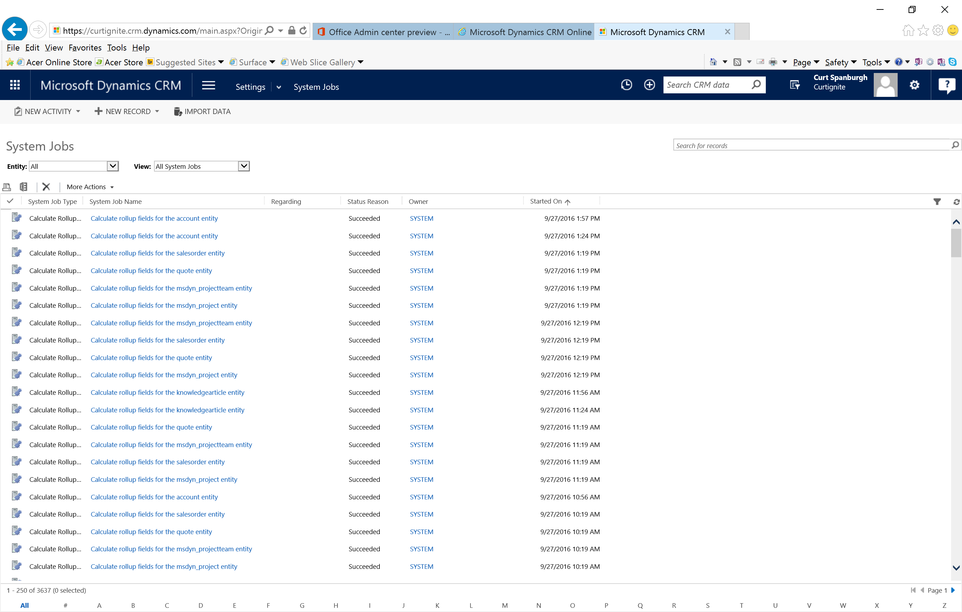
System Jobs

Slide 7
Calculated Field

Slide 8
Rollup Fields
These work well with records that are related in a hierarchy.
They are not real time.
They affect your storage space.

Slide 9
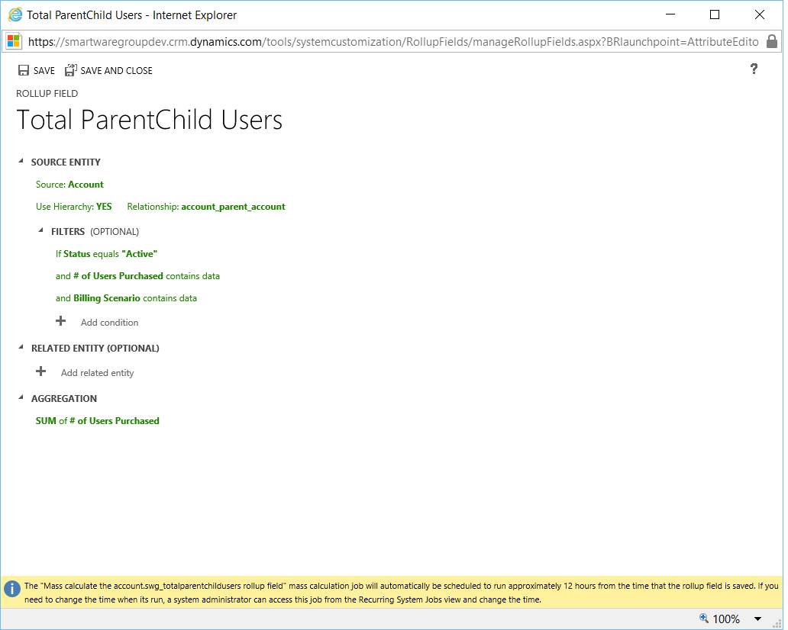
Example of Rollup field

Slide 10
Rollup

Slide 11
Some issues with Rollup fields
Only 100 Rollup fields to a CRM instance.
Only 8 rollups to an entity.
Not Real Time
Rollup recalculation is 12 hours by default.

Slide 12
Views and Advanced Find

Slide 13
Hierarchal views

Slide 14
Let’s look at a business rule

Slide 15
Example of working with Calculate fields

Slide 16
These tools can get you started, but there is more. There are more solutions to look at.
Inside Views
Ribbon Work Bench
Click Dimensions
Power Apps

Slide 17
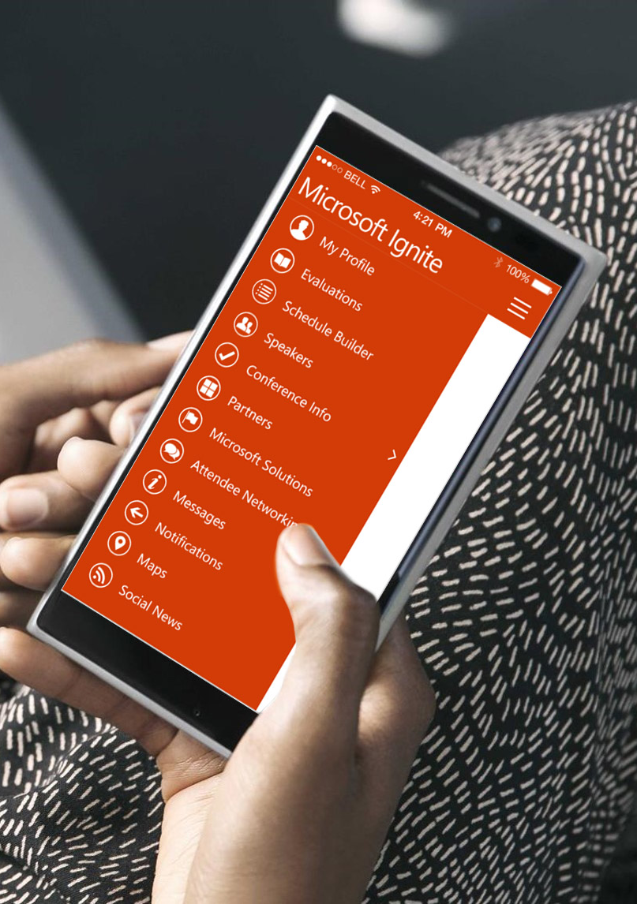
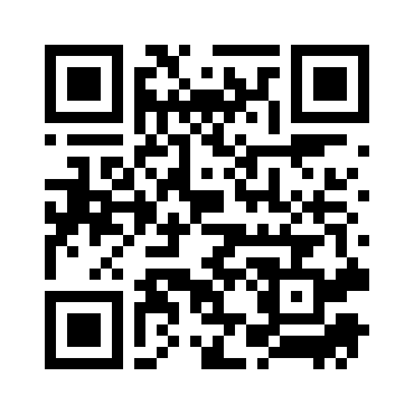
Please evaluate this session
Your feedback is important to us!
From your PC or Tablet visit MyIgnite at http://myignite.microsoft.com
From your phone download and use the Ignite Mobile App by scanning the QR code above or visiting https://aka.ms/ignite.mobileapp

