Slide 1
Meetup User Experience Design for SharePoint
BRK2281
Cathy Dew
Enterprise Delivery Manager

Slide 2
Transition from Old Methods to New Theories

Slide 3
What’s on the Roadmap

Slide 4
Maintain Balance in the Cloud

Slide 5
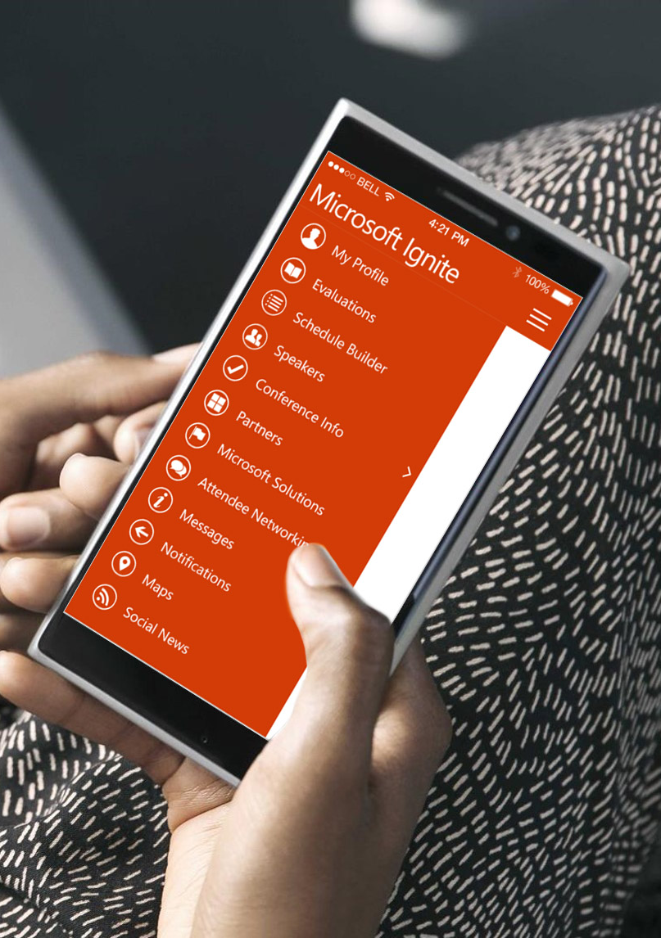
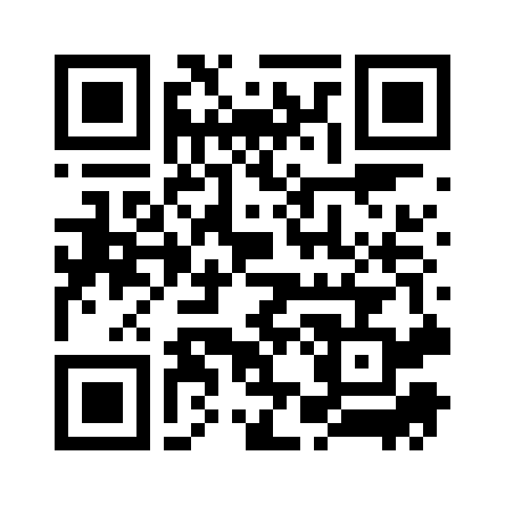
Please evaluate this session
Your feedback is important to us!
From your PC or Tablet visit MyIgnite at http://myignite.microsoft.com
From your phone download and use the Ignite Mobile App by scanning the QR code above or visiting https://aka.ms/ignite.mobileapp

