Slide 1
Meetup: Office 365 Developers
Radi Atanassov
Senior Director, Progress
Vesa Juvonen
Senior Program Manager, Microsoft

Slide 2
Do you think that the number of SharePoint developers is declining, and why?

Slide 3
How important is ASP.NET Core support to you?

Slide 4
Do you agree that our skills must transition into cloud development skills?

Slide 5
Where would you like to see us push SharePoint development?

Slide 6
Have Office client add-ins proved useful to you?

Slide 7
Where do you get your SharePoint/Office 365 development knowledge from?

Slide 8
aka.ms/OfficeDevPnP
https://github.com/OfficeDev/PnP
https://github.com/OfficeDev/PnP-Sites-Core
https://github.com/OfficeDev/PnP-PowerShell
https://github.com/OfficeDev/PnP-Tools
https://github.com/OfficeDev/PnP-Guidance
https://github.com/OfficeDev/PnP-Transformation
https://github.com/OfficeDev/PnP-OfficeAddIns
https://github.com/OfficeDev/PnP-Provisioning-Schema
https://aka.ms/OfficeDevPnPVideos
https://aka.ms/OfficeDevPnPMSDN
https://aka.ms/OfficeDevPnPYammer
https://docs.com/OfficeDevPnP
@OfficeDevPnP
https://aka.ms/OfficeDevPnPCall
https://aka.ms/OfficeDevPnPPartnerPack

Slide 9
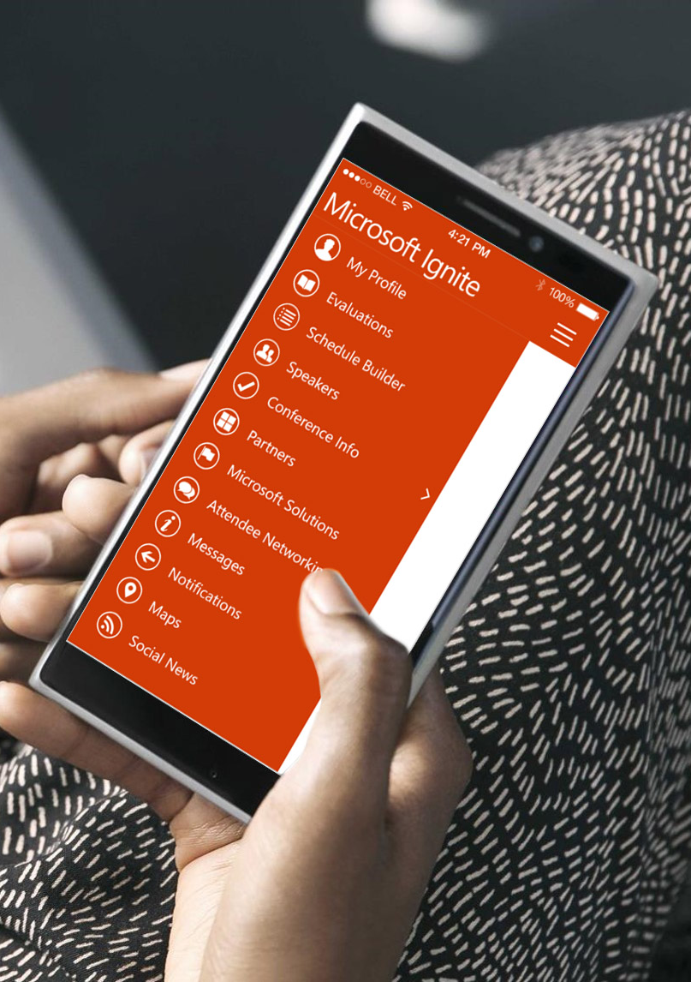
Please evaluate this session
Your feedback is important to us!
From your PC or Tablet visit MyIgnite at http://myignite.microsoft.com
From your phone download and use the Ignite Mobile App by scanning the QR code above or visiting https://aka.ms/ignite.mobileapp

