Slide 1
Understand the impact of the future of SharePoint
BRK2276
Jennifer Ann Mason, John Patrick White, Cathy Dew

Slide 2
Meet the Panelist
Jennifer Ann Mason
@JenniferMason
Cathy Dew
@catpaint1
John Patrick White
@diverdown1964

Slide 3
Tell us about your experiences with SharePoint updates over the last year?

Slide 4
Audience Questions

Slide 5
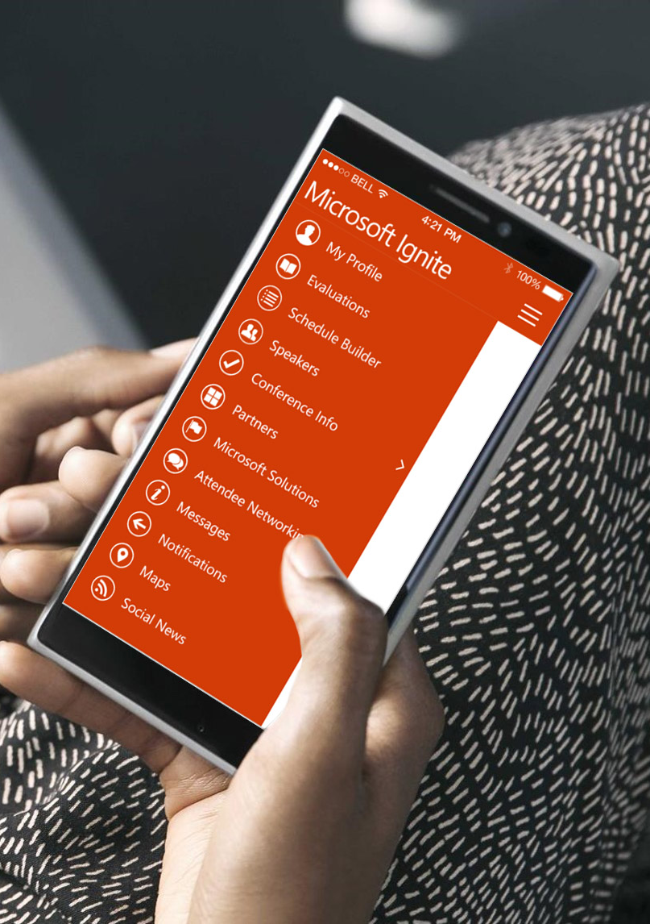
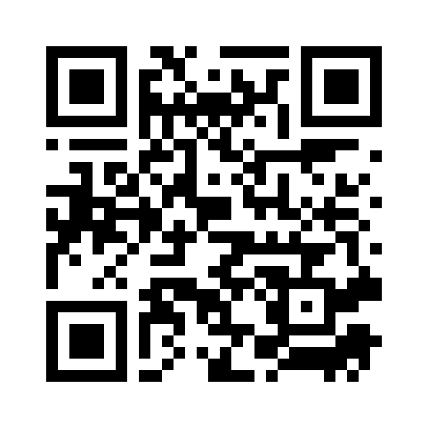
Please evaluate this session
Your feedback is important to us!
From your PC or Tablet visit MyIgnite at http://myignite.microsoft.com
From your phone download and use the Ignite Mobile App by scanning the QR code above or visiting https://aka.ms/ignite.mobileapp

