Slide 1
How to run a successful user group
BRK2274
Jason Himmelstein
Microsoft MVP

Slide 2
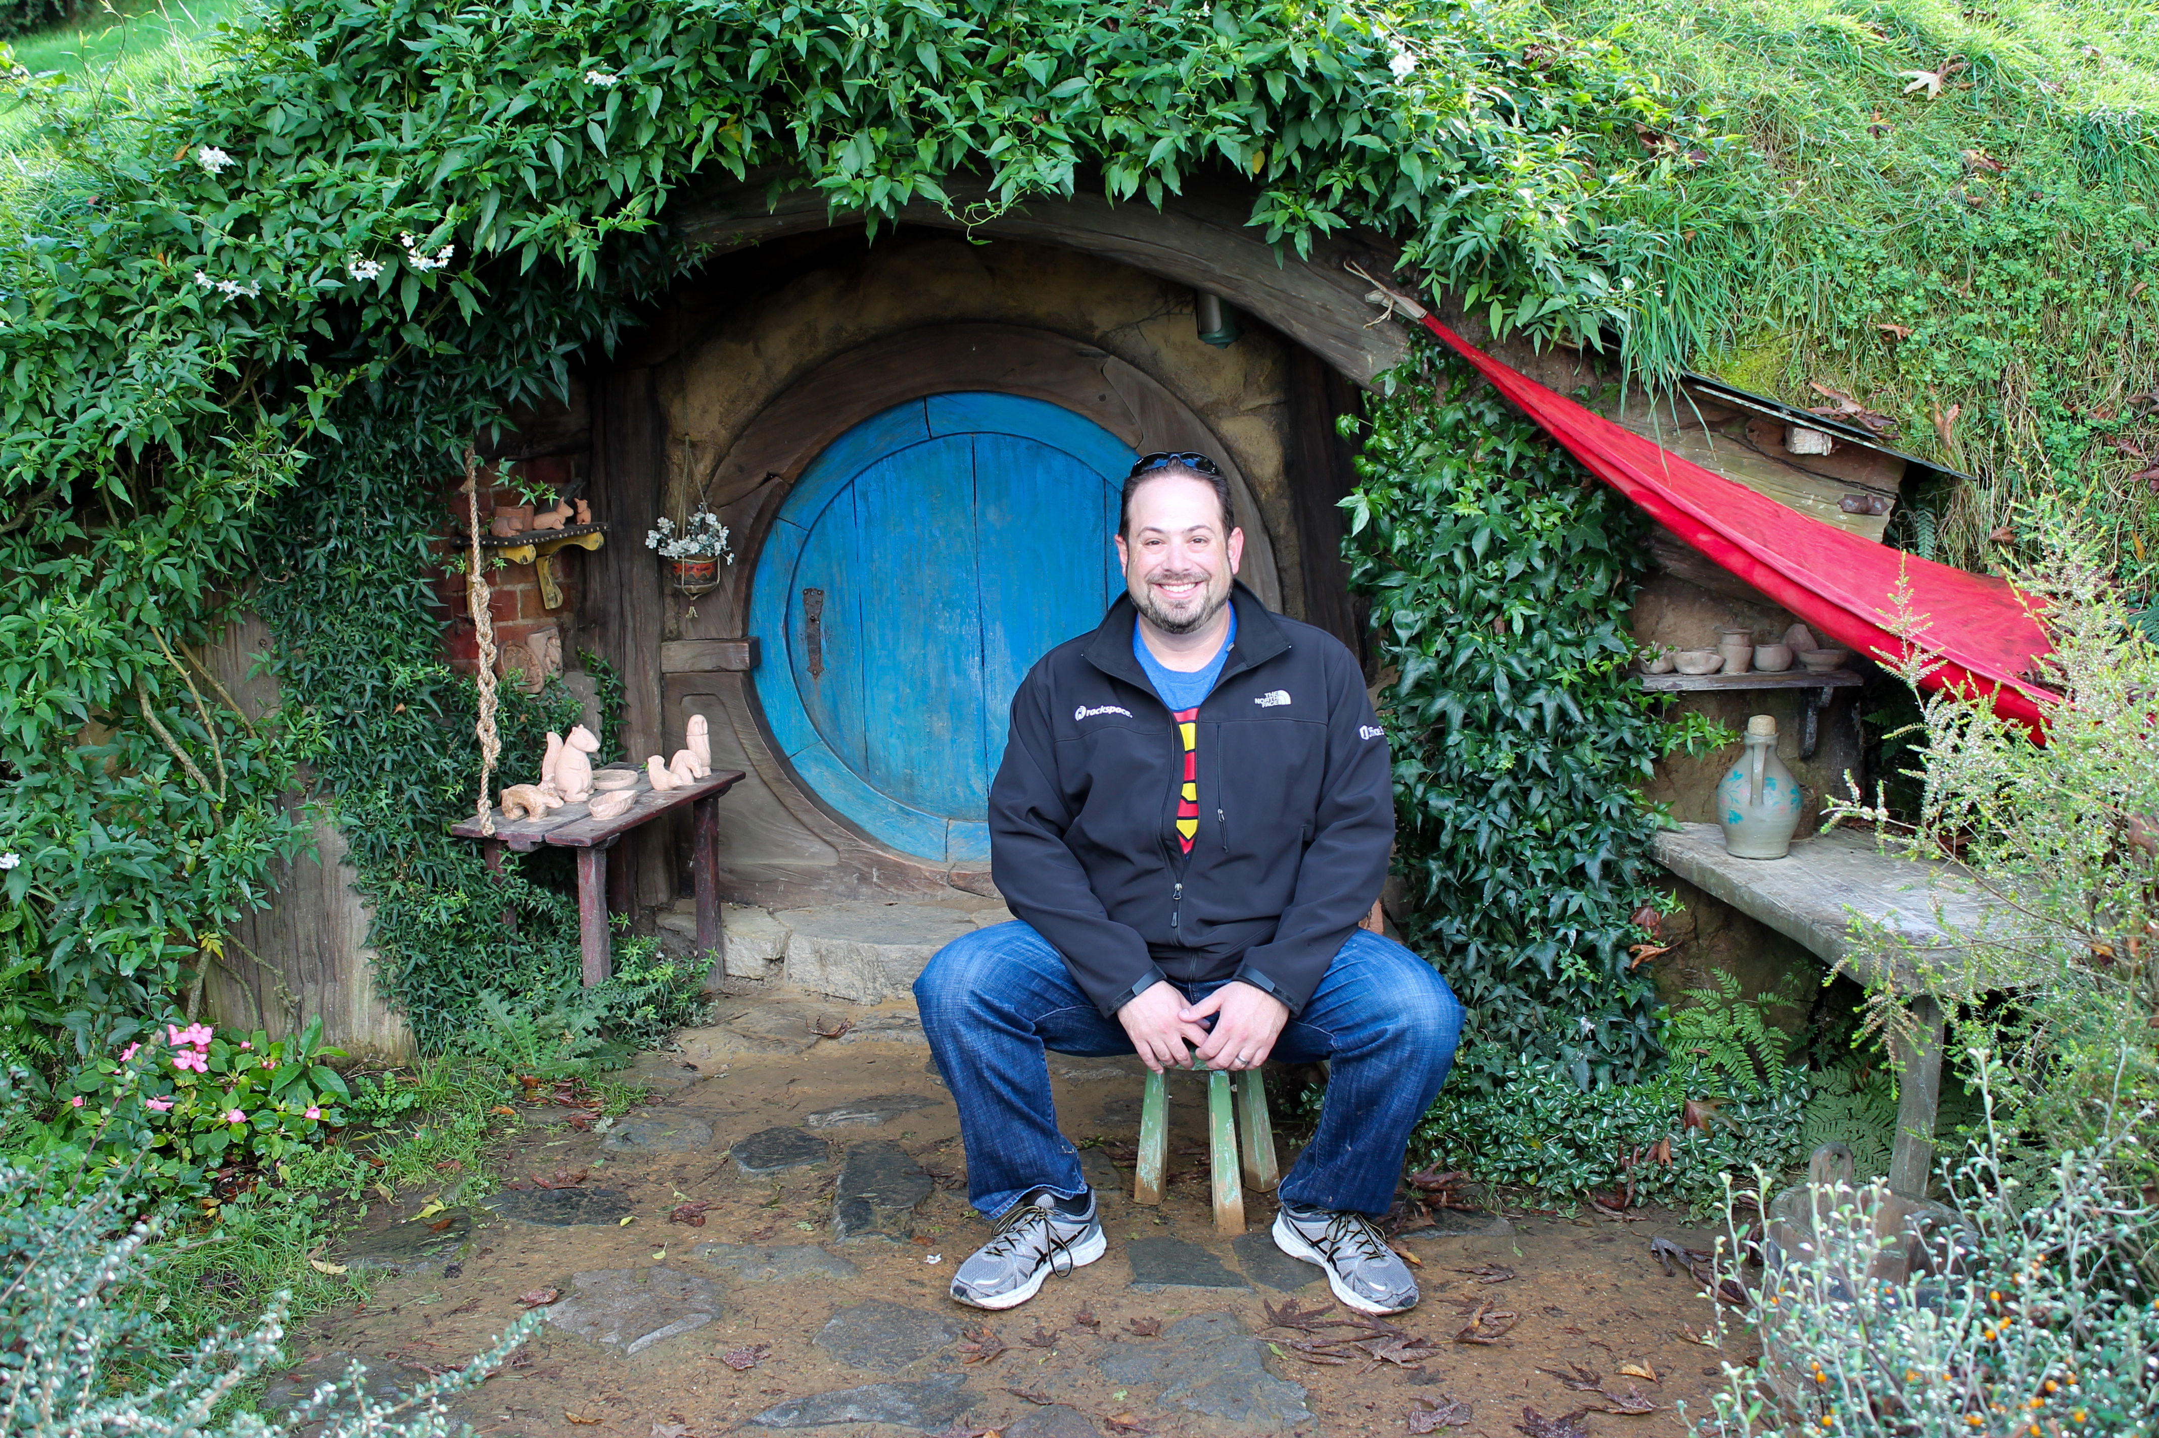


Jason Himmelstein
Microsoft MVP
ITPro & BI Geek
Re-installed Texan, die-hard Spurs, Longhorns, & Jaguars fan
Blog: www.sharepointlonghorn.com
Twitter: @sharepointlhorn

Slide 3
This is
Group Therapy

Slide 4
Who are you?
Why are you here?

Slide 5
What is a user group?

Slide 6
What have you found to be successful?

Slide 7
What have been the biggest hurdles for your group?

Slide 8
Some tips & tricks
Consistency of meetings
  Location
  Times
  Agenda
Use meeting sites
  Meetup
  EventBrite
Have a LinkedIn Group
  Drive conversations
  Lock it down!
Specialize your group
  Development
  ITPro
  End User
  Business Intelligence
  Azure
Cohabitate
Talk to food vendors in your community for help
Incorporate your UG

Slide 9


Please evaluate this session
Your feedback is important to us!
From your PC or Tablet visit MyIgnite at http://myignite.microsoft.com
From your phone download and use the Ignite Mobile App by scanning the QR code above or visiting https://aka.ms/ignite.mobileapp

