Slide 1
Move 13,000+ global Dynamics CRM users from on-premises to Online at Caterpillar Inc.
BRK2264
Todd Byrne & John Finney

Slide 2
Built for it Videos
Built for it
https://youtu.be/Za734QEW3W8?list=PLe56edc9e8AWpQrcRTkDnJ77LEgJ98EGw
Jenga
https://www.youtube.com/watch?v=DWc8dUl7Xfo

Slide 3
Caterpillar Inc. Journey to Product Support on-line

Slide 4
Agenda
Intro/background
Overview of processes
Project – move to CRM online
Commitment of Business
Define business support model
Development
Training
Deployment
Summary

Slide 5
Introductions
Todd Byrne
John Finney
Business Process Owner
Manufacturing
Service Engineering Marketing
Service Op Rep
CRM IS Process Owner
Desktop/Server/Web Infrastructure
Dealer Systems
Program Management Office (PMO)
Continually improving Caterpillar/ Dealer communications

Slide 6
Caterpillar Inc.
175
Cat®
Dealers
100,000 employees
across 500 facilities
Located Around the World
$40B
Sales
Over 3M+
products at work globally
90 years

Slide 7
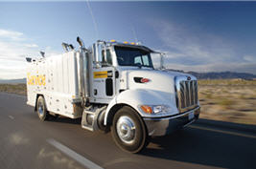
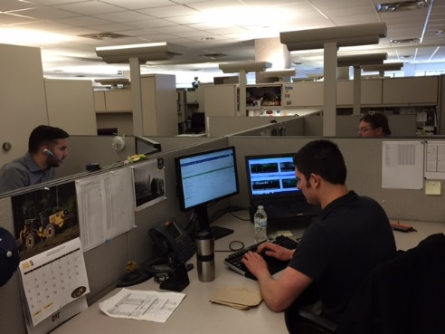
Product Support CRM
Dealers
PSCRM
13,000 Users
(80% Dealers, 20% Caterpillar)
300,000 questions/year
Service Technical
Parts Technical
Goodwill Communication
Global Warranty Support
Technical Literature
Partners In Quality
Incident Reporting…
Caterpillar

Slide 8
Business Process Owners
Internal IT
PSCRM Business
ISV Provider
Microsoft
Establish a
SUPPORT MODEL

Slide 9
Commitment of BUSINESS
Engagement in development
Perform testing
Own business process training

Slide 10
DEFINE BUSINESS SUPPORT MODEL
Change management portal
Access request process
Single repository for training material

Slide 11
Development process
https://www.youtube.com/watch?v=K3sdMEgor7E

Slide 12
DEVELOPMENT PROCESS
Process Business Owners
Internal IT
ISV
Microsoft

Slide 13
Integrations to legacy systems
Security
Scalability design
Migration of data
Summary table
TECHNICAL COMPLEXITIES
Global Warranty
Goodwill
DSN (Service Technical)
System Technologies
Partners In Quality
Parts Technical
Expanded Mining Products
Product Distribution

Slide 14
TESTING
Development team
Performance benchmarking testing
Process Owners
Feedback to development team

Slide 15
DEPLOYMENT
All the world in one week-end
First time failed – fall back plan
Training
Everyone involved

Slide 16
SUMMARY
Take-a-ways
Lessons learned
Up Next

Slide 17
Questions

Slide 18
Free IT Pro resources To advance your career in cloud technology
Plan your career path
Cloud role mapping
Expert advice on skills needed
Self-paced curriculum by cloud role
$300 Azure credits and extended trials
Pluralsight 3 month subscription (10 courses)
Phone support incident
Weekly short videos and insights from Microsoft’s leaders and engineers
Connect with community of peers and Microsoft experts
Microsoft IT Pro Career Center
www.microsoft.com/itprocareercenter
Get started with Azure
Microsoft IT Pro Cloud Essentials
www.microsoft.com/itprocloudessentials
Demos and how-to videos
Microsoft Mechanics
www.microsoft.com/mechanics
Connect with peers and experts
Microsoft Tech Community
https://techcommunity.microsoft.com

Slide 19
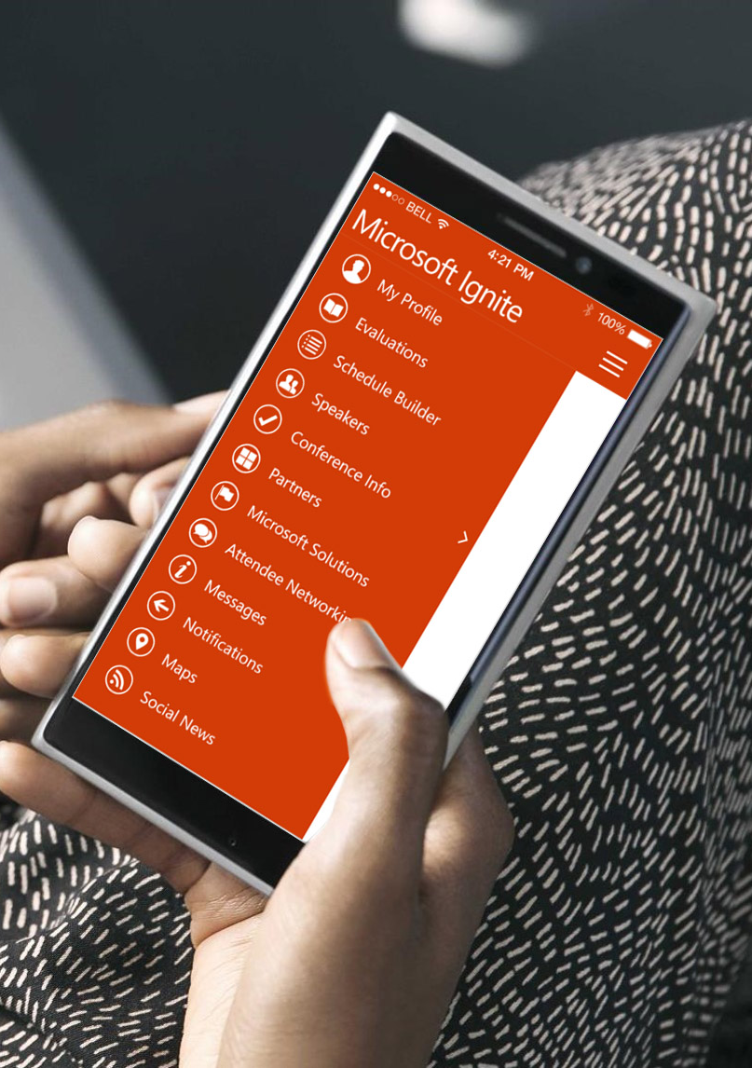
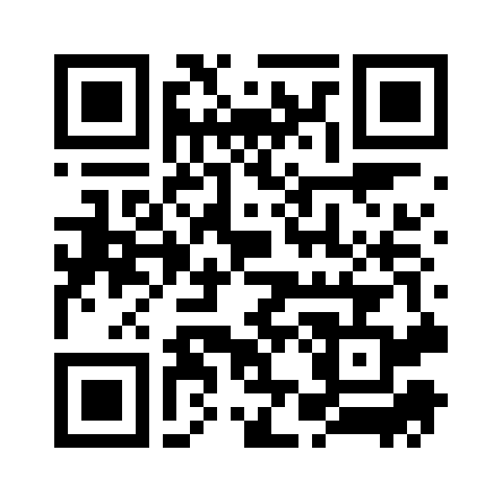
Please evaluate this session
Your feedback is important to us!
From your PC or Tablet visit MyIgnite at http://myignite.microsoft.com
From your phone download and use the Ignite Mobile App by scanning the QR code above or visiting https://aka.ms/ignite.mobileapp

