Slide 1
Building Custom Application With Office Add-Ins for OneNote
BRK2259
Fanguang Kong - Senior Product Manager
Han Jung – Senior Engineer

Slide 2
Agenda
OneNote Extensibility Scenario Overview
OneNote REST APIs
OneNote Add-In Framework
OneNote JavaScript API Deep Dive
OneNote Add-In Deployment
Roadmap
Q&A

Slide 3
OneNote Extensibility Scenarios
Capture and Retrieve Content.
Embed interactive web objects into canvas.
Extend OneNote Client Functionality.

Slide 4
Capture and Retrieve Content

Slide 5
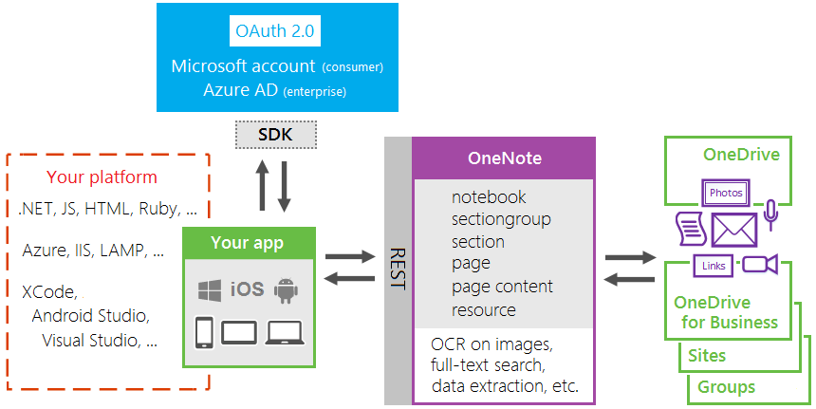
OneNote HTTP REST APIs
http://dev.onenote.com

Slide 6
OneNote REST API Partners

Slide 7
Demo - OneNote Clipper - REST APIs Empowered Apps

Slide 8
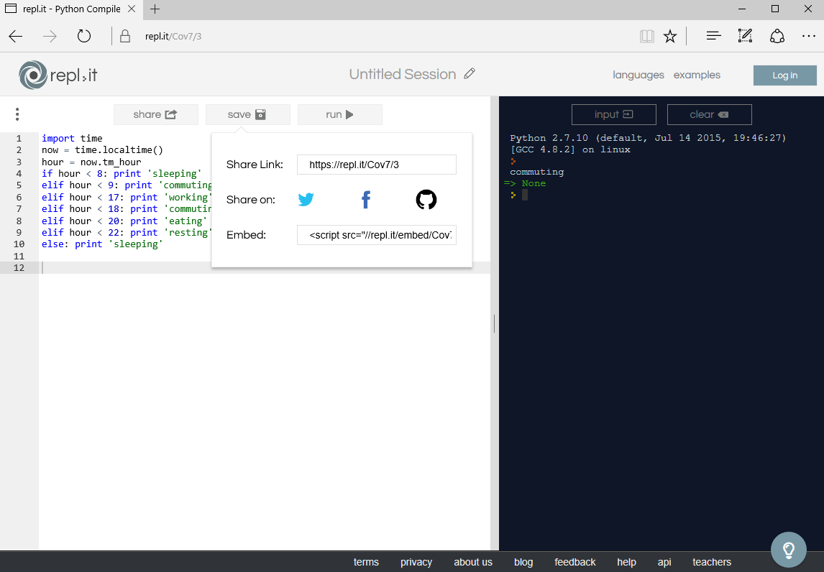
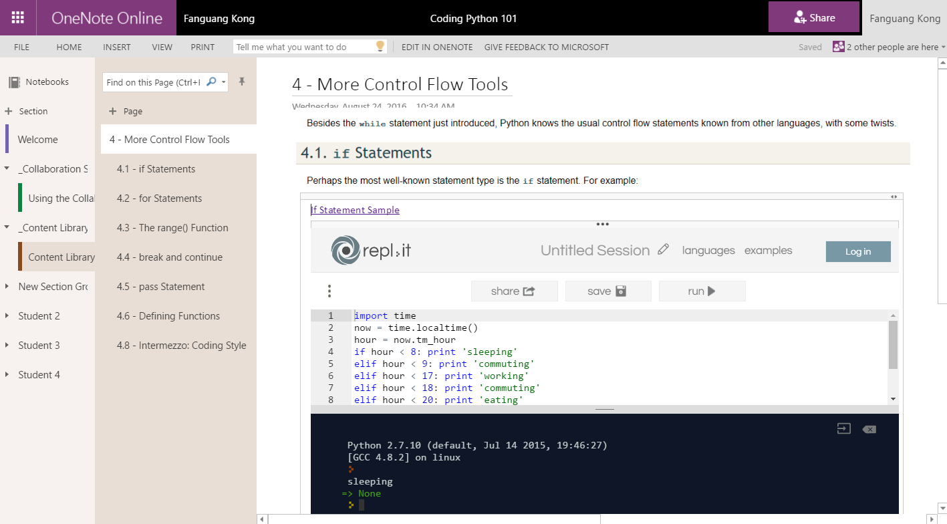
Embed Interactive Web Objects into Canvas

Slide 9
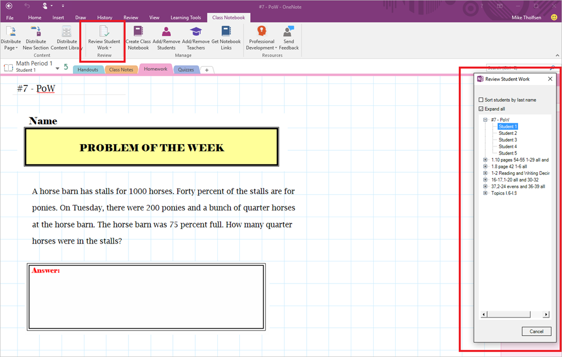
Extend Client Functionality

Slide 10
Office Add-Ins for OneNote
A new cross platform way to:
Extend OneNote client functionality.
Allow 3rd party embed rich, interactive objects into OneNote canvas.

Slide 11
What is Office Add-in?
Extends Office clients functionalities.
It is cross-platform
Composed of Manifest file and Web page.
Office Add-in
Manifest
<XML>
Web
Page
HTML+JS
Office Add-in

Slide 12
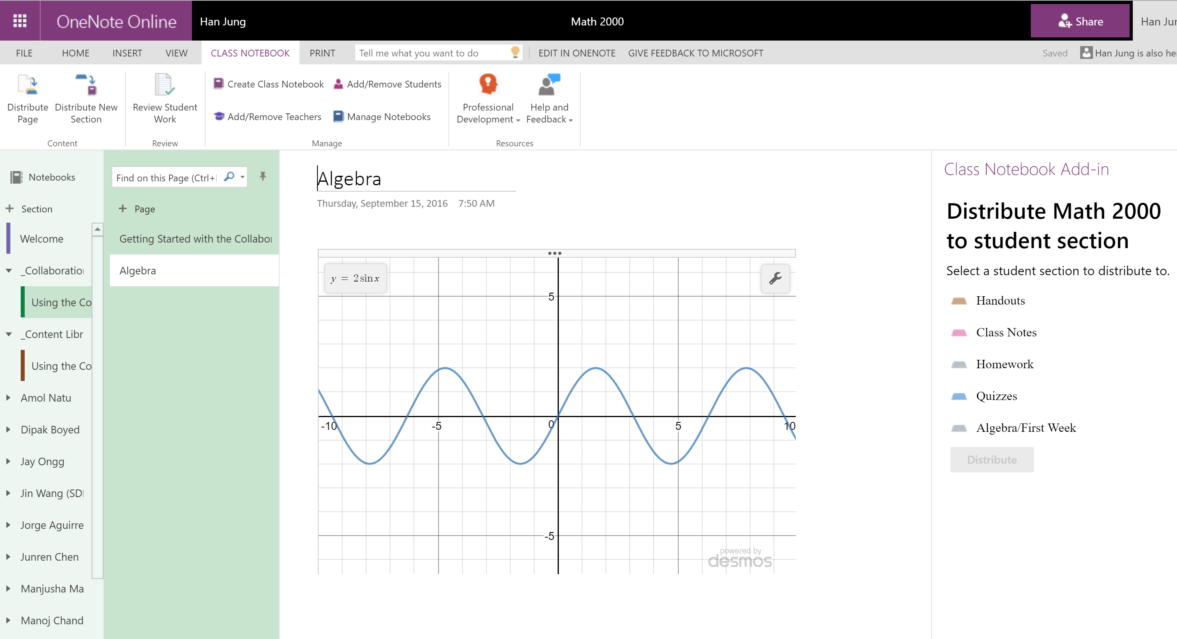
Commands Content Task pane

Slide 13
Demo – Add-Ins

Slide 14
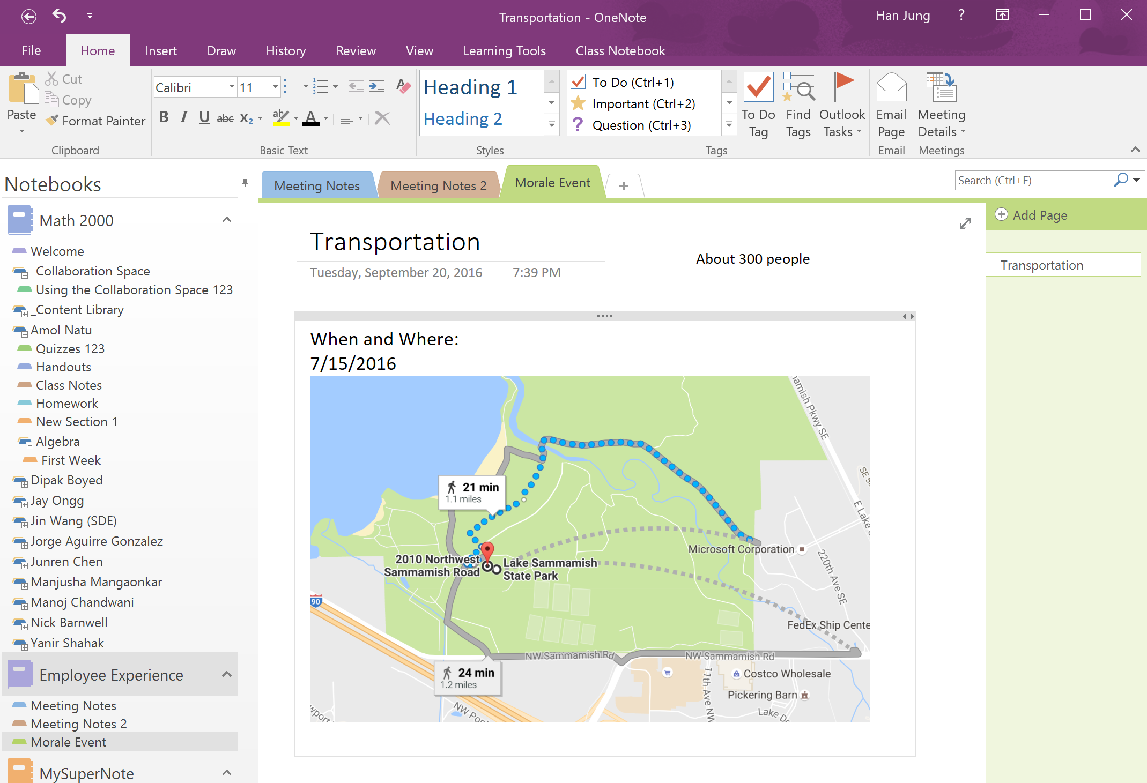
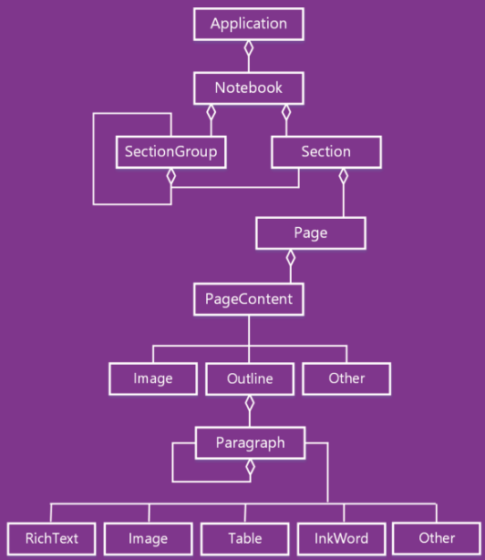
OneNote JavaScript APIs Overview

Slide 15
Office Shared APIs
APIs that work across Office Applications.
OneNote exposes below APIs.
APIs | Notes
Selections
Office.context.document.getSelectedDataAsync | Office.CoercionType.Text only
Office.context.document.setSelectedDataAsync | Office.CoercionType.Text, Office.CoercionType.Image, and Office.CoercionType.Html only
Office.EventyType.DocumentSelectionChanged
Settings
Office.context.document.settings.get(name) | Settings are supported by Content Add-ins only
Office.context.document.settings.set(name, value) | Settings are supported by Content Add-ins only

Slide 16
Demo – JavaScript APIs

Slide 17
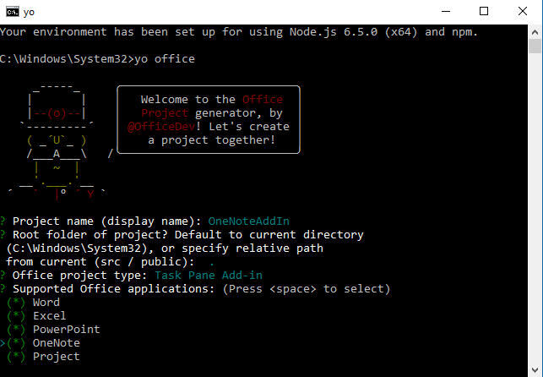
Development - Yeoman Generator
Creates the scaffolding of files
Prepares a self-hosted HTTPS site
Optionally can install Typescript intellisence

Slide 18
Deployment
Office Store
Use to distribute your add-in publicly to users.
Sideloading
Use as part of your development process to test your add-in.
Office 365 admin center preview (coming…)
Extension Point | Sideloading | SharePoint catalog | Office 365 admin center preview | Office Store
Content | Yes | No | No | Yes
Task pane | Yes | No | No | Yes
Command | Yes | No | No | Yes
Deploy and Publish Office Add-In

Slide 19
Design Guidelines for Office Add-ins
Core Design Principles
Design explicitly for Office
Make users more efficient
Favor content over chrome
Keep user in control
Design for all platform and input methods
Design language
Office UI Fabric
Building blocks
Add-in commands
Custom HTML-based UI
UX design patterns
Best practices
Office Add-in UX Design Patterns
Office Add-in UX design patterns code
Layout for task pane containers
Layout for content add-ins

Slide 20
Demo – Outlook Meeting Details Add-In

Slide 21
OneNote Add-In Framework Roadmap
Client | ETA
OneNote Online | RTW August 2016
OneNote Win10 Store App | End of CY16
OneNote 2016 | Early CY17
OneNote for Mac | Backlog
OneNote for iOS | Backlog
OneNote for Android | Backlog

Slide 22
Further Reading
OneNote REST API
Office Add-ins platform overview
OneNote Add-Ins Programming Overview
OneNote JavaScript API
Building Your First OneNote Add-in
Office Platform - Engage
Join the Office 365 Developer Program - http://dev.office.com
Follow us on Twitter - @OfficeDev
Code in our upcoming hackathon - http://hackproductivity.devpost.com
Provide feedback at User Voice - https://officespdev.uservoice.com
Interact on Stack Overflow - office-js, microsoftgraph, office365api, office365connectors, excel-addins, outlook-web-addins, sharepoint-api

Slide 23
Deploy, ramp-up on new services and onboard new users with Microsoft FastTrack: http://fasttrack.microsoft.com/

Slide 24
Join the Microsoft Tech Community to collaborate, share, and learn from the experts: http://techcommunity.microsoft.com

Slide 25
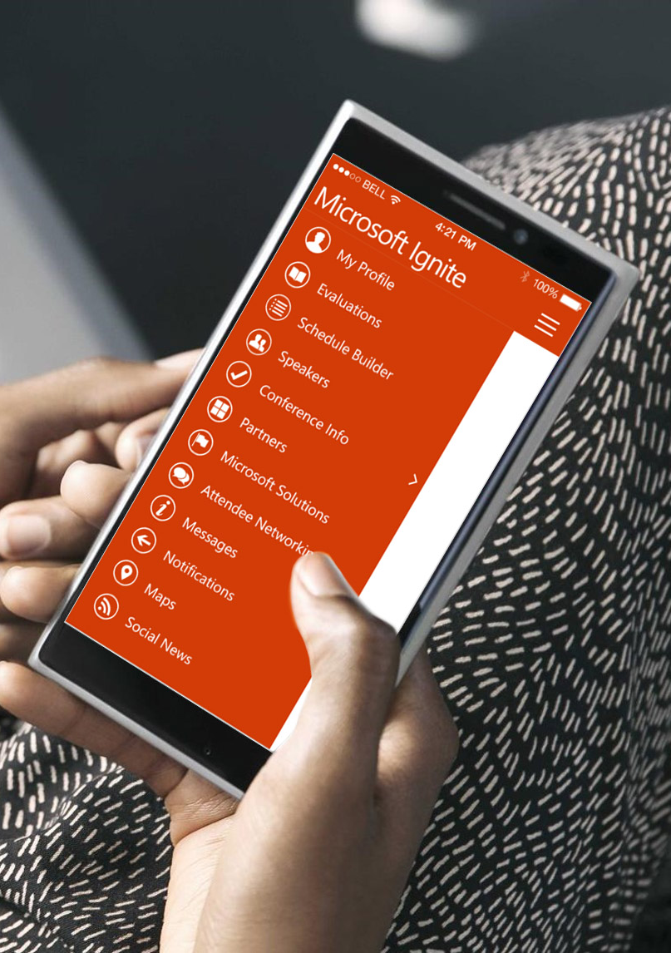
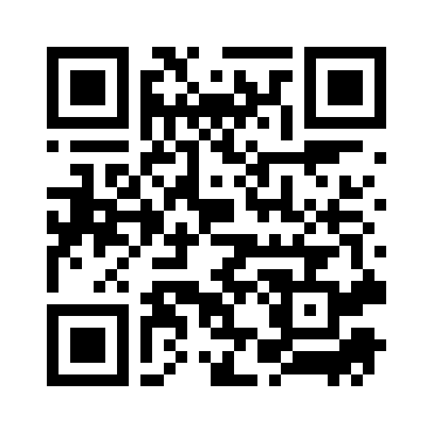
Please evaluate this session
Your feedback is important to us!
From your PC or Tablet visit MyIgnite at http://myignite.microsoft.com
From your phone download and use the Ignite Mobile App by scanning the QR code above or visiting https://aka.ms/ignite.mobileapp

