Slide 1
Understand Microsoft's Office 365 datacenter strategy and approach
BRK2252
Wim Coorevits
Senior Product Marketing Manager

Slide 2

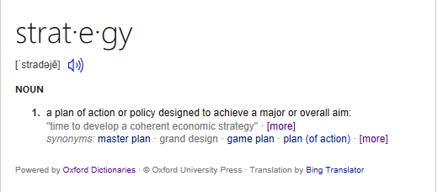

Slide 3


Microsoft mission
Empower every person and
every organization on the
planet to achieve more

Slide 4
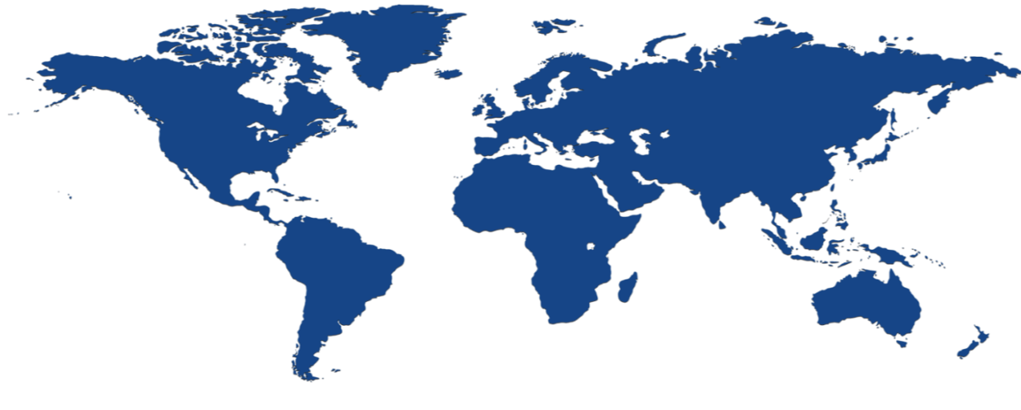

Global, hyper-scale, enterprise-grade infrastructure
Enterprise reliability via 100+ data centers
and Microsoft’s global network edge
Compliance leadership with standards including ISO 27001, FISMA, and EU Model Clauses
No standing access to data, transparent operational model, and financial-backed 99.9% SLA
Secure by design operationalized at the physical, logical, and data layers

Slide 5
Global, hyper-scale, enterprise-grade infrastructure
Global regions
Asia Pacific
Australia
Canada
Europe, Middle East and Africa
India
North America
South America
United Kingdom
Japan
Announced
South Korea
Sovereign regions
US Government
China operated by 21Vianet
announced
Germany

Slide 6

Global, hyper-scale, enterprise-grade infrastructure
London
Finland
Chicago, IL
Durham
Toronto, ON
Netherlands
Magdeburg**
Quincy, WA
Des Moines, IA
Ireland
South Korea
Quebec City, QC
Blue Ridge, VA
Frankfurt**
Beijing*
Saitama Prefecture
San Jose, CA
Austria
Boydton, VA
Shangai*
Osaka Prefecture
Mumbai
Hong Kong
San Antonio, TX
Chennai
Pune
Malaysia
Singapore
  13 datacenter regions
  Over 30 datacenter locations
  100 + datacenters
  One of 3 largest networks in the world
Brazil
New South Wales
Chile
Victoria
  *Operated by 21 Vianet
  **German data trustee services provided by T-systems

Slide 7

Datacenter region
Data residency
Consistent experience
Secure and compliant
Core customer data at rest
At least 2 datacenters
Failover and disaster recovery
Accommodate users across the globe
Part of the global Microsoft Cloud network
Worldwide availability
Built-in security
No standing access to customer data
Broadest standard support: ISO27018, HIPPA, EU Model Clauses & more

Slide 8
Data residency

Slide 9
Office 365 customer data at rest
In Every Datacenter Region – contractually committed*
Exchange Online mailbox content (e-mail body, calendar entries, and the content of e-mail attachments)
Advanced Threat Protection
Exchange Online Protection
E-Discovery
Skype for Business Conversation History
SharePoint Online Site content and files stored within that site
Delve
Office 365 Video
OneDrive For BUSINESS
Project Online
Office Online (Temp. Caching)
In Every Datacenter Region
Skype For Business Meeting Content
Excl. Broadcast meeting recordings
In Regional Hubs (USA, EMEA, APAC)
Skype For Business Broadcast meeting recordings
Planner
Power BI (Contractually committed in OST)
Azure Active Directory
In USA
SWAY
Yammer
Azure Active Directory
* Australia, Canada, the European Union, India, Japan or the United States

Slide 10
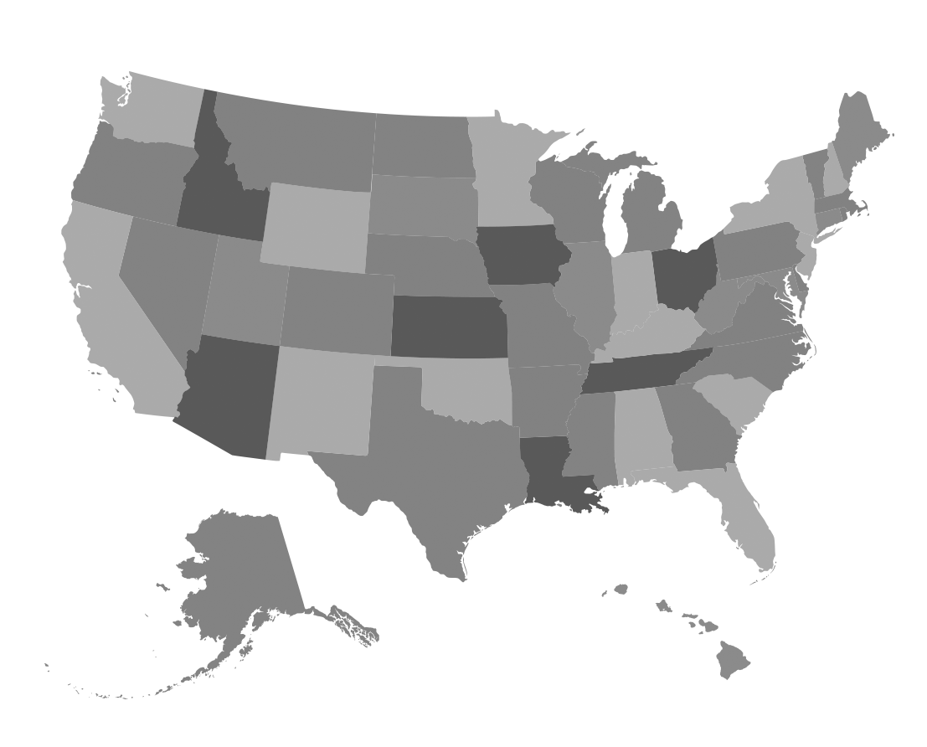

Office 365 in the US
All the productivity and collaboration tools provided by Office 365, with data residency in the US
IN-country data residency
We commit to store core customer data at rest within the US
  Exchange Online mailbox content (e-mail body, calendar entries, and the content of e-mail attachments)
  SharePoint Online site content and the files stored within that site
Core customer data stored at rest across datacenter locations in Des Moines (IA), Chicago (IL), Harrisonburg (VA), Blue Ridge (VA), Boydton (VA), San Antonio (TX), San Jose (CA) and Seattle (WA) for failover and disaster recovery
Global Datacenter Region
Services are delivered globally as part of the Office 365 service fabric
Powered by the hyper-scale Microsoft Cloud network and infrastructure
So, where is data at rest for these globally delivered Office 365 Services?
United States
Exchange Online mailbox content (e-mail body, calendar entries, and the content of e-mail attachments)
Advanced Threat Protection
Exchange Online Protection
E-Discovery
Skype for Business Conversation History
SharePoint Online Site content and files stored within that site
Delve
Office 365 Video
OneDrive For BUSINESS
Project Online
Office Online (Temp. Caching)
Skype For Business Meeting Content
Excl. Broadcast meeting recordings
Delve Analytics (aggregated Data)
SWAY
Yammer
Planner
Power BI
Azure Active Directory
Last Update: July 2016

Slide 11
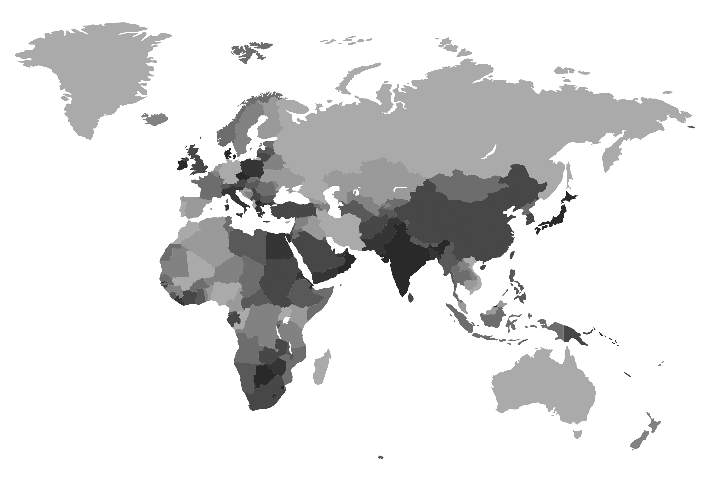
Office 365 in Europe
All the productivity and collaboration tools provided by Office 365, with data residency in Europe
IN-Region data residency
We commit to store core customer data at rest within Europe
  Exchange Online mailbox content (e-mail body, calendar entries, and the content of e-mail attachments)
  SharePoint Online site content and the files stored within that site
Core customer data stored at rest across both datacenter locations in Austria, Finland, Ireland and Netherlands for failover and disaster recovery
Global Datacenter Region
While core customer data is stored locally, services are delivered globally as part of the Office 365 service fabric
Powered by the hyper-scale Microsoft Cloud network and infrastructure
So, where is data at rest for these globally delivered Office 365 Services?
Europe
Out of Region
Exchange Online mailbox content (e-mail body, calendar entries, and the content of e-mail attachments)
Advanced Threat Protection
Exchange Online Protection
E-Discovery
Skype for Business Conversation History
SharePoint Online Site content and files stored within that site
Delve
Office 365 Video
OneDrive For BUSINESS
Project Online
Office Online (Temp. Caching)
Skype For Business Meeting Content
Excl. Broadcast meeting recordings
Planner
Power BI
United States
Delve Analytics (aggregated Data)
SWAY
Yammer
Europe – United States
Azure Active Directory
Last Update: July 2016

Slide 12
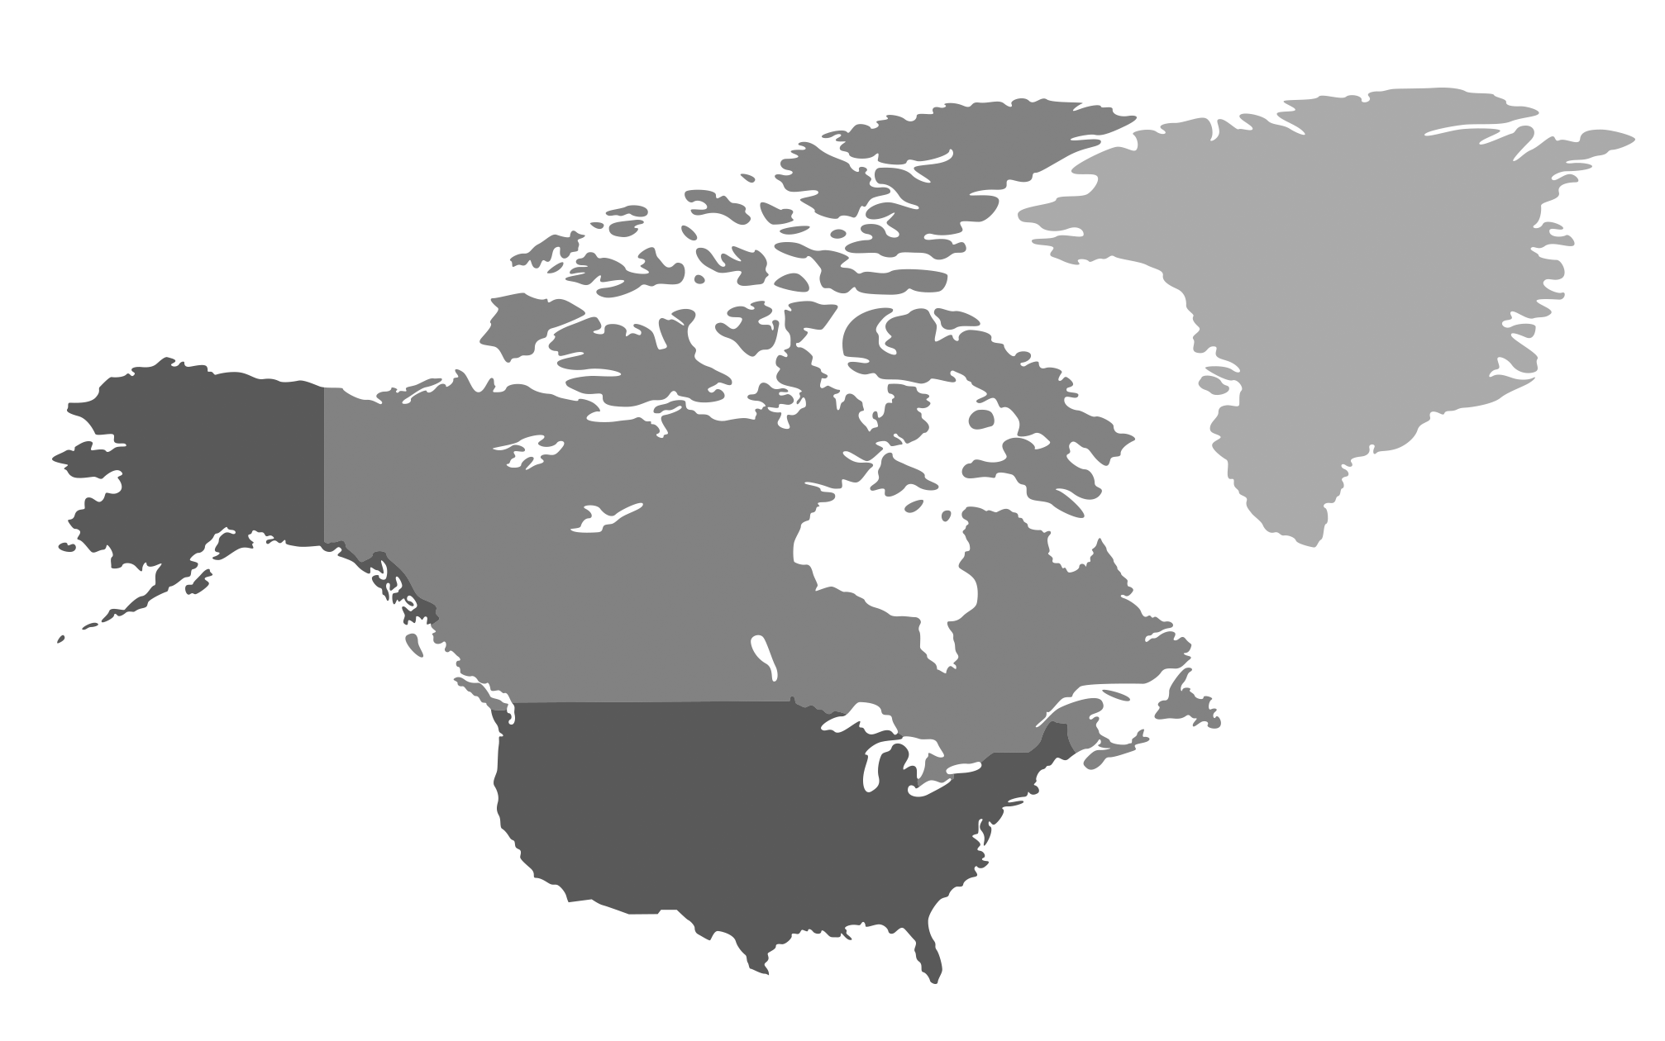
Office 365 in Canada
All the productivity and collaboration tools provided by Office 365, with data residency in Canada
IN-Country data residency
We commit to store core customer data at rest within Canada
  Exchange Online mailbox content (e-mail body, calendar entries, and the content of e-mail attachments)
  SharePoint Online site content and the files stored within that site
Core customer data stored at rest across both datacenter locations in Toronto and Quebec City for failover and disaster recovery
Global Datacenter Region
Services are delivered globally as part of the Office 365 service fabric
Powered by the hyper-scale Microsoft Cloud network and infrastructure
So, where is data at rest for these globally delivered Office 365 Services?
Canada
Out of Region
Exchange Online mailbox content (e-mail body, calendar entries, and the content of e-mail attachments)
Advanced Threat Protection
Exchange Online Protection
E-Discovery
Skype for Business Conversation History
SharePoint Online Site content and files stored within that site
Delve
Office 365 Video
OneDrive For BUSINESS
Project Online
Office Online (Temp. Caching)
Skype For Business Meeting Content
Excl. Broadcast meeting recordings
United States
Delve Analytics (aggregated Data)
Planner
SWAY
Yammer
Power Bi
Azure Active Directory
Last Update: July 2016

Slide 13
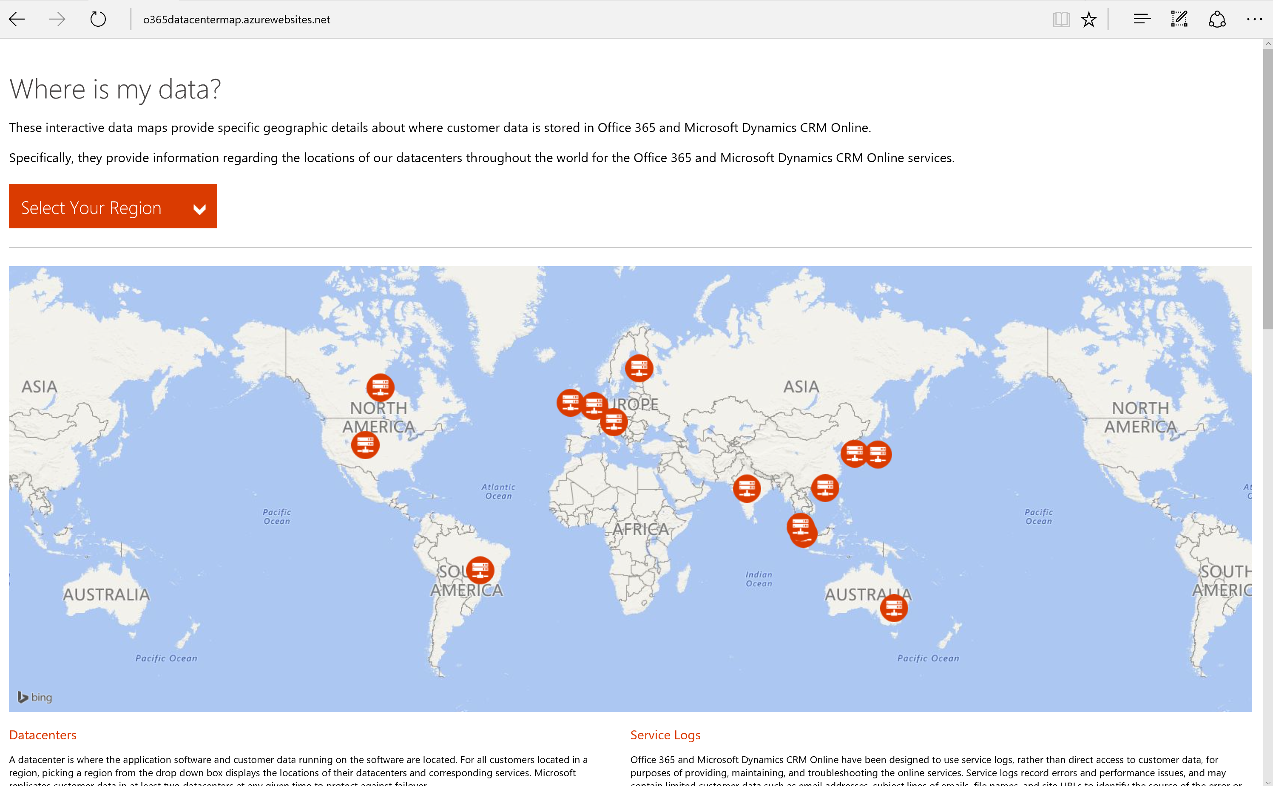
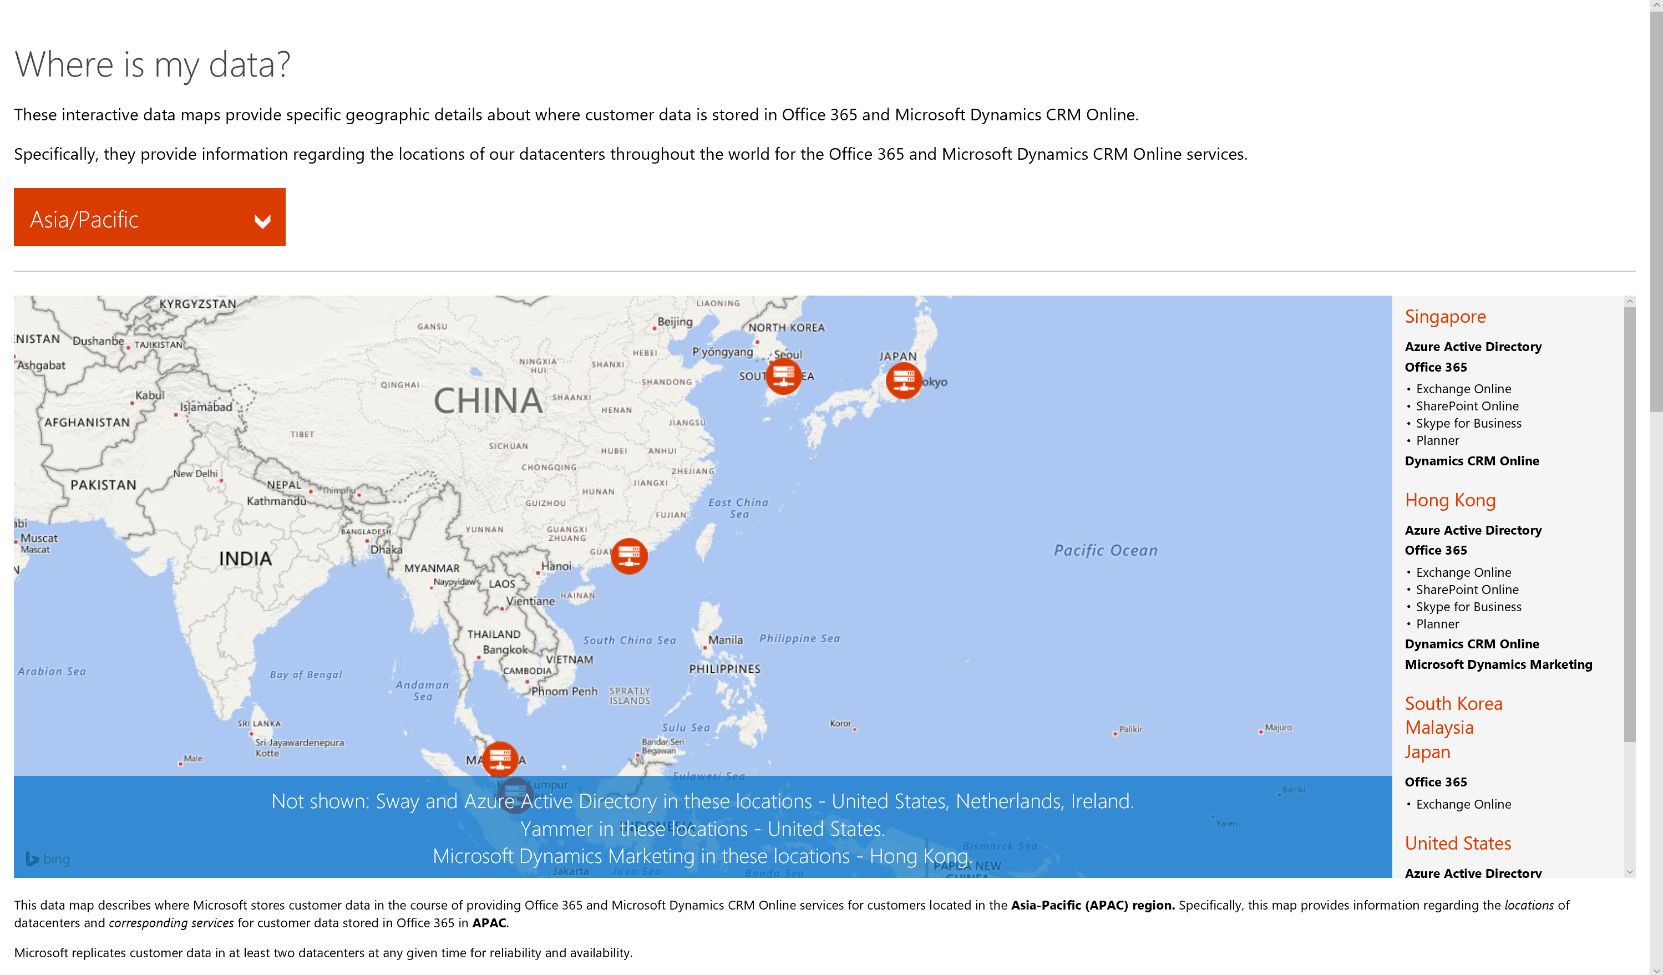
Location of customer data at rest
http://aka.ms/datamaps

Slide 14
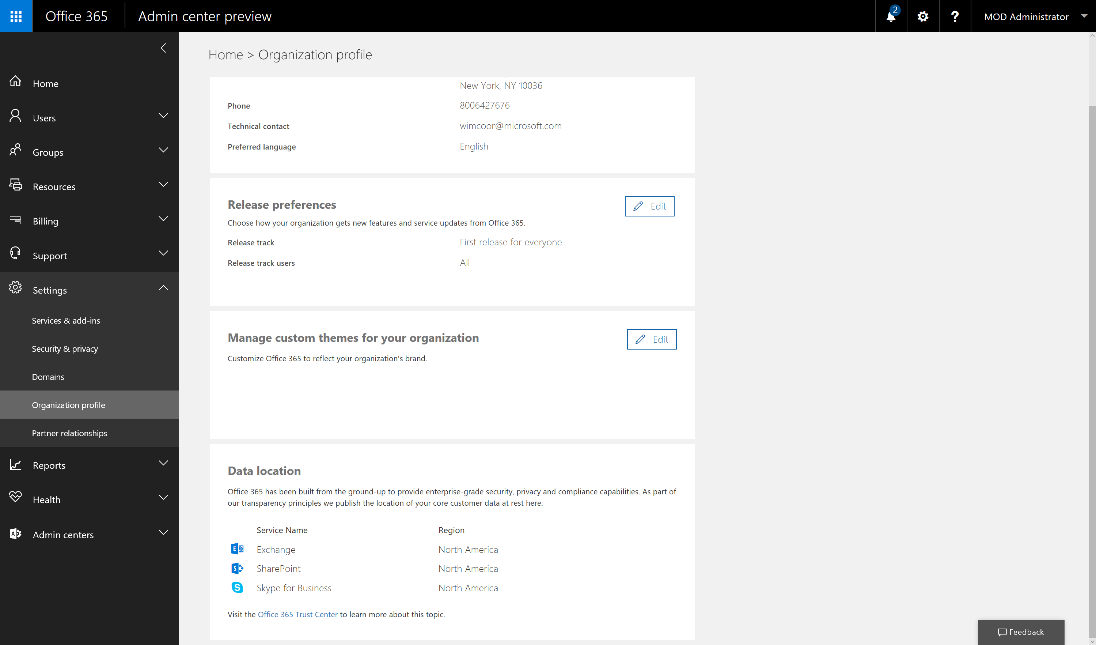
Location of customer data at rest

Slide 15
Skype for Business
Meeting content
  Content uploaded to a Skype for Business meeting
Retention period
  One-time meeting: 15 days starting from when the last person leaves the meeting.
  Recurring meeting: 15 days after the last person leaves the last session of the meeting.
  Meet Now meeting: Content is retained for 8 hours after the meeting end time.
Workarounds
  Only share files according to data classification rules
  Use alternative options: screen sharing, OneDrive for Business, ..
  Disable uploading of Meeting Content

Slide 16
Azure Active Directory
I don’t want Microsoft to store my user passwords
  A federated identity system enables forwarding authentication requests to the customer owned identity provider
I don’t want to synchronize all my user attributes to Microsoft
  Azure AD Connect allows configuration time selection of which attributes are sync’d and which are passed over.
I don’t want to share any name information with Microsoft
  Usernames based on identity instead of the actual names of the users (eg 111801@microsoft.com)

Slide 17
Consistent experience
Commercial availability
Feature availability
User experience

Slide 18
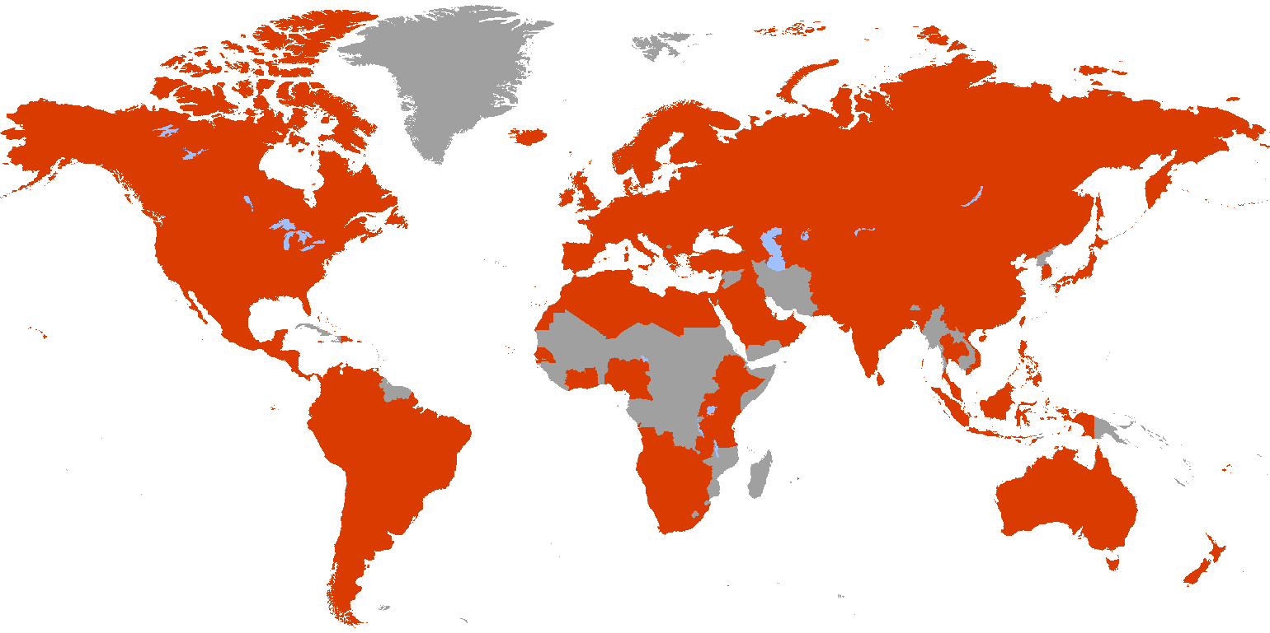
Commercial availability ≠ datacenter regions
Commercially available in 140 markets
Offered in 44 languages
Priced in 25 currencies

Slide 19

Office 365 Commercial Availability - Roadmap
Expanding into 107 markets over the next year
Aland Islands
American Samoa
Andorra
Anguilla
Antarctica
Antigua and Barbuda
Aruba
Benin
Bhutan
Bonaire
Bouvet Island
British Indian Ocean Territory
British Virgin Islands
Burkina Faso
Burundi
Cambodia
Central African Republic
Chad
Christmas Island
Cocos (Keeling) Islands
Comoros
Congo
Congo (DRC)
Cook Islands
Djibouti
Dominica
Equatorial Guinea
Eritrea
Falkland Islands
French Guiana
French Polynesia
French Southern Territories
Gabon
Gambia
Gibraltar
Greenland
Grenada
Guadeloupe
Guam
Guernsey
Guinea
Guinea-Bissau
Guyana
Haiti
Heard Island and McDonald Islands
Isle of Man
Jan Mayen
Jersey
Kiribati
Kosovo
Laos
Lesotho
Liberia
Madagascar
Malawi
Maldives
Mali
Marshall Islands
Martinique
Mauritania
Mayotte
Micronesia
Montserrat
Mozambique
Myanmar
Nauru
New Caledonia
Niger
Niue
Norfolk Island
Northern Mariana Islands
Palau
Papua New Guinea
Pitcairn Islands
Reunion
Saba
Saint Barthélemy
Saint Lucia
Saint Martin
Saint Pierre and Miquelon
Saint Vincent and the Grenadines
Samoa
San Marino
São Tomé and Príncipe
Seychelles
Sierra Leone
Sint Eustatius
Sint Maarten
Solomon Islands
Somalia
South Georgia and South Sandwich Islands
South Sudan
St Helena, Ascension, Tristan da Cunha
Suriname
Svalbard
Swaziland
Timor-Leste
Togo
Tokelau
Tonga
Turks and Caicos Islands
Tuvalu
U.S. Outlying Islands
Vanuatu
Vatican City
Wallis and Futuna
Yemen

Slide 20

Rings of deployment
RING 0
RING 1
RING 2
RING 3
RING 4
WORLDWIDE
FEATURE TEAMS
OFFICE 365 TEAM
MICROSOFT
FIRST RELEASE

Slide 21
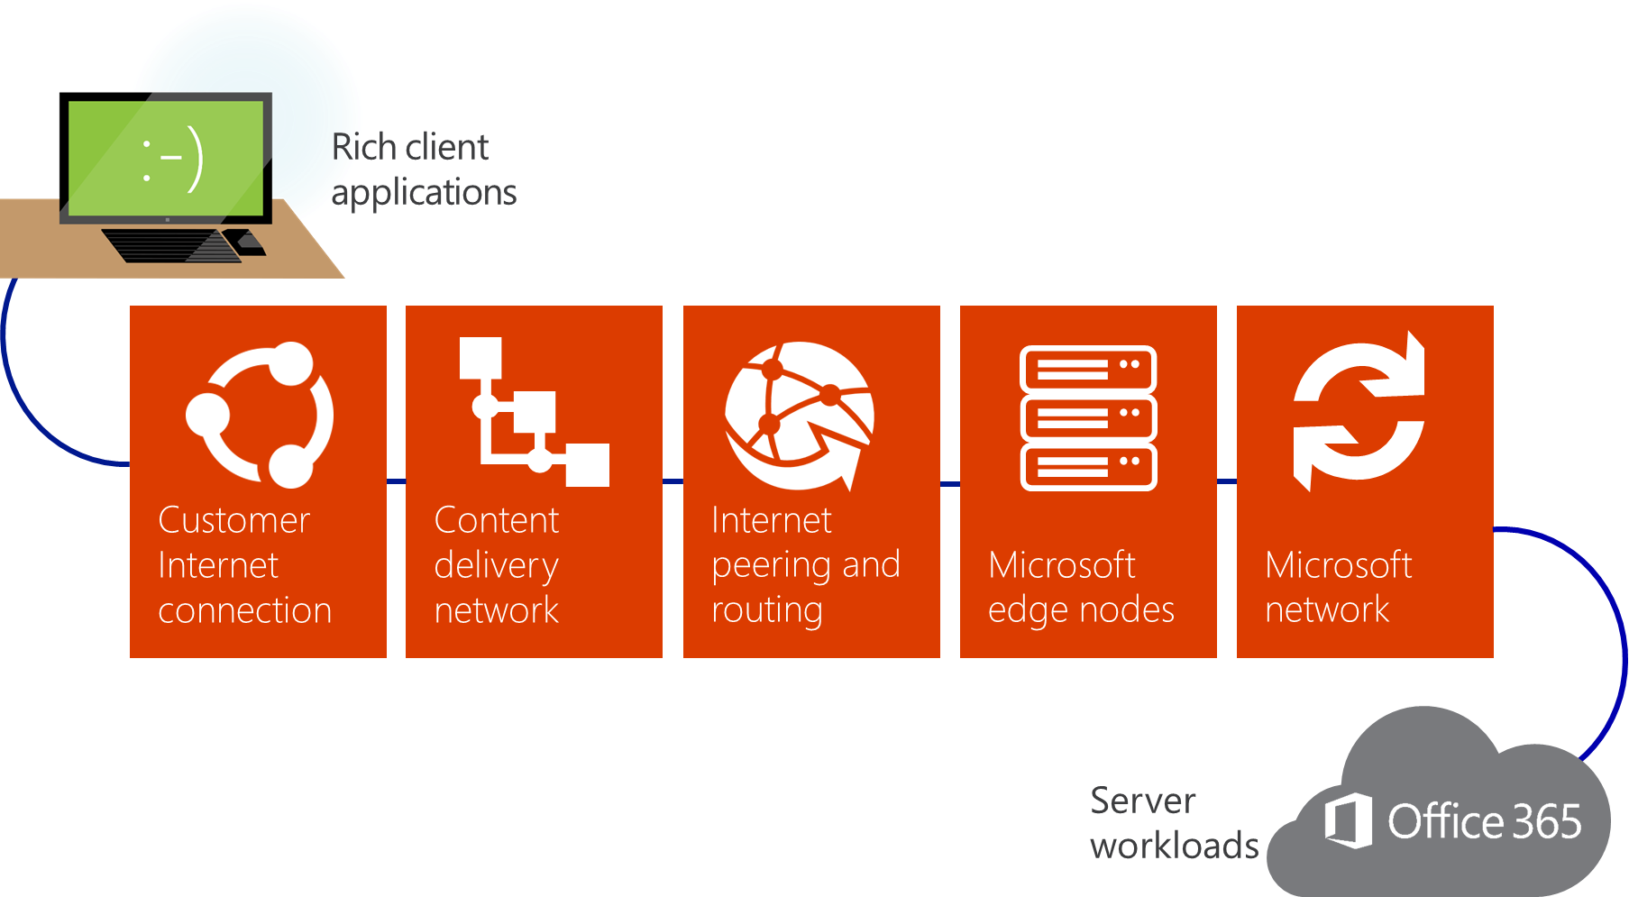
Singular Consistent Experience
  Office 365 aims to provide users a singular consistent experience independent of their location of core customer data at rest
  Microsoft has published guidance for Office 365 customers to plan for an optimize end user performance on the Office Support web site (http://aka.ms/tune).

Slide 22
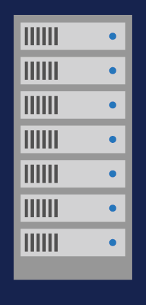

Connecting to Office 365
Please make diagram conform to TR Brand and palette, make lines wider etc
Microsoft Global Network
10ms
Public Internet
Internal Customer Network
Client Managed
External Internet based Network
ISP or Customer Managed
Microsoft Global Network
Microsoft Managed
Top three networks in the world
Very high bandwidth, low latency, failover capable links
Tens of thousands of miles of privately owned Dark Fiber
Multi terabit connections DC-DC and DC-Internet
Peer with over 2000 ISPs globally and over 60 Points of Presence
Optimized to get your traffic to it’s destination efficiently
Proximity to the Microsoft’s Global Cloud Network is the key ingredient to enable the best experiences

Slide 23
Client Connectivity
If the user is in the same region as the tenant, then we connect direct to it
Microsoft DNS
3
Microsoft’s DNS servers return the IP addresses of the local datacenter
North America Datacenters
Client’s DNS asks the Microsoft DNS Server
2
Portal
Customer Data
Customer tenant
EXO
SPO
SFB
Client’s DNS
5
The service accesses the datacenter where the data resides and proxies the requests
The client asks the local DNS Servers
1
4
The user accesses the local datacenter

Slide 24
Client Connectivity – Nearest datacenter
If the user is in a different region as the tenant, then we connect to a datacenter local to the user’s location.
Data is then backhauled over the global Microsoft network between the tenant location and the local datacenter.
Result is a fast connection for the client and data remains stored at rest in the tenant’s location.
Microsoft DNS
3
Microsoft’s DNS servers return the IP addresses of the regional datacenter
North America Datacenters
Client’s DNS asks the Microsoft DNS Server
2
The service accesses the datacenter where the data resides and proxies the requests
Customer tenant
Customer Data
Client’s DNS
5
The client asks the local DNS Servers
1
EU Datacenters
Portal
The user accesses the local datacenter
4
EXO
SFB

Slide 25
Client Connectivity – Active datacenter
If the user is in a different region as the tenant, then we connect to a datacenter local to the user’s location.
Data is then backhauled over the global Microsoft network between the tenant location and the local datacenter.
Result is a fast connection for the client and data remains stored at rest in the tenant’s location.
Microsoft DNS
3
Microsoft’s DNS servers return the IP addresses of the regional datacenter
North America Datacenters
Client’s DNS asks the Microsoft DNS Server
2
Customer Data
Customer tenant in
US
SPO
Client’s DNS
5
The user accesses the active datacenter
The client asks the local DNS Servers
1
EU Datacenters
Portal
4

Slide 26
Sovereign Regions

Slide 27
Sovereign Regions
Office 365 Government Cloud US
  Customer content is logically segregated and stored within the United States.
  Access to customer content is restricted to screened Microsoft personnel.
  Complies with certifications and accreditations that are required for US Public Sector customers.
Office 365 operated by 21Vianet
  Designed to meet the needs for secure, reliable and scalable cloud services in China.
  21Vianet operates, provides and manages delivery of the service.
  Services and data are subject to Chinese laws.
Microsoft Cloud Germany
  Isolated instance of Microsoft Azure, Microsoft Office 365, and Microsoft Dynamics CRM Online located in Germany.
  Commitment that all customer data and required supporting systems reside in German datacenters.
  A German data trustee, under German law, controls physical and logical access to customer data.

Slide 28
Microsoft Cloud Germany
A physical and logically separate instance of Microsoft Azure, Office 365, and
Dynamics available to all customers and partners in EU/EFTA
A commitment that all customer data and required supporting systems reside in German datacenters
A dedicated network within Germany datacenters, independent from the public cloud network
A commitment to meet applicable compliance requirements and certifications
A German Data Trustee that controls physical and logical access to customer data
The same value, technology and customer service levels that power the global versions of the Microsoft Cloud, including the robust security and compliance controls

Slide 29
Client Connectivity
Users always connect directly to their sovereign datacenter region, even if they are travelling across the world
Microsoft DNS
3
Microsoft’s DNS servers return the IP addresses of the local datacenter
Sovereign datacenter region
Client’s DNS asks the Microsoft DNS Server
2
Portal
Customer Data
Customer tenant
EXO
SPO
SFB
Client’s DNS
5
The service accesses the datacenter where the data resides and proxies the requests
The client asks the local DNS Servers
1
4
The user accesses the local datacenter

Slide 30
New regions

Slide 31
What we have learned so far…
Office 365 is built from the ground up to provide enterprise-grade security, privacy and compliance capabilities.
We introduce no unique capabilities, features or compliance certifications with the launch of a new datacenter region.
We aim to provide consistent experiences independent of the location of data at rest.

Slide 32
New datacenter regions
Enable customers in highly regulated industries or markets that require data residency to take advantage of the value of the cloud.

Slide 33
Q&A

Slide 34


Please evaluate this session
Your feedback is important to us!
From your PC or Tablet visit MyIgnite at http://myignite.microsoft.com
From your phone download and use the Ignite Mobile App by scanning the QR code above or visiting https://aka.ms/ignite.mobileapp

