Slide 1
Configure Your Heterogenous Environment with PowerShell and DSC
BRK2244
Kenneth Hansen Principal Program Manager @KHansenHansen
Joey Aiello Program Manager @joeyaiello

Slide 2
Built-in layers of security
Software-defined datacenter
Cloud-ready application platform
Windows Server 2016
Windows Server + System Center session guide: aka.ms/WS2016Ignite

Slide 3
Eras of Windows Server and PowerShell
Server for the Masses Era
Windows NT Simple GUI to setup and run server workloads | No PowerShell Rare automation with only VBS and DOS/.bat
Enterprise Server Era
Windows 2000 Server, Windows Server 2003 Active Directory/Group Policy eases management across the enterprise | PowerShell Begins! New shell and scripting language built around structured data Enables automation across many servers to reduce errors, cost, and downtime.
Datacenter Server Era
Windows Server 2008, Windows Server 2012 Added virtualization, network and storage management Enabled management of interconnected servers hosted in remote datacenters | Full PowerShell – Age of Automation on Windows Broad cmdlet coverage, full featured remoting, modules, and the Integrated Scripting Editor Enables a large and powerful community to completely automate Windows management across the datacenter

Slide 4
Eras of Windows Server and PowerShell
Cloud Server Era
Windows Server 2016 and Nano Server Cloud-ready with DevOps workflow that enables transition to public or private clouds Containers, Docker, Remote Server Management Tools (RSMT), and software-defined networking Nano Server deployment option provides a minimal footprint and attack surface, fewer reboots | PowerShell and the Cloud Era DevOps tooling: Desired State Configuration (DSC), Pester testing framework, PackageManagement (PowerShellGet), code analysis (ScriptAnalyzer), Visual Studio Code support, and remote debugging PowerShell classes: enables system programming Security: JEA (Just Enough Administration) and improved audit logs PowerShell Gallery: leverages the strength of the community to provide 100s of modules and resources to support automation and DevOps on Windows Servers Heterogenous: built on .NET Core to support Nano Server, macOS, and Linux

Slide 5
heterogenous - Powershell as Glue
^
Discoverable
Across Data, Text, APIs
COM, WMI, .NET, XML, CSV, JSON, Text, Registry, native PInvokes
Across versions of Windows
Windows Server 2008 R2, 2012, 2012 R2, 2016
Windows 7, 8.1, 10, Anniversary
Across .NET Framework and .NET Core
Nano Server
… now… Across Windows, macOS, and Linux

Slide 6
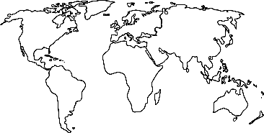
Cloud Era - Management Landscape
Power
(Scale * complexity) exceeds skill
Cloud scale demands power
Velocity
Ever-faster solution delivery needed
Pace of change is increasing
Ubiquity
Heterogeneous environments are norm
IT spans on-prem, hybrid, and cloud

Slide 7
PowerShell 5.0
Improvements in Desired State Configuration
Configurations
Specifying Cross Node Dependencies
Encrypted MOFs
Help support for DSC Configuration
Authoring Improvements using PowerShell ISE
Allowance for Identical Duplicate Resources in a Configuration
Import-DscResource keyword -moduleversion parameter
WOW64 support for Configuration Keyword
Resources
Class-based DSC Resources
DSC Resource Script Debugging
Automatic RunAs support for DSC Resources
Side-By-Side Versioning Support for DSC Resources
New in-box Resources
Local Configuration Manager
Configure Node with Multiple Config Fragments
Support for Mixed RefreshModes
Configure DSC Engine with New Attribute
Detailed information about LCM State
Frequencies fix for RefreshMode and ConfigurationMode
Additional Value for RefreshMode Property
Cmdlets
Details about Configuration Status
Test-DscConfiguration cmdlet supports Reference Configurations
Direct Access to DSC Resource Methods
Deliver Configuration Document without Applying
Remove DSC Documents
Unified and Consistent State and Status Representation
Set-DscLocalConfigurationManager cmdlet supports -force parameter
Pull Mode
On-demand PULL of DSC Configurations
Seperation of Node and Configuration Ids
Separation of Config, Resource, and Report Repositories
Report Configuration Status to Central Location
Just Enough Administration (JEA)
Creating and Connecting to JEA Endpoint
Reporting on JEA
PowerShell Classes
Define Custom Types
Declare Base Class
Declare Implemented Interface
Call Base Class Constructor
Call Base Class Method
PowerShell Script Debugging++
Audit PowerShell Usage using Transcript and Logging
Enhanced Transcription Options
Script Tracing and Logging
Cryptographic Message Syntax
PackageManagement and PowerShellGet
PackageManagement cmdlets
PowerShell Module with PowerShellGet
Register a PowerShell Repository
Side-by-Side Support on PowerShell 5.0 or newer
Installation of Module Dependencies
PowerShellGet Cmdlets for Module Management
PowerShell Script with PowerShellGet
PowerShellGet Cmdlets for Script Management
New and updated cmdlets based on community feedback
Symbolic links using Item cmdlets
Archive cmdlets
Clipboard cmdlets
Convert-String
Extract and Parse Structured Objects out of String
Format-Hex
NoNewLine parameter
New-TemporaryFile
New-Guid
Get-ChildItem has -Depth parameter
Updates to FileInfo object
Modules support for declaring version ranges
Information Stream
Generate PowerShell Cmdlets based on OData Endpoint
Network Switch Management with PowerShell
Software Inventory Logging

Slide 8
PowerShell 5.1
PowerShell Editions
Improvements in Desired State Configuration
DSC class-based resource improvements
DSC resource debugging improvements
DSC pull client supports TLS 1.1 and TLS 1.2
Improved pull server registration
Pull partial configuration naming convention
PsDscRunAsCredential with DSC composite resources
DSC module and configuration signing validations
Improvements in the PowerShell Console
VT100 Support
Vi mode support in PSReadline
Redirected stdin with interactive input
Performance Improvements
Startup time: ~4x faster
First command run: 2.5x faster
First command (w/ caching): 13x faster
ForEach-Object: ~2x faster
Improvements in PackageManagement
Removed -Version alias to –MinimumVersion
Fixed prompts for bootstrapping the NuGet provider
Support for PackageManagement on intranet-only nodes
Event logging improvements
Support for basic authentication
Support for using PackageMangement behind a proxy
New Cmdlets and Bug Fixes
Catalog Cmdlets
Pester updated from 3.3.5 to 3.4.0
Specify module version with ‘using module’
Module auto-discovery fully honors PSModulePath
File redirection no longer hard-codes –Encoding Unicode
Fixed a regression in accessing members of
System.Reflection.TypeInfo
Fixed some issues with COM objects
Now allow [ordered] inside classes
About topics with multiple versions returns the latest one

Slide 9
Power
Desired State Configuration (DSC)
Cross-Node Dependencies
Test-DscConfiguration cmdlet supports Reference Configurations
Direct Access to DSC Resource Methods
Reporting
PowerShell Classes
System programming and frameworks
Ability to create new types in pure PowerShell
Writing DSC resources is even easier with classes
New debugging/editing features
Remote psedit/editing
BreakAll for DSC debugging
DSC resources
DSC enables simpler configuration and deployment

Slide 10
Power - Security
Transcription logging/auditing
Just Enough Administration (JEA)
Protect against rogue admins with too much privilege
Only give server administrations exactly the permissions that they need to do their job
Allows you to define contexts in which admins can execute PowerShell
Desired State Configuration (DSC)
Now encrypting DSC MOFs by default
Pull server supports TLS 1.1/1.2
PowerShellGet and PowerShell Gallery now supports validating catalog signatures

Slide 11
Velocity/Power - PowerShellGet
Makes downloading, sharing PS modules easier
PowerShell Gallery
`Find-Module *azure*` to look for Azure related modules
`Install-Module AzureRM` gets you all modules for managing Azure
Easier to bring up cattle servers
Enables “getting dependencies” in your CI/CD pipeline
Can also publish your private modules to an internal Gallery
Over 4 million downloads; 500,000 in just August alone

Slide 12
Velocity - CI/CD Pipeline
Automation
Repeatability
Artifacts are:
internal PS modules
community PS modules
DSC resources
DSC configurations
.NET applications
WHATEVER YOU WANT
Get source and dependencies
Build artifacts
Test artifacts
Make changes
Deploy

Slide 13
Velocity
Pester
Check in code faster and be sure nothing breaks
CI/CD pipeline
Script Analyzer
Build modules using best practices quicker
PowerShell Core on Nano Server
Nano allows you to stand up and teardown servers quicker than ever
Remote debugging
Enables you to understand and remediate problems quicker
PowerShell Gallery
Leverage the PowerShell community to bootstrap your scripts

Slide 14
Ubiquity – Windows, mac, and Linux
Runs natively on Linux and Mac OS X
Open source on GitHub
Preview today → GA in 2017
♡
Existing PS Users
Mgmt Products
App Developers
Linux Users
Manage Linux and Windows systems from any computer
Single stack to manage anything from anywhere
Framework transforms a small amount of code into rich automation and configuration
Another tool in your toolbox. Optimized for structured data, REST APIs, and object models

Slide 15
Ubiquity - Powershell Everywhere
PowerShell and DSC play well with other config. mgmt. solutions like Chef and Puppet
WMF: Windows PowerShell 5.1 downlevel to Server 2008 R2 and Windows 7
Open-source, cross-platform PowerShell Core 6.0 alpha
Available on Windows, Nano, Mac, and Linux
Based on the .NET CoreCLR
PowerShell plugin for VS Code
Nearly at parity with the ISE
Integrated terminal
Debugging

Slide 16
Contribute!

Slide 17
Related sessions
1
Explore PowerShell Unplugged
2
Gain Insight into a Release Pipeline Model
3
Hubtalk: Intro to PowerShell
Resources
4
PowerShell Home Page
https://microsoft.com/PowerShell
5
PowerShell Open Source
https://github.com/PowerShell
Windows Server 2016
Windows Server + System Center session guide: aka.ms/WS2016Ignite

Slide 18
Free IT Pro resources To advance your career in cloud technology
Plan your career path
Cloud role mapping
Expert advice on skills needed
Self-paced curriculum by cloud role
$300 Azure credits and extended trials
Pluralsight 3 month subscription (10 courses)
Phone support incident
Weekly short videos and insights from Microsoft’s leaders and engineers
Connect with community of peers and Microsoft experts
Microsoft IT Pro Career Center
www.microsoft.com/itprocareercenter
Get started with Azure
Microsoft IT Pro Cloud Essentials
www.microsoft.com/itprocloudessentials
Demos and how-to videos
Microsoft Mechanics
www.microsoft.com/mechanics
Connect with peers and experts
Microsoft Tech Community
https://techcommunity.microsoft.com

Slide 19
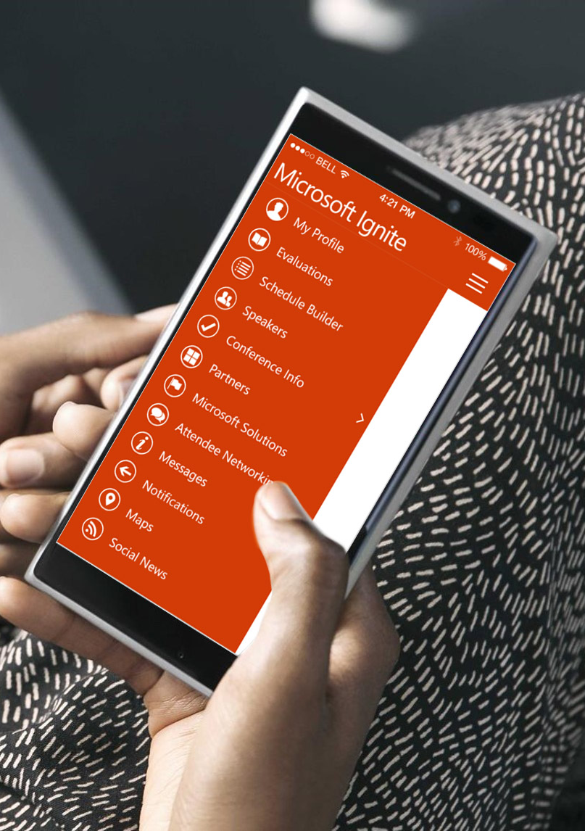
Please evaluate this session
Your feedback is important to us!
From your PC or Tablet visit MyIgnite at http://myignite.microsoft.com
From your phone download and use the Ignite Mobile App by scanning the QR code above or visiting https://aka.ms/ignite.mobileapp

