Slide 1
Explore Enterprise Clouds for Microsoft Environments
BRK2230
Mike McGhee – Sr. Technical Marketing Engineer
Chris Brown – Solutions Marketing Manager

Slide 2
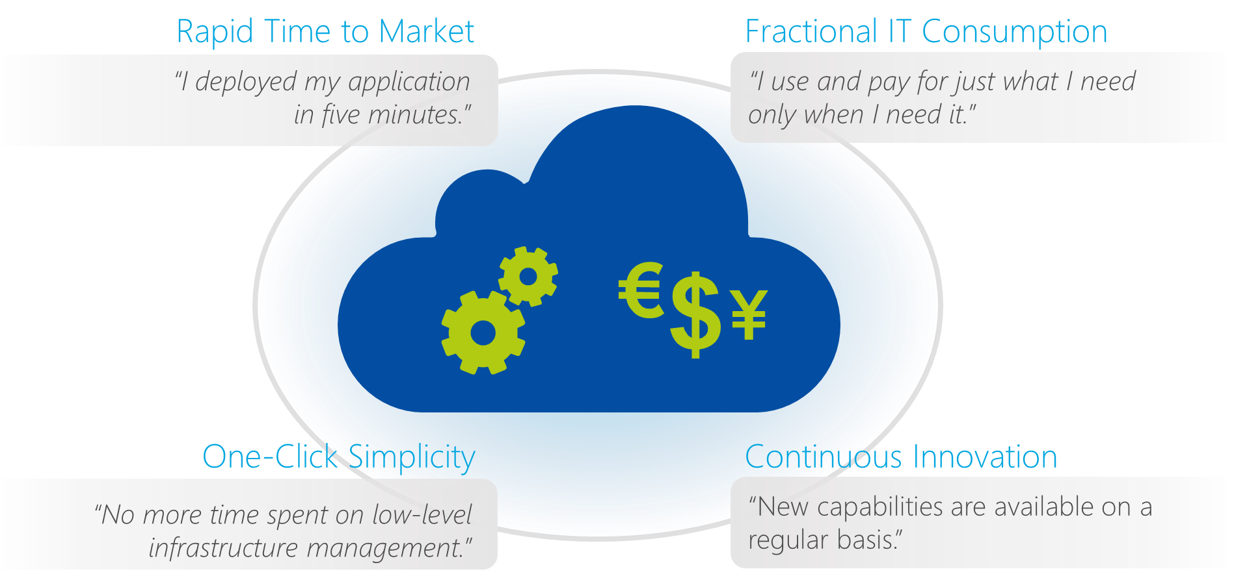
The Cloud Era Is Well Underway

Slide 3
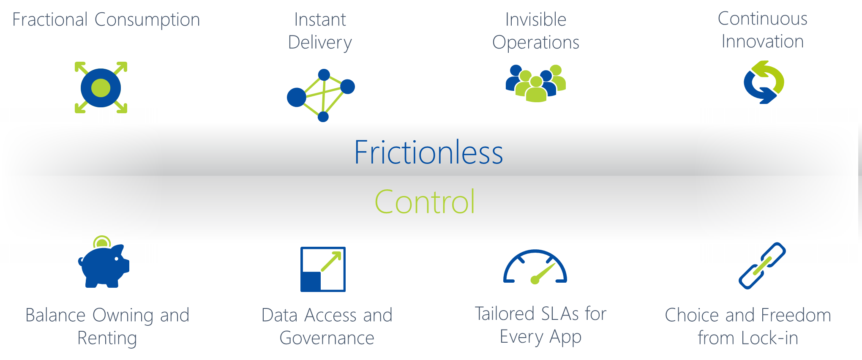
Bringing The Cloud To The Enterprise Datacenter

Slide 4

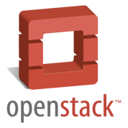










Complexity with Legacy Infrastructure
+ Automated operations
+ Self-service provisioning
+ Monitoring and analytics
Virtualization
Compute
x Lifecycle complexity
x Resource silos
x Support challenges
x High costs
Storage Network
Storage
Network

Slide 5
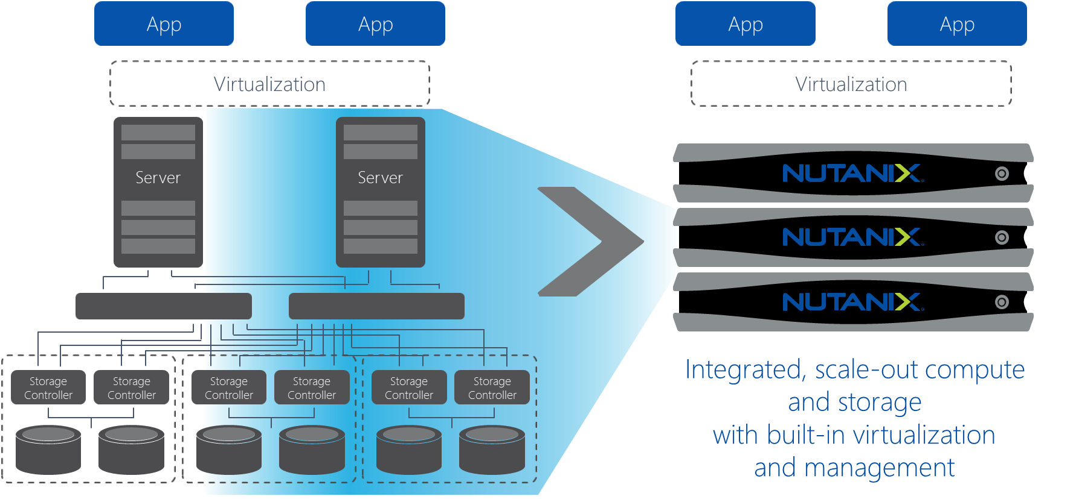
Re-Platforming the Enterprise Datacenter

Slide 6
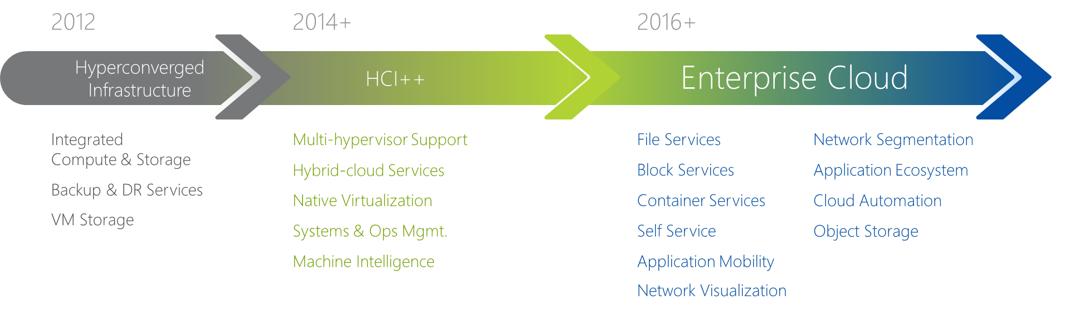
Hyperconverged >> Enterprise Cloud

Slide 7
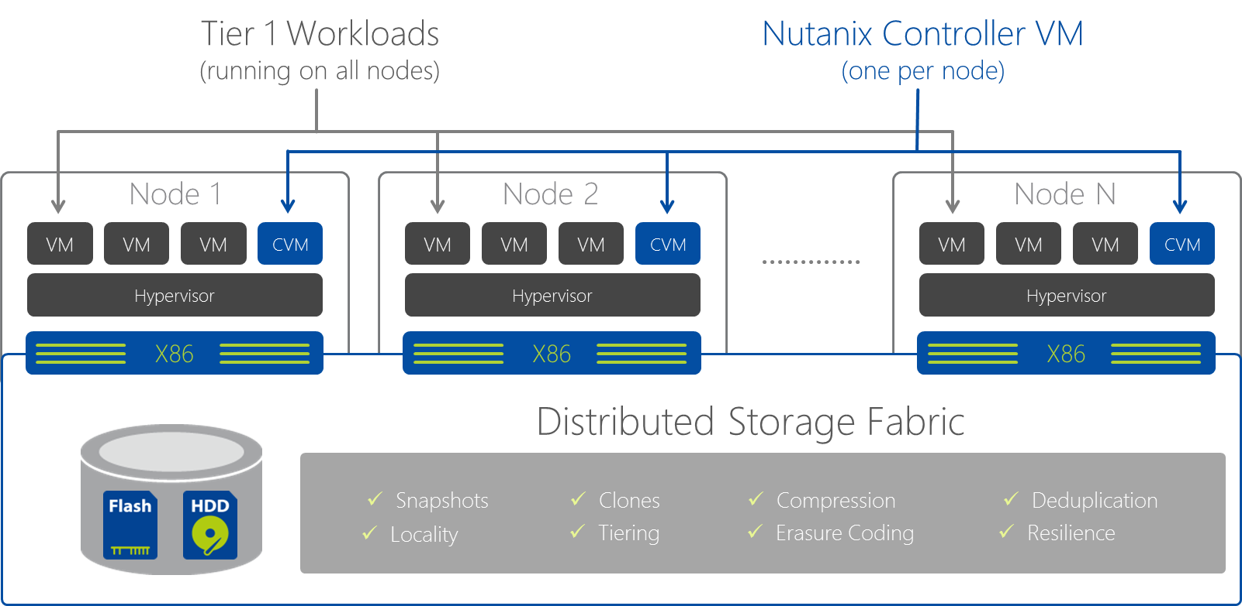
Scalable Distributed System Design

Slide 8
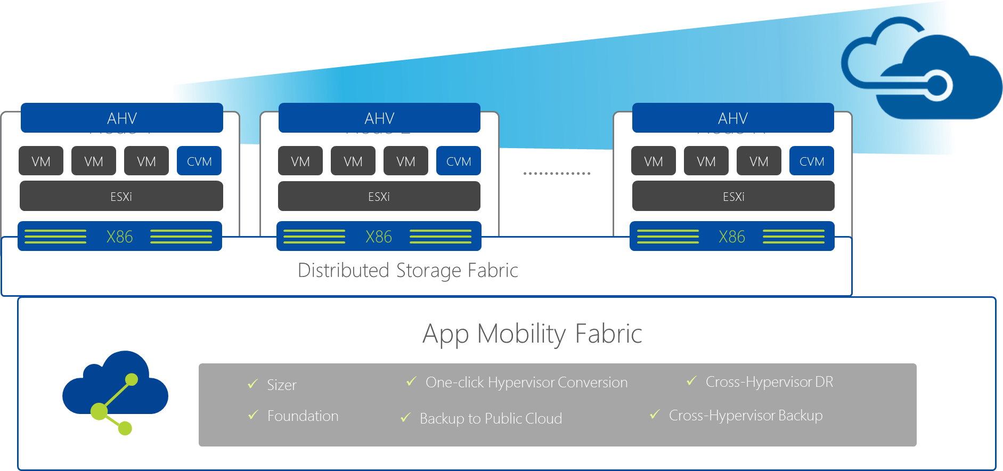
Seamless Application and Data Mobility

Slide 9
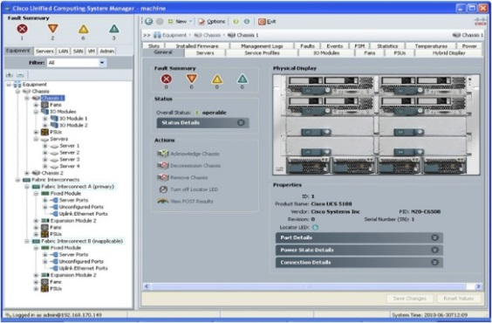
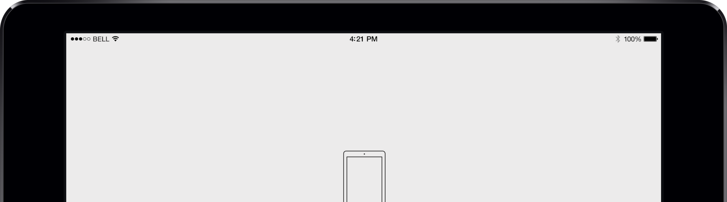
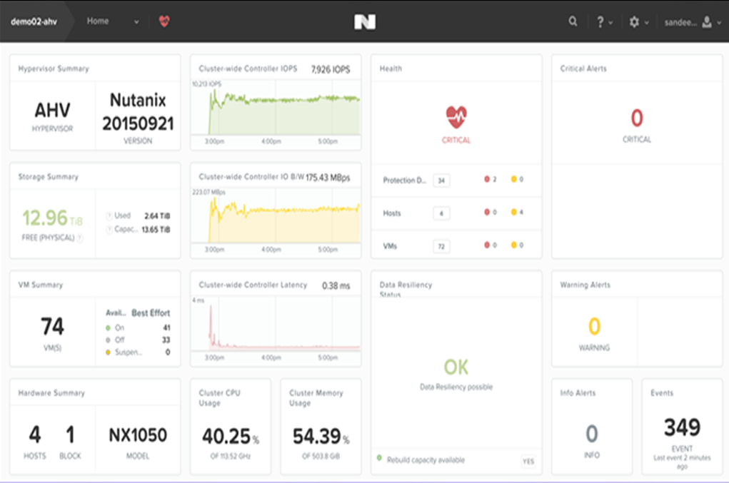
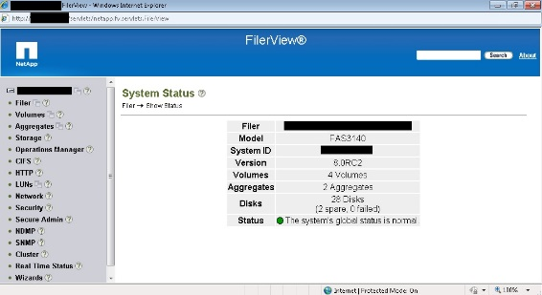
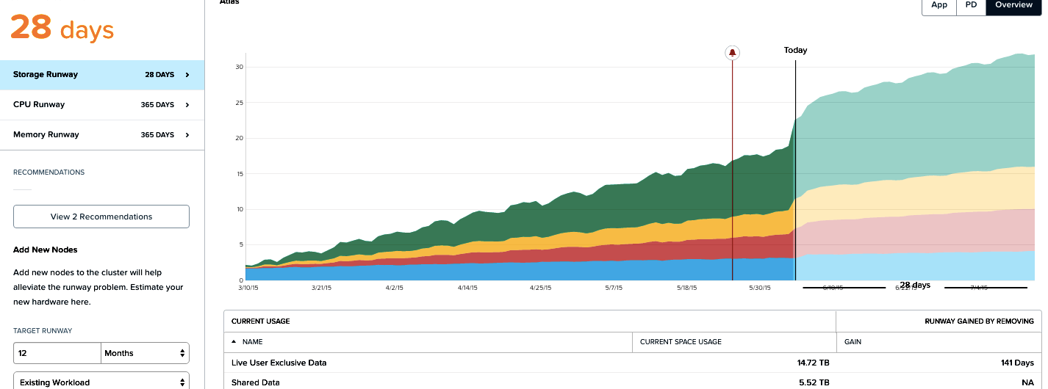
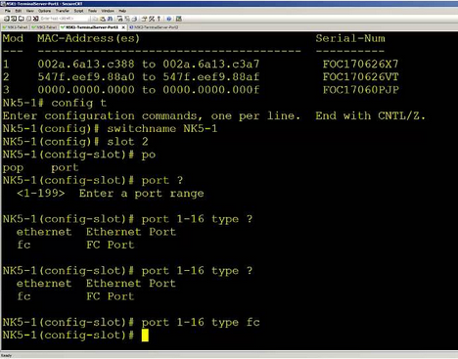

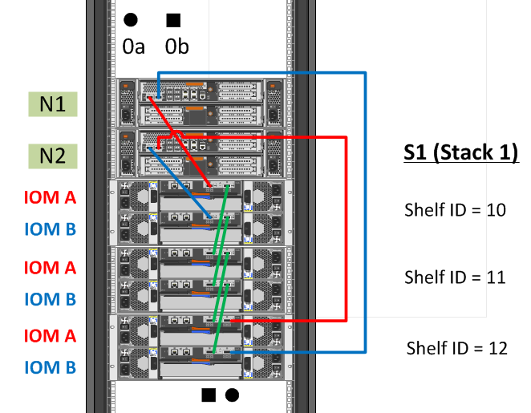

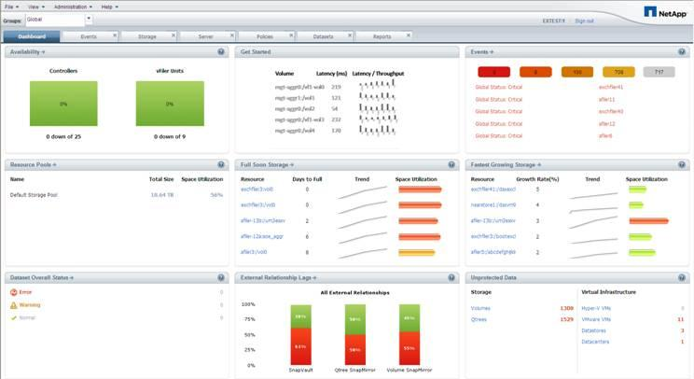
Integrated Consumer-Grade Management
Intuitive
Eliminate Complexity…
Beautiful
Insightful

Slide 10
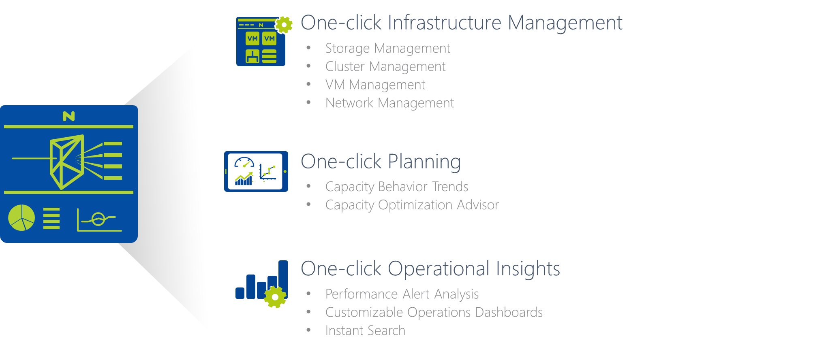
Simplified Datacenter Management

Slide 11
Nutanix with Hyper-V

Slide 12
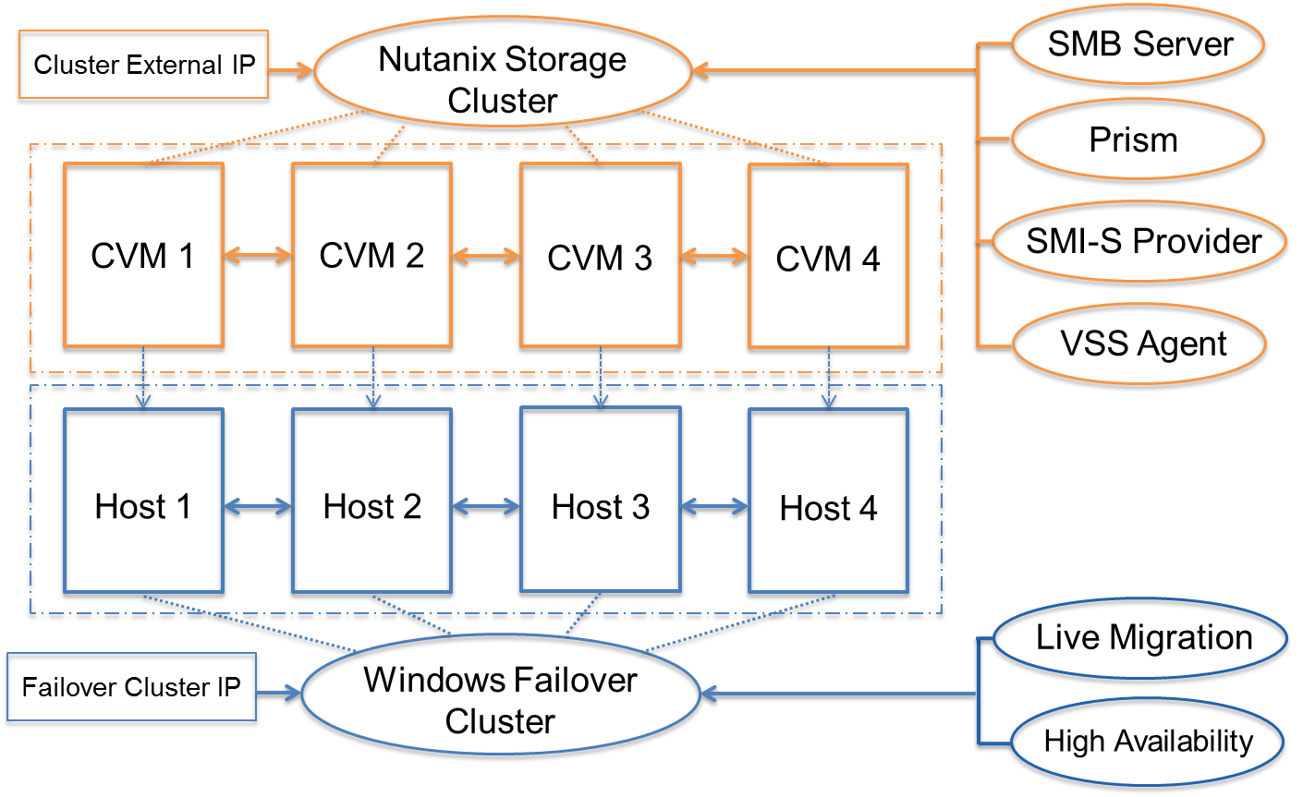
Nutanix and Hyper-V

Slide 13
Default Network Configuration
SMB Communication

Slide 14
Anatomy of a Write – RF2 Example
Node 1
Node
Node
Guest
VM
Hyper-V
Hyper-V
Hyper-V
Controller VM
Controller
VM
Controller
VM
Storage
Storage
Storage
  Data is written locally –and-
  Replicated on other nodes for redundancy
  Replicas are spread across cluster for high performance

Slide 15
Anatomy of a Read
Node
Node
Node
Guest
VM
Hyper-V
Hyper-V
Hyper-V
Controller
VM
Controller VM
Controller VM
Storage
Storage
Storage
  Data is read locally
  Remote access only if data is not locally present

Slide 16
Data Locality - Live Migration
Node
Node
Node
Guest
VM
Hyper-V
Hyper-V
Hyper-V
Controller VM
Controller VM
Controller VM
Storage
Storage
Storage
  Metadata service can access data from anywhere
  Locality improves over time as data is accessed

Slide 17
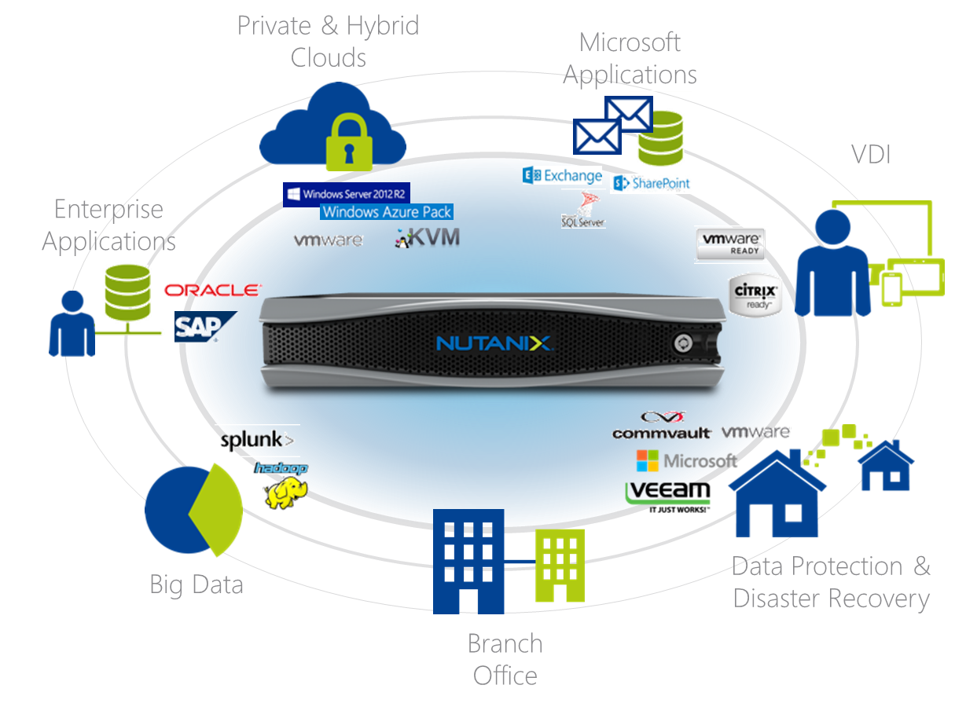
Nutanix Solutions for Enterprises

Slide 18
Private and Hybrid Clouds

Slide 19

Nutanix + Windows Azure Pack
Modular
Scalable
Fast Track Certified
Full RA Available
Simple.

Slide 20
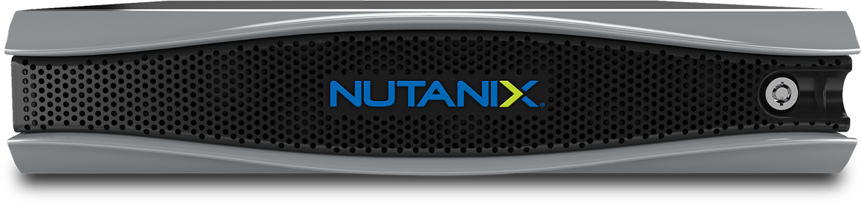
Cloud platform system standard on Nutanix
Azure Consistent UI and API
Disaster recovery
Cloud-based tenant backup
Telemetry and diagnostics
Azure Services
Windows Azure Pack
Fabric management
Monitoring
Infrastructure backup and restore
System Center 2012 R2
Windows Server 2012 R2
Automated deployment tool
Integrated patch and update tool
Certified reference architecture
Validated hardware components

Slide 21
Microsoft Applications

Slide 22



Why Microsoft Apps or any vBCA on Nutanix
Performance/Availability/Scalability
  Highly available, Self healing infrastructure
BC/DR , Security & Compliance
  Self auditing/remediating infrastructure
  Common DR procedure
Cost
  Less complexity = Reduced OPEX
  Fewer Silos = Reduced CAPEX/OPEX
  Better utilization of resources = Less waste
  Start small & scale if/when required (No guesswork!)
  On-Premises vs. the Cloud

Slide 23
When Cloud First
Office 365
Advantages:
Scalability
On Premise
Advantages:
Disadvantages:
Keep full control
More flexibility
Customer controlled
Possible data loss
Availability
Security
Costs
Cut out costs
Reduce risk of losing data
Always up to date
Disadvantages:
No administrative control
Migration can be a hassle
Move back to on-prem?

Slide 24
When Nutanix Enterprise Cloud First
Office 365
Advantages:
Scalability
On Premise
Advantages:
Disadvantages:
Keep full control
More flexibility
Customer controlled
Possible data loss
Availability
Security
Costs
Cut out costs
Reduce risk of losing data
Always up to date
Disadvantages:
No administrative control
Migration can be a hassle
Move back to on-prem?
Office 365
Advantages:
Scalability
On Premise
Advantages:
Keep full control
More flexibility
Customer controlled
Keep full control
Cut out costs
Reduce risk of losing data
Always up to date
Disadvantages:
No administrative control
Migration can be a hassle
Move back to on-prem?
More flexibility
Customer controlled
Scalability
Always up to date
Reduce risk of losing data
Possible data loss
Availability
Security
Costs

Slide 25



Deploying Microsoft Exchange with Nutanix
Unifed Platform for all Roles
Capacity Optimization
Available tools work in tandem
Data Locality
Match Scaleout with Scaleout
Acropolis
Hypervisor

Slide 26


Hypervisor Agnostic & Fully Supported on….
ESRP
ESRP
AHV
Virtualization of Exchange is a well understood, fairly common solution to this problem (scalability).

Slide 27



Microsoft Exchange On Nutanix
Primary site
1
Thousands of mailboxes/node
Industry’s first
HCI ESRP submission:
30K mailboxes on 3 hosts
Primary
copy
Secondary
copy
3
DR site (with VMware SRM etc)
DAG
replication
2
VM
clones
Immutable
copy
C:
DB
Logs
Now available: iSCSI volumes for DB/logs
Secondary
(also for
compliance)
For litigation/
in-place hold
Database Availability Groups – Microsoft Exchange 2010 and 2013
  Provides mailbox resiliency and can be used as the primary protection mechanism.
  Nutanix VMCaliber functionality can complement Microsoft Exchange

Slide 28

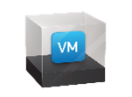


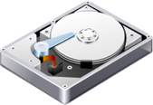

Design Methodology (cont.)
DAG1
DAG2
Mgmt
VMs
DAG1
DAG2
Mgmt
VMs
Scale out rather than scale up & do not exceed the sizing guidelines
(24 cores & 96GB RAM)
NX-8150-G5
Up to 36 pCores
(Intel Broadwell)
Up to 768GB RAM
4 x 2TB SSD
20 x 2TB SAS HDD
In Just 2RU!

Slide 29
Principles of Database Servers
Databases are an extension of storage
Performance is more than just
the underlying storage devices
Size for performance before capacity

Slide 30
Principles of Database Servers
Virtualize, but without compromise
Keep it standardized and simple
All Flash for the most demanding workloads

Slide 31
Best Practices for Best Performance
Platform Selection Considerations
SSD for performance, HDD for cold storage
  Utilize storage only nodes to reduce DB processor licensing costs
Large databases love lots of compute, memory and SSD
  NX8150, Dell XC730xd-24, Lenovo HX7500 (and all flash platforms)
Data Reduction Techniques - Your Mileage Will Vary
Use inline compression
Can be used in combination with DBs
  SQL Compression and Oracle Advanced Compression

Slide 32
Best Practices for Best Performance: SQL Server
Max memory should be less than total memory
Set the right max degree of parallelism (MAXDOP)
Separate drives for the following
  user data files,
  user log files,
  Temp DB Data, and
  Temp DB Logs (Automatic in SQL 2016)
Security policy: Lock pages in memory, perform volume maintenance operations
Balance size of SQL VM and number of DB per VM
Use trace flags with care

Slide 33
Scale Up vs Scale Out Conundrum
Performance Benchmarks using DVD Store 2.1 on NX3450

Slide 34
Scale Up vs Scale Out Conundrum
TPC-C Like Test Using Benchmark Factory for Databases

Slide 35
Reduce Database Licensing Costs
Isolate databases licensed per processor to a reduced number of hosts
Optimize Cores Per Socket and Clock Speed
All Flash CTO Options on All Platforms
Any Node can be a storage only node
It’s easy to be audit ready!
Storage only nodes

Slide 36


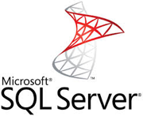

Efficient Dev / Test Environments
Give developers their own high performance environment
VM
clones
VM
clones or replicas
Benefit from a VM-centric approach to development and testing.
Quickly spin up local or remote VM clones for QA testing

Slide 37
Continuous Software improvements

Slide 38
Data Protection and Disaster Recovery

Slide 39




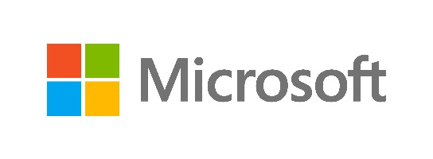


Nutanix Data Protection and Disaster Recovery
Complement app-native functionality
Hardware
Node
Data
App/VM
Site
Self-healing from disk failure
Redundancy of key components
Node failure resiliency
Non-disruptive upgrades
Tunable redundancy and Erasure coding
Transparent consistent checks
VM-centric Protection
HA & DRS
Eco-system integration (CommVault)
Multi-site replication
Cloud Connect
Metro Availability / Sync Replication

Slide 40
Nutanix Has You Covered
RPO
RTO
Nutanix Feature
Minutes
Minutes
Time Stream
Minor
incidents
Hours
Hours
Cloud Connect
Minutes
Minutes
Remote Replication
Major incidents
Zero
Minutes
Metro Availability

Slide 41
VM Centric Asynchronous Replication
Use Cases
  Protection against VM corruption/deletion
  Protection against complete site failure(s)
Protection Domain 1
Remote Site
Protection Domain 2
Remote Site
Location 1
Remote Site
Location 2
Protection Domain 2
Protection Domain 4
Protection Domain 3
  Points of differentiation
  Multiple DR topologies
  Multiple retention policies
  WAN optimized replication
  Rest API driven
  (customer DR runbooks)
  VM and application level consistency
Remote Site
Remote Site
Location 3

Slide 42
Synchronous Replication

Slide 43
Nutanix Cloud Connect
North Virginia
North California
Ireland
Tokyo
AWS
Cluster 1
AWS
Cluster 5
What is it
  Hybrid cloud solution from Nutanix
  Integration with Azure and AWS
AWS
Cluster 3
AWS
Cluster 4
AWS
Cluster 2
AWS
Cluster 5
Use Cases:
  Archiving
  Backup
  Points of differentiation
  Easy to setup and manage
  WAN optimized replication
  Interop with Nutanix DR portfolio
New York DC
Tokyo DC
One
Large Cluster
One
Large Cluster

Slide 44







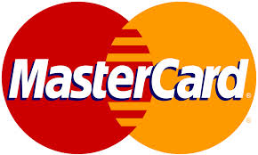



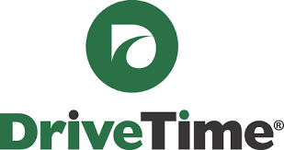











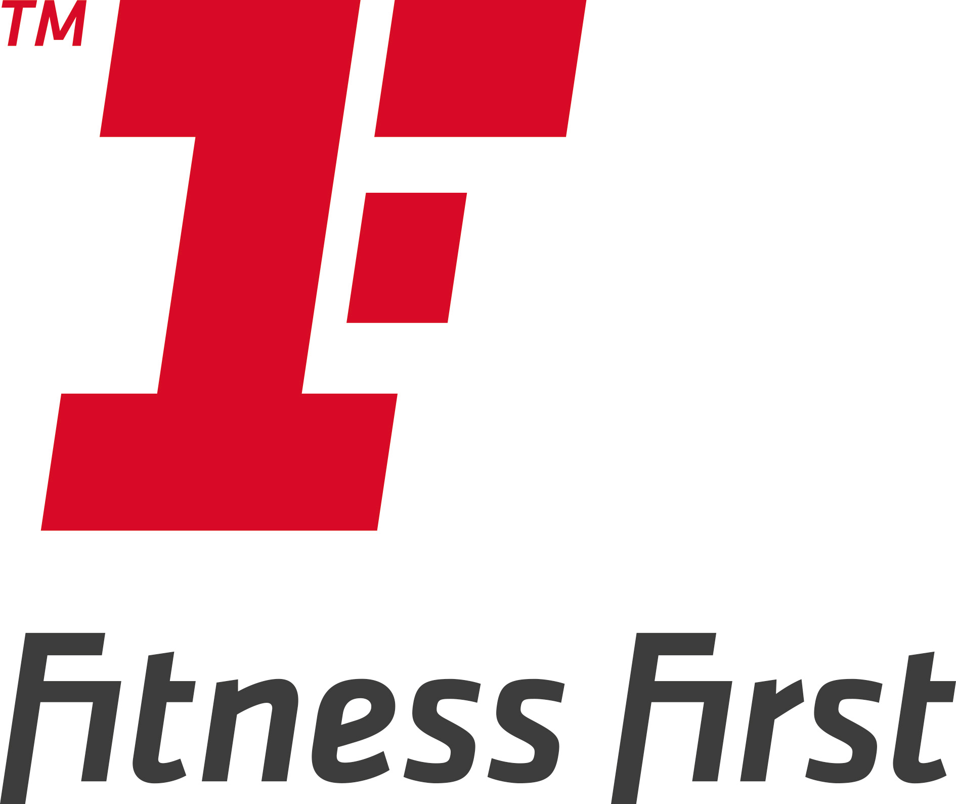













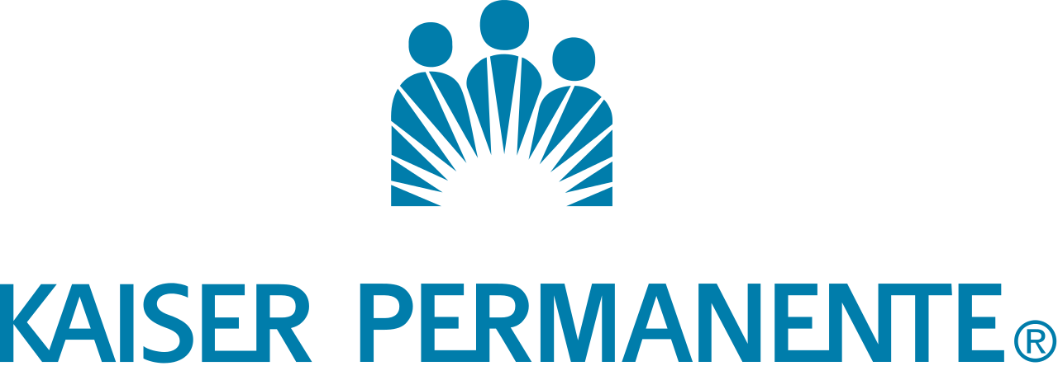




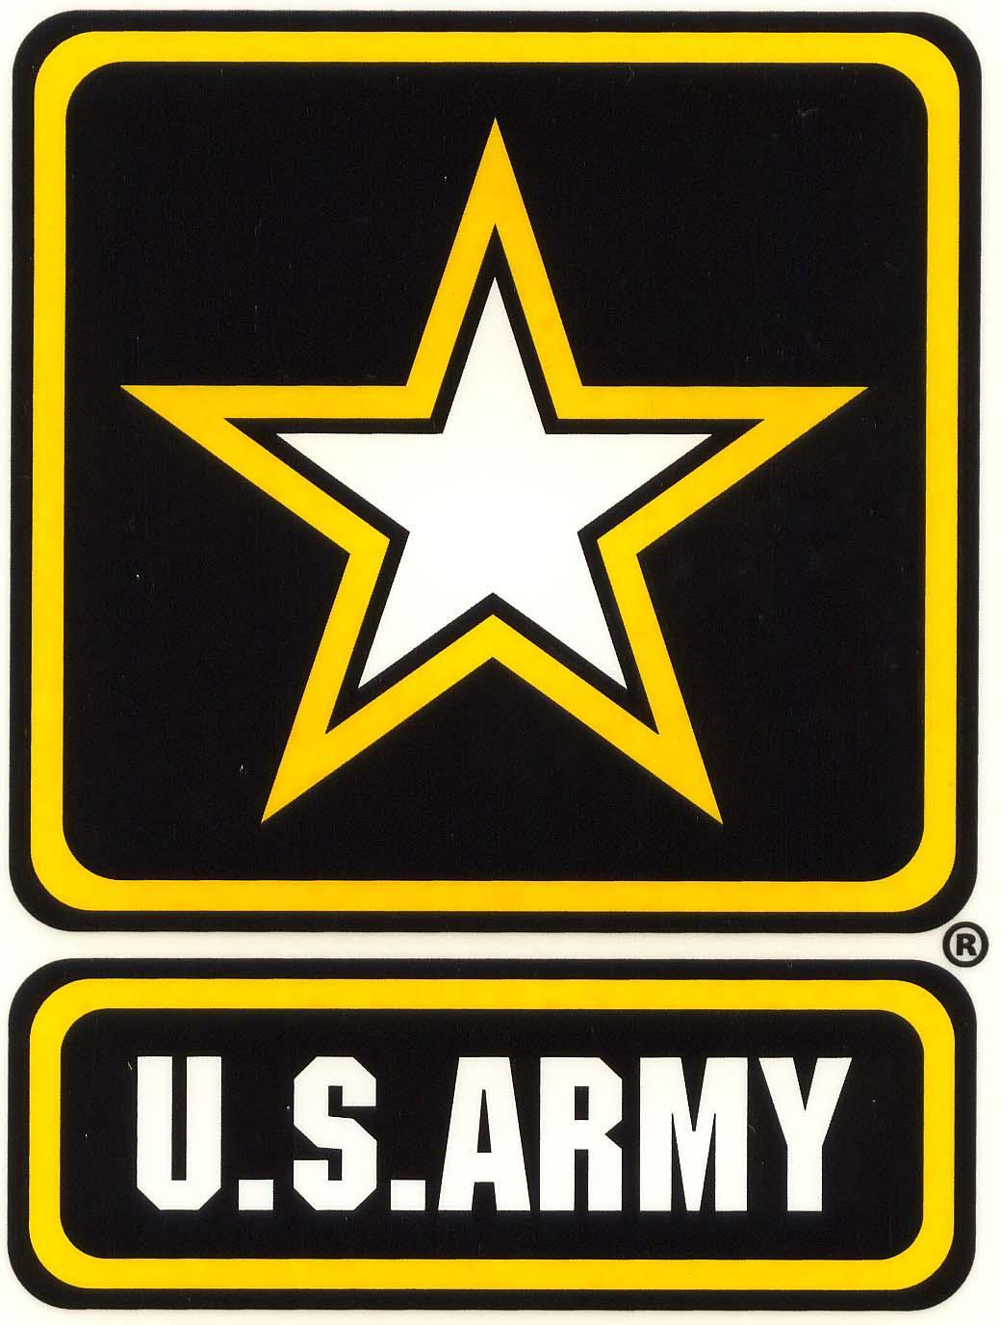




















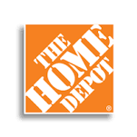






































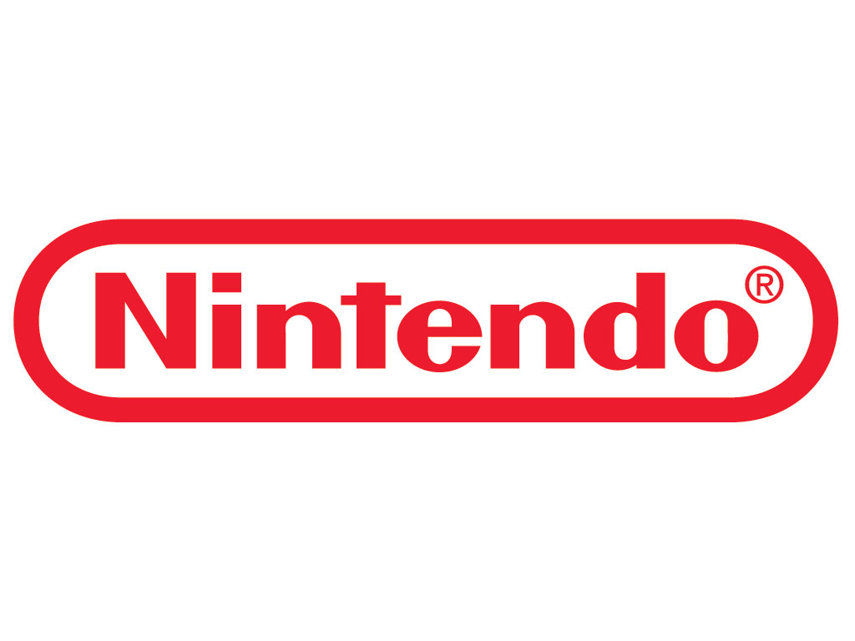



























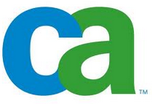










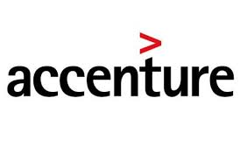




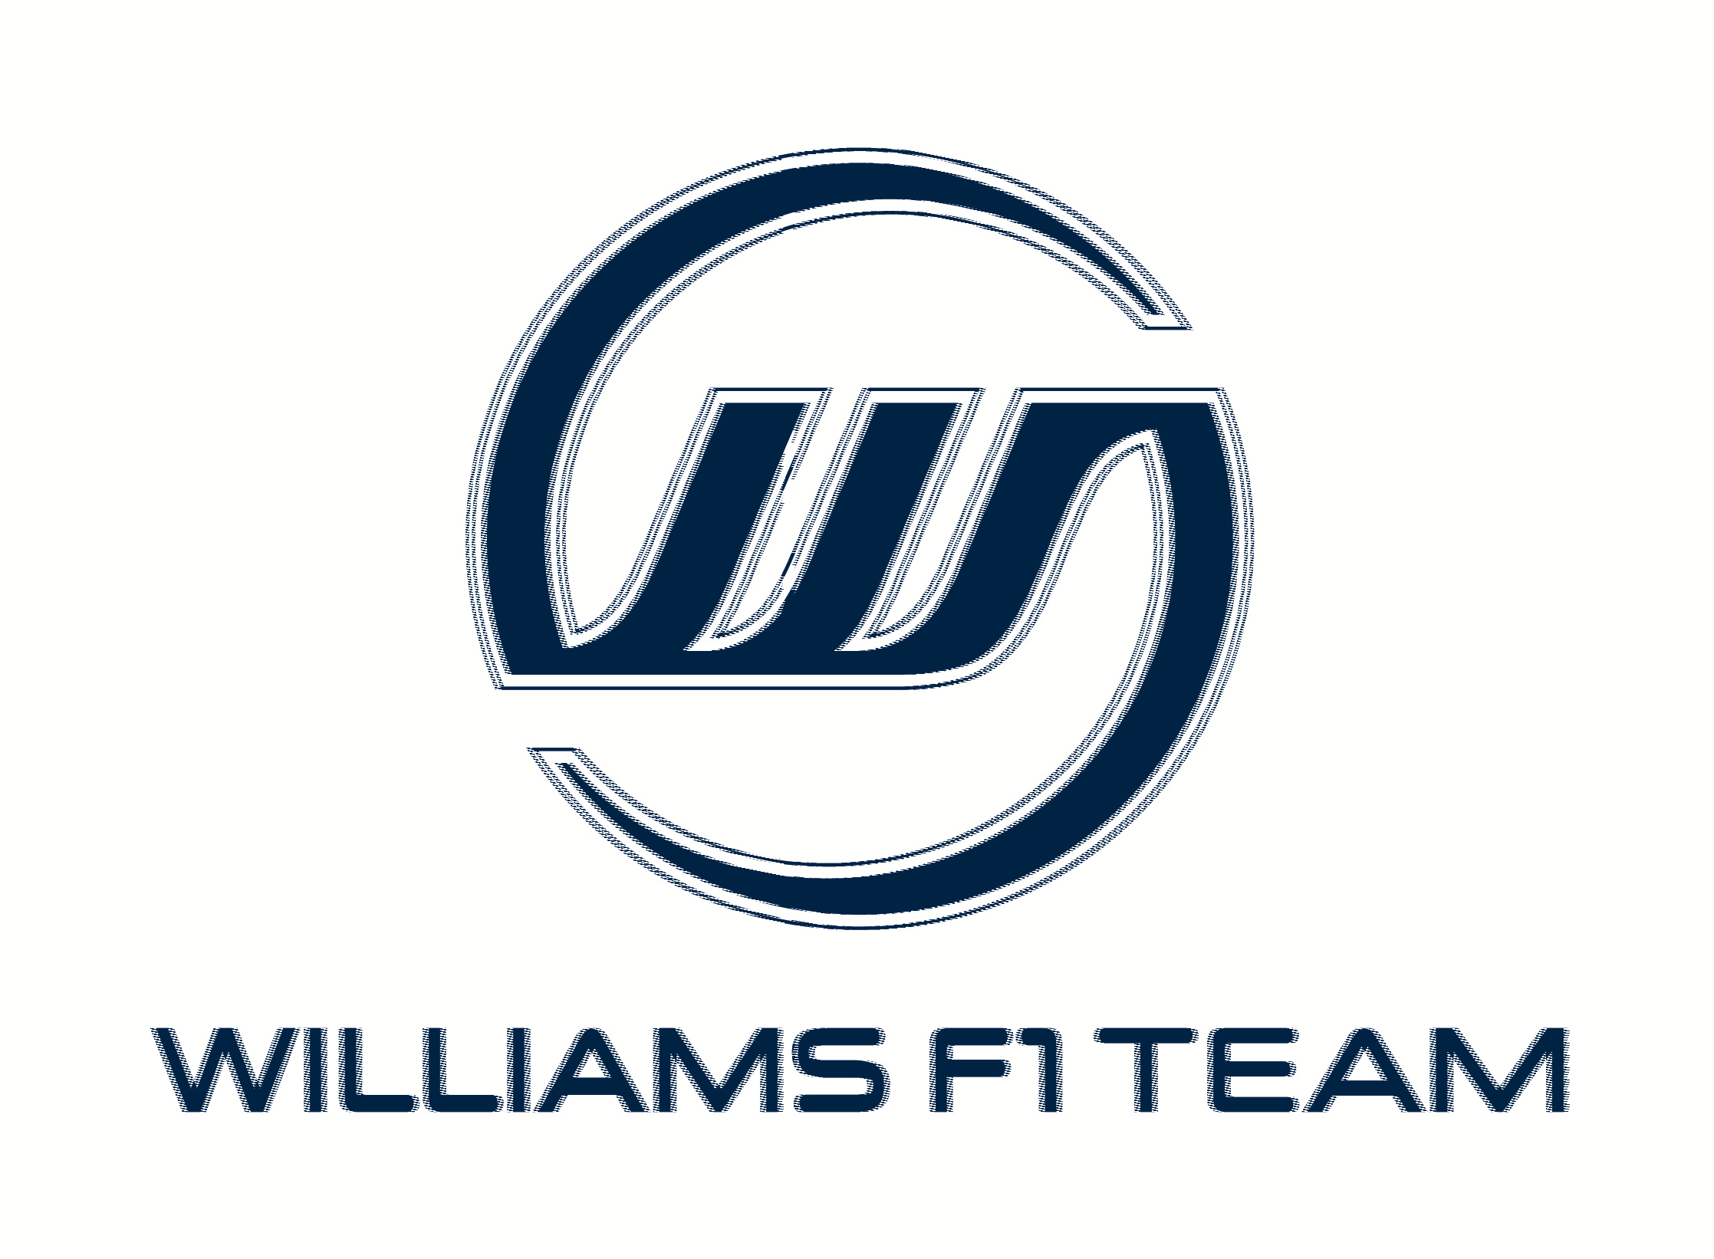
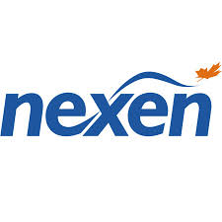




























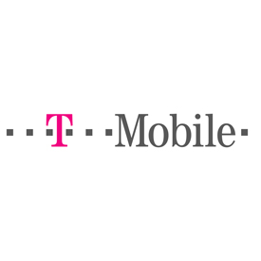









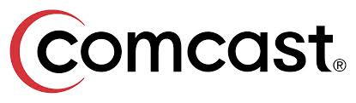
Broad Customer Adoption
Financial Services
Healthcare
Retail
Public Sector
Energy
Technology
Education
Manufacturing

Slide 45
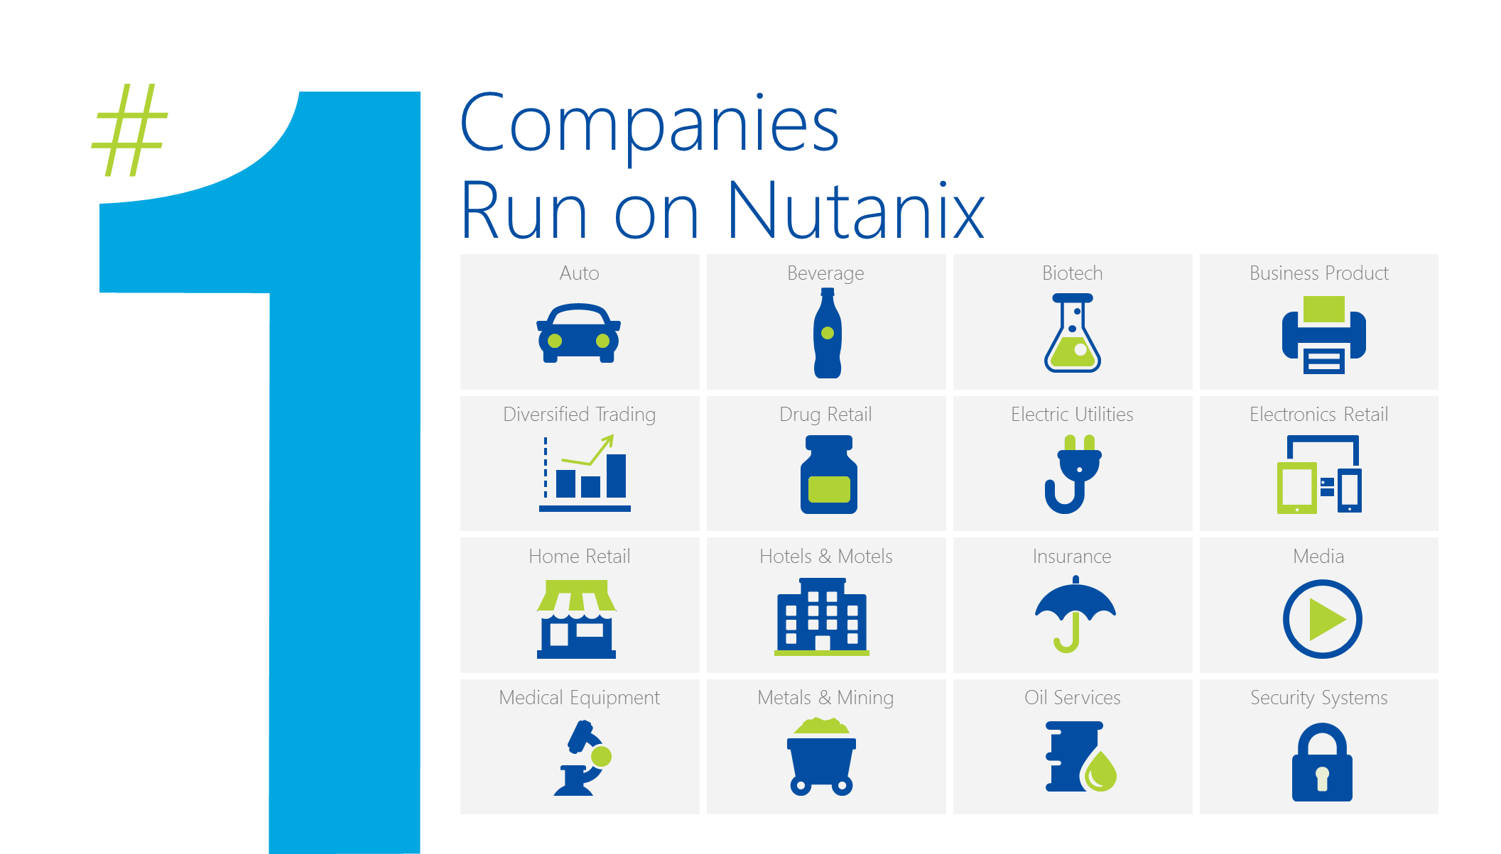

Slide 46
Q&A

Slide 47
Free IT Pro resources
To advance your career in cloud technology
Plan your
career path
Cloud role mapping
Expert advice on skills needed
Self-paced curriculum by cloud role
$300 Azure credits and extended trials
Pluralsight 3 month subscription (10 courses)
Phone support incident
Weekly short videos and insights from Microsoft’s leaders and engineers
Connect with community of peers and Microsoft experts
Microsoft IT Pro Career Center
www.microsoft.com/itprocareercenter
Get started
with Azure
Microsoft IT Pro Cloud Essentials
www.microsoft.com/itprocloudessentials
Demos and
how-to videos
Microsoft Mechanics
www.microsoft.com/mechanics
Connect with peers and experts
Microsoft Tech Community
https://techcommunity.microsoft.com

Slide 48


Please evaluate this session
Your feedback is important to us!
From your PC or Tablet visit MyIgnite at http://myignite.microsoft.com
From your phone download and use the Ignite Mobile App by scanning the QR code above or visiting https://aka.ms/ignite.mobileapp

