Slide 1
Dive into Scenarios and Customer Success Stories with Azure Storage
BRK2201
Andrew Chen and John Loveall
Azure Storage Program Management

Slide 2
Azure Storage Talks @ Ignite
Session ID | When/Where | Attend if you are interested in | Talk title
BRK2201 | Tuesday 9/27 10:45-12:00 C202 - C204 | Azure Storage Overview Storage Solutions: Backup and Recovery Hybrid Storage &Global Data Access | Dive into scenarios and customer success stories with Azure Storage
BRK3210 | Tuesday 9/27 12:30-1:45 B312 - B314 | Azure Object (Blob) Storage Overview Working with Blob Storage Blob Storage Design Patterns | Build tiered cloud storage in Microsoft Azure
BRK3209 | Wednesday 9/28 10:45-12:00 B312 - B314 | Overview, Deep Dive and roadmap for Azure Disks Azure Files | Optimize IaaS VM Storage using Azure Disks and Files
BRK3211 | Thursday 9/29 10:45-12:00 B304 - B305 | Azure Storage Security topics Control and data plane authorization Data Encryption – Client-side, in-transit and server-side | Secure your data in the cloud with Microsoft Azure Storage

Slide 3
Agenda
Azure Storage Primer
Azure Solutions Initiative
Backup and Disaster Recovery
Hybrid Storage and Global Data Access
Call To Action & References
Q & A

Slide 4
Azure Storage Primer

Slide 5
Current Storage Challenges
Business Can’t Move Forward
Scalability Limits
Risk Management
High Costs
(
)

Slide 6
Solving Storage Challenges with Azure
Limitless Scalability
Trusted
Cloud Economics
Business Agility

Slide 7
Azure Storage – Scale and Geo Reach
Scalability
Instantly grow
Near infinite capacity
  120 Trillion Objects stored
  19 Million Transactions/second
  120K new Subscriptions/month
Reach
Government and Sovereign Cloud options
Azure Stack
Regional coverage

Slide 8
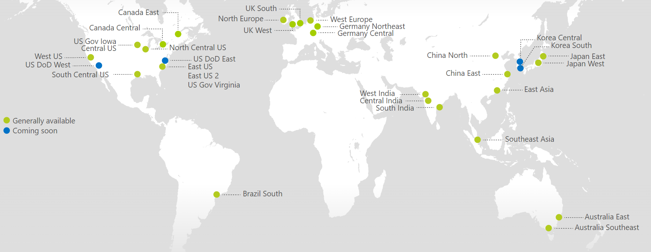
Azure Scale
30 GA, 4 coming soon – Storage is available in every region

Slide 9
Azure Storage - Trust
Resilient and Secure
Extreme durability
Data integrity protection
Tolerance against regional disasters
Data at Rest Encryption available
Trusted Leadership
Over 85% of Fortune 500 have Microsoft Cloud
Broad validation by industry analysts
Leading investments in compliance

Slide 10
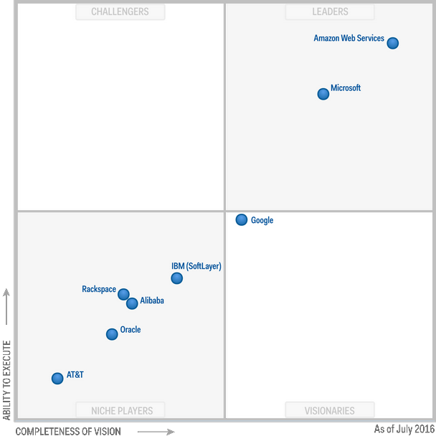
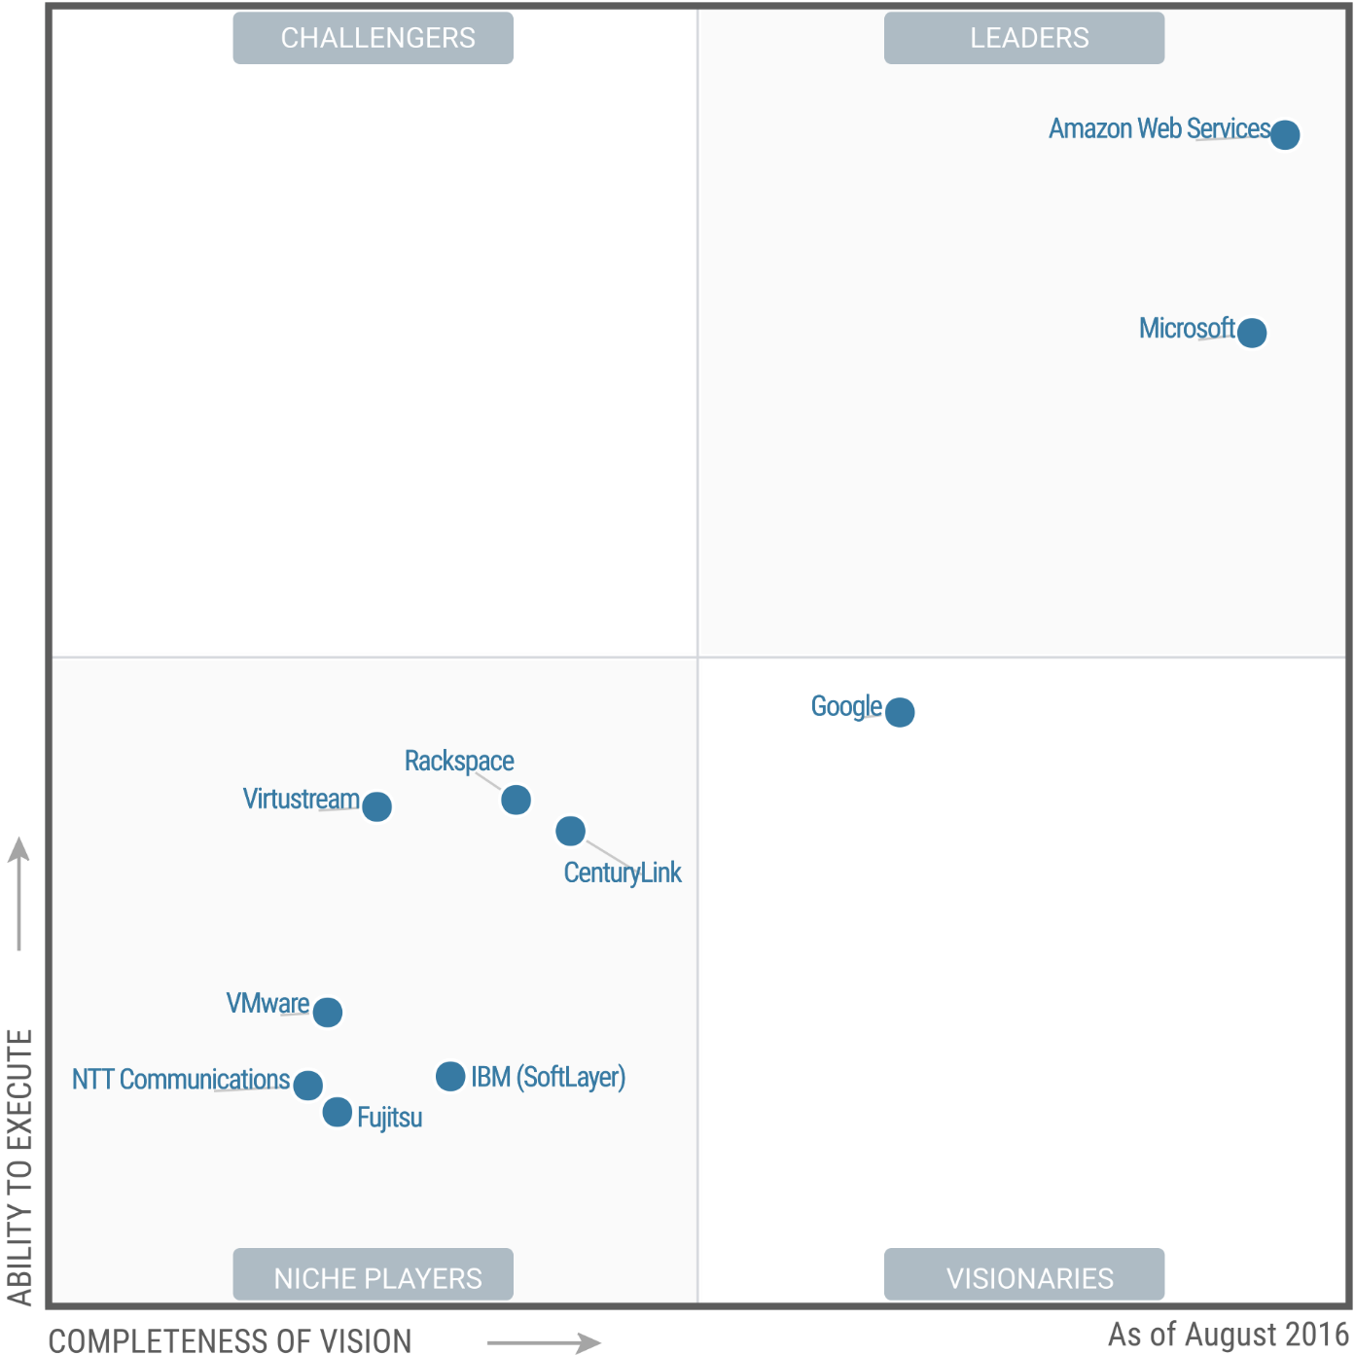
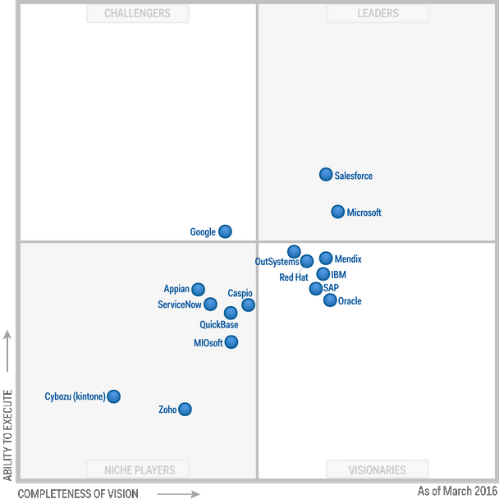
Recognized, Broad, Industry Leadership
Gartner Magic Quadrant for Public Cloud Storage Services, WW, 2016
Gartner Magic Quadrant for Cloud Infrastructure as a Service, WW, 2016
Gartner Magic Quadrant for Enterprise Application Platform as a Service, WW, 2016
The only Gartner MQ Leader across 3 key domains

Slide 11
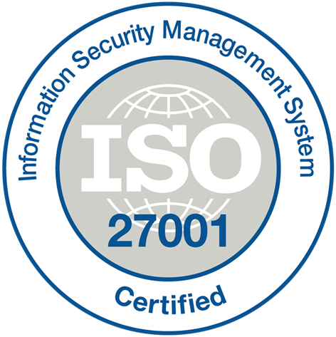



























Market Leadership in Compliance Coverage
ISO 27001
SOC 1 Type 2
SOC 2 Type 2
PCI DSS Level 1
Cloud Controls
Matrix
ISO 27018
Content Delivery and
Security Association
Shared
Assessments
FedRAMP
JAB P-ATO
HIPAA/
HITECH
FIPS 140-2
21 CFR
Part 11
FERPA
DISA Level 2
CJIS
IRS 1075
ITAR-ready
Section
508 VPAT
European
Union Model Clauses
EU Safe
Harbor
United Kingdom
G-Cloud
China Multi
Layer Protection
Scheme
China
GB 18030
China
CCCPPF
Singapore
MTCS Level 3
Australia
Signals
Directorate
New
Zealand
GCIO
Japan
Financial Services
ENISA
IAF

Slide 12
Azure Storage – Cloud Economics
Economic Benefits
Reduce business risk
Pay only for what you utilize
Always realize the current market price
Operational Benefits
No refresh or migration hassles
A fully managed service
Wide range of products and tiers

Slide 13
Azure Storage – Hybrid and Business Agility
Hybrid
Extend existing IT capabilities
Easily move workloads
Deploy tiered storage
Choice
Rich ecosystem of ISV Solutions
Azure Stack
IaaS, PaaS, and Services

Slide 14
Analyst Summary
Gartner Magic Quadrants | Leaders Quadrant
 | Microsoft | AWS
Application Development Lifecycle Management | ●
Business Intelligence and Analytics Platforms | ●
Cloud Infrastructure as a Service (IaaS), Worldwide | ● | ●
CRM Customer Engagement Center | ●
Data Warehouse and Data Management Solutions for Analytics | ●
Disaster Recovery as a Service (DRaaS) | ●
Enterprise Application Platform as a Service, Worldwide | ●
Enterprise Content Management | ●
Horizontal Portals | ●
Identity and Access Management as a Service, Worldwide | ●
Mobile App Development Platforms | ●
Operational Database Management Systems | ● | ●
Public Cloud Storage Services, Worldwide | ● | ●
Sales Force Automation | ●
Social Software in the Workplace | ●
Unified Communications | ●
Web Conferencing | ●
X86 Server Virtualization Infrastructure | ●

Slide 15
Azure Storage Services
IaaS
PaaS
Virtual
machines
Existing
frameworks
Web
and mobile
Microservices
Serverless
Compute
Storage
Networking
Disks
Persistent disks for Azure IaaS VMs
Premium Storage Disks option: SSD based, high IOPS, low latency
Files
Fully Managed File Shares in the Cloud
SMB and REST access
“Lift and shift” legacy apps
Objects
Highly scalable, REST based cloud object store
Block Blobs: Sequential file I/O
Cool Tier Available
Page Blobs: Random-write pattern data
Append Blobs
Tables
Massive auto-scaling NoSQL store
Dynamic scaling based on load
Scale to PBs of table data
Fast key/value lookups
Queues
Reliable queues at scale for cloud services
Decouple and scale components
Message visibility timeout and update message to protect against unreliable dequeuers
Built on a unified Distributed Storage System
Durability, Encryption at Rest, Strongly Consistent Replication, Fault Tolerance, Auto Load-Balancing

Slide 16
Azure Storage Solutions

Slide 17


The Dilemma
I understand the benefits of the cloud
I can’t give up existing features
I want to begin a journey
I can’t re-platform my workload
I don’t want to make new on-premises investments
How do I preserve my existing investments?

Slide 18


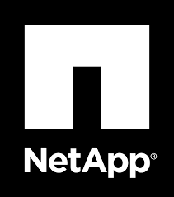
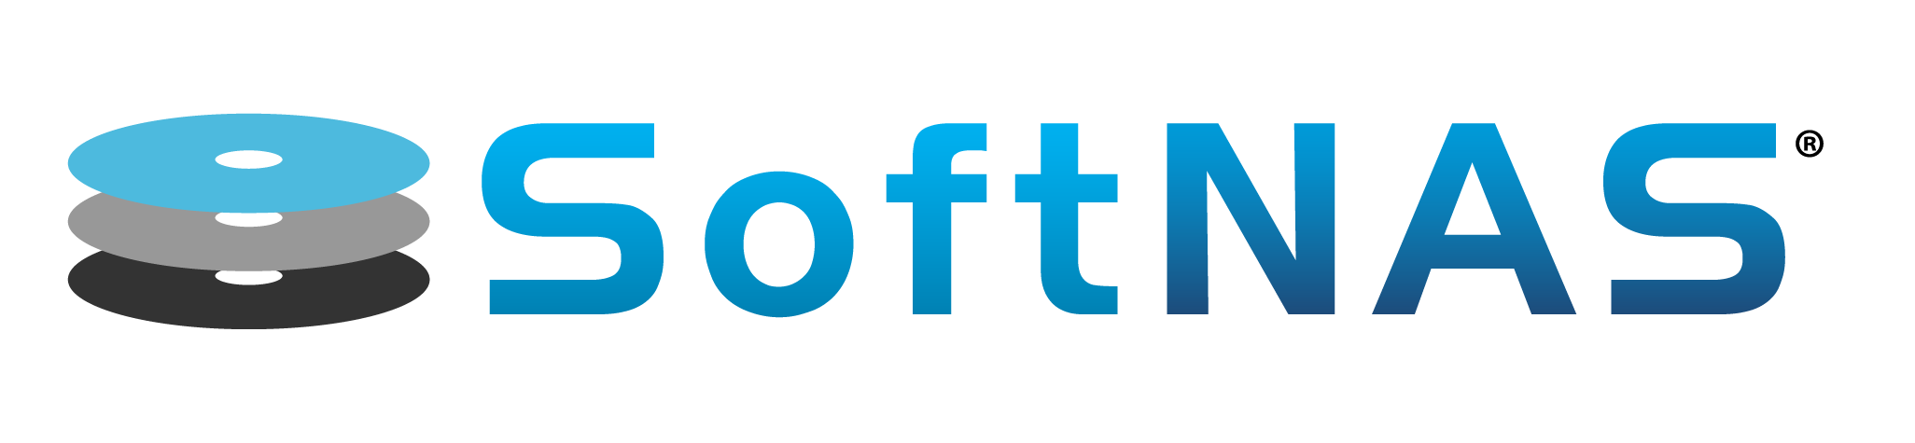






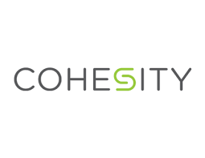



Azure Storage + ISV Offerings = Solutions
Azure Storage

Slide 19
Storage-Centric Customer Scenarios
Backup & Disaster Recovery
Enterprise Data Protection
Hybrid Storage and Global Data Access
Leveraging the cloud for enterprise file sharing

Slide 20



Backup and Disaster Recovery

Slide 21
Facing the cloud opportunity
My requirements are the same
  Protecting against data loss
  Meeting RPO and RTO objectives
  DR testing
  Moving backups and DR off-site
  Regulatory and retention policies
But I want to take advantage of the cloud
  Scalable, pay-as-you go storage
  Resilient, globally accessible backups
  DR in cloud or to alternate sites
  Centralized data management and analytics
My tools and processes work
I don’t want to reinvent everything
I have on-premises investments I need to use
I want to use my existing investments and the cloud

Slide 22
Solution Capabilities and Architecture
Backup
  On-premises data
  Cloud data and VMs
Target
  Object storage directly
  Virtual Backup Appliance
Disaster Recovery
  Recover workloads in the cloud
  Recover data to alternate sites
Migration
  Move data into the cloud
DR
Storage
DR

Slide 23






Featured Partner Solutions
Providing Backup and Disaster Recovery with Azure
Partner | Product Solution | Key Workloads
 | CommVault | Backup and DR, Workload and Data Migration, Endpoint Data Protection
 | Veritas NetBackup (in Beta) | Backup and DR, Workload and Data Migration, Endpoint Data Protection
 | HPE Data Protector (October 9.08 release) HPE VM Explorer (September 6.2 release) | Backup and DR
 | NetApp AltaVault NetApp AltaVault Cloud-Based Appliance | Backup and DR
 | EMC Isilon CloudPools EMC Avamar Virtual Edition EMC Data Protection Suite CloudBoost | Hybrid Storage Backup and DR Long-Term Retention
 | Veeam® Cloud Connect™ for the Enterprise Veeam® Cloud Connect™ for Service Providers Veeam® Direct Restore to Azure | Backup and DR, Workload and Data Migration, Endpoint Data Protection
 | Dell Rapid Recovery Replication Target for Azure | Backup and DR, Archiving
 | DatacastleRed | Endpoint Data Protection

Slide 24
Customer Case Study
Data Protection and Recovery
Commvault

Slide 25
Commvault and Microsoft
Leading Clients to the Cloud
Venkat Krishnamachari
Director, Product Management
Commvault Cloud BU

Slide 26














Power of the Data Management Platform
1
2
3
4
5
6
Open Standards
Self Service
Process Automation
Scalable Architecture
Secure Multi-tenancy
Reporting
Commvault Next Generation Data Management Platform
One Software
One Code
One Index
Virtual Machines
Physical
End-Point
Private Cloud
Hybrid Cloud
Public Cloud
Virtual
Commvault Content Store

Slide 27

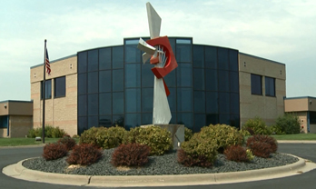
Innovative Systems – Overview
Microsoft environment 80 servers and growing
75% Virtualized with Microsoft Hyper-V
Microsoft SQL Server runs core business apps
Microsoft Office and Active Directory
.NET for Software Development
Microsoft Scale-Out File Server
Microsoft Azure

Slide 28





New Technology Dictated Operational Review
  Needed Multi-Platform Support Including Linux
  Needed Clustered Shared Storage Support
  Needed Hyper-V Backup and Protection
  Needed Backup to the Cloud and DR in the cloud
Private Cloud
Cloud
Copy
Encrypted & Deduplicated
Local Copy
Inc. Blob/Object
Value Benefits:
Primary storage savings
Short term tape savings
Storage efficiency
Better RTO
Long term complete tape replacement
Dedupe on Commodity Storage

Slide 29
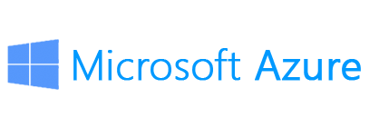

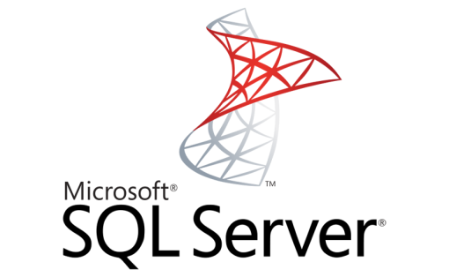


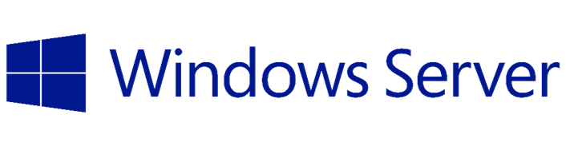

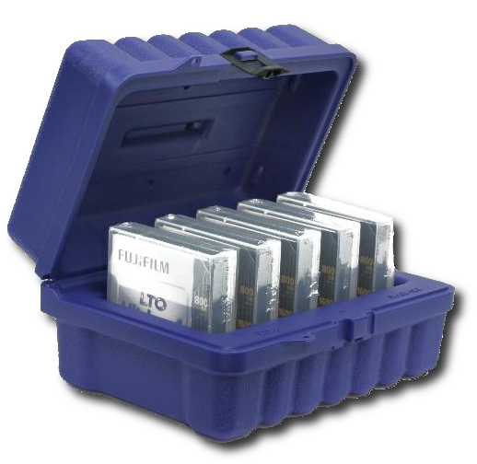
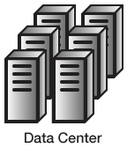

Accelerate Moving Data & Apps to Azure
Backup/Archive directly to Azure
Supports Block, Page & Cool storage
Use as primary or secondary storage
Maintains backup history across conversions
Full eDiscovery & searchability
Extend Datacenter to Azure
Recover apps and/or VMs directly into Azure
Data is already there ready to use
Full automation & integration with OMS/SCOM
Move on your Terms
Vmware to Hyper-V or Azure VM’s (DRaaS)
Protected, deduped & encrypted along the way
VM
VM
VM
Primary or
Secondary
Backup
Active DR
&
Migration

Slide 30
Vision Realized!
69TB (and growing) stored in Azure Cool Storage between 3 locations
Enabled 300% increase in retention and acceleration of recovery times from days to minutes
Realized >90% reduction in redundant data resulting in optimal resource utilization
Cloud storage eases the management of off-site vaulting
Cloud based DR now a realization

Slide 31
See how Commvault supports Microsoft Azure
At the conference
Visit us in our booth #1410
Listen to the Theater Session Today @1:35 in Theater 1 on the show floor.
Come to our presentation BRK2156 on 9/28 @ 2:15pm
Or on the web
Commvault Partners
Client Testimonial

Slide 32
Coming Soon
Data Protection and Recovery
Veritas

Slide 33


The Veritas Approach: Holistic Information Management
Business and IT Challenges
Dark Data Compliance Risk | Cloud Sprawl | Multi-Cloud Support | Information Growth | DevOps | IT Complexity
Information Management
Information Protection
Information Availability
Information Insight
Ensure data and apps are safe no matter where they travel
Ensure performance, uptime, resilience and scale
Reduce risk with visibility, control and governance
Heterogeneous Sources
On Premises | Hybrid Clouds | Structured Data | Unstructured Data | Open Source | Hyper Converged

Slide 34
Veritas Backup and Recovery with Microsoft Azure
Enterprise-class data protection for the Microsoft Hybrid Cloud
Easily integrate Azure storage with existing backup processes
Reduce or eliminate dependence on tape technologies
Unify data protection strategy across all workloads and storage targets
Automate storage tiering between on-prem and Azure storage
Quickly increase Azure storage capacity on-demand
License-free back end storage removes limits on Azure consumption
Restore process from Azure is identical to all other restore operations
Automate replication to Azure for disaster recovery and rehearsal
Deliver backup-as-a-service leveraging Azure cloud services
Maintain visibility of all data assets regardless of location, on-prem and within Azure
Uncover blind spots that may place data or the business at risk
Govern protection and retention of data across the Azure hybrid cloud
MAXIMIZE EFFICIENCY
CLOUD SCALABILITY
AGILE SERVICE
BROAD VISIBILITY

Slide 35
Veritas and Microsoft Azure Integration
NetBackup 8.0 Beta is now available (GA later this year)
  Includes Azure Storage connector
  Accelerator for Hyper-V
  Windows Server 2016 support
  Integration with StorSimple
BackupExec 16 Beta is now available (GA later this year)
  Includes Azure Storage Connector
  Windows Server 2016 & Hyper-V support
  Integration with StorSimple
Resources:
  https://www.veritas.com/solution/azure
  Solution Brief here
Visit us in Booth #621!

Slide 36
Coming Soon
Data Protection and Recovery
HPE

Slide 37
HPE Data Protector and VM Explorer
HPE Data Protector
HPE’s backup and recovery software and core data protection engine for heterogeneous environments
Supported in its 9.08 October release:
  Native integration with Microsoft Azure cloud to enable native backup and restore
  Integration via StoreSimple gateway to enable enhanced performance and data optimization for larger cloud backups
HPE VM Explorer
HPE’s low-cost, easy-to-use and reliable backup solution for Microsoft Hyper-V environments
Supported in its 6.2 release planned for the end of September:
  Native integration with Microsoft Azure to enable an easy offsite backup and archive repository
Visit HPE in booth #1501

Slide 38

Hybrid Storage and Global Data Access

Slide 39
Facing the cloud opportunity
My requirements are the same
  Access protocols (file, block)
  Throughput and latency
  Shared access and collaboration
  Snapshot and cloning capabilities
  Advanced security
But I want to take advantage of the cloud
  Global data access
  Scalable, pay-as-you go storage
  Centralized backups
  Centralized data management and analytics
Our existing user experience and workflow works
I don’t want to retrain our workforce
I have on-premises investments I need to use
I want to use my existing investments and the cloud

Slide 40
Solution Capabilities and Architecture
File or Block Access
Global Repository
  Allows consolidation and centralization of data into the cloud
Accessible Anywhere
Edge Caching
  Appliance (virtual or physical) in a location provides caching to address WAN throughput and latency issues
Global File Locking
  For collaboration and workloads requiring concurrent access
Enhanced Security
  AD/AAD, Encryption at Rest
Storage

Slide 41


Featured Partner Solutions
Hybrid Storage and Global Data Access with Azure
Partner | Product Solution | Key Differentiators
 | Enterprise File Service | SMB/NFS, global file sharing/locking, global deduplication and compression, Extensive Snapshot Capabilities, Replication
 | Panzura Global NAS Appliance | SMB/NFS, global file sharing/locking, Compression and Deduplication, Extensive Snapshot Capabilities
 | CloudFAST | SMB, global file sharing/locking, intelligent file caching
 | SoftNAS Cloud NAS | Unified storage (iSCSI, SMB/NFS), Deduplication and Compression, Extensive Snapshot/Cloning Capabilities, Replication
 | CloudArray CloudPools | iSCSI, SMB, NFS, Deduplication and Compression
 | DataPlatform | SMB, NFS, global data deduplication, snapshots, replication
 | Cloud Storage Gateway | SMB, NFS, AFP, FTP, WebDAV, rsync, iSCSI, CTERA Mobile, CTERA Sync desktop application, web browser

Slide 42
Customer Case Study
Hybrid Storage and Global Data Access
Nasuni

Slide 43

The Field Museum: Preserving the World’s Genetic Biodiversity with Nasuni File Services and Azure
John Capello
VP, Product Strategy
Nasuni

Slide 44


The Field Museum of Natural History
Founded in Chicago in 1893, it is the fourth largest natural history museum in the world
30 million artifacts and specimens in their growing collection
Protected 10MM acres of rainforest in 2015
“Inspiring curiosity about life on earth for more than a century”

Slide 45
The challenges

Slide 46
Four file management challenges
Create a digital archive of the Museum’s collection
  Over 30 million artifacts and specimens which need to be categorized and digitally preserved in a range of file types (DNG, spectrometry) and sizes from 10MB-100GB
Manage explosive growth of genetic data
  25,000 genes sequenced from thousands of species each year; gene assembly can result in potentially 100X storage footprint increase from initial sequence data
Improve existing data protection
  Add geo-redundancy and ease of management for file restores
Increase IT agility of small staff
  Rob Zchernitz, CTO and his staff of nine must manage three year growth without increasing the physical footprint of on-premise data center which would take from revenue-producing exhibit space

Slide 47
An integrated solution

Slide 48


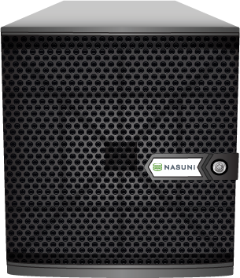

Nasuni File Services, backed by Azure
Version Timeline
Nasuni
Operations Center
Nasuni Management Console
Nasuni Mobile
Security Perimeter
Caching Appliance
48

Slide 49
The benefits

Slide 50
Scalability and Geo-Redundancy
  The Field Museum is able to expand to 150TB by 2018, without changing local footprint
  Capacity can be expanded on-demand which works with unpredictable funding from grants outside of traditional capital planning cycles
  With GRS, 6 copies of their data and geo-redundancy integrated into solution.

Slide 51
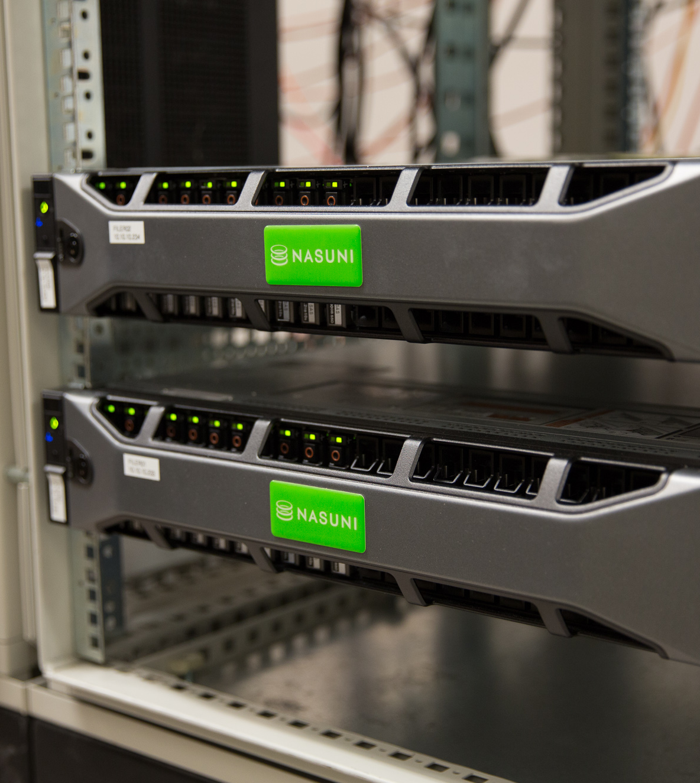
Burstable Local Performance
  Edge appliances can handle large bursts of ingestion when staff temporarily increases from 500 to almost 2000 with the addition of hundreds of interns and volunteers
  Edge appliances are sized for demands of ingestion of two challenging workloads – thousands of large digital image files (>100MB each) and millions of small genetic data files (<10K each)

Slide 52
Integrated Data Protection
  Immediate file and folder restores available from an unlimited version stream
  File and folder restores can be self-service and made available to end user
  With UniFS, they have a continuously versioned file system which can be DR’ed in under 15 minutes

Slide 53
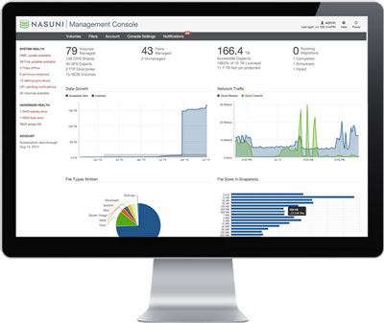
Increase IT agility
  Nasuni’s single pane of glass management console enables current IT staff to manage exponential growth of file system and an unlimited number of endpoints, filers or mobile devices
  No one outside of IT staff notices latency. In fact, some have reported that file access is faster now than it was on the previous systems

Slide 54
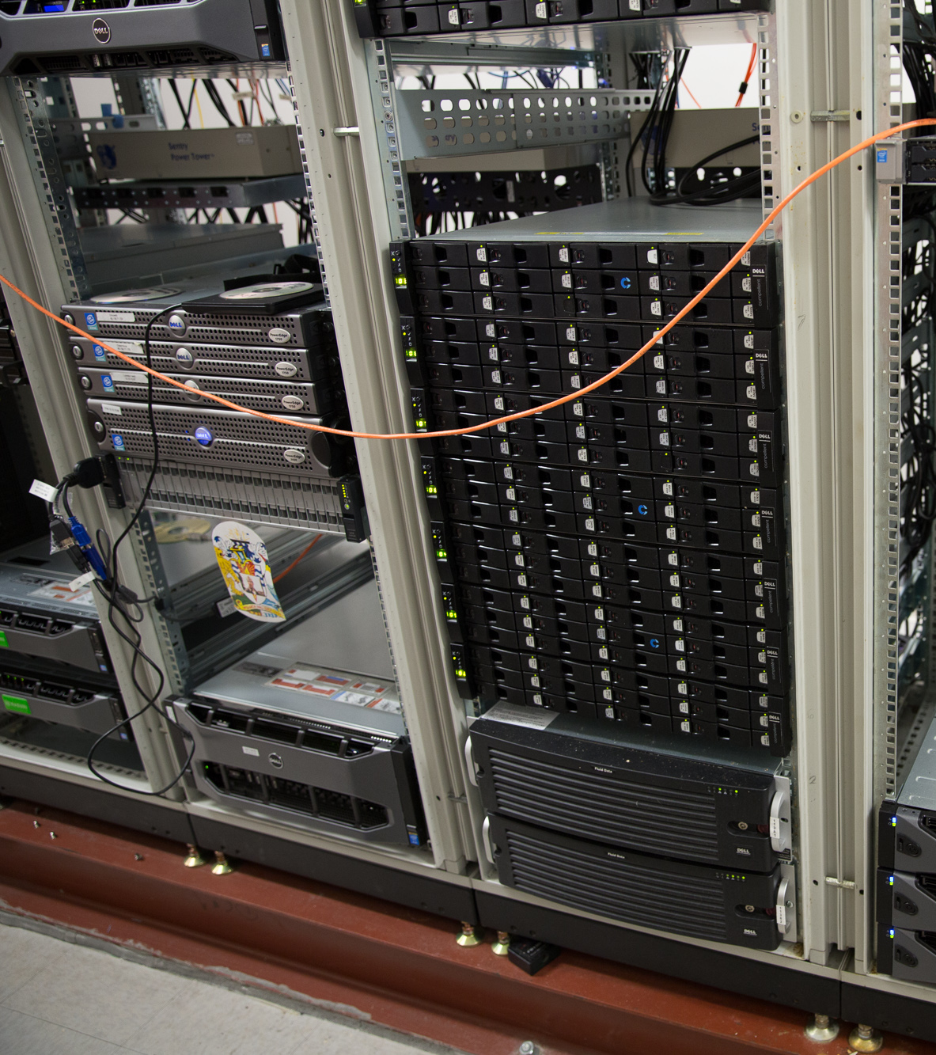
The first 10TB

Slide 55
…the next PB

Slide 56
Azure Storage + ISV Offerings = Solutions
Azure Storage

Slide 57
Call to Action
Understand your storage scenarios and requirements
  Backup and Disaster Recovery
  Hybrid Storage and Global Data Access
Investigate cloud solutions from your current partners
  Azure storage solutions partners can allow you to maintain your infrastructure investment
Pick a project and do a Proof of Concept trial
  Azure storage and partners are enabling simple PoC trials
Use your data in the cloud as a base for cloud workloads
  Data movement is the most common starting point for overall datacenter migration to the cloud

Slide 58

Azure Storage Related Sessions, Links, & Partner Booths
Azure Storage Sessions
  Dive into scenarios and customer success stories with Azure Storage Tue 10:45 BRK2201 C202 - C204
  Customer case studies: Innovative Systems (Commvault), The Field Museum (Nasuni)
  Build tiered cloud storage in Microsoft Azure Tue 12:30 BRK3210 B312 - B314
  Customer case studies: Seminole County Public Schools (Netapp), Woodard & Curran (Panzura), CarMax
  Optimize IaaS VM Storage using Azure Disks and Files Wed 10:45 BRK3209 B312 - B314
  Customer case study: Robert Bird Group (Talon)
  Secure your data in the cloud with Microsoft Azure Storage Thu 10:45 BRK3211 B304 - B305
Azure Product Sessions
  Deploy Microsoft Azure StorSimple across your enterprise Fri 12:30 BRK2148 B405 - B407
  Back up born-in-the-cloud and hybrid applications with Operations
  Management Suite and Azure Backup Tue 10:45 BRK3063 C302
Partner Sessions
Simplify and enhance Windows and Azure heterogeneous data management (Commvault) Tue 1:35 THR2061 Expo Theater 1
Protect Windows 2016 with Veritas and Microsoft Azure Wed 11:35 THR2206 Expo Theater 5
Reinvent disaster recovery leveraging Microsoft Azure cloud infrastructure (Commvault) Wed 2:15 BRK2156 B216 - B217
Useful Azure Storage Resources
Documentation http://Aka.ms/AzureStorageDocs
StackOverFlow user forum http://Aka.ms/AzureStorageStackOverflow
MSDN user forum http://Aka.ms/AzureStorageMSDNForum
Azure Storage Feedback email AzureStorageFeedback@microsoft.com
Partner Booths
Commvault Booth #1410
Veritas Booth #621
Veeam Software Booth #1304
Dell Software Group Booth #1210
NetApp Booth #427
HPE Booth #1501

Slide 59
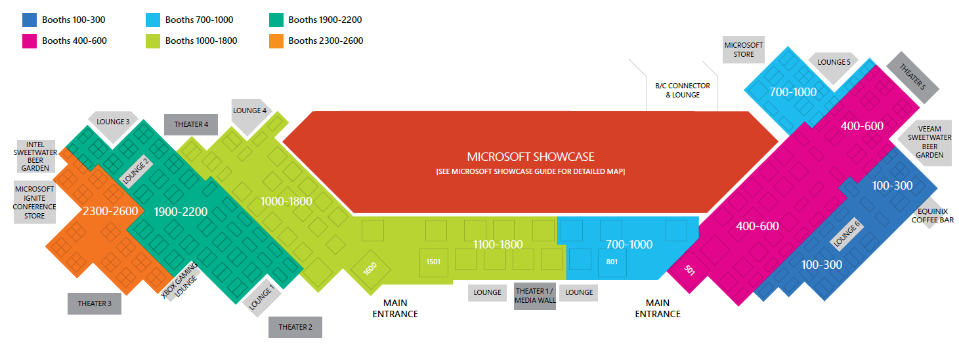
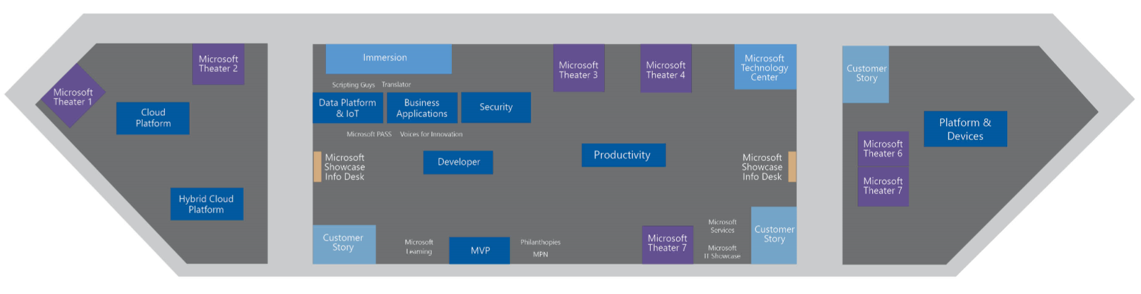
Visit us at the Microsoft Showcase
Bring your top questions and challenges to the Microsoft Showcase in the Expo, where you can explore you organization’s opportunities in focused conversations with Product Experts for all of Microsoft’s products and services at over 150 product demos.
Microsoft Showcase hours
Tuesday, September 27 | 10:00 AM – 6:00 PM
Wednesday, September 28 | 10:00 AM – 6:00 PM
Thursday, September 29 | 10:00 AM – 4:00 PM

Slide 60


Please evaluate this session
Your feedback is important to us!
From your PC or Tablet visit MyIgnite at http://myignite.microsoft.com
From your phone download and use the Ignite Mobile App by scanning the QR code above or visiting https://aka.ms/ignite.mobileapp

Slide 61
Free IT Pro resources
To advance your career in cloud technology
Plan your
career path
IT Pro Career Center
http://www.microsoft.com/itprocareercenter
Get started
with Azure
IT Pro Cloud Essentials
https://www.microsoft.com/itprocloudessentials
Demos and
how-to videos
Microsoft Mechanics
https://www.microsoft.com/mechanics
Connect with peers and experts
Ask questions, get answers, exchange ideas
https://techcommunity.microsoft.com
Azure Solutions
Get started with Azure Solutions today
http://azure.com/solutions
Azure monthly webinar series
Join live or watch on-demand
http://aka.ms/AzureMonthlyWebinar

Slide 62
Free IT Pro resources
To advance your career in cloud technology
Plan your
career path
Cloud role mapping
Expert advice on skills needed
Self-paced curriculum by cloud role
$300 Azure credits and extended trials
Pluralsight 3 month subscription (10 courses)
Phone support incident
Weekly short videos and insights from Microsoft’s leaders and engineers
Connect with community of peers and Microsoft experts
Microsoft IT Pro Career Center
www.microsoft.com/itprocareercenter
Get started
with Azure
Microsoft IT Pro Cloud Essentials
www.microsoft.com/itprocloudessentials
Demos and
how-to videos
Microsoft Mechanics
www.microsoft.com/mechanics
Connect with peers and experts
Microsoft Tech Community
https://techcommunity.microsoft.com

