Slide 1
Build Angular 2 Apps with TypeScript and Visual Studio Code
John Papa
Principal Architect
@john_papa

Slide 4
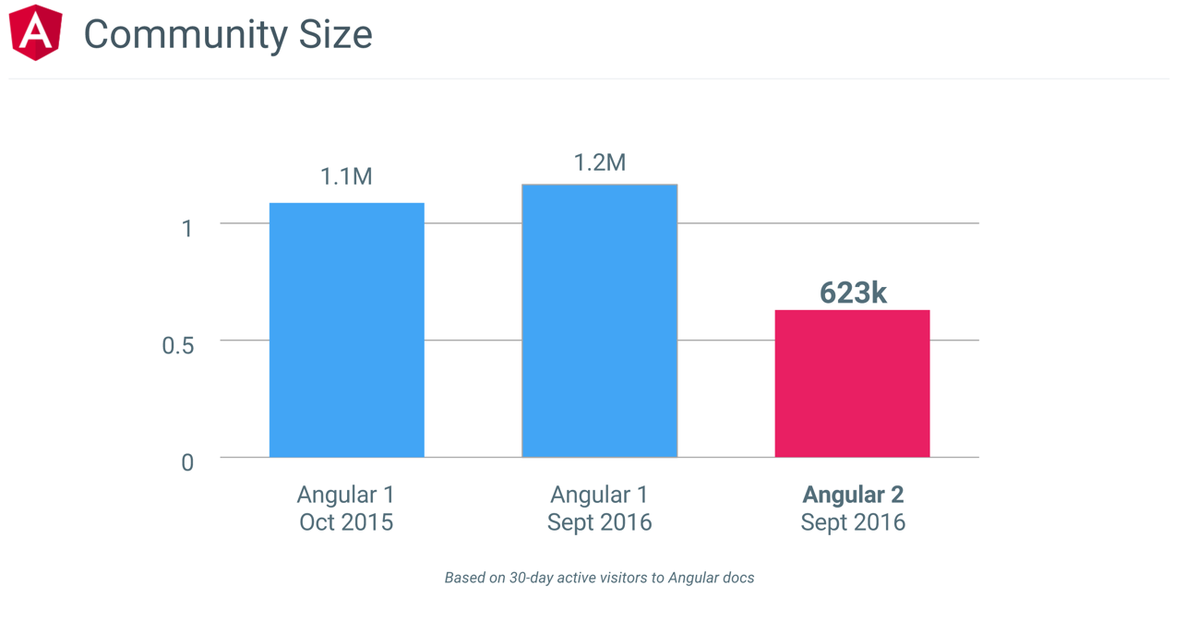
According to metrics the Angular Team measures

Slide 6
Deliver Optimized and Smaller Code to the Client
Minified
Tree
Shaking
Remove unused code
Offline Compilation
Compile templates on the server
Our App

Slide 7
Angular

Slide 8
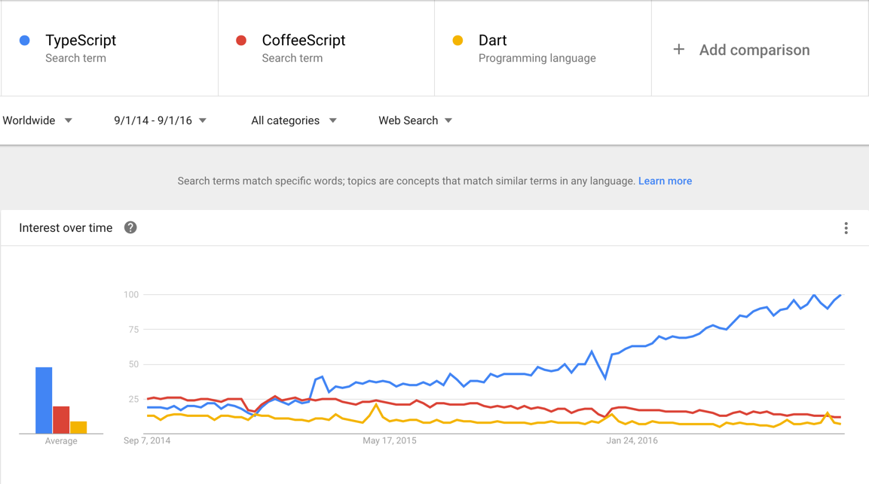
TypeScript

Slide 9
Angular 2 with TypeScript in VS Code

Slide 10
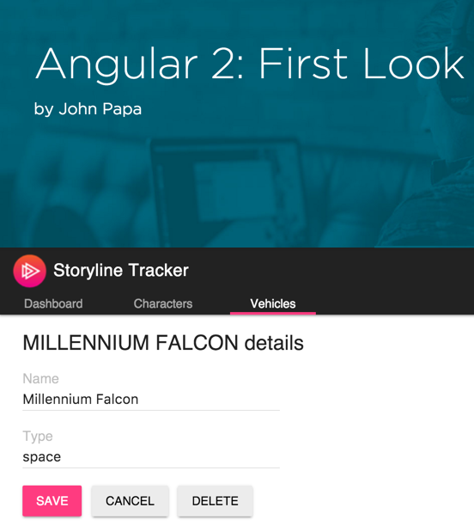
John Papa @john_papa Google Developer Expert MS Regional Director and MVP Pluralsight Author Angular Style Guide & Tour of Heroes
http://jpapa.me/a2ps1stlook

Slide 11
Language Choices

Slide 12
Coding Angular 2
ES5
ES6/ES2015+
TypeScript

Slide 13
Angular uses Familiar Concepts

Slide 14
Familiar Concepts
Services
Components
HTTP
Events
Data Binding

Slide 15
Components
A Component contains application logic that controls a region of the user interface that we call a view.

Slide 16
Anatomy of a Component
Imports (use other modules)
Metadata (describe the component)
Class (define the component)

Slide 17
Assembling our App from Components
App Component
Header Component
Nav
Component
Content Component
Footer Component

Slide 18
Bootstrapping a Component
main.ts
Entry point for the app
This is where we start

Slide 19
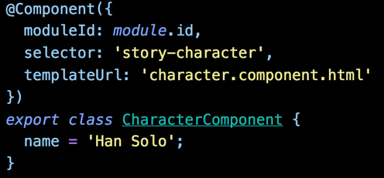
story.component.ts
Component has logic
story.component.html
What is rendered
Where the component is placed
index.html

Slide 20
story.component.ts
Component has logic
story.component.html
What is rendered
Where the component is placed
index.html

Slide 21
Components
Demo

Slide 22
Templates
Templates are mostly HTML, with a little help from Angular. They tell Angular how to render the Component

Slide 23
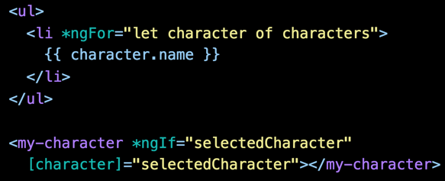
Templates
Directives (e.g. *ngFor)
Interpolation
Nested Component
HTML
Directives, as needed
Template Binding Syntax

Slide 24
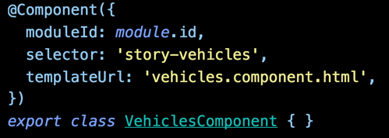
Linked Templates
Template Url
templateUrl links the Component to its Template

Slide 25
Components have templates, which may use other components

Slide 26
Metadata
We use Metadata to tell Angular about the objects we build.

Slide 27
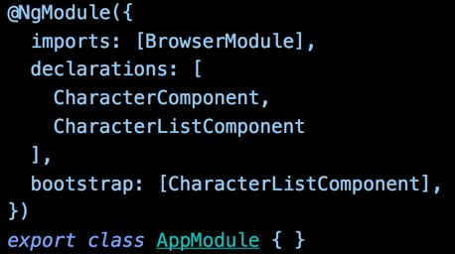
Declaring Components
app.module.ts
Declare these to our app
We tell Angular what <my-character-list> and <my-character> are
BrowserModule includes CommonModule
Built-in directives like *ngFor and ngClass are in CommonModule

Slide 28
Examining a Component and its Metadata

Slide 29
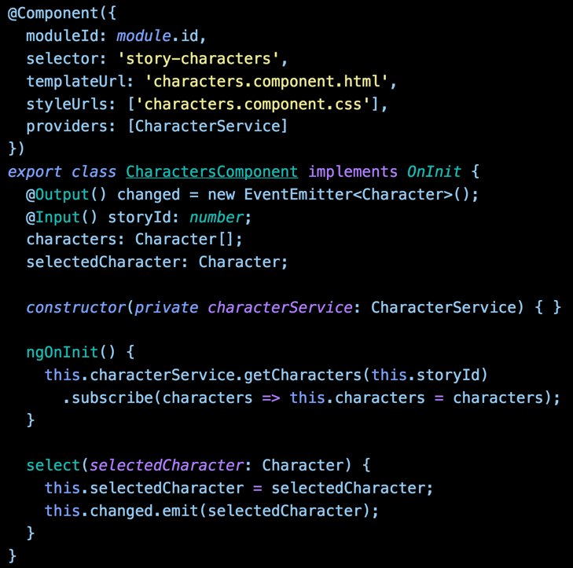
Decorators
The @ is a decorator that provides metadata describing the Component
Component
Component definition class. Controls a patch of screen real estate that we call a View

Slide 30
Template and Styles
Tells the Component where to find them.

Slide 31
Providers
These services will be registered with this component’s injector. Only do this once.
Generally, prefer registering providers in angular modules to registering in components.

Slide 32
Injection
Inject a Service into another object.

Slide 33
Properties
Component exposes properties that can be bound to its Template

Slide 34
Actions
Functions can be exposed, bound and called by the Template to handle events

Slide 35
Components Templates Metadata
Demo

Slide 36
Data Binding
We use data binding to help coordinate communication between a Component and its Template.

Slide 37
{{expression}}
Interpolation
[property] = “expression”
One Way Binding
(event) = “statement”
Event Binding
DOM
Component
[(ngModel)] = “property”
Two Way Binding

Slide 38
Data Binding Communication
Template
Property
Binding
Event
Binding
Metadata
Component

Slide 39
Angular 2’s change detection is based on unidirectional data flow

Slide 40
Benefits of Angular 2’s Unidirectional Data Flow
Easier 3rd party widget integration
No more $apply
No more repeated digest cycles
No more watchers
No more performance issues with digest cycle and watcher limits

Slide 41
Interpolation
One Way In
Evaluate an expression between double curly braces
{{ expression }}

Slide 42
Property Binding
Using the [ ] to send values from the Component to the Template

Slide 43
Property Binding
One Way In
Element property
Component property
Directive property
[property]=“expression”
Bind to element, Component or a directive property

Slide 44
We set properties and events of DOM elements, not attributes

Slide 45
Event Binding
Using the ( ) to send events from the Template to the Component

Slide 46
Event Binding
One Way to the Component
Element event
Component event
Execute an expression when an event occurs
(event-target)=“statement”

Slide 47
Two Way Binding
[( )] sends a value from Component to Template,
and sends changes in the Template to the Component

Slide 48
Two Way Binding
Value in, Value Out
Built-in directive
[( )] = Football in a box

Slide 49
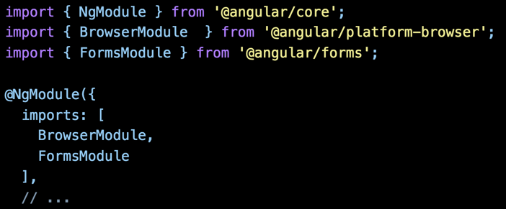
Using ngModel
Importing the FormsModule
Import FormsModule
Import into the Angular module
Import FormsModule
Add it to the Angular module’s import list

Slide 50
Data Binding
Template
Demo
Component

Slide 51
Built-In Directives
When Angular renders templates, it transforms the DOM according to instructions from Directives

Slide 52
*ngIf
Conditional Template
Show template if truthy
Conditionally removes elements from the DOM
Structural directive
Use [style.visibility]=“isVisible()” to hide

Slide 53
*ngFor
Repeating a Template
Iterate over the characters
Local variable
Structural directive
Show an element n number of times
let declares a local variable

Slide 54
Using Built-In Directives
Importing the CommonModule
Import BrowserModule
Import into the Angular module
BrowserModule imports CommonModule
Import and add it to the Angular module’s import list

Slide 55
Built-In Directives
Demo

Slide 56
Angular Modules
We use NgModule to organize our application into cohesive blocks of related functionality

Slide 57
An Angular Module is a class decorated by @NgModule

Slide 58
Roles of Angular Modules
Import other Angular Modules
Identify Components, Pipes, and Directives
Export its features
Provide services to injectors
Can be eagerly or lazily loaded

Slide 59
Every app begins with one Angular Module

Slide 60
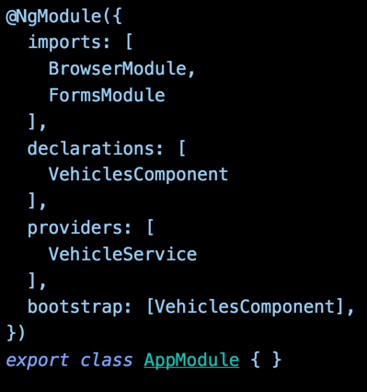
The Root Angular Module
Import modules we depend on
Declare components, directives, pipes
Provide services to app root injector
Bootstrap a component
Class to define the NgModule

Slide 61
NgModule
Demo

Slide 62
Services

Slide 63
Services
Angular 1
Angular 2
Factories
Services
Providers
Class
Constants
Values

Slide 64
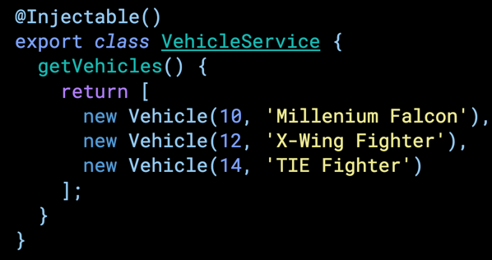
Service
vehicle.service.ts
A Service is simply a class
Provides something of value
Shared data or logic
e.g. Data, logger, exception handler, or message service

Slide 65
Injecting a Service into a Component
vehicle.component.ts
Injecting VehicleService
Locates the service in an Angular injector
Injects the service into the constructor

Slide 66
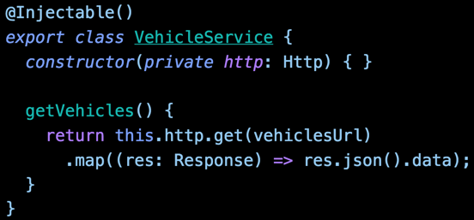
Injecting a Service into a Service
vehicle.service.ts
Provides metadata about the Injectables
Injecting http
Same concept as injecting into a Component

Slide 67
We need to provide the service to an Angular injector

Slide 68
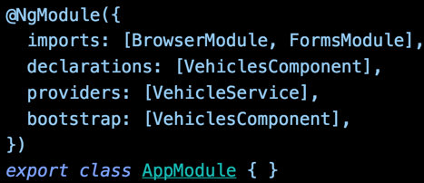
Providing a Service
in Angular 2
The Service is now available in the root application injector

Slide 69
When we inject a service, Angular searches the appropriate injectors for it
Component
constructor(HeroService )
VehicleService
Injector
StoryService
VehicleService
ErrorService
LoggerService
{ }
{ }
{ }
{ }

Slide 70
We have an injector for the application root (in AppRootModule)

Slide 71
We have a tree of injectors that parallel an application's component tree

Slide 72
So where do we set the providers?
In the Component or an Angular Module?

Slide 73
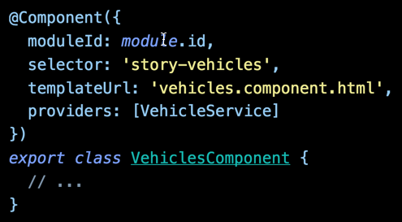
vehicles.component.ts
app.module.ts
Providing to Component
Providing to NgModule
Prefer registering providers in Angular Modules

Slide 74
Services and Injectors
Demo

Slide 75
Http
We get and save data with Promises or Observables

Slide 76
Http Step by Step
Import HttpModule
Call Http.get in a Service and return the mapped result
Subscribe to the Service’s function in the Component

Slide 77
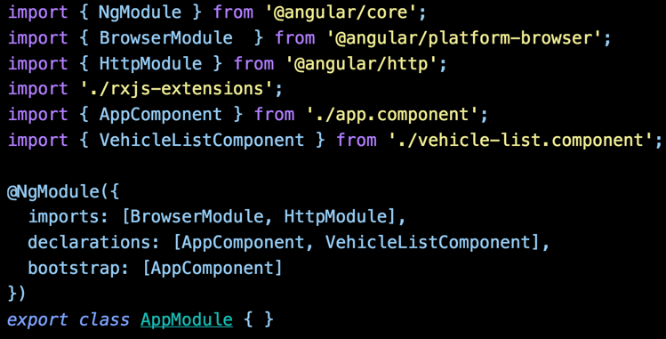
Http Requirements
Providers
Located in module @angular/http
Import the Http module
We need the HttpModule to make Http calls

Slide 78
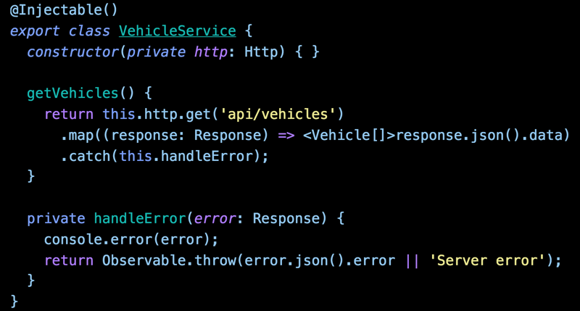
vehicle.service.ts
Make and return the async GET call
Map the response
Handle any exception

Slide 79
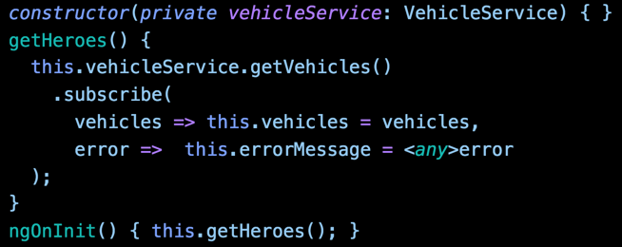
Subscribing to the Observable
vehicle-list.component.ts
Subscribe to the observable
Success and failure cases
Component is handed an Observable
We Subscribe to it

Slide 80
RxJs
http://reactivex.io/
RxJs (Reactive Js) implements the asynchronous observable pattern and works well with Angular

Slide 81
app.module.ts
rxjs-extensions.ts
Prefer importing only what we use from RxJs

Slide 82
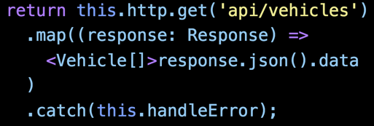
Returning from Http
vehicle.service.ts
Retrieve the JSON
data is what we defined on the server
We don’t return the response
Service does the work
The consumers simply get the data

Slide 83
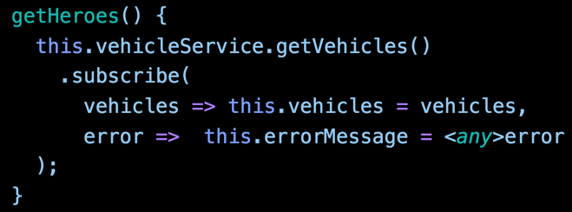
Subscribing to the Observable
vehicle-list.component.ts
Subscribe to the observable
Success and failure cases
Component is handed an Observable
We Subscribe to it
We can handle errors here, for presenting to the user if we wish

Slide 84
Http and RxJS
Demo

Slide 85
Please evaluate this session
Your feedback is important to us!
From your PC or Tablet visit MyIgnite at http://myignite.microsoft.com
From your phone download and use the Ignite Mobile App by scanning the QR code above or visiting https://aka.ms/ignite.mobileapp

