Slide 1
Architecting the hybrid cloud platform with Azure Stack
Jeffrey Snover, Chief Architect,
Enterprise Cloud
Mark Russinovich, CTO Azure

Slide 2

Microsoft Azure Cloud
Global Trusted Hybrid

Slide 3
Last mile of public cloud adoption
Business requirements
Application flexibility
Inadequate alternatives

Slide 4




Snowflake servers? How about Snowflake clouds?
People Silos
Process Silos
Functional Silos
Isolation & Despair

Slide 5
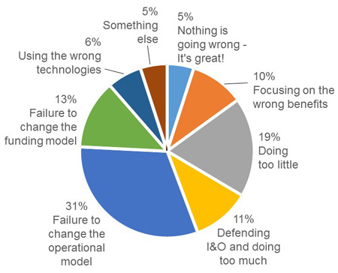
Where do people run into trouble?
84% People and Process
Probably, most of them never even got to the tech problems…so that would be higher too…
http://blogs.gartner.com/thomas_bittman/2015/02/05/why-are-95-of-private-clouds-failing/

Slide 6
Design Corner
“We know from painful experience that letting a third party layer of software come between the platform and the developer ultimately results in sub-standard apps and hinders the enhancement and progress of the platform.”
-Steve Jobs, Thoughts on Flash

Slide 7
Microsoft Azure Stack
Power of Azure in your datacenter

Slide 8
End user experiences
Cloud application model
Infrastructure services
Platform services
Cloud infrastructure
Private | Hosted | Public

Slide 9
Microsoft’s hybrid cloud platform
Power of Azure in your datacenter
Portal | PowerShell | DevOps tools
Portal | PowerShell | DevOps tools
Portal | PowerShell | DevOps tools
Azure Resource Manager
Developers
Azure Resource Manager
Azure Resource Manager
One Azure ecosystem
Azure IaaS | Azure PaaS
Compute | Network | Storage
App Service | Service Fabric*
Azure IaaS | Azure PaaS
Compute | Network | Storage
App Service | Service Fabric*
IaaS | PaaS
Unified app development
Azure services in your datacenter
Cloud-inspired infrastructure
Cloud-inspired infrastructure
Cloud infrastructure
IT
Microsoft Azure Stack
Private | Hosted
Microsoft Azure Stack
Private | Hosted
Microsoft Azure
Public

Slide 10



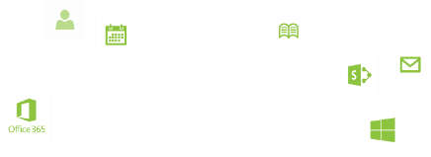
Demo: Azure Consistency

Slide 11
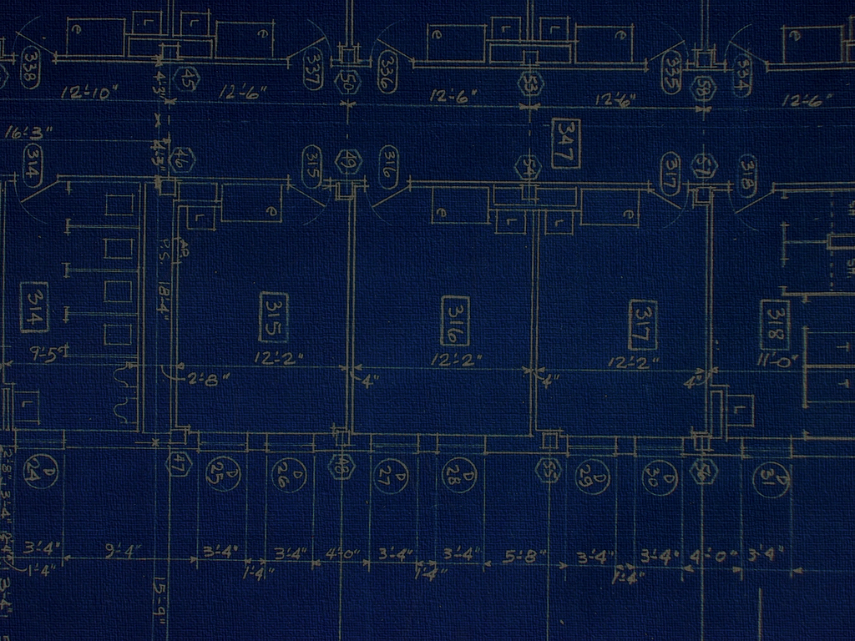
Azure
Quick Start Templates
VM
(Azure)
VS Code
Azure PowerShell
VM
(Azure Stack)

Slide 12
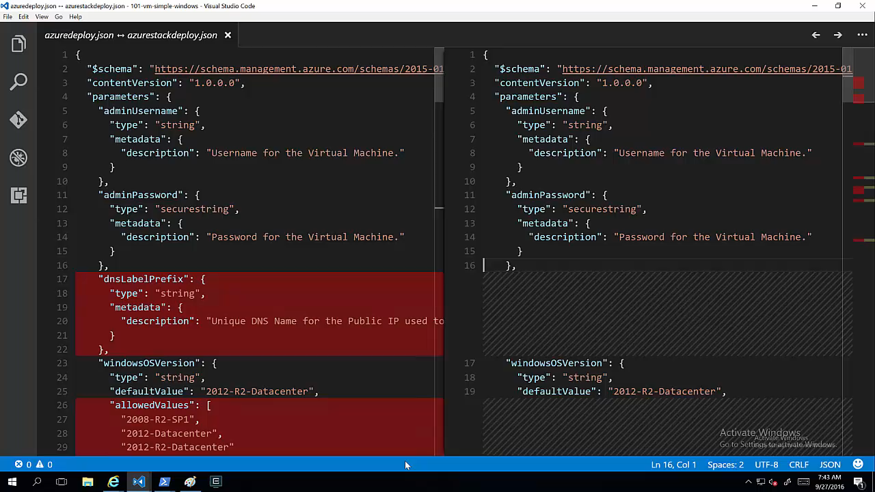

Slide 13
Design Corner
Wide Ecosystem Of Apps
Choice of deployment
Our Goal
Skilled practitioners
Successful Platform

Slide 14


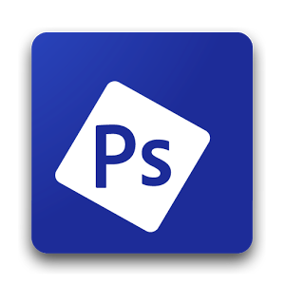
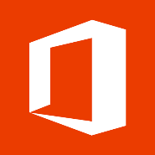
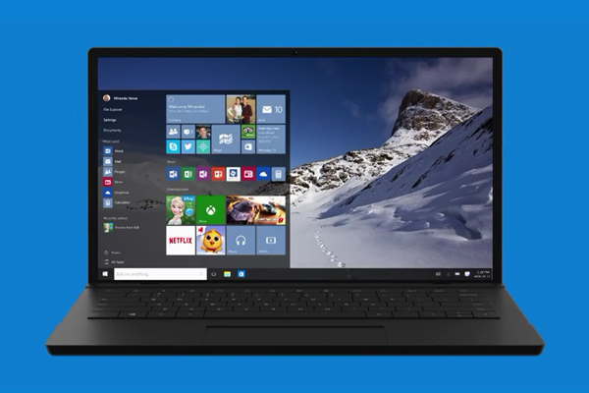
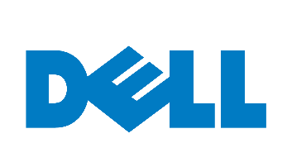



More…
More…

Slide 15

End User Input
Applications
Physical Hardware
Azure Platform
End User Input
Cloud Applications
Cloud Services
Software Defined Infrastructure
Physical Hardware

Slide 16
Key Design Decisions
Infrastructure manager vs System Center
Hyper-converged vs Converged
Integrated Systems
Sealed host
Scaling

Slide 17


Azure Stack Integrated Systems Partners

Slide 18


Hybrid scenarios
Performance
Latency
Data sovereignty
ISO<..>
Security
Regulations
Disconnected

Slide 19
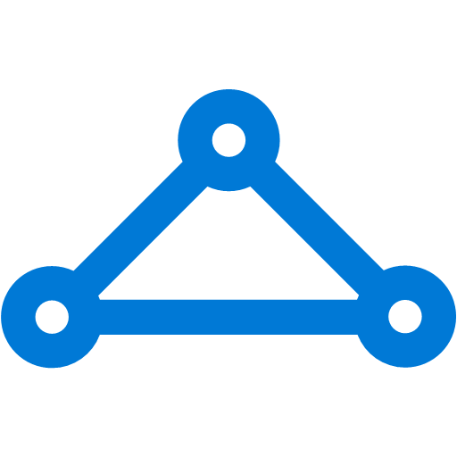
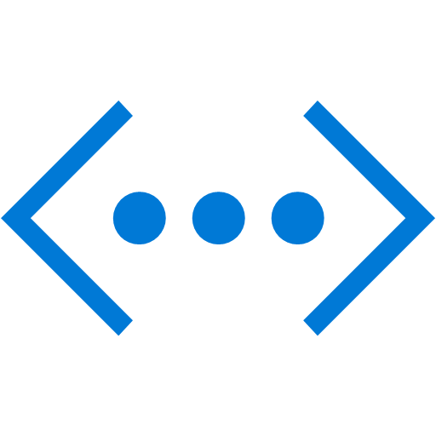
Azure Stack hybrid topology ideas…
Hosted Public and Hybrid Cloud
Adjacent
Compliant
Central IT
Low-Latency
Single Service

Slide 20
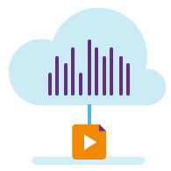

Azure Solutions
Development
and test
E-commerce
App
modernization
Mobile
https://azure.microsoft.com/en-us/solutions/?v=2

Slide 21
What we’re going to look at…
Working Close to the Data
Cloud Native Tooling
Infrastructure as Code
Trusted Hybrid Cloud Transactions
E-commerce
App
modernization
Development
and test
Mobile
Data sovereignty
Security
Latency
ISO<..>
Regulations
Adjacent
Low-Latency
Compliant
Central IT

Slide 22
Working Close to the Data
E-commerce
Data sovereignty
Adjacent

Slide 23
E-commerce
Platform in Azure
Azure Queue
transaction
Transaction data
polling
Custom Service running on Azure Stack
transactions
On-premises
Oracle

Slide 24
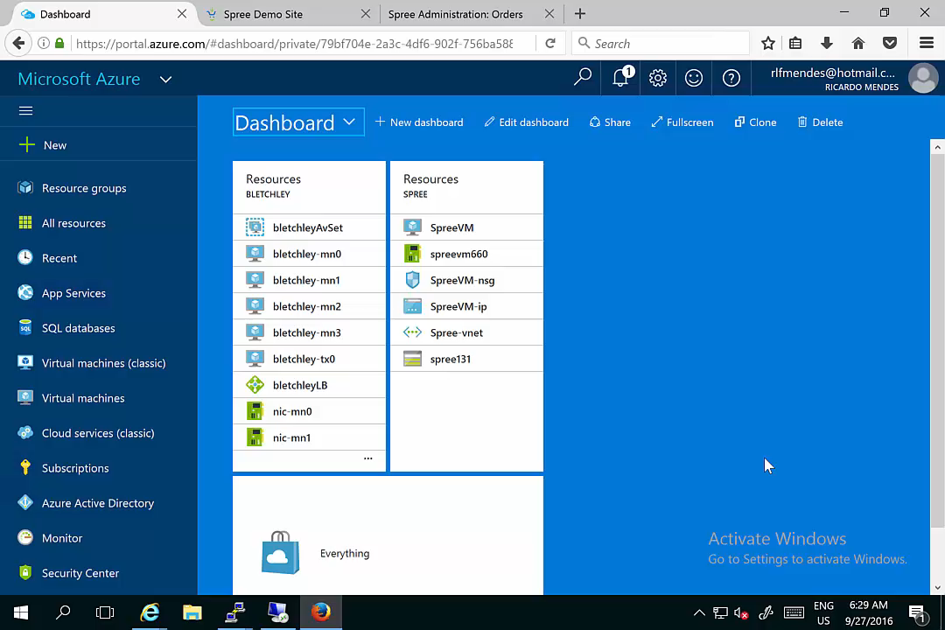

Slide 25
Cloud Native Tooling
App
modernization
Latency
Low-Latency

Slide 26
Azure
Params
Azure
deployment
Visual Studio GitHub
Quickstart
Visual Studio Solution
Azure Stack
Params
Azure Stack
deployment

Slide 27
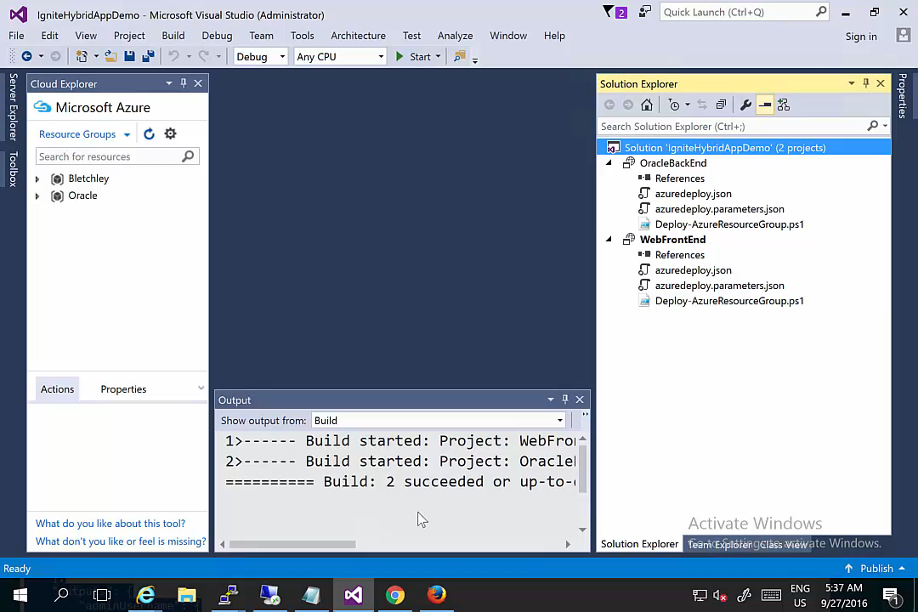

Slide 28
Infrastructure as Code
Development
and test
ISO<..>
Regulations
Compliant

Slide 29
GitLab
Commit
Change
Jenkins
App Code
ARM Templates
Azure DevTest
Deployment
IFF pass
Azure Stack Prod Deployment

Slide 30
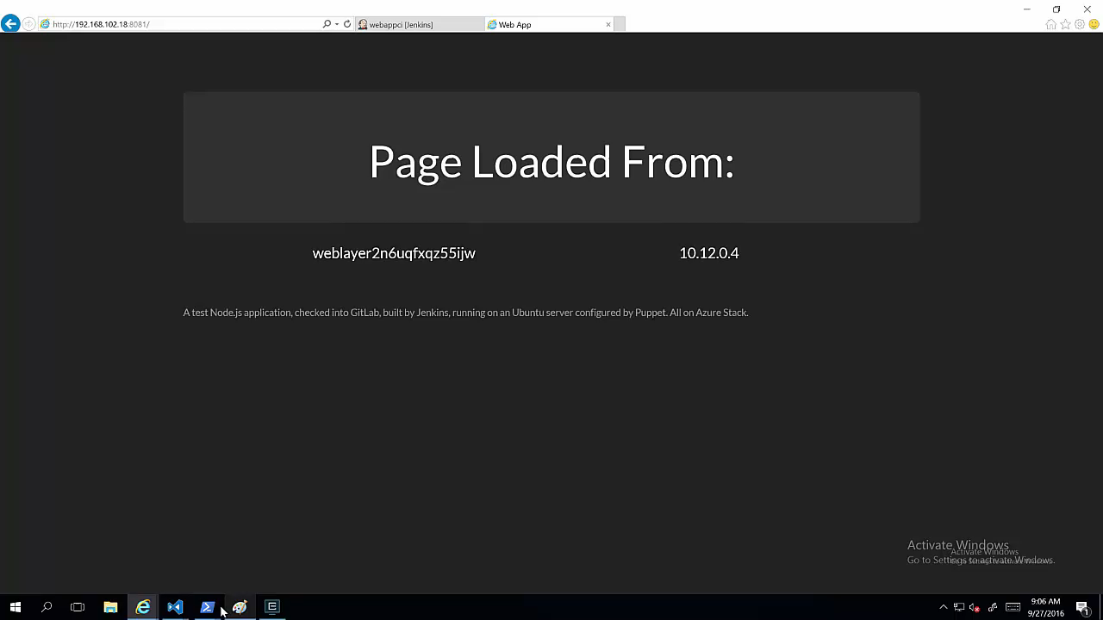

Slide 31
Trusted Hybrid Cloud Transactions
Mobile
Security
Central IT

Slide 32
Azure
BLOCKCHAIN
Ethereum GitHub
Quickstart
PowerShell
deployment
Azure Stack
BLOCKCHAIN

Slide 33
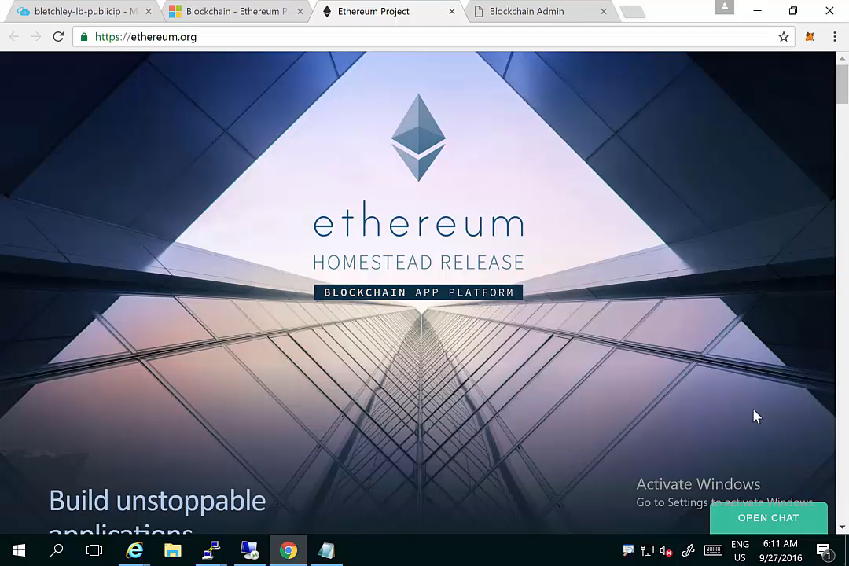

Slide 34
Recap
Working Close to the Data
Cloud Native Tooling
Infrastructure as Code
Trusted Hybrid Cloud Transactions
E-commerce
App
modernization
Development
and test
Mobile
Data sovereignty
Security
Latency
ISO<..>
Regulations
Adjacent
Low-Latency
Compliant
Central IT

Slide 35
Durable Hybrid scenarios
Performance
Latency
Data sovereignty
ISO<..>
Security
Regulations
Disconnected

Slide 36
Microsoft’s hybrid cloud platform
Power of Azure in your datacenter
Portal | PowerShell | DevOps tools
Portal | PowerShell | DevOps tools
Portal | PowerShell | DevOps tools
Azure Resource Manager
Developers
Azure Resource Manager
Azure Resource Manager
One Azure ecosystem
Azure IaaS | Azure PaaS
Compute | Network | Storage
App Service | Service Fabric*
Azure IaaS | Azure PaaS
Compute | Network | Storage
App Service | Service Fabric*
IaaS | PaaS
Unified app development
Azure services in your datacenter
Cloud-inspired infrastructure
Cloud-inspired infrastructure
Cloud infrastructure
IT
Microsoft Azure Stack
Private | Hosted
Microsoft Azure Stack
Private | Hosted
Microsoft Azure
Public

Slide 37

Choose an ecosystem, not a cloud
34
Azure regions today
More than AWS & Google combined
100s of service providers
1,000s of enterprises

Slide 38
What to do next
Learn
Build
Do
Read the whitepaper
Deploy Azure Stack
Deploy Azure Apps
aka.ms/azurestackwhitepaper
aka.ms/azurestack
aka.ms/azurestackgithub
Read the Docs
Try Azure PaaS Services
aka.ms/azurestackdocs
aka.ms/azurestackpaasservices
Build Hybrid Apps
http://aka.ms/DesignHybridApps

Slide 39
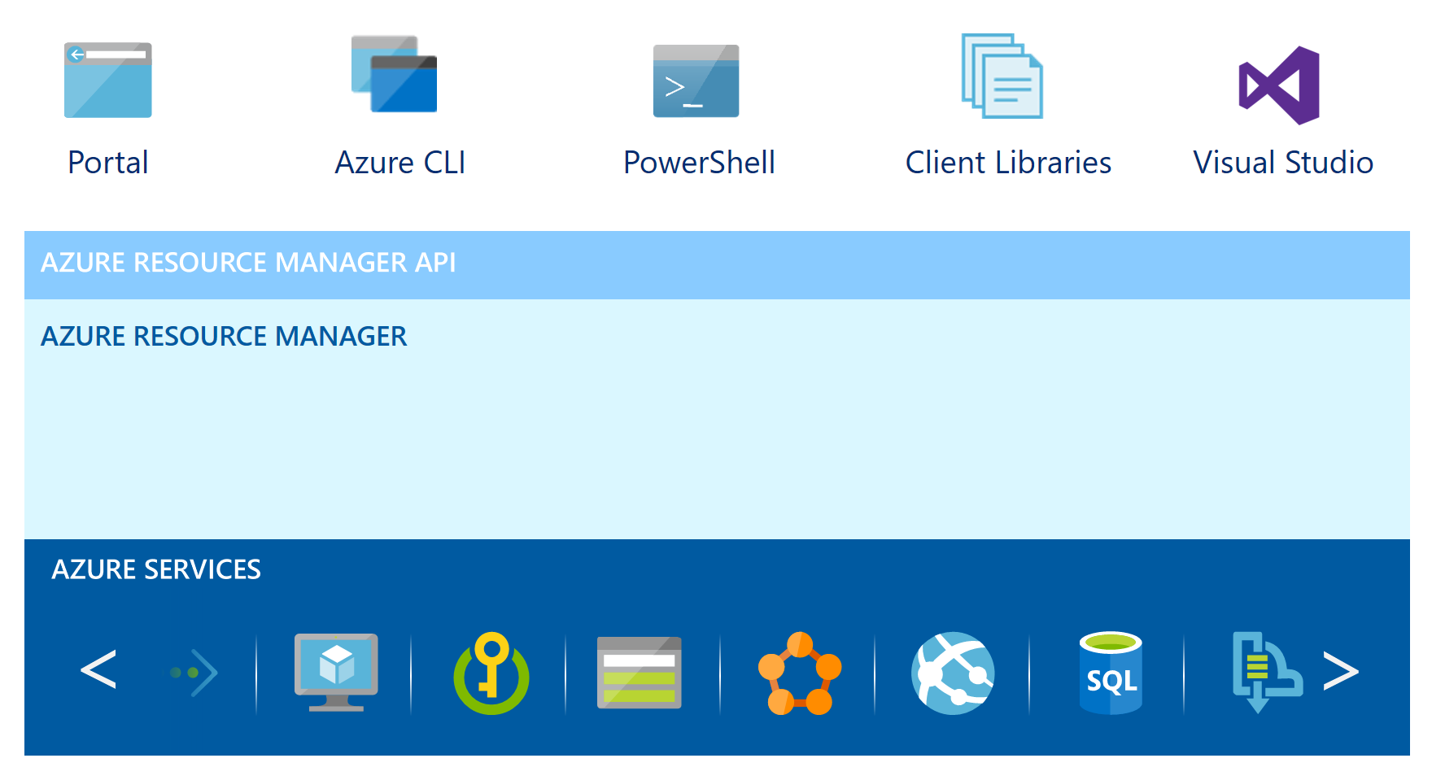
Azure Resource Manager
Whitepaper http://aka.ms/GettingStartedWithARM

Slide 40
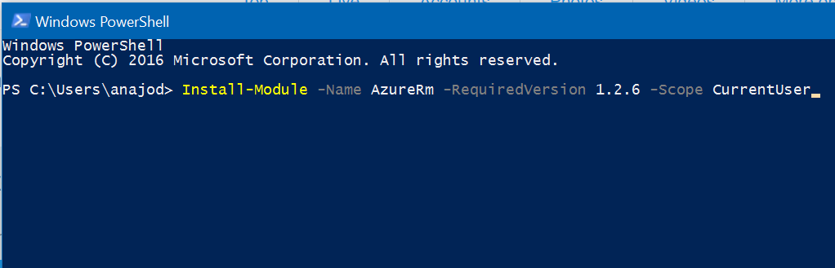
Get going with PowerShell
Install-Module -Name AzureRm -RequiredVersion 1.2.6 -Scope CurrentUser

Slide 41

Start in Azure
Will your Azure solution work on Azure Stack?
2 new tools you can get from the Azure Stack Tool repository on GitHub.
Guardrails to check your ARM template for resource dependencies that may not be available on Azure Stack
  Azure Resource Manager Template Validator for Azure Stack
  Azure Resource Manager Policy for Azure Stack
Download the tool: https://github.com/Azure/AzureStack-Tools

Slide 42
Session Code | Title | When
BRK2204 | Drive business transformation with Windows Server 2016 and System Center 2016 | Monday 14:15
BRK2154 | Explore Microsoft Azure Stack “State of the Union” | Tuesday 09:00
BRK2030 | Learn about Azure Stack Agile Service Delivery | Tuesday 12:30
BRK2187 | Review Microsoft Azure Stack with Jeffrey Snover and Mark Russinovich | Tuesday 14:15
BRK2188 | Learn about Azure Stack Infrastructure Operations and Management | Wednesday 09:00
BRK2260 | Explore Microsoft Cloud Platform System - delivering Azure experiences in an integrated system | Wednesday 12:30
BRK4019 | Dive into Microsoft Azure Stack Architecture | Wednesday 14:15
BRK3327 | Dive deep in the Microsoft Azure Stack IaaS | Thursday 14:15
BRK3115 | Become a Microsoft Azure Stack infrastructure rockstar | Thursday 16:00
BRK3112 | Learn about the community of templates for Azure Stack | Friday 09:00
BRK3141 | Discuss Microsoft DevOps on Azure Stack | Friday 10:45
BRK3148 | Learn about hybrid applications with Azure and Azure Stack | Friday 12:45

Slide 43
Free IT Pro resources
To advance your career in cloud technology
Plan your
career path
Cloud role mapping
Expert advice on skills needed
Self-paced curriculum by cloud role
$300 Azure credits and extended trials
Pluralsight 3 month subscription (10 courses)
Phone support incident
Weekly short videos and insights from Microsoft’s leaders and engineers
Connect with community of peers and Microsoft experts
Microsoft IT Pro Career Center
www.microsoft.com/itprocareercenter
Get started
with Azure
Microsoft IT Pro Cloud Essentials
www.microsoft.com/itprocloudessentials
Demos and
how-to videos
Microsoft Mechanics
www.microsoft.com/mechanics
Connect with peers and experts
Microsoft Tech Community
https://techcommunity.microsoft.com

Slide 44
Free IT Pro resources
To advance your career in cloud technology
Plan your
career path
IT Pro Career Center
http://www.microsoft.com/itprocareercenter
Get started
with Azure
IT Pro Cloud Essentials
https://www.microsoft.com/itprocloudessentials
Demos and
how-to videos
Microsoft Mechanics
https://www.microsoft.com/mechanics
Connect with peers and experts
Ask questions, get answers, exchange ideas
https://techcommunity.microsoft.com
Azure Solutions
Get started with Azure Solutions today
http://azure.com/solutions
Azure monthly webinar series
Join live or watch on-demand
http://aka.ms/AzureMonthlyWebinar

Slide 45


Please evaluate this session
Your feedback is important to us!
From your PC or Tablet visit MyIgnite at http://myignite.microsoft.com
From your phone download and use the Ignite Mobile App by scanning the QR code above or visiting https://aka.ms/ignite.mobileapp

Slide 47
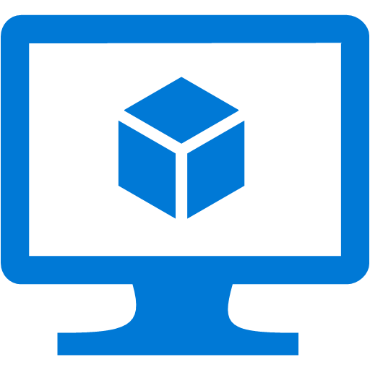
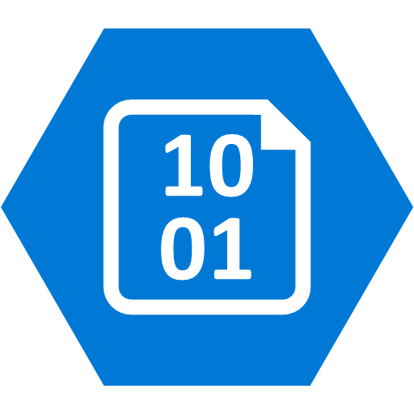

Azure Stack architecture summary
Storage Blobs
Websites
(.NET, PHP, Python … )
Cloud Resources
(IaaS + PaaS)
Virtual Machines
(Linux or Windows)
Virtual Networks
Service Fabric Clusters
End User Experiences
Microsoft Azure Services
Unified Application Model
Core Services
Azure Stack Software
Extensible Service Framework
Additional Services
Additional Services
Foundational Services
Cloud Infrastructure
3rd Party Services
Physical Hardware: TP2 Proof of Concept = 1 Server

Slide 48
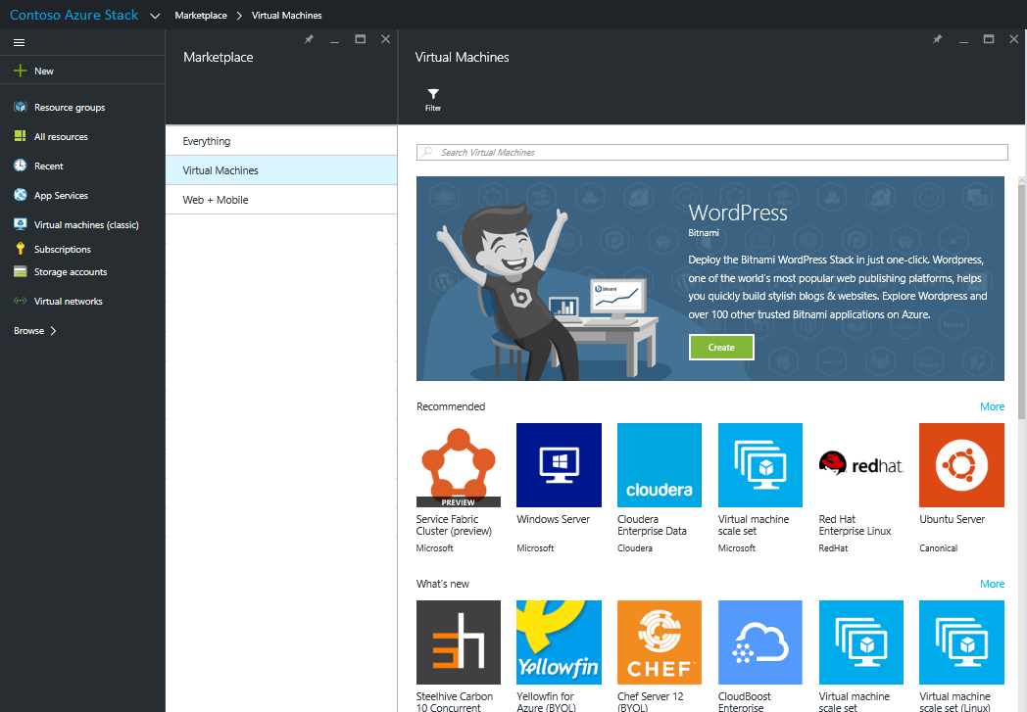
Continuing the Azure-consistency journey
    TP2 Enhancements:
    Key Vault service for protecting an application’s digital secrets
    Queue Storage for asynchronous messaging
    VPN Gateway for cross-site connectivity between ARM resource groups
    ARM template compatibility improvements
    Infrastructure management beginnings

Slide 49
Azure Resource Manager
Describe
Deploy
Control
RESOURCE
GROUP
Azure Resource Manager
Azure Resource Manager
App
Database
Compute
Network
Storage
MICROSOFT AZURE STACK
MICROSOFT AZURE

Slide 50
Complex Deployments

Slide 51



Azure Resource Manager
Describe
WHERE
Resource Inventory
WHAT
Component Relationships
HOW
Tags + links + groups
Provision
WHERE
Across Regions
WHAT
Across Resources
HOW
In service and in guest
Control
WHO
Access control
WHAT
Changes
HOW
RBAC, subscriptions, and locks

Slide 52
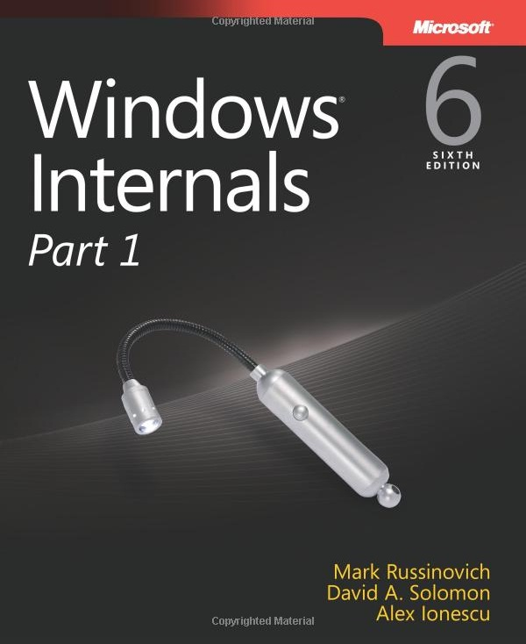


Delve inside Windows architecture and internals—and see how core components work behind the scenes.

