Slide 1

Do more with less: Dynamics AX strategy and roadmap session
BRK2182
Arif Kureshy
Director Program Management
Arijit Basu
Principal Program Manager

Slide 2


Microsoft Dynamics AX
Intelligent user interface
Any device Modern UI Power BI In-memory ML IoT Big data Integration platform
Proven business logic
Production
Supply chain management
Finance
Lifecycle services
Procurement
HR
Continuous life to your system
The power of
Microsoft Cloud
Business anytime, anywhere
Retail
Extensions

Slide 3

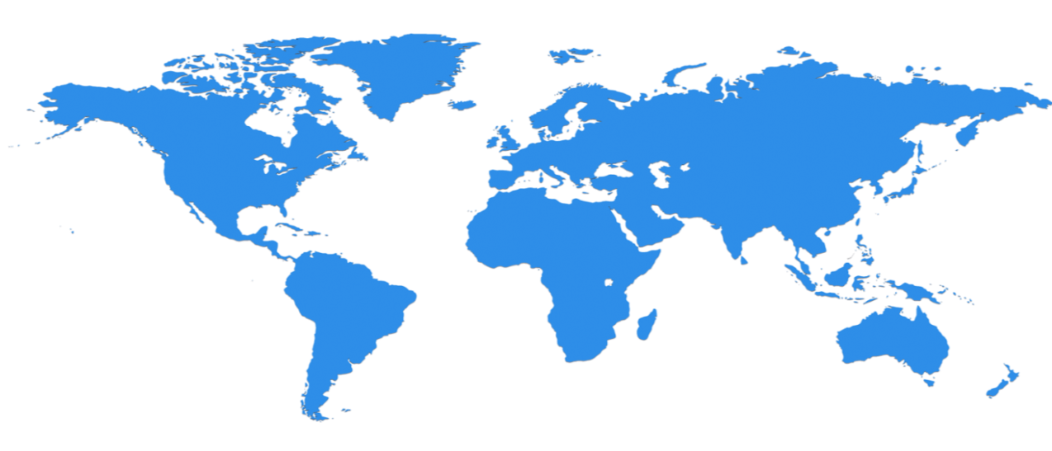























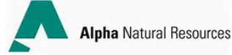














Customers across the globe
Goal of the slide is to highlight customers selecting Dynamics across the world. Please clean slide- add animation as appropriate.
Retail
Manufacturing
Public Sector
Distribution
Service
industries
Project
Budget formulation
Expense
Finance
HCM

Slide 4
Dynamics AX Cloud Platform Investments
App
Functionality
On
Premises
Hybrid
Cloud
AX7 Business Continuity
(On premise Retail Store Server)
AX 2012 Analytics, Intelligence & IOT
Deliver on
Dynamics 365
Build out
core & local functionality
Serve existing customers &
bring value of
cloud and hybrid
The best of
Cloud & On-premises
Scale
Self Serve
Sovereignty
Compliance
Microsoft managed
AX 2012 R3 Parity
Finance, HCM
Manufacturing
Supply chain
Retail
Regulatory Updates
Upgrade Tools
Mobile Experiences
Dynamics AX 2012:
Bi-annual Updates
Regulatory Updates
Support to 10/2021
The best of
The Public
Cloud
Updated plans for Dynamics 365 to be disclosed October 2016
“…We will update our hybrid strategy with an announcement at the Oct 11 Dynamics Summit. “

Slide 5




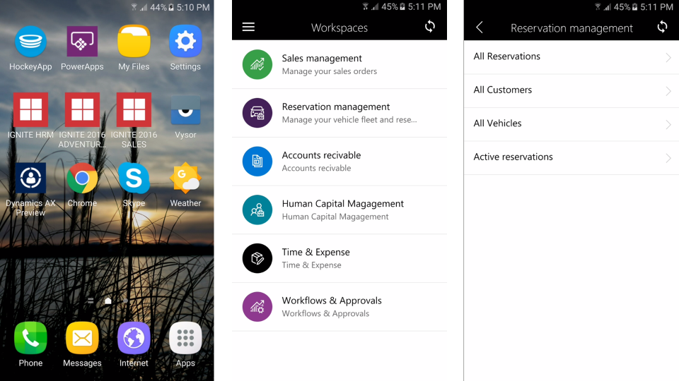
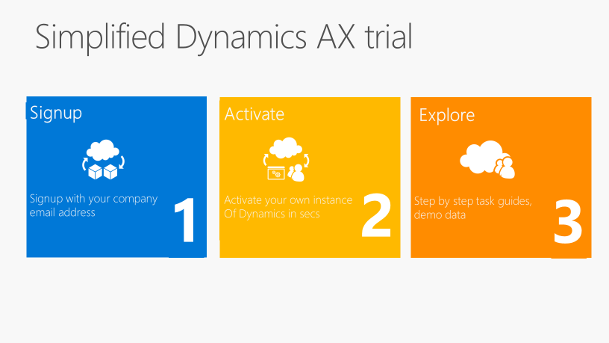






















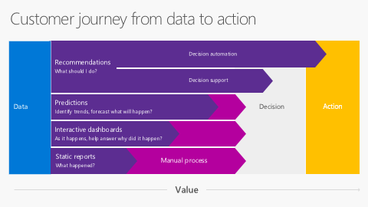

Dynamics AX Cloud Platform Investments
EXISTING COMMITMENTS | “MOST WANTED” SOLUTIONS | MARKET-FOCUSED INNOVATION | INTELLIGENT BUSINESS CLOUD | REFINING THE SAAS OFFERING
Complete our commitment to migrating AX2012 R3 functionality to AX7, including localizations. | Eliminate gaps based on customer and partner demand. | Functional enhancement based on market demands. | Incorporating process analytics for optimization and learning. | Continue to improve SaaS delivery with continuous updates and self service capabilities.
Migrate from AX 2009 & Upgrade from AX 2012 Client Productivity | LCS Solutions++ in AppSource Improved BPM in LCS | Enhanced Integration capabilities – data quality, data packaging, bring your own database Mobile capabilities | Real Time Entity Store Enhanced BI Capabilities Cortana Intelligence Integration | Trial as a Service Sealed platform to enable continuous delivery of the platform Increased capabilities in diagnostics/telemetry Continual improvements to Servicing Experience

Slide 6










Existing Commitments
Retail
Point of Sale (POS)
Centralized store management
Omni-channel management
Order management |payment processing
Merchandizing and catalog management
Manufacturing
Lean, process and discrete manufacturing
Product configuration
Shop floor management
Sales, service & marketing
Sales force and marketing automation
Lead and opportunity management
Sales and case management
Service management
Microsoft Dynamics CRM connector
Procurement and sourcing
Direct and indirect procurement
Purchase requisitions
Supplier relationship management
Vendor self-service portal
Supply chain management
Inventory management
Multisite warehouse management
Order promising
Distribution planning
Quality management
Project accounting
Project accounting and invoicing
Grants management
Project cost control
Work breakdown structure
Interoperability with Microsoft Project
Financial management
General Ledger
Accounts receivables
and payables
Commitment Accounting
Cash and bank management
Business intelligence
Standard and analytical reports with Microsoft SQL Server Reporting Services
Role Tailored, pre-defined data cubes
Dashboard views with KPIs
Self-service reporting
Human capital management
Core Human Resource Management
Talent management
Workforce management
Travel and expense
Shared services and consolidation
Budget planning
and control
Compliance management

Slide 7
Focus on Microsoft AppSource for Solution Delivery
One destination for business users to discover, try, and acquire line-of-business SaaS apps
Simplifies the discovery,
trial, and acquisition of
line-of-business apps
An ecosystem to help business users get started using apps faster
Helps business users do
more with their existing Microsoft Apps

Slide 8
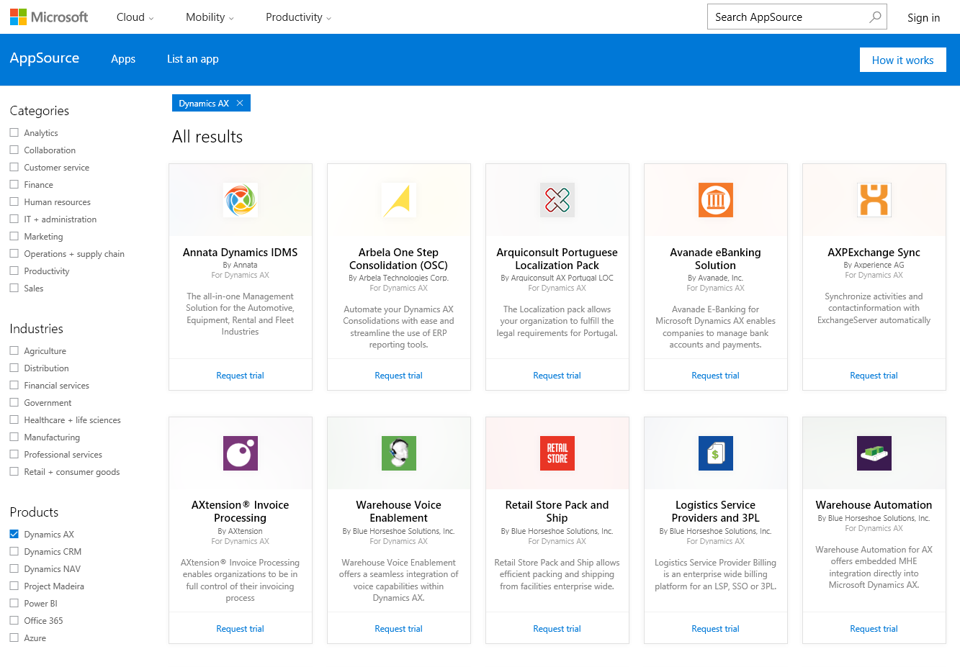
Demo: AX Solutions in AppSource
Arif Kureshy

Slide 9
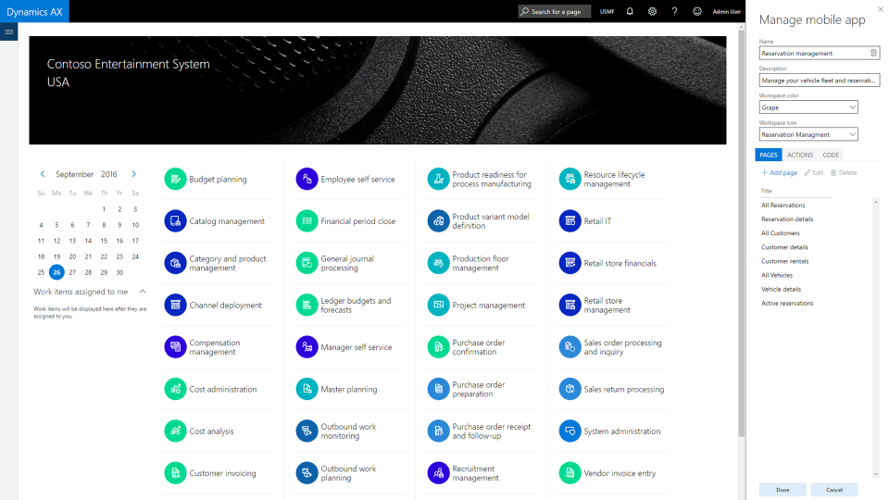
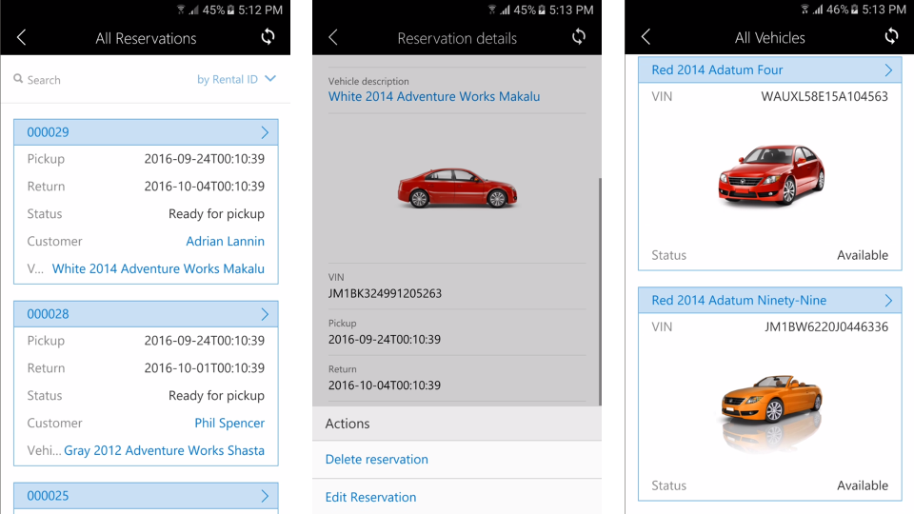
Demo: AX Mobile Experiences
Start with AX Forms
  Create mobile experiences on top of forms via the new Mobile Experience Designer
  Tailor experiences to only include tasks required for scenario
Mobile client supports intermittently connected devices
Public preview coming with update 3 with apps to follow soon after
Run scenario specific designs on intermittently connected mobile client
Design mobile flows against AX Forms in the cloud

Slide 10
Demo: AX Mobile Experiences
Arijit Basu

Slide 11
Customer journey from data to action
Data
Recommendations
What should I do?
Decision
Action
Decision automation
Decision support
Predictions
Identify trends, forecast what will happen?
Interactive dashboards
As it happens, help answer why did it happen?
Static reports
What happened?
Manual process
Value

Slide 12
Demo: Retail Recommendations in Dynamics AX
Dynamics AX
Cortana intelligence
Point of Sale
People
Cognitive services
AX Operational DB
Recommendations
Entity store
Data factory
Data
Intelligence
Action

Slide 13
Demo: Intelligence Recomendations
Arijit Basu

Slide 14


Continued Investments in Operations and Readiness
Reliability
Business Continuity
SLAs
99.5% Uptime
Customer control over updates and planned maintenance
Pro-active monitoring by Microsoft
Redundancy and resiliency designed in
Disaster recovery through
geo-replication
Financially backed SLAs
Customer and Partner support agreements

Slide 15
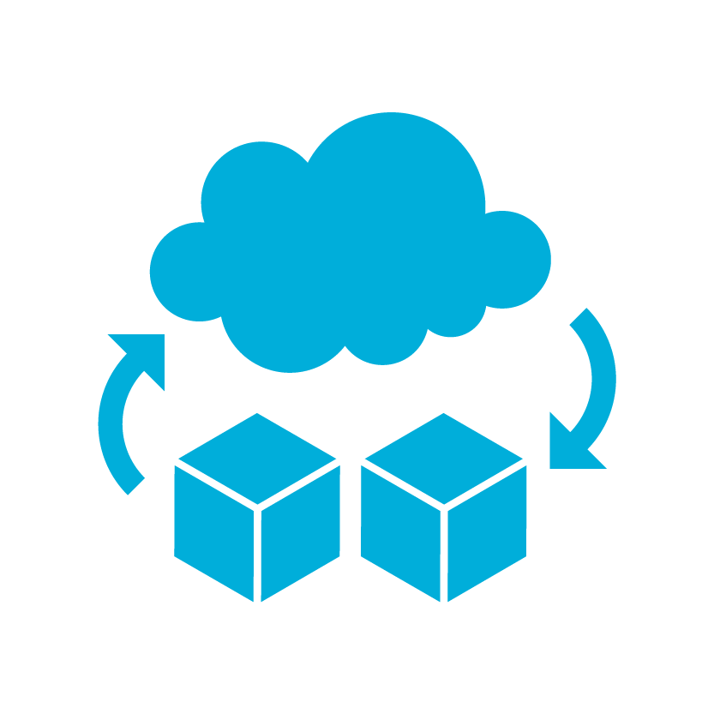
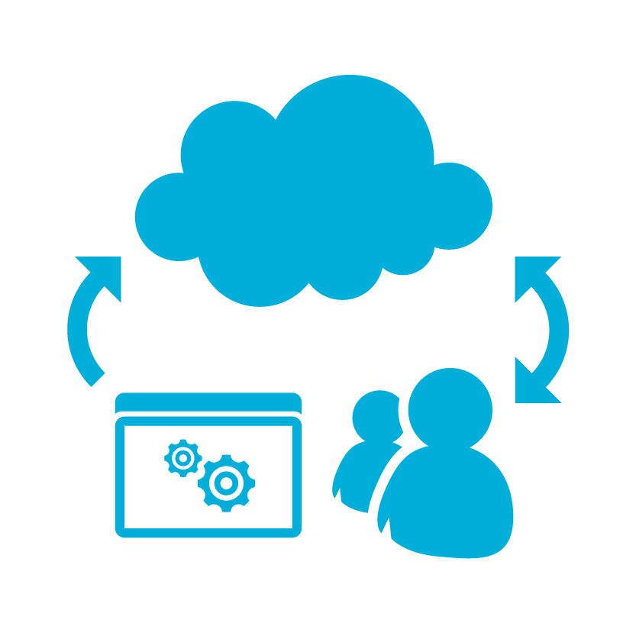

Demo: Simplified Dynamics AX trial
Signup
Signup with your company email address
Activate
Activate your own instance
Of Dynamics in secs
Explore
Step by step task guides,
demo data
1
2
3

Slide 16
Demo: AX Trials
Arif Kureshy

Slide 17
Dynamics AX cloud platform roadmap
Productivity
Analytics & Integration
Elastic
Scale
Provisioning
Managed Lifecycle
Upgrades and Updates
TODAY
Web Based Client
Office Integration
Workflow
Workspaces
Data management workspace
SSIS based bulk data integration framework
Power BI Integration
Cortana Intelligence Integration
Tenant Configured for Scale
Ability to Scale up and Down on Azure SQL with no downtime
Basic Runbook Capabilities
Curated ISV Solutions
Rapid Templates
Data Migration/Load
Partner Led Trials
Regional Deployments
Dev-Test-Prod
Life Cycle Services
HA/DR for tenant
Monitoring and Diagnostics
Telemetry dashboards
Built-in User Assistance
Code Upgrade Service
Azure Cloud is continually updated
Update 3
Mobility
End users can build workspaces from existing forms
Export to private data warehouse
PowerBI near real time data warehouse
PowerApps and Flow connector
Support for larger SQL Azure scale up SKUs
Customer Led Trials
Deployment performance improvements
Multi box test topology
Canadian regional deployments
Business Continuity(<4 Hours RTO)
Multi box test topology
Customer / Partner self service
Hotfix
SQL optimization
AX Platform is continually updateable
AX2009 Migration Toolkit

Slide 18
Dynamics AX cloud platform roadmap (cont.)
Productivity
Analytics & Integration
Elastic
Scale
Provisioning
Managed Lifecycle
Upgrades & update
Updates in 2017
Data change Alerts
Productivity Improvements
Grid data entry
Personalization features
Keystroke analysis and improved efficiency
Outlook integration via CDM
Incremental export to your own Data warehouse
Embedded PowerBI
CDM as Data warehouse
Dynamics 365 first party integrations
Customer defined scale up and down schedule
Azure Scale set and Auto Scale Support
Enhanced Runbook Support
German Sovereign Cloud
Chinese Sovereign Cloud
Additional sovereign clouds (UK, AU)
Customer self service
AX2012 Upgrade Toolkit
AX Application Components evolve, beginning with common abstractions and Financials

Slide 19
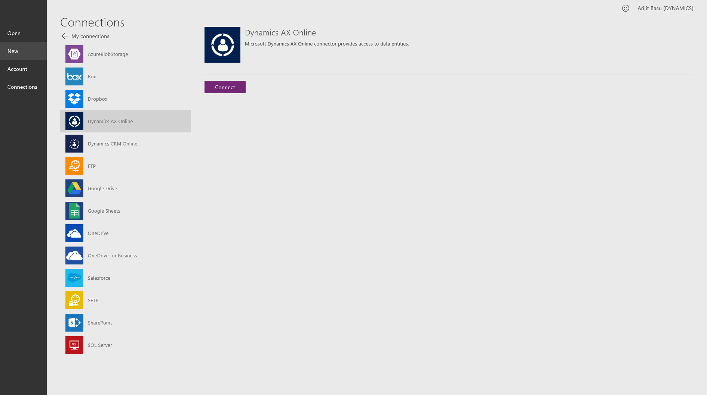
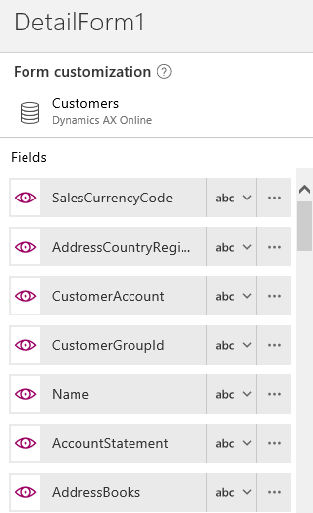

Dynamics AX connector for PowerApps and Flow
Integrate with Microsoft Dynamics AX
BRK3172

Slide 20
Native Platform Versus PowerApps + CDM?
If you are extending AX, use the built-in extensibility and AOT/X++
If you are building independent solutions or solutions that talk to multiple services, including non-Dynamics services, use PowerApps and CDM

Slide 21
The intelligent business cloud
AppSource
Office 365
Power BI
Cortana Intelligence
Azure IoT
Dynamics 365
AX, MSCRM, NAV
3rd party
business apps
Application platform (PowerApps, Power BI Embedded, Flow) and Common Data Model
Azure
Retail
Manufacturing
Public Sector
Distribution
Service
industries
Project
Budget formulation
Expense
Finance
HCM

Slide 22
Dynamics AX / Dynamics 365 for Operations
Q: Will the CRM AX integration be released with the Dynamics 365 rollout?
A: Yes, we will have integration between the different services with a common shell.
Q: What business processes will be integrated?
A: We will show proof of concepts very soon

Slide 23
Dynamics AX / Dynamics 365 for Operations
Q: Can I do bulk integration into AX using the CDM tools?
A: AX has tools (BRK3172 - Integrate with Microsoft Dynamics AX)
- Not obsoleting or deprecating any tools
- Adding to the tool set to enhance experiences
- Simplifying migrations from 2009 and 2012

Slide 24
Next steps..
Attend
other
sessions
Visit
the
Expo
Join
us
Oct 11
Customer led – 2
Cloud – 5
Productivity and readiness – 4
Migrating to AX - 1
Retail and commerce - 1
Insights and Intelligence – 2
Integrations, code upgrade, dev – 4
Staffed throughout the show
Meet our experts, partners and sponsors
Expert Finder
Dynamics User Group Meeting
Over 200 sessions
Live stream of Keynote and General session
www.microsoft.com/dynamics for more info

Slide 25
Free IT Pro resources
To advance your career in cloud technology
Plan your
career path
Cloud role mapping
Expert advice on skills needed
Self-paced curriculum by cloud role
$300 Azure credits and extended trials
Pluralsight 3 month subscription (10 courses)
Phone support incident
Weekly short videos and insights from Microsoft’s leaders and engineers
Connect with community of peers and Microsoft experts
Microsoft IT Pro Career Center
www.microsoft.com/itprocareercenter
Get started
with Azure
Microsoft IT Pro Cloud Essentials
www.microsoft.com/itprocloudessentials
Demos and
how-to videos
Microsoft Mechanics
www.microsoft.com/mechanics
Connect with peers and experts
Microsoft Tech Community
https://techcommunity.microsoft.com

Slide 26


Please evaluate this session
Your feedback is important to us!
From your PC or Tablet visit MyIgnite at http://myignite.microsoft.com
From your phone download and use the Ignite Mobile App by scanning the QR code above or visiting https://aka.ms/ignite.mobileapp

