Slide 1
Office 365 Secure Score: Actionable Security Analytics
BRK2166
Brandon Koeller
Principal Program Manager

Slide 2
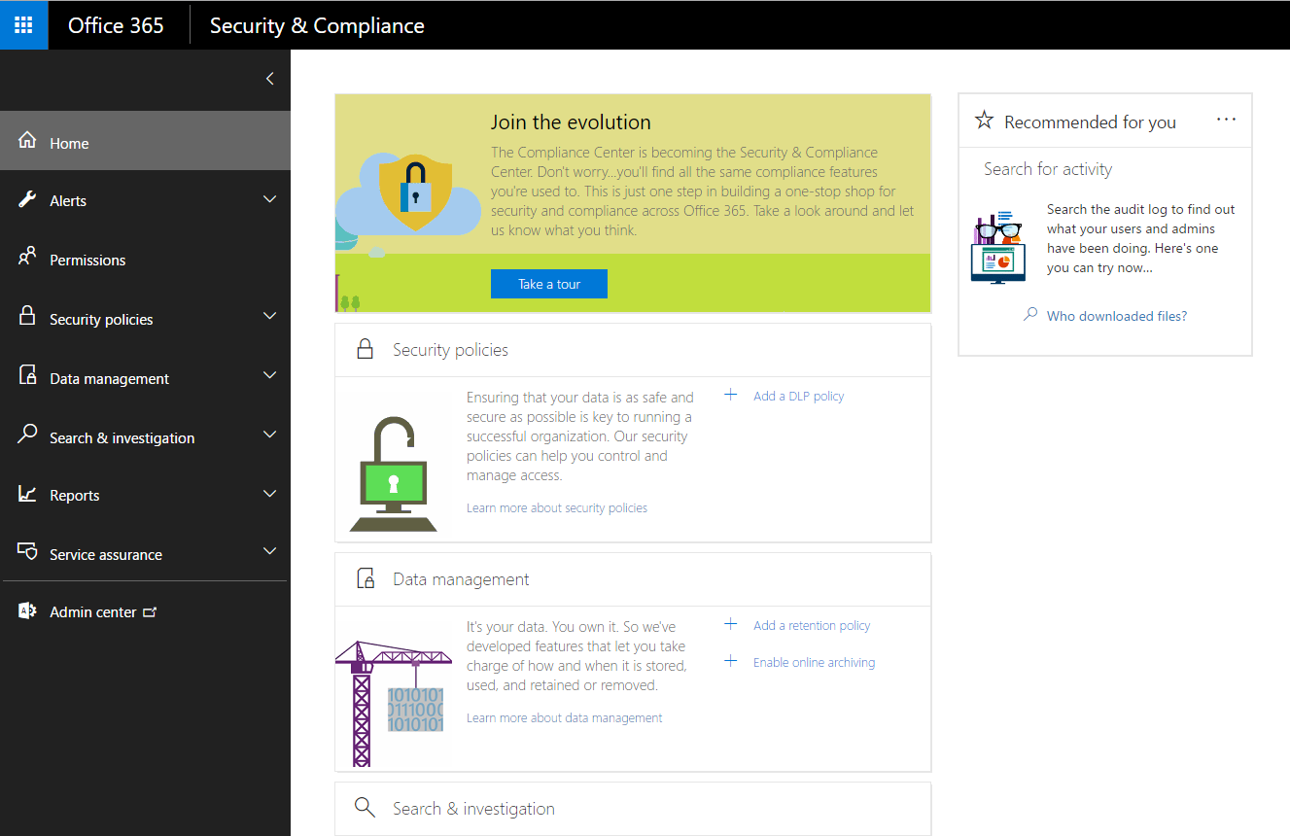
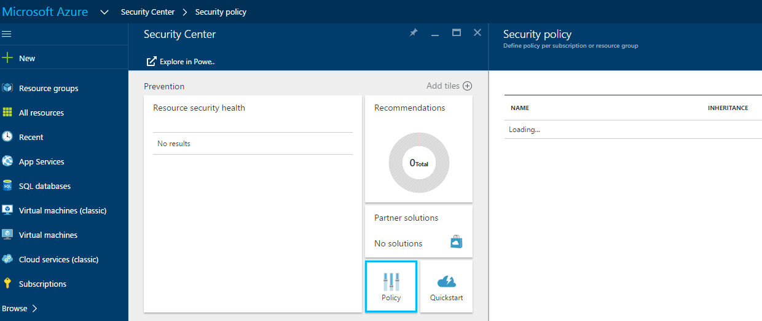
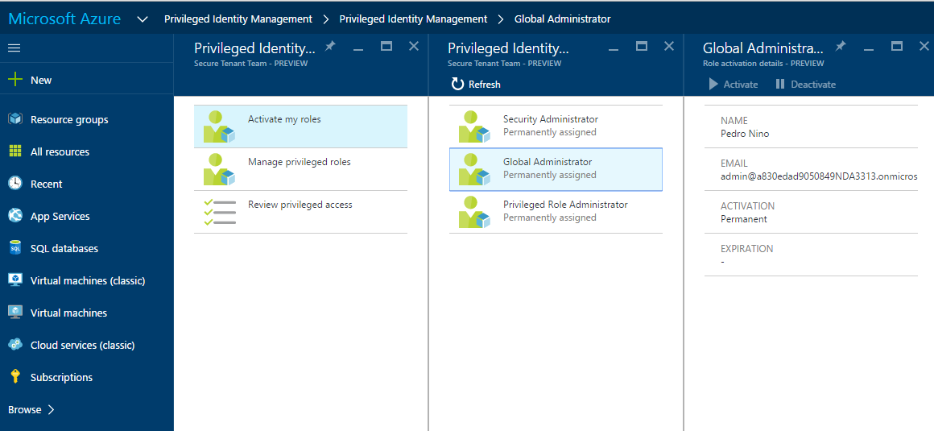
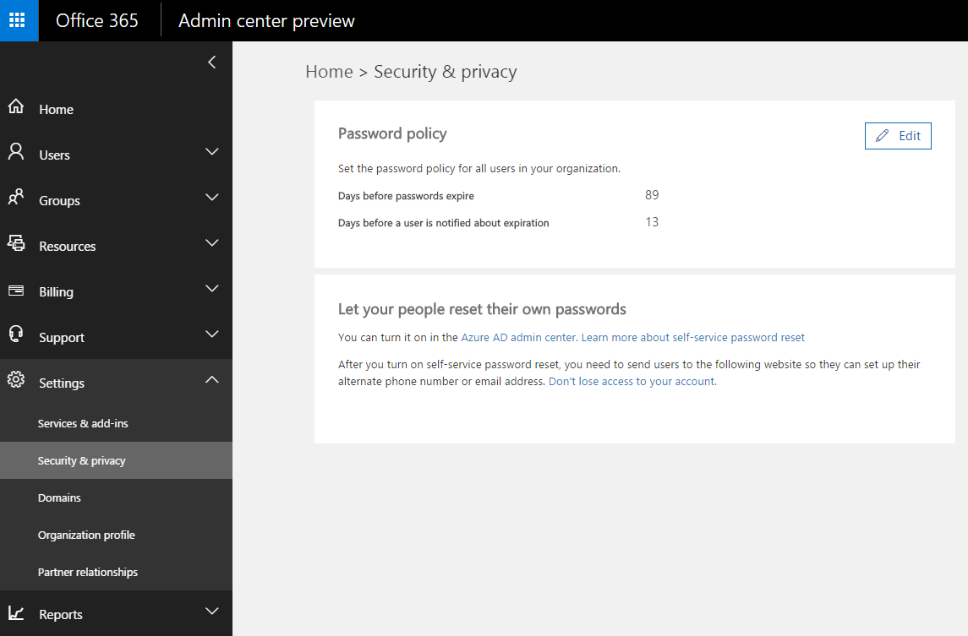
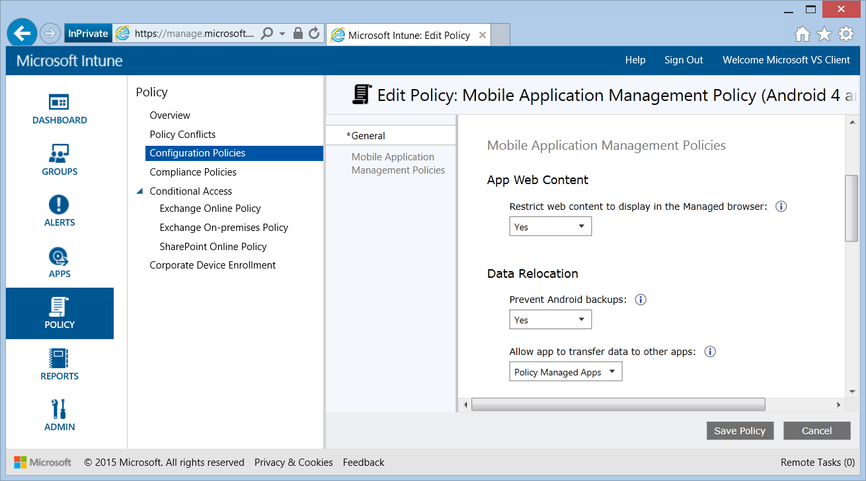
Where…how…what?
Customers don’t know where to go to explore and adopt cloud security technologies.

Slide 3
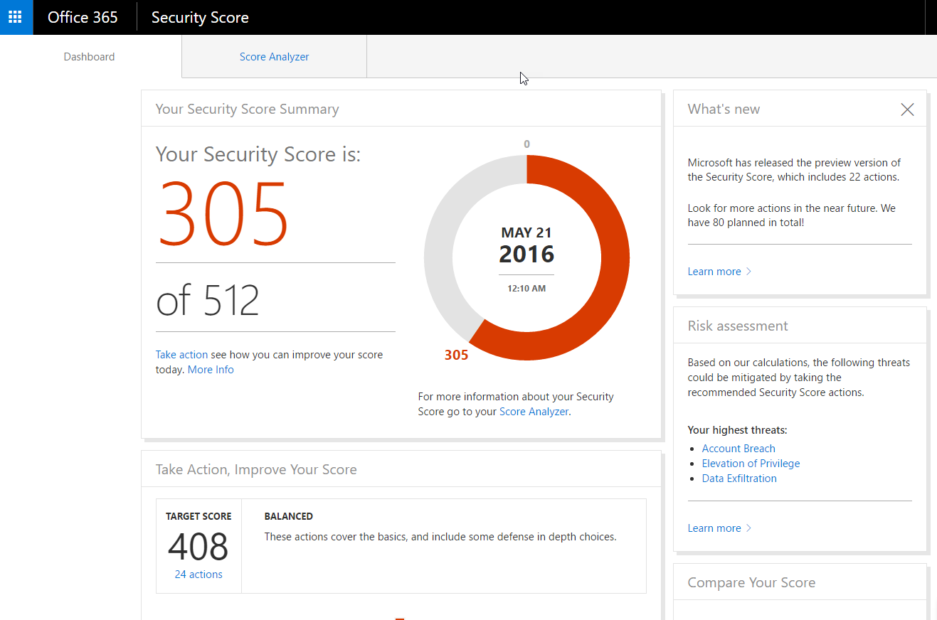
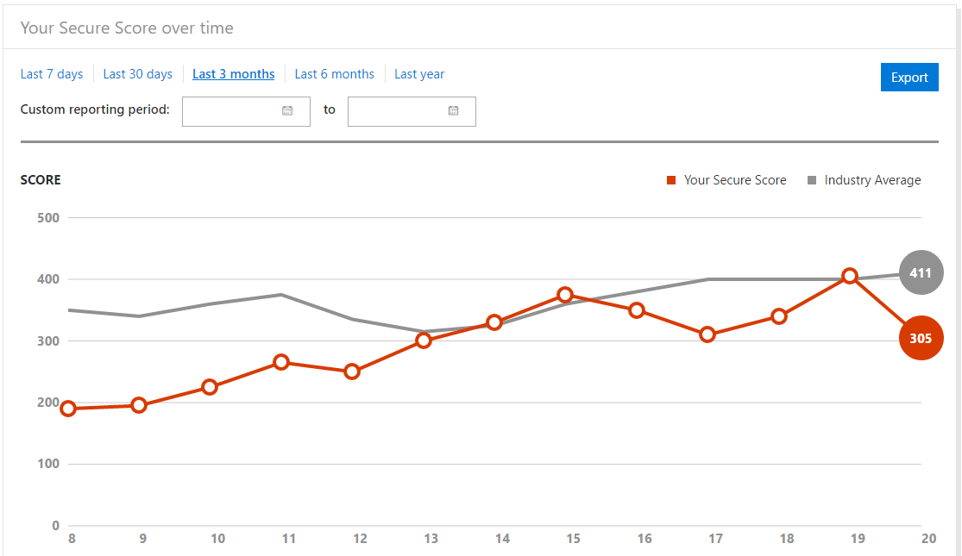
What if?
All Cloud Security Controls in one place, with a score-based framework to determine what the highest impact actions are, and an easy way to do them.

Slide 4
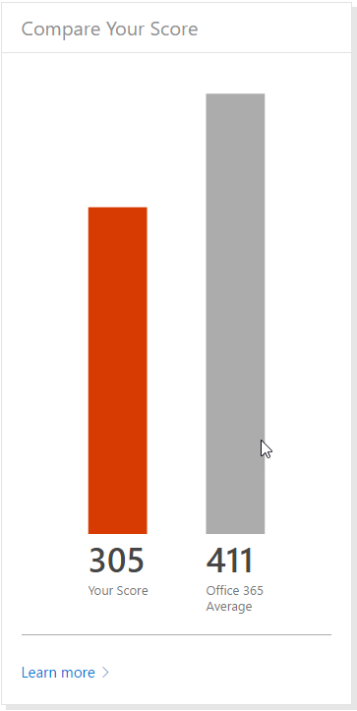
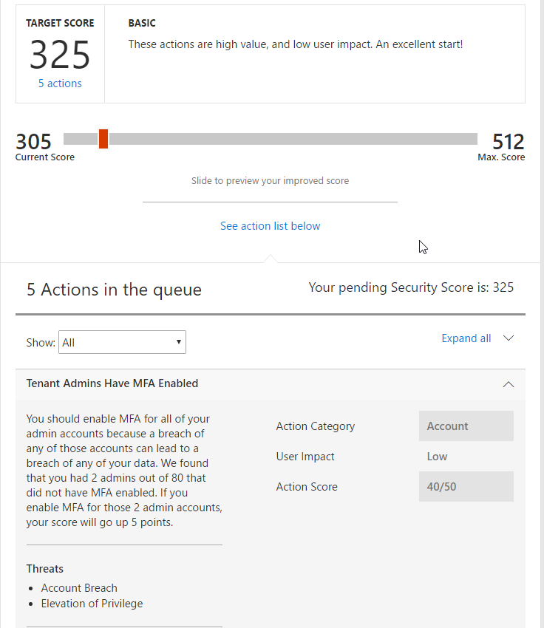
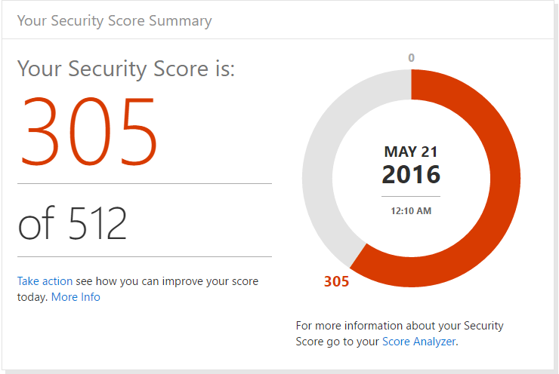
Your Secure Score
Secure Score figures out what Office 365 services they are using, then looks at their configuration and behaviors and compares it to a baseline asserted by Microsoft. If their configuration and behaviors are in line with best practices, they’ll get points, which they can track over time. More importantly, they’ll be able to quick determine what things they can do to reduce their risk.

Slide 5
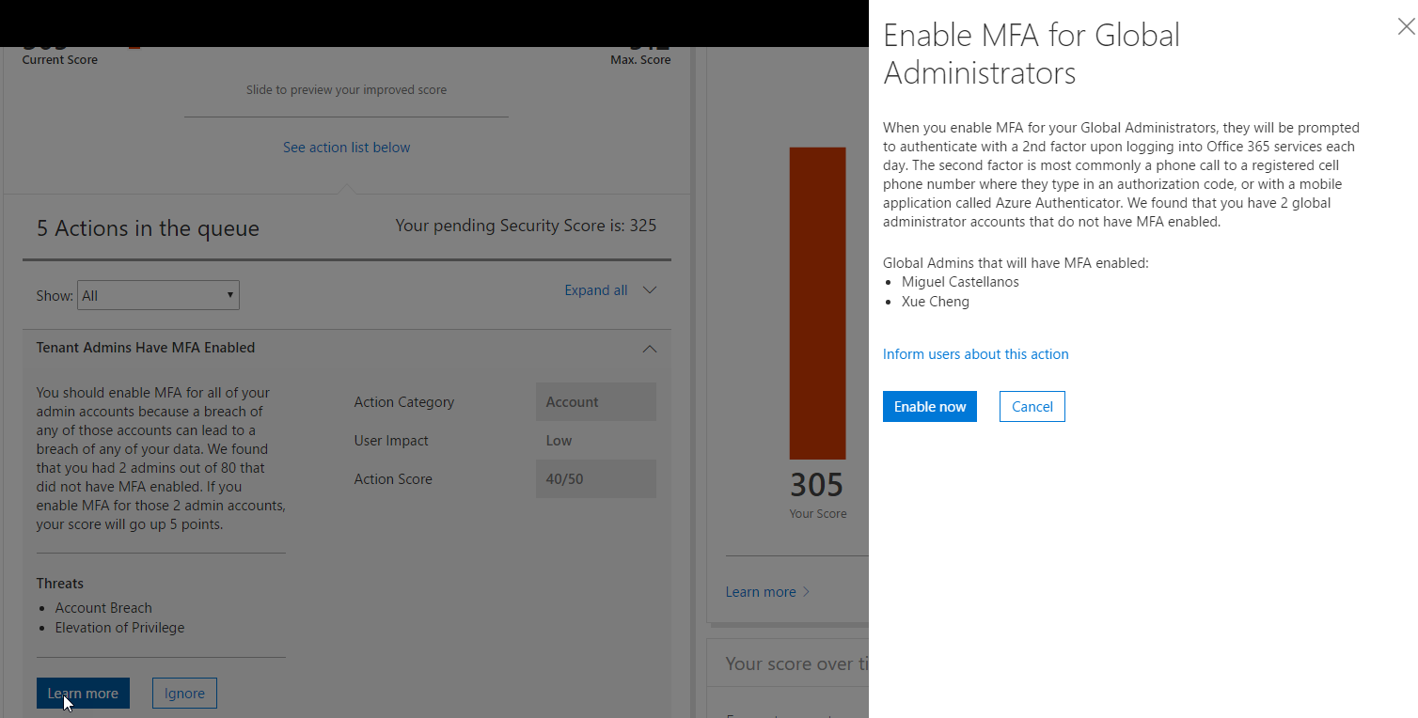
Take Action, Improve Your Score
Secure Score helps customers quickly figure out what actions they can take to improve your score. They can check their action queue and find the change they can make that most improves their security posture with the least amount of usability impact for their users.

Slide 6
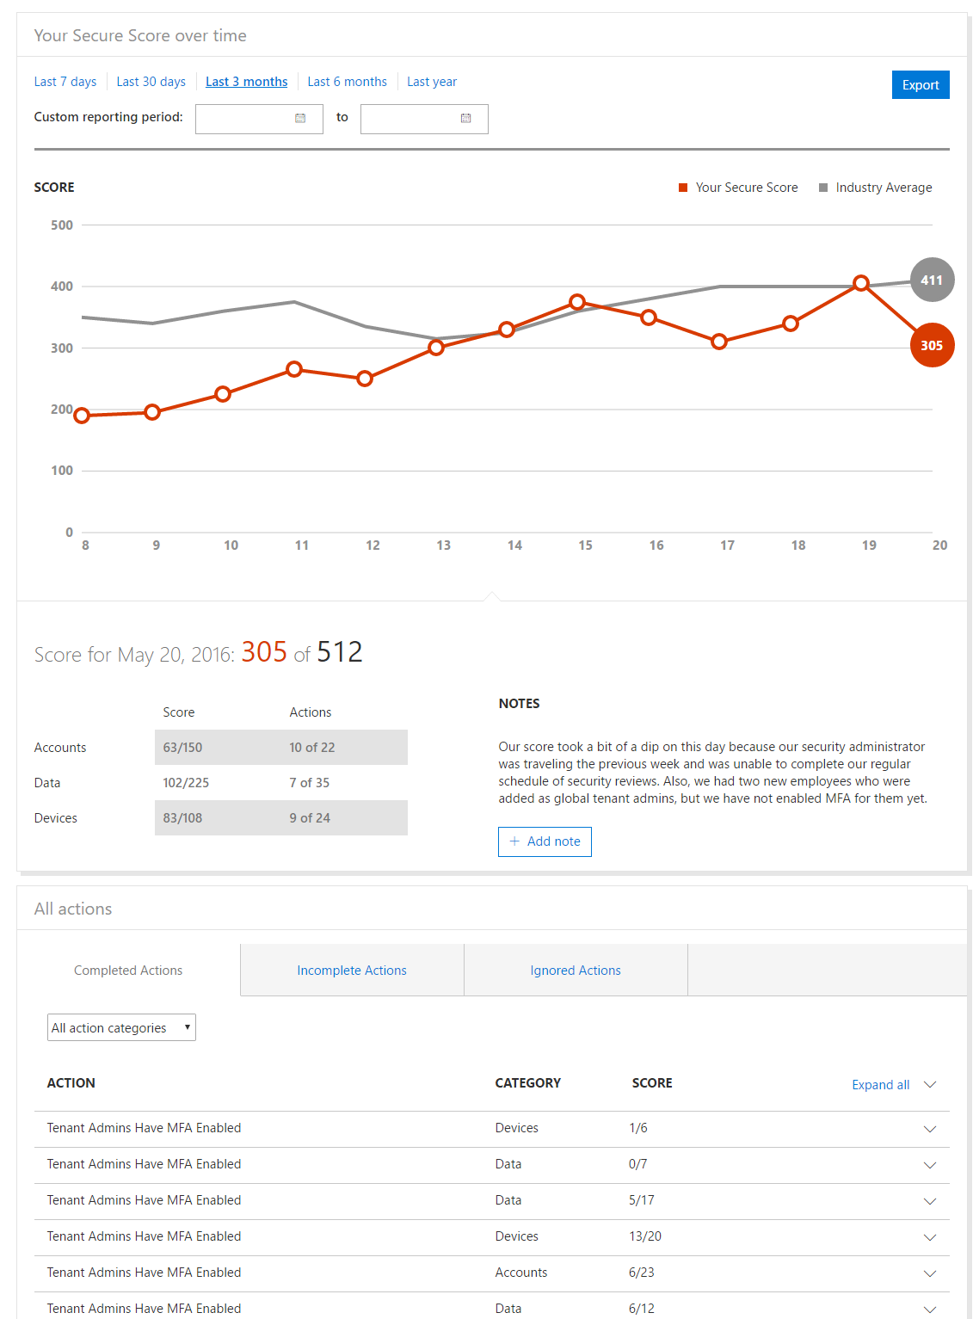
Analyzing Your Score
Secure Score gives customers a different way of managing their risk. Rather than reacting or responding to security alerts, the Secure Score lets them track and plan incremental improvements over a longer period of time.

Slide 7
Demo

Slide 8
Insights
Who is visiting the Secure Score?
Enterprise heavy, but reasonable distribution.
Security conscious tenants. Visitors start with more than double the average.
Is it working?
9% increase in Secure Score for users vs. O365 Average (39-44). Growth velocity is 5%.
11% increase for < 50 seat customers (36-41).

Slide 9
Questions?

Slide 10
Deploy, ramp-up on new services and onboard new users with Microsoft FastTrack: http://fasttrack.microsoft.com/

Slide 11
Join the Microsoft Tech Community to collaborate, share, and learn from the experts: http://techcommunity.microsoft.com

Slide 12
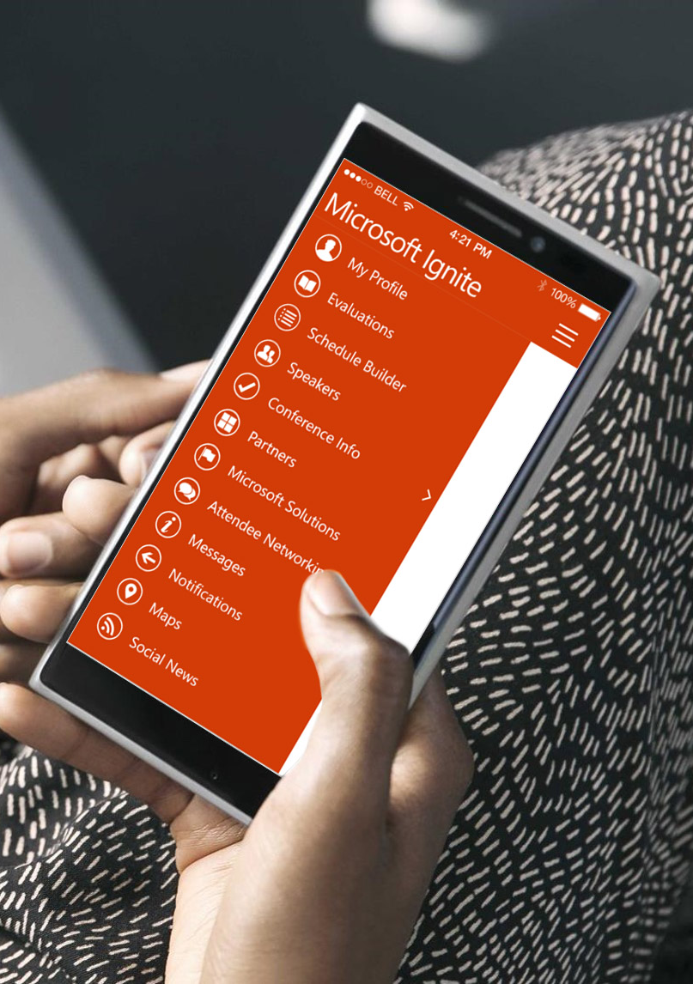
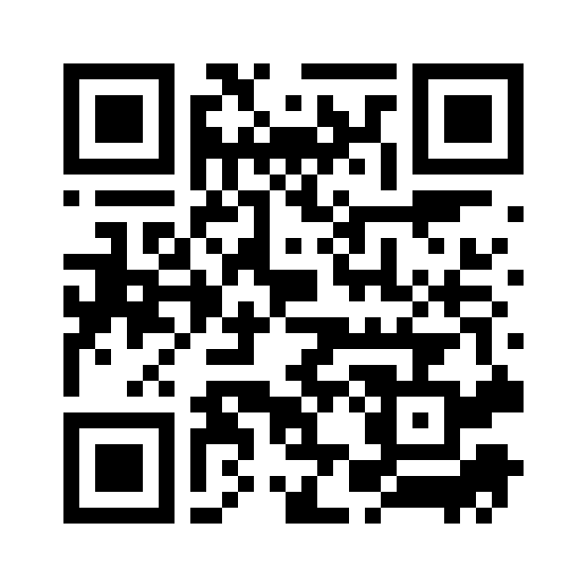
Please evaluate this session
Your feedback is important to us!
From your PC or Tablet visit MyIgnite at http://myignite.microsoft.com
From your phone download and use the Ignite Mobile App by scanning the QR code above or visiting https://aka.ms/ignite.mobileapp

