Slide 1
Reporting and Analytics Dynamics CRM 2016 What’s new
BRK2163
Dev Vidhani
Principal Program Manager

Slide 2
Range of BI and Analytics capabilities
Topics for discussion and demo
Reporting | PowerBI integration with CRM | Personalized, self-service BI
 |  | Improved PowerBI content packs
 |  | Solution templates for Enterprise BI
Advanced analytics | Embedded Insights | Cross sell recommendation Knowledge article recommendation Automatic case topic analysis Similar cases suggestion
 | Cortana Intelligence Suite solutions | Opportunity scoring

Slide 3
Power BI Integration in
Dynamics CRM 2016

Slide 4
Power BI Integration
What’s accomplished with Dynamics CRM 2016
Dynamics data in Power BI
Analyze with Power BI
Web APIs with marked performance improvements to extract data Batch query support $expand support for navigation properties | Improved Content Packs for Sales with OData v4 endpoint Content Pack for Service with Odata v4 endpoint Embed Power BI Tile in CRM Dashboard
Self Service BI
Personal BI

Slide 5
Performance and throughput improvements to extract data from Dynamics CRM
>10X reduction in data download size with Power Query with json format and gzip compression
>10X improvement in data refresh times with Excel and PowerBI.com
Simplified metadata for Optionsets, Currency and Lookup fields as simple data types
Web API based on OData v4 available
Power Query supports Dynamics CRM v4 endpoint
Use Dynamics CRM Web API with Power BI
Extract slices of data for personal or team BI

Slide 6
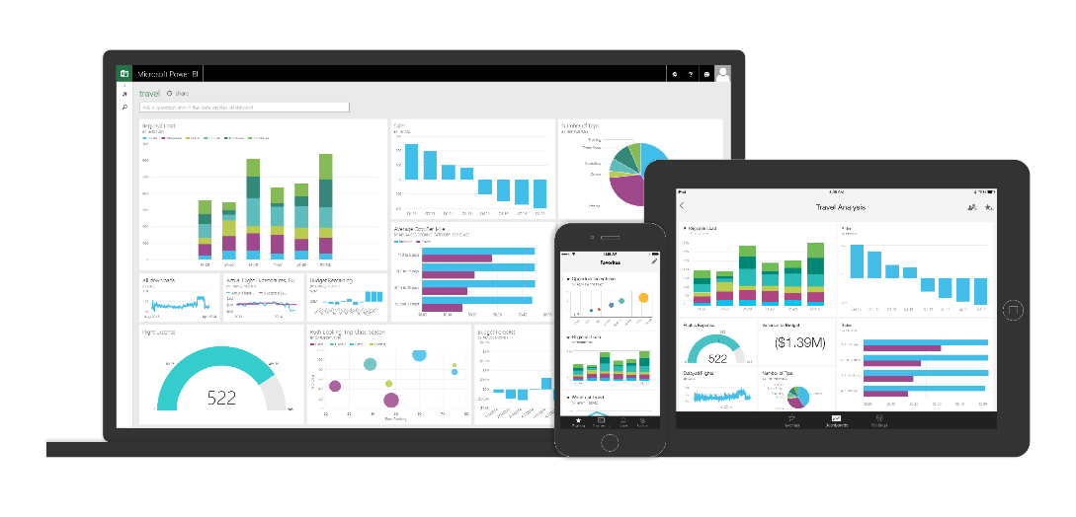
Personal BI with Dynamics CRM data
Familiar Tools
Dynamics CRM
Self-service BI
EXTRACT (OData v4)
Access across Devices
Online + Offline
Share/Collaborate
CRM Content Pack
Self-service ETL
Data Refresh
Self Service BI
Personal BI

Slide 7
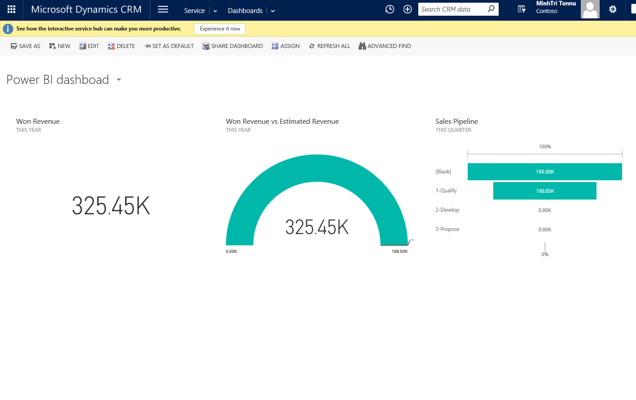
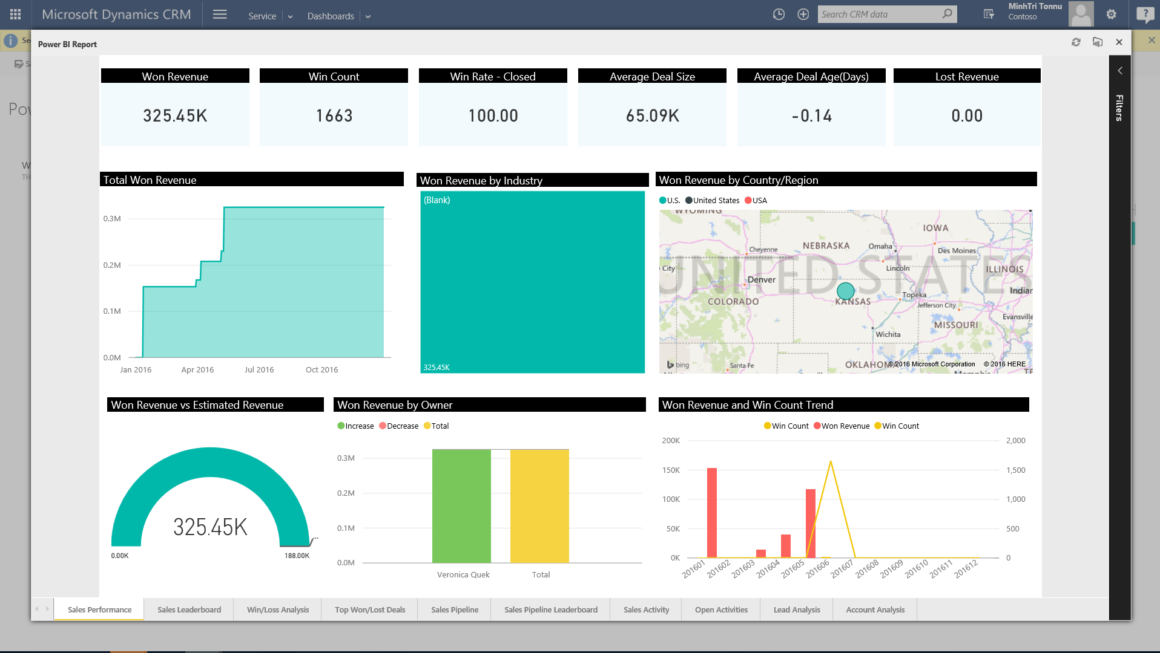
Power BI for Microsoft Dynamics CRM
Embed Power BI Tile
Embed Power BI Tile in CRM Dashboard
Simple configuration to add a Power BI Tile
Immersive drill through to the Power BI Report
Full interactivity with Power BI Report

Slide 8
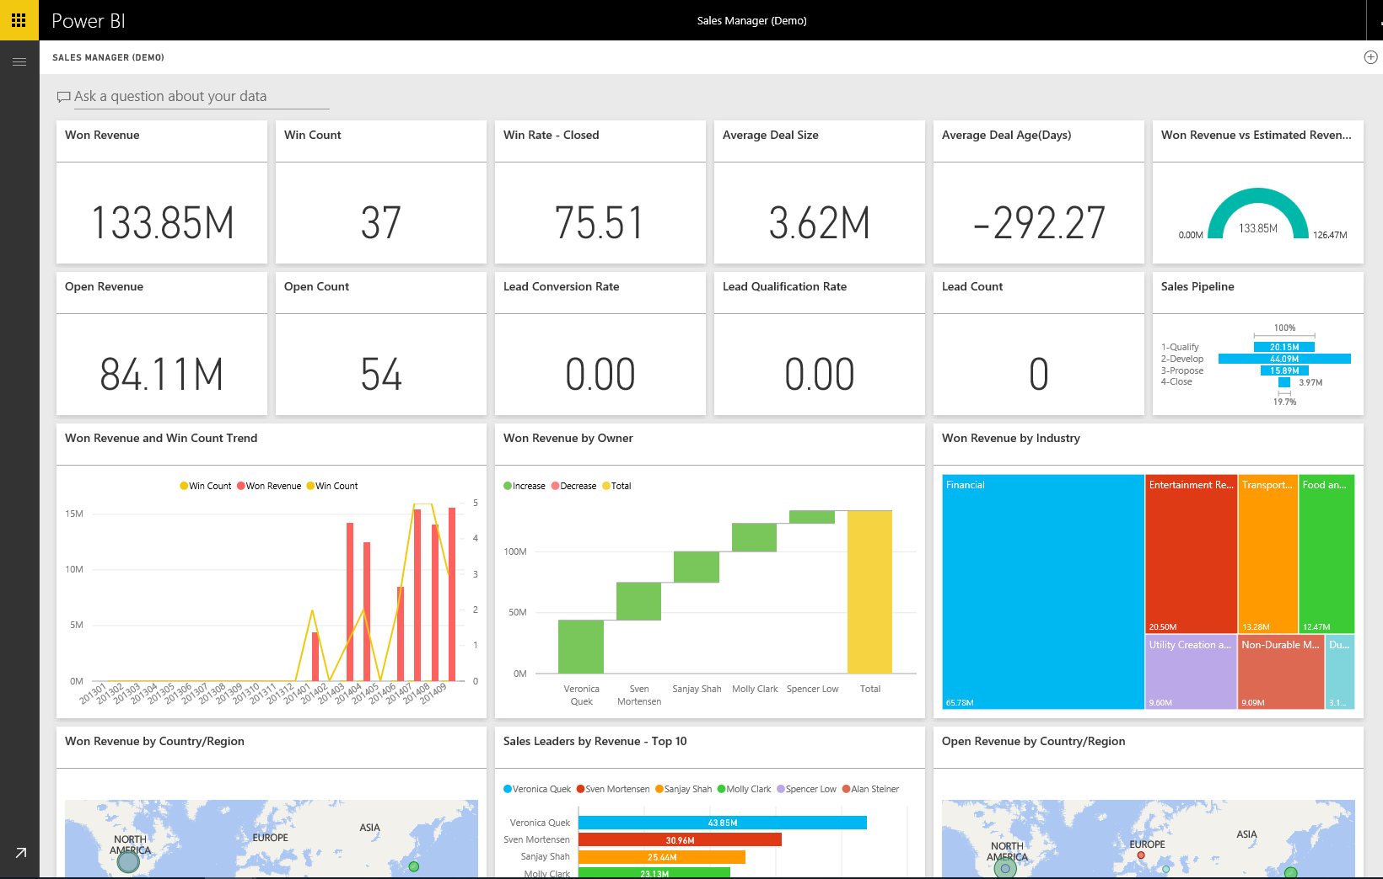
Power BI for Microsoft Dynamics CRM
Analyze sales performance, sales pipeline, team activities and lead pipeline
Improved Out-of-the-Box Sales Analytics Power BI Content Pack
Sales Manager dashboard
OData v4 for data refresh

Slide 9
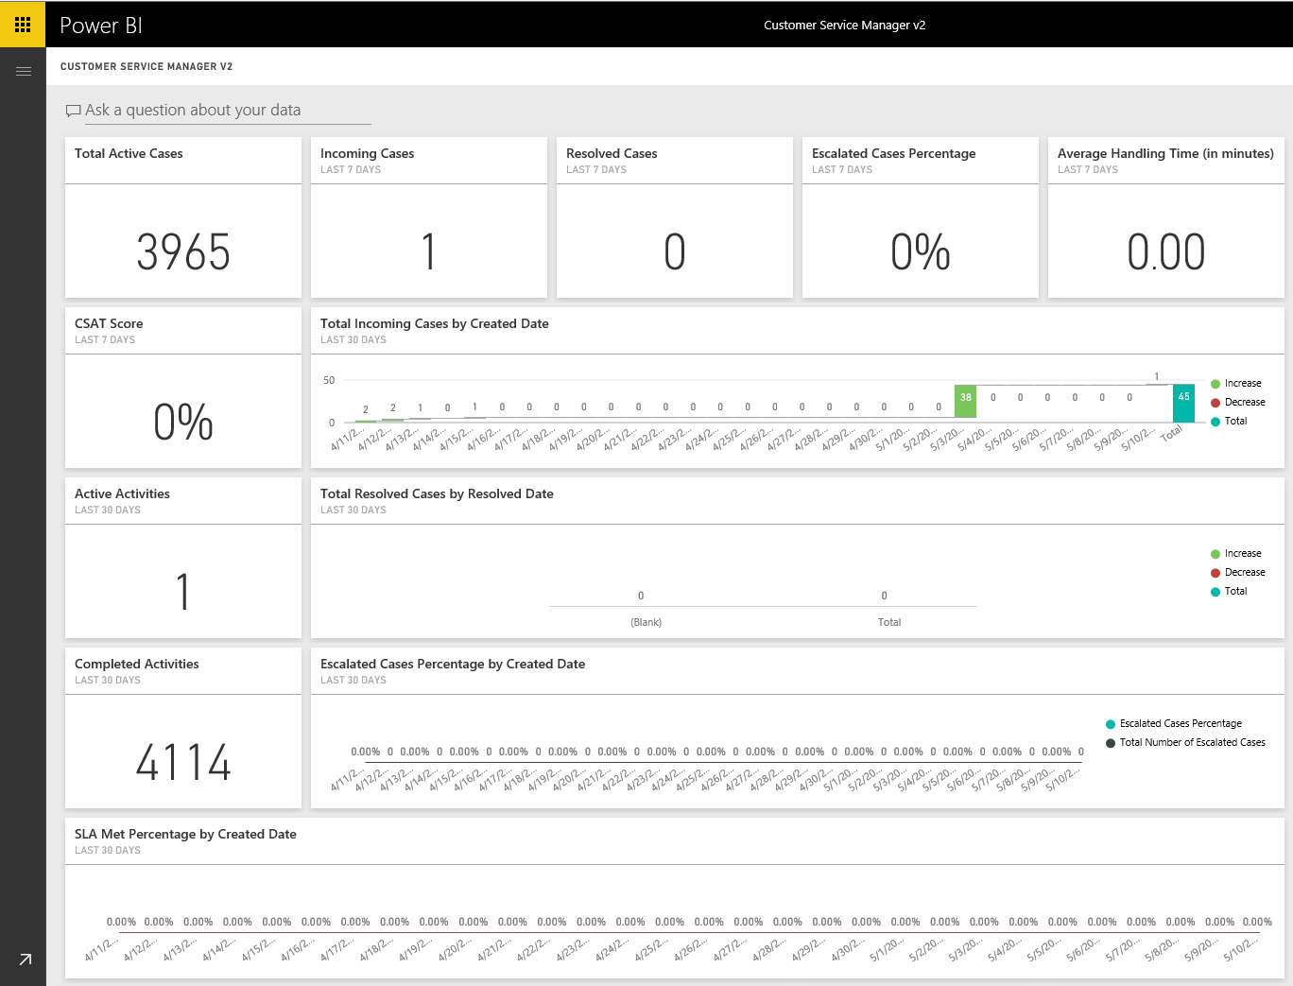
Power BI for Microsoft Dynamics CRM
Analyze service performance, incoming cases, team activities
Out-of-the-Box Customer Service Analytics Power BI Content Pack
Customer Service Manager dashboard
Metrics and charts to measure customer service performance across teams and subject categories
See incoming vs resolution vs escalated trends
OData v4 for data refresh
50
150.00

Slide 10
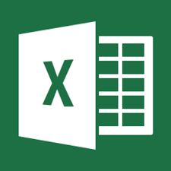
Enterprise BI with Dynamics CRM Online
Power BI Solution Templates for Sales
Self-service BI
SQL Server Analysis Services
Dynamics CRM
DW/DMs/OLAP
Direct Query
Scheduled Refresh
Data Export
Excel
Power BI Desktop
Azure SQL Azure DW
SSAS
Other…

Slide 11
Demo

Slide 12
ML Features in
Dynamics CRM 2016

Slide 13
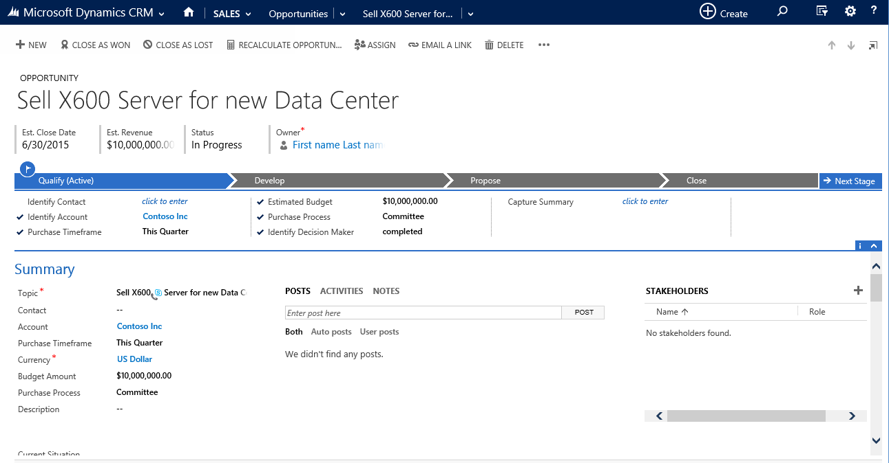
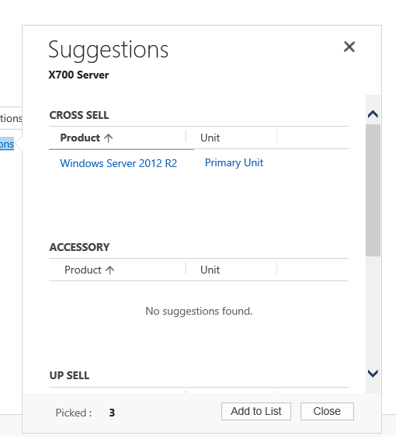
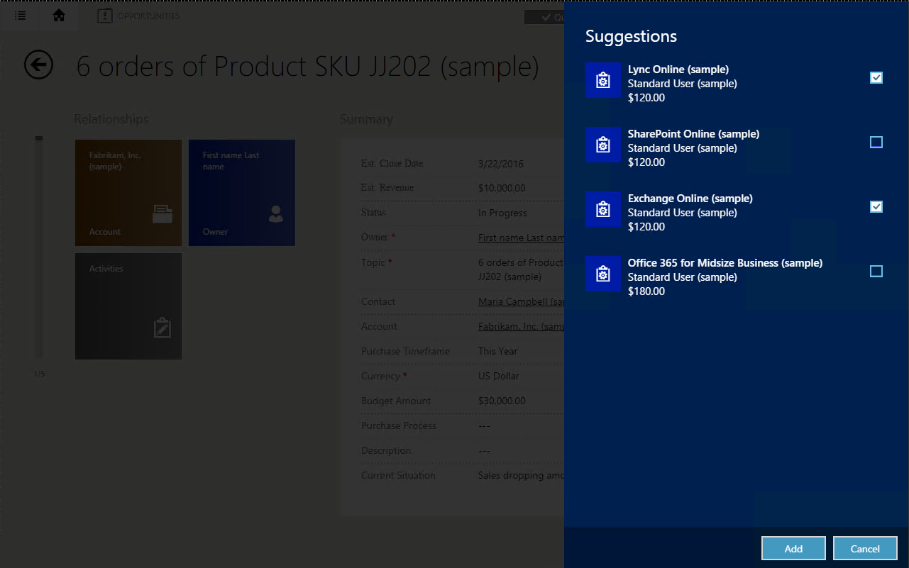
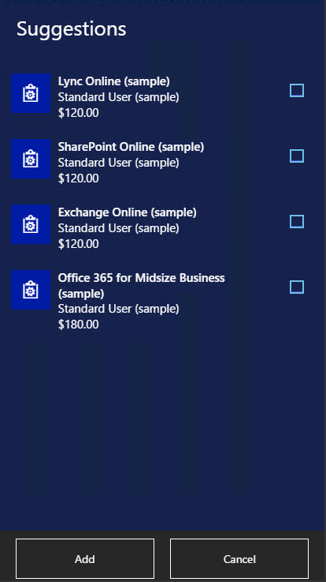
Cross-sell Recommendations
Integrated with Azure ML Recommendation API
Configure and build recommendation model in Dynamics CRM using historical data
Embedded Insights in Dynamics CRM
Mix ML and product links based recommendations
Preview Feature for CRM Online

Slide 14
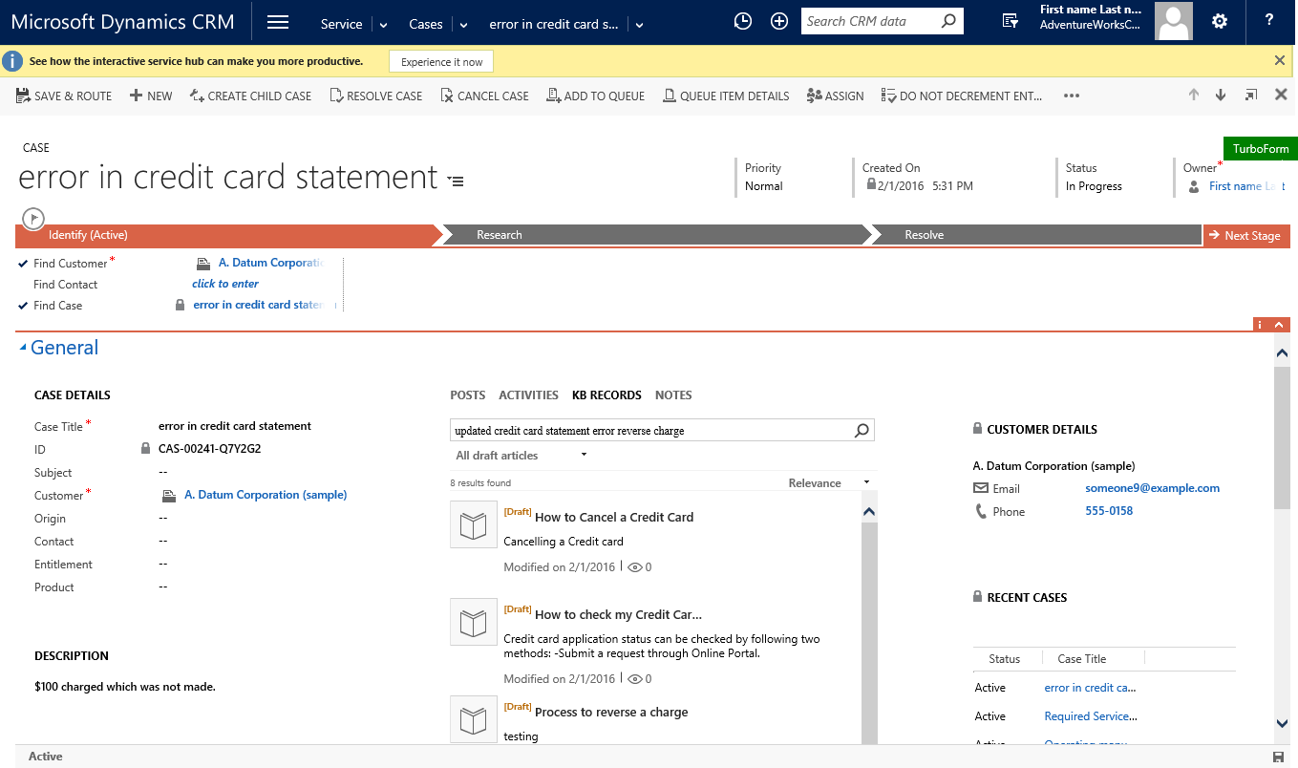
Suggest Knowledge Articles
Integrated with Azure ML Text Analytics API
Analyzes Case with its activities/notes/attachments for key phrases
Relevant Cases and Knowledge Articles suggested with key phrases
Embedded Insights in Dynamics CRM
Preview Feature for CRM Online only
Suggest Knowledge Articles – Available in Public Preview with CRM 2016 Update 1
Preview Feature for CRM Online

Slide 15
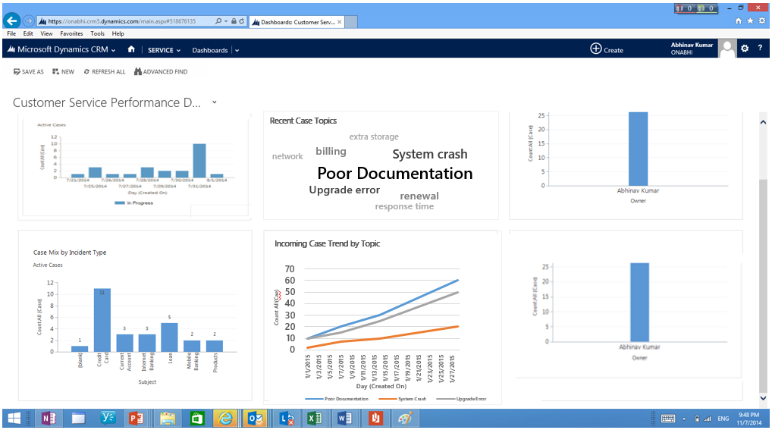
Topic Analysis
Integrated with Azure ML Text Analytics API
Configure and do topic analysis on Cases in Dynamics CRM using historical data
Embedded Insights in Dynamics CRM
Helps in automatic discovery of issues reported in service cases
Preview Feature for CRM Online only
Similar Cases – Available in Public Preview with CRM 2016 Update 1
Preview Feature for CRM Online

Slide 16
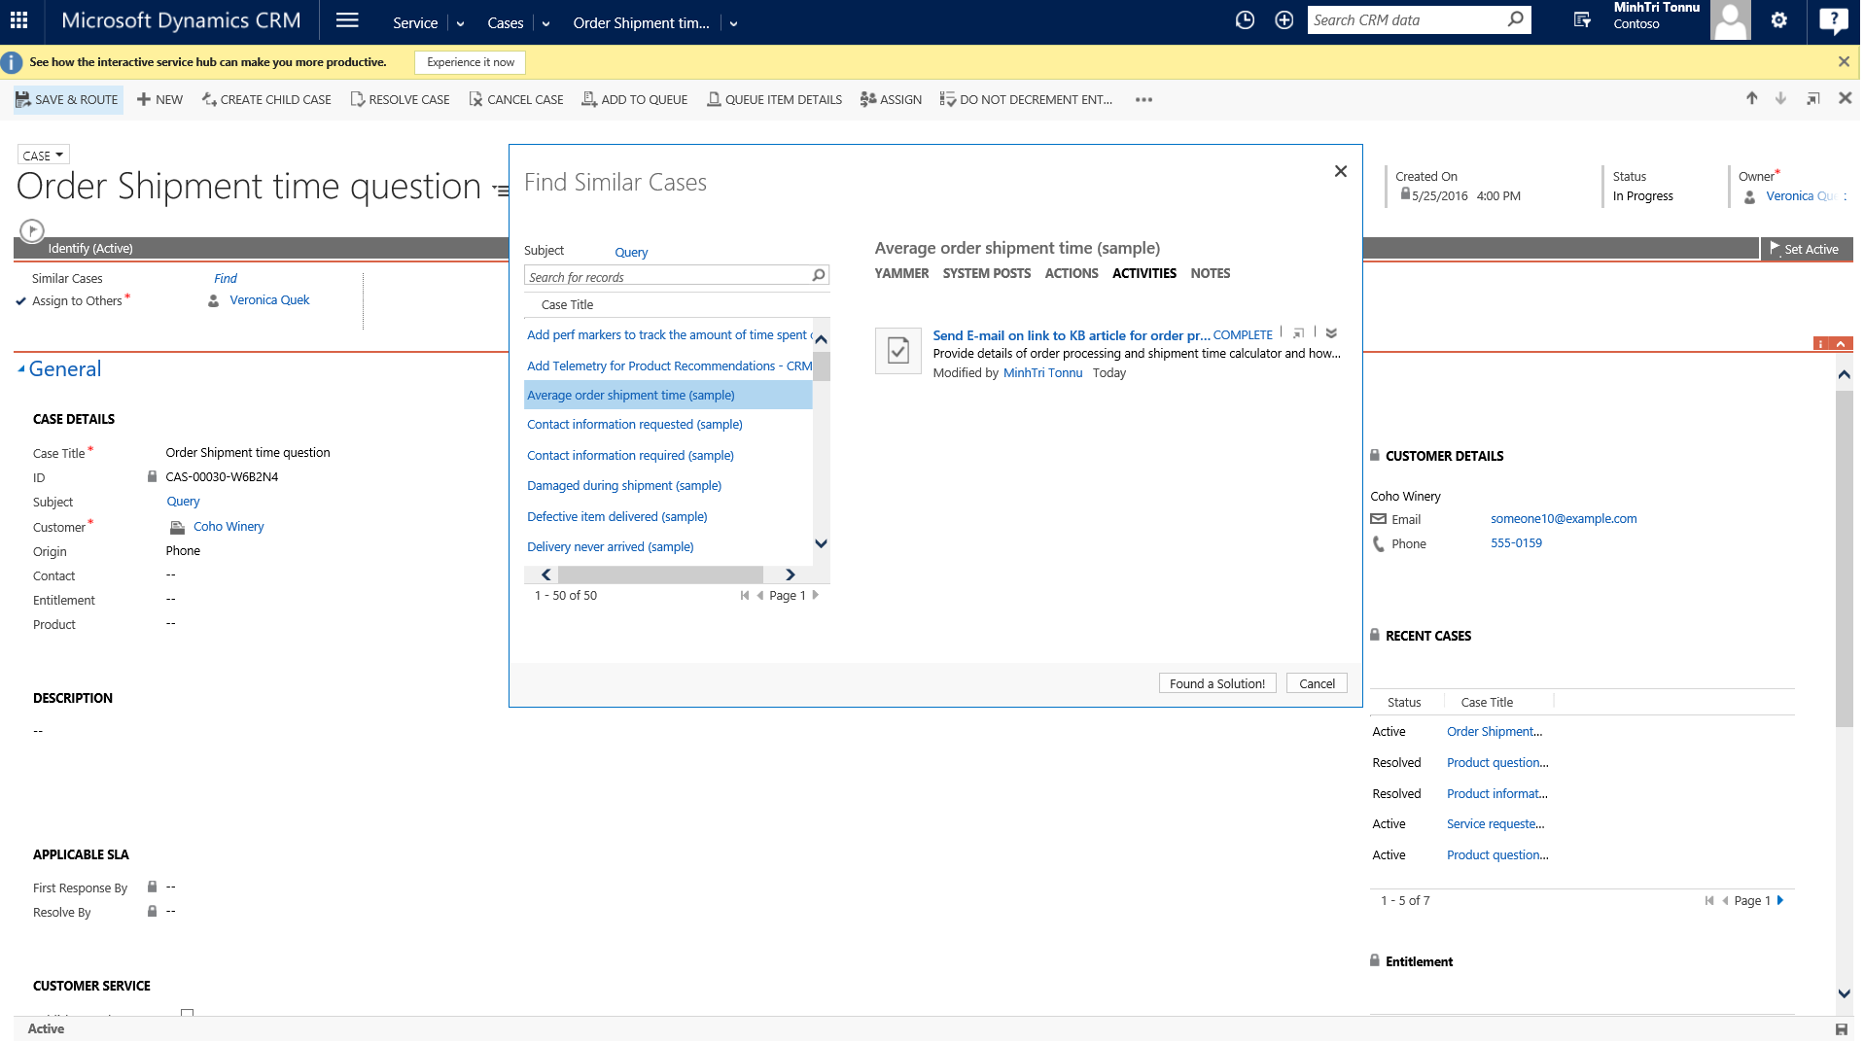
Suggest Similar Cases
Configure and get Similar Cases suggestions in Dynamics CRM
Analyzes Case along with its activities/notes for keywords/keyphrases for suggesting Similar Cases
Integrated with Azure ML Text Analytics API
Embedded Insights in Dynamics CRM
Preview Feature for CRM Online only
Similar Cases – Available with upcoming Naos release - May 2016
Preview Feature for CRM Online

Slide 17
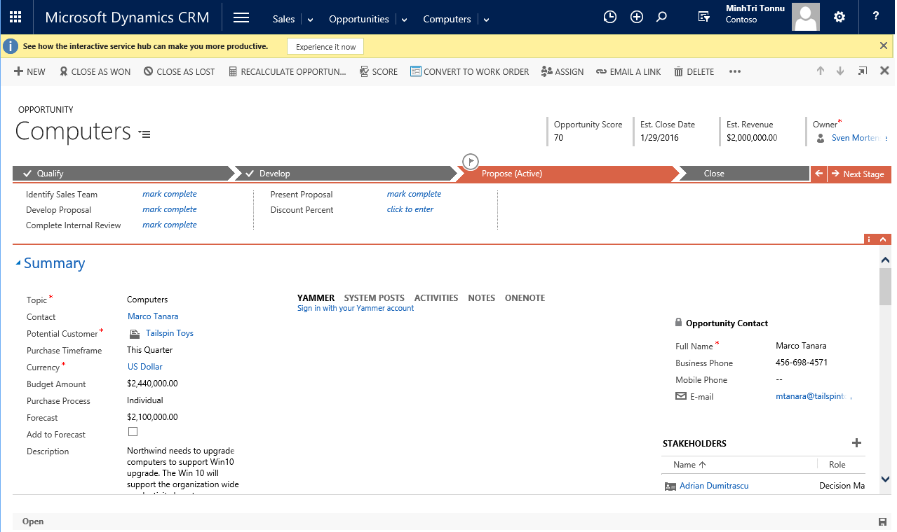
Predictive Opportunity Scoring
Cortana Intelligence Suite Solution
Predictive Opportunity Scoring with explanations
End to end Cortana Intelligence solution template
Full extensibility with Cortana Intelligence stack
Preview Feature for CRM Online only
Similar Cases – Available with upcoming Naos release - May 2016
Cortana Intelligence based Solution

Slide 18
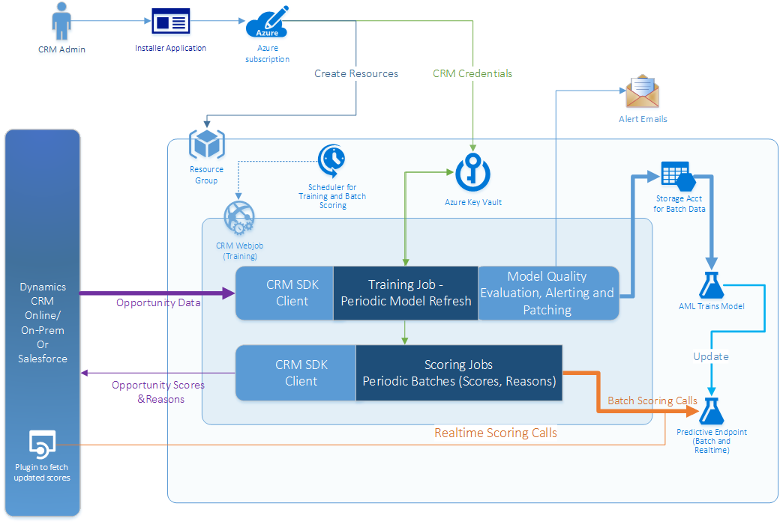

Slide 19
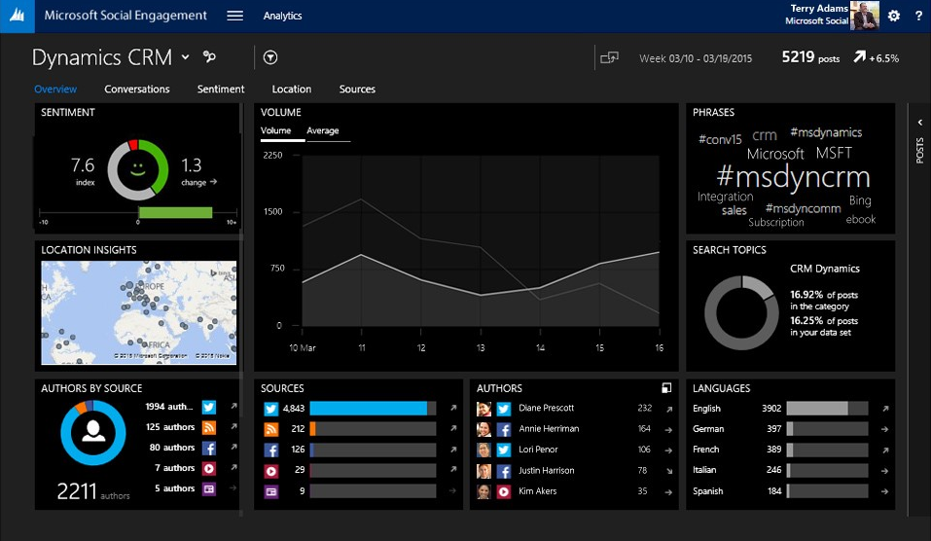
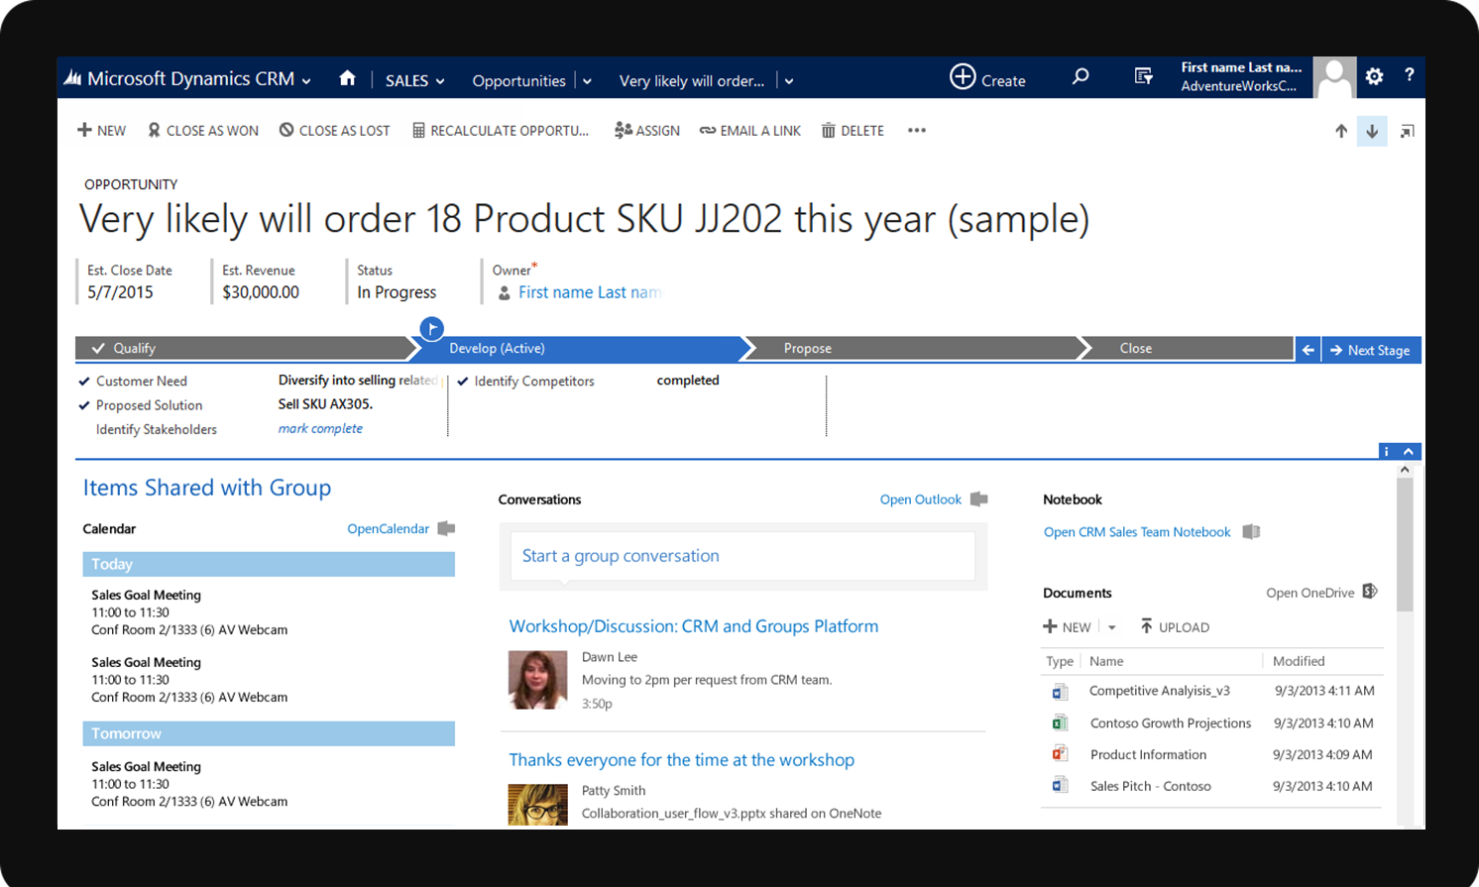
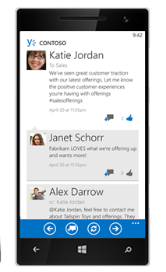
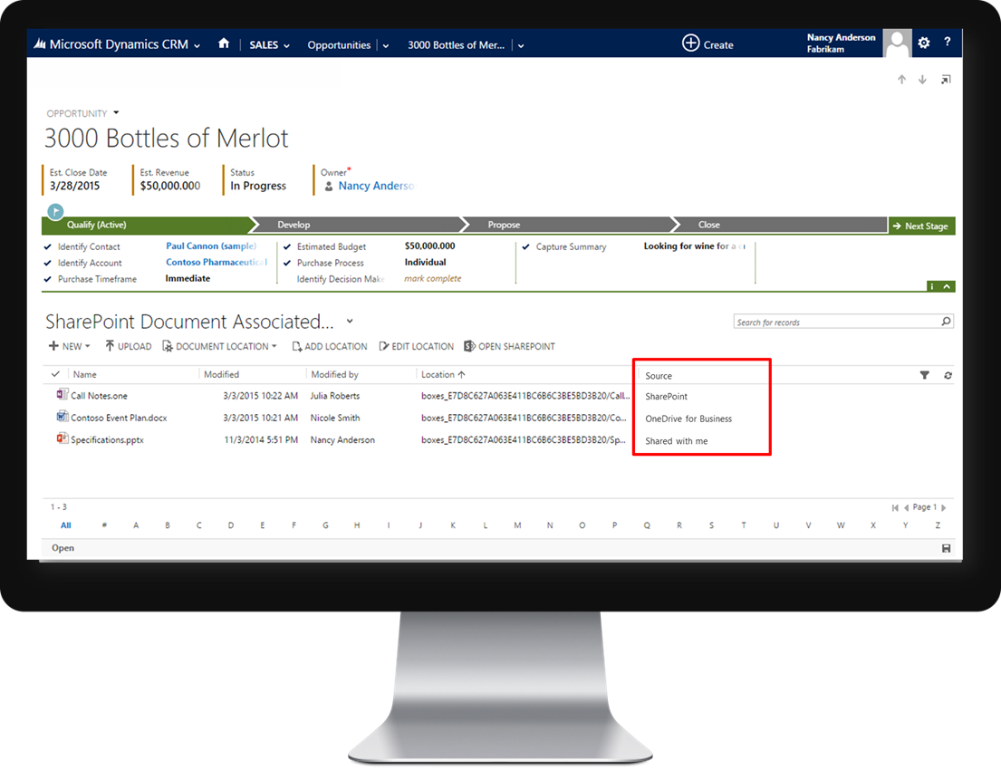
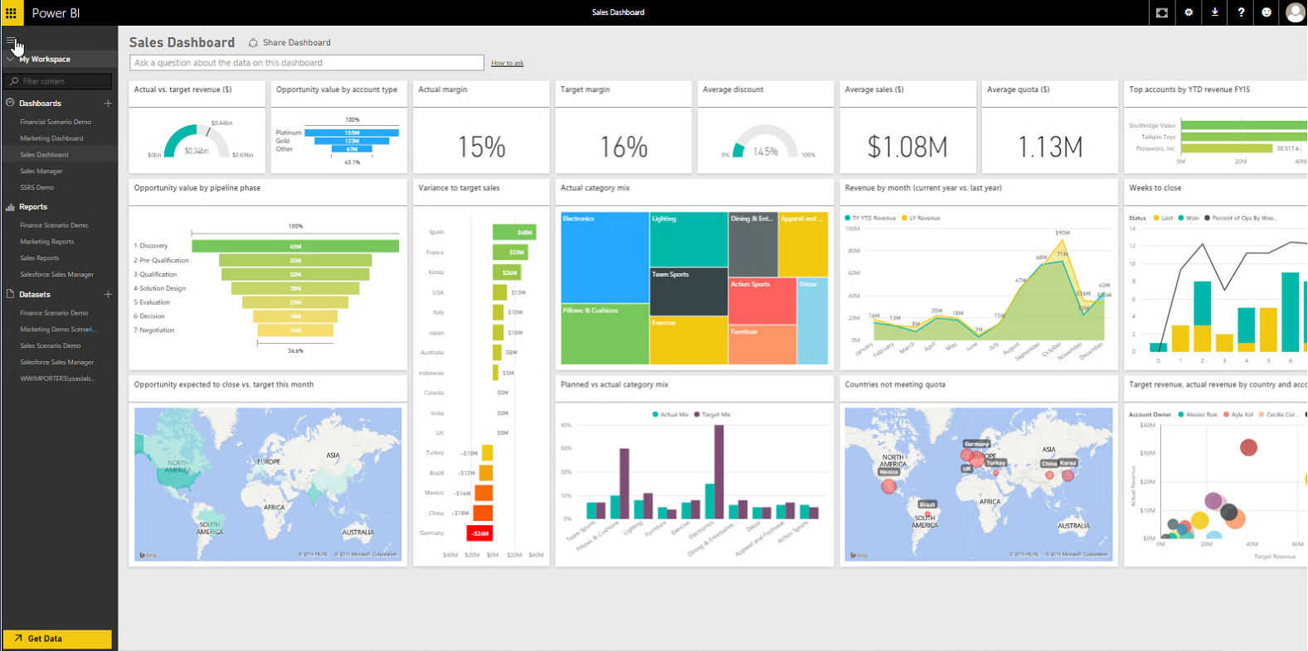
Intelligent Customer Engagement with CRM, Azure ML
1 - John (CIO at 123 Health) is tweeting in regard to a Contoso product (medical measurement device). Through MSE we automatically determine intent and create lead from twitter post
3 - Based on the updated lead information CRM performs predictive lead scoring with both internal and external (bing) data.
5 - Based on the updated opportunity information CRM performs predictive opportunity scoring.
Sales rep opens the opportunity and understands current score, probability to close.
6 - CRM is displaying reasoning (signals identified). Sales rep receives information through which step probability to win can be increased (suggest reference call with specific customer)
Automatically create Lead from Post
Predictive Lead Score with External Data
Predictive Opportunity Score
Qualify
Propose
Close
Develop
Follow-up call with Lead
Route to Sales
Recommend products
Analyze Sales Pipeline
2 - The lead will be routed to telemarketing. Telemarketer contacts John only 2 minutes after his post and adds further information to the lead based on the phone conversation with John.
4 - As the predictive lead score is > 80 (hot lead) the lead is automatically classified as sales qualified lead and routed to sales rep. Furthermore CRM automatically creates opportunity record.
Sales rep performs customer call and is adding further information (budget, timeline, role of contact, other signals)
7 - Based on the opportunity information CRM system provides upselling information. Product recommendation to sell e.g. outsourcing service
8 - Sales rep picks up the information and is closing the now bigger deal faster.

Slide 20
Demo

Slide 21
Predictive Analytics PoC Let’s learn together

Slide 22
Program Overview – What you provide
Business Scenarios
Your business scenarios where predictive insights can be leveraged e.g. Product Cross-sell, Lead/Opportunity scoring, Predictive Service, Customer Churn etc. A business domain owner helps explain the scenario and datasets.
Data
Sign an agreement with Dynamics CRM for sharing relevant production data for a limited period to build machine learning models.
Model validation
Test/Validate the model and outcomes. A business domain owner helps with model validation and tests outcomes with a small unit in the organization and see the benefits.

Slide 23
Program Overview - What you get
ML Model
Access to ML model for your specific scenario. Recommendation on operationalizing the ML model with Dynamics CRM and Cortana Intelligence Suite
Drive Future ML Capabilities
Help define the ML scenarios so it can best meet your requirements with future ML capabilities in Dynamics CRM

Slide 24
Free IT Pro resources To advance your career in cloud technology
Plan your career path
Cloud role mapping
Expert advice on skills needed
Self-paced curriculum by cloud role
$300 Azure credits and extended trials
Pluralsight 3 month subscription (10 courses)
Phone support incident
Weekly short videos and insights from Microsoft’s leaders and engineers
Connect with community of peers and Microsoft experts
Microsoft IT Pro Career Center
www.microsoft.com/itprocareercenter
Get started with Azure
Microsoft IT Pro Cloud Essentials
www.microsoft.com/itprocloudessentials
Demos and how-to videos
Microsoft Mechanics
www.microsoft.com/mechanics
Connect with peers and experts
Microsoft Tech Community
https://techcommunity.microsoft.com

Slide 25
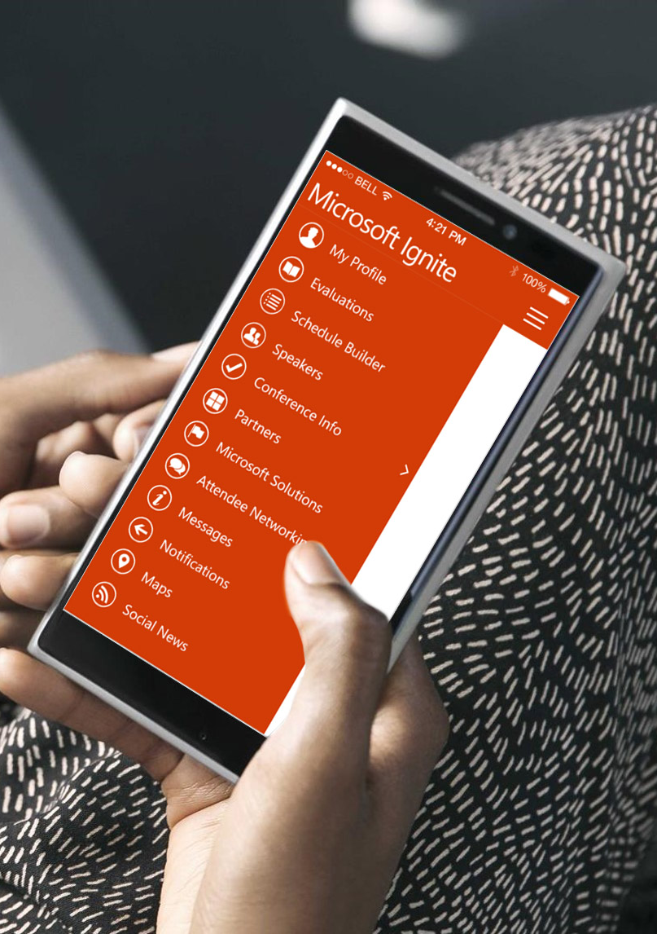
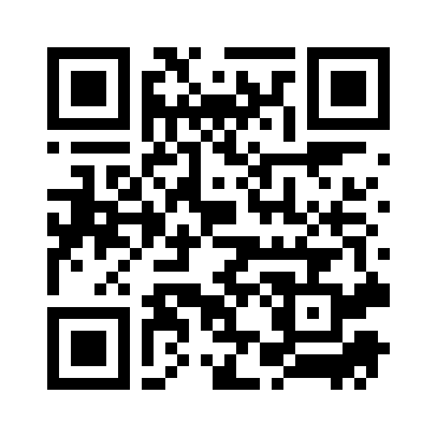
Please evaluate this session
Your feedback is important to us!
From your PC or Tablet visit MyIgnite at http://myignite.microsoft.com
From your phone download and use the Ignite Mobile App by scanning the QR code above or visiting https://aka.ms/ignite.mobileapp

