Slide 1
Microsoft Social Engagement Update and Roadmap
BRK2162
Kishore Mantravadi
Senior Program Manager

Slide 2
Microsoft Social Engagement
Social Listening
Intelligent Social
Twitter, FB, Instagram, YouTube, Blogs, Forums, News & RSS
Listen globally in 20 languages
Sophisticated Alerts to detect trends and specific posts
Simple and powerful Search Topic setup
Powerful insights with a highly interactive experience
Adaptive Sentiment analysis using Azure ML
Identify key influencers – fans and critics
Automated Triage: intention analysis and rules-based routing
Social Engagement
Social CRM
Engage on Twitter and Facebook using your social profiles
Team collaboration via tracking and sharing
E2E customer experience with link to CRM actions
Personalized Streams dashboard with Inbox
Link Posts to CRM and get Social insights in CRM and MDM
Sales: Buy signals, Competitive intelligence, Track Accounts
Marketing: Brand sentiment, Track Campaigns, Influencers
Service: Social Care, Service sentiment, Customer feedback

Slide 3
Microsoft Social Engagement: Today
3,500+ active customers
Launched April’14
Microsoft Social Engagement runs on the Microsoft Azure cloud
17,000+ customer brands, companies, etc. followed on social media
13,700+ Facebook pages followed
10,000+ active Alerts configured
1.1+ billion social posts processed
Stand-alone, Microsoft Dynamics CRM Online, and Microsoft Dynamics CRM On-Premises

Slide 4
Strategic Investment Pillars
Intelligence & Automation
Omni-Channel & Immersive
Access
One Microsoft

Slide 5
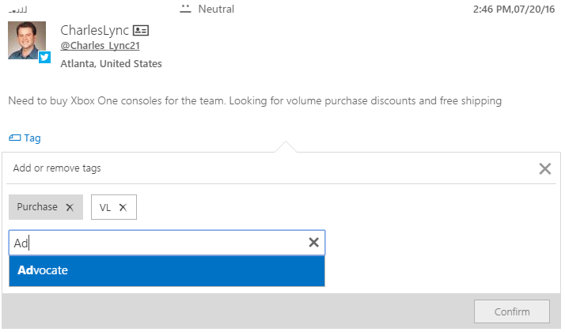
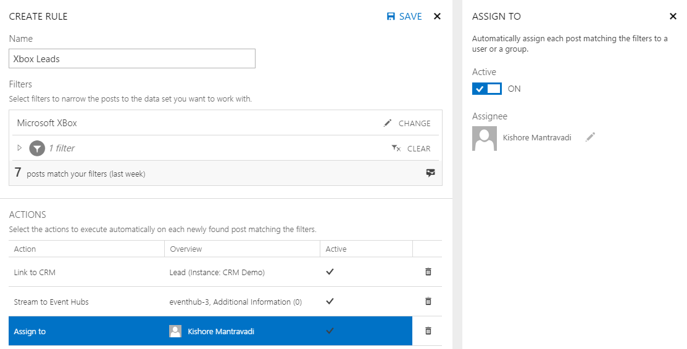
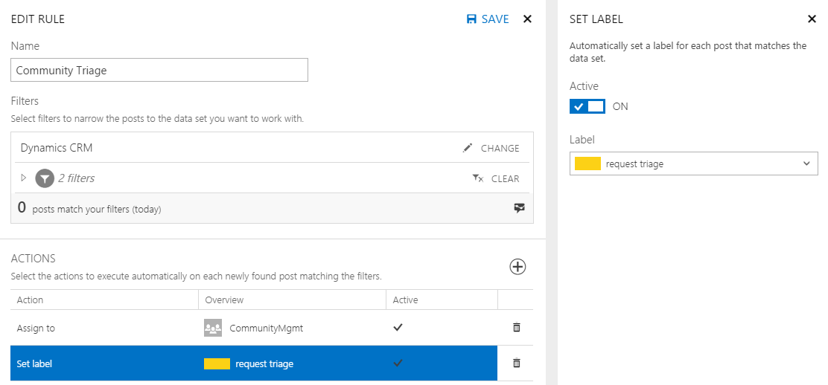
Spring & Summer 2016
Intelligence & Automation
Intentions & Tags
ML-based intent detection using post text. Custom and auto tagging of posts
Sentiment Languages
Support for sentiment analysis added for Arabic, Chinese & Japanese
Automated Triage
Rules-based routing of posts to CRM, assign to users or groups and set label
Stream real-time social data
To Azure Event Hubs based on pre-defined filter criteria

Slide 6
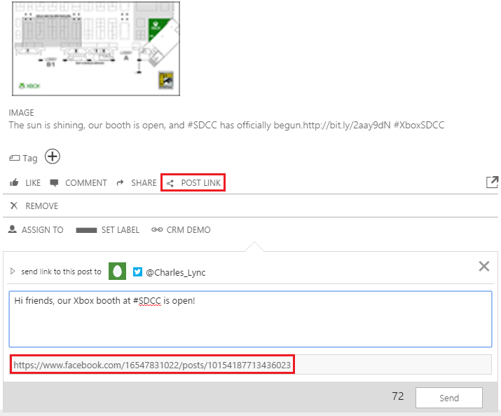
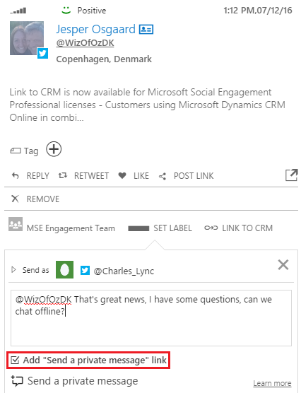
Spring & Summer 2016
Omni-channel & Immersive
Forums, Instagram & more Blogs
New listening sources added and extended existing Blogs source
Share Posts
Share the link to any post you see in MSE on your social profiles
Public to Private
Reply to any public Tweet with a link to take the conversation private
Twitter Replies
Replies to tweets are shown as a threaded message on the original

Slide 7
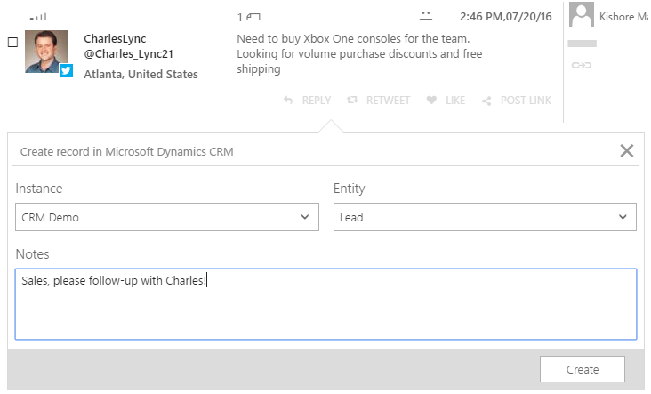
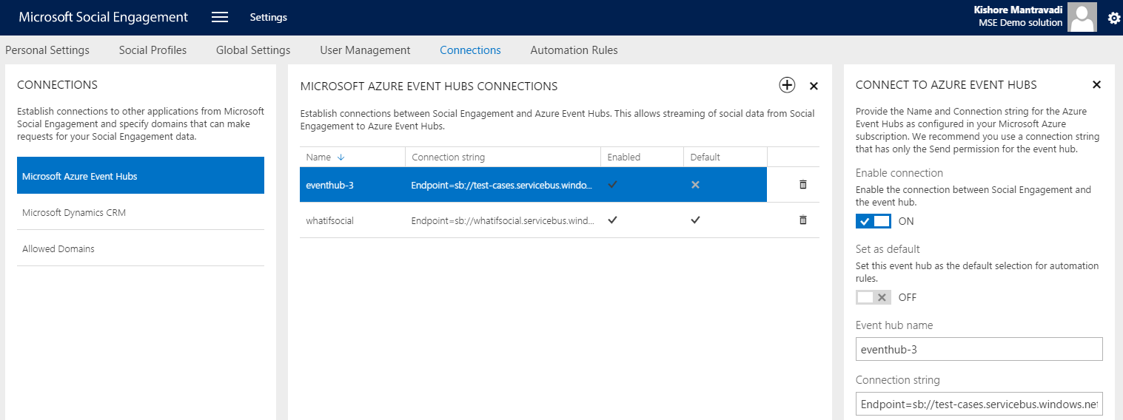
Spring & Summer 2016
Access
Link to CRM for Pro license
Users with MSE Pro license can also link posts to CRM as Cases or Leads
Social Data Access
Easily access real-time social data in your apps via Azure Event Hubs

Slide 8
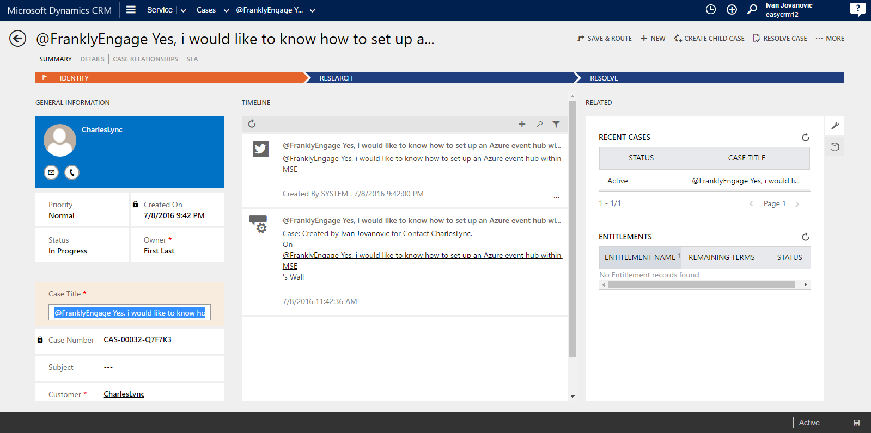
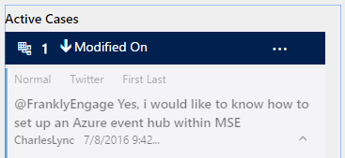
Spring & Summer 2016
One Microsoft
CRM Interactive Service Hub
Show linked CRM records directly in the new CRM Interactive Service Hub
Office 365 Groups
Support for soft deletion of groups used for assigning & sharing in MSE
Link to CRM Enhancements
Improved performance, authentication & integration experience with CRM
Azure Event Hubs
Stream social posts in real-time from MSE to Azure Event Hubs

Slide 9
Demo
What’s new in MSE

Slide 10
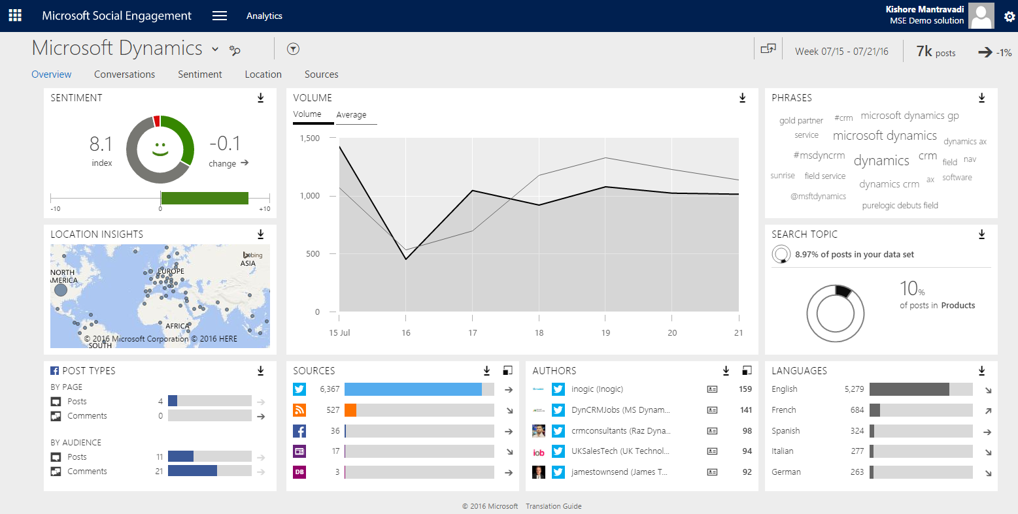
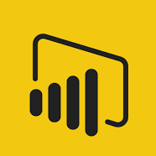
Intelligence & Automation
Tara ‘Community Manager’
Manages team that engages with customers on social media. Sets up automation rules
Microsoft Social Engagement
Social Media
Learning from User feedback
User Interface
Meredith ‘Executive’
Gets insights for data-driven decision-making with real-time and interactive dashboards
Intent Detection
(Azure ML)
Posts Index
(Azure DocDB)
Automation Rules
Microsoft
Power BI
Charles ‘Lead’
Tweets: “Need to buy Xbox One consoles for the team. Looking for volume purchase discounts and free shipping.”
Microsoft Dynamics CRM
Microsoft Azure Event Hub
Azure Stream Analytics
Data from other “sources”

Nancy ‘Sales’
Xbox Enterprise Sales Manager

Slide 11
Roadmap

Slide 12
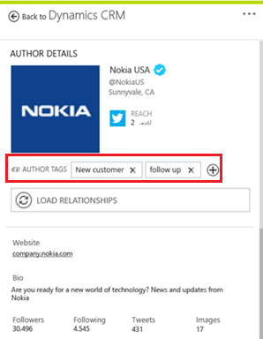
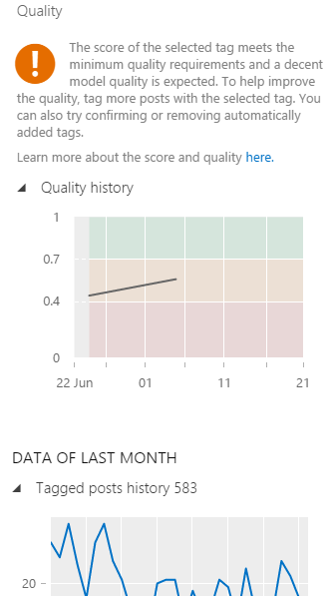
Intelligence & Automation
Author Tags
Add tags to authors on any source for easy tracking and filtering
Auto Tags Quality
Get feedback on the expected quality of the ML-based tagging of posts
Automation Stats
Keep track of automation rules execution with detailed breakdown
Recommendations
Get recommendations on content to stay on top of and share

Slide 13
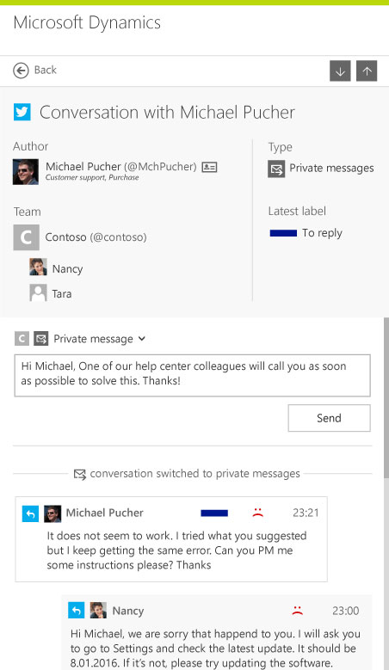
Omni-channel & Immersive
Social Selling App
Immersive CRM MoCA application for personalized social selling
Conversations
See the complete conversation thread on any post to get the full context
Listen
Support for acquiring data from Reddit, Disqus and LinkedIn
Social Care
Native experience within CRM for customer service on social media

Slide 14
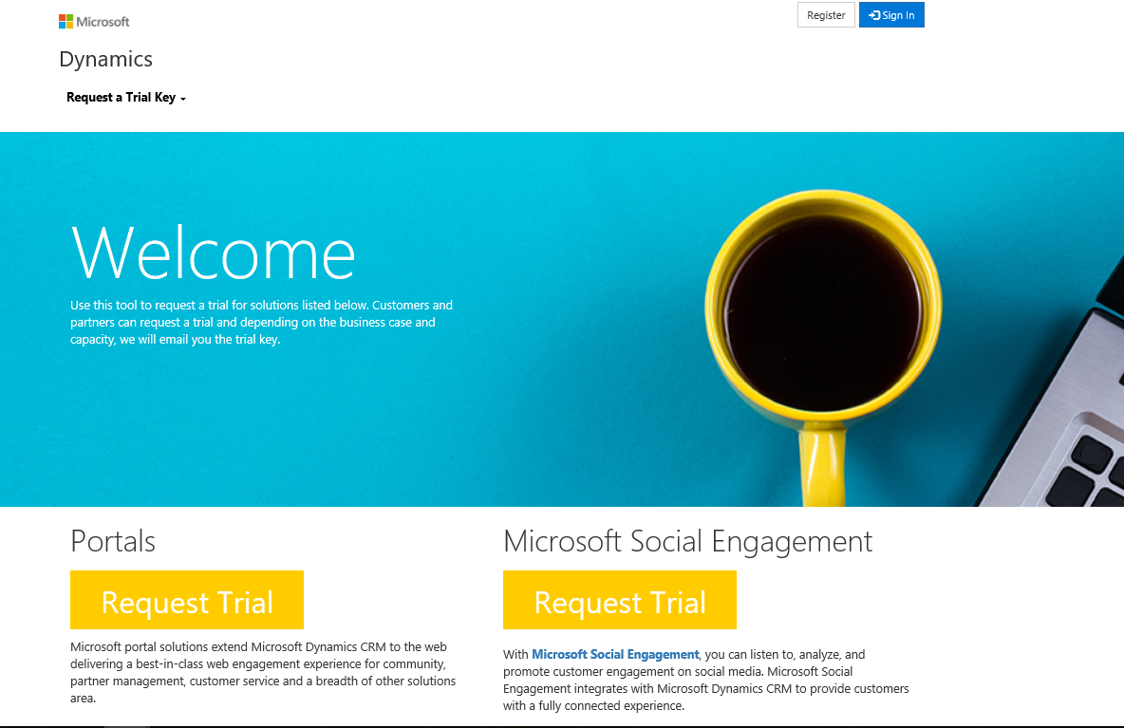
Access
Managed Trials
Access to MSE trials for Customers and Partners without a Microsoft Sponsor
Languages
Listening: Slovenian, Serbian, Croatian & Bosnian. UI: Japanese & Chinese
Licensing
More ways to get MSE from Dynamics 365 re-branding & license model

Slide 15
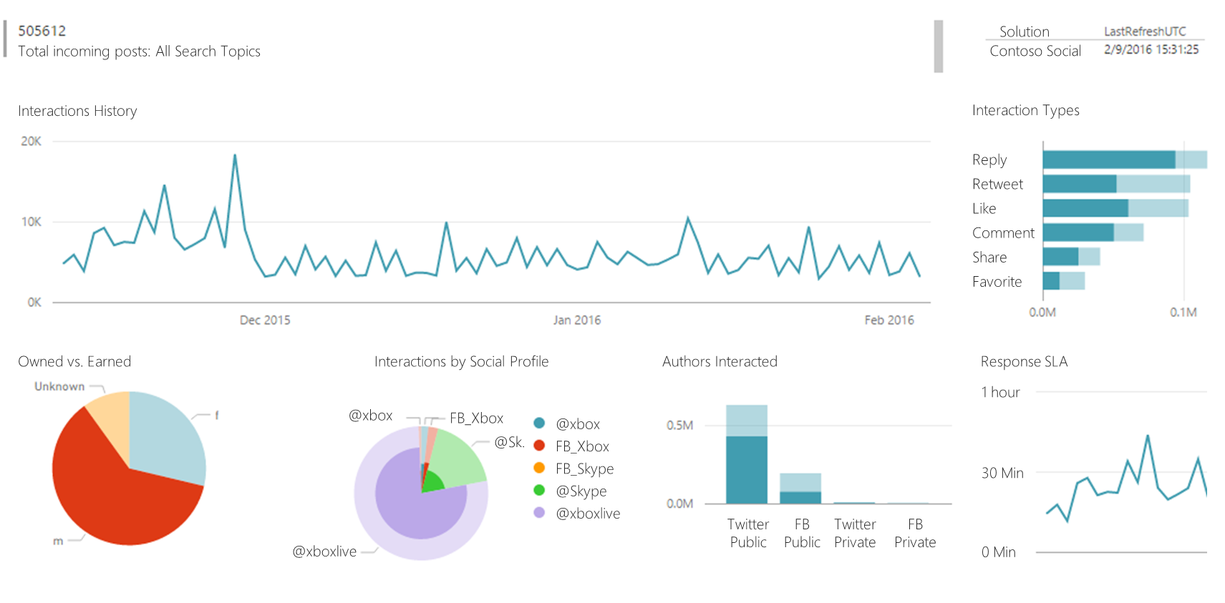
One Microsoft
Power BI
Content packs for powerful dashboards and reporting using MSE data
CRM Moca
Immersive social selling application on the CRM MoCA platform

Slide 16
Social Selling

Slide 17
Social Selling is happening now…
78% of salespeople using social media perform better than their peers
75% of B2B buyers are influenced by information found on social media
2/3 companies have no social media strategy for their sales organizations
Salespeople who exceed quota share 23% more content each month on social media
Sources: Dell, Forbes, LinkedIn, SMA

Slide 18
Social Selling with MSE
Gain Trust
Grow Network
Get Connected
Definition
Empower sales people to sell more by leveraging social media
Share knowledge and participate in social conversations to be seen as a thought leader
Find and connect to new companies and people to develop your contacts and generate new leads
Keep track of all your stakeholders to stay on top of the latest developments
Direct selling on Twitter
Replace traditional sales processes
Mobile
Simple
Relevant
Gamified
Approach
Personalized smart recommendations requiring minimal time commitment
Be and stay up-to-date whenever and wherever, on your primary device
Easy to setup and easy to use – get going in minutes
Personalized and fresh information you can actually use and act upon
Incentivized for growth and adoption via KPI scoreboards and targets

Slide 19
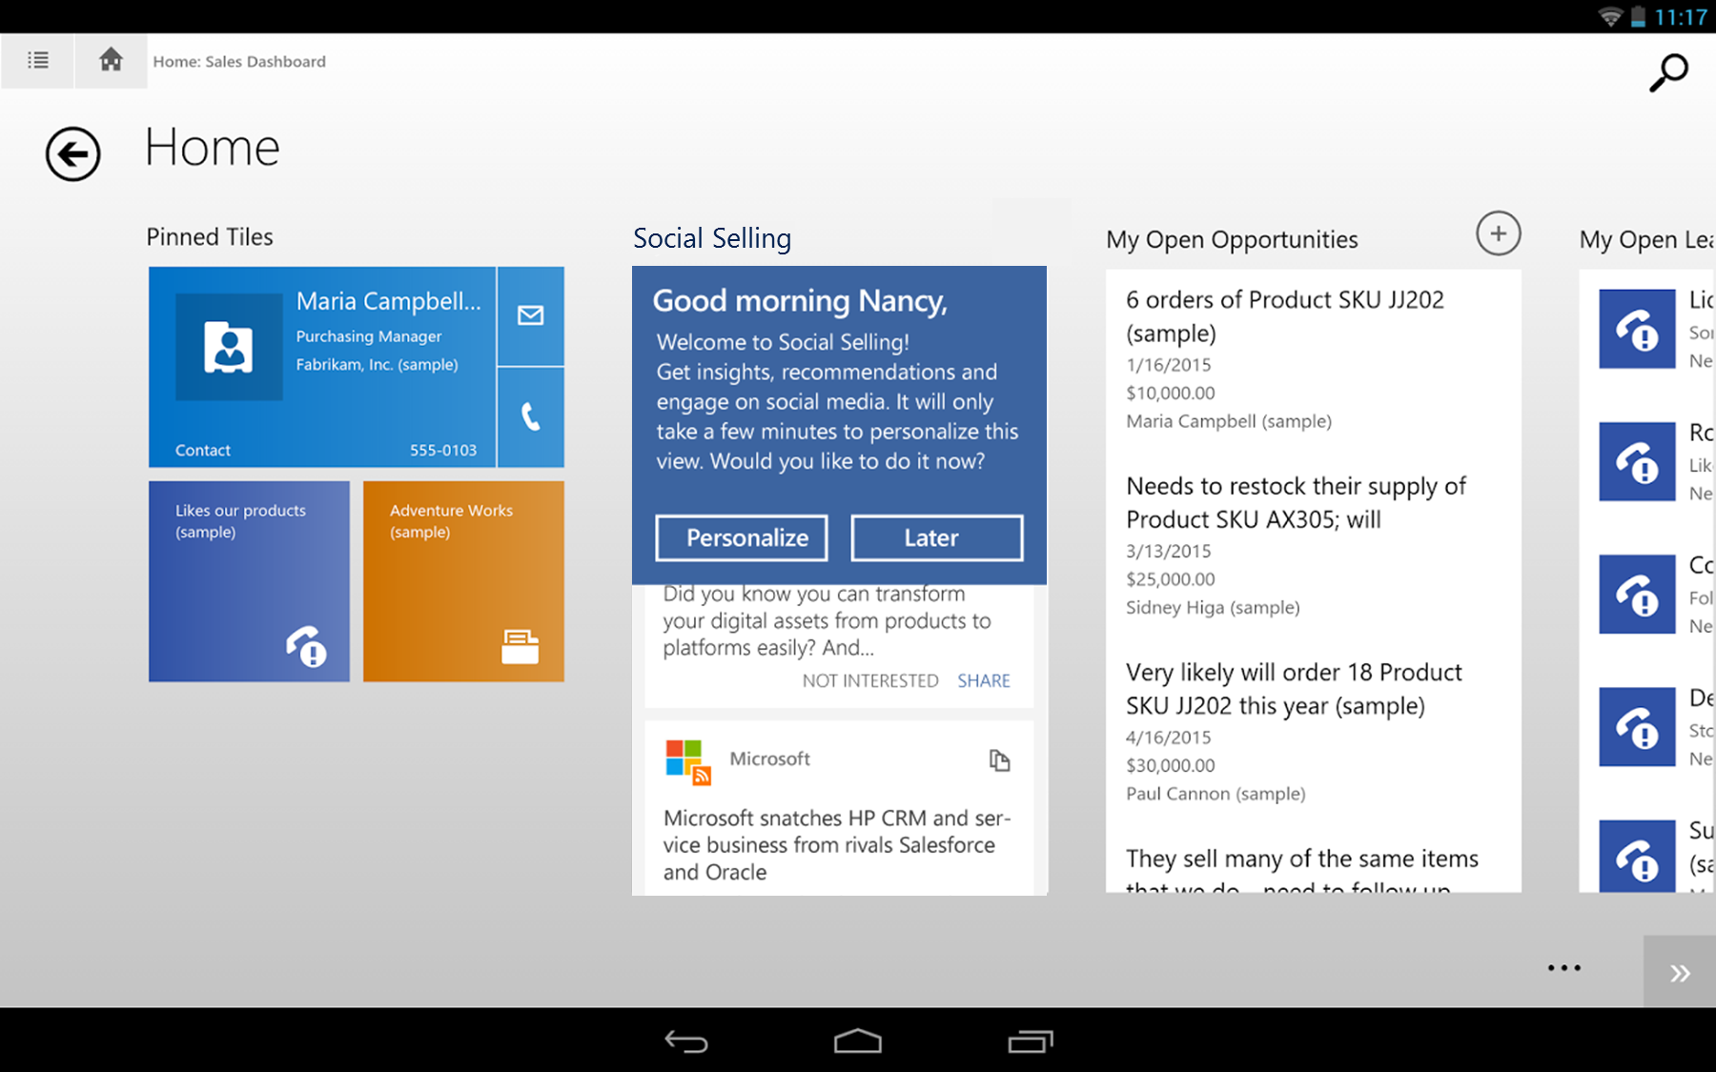
CRM MoCA Dashboard

Slide 20
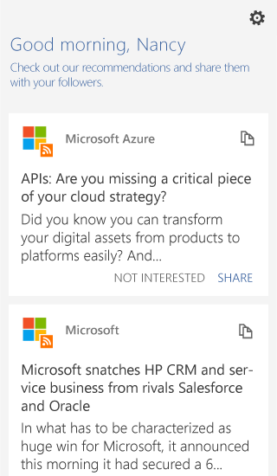
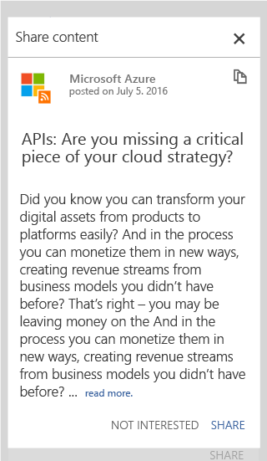
Get actionable recommendations

Slide 21
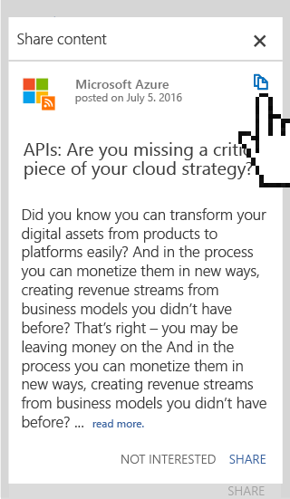
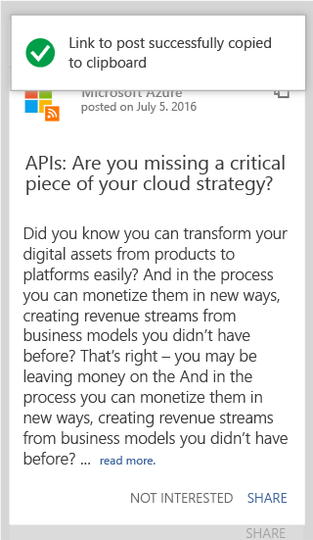
Copy link to the original post

Slide 22
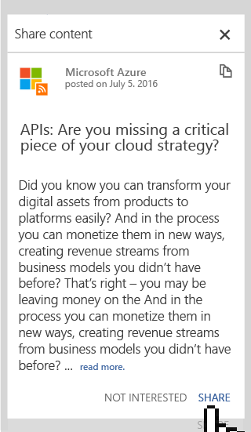
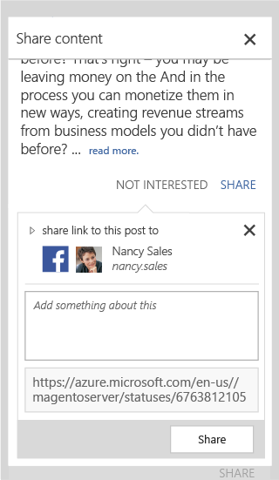
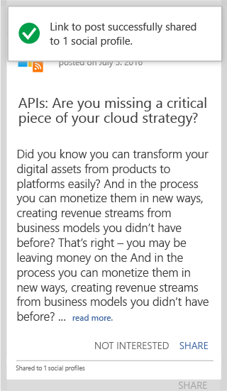
Share on your networks

Slide 23
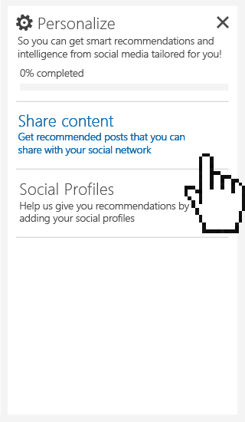
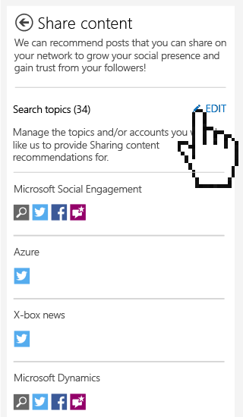
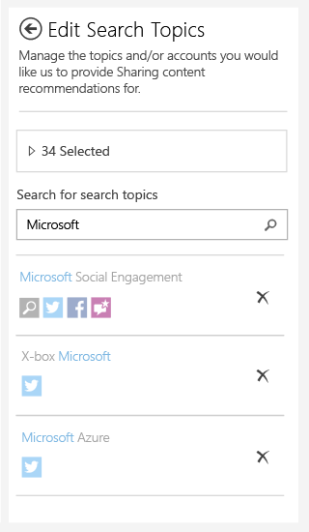
Personalized content

Slide 24
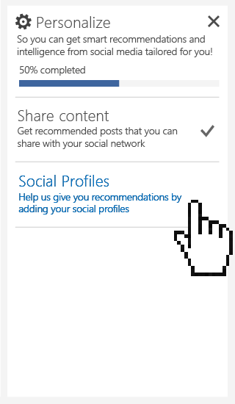
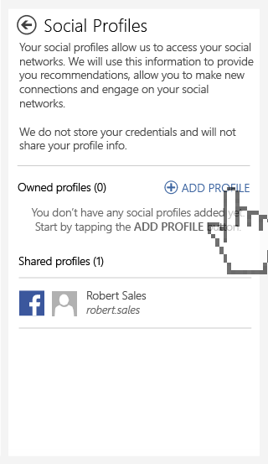
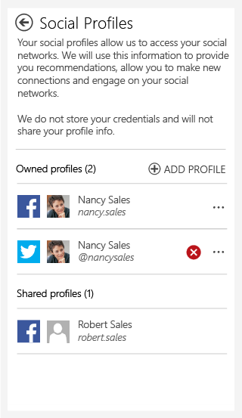
Personal profiles

Slide 25
Customer Updates

Slide 26
New MSE Reference Customer: Rigi Bahn
Video | Customer story
“The RIGI Bahn at the heart of Switzerland is Europe's oldest still running mountain railway. As "Queen of the Mountains" the Rigi stands for a place, even today, where untouched nature and deeply rooted customs go hand in hand. As the people in charge have recognized the elusiveness of this idyll and have reacted by way of a social media task force to the changes in tourism, the Rigi has also become a showcase project when it comes to timely interaction with guests.”

Slide 27
How to request MSE Trials
Customers and Partners can request an MSE trial through Managed Trial Portal: https://crmmanagedtrials.dynamics.com/
Note:
Depending on the business case and capacity, a trial key will be provided
30 days trial with post quota of 10k/month

Slide 28
In closing…

Slide 29
Why Microsoft Social Engagement
Democratized
Social for everyone
One Microsoft
Benefit from deep expertise in AI (Azure ML), Analytics (Power BI) and more
Intelligent Social
Adaptive Sentiment
Intention Analysis
Interactive experience
Integrated social
E2E customer experience: Listen, Engage & Publish. Create CRM actions

Slide 30
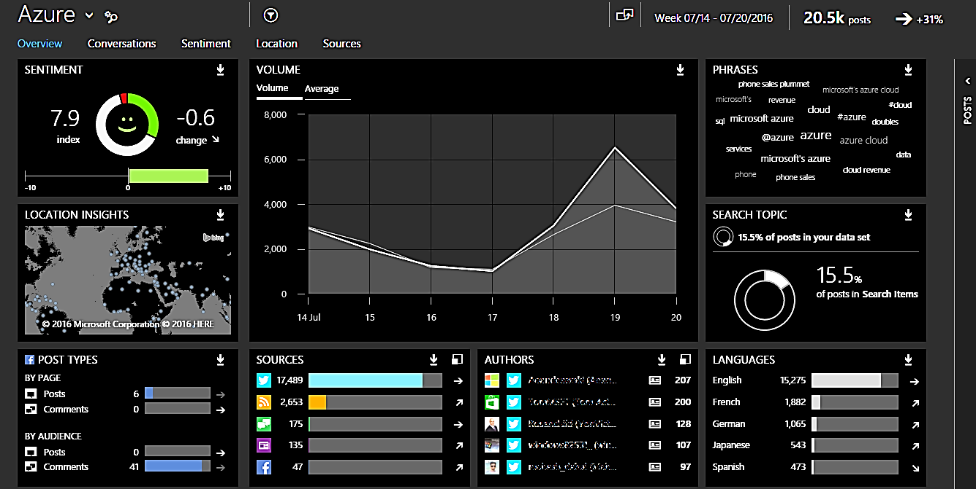
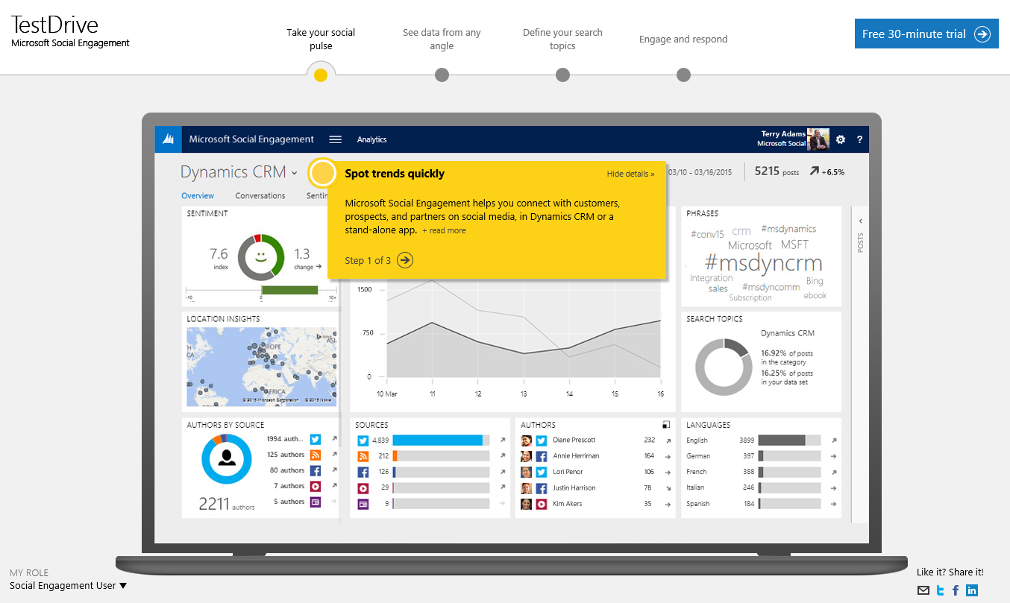
Get started with these MSE resources!
Take a guided click-through tour
Visit Social Engagement website
See pricing information
Find detailed information in Social Help Center
Watch short videos:
Overview, Getting Started
Analytics, Social Center, Alerts
Search Setup, Quota Management
Blog post instructions:
How to add RSS feeds
How to connect CRM and MSE
How Link to CRM & Intention Analysis & Automation works
How to create records in CRM

Slide 31
Free IT Pro resources To advance your career in cloud technology
Plan your career path
Cloud role mapping
Expert advice on skills needed
Self-paced curriculum by cloud role
$300 Azure credits and extended trials
Pluralsight 3 month subscription (10 courses)
Phone support incident
Weekly short videos and insights from Microsoft’s leaders and engineers
Connect with community of peers and Microsoft experts
Microsoft IT Pro Career Center
www.microsoft.com/itprocareercenter
Get started with Azure
Microsoft IT Pro Cloud Essentials
www.microsoft.com/itprocloudessentials
Demos and how-to videos
Microsoft Mechanics
www.microsoft.com/mechanics
Connect with peers and experts
Microsoft Tech Community
https://techcommunity.microsoft.com

Slide 32
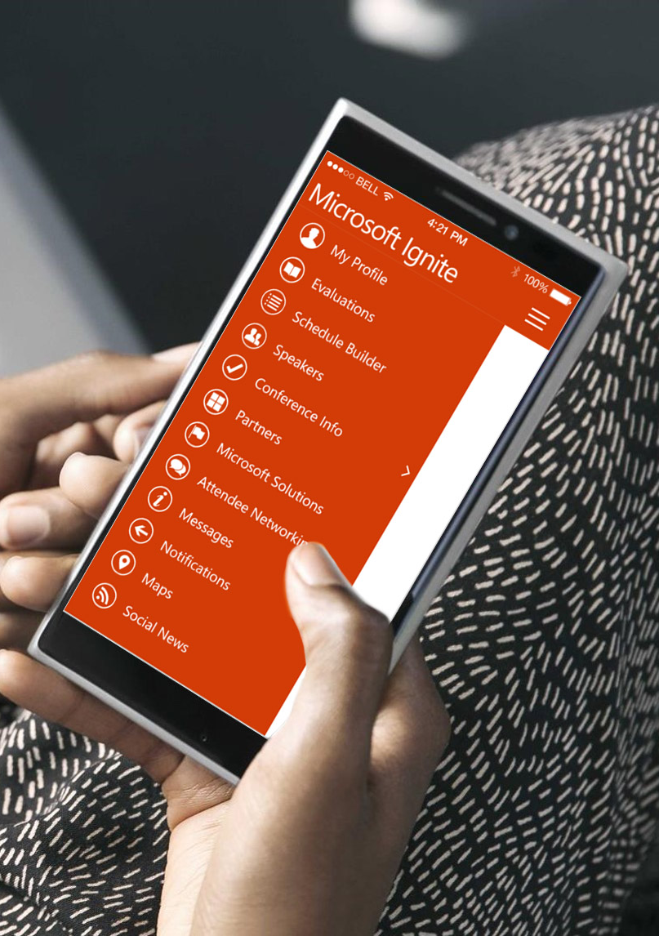
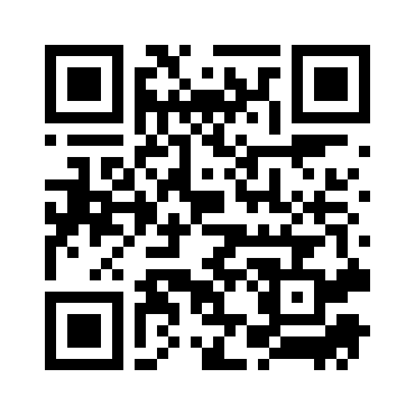
Please evaluate this session
Your feedback is important to us!
From your PC or Tablet visit MyIgnite at http://myignite.microsoft.com
From your phone download and use the Ignite Mobile App by scanning the QR code above or visiting https://aka.ms/ignite.mobileapp

