Slide 1
Build business applications with Power Apps, Microsoft Flow, and Office 365
BRK2160
Merwan Hade
Senior Program Manager
James Oleinik
Senior Program Manager

Slide 2
How many of you have tried out PowerApps and Flow?
102,000+
creators
42,000+
organizations
137
countries

Slide 3
Agenda
Introduction to PowerApps and Flow
What are Microsoft Flow and Microsoft PowerApps?
Microsoft’s Business Application Platform
PowerApps and Flow with SharePoint Modern Lists
PowerApps and Flow with Connectors, Custom APIs, Gateways
Enterprise readiness
Roadmap and call to action
How can I get Flow and PowerApps for myself and my organization?
GA this Quarter

Slide 4
Why?

Slide 5
Only a handful of business apps merit the time and cost of traditional custom software development…
…and only so many problems can be solved with off-the-shelf SaaS.
What about every other need your business faces?

Slide 6
Secure Scalable Managed Integrated Compliant
Fast Iterative
Cross-platform
Beautiful Easy
VS

Slide 7
Only Microsoft has all the pieces to deliver an intelligent business cloud
Microsoft AppSource
Office 365
Power BI
Cortana Intelligence
Azure IoT
Dynamics 365
Custom Line-of-Business Applications
Third Party Business Applications
Sales
Customer Service
Field Service
Project Service Automation
Marketing
Operations
Application Platform (PowerApps, Power BI Embedded, Microsoft Flow) & Common Data Model
Azure

Slide 8
Microsoft PowerApps

Slide 9
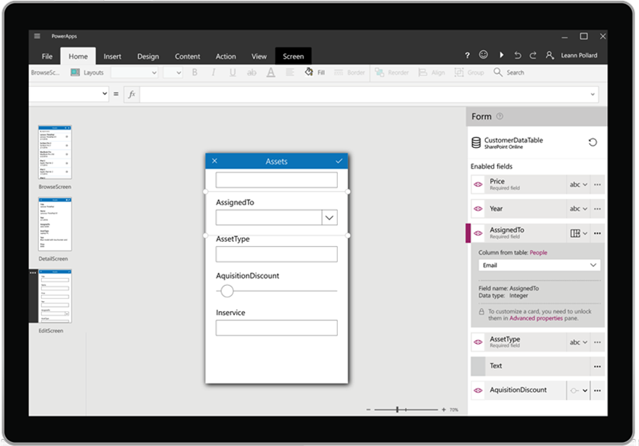
Microsoft PowerApps is a service for creating and using custom business apps across platforms
Connect to existing systems and data sources
Common Data Platform
Azure Functions & REST services
Build apps, forms, and workflows without writing code
Publish apps instantly for web and mobile

Slide 10
Microsoft Flow

Slide 11
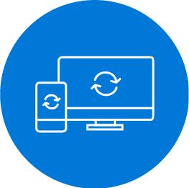
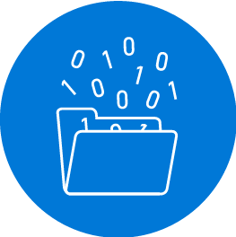
Microsoft Flow helps you work smarter by automating workflows across your apps and services
Get notifications
Synchronize files
Collect data
Automate approvals

Slide 12
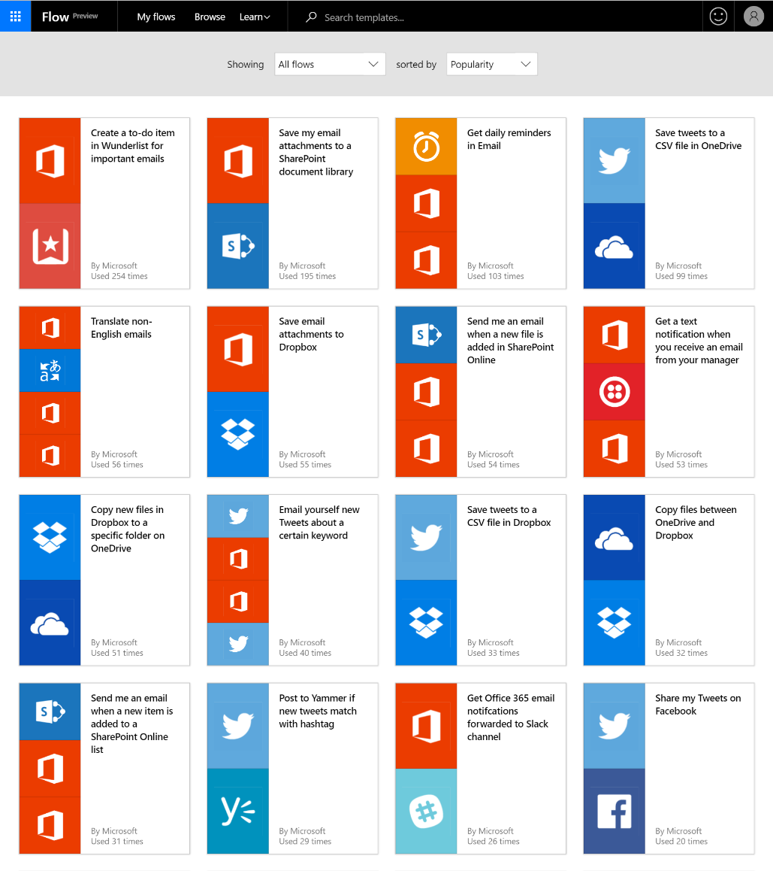
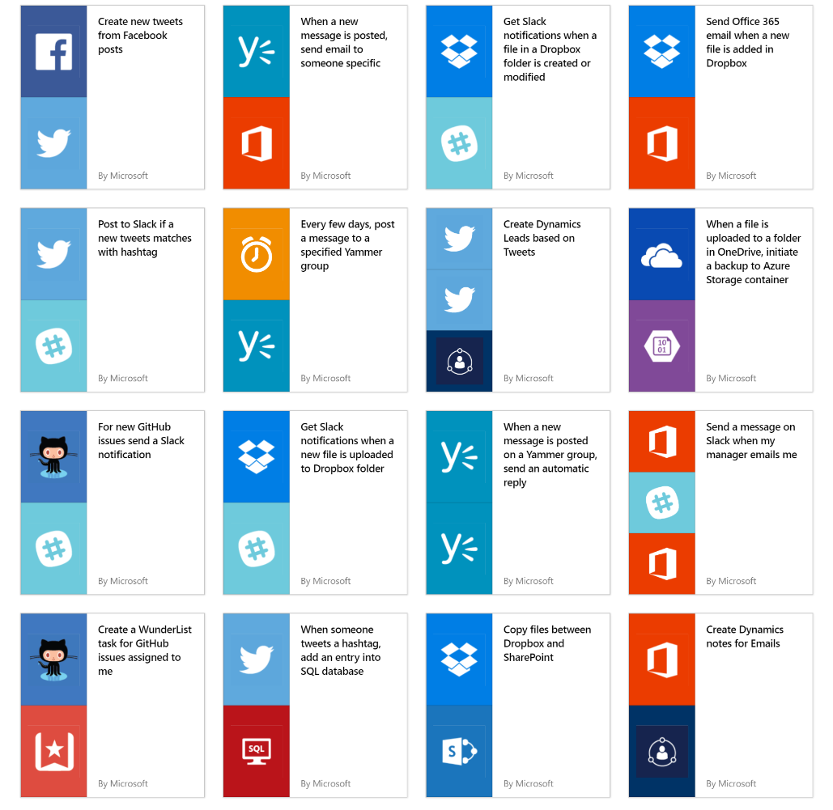
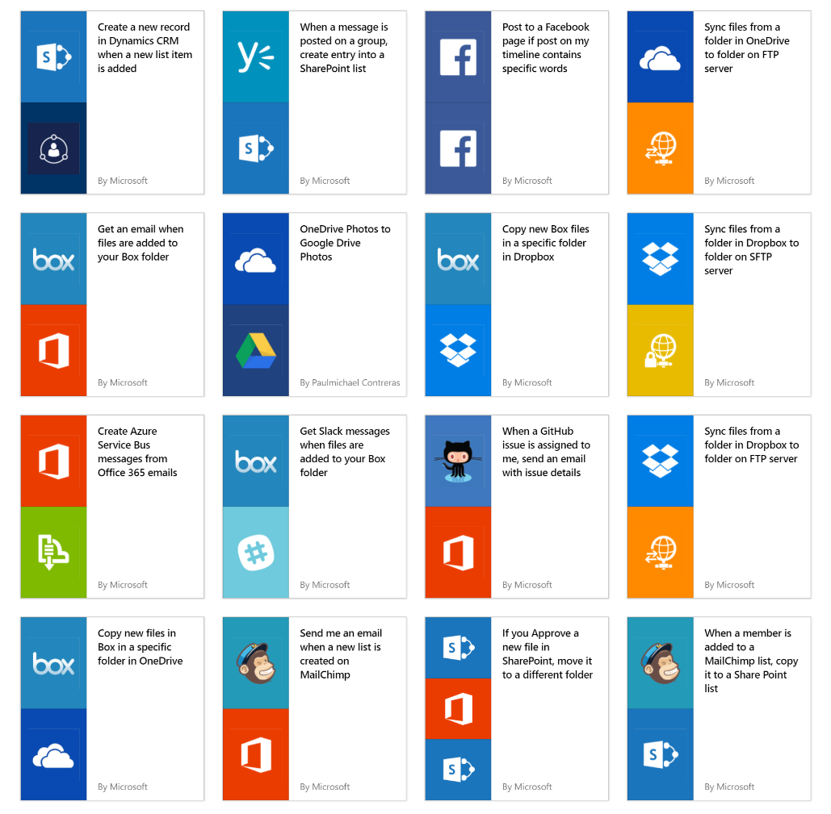
Get started quickly with over a hundred useful templates

Slide 13
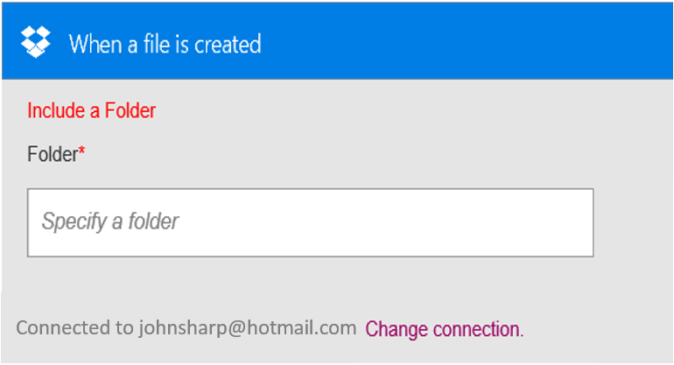
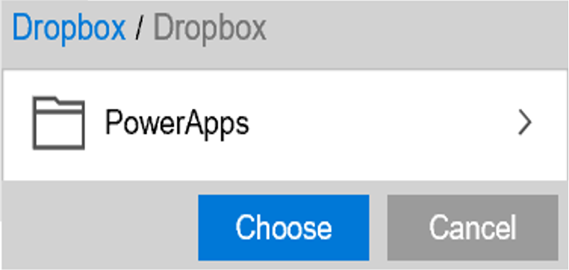
Build your own flows in an easy to use visual designer
Sending an Exchange email when a new file is added in Dropbox
Authenticate to your Dropbox account.
Select folder to monitor
PowerApps
Choose to include properties from previous step (Dropbox file) to improve relevance
Authenticate to your O365 account. Build email Subject and Body
Specify Send To email address and additional properties (optional): From, CC, BCC and Importance
Connected to johnsharp@contoso.com

Slide 14
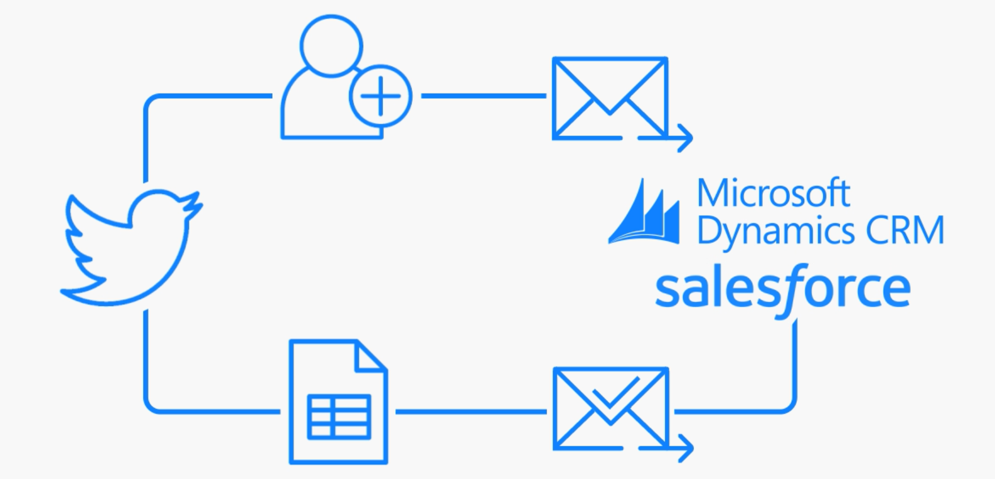
Automate advanced scenarios with multiple steps, looping, branching conditions, and more

Slide 15
PowerApps & Flow ♥ SharePoint

Slide 16
PowerApps and Flow are the tools for business users for building business applications in SharePoint today and tomorrow.

Slide 17
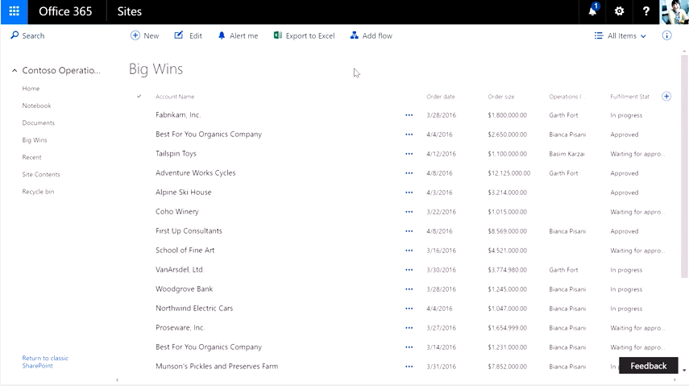
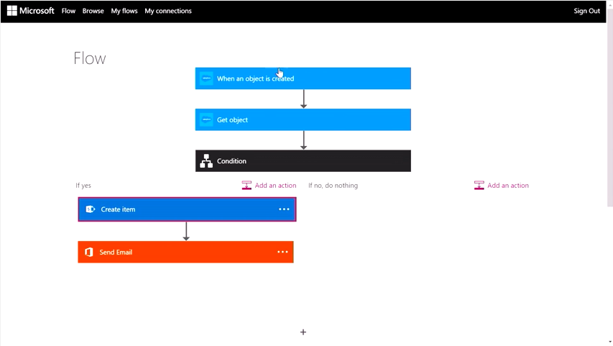
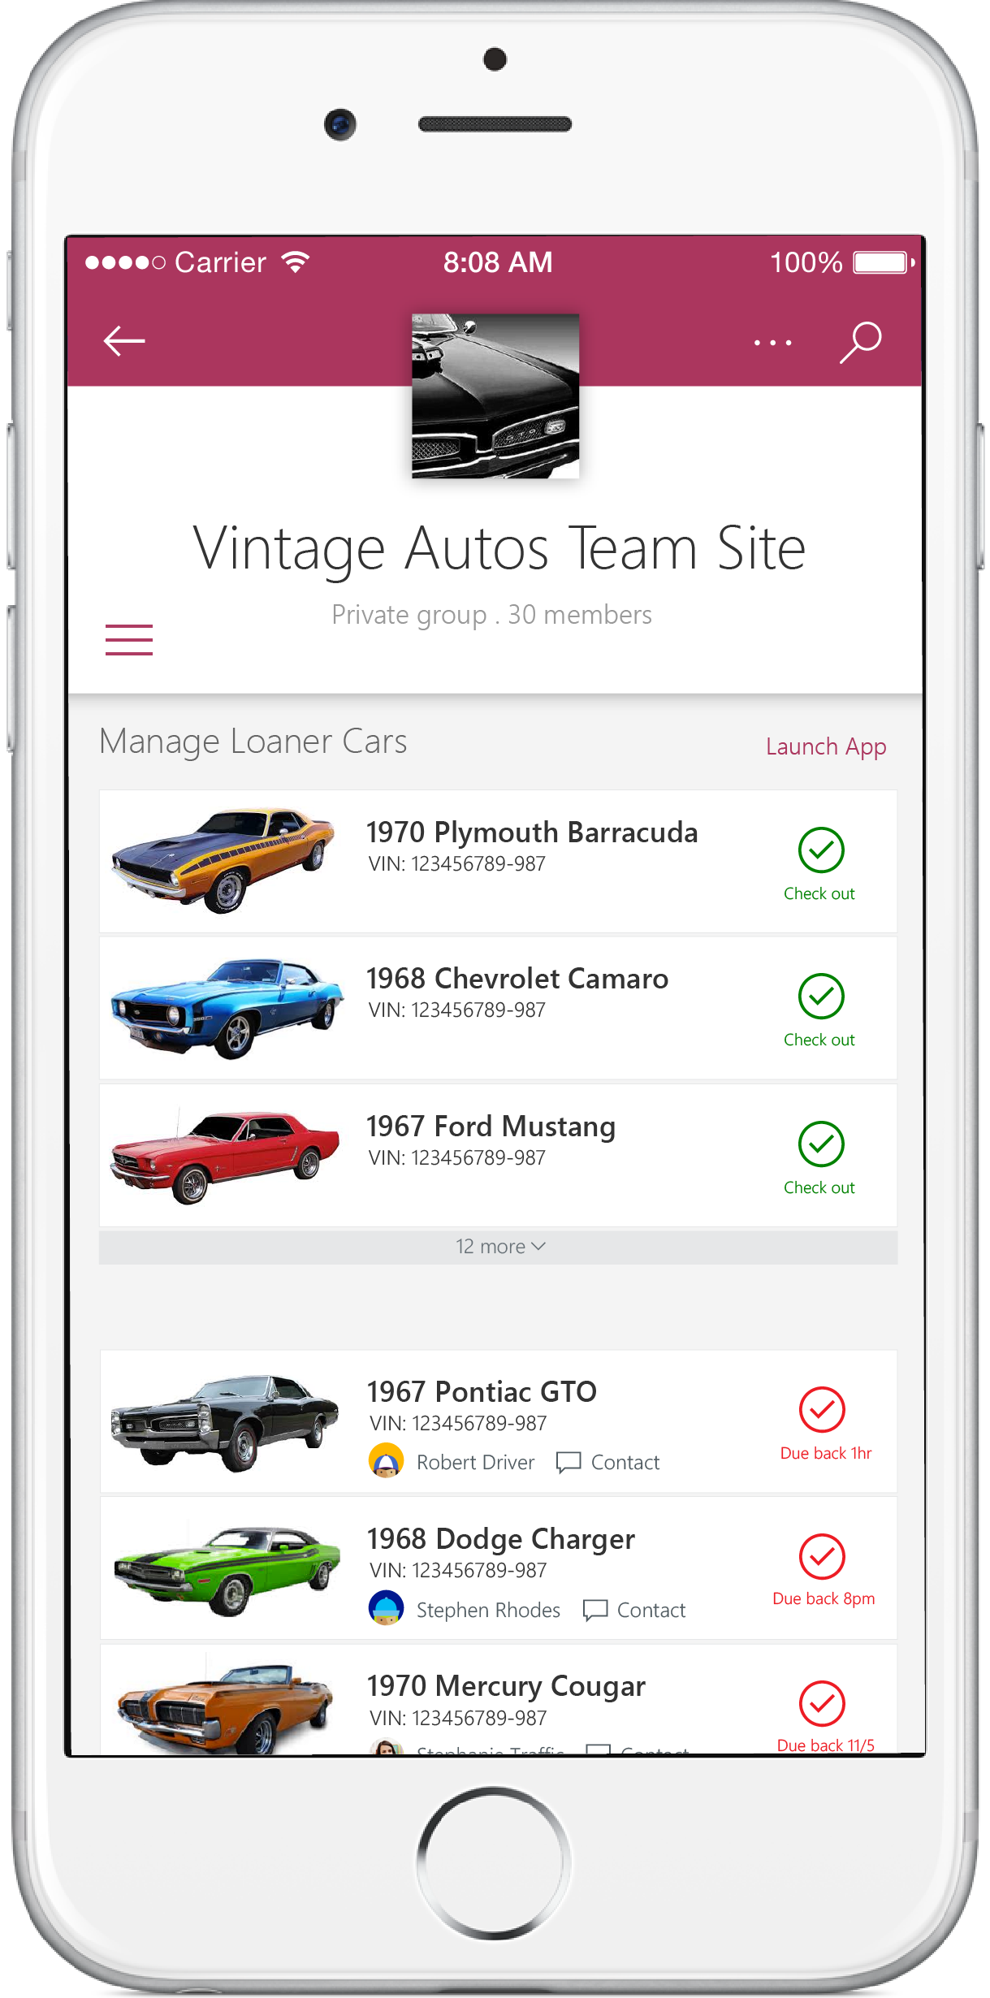
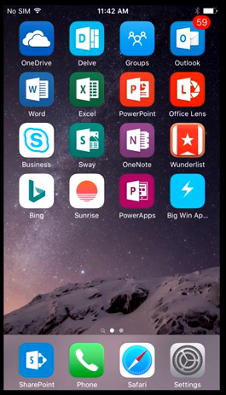
Modern Lists Integration
Add external content and logic to lists with Microsoft Flow
Access SharePoint content using Power Apps

Slide 18
Demo – Booth Inspection

Slide 19
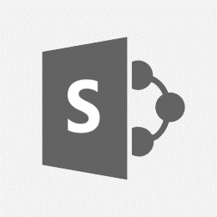
Future improvements
Support for images, attachments, and multi-value fields
Flow integration for document libraries and ODB
Kick off flows for selected items in SharePoint
Using PowerApps to create customized forms
Embedding PowerApps in SharePoint

Slide 20
What you just saw
Booth Inspector App
Poor Rating Flow
PowerApps
PA embedded in SPO lists*
Embedded PA player *
App and form customization
Adding controls (e.g. camera)
Booth Inspector App
Poor Rating Flow
Rating Poor?
Booth name, rating, and picture
new
If Yes
Flow
Flow embedded in SPO lists
Conditional logic
Send HTML formatted emails for notifications
View run inputs and outputs
Flow
Flow embedded in SPO lists*
Conditional logic
Send HTML formatted emails for notifications
View run inputs and outputs
Application Platform
Booth Inspections List
Poor Rating Email
* Coming soon

Slide 21
Connectors, Custom APIs, and Gateways

Slide 22
Integrate the systems you’re already using…

Slide 23
Connecting your services to PowerApps & Flow
PowerApps & Flow are fully metadata-driven and extensible so you can connect to any of your own services
Even connect to 3rd party services you consume
Custom APIs within an organization
Scoped to a company so that you can build something that’s unique to that organization
Leverage Azure functions within your apps & flows
Via custom APIs today, integrated support coming soon

Slide 24
On premises data gateway
Install from PowerApps Portal
Manage on the gateway
Upgrades and replaces PowerBI gateway (if present)
Sign in to register
Build connections
Consume from your business apps
Power Apps and Flow
On premises data gateway
SharePoint
2013/2016
SQL Server

Slide 25
Demo – Swag Emergency

Slide 26
What you just saw
New swag order
Booth Inspector App
Order Swag Flow
Ignite 2016?
Manager approves?
Get Address
Swag manager and items
Booth name, rating, and picture
If Yes
If Yes
Application Platform
Get Address Function
Booth Swag On-Prem List
Booth Inspections List
Approve Order Email
New Task
Delivery Text

Slide 27
What you just saw
PowerApps
Customized navigation across screens
Custom APIs to connect to external APIs & Azure functions
Connection to on-premise services using enterprise gateways
Mobile, cross-platform on iOS, Android, and Windows Phone*
Integration with SharePoint mobile*
* Coming soon
Flow
Flow embedded in PowerApps
Nested conditional logic
Access to org hierarchy w/Microsoft Graph
Easy approvals over email
Connectivity to external data sources (Wunderlist and Twilio)

Slide 28
Enterprise Readiness

Slide 29
GA Enterprise-readiness of PowerApps & Flow
Common Data Platform
Environments
Data Loss Prevention Policies
App Source
Flow Sharing and Collaboration
Localization (42 languages)

Slide 30
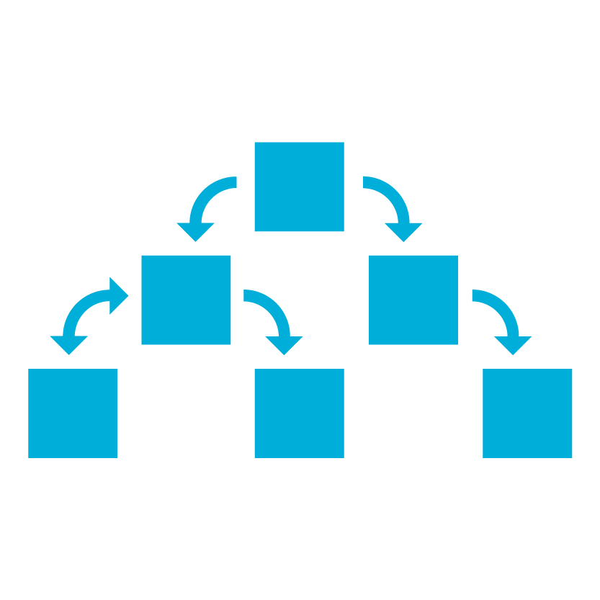
The Common Data Platform Built-in platform for extending your existing Dynamics 365 & Office 365 data
Power BI
PowerApps
Microsoft Flow
Security Model
Common Data Model and custom entities
Cloud services
Real time sync
Pro development
tools
Operational data store
^{Data} ^{API}
On-premise data

Slide 31
Deployment environments
Support for environments to enable enterprise scale out and improved manageability
Contoso Corp.
b
Dev
Dev
Dev
Test
b
b
Test
b
Contoso Australia
Test
Contoso Australia
Contoso Australia
b
b
b
Prod
Contoso Australia
Prod
Contoso Australia
Prod
Contoso Australia
Contoso Canada
Contoso Canada
Contoso Australia
Contoso USA
Contoso Canada
Apps
Flows
CDM
Apps
Flows
CDM
Apps
Flows
CDM
Apps
Flows
CDM
Apps
Flows
CDM
Apps
Flows
CDM
Apps
Flows
CDM
Apps
Flows
CDM
Apps
Flows
CDM

Slide 32
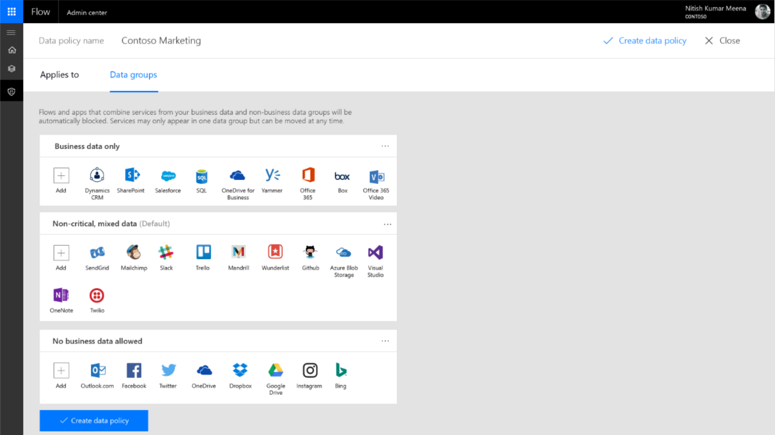
Tell us what you think via this survey:
https://aka.ms/flow_dlp
Any Flow or PowerApp that uses services from the Business data only and No business data allowed groups will be blocked.
In the future, we’ll add more actions like info tips, block pending business justification, audit logs, and custom groups.

Slide 33
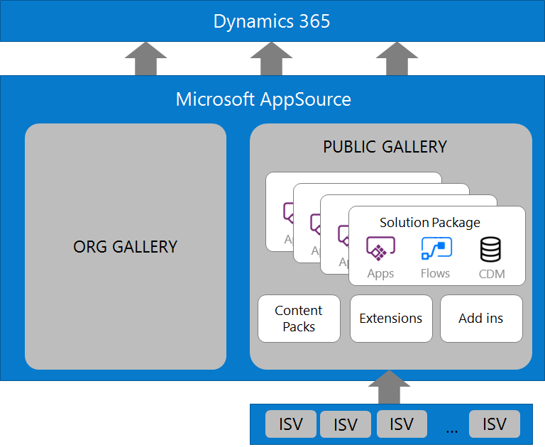
AppSource Integration
Organizational gallery
Create and distribute apps within your company
Role-based access control
Get apps from partners
Deploy apps, templates and components provided by partners
Solution packages allow moving apps and data across tenants
Try and buy ISV solutions
ISVs can publish finished

Slide 34
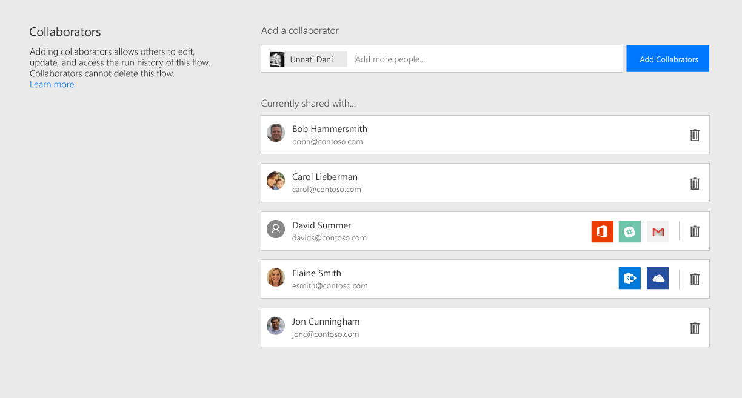
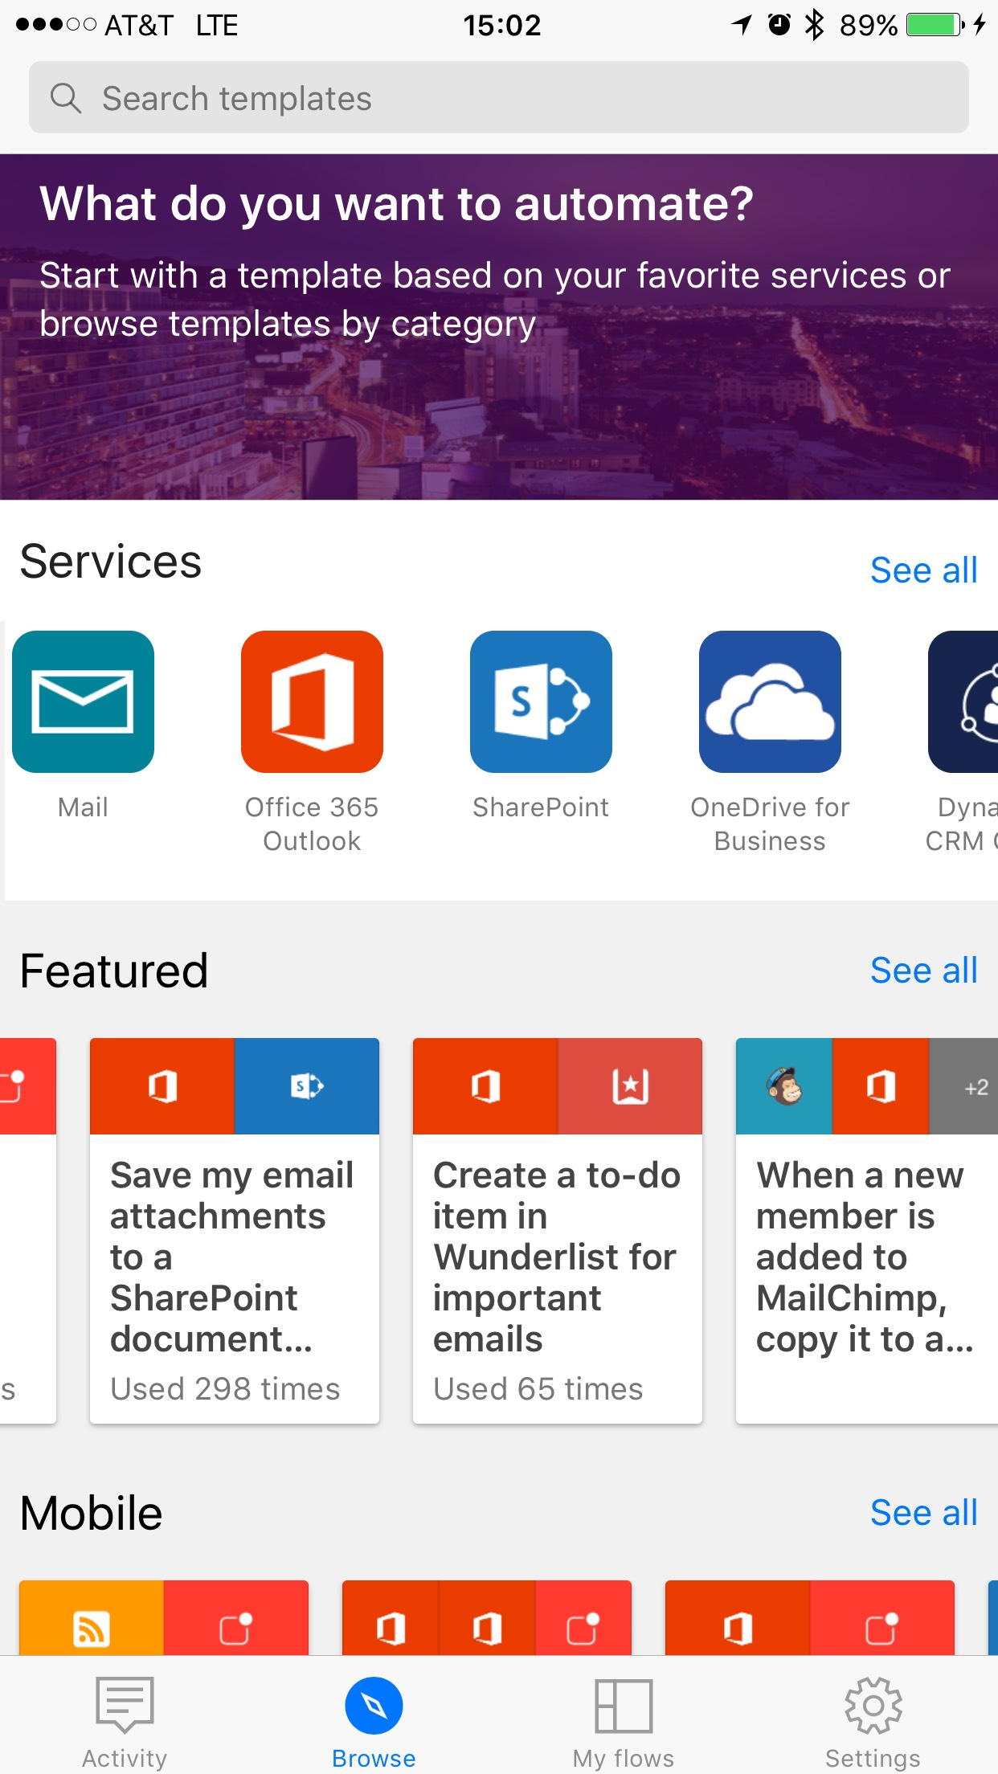
Microsoft Flow Sharing and Collaboration
Co-authoring
Many people can edit a flow, rather than a single owner
If the original author leaves the company the flow continues to function
Publish to AppSource
Make flows available to others inside of an organization for consumption
Creation from Mobile
Develop and co-author on flows right from the Microsoft Flow app for iOS or Android
Enhanced Flow mobile integration

Slide 35
Looking forward

Slide 36
When is this available?
Now - PowerApps preview @ http://powerapps.microsoft.com
Now – Flow preview @ http://flow.microsoft.com
Coming soon – Microsoft PowerApps & Microsoft Flow integration with SharePoint Online modern lists
Q4 CY2016 – Microsoft PowerApps and Microsoft Flow Microsoft General Availability

Slide 37
PowerApps & Flow roadmap - highlights
Q4 Calendar 2016
H1 Calendar 2017
General available, 7 regions, 42 languages
AppSource for company wide app sharing
Platform Admin center
Data flow policies
Deployment Environments
Re-usable, dynamic forms support (preview)
Flow sharing & collaboration
Mobile Flow creation
Windows Phone support
Power BI integration across the platform
Solution packages
Pro-dev control extensibility
Re-usable, dynamic business process & logic
Common Data Platform Office data sync
Enhanced mobile Flow integration
Extended Common Data Platform security model
Embedded, in-context SharePoint Online
Additional embedded experiences
Sovereign cloud deployments
Roadmap is for general information purposes only and subject to change

Slide 38
How to get PowerApps?
PowerApps for Office 365
PowerApps for Dynamics 365
PowerApps Plan 1
PowerApps Plan 2
Extending Office 365 and
Dynamics 365
For business users
Run any app using CDM
For creators and IT admins
Full creation & admin capabilities
Included for free with most* Office 365 and Dynamics 365 application SKUs
Can be purchased by an individual or an admin
Can be purchased by an individual or an admin
90 free trial available
Also included with Dynamics 365 Plans 1 and 2
PowerApps & MSFT Flow capabilities
Create & run within the context of O365 & D365 data sources
PowerApps & MSFT Flow (Plan 1) capabilities
Access to Common Data Model and premium connectors
Run any app or flow & build against any existing data source
Includes everything in P1, plus
Create any app or flow
Model your business data and create custom entities (CDM)
Create/manage environments and databases
Set policy and view usage
Quotas (per user; pooled tenant-wide):
2,000 flow runs per month
Quotas (per user; pooled tenant-wide):
4,500 flow runs per month
20MB Data Storage
2GB File Storage
Quotas (per user; pooled tenant-wide):
15,000 flow runs per month
200 MB Data Storage
20 GB File Storage per user
Additional flow runs, Data Storage, and File Storage may be purchased as needed

Slide 39
How to get Flow?
Flow Free
Flow for Office 365
Flow for Dynamics 365
Flow Plan 1
Flow Plan 2
Anyone can sign up for free with their personal, work or school email
Included for free with most* Office 365 and Dynamics 365 application SKUs
Can be purchased by an individual or an admin
90 free trial available
Also included with Dynamics 365 Plans 1 and 2 and PowerApps Plans 1 and 2
750 flow runs per month included
Limited to connect to “standard” services
No on-premises connectivity
(Post-GA) No co-authoring or sharing within an organization
No SLA
2,000 flow runs per month included
Limited to connect to “standard” services
On-premises connectivity to Office, Dynamics services*
(Post-GA) Includes co-authoring or sharing within an organization
4,500 flow runs per month included
Full “premium” connectivity to cloud and on-premises
(Post-GA) Includes co-authoring or sharing within an organization
No governance or management features
15,000 flow runs per month included
Full “premium” connectivity to cloud and on-premises
(Post-GA) Includes co-authoring or sharing within an organization
Full governance and management features

Slide 40
Call to Action
Join a deep dive session
Meet us at our booth (Booth 21) @ the Expo in ‘Hybrid Cloud Platform’ area
Explore our services, sign up for preview:
http://PowerApps.microsoft.com
http://Flow.microsoft.com
http://PowerBI.microsoft.com
Code | Title | Location | Date | Time
BRK2051 | Build business apps for Office 365 - InfoPath, PowerApps, Flow and more | Thomas Murphy Ballroom 1 | Thu, 29 Sep | 14:15 to 15:30
BRK3311 | Dive into Microsoft Flow, create automated workflows between your favorite apps and services | C112 | Thu, 29 Sep | 14:15 to 15:30
BRK3326 | Dive into PowerApps, building apps that mean business without writing code | C111 | Fri, 30 Sep | 09:00 to 10:15

Slide 41
Questions & Answers
Merwan Hade - @merwanhade
James Oleinik - @joleinik

Slide 42
Deploy, ramp-up on new services and onboard new users with Microsoft FastTrack: http://fasttrack.microsoft.com/

Slide 43
Join the Microsoft Tech Community to collaborate, share, and learn from the experts: http://techcommunity.microsoft.com

Slide 44
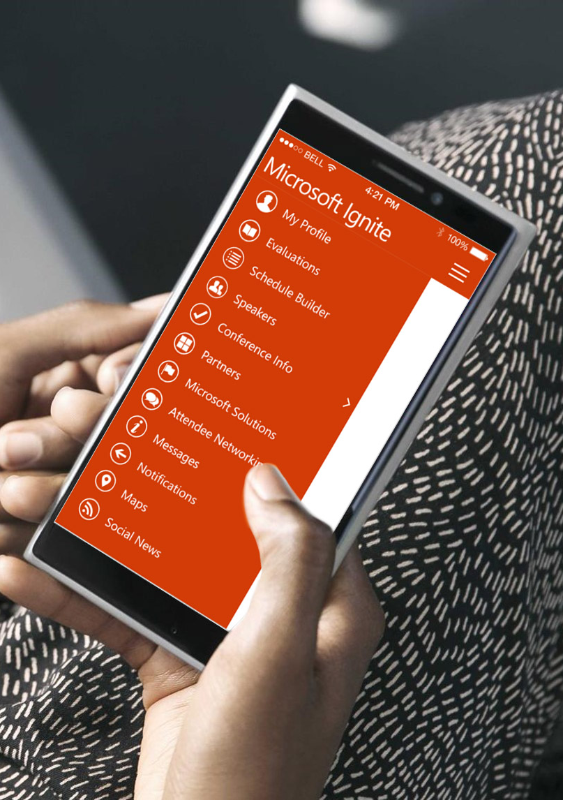
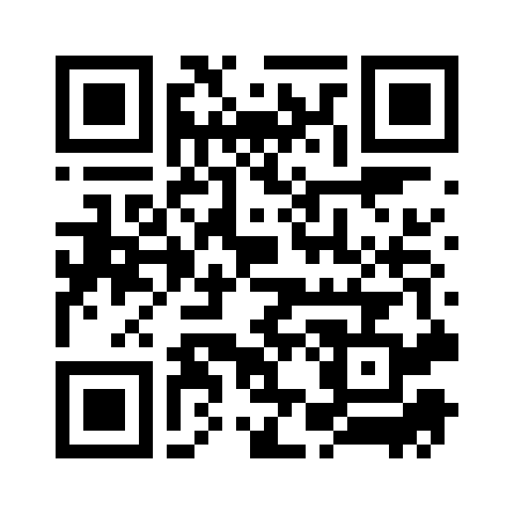
Please evaluate this session
Your feedback is important to us!
From your PC or Tablet visit MyIgnite at http://myignite.microsoft.com
From your phone download and use the Ignite Mobile App by scanning the QR code above or visiting https://aka.ms/ignite.mobileapp

Slide 45
PowerApps packaging
Extending Office 365 and Dynamics 365
For business users
Run any app using CDM
For creators and IT admins
Full creation & admin capabilities
PowerApps and MSFT Flow for
Office 365 and Dynamics 365
PowerApps P1
PowerApps P2
Included with O365 & D365 workloads PowerApps & MSFT Flow capabilities Create & run within the context of O365 & D365 data sources |  | PowerApps & MSFT Flow capabilities Access to Common Data Model and premium connectors Run any app or flow & build against any existing data source |  | Included in full D365 Plans Includes everything in P1, plus Create any app or flow Model your business data and create custom entities (CDM) Create/manage environments and databases Set policy and view usage
Quotas (per user; pooled tenant-wide): 2,000 flow runs per month |  | Quotas (per user; pooled tenant-wide): 4,500 flow runs per month 20MB Data Storage 2GB File Storage |  | Quotas (per user; pooled tenant-wide): 15,000 flow runs per month 200 MB Data Storage 20 GB File Storage per user
Additional flow runs, Data Storage, and File Storage may be purchased as needed

