Slide 1
Towards Trustworthy Internet of Things Infrastructure enabled by Microsoft
BRK2150
Arjmand Samuel
Principal Program Manager, Azure IoT

Slide 2
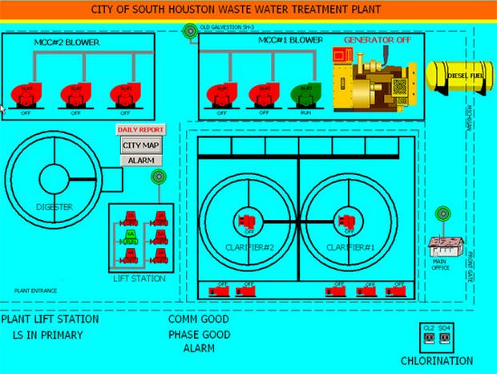
IoT infrastructure under attack
North Carolina Highway Signs Compromised By a Foreign Hacker*
Penetration of a Water Treatment Facility by a Foreign Hacker*
*NSTAC Report to the President on the Internet of Things. www.dhs.gov/sites/default/files/publications/

Slide 3
Why securing Industrial Internet of Things is hard?
System of Systems
Information
Technology
Operational
Technology

Slide 4
Information technology perspective
Information Technology (IT) the application of computers and telecommunications equipment to store, retrieve, transmit and manipulate data*
Mission of IT
Design and maintain software, hardware and network resources which run securely and provide privacy
How?
Secure Development Lifecycle
Secure Network Technologies
Threat & Vulnerability Mitigation
Monitoring and Alerting
Software/Firmware Auto-Updates
Privacy Models
*en.wikipedia.org/wiki/Information_technology

Slide 5
Operational technology perspective
Operations Technology (OT)
collects information and causes changes in the physical world through the direct monitoring and control of physical devices in industrial contexts
Mission of OT
Design and maintain machines which run reliably, and safely (do not cause injury or harm to other machines, humans, and the environment)
How?
Robust machines, with built-in safety features
Automated monitoring and control
Isolate and control – cut off all interaction with the world
Design to protect against natural and man-made disasters

Slide 6
Why securing Industrial Internet of Things is hard?
System of Systems
Information
Technology
Operational
Technology

Slide 7
Why securing Internet of Things is hard?
System of Systems
Information
Technology
Specialists
Hardware
Device
Specialist

Slide 8
Trustworthy Internet of Things
Environment
Threats
Security
Privacy
Trustworthy
IoT
Reliability
Safety
System faults
Human Errors

Slide 9
Windows 10 IoT Designed for smart THINGS that bring intelligence to the edge
Partha: Remove the background pictures, need to move ‘Trusted’ pillar in the place of connected and connected moves to the bottom. Slide 10 should become the next slide and should have a similar design as this slide with IoT Core.
PRODUCTIVE
TRUSTED
Commercial OS platform that brings modern user experience to your things
Trusted platform for cloud-connected devices
Windows 10 IoT
CONNECTED
Open platform that easily connects things, endpoints, and the cloud

Slide 10
Windows 10 IoT Portfolio
Windows 10 IoT Enterprise
Windows 10 Enterprise for IoT devices
Windows 10 IoT Mobile
Windows 10 Mobile for IoT devices
Windows 10 IoT Core
Windows 10 for small footprint IoT devices

Slide 11
Windows 10 IoT Cloud access through secure platform
Windows platform provides secure key handling
Windows IoT uses TPM 2.0 to handle Azure credentials
Credential storage is platform independent and SW update resistant
Support for discrete TPMs and Firmware TPMs
Developers can easily build secure cloud applications for Windows IoT
Removing the burden from developers to handle access keys in their code by moving credential storage and processing into the TPM
Client libraries utilizing TPM 2.0 infrastructure for quick time to market development (Connected Service for Azure IoT Hub )
TPM simulator for hardware indented development
Access key provisioning tools for rapid prototyping (IoT Dashboard, Device Portal)

Slide 12
Microsoft Azure
Security from the ground up
Microsoft Cloud
Largest online services in the world
Centers of excellence
Microsoft Digital Crimes Unit
Microsoft Security Response Center
Microsoft Malware Protection Center.
Operational Security Assurance (OSA) process
Security Development Lifecycle (SDL)
azure.microsoft.com/documentation/articles/securing-iot-ground-up/

Slide 13
Azure IoT Suite
Device Connectivity & Management
Data Ingestion and Command & Control
Stream Processing & Predictive Analytics
Workflow Automation and Integration
Dashboards and Visualization
Preconfigured Solutions
Remote Monitoring
Predictive Maintenance

Slide 14
Benefit from a comprehensive solution
Connect and scale
with efficiency
Analyze and act
on new data
Integrate and transform
business processes
Business Systems
----101010110101010001101000101 11----˃
--- 101 0110001010111--˃
Analytics
Device Registry
Rules and Actions
Dashboards & Visualization
SAP | SalesForce | Dynamics
Oracle | DB2 | WebSphere
Informix | Twitter | Office 365
Real-time operating systems
And more. . .

Slide 15
Azure IoT Suite security
Defense in depth
Securely connect millions of devices . . .
Over a secure internet connection . . .
To Microsoft Azure – built with security from the ground up
˂---1010101101010101010110101110100100100010111----
----1010101101010101010110101110100100100010111----˃
Device Security
Device Provisioning and Authorization
Connection Security
X.509/TLS-Based Handshake and Encryption
Cloud Security
Azure Security Center
Azure Active Directory
Key Vault
Policy-Based Access Control

Slide 16
Defense in Depth
… represents the use of multiple computer security techniques to help mitigate the risk of one component of the defense being compromised or circumvented*
Each role is responsible for a layer of depth, and each layer has further layers of safeguards so as to build defense in depth
*en.wikipedia.org/wiki/Defence_in_depth#Information_security

Slide 17
Defense in Depth
Roles
IoT hardware manufacturer and integrator
IoT solution developer
IoT cloud and solution provider
IoT solution deployer
IoT solution operator
azure.microsoft.com/documentation/articles/iot-security-best-practices/

Slide 18
IoT Threats
The STRIDE model
Element | S | T | R | I | D | E
External entity | ü |  | ü
Process | ü | ü | ü | ü | ü | ü
Data Store |  | ü | ? | ü | ü
Data Flow |  | ü |  | ü | ü
Spoofing Identity
A person or device using another person’s or device’s credentials
Tampering with Data
Altering the data related to a device or traversing the network
Repudiation
Denial that a person or device was involved in a particular transaction or event
Information Disclosure
Exposure of information to individuals who are not supposed to have access to it
Denial of Service
A particular service unavailable
Elevation of Privilege
An unprivileged user gains privileged access and thereby has sufficient access to compromise or destroy the entire system
Azure Services Zone
Remote User Zone
Identity
System
User
Trust Boundary
Field Gateway Zone
Cloud Gateway Zone
Local Zone
Device Zone
User
Device
Field Gateway
Cloud Gateway
Front End
Services
Backend
Services
Data
Federation
Partners
Local User Zone
Gateway Zone
Services Zone
azure.microsoft.com/documentation/articles/iot-security-architecture/

Slide 19
Get started today
Go to www.InternetOfYourThings.com
Partners – join the community: http://aka.ms/CEPartnerForm (select IoT)
Follow Us! Blog : https://blogs.microsoft.com/iot/

Slide 20
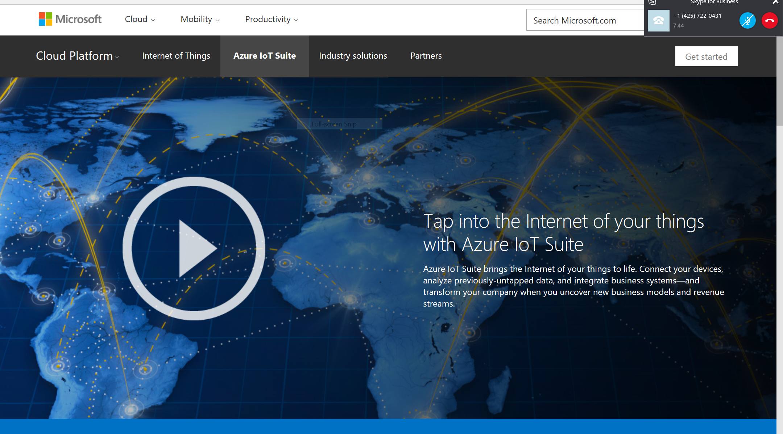
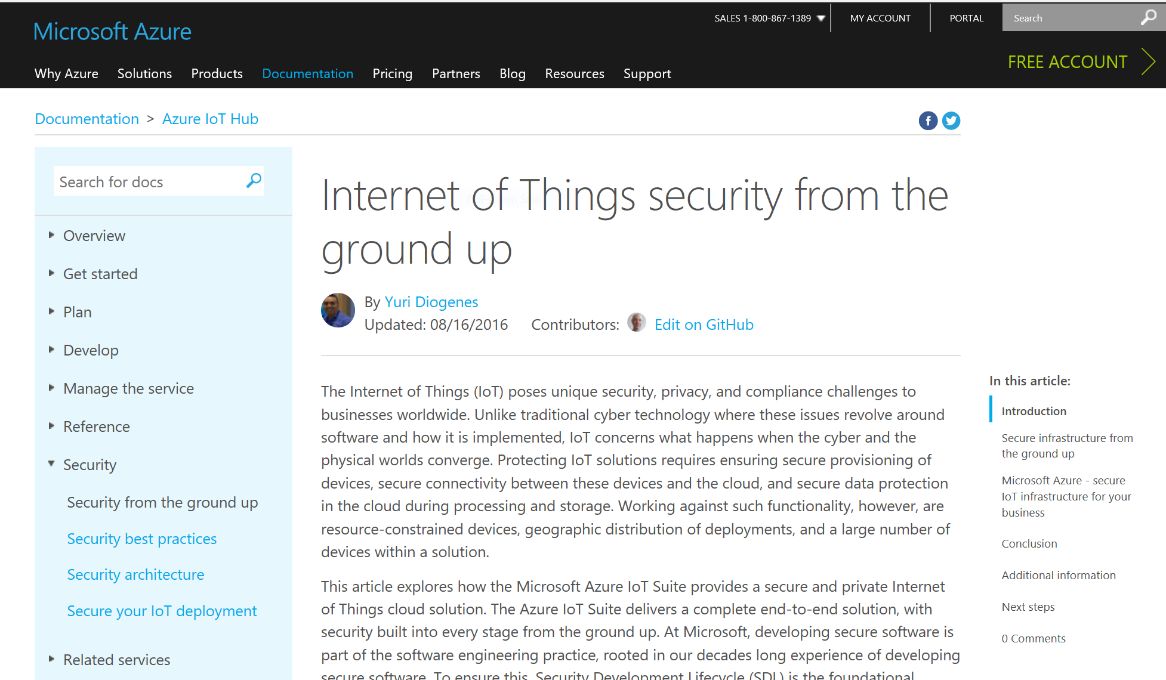
Azure IoT Security resources
IoT Site
Azure.com Site
Learn how to build in security from the ground up
Gartner Predicts 2016: Security and the Internet of Things
https://azure.microsoft.com/en-us/documentation/articles/iot-hub-security-ground-up/

Slide 21
Free IT Pro resources To advance your career in cloud technology
Plan your career path
Cloud role mapping
Expert advice on skills needed
Self-paced curriculum by cloud role
$300 Azure credits and extended trials
Pluralsight 3 month subscription (10 courses)
Phone support incident
Weekly short videos and insights from Microsoft’s leaders and engineers
Connect with community of peers and Microsoft experts
Microsoft IT Pro Career Center
www.microsoft.com/itprocareercenter
Get started with Azure
Microsoft IT Pro Cloud Essentials
www.microsoft.com/itprocloudessentials
Demos and how-to videos
Microsoft Mechanics
www.microsoft.com/mechanics
Connect with peers and experts
Microsoft Tech Community
https://techcommunity.microsoft.com

Slide 22
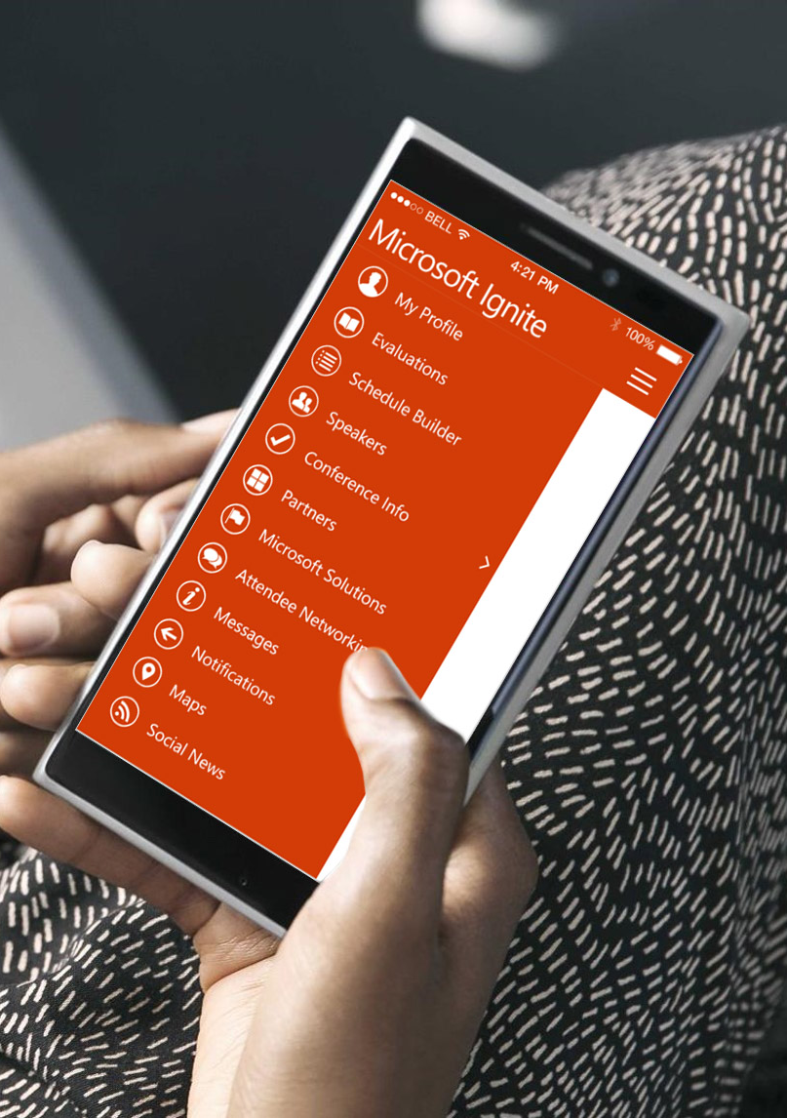
Please evaluate this session
Your feedback is important to us!
From your PC or Tablet visit MyIgnite at http://myignite.microsoft.com
From your phone download and use the Ignite Mobile App by scanning the QR code above or visiting https://aka.ms/ignite.mobileapp

