Slide 1
Manage your mobile devices and apps with System Center Configuration Manager and Microsoft Intune
BRK2138
Jason Githens - Principal Group PM Manager
Paul Mayfield - Partner Group PM Manager
Clay Taylor - Senior Program Manager

Slide 2
Session overview
Enterprise Mobility Overview
Mobile Data Protection
Managing Windows 10
Traditional PC Management

Slide 3
Enterprise Mobility Management

Slide 4


Enterprise mobility vision
Enterprise mobility vision
Enable
your users
Protect
your data
Devices
Apps
Data
User
IT
User
IT
Unify your environment
Help organizations enable their users to be productive on the devices they love while keeping corporate assets secure.

Slide 5
Enterprise Mobility Management
Mobile Device Management
Enrolling corporate devices for management
Mobile App Management
Publishing mobile apps to users
Enrolling personal devices for management
Provisioning settings, certs, profiles
Reporting device inventory
Measuring device compliance
Removing corporate data from devices
All of the above using OS standards
Configuring mobile apps
Securing corporate data in mobile apps
Removing corporate data from mobile apps
Updating mobile apps
Reporting app inventory and usage
All of the above with or without MDM

Slide 6
Devices in the Enterprise
IT managed
Information worker
Employee managed
Contractor
Companion
Foreign managed
Primary
Public kiosk
Shared
Corporate managed devices only
All devices/PCs are enrolled in the company MDM and managed the same
Companion devices allowed
Employee managed devices allowed as companions to corporate managed devices
Corporate apps and data focused
Devices are not enrolled in MDM at all; rather, the apps and data are managed

Slide 7
Demo
Intune on Azure

Slide 8
Mobile Data Protection

Slide 9


Traditional access control to corporate data
Corporate network
DMZ
Internet
Active
Directory
Mobile
devices
PCs
Policies
Filter EAS
Filter web access
Filter or block mobile app access
Block unmanaged devices
Prevent downloads
Force multifactor authentication
Require domain joined
Force traffic via proxy/VPN
Browsers
Exchange Server
SharePoint
Server

Slide 10





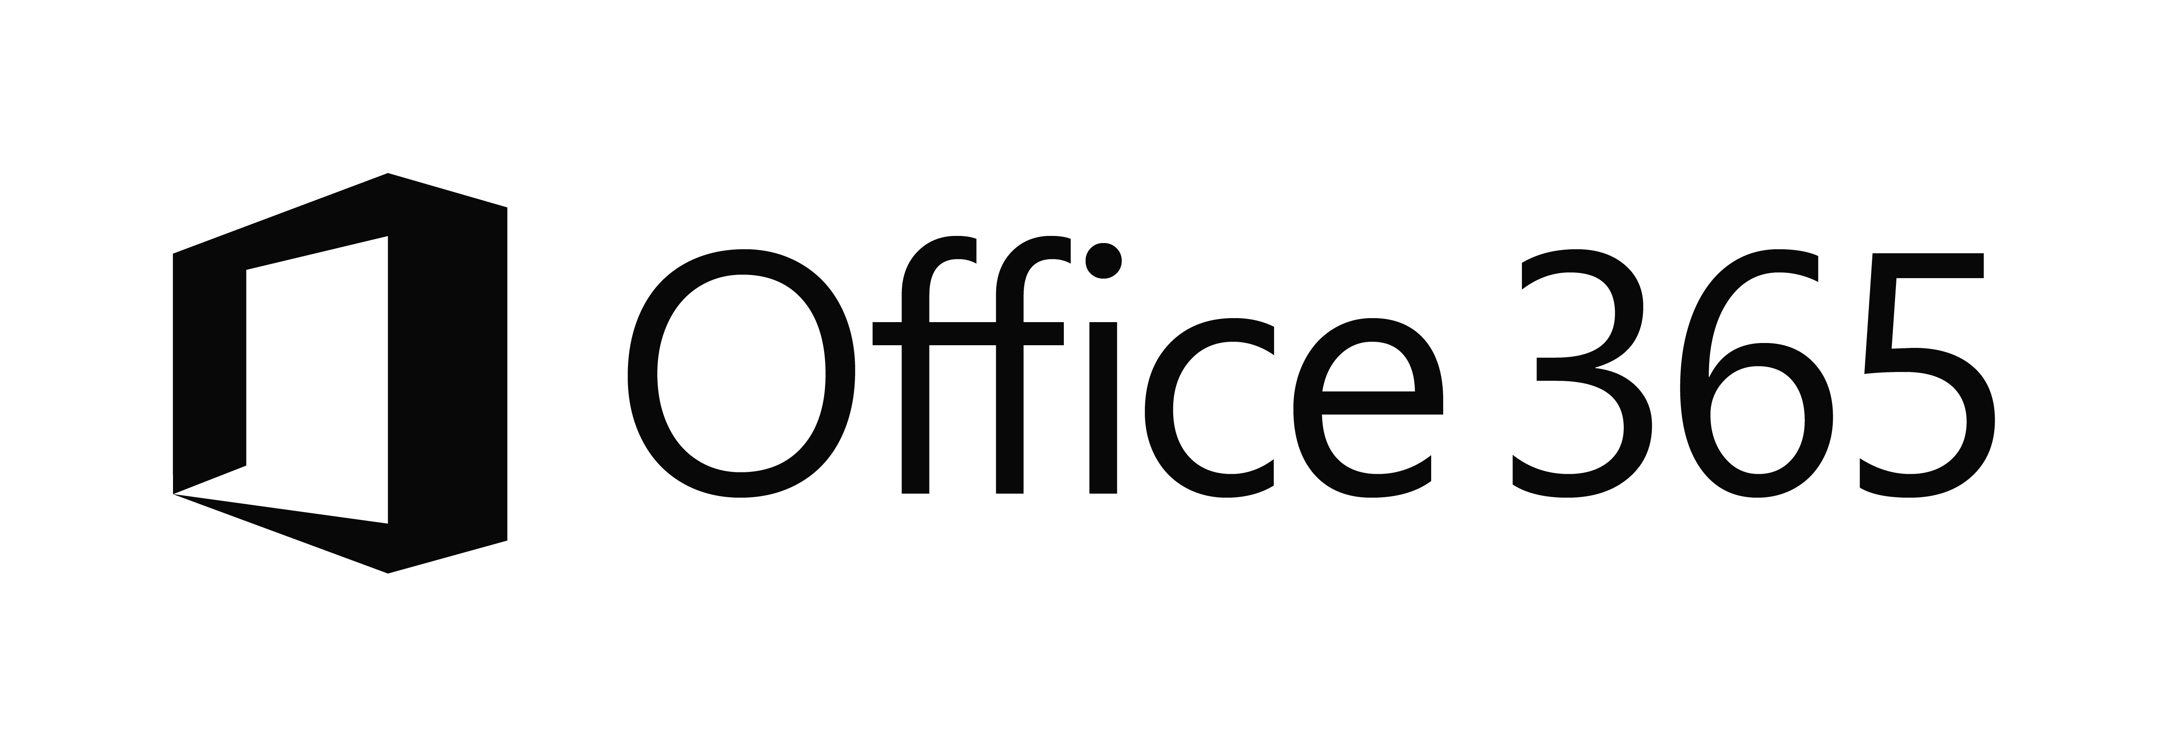








The current reality…
EC2
On premises
Managed devices
Private cloud

Slide 11


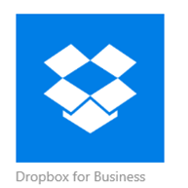
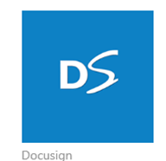
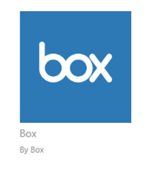
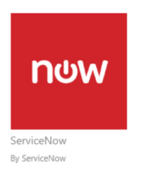
Controlling access to data
User
Group memberships
Auth strength (MFA)
Risky behavior
Device
Managed (Intune or CM)
Compliant
Risky behavior
App
Mobile app is managed
Mobile app reputation
SaaS app sensitivity
Conditional access with EMS
Other
Network location
Breach detected
On-premise data

Slide 12
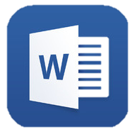





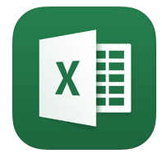
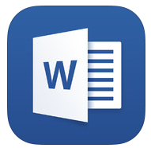





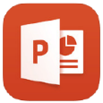





Containing data after it has been accessed
Protect corp data
Managed apps
Managed apps
Corporate
data
Personal
data
Monitor and
restrict activity
IT
Control sharing and downloading
Personal apps
Personal apps
via mobile app
via browser

Slide 13
Demo
Mobile Data Protection

Slide 14
Managing Windows 10

Slide 15
Management options (Traditional vs. Modern)
Provisioning
OS Deployment/Imaging
AAD Join and Auto enrollment into Intune / Provisioning Package
Identity and Authentication
Active Directory
Azure Active Directory
Membership
Domain Join | Workgroup
Azure Active Directory join
Software Updates
Granular patch selection, targeting, scheduling
Windows Update for Business, light scheduling with rings/deferrals
Applications
Win32
Universal, Centennial, SaaS*
Agent
SCCM
Inbox MDM (OMA-DM)
Policy
Group Policy
MDM Policies (OMA-DM)
* Only basic, single-file MSI support is available through inbox MDM for application deployment

Slide 16
Azure AD Join for Windows 10
Azure AD Join makes it possible to connect work-owned Windows 10 devices to your company’s Azure AD.
With Azure AD Join, you can auto-enroll devices in Microsoft Intune for management.
Azure AD
Microsoft Intune
Third-party apps and clouds
Apps in Azure
Intune/MDM
Auto enrollment
Intune auto enrollment
On-premises apps
Enterprise-compliant services
Windows 10 Azure AD Joined devices
Single sign-on from the desktop to the cloud and on-premises applications with no VPN
Support for hybrid environments

Slide 17
Demo
Azure Active Directory Join

Slide 18
PC Management

Slide 19


Configuration Options for ConfigMgr and Intune
Intune standalone (cloud only)
ConfigMgr with Intune (hybrid)
Intune web console
ConfigMgr console
System Center Configuration Manager
MDM
MDM
MDM or agent
Agent
IoT/Kiosk devices
Mobile devices and PCs
Domain-joined PCs
Mobile devices

Slide 20

The new System Center Configuration Manager
Simplify the upgrade experience: Perform in-place upgrades from Configuration Manager 2012 and R2 to the latest product version, and version-to-version upgrades with ConfigMgr Current Branch.
Support faster-paced updates for Windows 10, Windows cloud services, Office 365, EMS, and Intune: New updates and servicing nodes deliver periodic updates for new features, bug fixes, and extensions for hybrid deployments using Intune.
Listen and respond quickly to customer feedback: Foundational improvements made in the latest version of the product allow us to respond to customer feedback more quickly.
The product maintains its continuous focus on lowering TCO and simplification.

Slide 21
Configuration Manager Current Branch
Product version | Release vehicle | Availability | Windows 10 features supported | Support | Windows servicing model supported
System Center Configuration Manager | Current Branch | In market for 9+ months, 3 releases (1606 the latest); tech preview every month | New features, security updates, and bug fixes | Can defer updates for up to 12 months before you must deploy updates to maintain support | Windows 10 Current Branch, Current Branch for Business, and Long Term Servicing Branch
System Center Configuration Manager
Current Branch (version 1602)
Current Branch (version 1606)
Current Branch (version 1511)
(1610)
2016
Winter 2015

Slide 22
20,533 total tenants

Slide 23
40,497,142 million total clients

Slide 24
1511
Deploy, upgrade, and manage Windows 10, including new features
Servicing model for ConfigMgr Current Branch
1602
Client online status
Support for SQL Server Always On
1606
Windows Information Protection
Windows Store for Business integration
1610
Combined end-user portal
Windows 10 Device Health Attestation reporting
Office 365 update management
Manage Windows as a Service
Conditional Access support for PC management
Windows Defender Advanced Threat Protection
Windows Hello for Business
Content status links in admin console
End user portal improvements
Windows Anniversary Edition support
Cloud-based management service
Peer caching for all content types

Slide 25


Microsoft Azure
Office 365
Windows Upgrade Analytics
Windows as a Service
Microsoft Intune
Windows Store for Business
Windows Update for Business
Windows Defender Advanced Threat Protection
Health Attestation
Configuration Manager
Operations Management Suite (OMS)
Azure AD
Microsoft Cloud Services

Slide 26
Demo
What’s new: Azure Hosted ConfigMgr, Cloud-based management, Windows as a Service, and Peer Caching

Slide 27
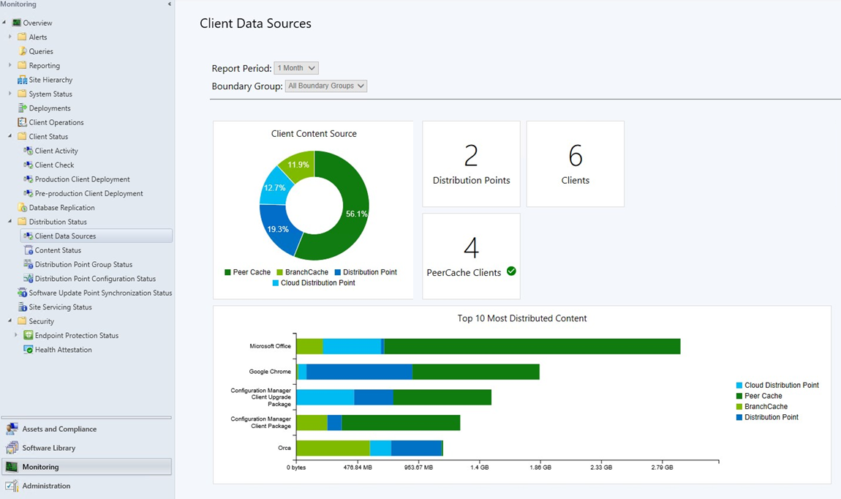
Dashboard

Slide 28
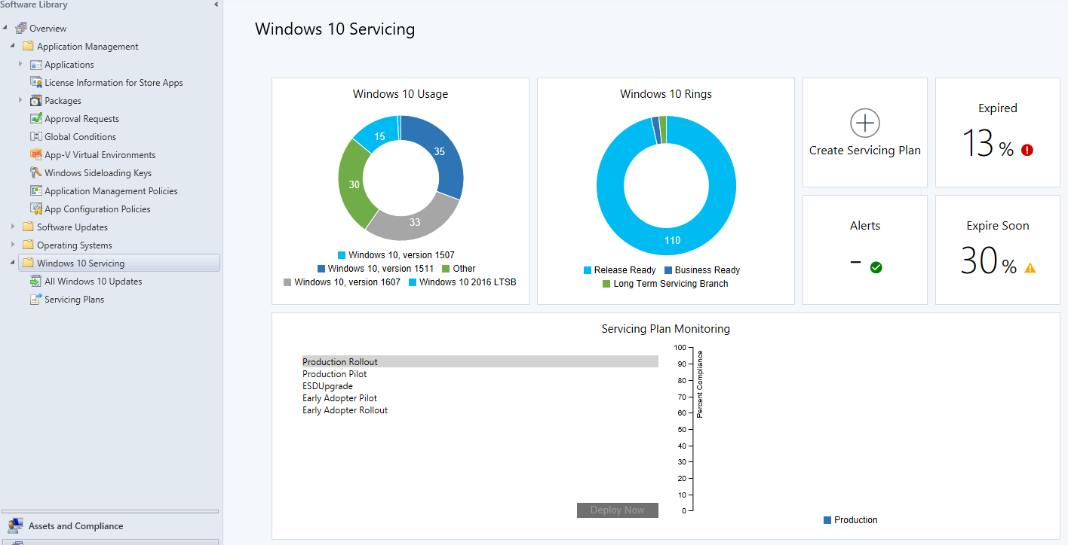
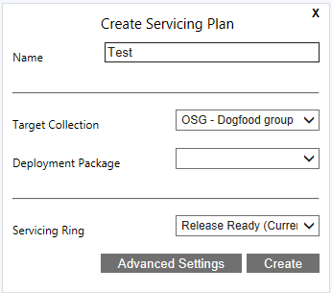
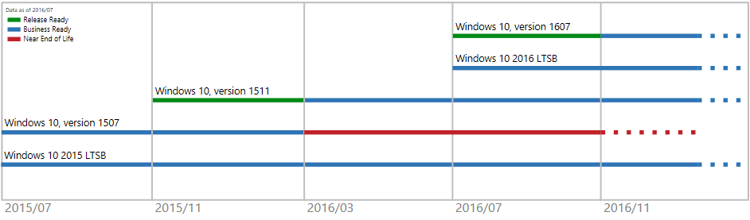

Slide 29
Bringing it all together
Enterprise Mobility is about enabling your users across all of their devices while keeping your corporate data safe
Intune and Configuration Manager provide a complete device, application, and PC management solution for all of the device types in your organization
Intune and Configuration Manager integrate with Enterprise Mobility + Security to address all of your Enterprise Mobility needs

Slide 30
Check out other sessions
BRK3149 - Learn what's new with OSD in System Center Configuration Manager and Microsoft Deployment Toolkit (Tuesday 9 A.M.)
BRK2138 – Intune and Configuration Manager overview (Tuesday 10:45 A.M.)
BRK3225 - Secure access to Office 365, SaaS, and on-premises apps and files with Azure AD and Intune (Tuesday 2:15 P.M.)
BRK2273 - Secure Android devices and apps with Intune (Wednesday 10:45 A.M.)
BRK3101 - Manage and secure iOS and Mac devices in your organization with Intune (Wednesday 2:15 P.M.)
BRK2120 - Manage modern enterprise applications with Microsoft Intune & HockeyApp (Wednesday 4 P.M.)
BRK3012 - Enhance Windows 10 security and management with ConfigMgr, Intune, and new cloud services (Wednesday 4 P.M.)
BRK3093 - Accelerate your Microsoft Enterprise mobility and security deployment with FastTrack (Thursday 9 A.M.)
BRK3102 - Conduct a successful pilot deployment of Microsoft Intune (Thursday 10:45 A.M.)
BRK2292 - Learn how Intune helped Avanade’s global workforce get more productive (Thursday, 12:45 P.M.)
BRK2137 - Align your Windows 10 management strategy to end-user and IT needs (Thursday 4 P.M.)
BRK3281 - Deliver a BYOD program that employees and security teams will love with Intune (Friday 12:30 P.M.)

Slide 31
Free IT Pro resources
To advance your career in cloud technology
Plan your
career path
Cloud role mapping
Expert advice on skills needed
Self-paced curriculum by cloud role
$300 Azure credits and extended trials
Pluralsight 3 month subscription (10 courses)
Phone support incident
Weekly short videos and insights from Microsoft’s leaders and engineers
Connect with community of peers and Microsoft experts
Microsoft IT Pro Career Center
www.microsoft.com/itprocareercenter
Get started
with Azure
Microsoft IT Pro Cloud Essentials
www.microsoft.com/itprocloudessentials
Demos and
how-to videos
Microsoft Mechanics
www.microsoft.com/mechanics
Connect with peers and experts
Microsoft Tech Community
https://techcommunity.microsoft.com

Slide 32


Please evaluate this session
Your feedback is important to us!
From your PC or Tablet visit MyIgnite at http://myignite.microsoft.com
From your phone download and use the Ignite Mobile App by scanning the QR code above or visiting https://aka.ms/ignite.mobileapp

Slide 34
Azure-Hosted Configuration Manager
Definition: Part or all of the ConfigMgr environment hosted on virtual machines on Microsoft Azure
  It is an Infrastructure as a Service (IaaS) solution
  Can be an extension OR even a replacement of your datacenter
  It is an officially supported scenario with Current Branch of ConfigMgr https://technet.microsoft.com/en-us/library/mt617256.aspx
  500+ customers have site roles deployed in Azure
Why?
Main reason is to reduce your Capex and Opex costs

Slide 35
Best practices for Azure hosting
Depends on your environment and your users’ needs/requirements
  Identify ConfigMgr feature requirements for your organization
  All features can be supported (including OSD) but everything needs to be carefully planned and located (e.g., on-premises DP required for OSD)
  Follow product teams’ guidance on Azure VMs and disks
Many combinations of keeping different site system roles in Microsoft Azure vs. physical corporate network exist, but the most popular is:
Keep all site system roles in Azure, keep Distribution Points (push or pull) in physical corporate network.

Slide 36
Cloud-based management service
Manage traditional clients that roam on the Internet
  Without additional infrastructure
  Without exposing infrastructure to the Internet
  Easily configured through the Configuration Manager console
  Key features continue to work on the device when not on the corporate network
    Settings
    Software updates
    Applications
    Hardware and software inventory
    Endpoint protection

Slide 37

Architecture
Windows
Update
HTTPS
Mutual SSL
DMZ
MP
AD
CA
SSL Cert
Azure
Root Cert
Site Server
DP
HTTPS
Mutual SSL
Proxy Connector Point
SSL Cert
HTTPS
Root Cert
SSL Cert
Proxy Service
Cloud DP
Root Cert
Client Cert
Root Cert
HTTPS
Mutual SSL
SUP
HTTPS
Mutual SSL
SSL Cert
Firewall
Firewall
Root Cert
Client Cert
Root Cert

Slide 38
Peer Cache in Configuration Manager
Peer Cache is a 100% native ConfigMgr solution to accomplish peer-to-peer content sharing “in” and “across” subnets
Extension of the existing Windows PE Peer Cache solution
Now ConfigMgr full client can share its content cache to its peers

Slide 39
Peer Cache end-to-end scenario
Admin creates a collection and adds the PCs chosen to be Cache Source PCs in each branch to this collection
Admin then uses client cache settings in client settings to enable Peer Cache in his/her environment
  Optionally, cache size and BranchCache can also be configured from the same location
Admins deploy this setting to the collection that they created
All clients in that collection become Peer Cache Sources
Another client in the same boundary can pull content from the Peer Cache Source

Slide 40

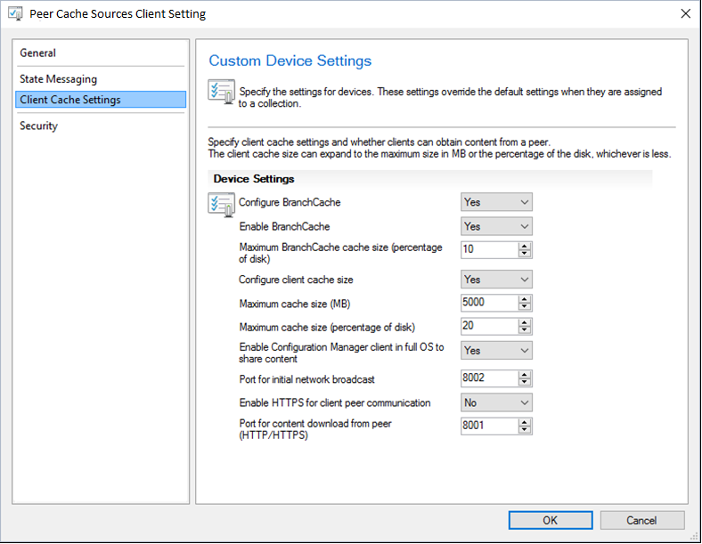

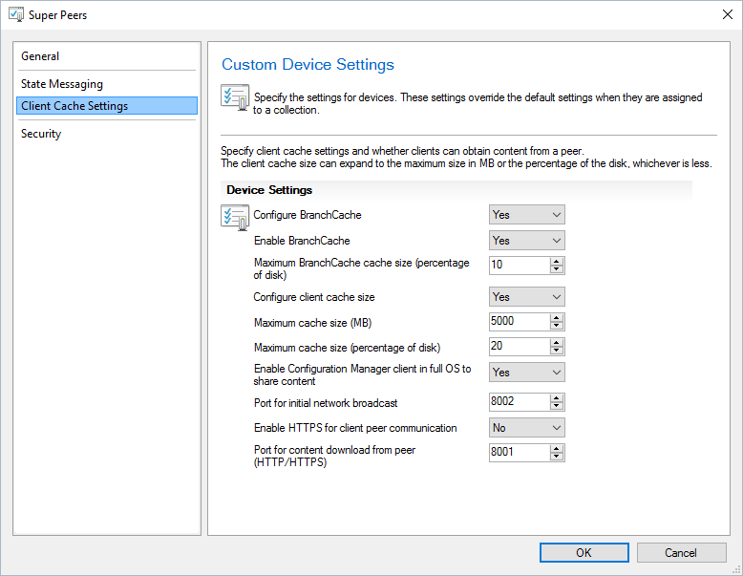


Configuration
Peer Cache Source PCs Collection
New York
I am a now a Peer Cache Source
Here is my network, boundary info
Here is what I currently have in my cache
Redmond
Primary
MP
SQL
Boston

Slide 41


You need “Contoso.exe.”
Here are all the locations
where it is available.
Client2
MP
Redmond
New York
Client1
Client2
DP2 (Boston)
Boston
Contoso.exe
Primary
DP2
SQL
Contoso.exe
Client1
What do you have for me?
Contoso.exe

Slide 42
When Peer Cache is set from this setting for the full client, this will also work for Windows PE Peer Cache client
Administrators will have the control to configure the cache size for all of their Peer Cache Sources
BranchCache can be used together with Peer Cache
Peer Cache is optimized to keep content in cache longer if content is downloaded frequently
BranchCache, Peer Cache, and client cache settings can be applied together or individually

Slide 43


Microsoft Enterprise Mobility + Security
Identity and access management
User and entity behavioral analytics
Mobile device and app management
Information protection
Cloud and SaaS app security
Azure Active Directory Premium
Advanced Threat Analytics
Intune
Azure Information Protection
Cloud App Security
Enterprise Mobility + Security (EMS)

