Slide 1
Get an Introduction to the SharePoint Framework
BRK2114
Daniel Kogan
Group Program Manager
Microsoft
Bill Baer
Senior Product Manager
Microsoft

Slide 2
SharePoint Development Background

Slide 3

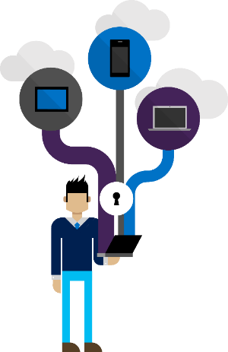
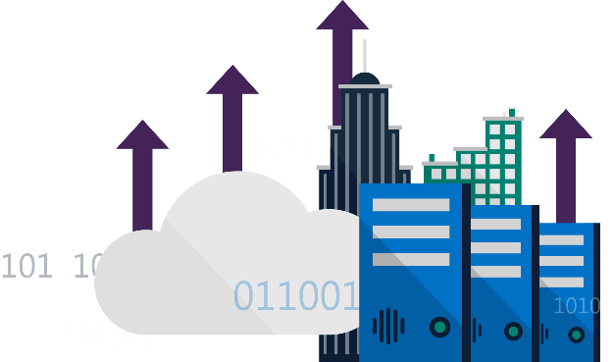
Accelerating web development
2000
2001
2003
2007
2010
2013
2016
  Custom Presentation
UX Extensions
Data Access
Eventing
Solutions Host
Microsoft
Managed Solutions
Microsoft
Online Services
Client Side and
Open Source
Client Side and Remotely Hosted
REST and Cleaner Contracts
Web Hooks and
Web Sockets
Cloud SaaS and
Client Side Logic
Full Trust Code
Partial Trust Code
App Model
Sources:
451 Research, Hosting and Cloud Study, 2014
Customer
72%
Consistent
Platform
Microsoft
Patterns
Enterprise-Grade
Modern Toolchain
User Focused
of customers are leveraging cloud for their applications—from pilots to production apps¹

Slide 4
Accelerating web development
2000
2001
2003
2007
2010
2013
2016
  Custom Presentation
UX Extensions
Data Access
Eventing
Solutions Host
Microsoft
Managed Solutions
Microsoft
Online Services
Client Side and
Open Source
Client Side and Remotely Hosted
REST and Cleaner Contracts
Web Hooks and
Web Sockets
Cloud SaaS and
Client Side Logic
Full Trust Code
Partial Trust Code
App Model
Sources:
451 Research, Hosting and Cloud Study, 2014
Customer
72%
Consistent
Platform
Microsoft
Patterns
Enterprise-Grade
Modern Toolchain
User Focused
of customers are leveraging cloud for their applications—from pilots to production apps¹

Slide 5
Momentum
“The SharePoint Framework is key to SharePoint's cloud-first, mobile-first strategy and could modernize Redmond's content management strategy…”
–TechTarget
10K
2.8K
25K
“SharePoint is back, baby!”
–Mary Jo Foley
Video Views
Unique Visitors
Doc Views
“As a “cloud first, mobile first” vision towards the management platform, Microsoft is embracing the open source community by bringing developers towards the SharePoint Framework.”
–WinBeta
Top #
50
On 5/4
Forks

Slide 6
The SharePoint Framework

Slide 7
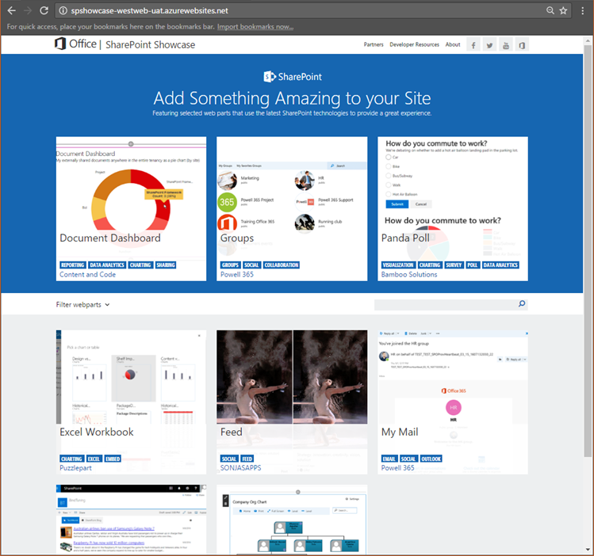
Why did we need SPFx?
New Tech? Another thing?
We saw what developers where doing in SharePoint
We knew we needed to refresh the UI
Responsive Design is now expected
iFrame … love it or hate it

Slide 8

SharePoint extensibility principles
Build long-term, value-added services
Principles
Modern client-side development
Lightweight web and mobile
Powers our own experiences
Backward compatible
Supports open source tools
and JavaScript web frameworks

Slide 9
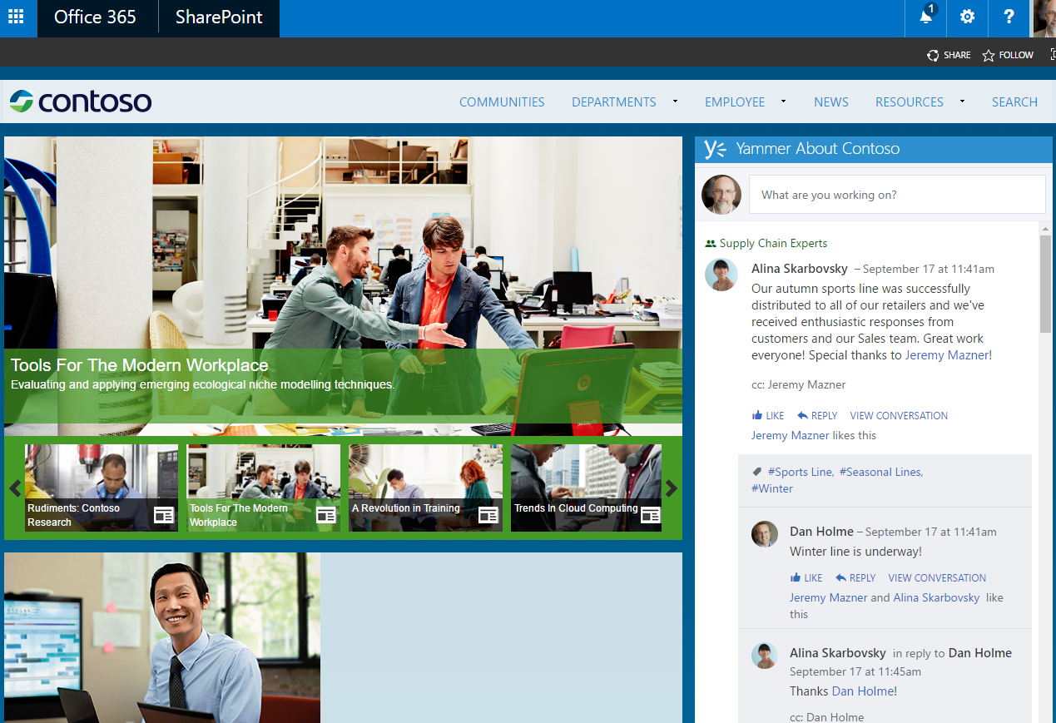
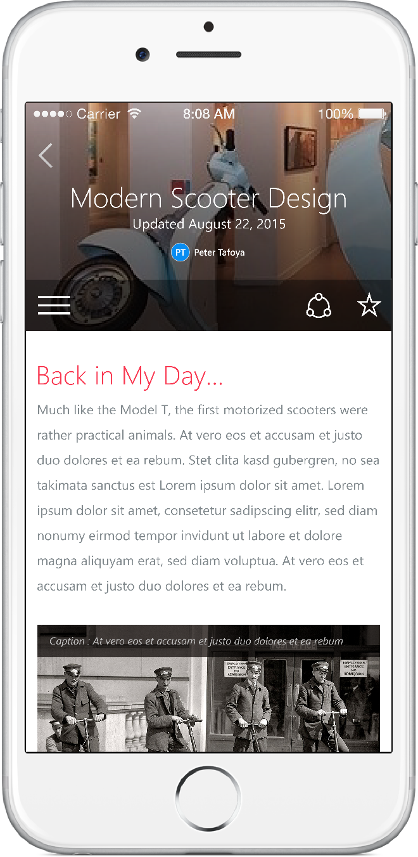
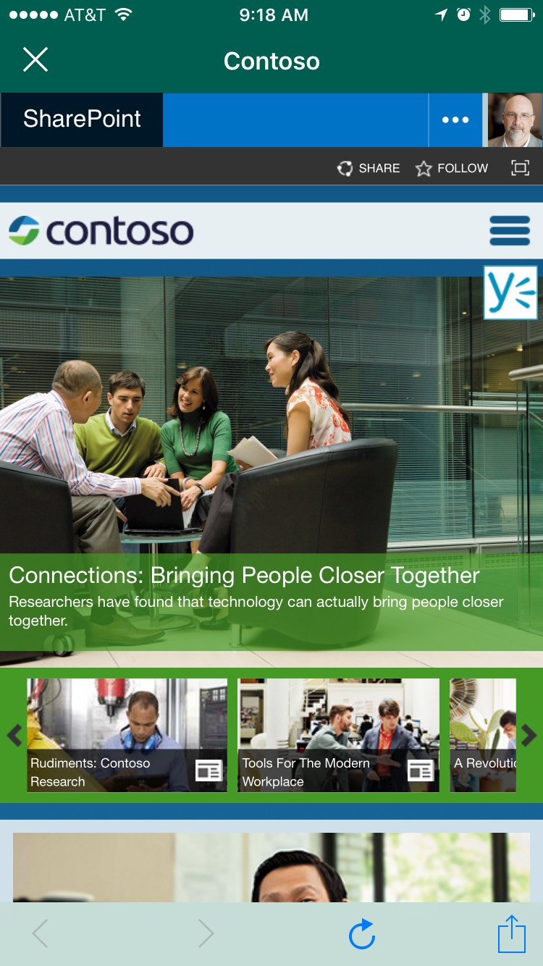
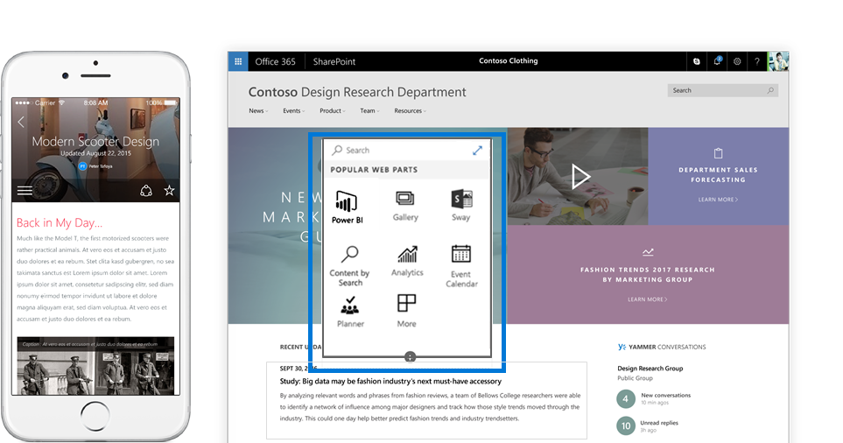
Scenarios
Building custom Web Parts
  Building vertical focused applications
  Integrating with external systems
Enhancing the out of the box experience
  Branding custom portals
  Building custom Intranet Portals

Slide 10
Using The SharePoint Framework

Slide 11
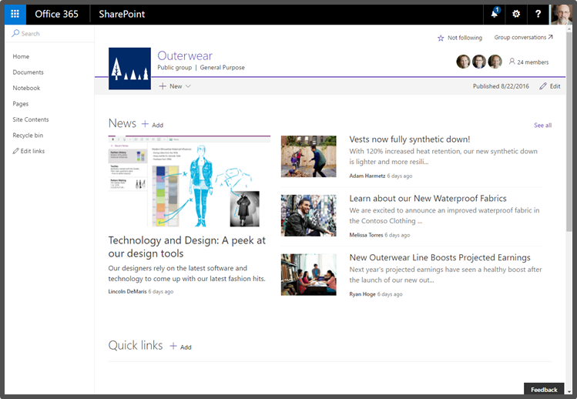
The Modern SharePoint page
Provides more productive experiences in all out-of-the-box SharePoint site types and custom applications
Built using the SharePoint Framework (client-side HTML and JavaScript)
Support across all types of devices and modern browsers
Pages and Web Parts are responsive by design and support existing add-ins

Slide 12
The Authoring Canvas
Updated experiences for end user configuration
Web Parts work in both classic pages
and new pages
Container for Web Parts, rich text, and more…

Slide 13



Open source tooling support
Make all of the tools and technologies that internal engineers use to build available to third party developers
React components
Office UI Fabric

Slide 14
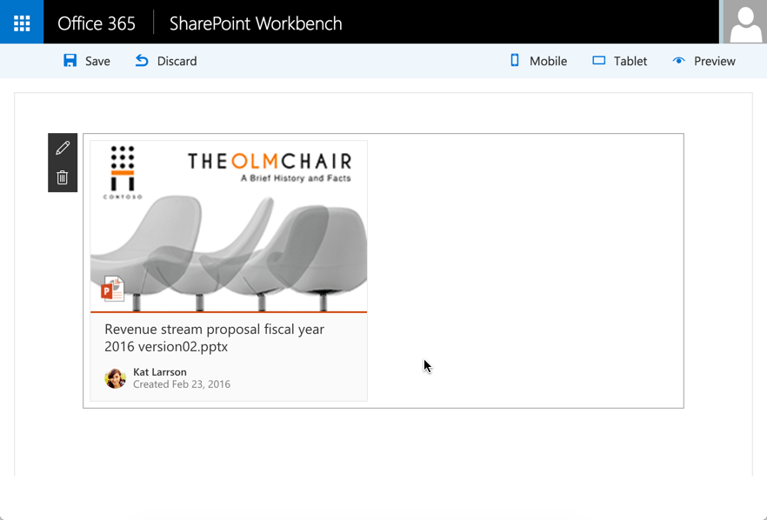
React Components
Front-end framework for building experiences for Office and Office 365
Includes a robust collection of responsive, mobile-first components

Slide 15
Client Side Web Parts

Slide 16
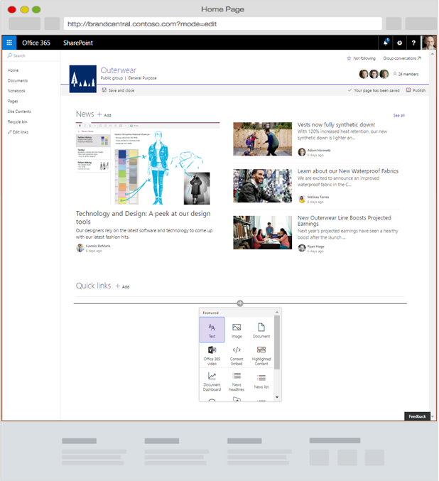
Client-side web parts
Web Part Value
End users add functionality to SharePoint experiences
Configurable, reusable, purpose built components
built by developers
Framework for connecting related components
Context aware
Client-side Web Parts remain Web Parts
  Built for the modern, JavaScript-driven web
  Can run directly inside a SharePoint page,
  new and existing
  Web framework agnostic
  Support both on-premises and Office 365

Slide 17

Client Side Web Parts
Integrating 3rd Party Libraries
Bill Baer

Slide 18


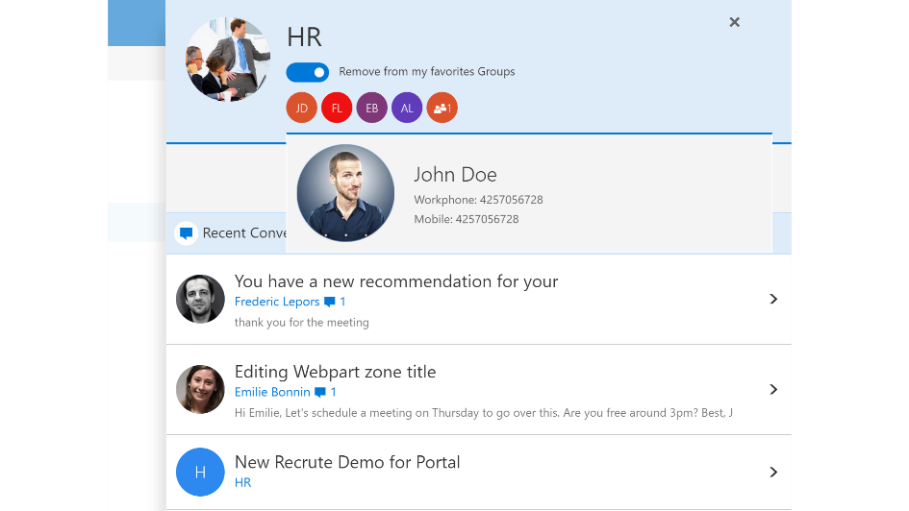

Web Part contest winner!!!
Connect Office Groups and SharePoint Online in order to get the best out of each program. It provides seamless access to your Office Groups from within a SharePoint page.

Slide 19

Packaging
Artifacts are deployed to a CDN, SharePoint list, or Azure web site
SharePoint
Manifest File
Provisioning Logic
Package
JavaScript
Resources
CDN

Slide 20
Introduction to Developer Tooling

Slide 21
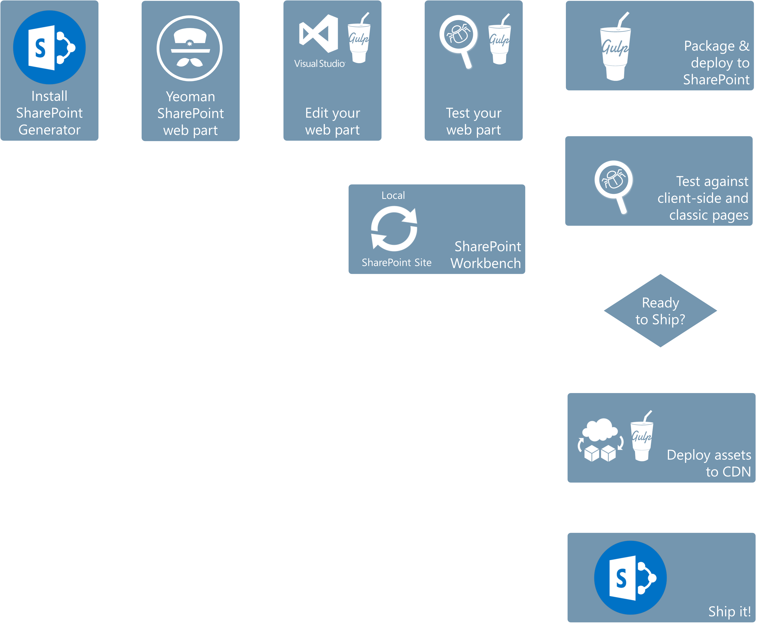

Slide 23



Slide 25



Server side tool comparison
IIS Express
C#
MSBuild
Project Templates

Slide 26

Roadmap
Now
Sites on Microsoft Graph preview
Client-side Web Parts for Classic pages preview
SharePoint Webhooks preview
SharePoint and PowerApp integration preview
Later
Sites on Microsoft Graph GA
Client-side Web Parts for Modern Pages preview
SharePoint Webhooks GA
SharePoint and PowerApp integration GA

Slide 27
Learn more about the SharePoint Framework
@Ignite
  BRK4015 Build Client-side Web Parts for Microsoft SharePoint
  BRK2115 Learn about PnP and the new SharePoint Framework
  BRK2117 The Future of SharePoint Development
  THR2153 Review the SharePoint Framework: An Open and Connected Platform
  IDL3083 Serve HelloWorld in a SharePoint page (using the new SharePoint Framework)
  IDL3082 Talk to SharePoint with your HelloWorld WebPart (using the new SharePoint Framework)
  IDL3084 Add jQueryUI Accordion WebPart to HelloWorld (using the new SharePoint Framework)
  IDL3085 Use Office UI Fabric Components (with the new SharePoint Framework)
  IDL3081 Create HelloWorld WebPart in the new SharePoint Framework
@Your own pace
  GitHub @ http://github.com/SharePoint
  Developer Hub @ http://dev.office.com/SharePoint
Visit the SharePoint Framework Booth in the Expo Hall!

Slide 28

Deploy, ramp-up on new services and onboard new users with Microsoft FastTrack: http://fasttrack.microsoft.com/

Slide 29

Join the Microsoft Tech Community to collaborate, share, and learn from the experts: http://techcommunity.microsoft.com

Slide 30


Please evaluate this session
Your feedback is important to us!
From your PC or Tablet visit MyIgnite at http://myignite.microsoft.com
From your phone download and use the Ignite Mobile App by scanning the QR code above or visiting https://aka.ms/ignite.mobileapp

