Slide 1
Adapt field service scheduling and explore connected Field Service and the World of IoT
BRK2112
Kyle Young – Principle PM Manager
Mitch Milam – Technical Solutions Professional

Slide 2

What’s top of mind for field service leaders
Customer first
Connected interactions
Empower organizations

Slide 3

Improve customer satisfaction and resource productivity
73%
of consumers say valuing their time
is the most important thing a company can do to provide good service
65%
of incoming service requests require field visits AND of those service visits
26%
require secondary or follow-up visits
Source: Forrester Research’s Trends 2016: The Future Of Customer Service
Source: Field service automation trends: Best-in-Class - Aberdeen Group, Dec, 2015

Slide 4

Microsoft Dynamics 365 for Field Service
Optimized Scheduling & Dispatch
Service Agreements
Inventory Management
Mobile
Connected Field Service

Slide 5
Demo
Scheduling & Dispatch

Slide 6
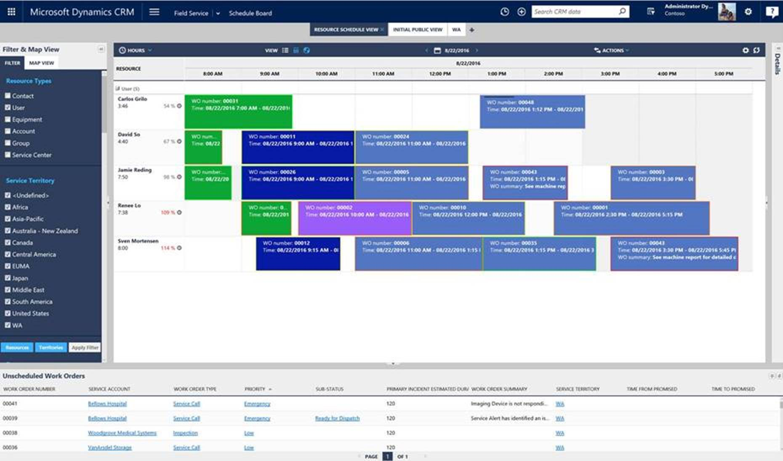
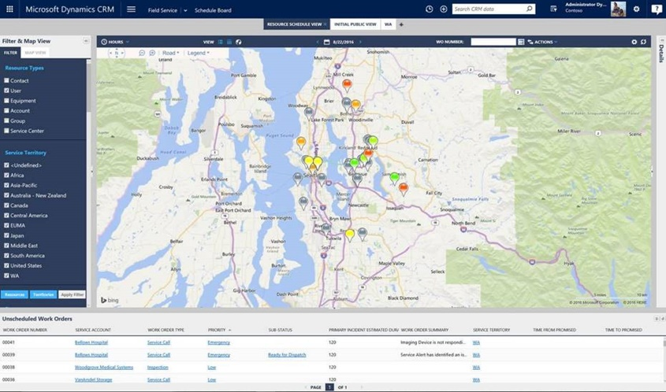

Optimized Scheduling & Dispatch
Identifies and organizes available resources by several categories to intelligently balance workloads and resources.
Matches skill sets of the technician against the requirements of the work order.
Understands geography, availability, truck inventory, regulatory requirements, customer preference, and service level agreement.
“Every time a service company rolls a truck to a customer, it costs over $1,000. When you aren’t
able to solve the problem on the first visit, you are flushing another thousand dollars down [the drain].
With numbers this big, the ROI for improving key productivity metrics is fast and dramatic.”

Slide 7
Demo
Mobile

Slide 8
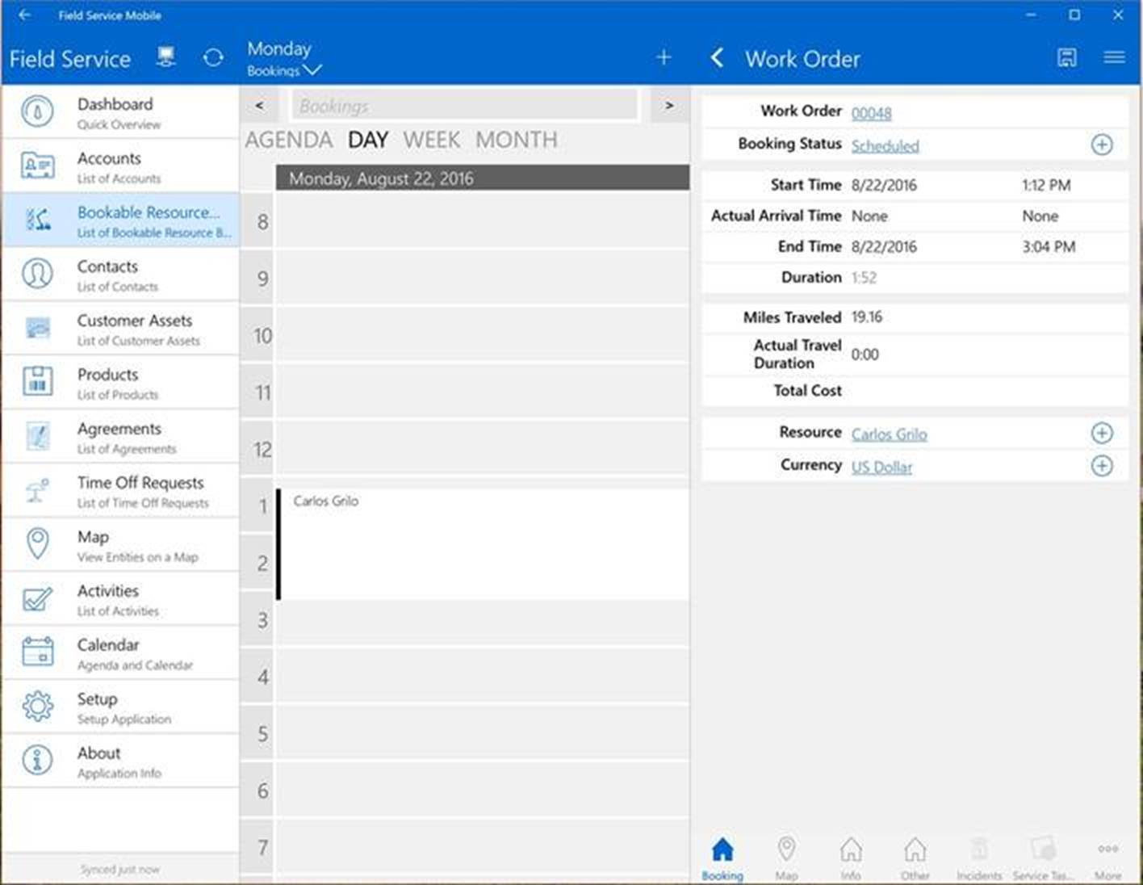
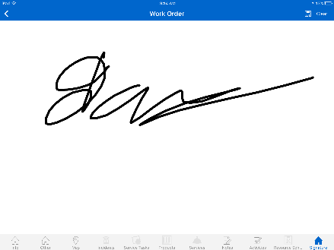

Mobile
Provide technicians a full 360 degree view of customer and case.
Show step by step instructions on how to complete the task at hand.
Allows the technician to take photos of the completed work, get customer sign-off, and even collect payment.
“A lot of field service organizations have also started seeing mobility solutions as a way of gaining competitive
advantage over their peers. Having real-time visibility into critical operations help these organizations to make
smarter decisions, have fewer issues with data integrity and quality, all in addition to realizing productivity gains.”

Slide 9
Demo
Service Agreements

Slide 10
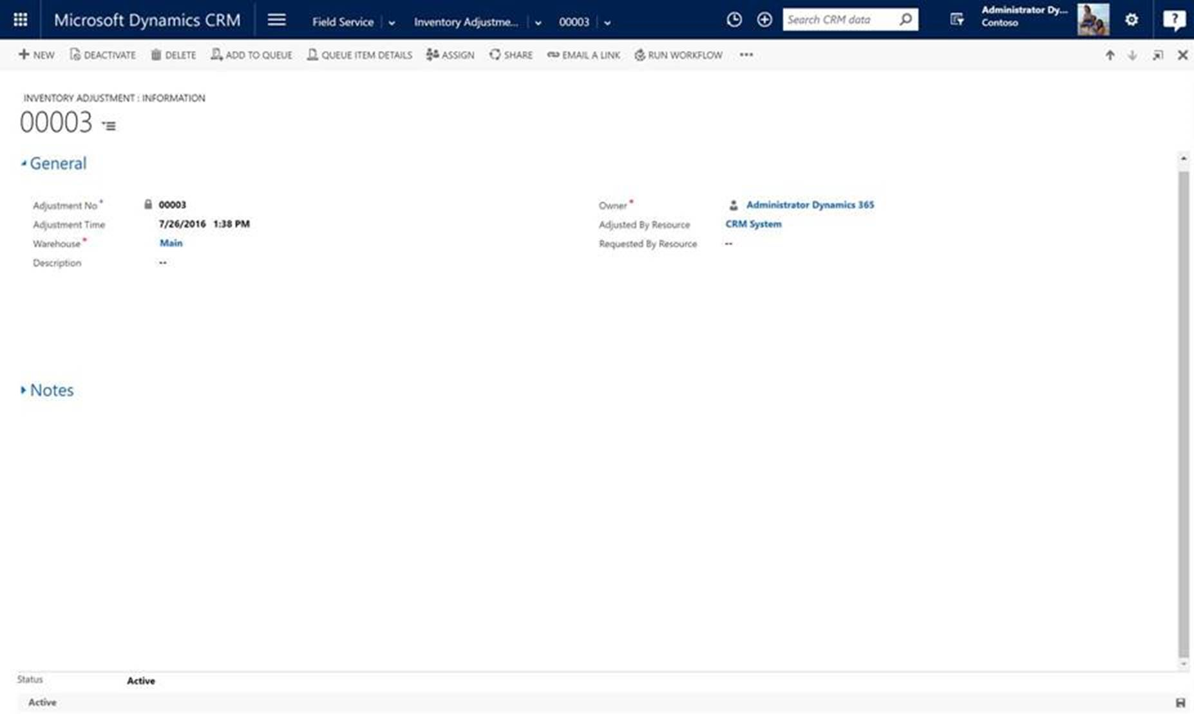
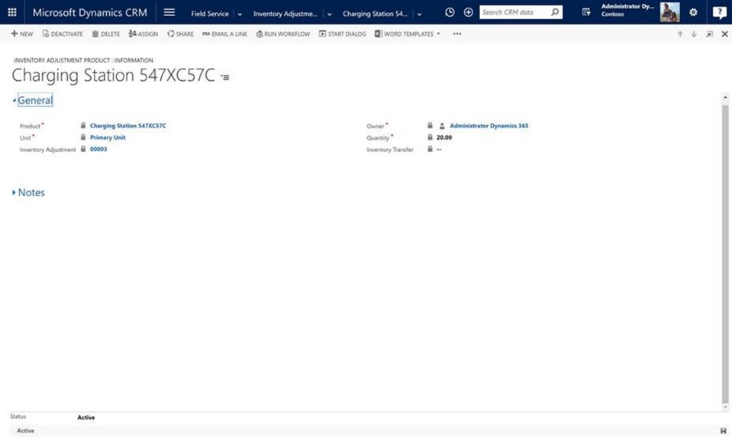
Service Agreements
Manage terms, conditions, and automated renewals of contracts & Service Level Agreements.
Classify assets with barcodes or serial numbers; track asset location, maintenance needs, and repair history.
Track warranties against assets, provide ﬁeld staff with visibility into terms and expiration dates, and ensure that service and billing conform to warranty stipulations.

Slide 11
Demo
Inventory Management

Slide 12

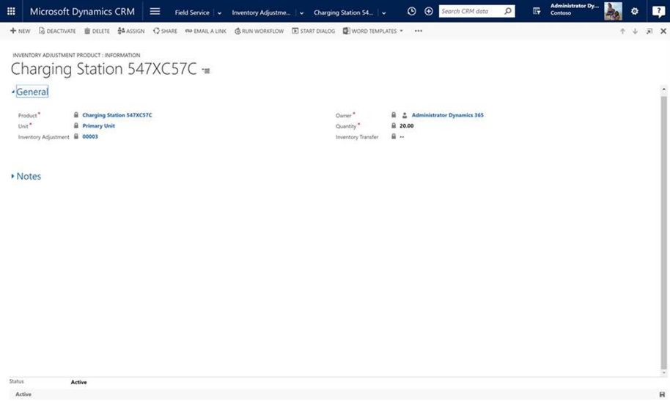
Inventory Management
Manage updates and stock history for any location including updating truck stock.
Manage inventory information for any part transaction including requests, return material authorizations (RMAs), stock adjustment, or stock transfer
Provide mobile access to inventory and parts information and management resources

Slide 13
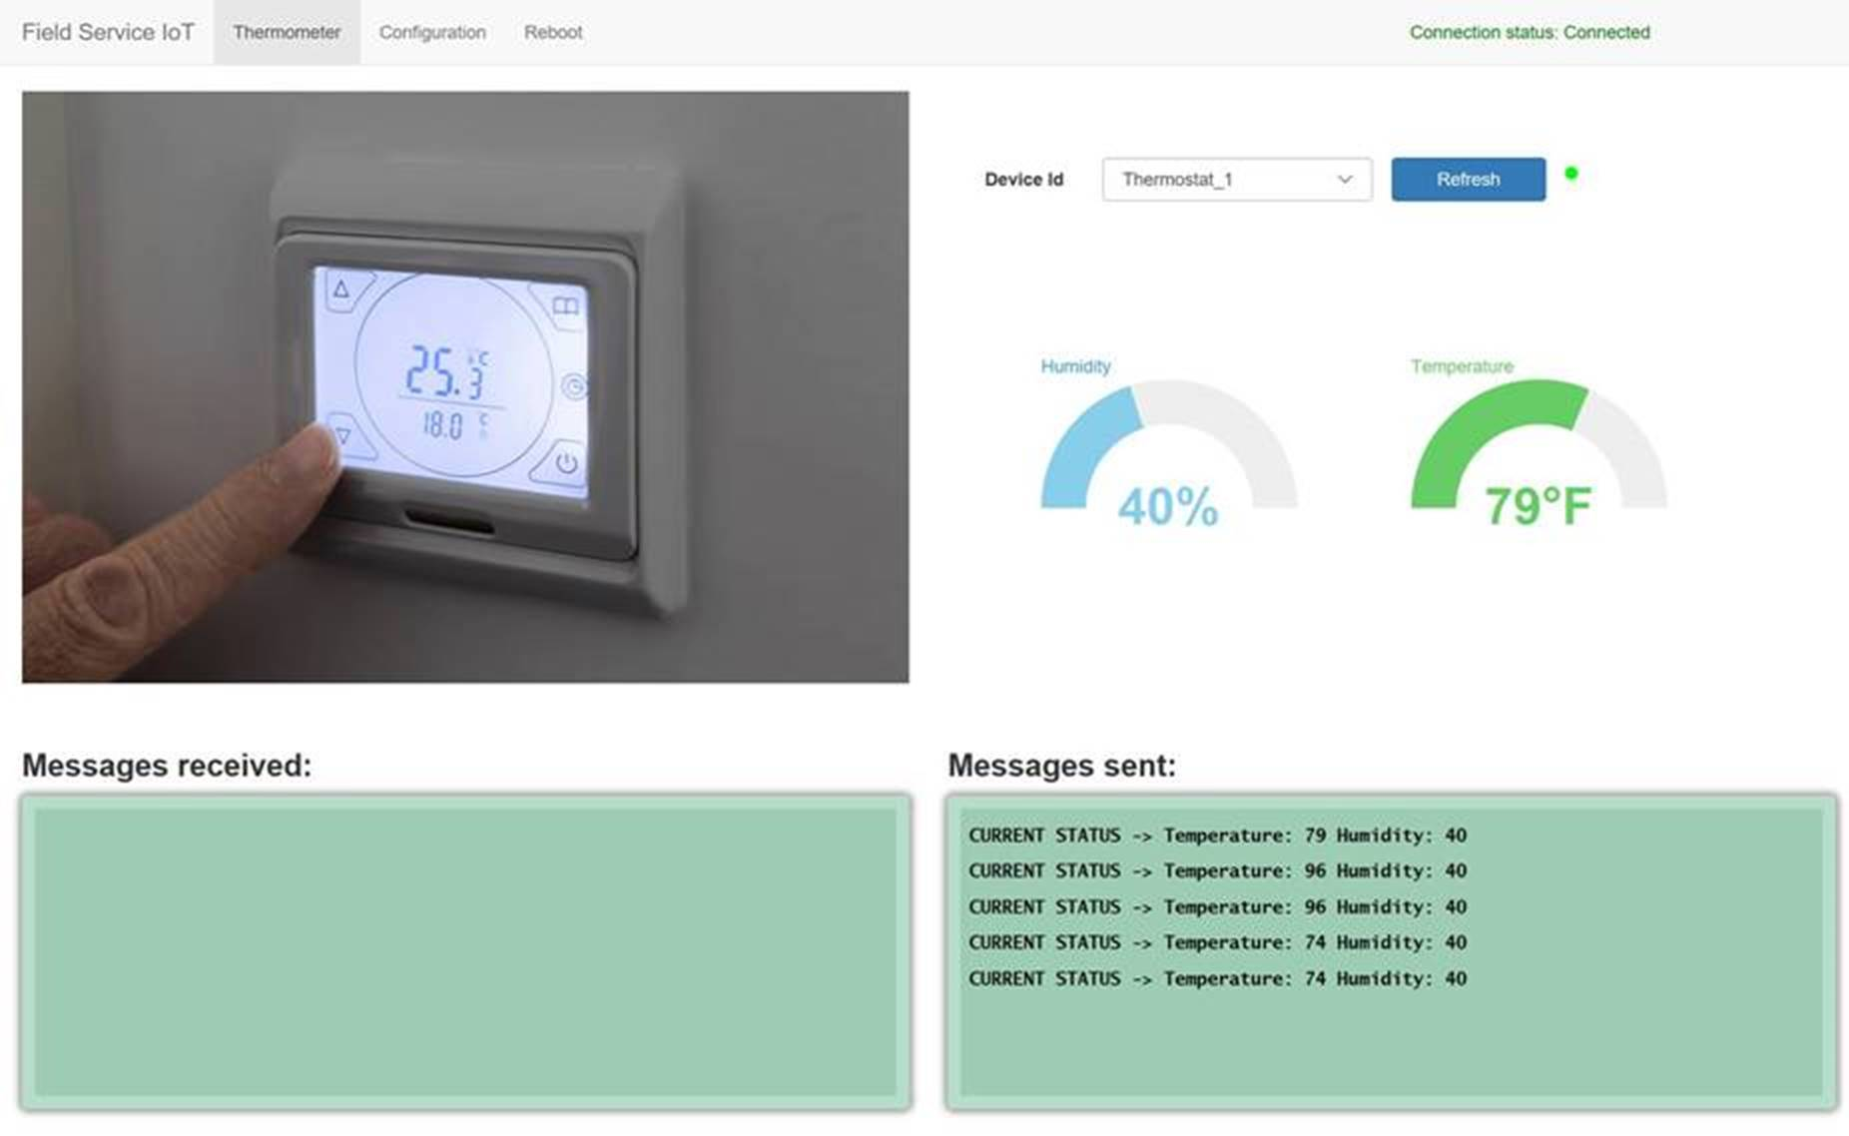
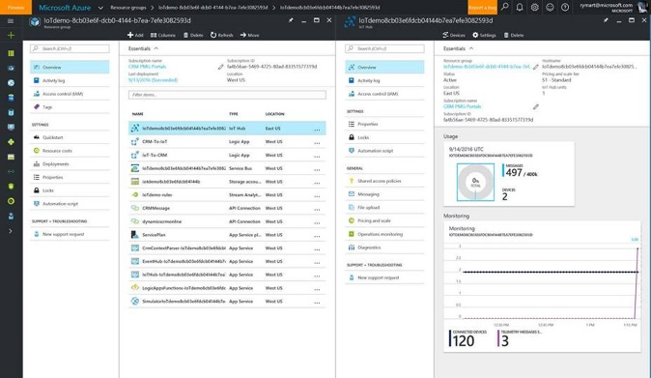
Connected Field Service
Detect, troubleshoot, and resolve issues remotely
Predict when maintenance is needed
Proactively investigate anomalies before customers know about issues
“The goal for Field Service has changed… They now want to create a long tail of services that
capitalizes on internet-enabled devices, involves intricate levels of services, and goes
beyond fix-it-when-it's-down and into building new levels of customer engagement.”

Slide 14
Connected Field Service
Objectives
Know about a problem before the customer does
Solve the problem at the smallest cost
Device
with sensor
IoT
hub
Field
service

Slide 15
Incremental implementation
When an anomaly is detected
Basic
  Automatically schedule/dispatch technician
Advanced
  Try a troubleshooting step before sending a technician
Expert
  Try multiple troubleshooting steps before sending a technician

Slide 16
Preventative maintenance
Scheduled
Just-in-time
Regular intervals
on a time-bound schedule
VS.
As needed,
based on
consumption

Slide 17
Demo
Connected Field Service

Slide 18








Field Service Roadmap Areas
Connected Field Service
Resource Ecosystem
Innovation for Technician Experience
Machine Learning
Mapping
Service Agreements
Resource Scheduling Optimization
Exchange Integration

Slide 19

Field service
Delivers predictive and proactive service to improve customer satisfaction, first time fix rates, and resource productivity through advanced scheduling, resource optimization, and mobile enablement.

Slide 20
Questions / Discussion

Slide 21
Free IT Pro resources
To advance your career in cloud technology
Plan your
career path
Cloud role mapping
Expert advice on skills needed
Self-paced curriculum by cloud role
$300 Azure credits and extended trials
Pluralsight 3 month subscription (10 courses)
Phone support incident
Weekly short videos and insights from Microsoft’s leaders and engineers
Connect with community of peers and Microsoft experts
Microsoft IT Pro Career Center
www.microsoft.com/itprocareercenter
Get started
with Azure
Microsoft IT Pro Cloud Essentials
www.microsoft.com/itprocloudessentials
Demos and
how-to videos
Microsoft Mechanics
www.microsoft.com/mechanics
Connect with peers and experts
Microsoft Tech Community
https://techcommunity.microsoft.com

Slide 22


Please evaluate this session
Your feedback is important to us!
From your PC or Tablet visit MyIgnite at http://myignite.microsoft.com
From your phone download and use the Ignite Mobile App by scanning the QR code above or visiting https://aka.ms/ignite.mobileapp

