Slide 1
BRK2105: Simplify OS deployments with Windows Provisioning
BRK2105
Marc Shepard
Principal Program Manager Lead

Slide 2
Session Goals
Learn how Windows Configuration Designer (WCD- aka WICD) and Windows Provisioning can simplify OS deployments
Learn what’s new in Anniversary Update
Understand current limitations and product roadmap

Slide 3
Agenda
Overview
Walkthroughs and Tips
Advanced Topics
Roadmap

Slide 4
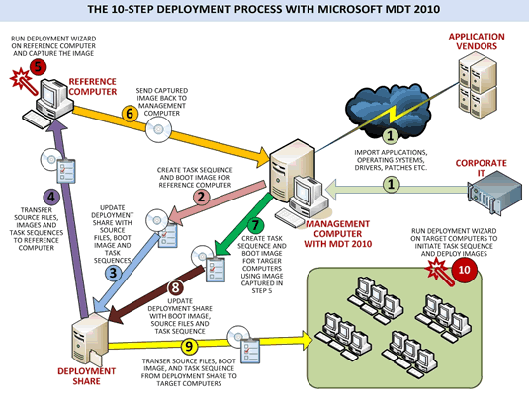
Imaging is complex and costly
Image management
Driver management
Network bandwidth
Desktop only

Slide 5
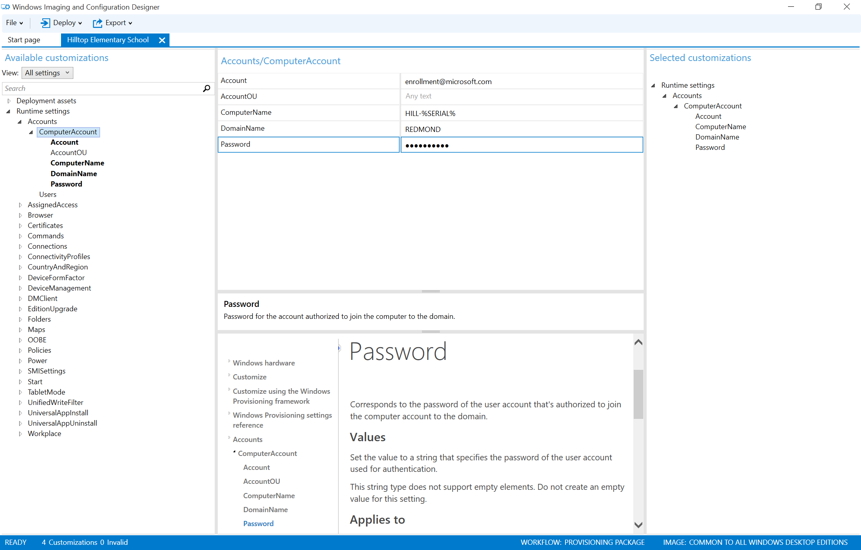
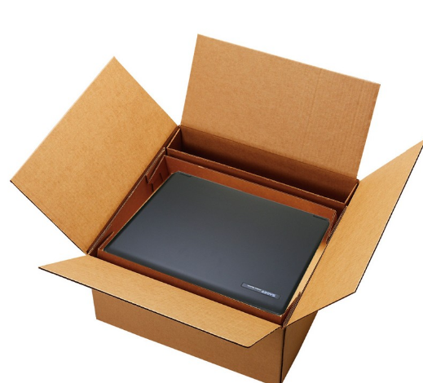
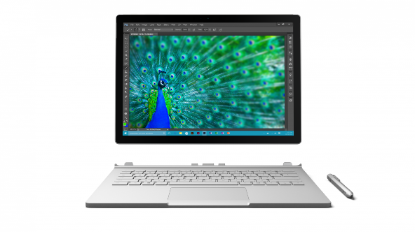
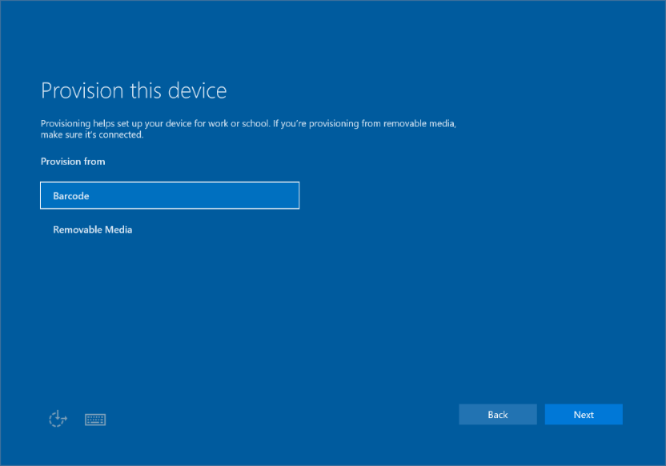
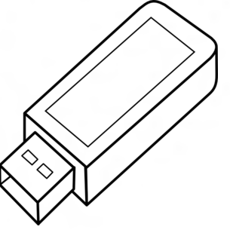
WCD provisioning: deltas to an OEM image
We are moving to a world where “OEMs image, IT provisions”
1 - IT uses WCD (fka WICD) to create a provisioning package of settings, assets, and enrollment instructions
2 – New devices arrive with a “clean” OS image (Windows + Office + drivers). IT boots devices and applies provisioning pack during first boot
3 – After first boot completes, device is at login screen and ready to hand out
Works on Desktop, mobile, and industry devices (the latter two also supports NFC and MTP, in addition to removable media)

Slide 6
What can be provisioned?
Initial Setup
Management Enrollment
Offline content
Rich collection of settings available to provision
Best practice:
Provision minimal settings to get managed
The rest come from management tool
Best to avoid conflicts between the two
Edition Upgrade
Certificates
Connectivity Profiles
Universal Windows Apps
Win32 Applications
Scripts
Enterprise Policies
Browser Settings
Start Menu Customization
Assigned Access

Slide 7
Alternatives to imaging in Win10
WCD provisioning is part of a set of win10 imaging alternatives
Scenario | Old Method | New Option
OS Upgrade | Imaging + migration | In-place upgrade
Re-provisioning | Imaging (reimage) | Reset this PC
Provisioning | Imaging (e.g., using MDT/Sysprep/DiSM) | WCD Provisioning
However imaging is still fully supported

Slide 8
Agenda
Overview
Walkthroughs and Tips
Advanced Topics
Roadmap

Slide 9
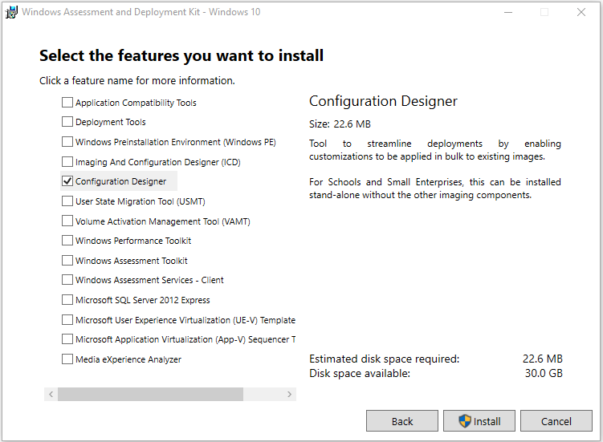
Installing WCD
Download and install the Windows Assessment and Deployment Kit
When prompted for optional components, select the “Configuration Designer”

Slide 10
Creating a Provisioning package (ppkg)
Creating a ppkg for bulk enrollment

Slide 11
Enrollment options summary
Domain Join – for desktops in AD environment
Use creds from a low-rights AD account
MDM enrollment – for mobile and shared/POS devices
Bulk enrolled devices get per-device (not per-user) settings
MDM-specific ppkg creation (ask your MDM)
AAD Join
Not yet supported; must enroll each device manually
Recommend; create tmp_admin account, delete via GP
SCCM or SCCM/Intune hybrid - get ppkg from SCCM admin console
Intune standalone support – not yet available
Other MDMs – check with them on method (cert or creds)

Slide 12
App/cert provisioning summary
Only add bootstrap-critical items
Provision minimal apps/certs to get managed
Leverage “ProvisioningCommands”
Powerful desktop-specific feature
Rest come from management tool to enable compliance reporting and change management
Keep it short: 30 minute OOBE timeout
Cab multi-file installers, uncab in install script
Add logging to the master install script for tshooting
Add files, run a single command line - can be a script file that orchestrates multiple installs/actions

Slide 13
Deploying a PPKG
Simple example of deploying a ppkg

Slide 14
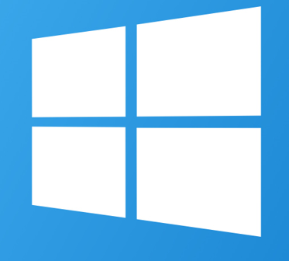
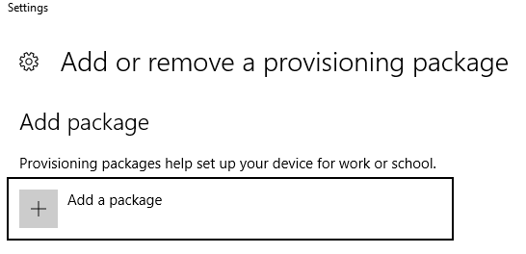
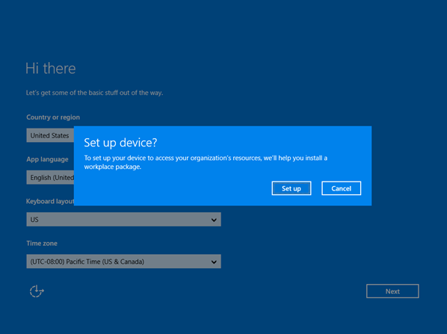
Common Deployment Options
1. Interactively – for testing
Double click or add from settings
Install new version of the ppkg to update the content
2. OOBE time – smaller deployments
Tap 5 times on first screen
Install ppkg from USB
Embed in an image – for very large deployments
DISM.exe /Image:<path_to_offline_image> /Add-ProvisioningPackage /PackagePath:<package_path>

Slide 15
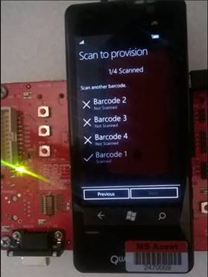
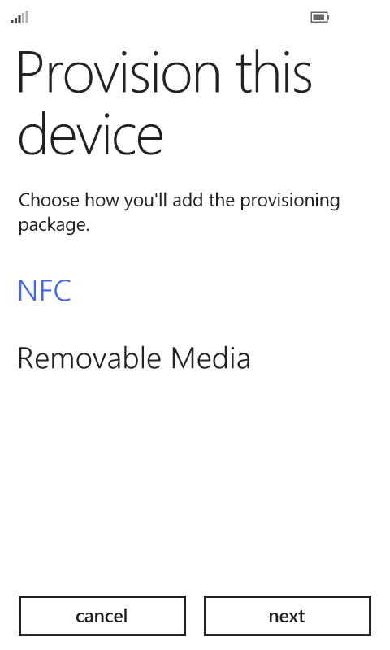
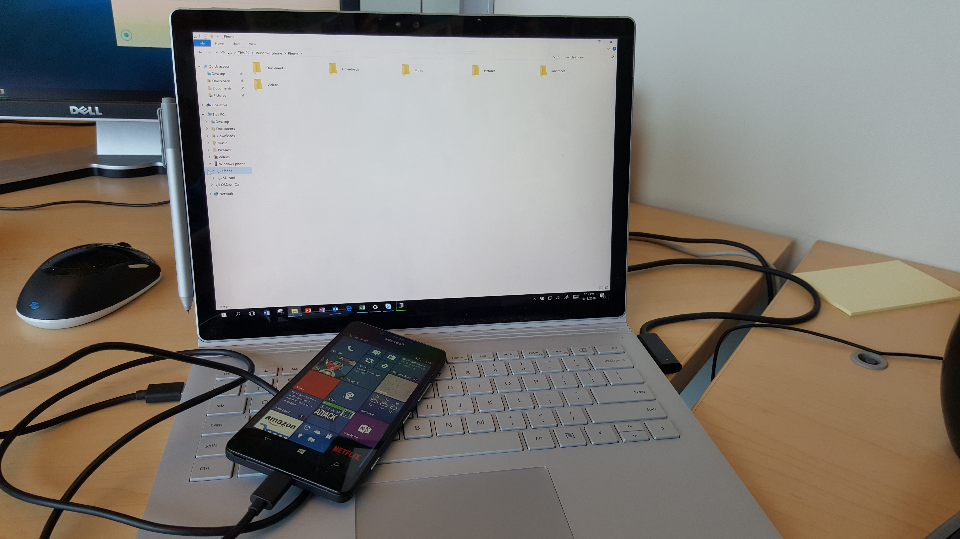
Additional Deployment Options for Mobile
3. NFC tap-n-share
4. From bar code - for mobile industry devices w integrated bar-code scanners
NFC provisioning app
5. Drag-n-drop from tethered PC

Slide 16
Agenda
Overview
Walkthroughs and Tips
Advanced Topics
Roadmap

Slide 17
Provisioning Execution Timing
When does the provisioning engine run?
Before OOBE - for embedded packages
During OOBE - for ppkgs installed at OOBE time (30 min timeout, single reboot)
At idle time after first login – retries failures in earlier runs
Interactively at any time
Note: App installs and MDM enrollment are asynchronous(!)
How are failures handled?
Successive retries at 2 mins, 15 mins, 1hr, 4hrs, then on reboot
Only parts of the package that fail are retried

Slide 18
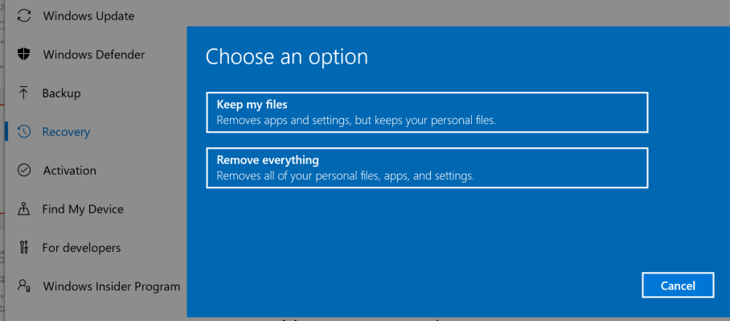
Device Reset
Keep my files: ppkgs are rerun
Remove everything: interactively installed ppkgs are removed (DISM/imaged ppkgs are rerun)

Slide 19
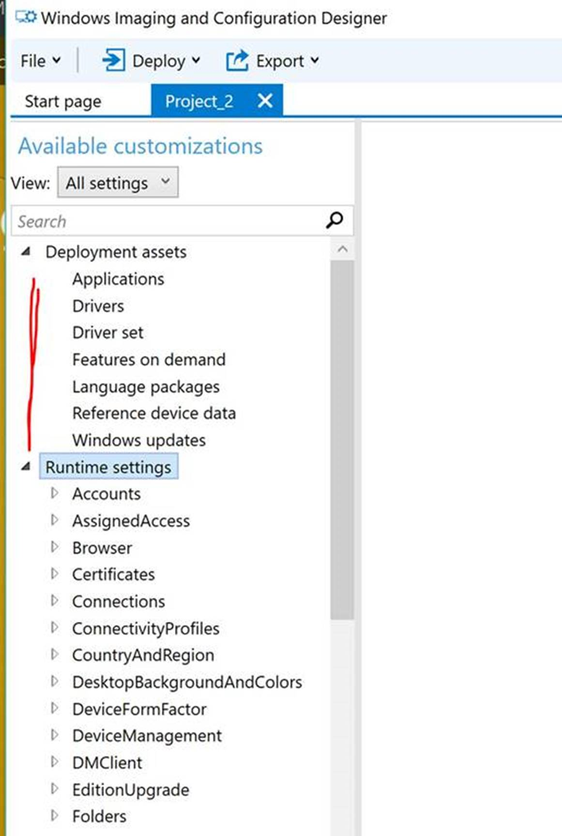
Don’t use Deployment Assets
They will be removed next released
Why? They are duplicative and confusing
They are used only at OS build time, and OS build tools already have simpler alternatives
They are not processed by provisioning engine, and trying to manually install such a ppkg will fail

Slide 20
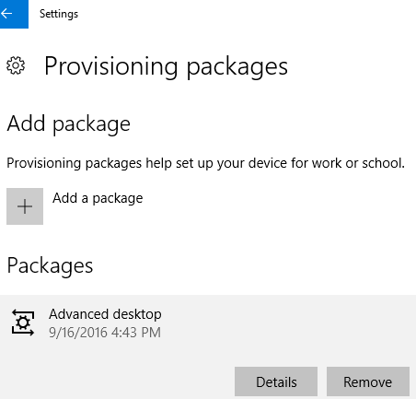
Troubleshooting
Start in the settings UX
Settings/Accounts/Access work or school/Add or remove a provisioning package
Click through for Details
Note: Enrollment, app install not rolled back on package removal

Slide 21
Agenda
Overview
Walkthroughs and Tips
Advanced Topics
Roadmap

Slide 22
Release History
1506
Initial release of WICD/Provisioning
1511
Added ProvisioningCommands
1607
Install from ADK without the imaging tools (20 MB vs 1 GB)
Simple provisioning wizard for bulk domain join
Improved documentation for advanced scenarios
Improved diagnostics

Slide 23
Beyond 1607
We’ll focus exclusively on runtime provisioning
Requests we’ve heard:
Bulk AAD Join
Ability to remove OEM pre-installs (but keep drivers)
PS cmdlets for scripting (e.g., in an MDT task sequence)
WCD as a store app
Simplified app installation
Media-free provisioning options

Slide 24
Next Steps
Install WCD from the Windows 10 ADK at http://go.microsoft.com/fwlink/p/?LinkId=526740
Build provisioning packages
https://msdn.microsoft.com/en-us/library/windows/hardware/dn898375%28v=vs.85%29.aspx
https://technet.microsoft.com/en-us/itpro/windows/deploy/provisioning-packages
Become a Windows Insider and get early access to releases!
Visit the Insiders at the MSFT Showcase in Expo Hall or see http://insider.windows.com

Slide 25
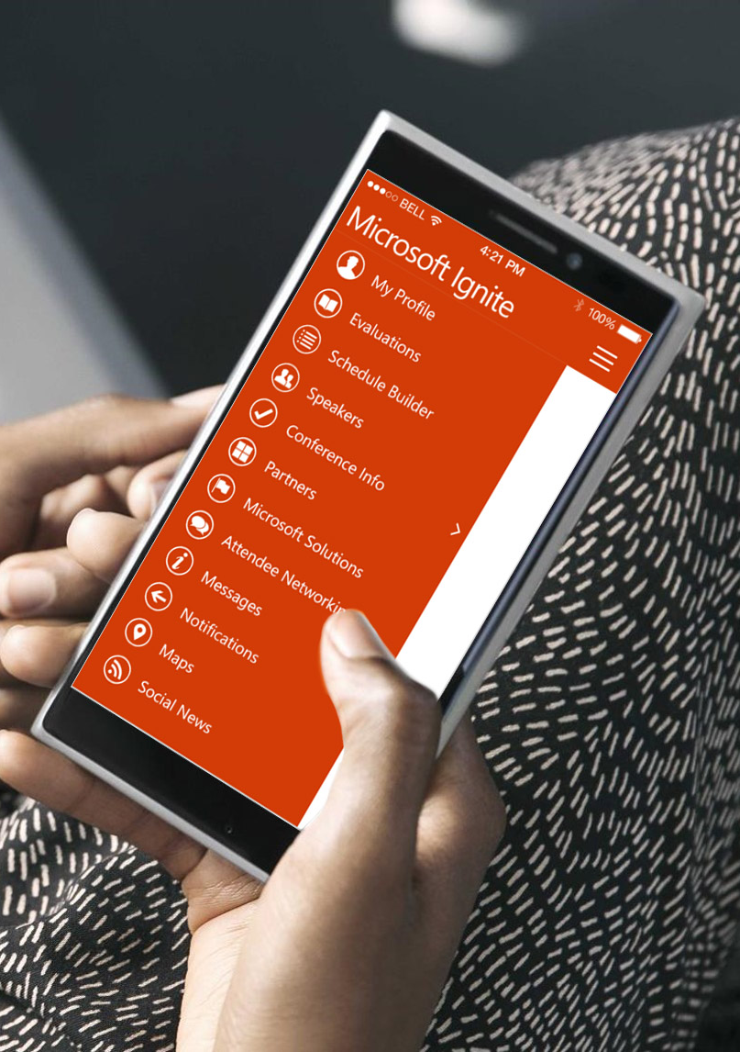
Please evaluate this session
Your feedback is important to us!
From your PC or Tablet visit MyIgnite at http://myignite.microsoft.com
From your phone download and use the Ignite Mobile App by scanning the QR code above or visiting https://aka.ms/ignite.mobileapp

